Slide 1
Peripheral Vascular system examination
Miss Sandy Abeysiri
Clinical Teaching Fellow
Bart’s Health NHS Trust

Slide 2
‘Peripheral Vascular disease’
Arteries Or Veins (or Lymphatics – not covered this time)
Progressive and chronic
Aorto-iliac or infrainguinal
Arterial : Aneurysmal, or Occlusive / Ischaemic
Venous: DVT / Varicose veins / Chronic insufficiency
(Lymphatic: Lymphoedema / lymphangitis)

Slide 3
Assessment
Anatomy
History / clinical presentation
Aetiology or Causes / Risk Factors
Examination – special tests

Slide 4
Peripheral vascular tree - Anatomy

Slide 5
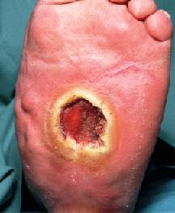
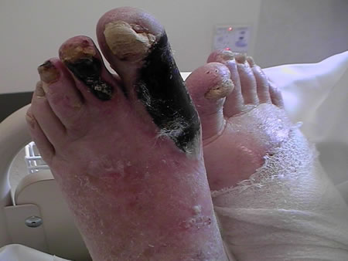
History / Clinical Presentation
Full History –
Claudication – Site?
Rest Pain !!!!!
Ulceration? Chronic Wounds / poor healing
Bleeding / itching / skin changes / swelling / cellulitis
Impotence
Skin / sensation changes

Slide 6
RISK FACTORS
SMOKING! (even a few cigarettes/day)
Diabetes (esp poorly controlled)
Dyslipidaemia
Hypertension
Family Hx (CVS/PVD/dyslipidaemias)
Age
Ethnicity
Obesity
(Vasculitides – active inflammation, hyperhomocysteinaemias)

Slide 7
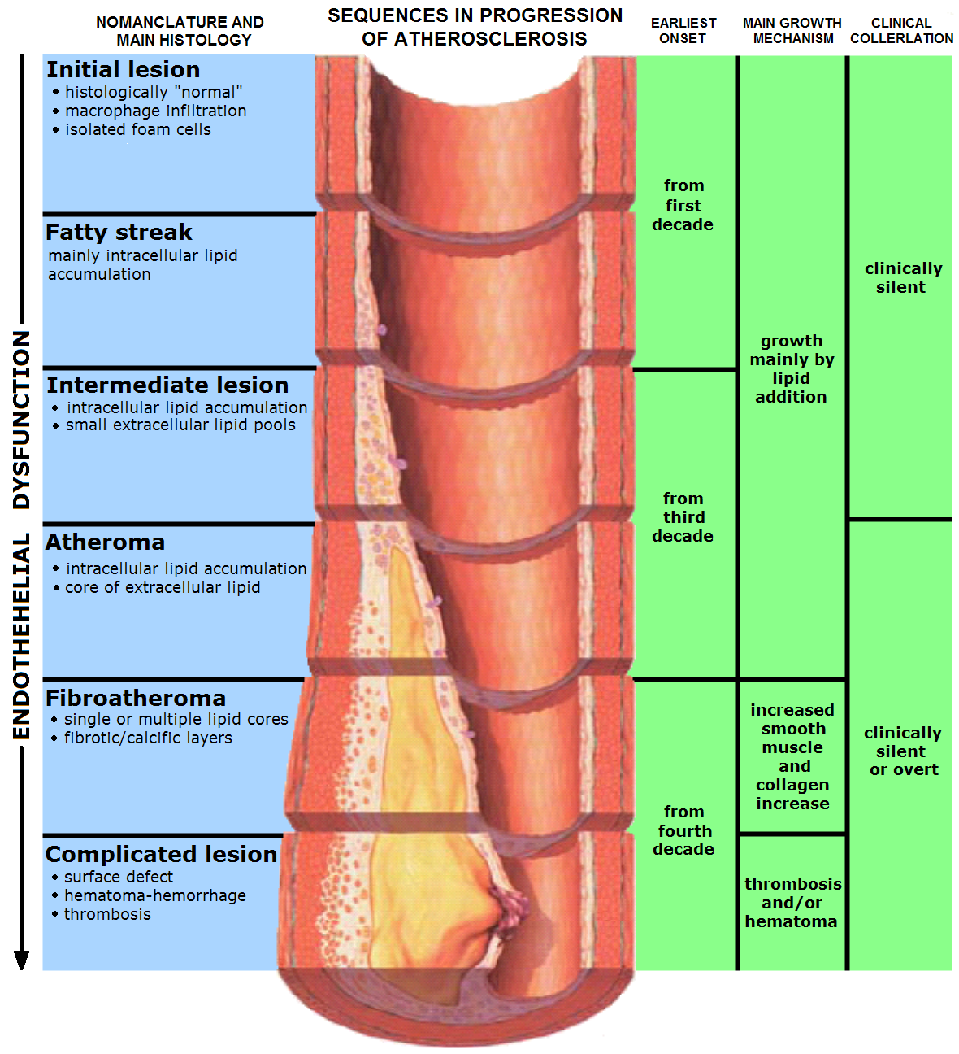
atheroGenesis and atherosclerosis
LDL ingestion by mono/macrophage in subendothelial space – fatty streaks
Smooth muscle cells migrate – form atheroma with cap
Stenosis of vessel – decreased blood flow – reduction in oxygenation and nutrition to tissues (chronic)
Worse when increased demand eg.exercise and therefore symptoms

Slide 8
Arterial System

Slide 9
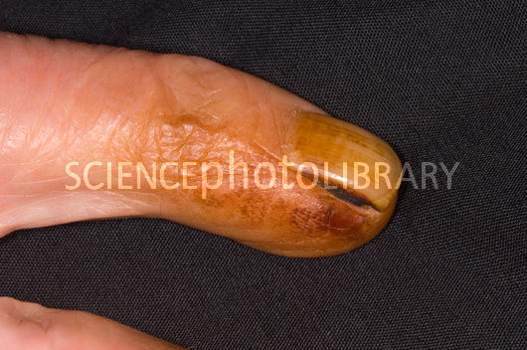
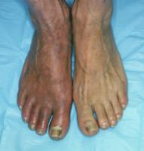
Inspection
REMEMBER inspection can give you clues to causes also –
Insulin Pens, Tar Staining
General inspection including hands and face
Look closer at legs –
Skin changes / Hair changes / Colour changes
Ulcers / Wounds
Scars

Slide 10
Palpation
SUPINE – expose abdomen and legs: underwear left on initially, have a blanket for comfort
Feel –
Start distally – temperature / scars (compare L Vs R)
Tibial shaft for oedema (pitting or non) – note upper level (severity)
scrotum /abdominal wall maybe involved –
unilateral disease – DVT or compression of large veins by node/tumour
Non pitting – lymphatic diseases / hypothyroidism

Slide 11
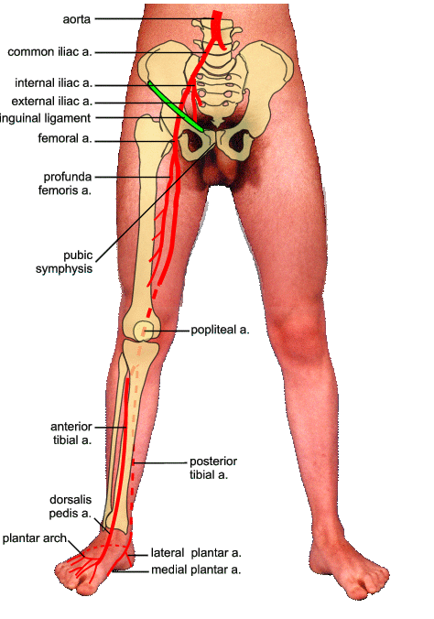
Palpation (and auscultation)
Feel PULSES (against som’ hard)
(and auscultate each for bruits at same time or you will forget!!!)
DP / Post Tib / Pop / Femoral
Abdo– MUST complete exam by assessing Abdominal Aorta, bruits and assess for sacral oedema…
AT LEAST SAY- full abdo exam: ascites (severe CF), tender liver- capsule/veins, splenomegaly, full CVS exam

Slide 12
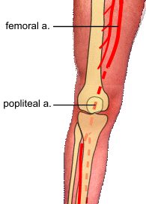
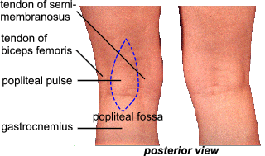
PULSES POPLITEAL
Relax the fossa
Use both hands to feel behind fat pad – almost like bimanual palp
DEMO

Slide 13
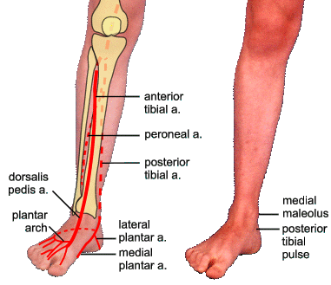
PULSES ANT tibial / D.PEDIS / POST TIB

Slide 14
Buerger’s test
“Any hip pain if I lift your leg up straight…?”
Angles ?
15-30 ischaemia - <20 severe

Slide 15
SPECIAL TESTS - ABPI
Ratio BP lower limb to BP Upper limb
Indicates - Severity of PVD
BP ankle – systolic DP or post Tib
BP arm – highest of left or right Brachial systolic
ABPI = BP ankle / BP arm

Slide 16
ABPI – interpretation
>1.2 – suggests calcification of vessels (age)
1.2-1.0 – Normal Range
0.9 – 1.0 – Acceptable (borderline abnormal) No referral needed
0.8-0.9 – mild disease (manage risk factors)
0.5 – 0.8 - moderate disease (routine referral) (mixed ulcers – bandage with care)
<0.5 – severe disease (URGENT referral) (no compression bandaging!!!)

Slide 17
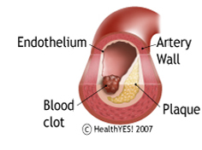
Remember – acute ischaemia
Painful
Pale
Pulseless
‘Perishingly’ cold
Paraesthetic
?paralysed

Slide 18
Venous System

Slide 19
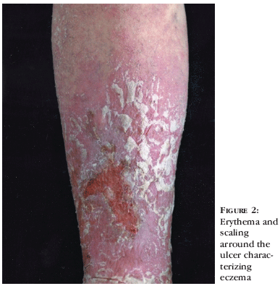
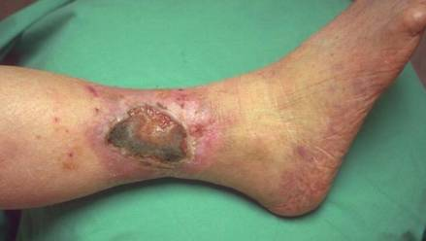
Venous system
Position – this time STANDING
Remainder the same – Inspect / Palpate /
Special tests
WEAR GLOVES!

Slide 20
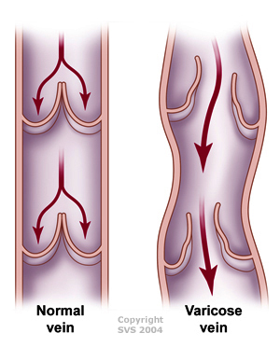
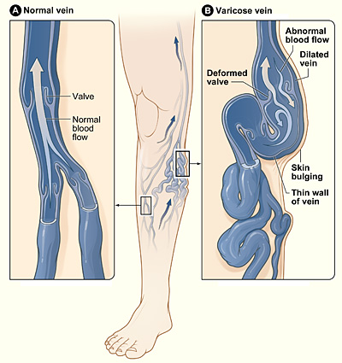
Varicose Veins

Slide 21
Examination
Inspect WHOLE leg – long saph / short saph regions
If unilateral swelling – you may be asked to measure circumference
(Use bony landmark as point of reference)
Palpate – hard veins = Thrombosis, Tenderness = phlebitis
Cough Impulse test: saphenofemoral valve (thrill – incompetence)
Trendelenburg – incompetence of saphenofemoral valve (POSITIVE)
If veins still fill up – incompetence lower - Perthes Test

Slide 22
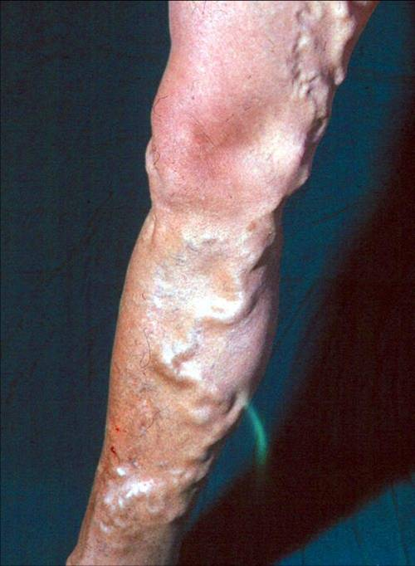
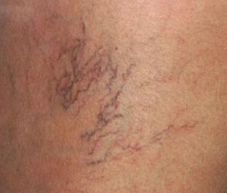
Varicose veins

Slide 23
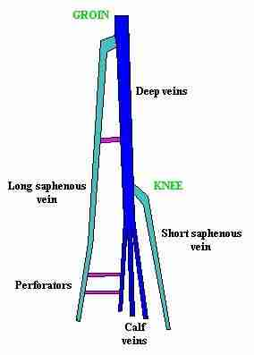
Trendelenberg tests

Slide 24
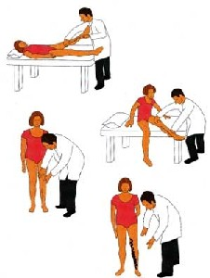
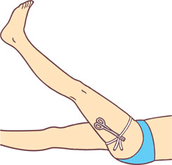
Special tests - Trendelenburg

Slide 25
Perthes test
Same as Trendelenburg – but on standing release small vol blood into veins
Ask patient to pump calves (stand up and down on tip toes)
Veins become less tense if perforators have competent valves
More tense if incompetence
Note Pt will feel pain when veins fill up!!!!
So BE VIGILANT and ready to STOP IMMEDIATELY
PAIN TO PATIENT IN EXAM = BAD!!!!

Slide 26
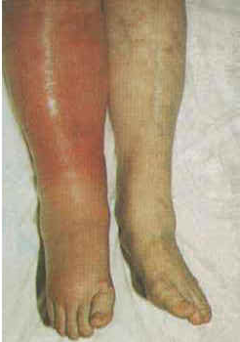
DVT
Difficult clinical diagnosis
High index of suspicion!!
Unilateral swelling – and high risk (history)
Can possibly demonstrate difference in calf size
Differential diagnoses
When presenting include investigations
Wells Score

Slide 27
Dvt

