Slide 1
PERIPHERAL NERVOUS SYSTEM EXAMINATION
Dr Will Ricketts
Clinical Teaching Fellow, Bart’s Health NHS Trust
Honorary Lecturer, QMUL
thanks to
Kate Breckenridge

Slide 2
GENERAL CONSIDERATIONS

Slide 3
PERIPHERAL NERVOUS SYSTEM EXAMINATION
Assess motor and sensory function
Upper limb
Lower limb
Where is the lesion?

Slide 4
BASIC STRUCTURE
ToP CaRS
TONE
POWER
COORDINATION
and
REFLEXES
SENSATION
EXTRA TESTS

Slide 5
INTRODUCE YOURSELF GAIN CONSENT WASH YOUR HANDS
Hello, my name is, I am a medical student
What is your name?
I would like to examine you today to assess the movement and feeling in your arms and legs

Slide 6
EXPOSE THE PATIENT
UPPER LIMB: arms, shoulders & torso
LOWER LIMB: hips and legs
POSITION THE PATIENT
UPPER LIMB: sitting in chair/edge of couch or lying on couch
LOWER LIMB: lying on couch

Slide 7
INSPECTION – END OF THE BED
AROUND THE BED:
Sensory aids
Mobility aids
Any other clues
Catheter
THE PATIENT:
Well or unwell?
Deformities

Slide 8
CLOSER INSPECTION
Posture
Muscle bulk
Abnormal movements
Fasciculations
Skin

Slide 9
CLOSER INSPECTION
Posture
e.g. Hemiplegia – fixed flexion of UL, fixed extension of LL
Muscle bulk
Abnormal movements
Fasciculations
Skin

Slide 10
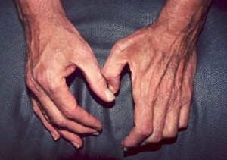
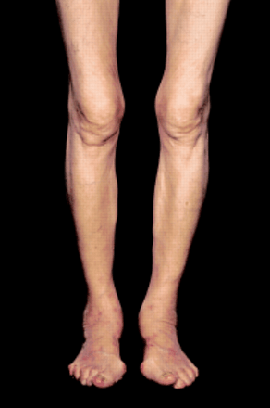
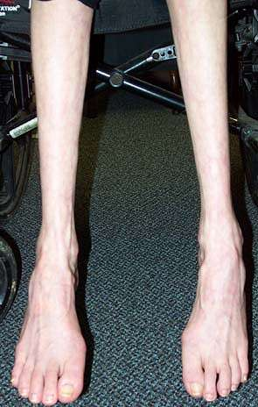
CLOSER INSPECTION
Posture
Muscle bulk
Causes of wasting:
Denervated muscle
Primary muscle disease
Disuse atrophy
Abnormal movements
Fasciculations
Skin
Generalised?
Symmetrical or asymmetrical?
Proximal or distal?

Slide 11
CLOSER INSPECTION
Posture
Muscle bulk
Abnormal movements
e.g. Tremor
Fasciculations
Skin

Slide 12
CLOSER INSPECTION
Posture
Muscle bulk
Abnormal movements
Fasciculations
Irregular contractions of small areas of muscle at rest. No rhythmical pattern.
Skin

Slide 13
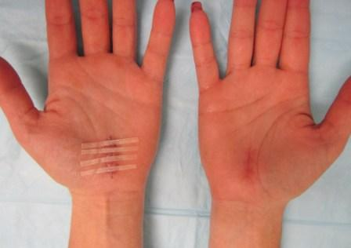
CLOSER INSPECTION
Posture
Muscle bulk
Abnormal movements
Fasciculations
Skin
Scars – injury or surgery
Neurofibromatosis

Slide 14
UPPER LIMB EXAMINATION

Slide 15
BASIC STRUCTURE
ToP CaRS
TONE
POWER
COORDINATION
and
REFLEXES
SENSATION
EXTRA TESTS

Slide 16
UPPER LIMB EXAMINATION TONE
PAIN!!!
WRIST
ELBOW
Hold the patients hand
Support the elbow
Random, unpredictable movements of arm and wrist
Flex/Extend the elbow
Pronate/Supinate the wrist

Slide 17
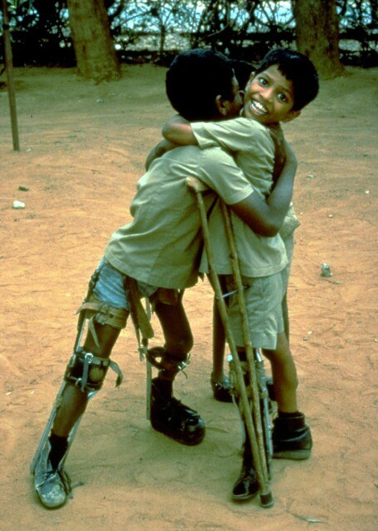
UPPER LIMB EXAMINATION TONE
↑ Tone (hypertonia)
↓ Tone (hypotonia)

Slide 18
UPPER LIMB EXAMINATION POWER
Movement against resistance
Isolate the joints
Shoulder
Elbow
Wrist
Finger
Thumb

Slide 19
UPPER LIMB EXAMINATION POWER
Shoulder
- ABduction (C5,6 – supraspinatus then deltoid)
[- ADduction (C6,7 – latissimus dorsi, pectoralis)]
Elbow
Wrist
Finger
Thumb

Slide 20
UPPER LIMB EXAMINATION POWER
Shoulder
Elbow
Flexion (C5,6 – biceps, brachioradialis)
Extension (C7,8 - triceps)
Wrist
Finger
Thumb

Slide 21
UPPER LIMB EXAMINATION POWER
Shoulder
Elbow
Wrist
Flexion and Extension (C7,8)
Finger
Thumb

Slide 22
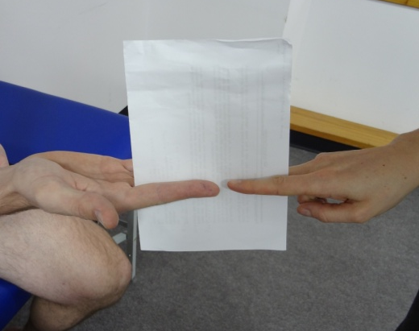
UPPER LIMB EXAMINATION POWER
Shoulder
Elbow
Wrist
Finger
Flexion (C7,8)
ABduction and ADduction (T1 – interossei, abductor digiti minimi)
Thumb

Slide 23
UPPER LIMB EXAMINATION POWER
Shoulder
Elbow
Wrist
Finger
Thumb
Opposition and ABduction
(T1 – abductor policis brevis)

Slide 24
UPPER LIMB EXAMINATION POWER
Grade | Description
0 | Total paralysis
1 | Slight flicker of muscle activity
2 | Able to move with gravity eliminated
3 | Able to move against gravity
4 | Able to move against resistance
5 | Normal power

Slide 25
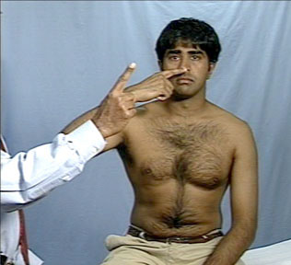
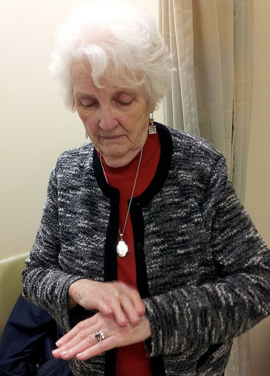
UPPER LIMB EXAMINATION COORDINATION
Finger-Nose test
Near full extension of arm
L k for:
Intention tremor
Past-pointing
Disdiadochokinesis
Rapid, Alternating Hand Movements
L k for:
Slow, Clumsy movement

Slide 26
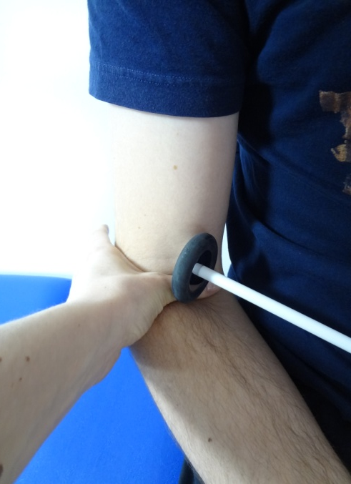
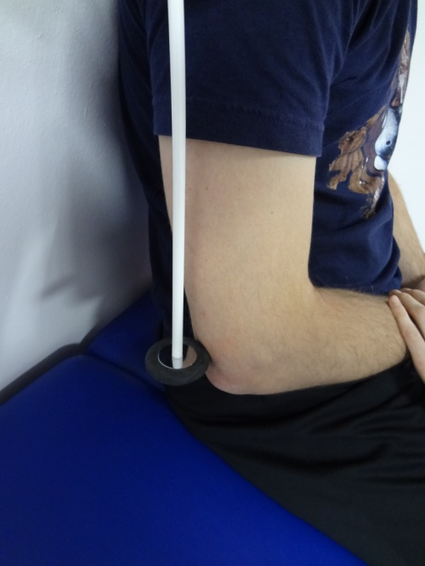
UPPER LIMB EXAMINATION RELFEXES
BICEPS JERK C5, C6
TRICEPS JERK C7, C8
SUPINATOR JERK C5, C6
Allow the tendon hammer to fall with gravity
Reinforce if needed

Slide 27
UPPER LIMB EXAMINATION RELFEXES
Grade | Description
0 | Absent
+ | Depressed
++ | Normal
+++ | Brisk
++++ | Greatly increased Often with Clonus

Slide 28
UPPER LIMB EXAMINATION SENSATION
Mixed:
Light touch
Posterior columns:
Proprioception
Vibration
Spinothalamic tract:
Pain (pin prick)
Temperature

Slide 29
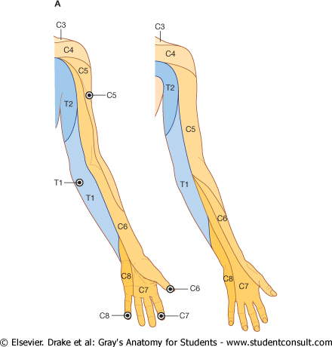
UPPER LIMB EXAMINATION SENSATION – Light touch
MAP OUT THE DEFICIT
VS
VS

Slide 30
UPPER LIMB EXAMINATION SENSATION – Light touch
Demonstrate on sternum
Dermatomes
= area of skin supplied by a vertebral spinal segment
Wisp of cotton wool
Do NOT stroke

Slide 31
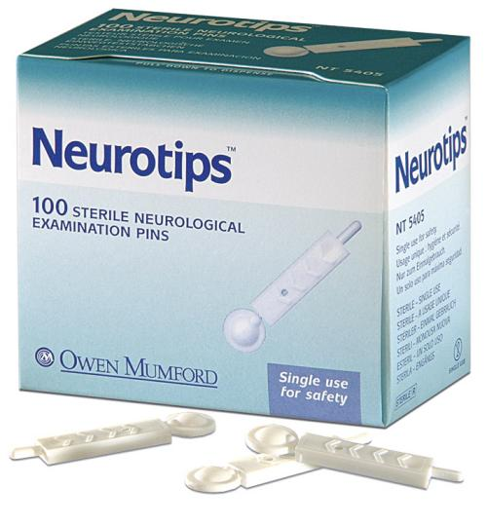
UPPER LIMB EXAMINATION SENSATION – Pain/pin prick
As light touch - dermatomes
Neurotip
Map abnormalities

Slide 32
UPPER LIMB EXAMINATION SENSATION – Proprioception
Test at DIP joint
Isolate the joint
Hold distal phalanx at the sides
Move UP and DOWN to demonstrate to patient
Ask the patient to close their eyes
Move the distal phalanx UP or DOWN and ask the patient to state the position
Repeat a few times
If any deficit move proximally until normal

Slide 33
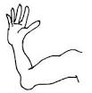
UPPER LIMB EXAMINATION SENSATION – Vibration
128 Hz Tuning fork
Bony prominences
Demonstrate at sternum
Begin distal
If deficit move proximal
DIP joint/ ulnar head/
olecranon/ shoulder
Assess when vibration starts and stops
1
4
2
3

Slide 34
UPPER LIMB EXAMINATION EXTRA TESTS
DRIFT
Hold out arms fully extended, palms up
Eyes closed
L k for drift from neutral position

Slide 35
UPPER LIMB EXAMINATION DRIFT
DOWN +/- pronation
UMN weakness
UP with slow pronation
Cerebellar disease
Wondering/searching
Loss of joint proprioception

Slide 36
THANK THE PATIENT OFFER ASSISTANCE WITH DRESSING ENSURE COMFORT WASH HANDS
“To complete my examination I would like to carry out a cranial nerve examination and peripheral nervous system examination of the lower limbs” (as appropriate)

Slide 37
LOWER LIMB EXAMINATION

Slide 38
BASIC STRUCTURE
ToP CaRS
TONE
POWER
COORDINATION
and
REFLEXES
SENSATION
EXTRA TESTS

Slide 39
LOWER LIMB EXAMINATION TONE
PAIN!!!
KNEE
ANKLE
Roll the leg
Abruptly lift and drop knee
Test for clonus at the ankles
Leg externally rotated, knee flexed, abruptly dorsiflex the foot
Clonus = sustained rhythmical contraction of muscles following sudden stretch. UMN lesion.
Notes:
A few beats of clonus is allowed

Slide 40
LOWER LIMB EXAMINATION POWER
Movement against resistance
Isolate the joints
Hip
Knee
Ankle
Foot
Toes

Slide 41
LOWER LIMB EXAMINATION POWER
Hip
- Flexion (L1,2 - iliopsoas)
[- Extension & ABduction (L5, S1 - glutei)]
[- ADduction (L2,3,4 – adductors)]
Knee
Ankle
Foot
Toes
Notes:
??

Slide 42
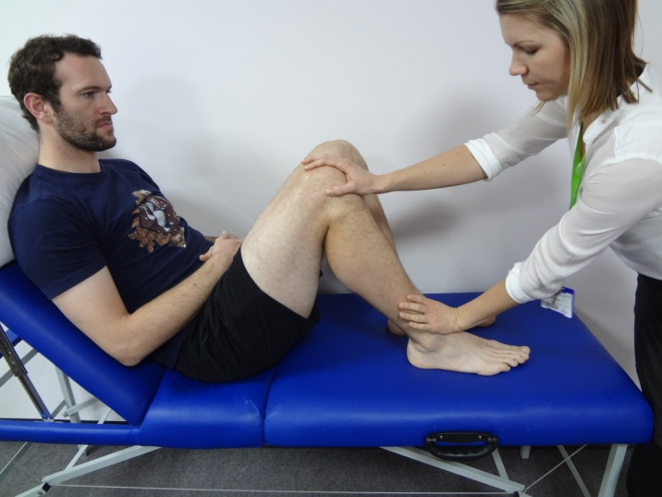
LOWER LIMB EXAMINATION POWER
Hip
Knee
Flexion (L5, S1 - hamstrings)
Extension (L3,4 - quadriceps)
Ankle
Foot
Toes

Slide 43
LOWER LIMB EXAMINATION POWER
Hip
Knee
Ankle
Dorsiflexion (L4,5 – tibialis anterior)
Plantarflexion (S1,2 - gastrocnemius)
Foot
Toes

Slide 44
LOWER LIMB EXAMINATION POWER
Hip
Knee
Ankle
Foot
Inversion (L4,5 – tibialis anterior & posterior)
Eversion (L5,S1 – peroneus longus & brevis)
Toes

Slide 45
LOWER LIMB EXAMINATION POWER
Hip
Knee
Ankle
Foot
Toes
Flexion (S1,2 – flexor digitorum longus)
Extension (L5, S1 – extensor digitorum longus)

Slide 46
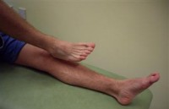
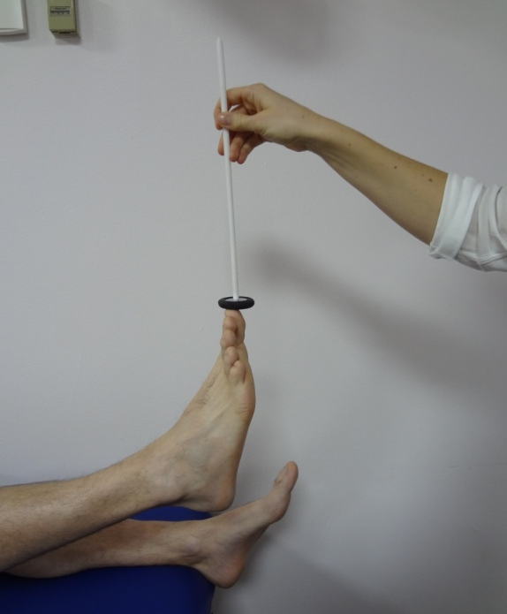
LOWER LIMB EXAMINATION COORDINATION
Heel-shin test
Toe touch

Slide 47
LOWER LIMB EXAMINATION RELFEXES
KNEE JERK L3, L4
ANKLE JERK S1, S2
Allow the tendon hammer to fall with gravity
Reinforce if needed

Slide 48
LOWER LIMB EXAMINATION RELFEXES
PLANTAR REFLEX
Run a blunt object up the lateral sole of the foot and across the MTP joints.
DOWN (flexion of big toe at MCP) is normal
UP (extension) is abnormal = Babinski’s sign
Bilateral UP = diffuse brain disturbance

Slide 49
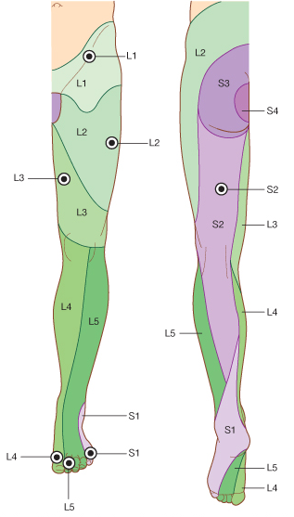
LOWER LIMB EXAMINATION SENSATION – Light touch
Demonstrate on sternum
Dermatomes
= area of skin supplied by a vertebral spinal segment
Wisp of cotton wool
Do NOT stroke
L4
L5

Slide 50
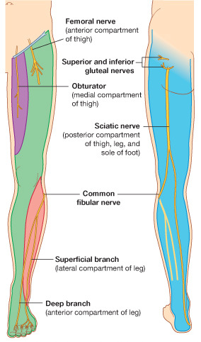
LOWER LIMB EXAMINATION SENSATION – Light touch
MAP OUT THE DEFICIT
VS
VS
L4
L5

Slide 51
LOWER LIMB EXAMINATION SENSATION – Pain/pin prick
As light touch - dermatomes
Neurotip
Map abnormalities

Slide 52
LOWER LIMB EXAMINATION SENSATION – Proprioception
Test at IP joint
Isolate the joint
Hold distal phalanx at the sides
Move UP and DOWN to demonstrate to patient
Ask the patient to close their eyes
Move the distal phalanx UP and DOWN and ask the patient to state the position
Repeat a few times
If any deficit move proximally until normal

Slide 53
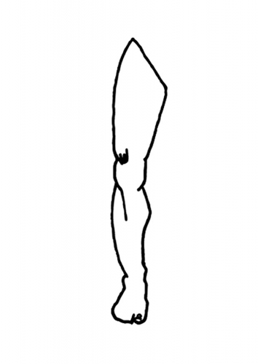
LOWER LIMB EXAMINATION SENSATION – Vibration
128 Hz Tuning fork
Bony prominences
Demonstrate at sternum
Begin distal
If deficit move proximal
Base of great toe/ ankle/
knee/ hip
Assess when vibration starts and stops
4
3
2
1

Slide 54
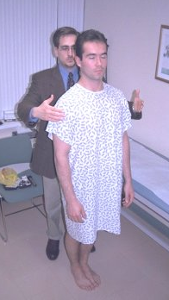
LOWER LIMB EXAMINATION EXTRA TESTS
GAIT
Walk normally few metres
Turn quickly
Walk back
Additional Gait Tests:
Heel-to-toe – Cerebellar
On toes – S1
On heels – L4, L5
ROMBERG
Ask patient to stand with feet together and eyes closed
Loss of balance = Positive test

Slide 55
THANK THE PATIENT OFFER ASSISTANCE WITH DRESSING ENSURE COMFORT WASH HANDS
“To complete my examination I would like to carry out a cranial nerve examination and peripheral nervous system examination of the upper limb” (as appropriate)

Slide 56
CEREBELLAR FUNCTION

Slide 57
Cerebellar dysfunction - ‘DANISH’ Dysdiadochokinesis Ataxia Nystagmus Intention tremor Slurred/Scanning/Stacatto Speech Hypotonia

Slide 58
TYING IT ALL TOGETHER

Slide 59
Tying it All Together
Is the problem?
Motor
Sensory
Both
Is the problem?
Unilateral
Below a level
Localised
Generalised
Motor
Upper Motor Neurone
Lower Motor Neurone
Neuromuscular Junction
Muscle
Cerebellum
Sensory
Hemisensory
Sensory Level
Dermatomal
Glove and Stocking
Peripheral Nerve Distribution
Which modalities?
All
Posterior Columns
Spinothalamic Tracts

Slide 60
Motor problems
Where?
Upper Motor Neurone
Lower Motor Neurone
Neuromuscular Junction
Muscle
Cerebellum

Slide 61
Upper or Lower Motor Neurone?
Modality | UMN | LMN
Tone | ↑ | ↓
Power | ? | ↓
Coordination | ? | ?
Reflexes | ↑ | ↓
Sensation | ? | ?

Slide 62
Reflexes
Increased reflexes:
UMN lesion
Decreased/absent reflexes:
Muscle
Motor nerve
Anterior spinal cord root
Anterior horn cell
Sensory root
Sensory nerve
ANY PART OF THE REFLEC ARC!

Slide 63
Sensory problems What’s the Pattern?
Where?
Hemisensory
Sensory Level
Dermatomal
Glove and Stocking
Peripheral Nerve Distribution
Which modalities?
All
Posterior columns
Spinothalamic tracts

Slide 64
Sensory Deficit
VS
VS

Slide 65
Sensory Deficit
VS
VS
L4
L5

Slide 66
A Few Examples
UMN – Unilateral Signs
Site = Brain
Pathology
Stroke
Brain tumours
UMN – Signs Below Level
Site = Cord
Pathology
Trauma/Fracture
Tumour
Spinal Artery Infarction
LMN /Sensory – Glove & Stocking
Site = long peripheral nerves
Diabetic neuropathy
LMN / Sensory – Dermatomal
Site = nerve root
Disc herniation
LMN / Sensory – Peripheral nerve distribution
Site = single nerve
Carpal Tunnel Syndrome
Common peroneal nerve trauma

Slide 67
BASIC STRUCTURE
ToP CaRS
TONE
POWER
COORDINATION
and
REFLEXES
SENSATION
EXTRA TESTS

Slide 68
A Few Extra Revision Slides

Slide 69
Dermatomes

Slide 70
Dermatomes and Myotomes

