Slide 1
Cranial Nerve Examination
Dr Will Ricketts
Clinical Teaching Fellow, Bart’s Health NHS Trust
Honorary Lecturer, QMUL
thanks to
Kate Breckenridge

Slide 2
BACKGROUND

Slide 3
CRANIAL NERVE EXAMINATION
12 pairs of cranial nerves:
CN1 Olfactory
CN2 Optic
CN3 Oculomotor
CN4 Trochlear
CN5 Trigeminal
CN6 Abducens
CN7 Facial
CN8 Vestibulocochlear
CN9 Glossopharyngeal
CN10 Vagus
CN11 Accessory
CN12 Hypoglossal

Slide 4
CRANIAL NERVE EXAMINATION
Assessing motor and/or sensory function
Can be a tough examination:
Requires patient cooperation
Communication skills are key
Where is the lesion?

Slide 5
BASIC STRUCTURE

Slide 6
STARTING THE EXAMINATION
WASH HANDS
INTRODUCE & CONSENT
“Hello, my name is **. I am a medical student. I would like to examine your eyes and the movement and feeling in your face today. Would that be OK?”
POSITION
Sitting (in bed/on couch/on chair)
EXPOSE
Head and neck
RETREAT to end of bed to observe

Slide 7
INSPECTION – END OF THE BED
AROUND THE BED:
Sensory aids – Including Spectacles
Mobility aids
Special Diet
Catheter
THE PATIENT:
Well/Unwell?
Level of Consciousness
Obvious Neurological Signs?

Slide 8
CLOSER INSPECTION
Face:
Asymmetry
Eyes:
Deviation
Ptosis
Pupil size
Skin:
Scars
Neurofibromas
Rashes

Slide 9
CLOSER INSPECTION
Face:
Symmetry
Eyes:
Deviation
Ptosis
Unequal Pupils (Anisocoria)
Skin:
Scars
Neurofibroma
Rashes

Slide 10
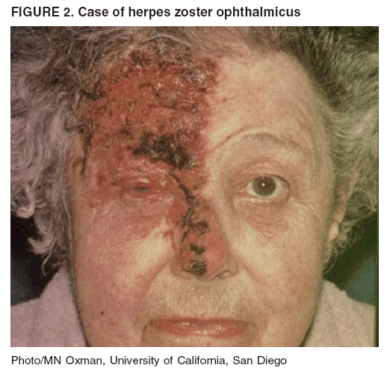
CLOSER INSPECTION
Face:
Symmetry
Eyes:
Deviation
Ptosis
Pupil size
Skin:
Scars
Neurofibromas
Rashes

Slide 11
CRANIAL NERVE EXAMINATION

Slide 12
BASIC STRUCTURE

Slide 13
CN1 - OLFACTORY
SENSORY only
Smell sensation

Slide 14
CN1 - OLFACTORY
Ask patient:
Any problems with sense of smell?
Does food/drink taste normal?
Formal testing:
Test each nostril separately with familiar smells (e.g. coffee)
Scratch and sniff (Upsit) cards available for this
Not routinely done

Slide 15
CN2 - OPTIC
SENSORY only
Visual acuity
Visual fields
Reflexes:
Pupillary light reflex
Accommodation reflex
Colour vision
Fundoscopy

Slide 16
CN2 - OPTIC
Visual Acuity
Snellen chart at 6 metres (bring them closer if they cannot read top letter)
One eye at a time
With normal correction
Establish smallest line patient can read
If acuity too poor for Snellen chart, try:
Finger counting at 20cm
Hand movement
Perception of light

Slide 17
CN2 - OPTIC
Documented as:
R L
x/y x/y
x=Distance from Chart (m)
y = Text Size
Larger Number = Larger Font
Normal = 6/6
Historically 20/20

Slide 18
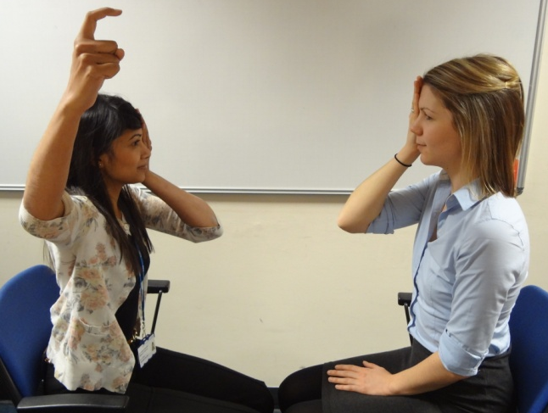
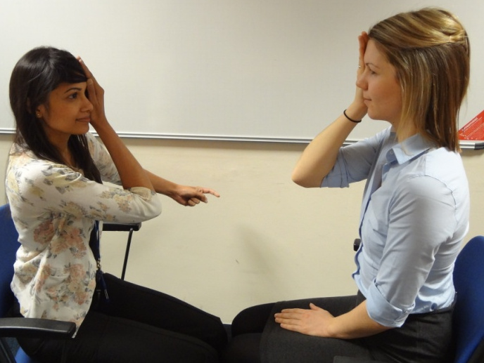
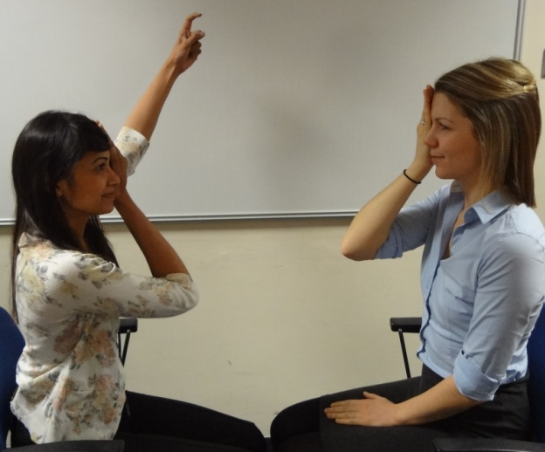
CN2 - OPTIC
Visual fields:
Ask patient to look at your eye
Test one eye at a time
Cover your eye that is opposite the patient’s covered eye
Ask patient to report finger movements on both sides, move inwards until they are able to see them
Compare with your own visual field

Slide 19
CN2 - OPTIC
Visual fields:
Consider whether any field defect is:
Unilateral field loss (i.e. all vision in one eye)
One side of the visual field in each eye (hemianopia):
Bitemporal
Homonymous
Or even one quadrant only (quadrantanopia)

Slide 20
CN2 - OPTIC
Central fields:
Use red pin
Assess central fields:
Ask patient to report when the pin appears red
Fovea has more cones to detect colour
Assess blind spot:
Ask patient to report when pin disappears
Normally 15 degrees lateral to centre of vision

Slide 21
CN2 - OPTIC
Reflexes:
Pupillary light reflex
Ask patient to fixate on a distant point
Shine light into one eye
Look for constriction of that pupil (direct reflex) and the other pupil (consensual reflex)
Swinging light test
Accommodation reflex

Slide 22
CN2 - OPTIC
Reflexes:
Pupillary light reflex
Swinging light test
Swing light between the eyes
If optic nerve intact, both stay constricted
If optic nerve damaged, pupils appear to dilate when light shone directly into it
Relative afferent pupillary defect
Accommodation reflex

Slide 23
CN2 - OPTIC
Reflexes:
Pupillary light reflex
Swinging light test
Accommodation reflex
Ask patient to fixate on distant object
Present an object around 6 inches from their face and ask them to focus on it
Look for pupil constriction
PEARLA
Pupils Equal And Reactive to Light and Accommodation

Slide 24
CN2 - OPTIC
Colour vision:
Ishihara plates – ask patient to read out the numbers
Not always available (unless you have the iPhone app!)

Slide 25
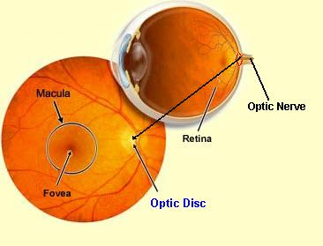
CN2 - OPTIC
Fundoscopy
This involves looking into the back of the patient’s eye with an ophthalmoscope to visualise the retina and optic disc.
We will not be covering this in today’s session, but you should be aware that it forms part of the CN examination.
Notes:
Check this

Slide 26
CN3 (OCULOMOTOR) CN4 (TROCHLEAR) CN6 (ABDUCENS)
MOTOR ONLY
Eye movements:
CN3 – Superior rectus, Inferior rectus, Medial Oblique, Inferior oblique
CN4 – Superior Oblique
CN6 – Lateral Rectus
LR6 SO4

Slide 27
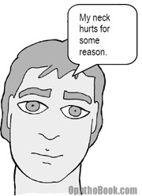
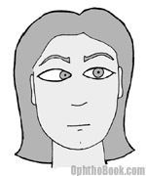
CN3 (OCULOMOTOR) CN4 (TROCHLEAR) CN6 (ABDUCENS)
On inspection:
Eye moves towards the muscles that still work
Third nerve palsy:
Down and outward deviation
= Tramps Pupil
Fourth nerve palsy:
Subtle – Head tilted away from lesion
Sixth nerve palsy:
Inward deviation
Inability to look out
“False Localising Sign”

Slide 28
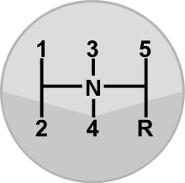
CN3 (OCULOMOTOR) CN4 (TROCHLEAR) CN6 (ABDUCENS)
Ask patient to keep their head still and follow your finger with their eyes
Ask patient to report any double vision in neutral position or during test
Move your finger slowly through a large double letter
HH
Observe for full eye movements

Slide 29
CN5 - TRIGEMINAL
SENSORY & MOTOR
Sensory – 3 divisions:
Ophthalmic
Maxillary
Mandibular
Motor:
Muscles of mastication:
Jaw jerk reflex

Slide 30
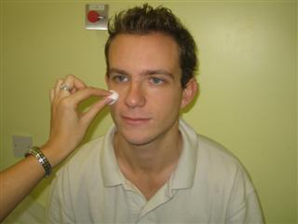
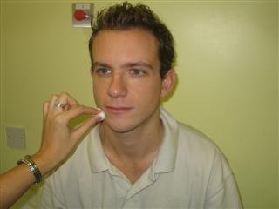
CN5 - TRIGEMINAL
Sensory:
Test light touch sensation in each of the areas shown
Demonstrate on sternum
Ask patient to close their eyes and report when they feel it and if it feels normal
Corneal reflex – touch cornea lightly with cotton wool and look for blink in both eyes
Not done in exam setting

Slide 31
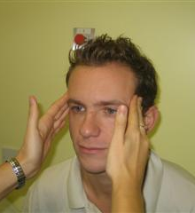
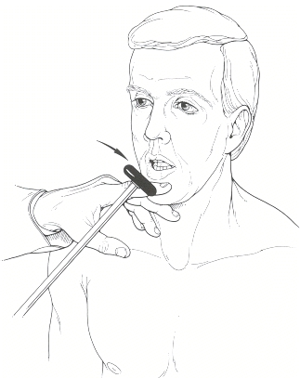
CN5 - TRIGEMINAL
Motor:
Muscles of mastication:
Inspect for wasting
Palpate on jaw clenching
Resisted mouth opening
Jaw jerk reflex:
Mouth slightly open, jaw relaxed
Place finger on chin and tap with tendon hammer
Normally absent or small
Brisk in UMN lesions

Slide 32
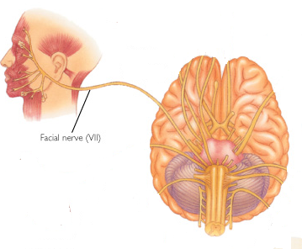
CN7 - FACIAL
SENSORY & MOTOR
Sensory:
Taste sensation to anterior 2/3 of tongue
Motor:
Muscles of facial expression

Slide 33
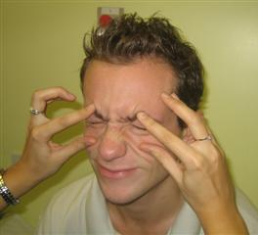
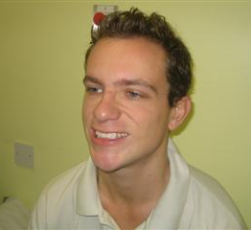
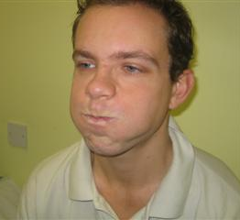
CN7 - FACIAL
Sensory:
Not routinely tested
Motor:
Muscles of facial expression – ask patient to:
Raise eyebrows
Close their eyes and don’t let you open them
Smile
Puff out their cheeks

Slide 34
CN8 - VESTIBULOCOCHLEAR
SENSORY only
Carries hearing and balance input from ear

Slide 35
CN8 - VESTIBULOCOCHLEAR
Crudely test hearing:
Whisper a number into each ear whilst making a distracting sound in the other ear
Ask patient to repeat the number
If concerned, perform Weber’s and Rinne’s tests
Notes:
Do we need to give

Slide 36
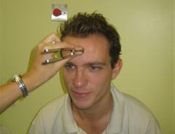
CN8 - VESTIBULOCOCHLEAR
Weber’s test:
Tuning fork in centre of forehead – in which ear does it sound louder?
Normally equal in both ears.
Conductive hearing loss:
Lateralises to affected side
Sensorineural hearing loss:
Lateralises to non-affected side
How do you know which?
Rinne’s Test
Notes:
Do we need to give

Slide 37
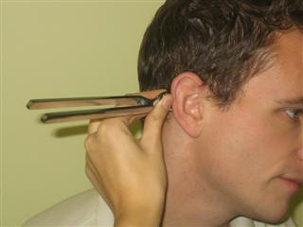
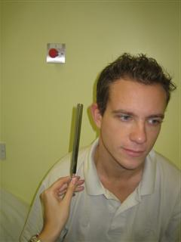
CN8 - VESTIBULOCOCHLEAR
Rinne’s test:
Tuning fork on Mastoid
When sound stops move next to ear
Ask if can now hear it?
Yes = Normal
or Equally affected = Sensorineural Deafness
No = Conductive deficit
Notes:
Do we need to give

Slide 38
CN9 & 10 – GLOSSOPHARYNGEAL & VAGUS
SENSORY & MOTOR
CN9 Sensory
Nasopharynx
Posterior 1/3 Tongue
Middle + Inner Ear
CN10 Sensory
Pharynx + Larynx
CN10 Motor
Pharynx + Larynx
Palate

Slide 39
CN9 & 10 – GLOSSOPHARYNGEAL & VAGUS
Observe for any dysphonia
Ask patient to open mouth wide and say “aah”
Observe for any deviation of the uvula
Deviation would be AWAY from the side of the lesion
Gag reflex
Not routinely done

Slide 40
CN11 - ACCESSORY
MOTOR only
Trapezius muscle
Sternocleidomastoid muscle

Slide 41
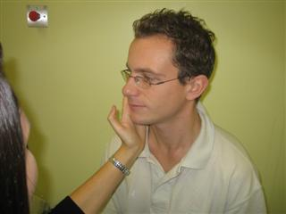
CN11 - ACCESSORY
Trapezius muscle
Ask patient to shrug their shoulders against resistance
Sternocleidomastoid muscle
Ask patient to turn their head to each side against resistance

Slide 42
CN 12 - HYPOGLOSSAL
MOTOR only
Muscles of the tongue

Slide 43
CN 12 - HYPOGLOSSAL
Muscles of the tongue
Observe for fasciculations
Ask patient to stick out their tongue
Observe for deviation
Deviation would be TOWARDS the side of the lesion
Check power of muscles by asking patient to push their tongue into the side of their cheek and pressing on it from the outside

Slide 44
COMPLETING THE EXAMINATION
THANK PATIENT
ENSURE COMFORT
WASH HANDS
“To complete my examination I would like to perform the reflexes mentioned, plus a full peripheral nerve examination.”

Slide 45
TYING IT ALL TOGETHER

Slide 46
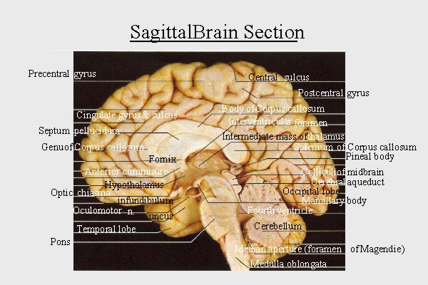
Cranial Nerves and the Brain Stem
I
II
Midbrain
III & IV
Cb
Pons
V - VIII
Medulla or ‘Bulb’
IX - XII
cerebellum
CPA
Feather’s Cartoon Version
Thanks to Dr Adam Feather

