Slide 1
Cardiac Examination
Dr Will Ricketts
Clinical Teaching Fellow, Bart’s Health
Honorary Lecturer, QMUL

Slide 2
Standard Order
Getting Started
Patient’s Road Map
Order of the Examination
Tying it All Together

Slide 3
Standard Order
Getting Started
Patient’s Road Map
Order of the Examination
Tying it All Together

Slide 4
Getting Started - WIPER
Wash Hands
Introduce (& Consent)
Position (on couch, sat at 45°)
Expose (from waist up)
Retreat to Observe

Slide 5
Order of the Examination
Retreat to Observe
End of Bed
Age/General Appearance (Well/Unwell)
Paraphernalia (Oxygen, Drugs etc)
Pacemaker
Obvious Oedema
Syndromes
Close Up
Scars (Chest/Legs)
Hands

Slide 6
Standard Order
Getting Started
Patient’s Road Map
Order of the Examination
Tying it All Together

Slide 7
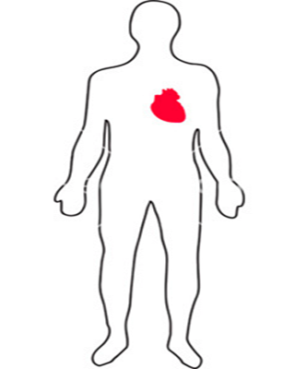
Patient’s Road Map
Hands
Wrists (+ Groin)
Arm
Neck
Eyes
Mouth
Chest
2
1
3

Slide 8
Hands
Hands
Clubbing
Tar Staining
Stigmata of Endocarditis
Peripheral Cyanosis
Wrists (+ Groin)
Arm
Neck
Eyes
Mouth
Chest
1

Slide 9
Wrist
Hands
Wrist (+ Groin)
Radial Pulse
Rate (6s x 10 or 15s x 4)
Rhythm
Regular
Irregularly Irregular (AF)
Regularly Irregular (Heart Blocks)
Collapsing Pulse
Arm
Neck
Eyes
Mouth
Chest
1

Slide 10
Radial-Radial Delay
Hands
Wrists (+ Groin)
Radial-Radial Delay
Arm
Neck
Eyes
Mouth
Chest
1

Slide 11
Radio-Femoral Delay
Hands
Wrist (+ Groin)
Radio-Femoral Delay
In Exam just state “I would like to assess for Radio-Femoral Delay”
Arm
Neck
Eyes
Mouth
Chest
1

Slide 12
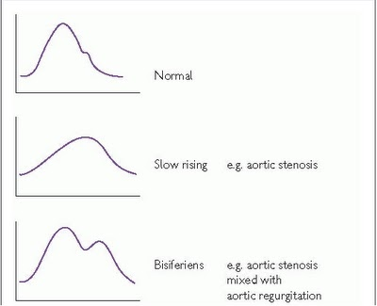
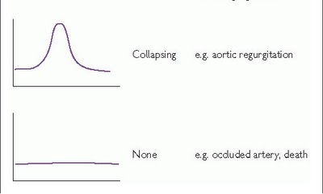
Brachial Pulse
Hands
Wrists (+ Groin)
Arm
Brachial Pulse
Character
Neck
Eyes
Mouth
Chest
1

Slide 13
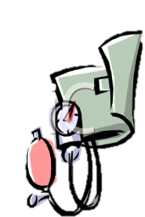
Blood Pressure
Hands
Wrists (+ Groin)
Arm
Brachial Pulse
Character
Blood Pressure
Just ask
Absolute
+ Pulse Pressure
= Systolic – Diastolic
Neck
Eyes
Mouth
Chest
1

Slide 14
Neck
Hands
Wrists (+ Groin)
Arm
Neck
Carotid Pulse
Character
JVP
Height
Wave Form!
Trachea
Eyes
Mouth
Chest
2
1

Slide 15
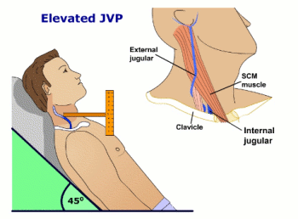
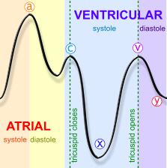
Jugular Venous Pulsation/Pressure
Hands
Wrists (+ Groin)
Arm
Neck
Carotid Pulse
Character
JVP
Height
Wave Form
Trachea
Eyes
Mouth
Chest
2
1

Slide 16
Eyes
Hands
Wrists (+ Groin)
Arm
Neck
Eyes
Pallor – Anaemia
Arcus
Xanthalasma
Mouth
Chest
2
1

Slide 17
Mouth
Hands
Wrists (+ Groin)
Arm
Neck
Eyes
Mouth
Central Cyanosis
Chest
2
1

Slide 18
Chest
Hands
Wrists (+ Groin)
Elbows
Neck
Eyes
Mouth
Chest
2
1
3

Slide 19
Chest – Standard Order
Hands
Wrists (+ Groin)
Elbows
Neck
Eyes
Mouth
Chest – Standard Order
Observe
Palpate
(Percuss)
Auscultate
2
1
3

Slide 20
Chest – Observation
Hands
Wrists (+ Groin)
Elbows
Neck
Eyes
Mouth
Chest
Observe
Should have already done this!
Palpate
Auscultate
2
1
3

Slide 21
Chest – Palpation
Hands
Wrists (+ Groin)
Elbows
Neck
Eyes
Mouth
Chest
Observe
Palpate
Apex
Heaves
Thrills
Auscultate
2
1
3

Slide 22
Palpation – Apex Beat
Apex =
Most Inferior-Lateral point cardiac impulse can be palpated
Palpate with radial border of index finger
Mark out location
Start at Manubriosternal angle = 2nd Costal Space
Normal =
5th ICS
MCL

Slide 23
Palpation – Heaves
Hands
Wrists (+ Groin)
Elbows
Neck
Eyes
Mouth
Chest
Observe
Palpate
Apex
Heaves
Ulnar Border of Hand
Left Sternal Edge
Parasternal Heave = RVH
Thrills
Auscultate

Slide 24
Palpation – Thrills
Hands
Wrists (+ Groin)
Elbows
Neck
Eyes
Mouth
Chest
Observe
Palpate
Apex
Heaves
Thrills = Palpable Murmurs
Ulnar Border 2nd ICS
Auscultate

Slide 25
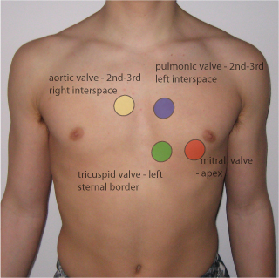
Chest – Auscultation
Hands
Wrists (+ Groin)
Elbows
Neck
Eyes
Mouth
Chest
Observe
Palpate
Auscultate
Four Areas
Usually start at Mitral
2
1
3

Slide 26
Auscultation
Heat Sounds = Valves Snapping Shut
S1(with pulse) = Mitral + Tricuspid Closing
S2 (between pulses) = Aortic + Pulmonary Closing
Are the heart sounds normal?
Additional Sounds?
Split Sounds?
Is there silence between the sounds?
If not = Murmur

Slide 27
Standard Order
Getting Started
Patient’s Road Map
Order of the Examination
Tying it All Together

Slide 28
Murmurs
Where is it loudest?
Does it radiate?
Aortic to Neck
Mitral to Axilla
Is it:
With the Pulse?
= Systolic
Between Pulses?
= Diastolic
Louder on:
Expiration? = Left
Inspiration? = Right
Sitting Forward = A/P
Rolled Left = Mitral

Slide 29
Murmurs
 | Aortic | Pulmonary | Mitral | Tricuspid
Systolic | Aortic Stenosis | Pulmonary Stenosis | Mitral Regurgitation | Tricuspid Regurgitation
Diastolic | Aortic Regurgitation | Pulmonary Regurgitation | Mitral Stenosis | Tricuspid Stenosis

Slide 30
Murmurs from First Principles
Murmur = Turbulent Blood Flow through a Faulty Valve
Stenosis = Stiff/Slow to Open ≈ Creaky Door
Regurgitation = Failure to Close
Where is it Loudest/Radiate to? = Valve Involved
Is it With Pulse? = Systolic
Between Pulses? = Diastolic
Should that valve be Open/Closed in Systole/Diastole?
Aortic + Pulmonary – Open Systole/Closed Diastole
Mitral + Tricuspid – Closed Systole/Open Diastole

Slide 31
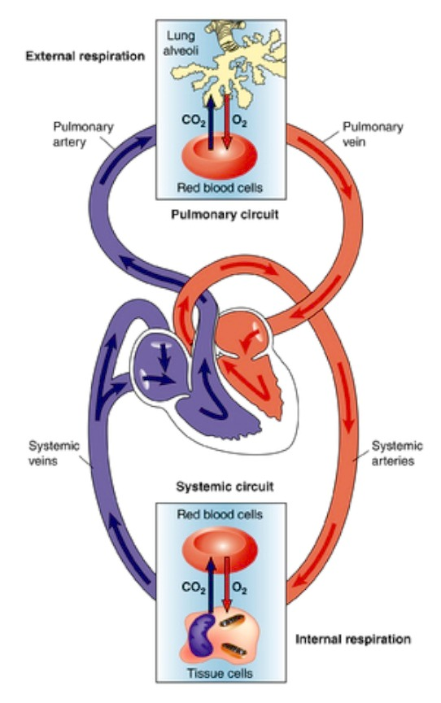
Circulation Schematic
LA
RA
LV
RV

Slide 32
Cardiac Schematic
RA
LA
RV
LV

Slide 33
Cardiac Schematic
RA
LA
RV
LV
Pulmonary Artery
Aorta

Slide 34
Cardiac Schematic
RA
LA
TV
MV
RV
LV
Pulmonary Artery
Aorta
PV
AV

Slide 35
Cardiac Schematic – Normal Systole
TV Closed
MV Closed
PV Open
AV Open

Slide 36
Cardiac Schematic – Normal Diastole
TV Open
MV Open
PV Closed
AV Closed

Slide 37
Systolic Murmurs – Aortic Stenosis
TV Closed
MV Closed
PV Open
AV Partially Open

Slide 38
Systolic Murmurs – Mitral Regurgitation
TV Closed
MV Partially Closed
PV Open
AV Open

Slide 39
Diastolic Murmurs - Aortic Regurgitation
TV Open
MV Open
PV Closed
AV Partially Closed

Slide 40
Diastolic Murmurs - Mitral Stenosis
MV
Partially
Open
TV Open
PV Closed
AV Closed

Slide 41
Right Sided Murmurs
These can be extrapolated from their left sided equivalents
E.g.
PS ≈ AS
PR ≈ AR
TS ≈ MS
TR ≈ MR
They are quieter
And (with the exception of TR) Rarer
As is MS

Slide 42
Murmurs – Improve the Odds! Common things are Common!
 | Aortic | Pulmonary | Mitral | Tricuspid
Systolic | Aortic Stenosis | Pulmonary Stenosis | Mitral Regurgitation | Tricuspid Regurgitation
Diastolic | Aortic Regurgitation | Pulmonary Regurgitation | Mitral Stenosis | Tricuspid Stenosis

Slide 43
Remember the Systems
Getting Started
Patient’s Road Map
Order of the Examination
Tying it All Together

Slide 44
Remember the Systems
Getting Started
Patient’s Road Map
Order of the Examination
Tying it All Together
Does your murmur fit with the rest of your findings?

Slide 45
Remember the Systems
Getting Started
Patient’s Road Map
Order of the Examination
Tying it All Together
Does your murmur fit with the rest of your findings?
Completing your examination
Peripheral Oedema
Pulmonary Oedema

Slide 46
Worked Example – Aortic Stenosis
Hands - Normal
Wrists (+ Groin) - Normal
Arm
Low Volume, Slow Rising Pulse
Narrow Pulse Pressure
Neck - ?↑JVP
Eyes – Normal
Mouth - Normal
Chest
?Aortic Thrill
Ejection Systolic Murmur
Loudest – Aortic area on Expiration
Radiates to Carotids
2
1
3

Slide 47
Summary
Getting Started
WIPER
Patient’s Road Map
Standard Order
Observe
Palpate
(Percuss)
Auscultate
Tying it All Together
2
1
3

Slide 48
Video

