Slide 1
Abdominal Examination
Dr Will Ricketts
Clinical Teaching Fellow, Bart’s Health NHS Trust
Honorary Lecturer, QMUL
thanks to
Tessa Pepper

Slide 2
Areas Covered
The divisions of the abdomen, and the structures underlying these
Identifying abnormalities of the abdomen
Peripheral signs of abdominal disease
How to examine the abdomen
Inspect
Palpate
Percuss
Auscultate
How to complete your examination and investigations you might do

Slide 3
Divisions of the Abdomen

Slide 4
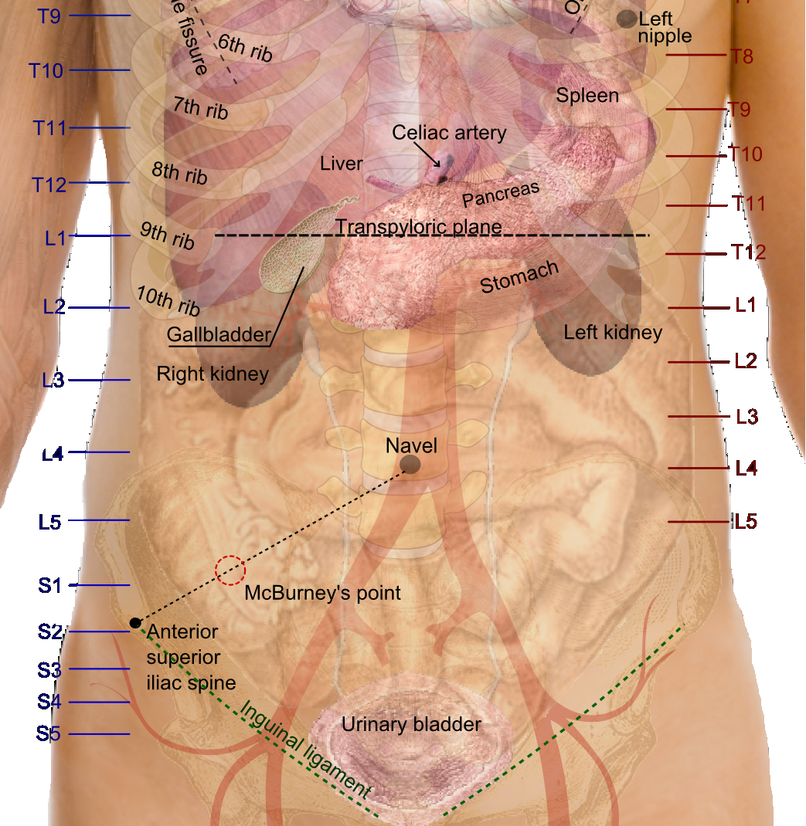
Anatomy

Slide 5
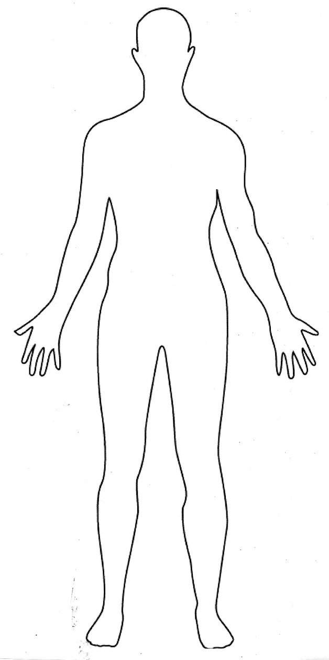
The examination – the order
Introduction
Inspection
Hands
Arms
Face and Eyes
Neck
Chest
Abdomen
Inspect
Palpate
Percuss
Auscultate
Completing the examination

Slide 6
Examination
Wash hands!!!
Introduce; Ensure that you ask the patient about pain – before you position.
Position; Lay the patient flat with their hands by their sides.
Exposure is ideally nipples to knees – realistically exposure of their chest to just below the ASIS is acceptable.
Retreat; Now is a good time to ask the patient to cough.
This will elicit hernias and peritonitic pain.

Slide 7
Why Cough?

Slide 8
The examination – the order
Introduction
Inspection
Hands
Arms
Face and Eyes
Neck
Chest
Abdomen
Inspect
Palpate
Percuss
Auscultate
Completing the examination

Slide 9
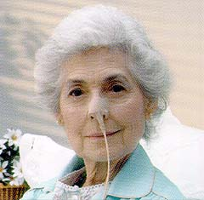
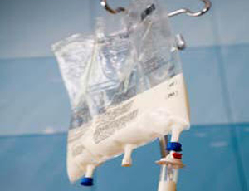
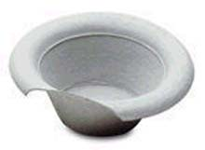
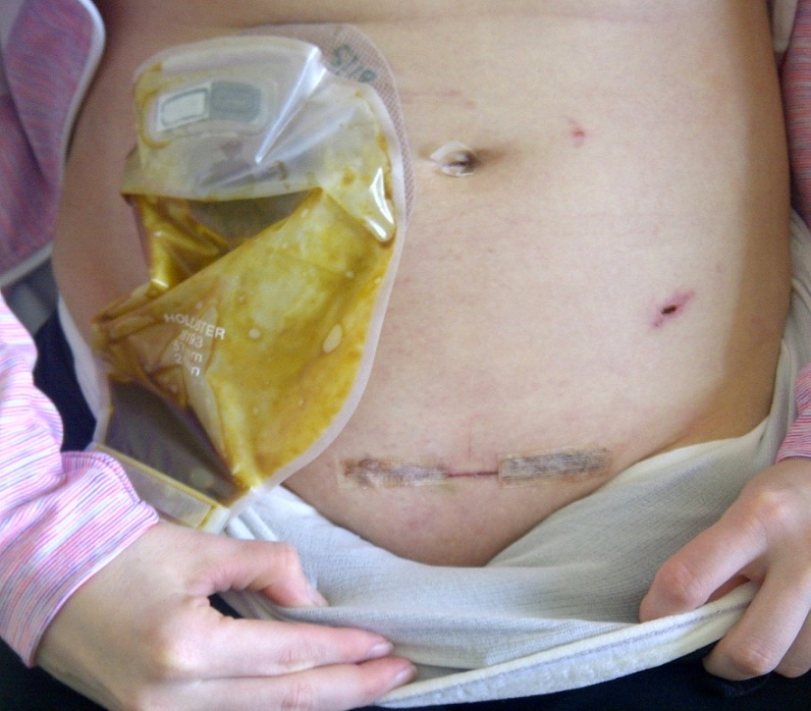
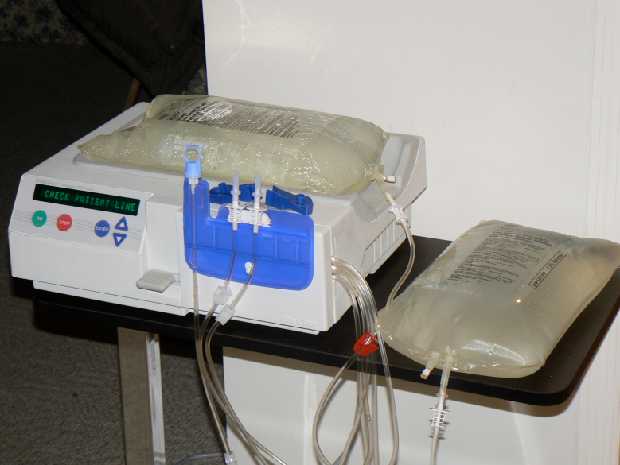
Retreat – what will you see from the end of the bed?
Notes:
Distension
Organomegaly
Colour
Hernias
Pain
Things around the bed – vomit bowls, TPN, Dialysis

Slide 10
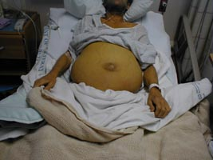
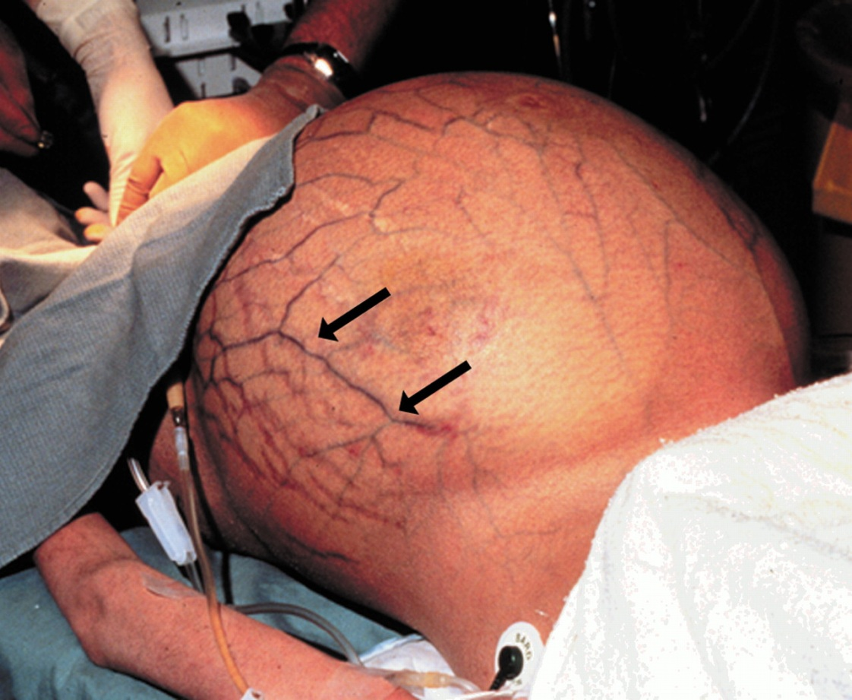
Retreat – what will you see from the end of the bed?
6 F's:
Fat
Fetus
Flatus
Fluid
Faeces
Flipping Big Tumour
Notes:
Distension
Organomegaly
Colour
Hernias
Pain
Things around the bed – vomit bowls, TPN, Dialysis

Slide 11
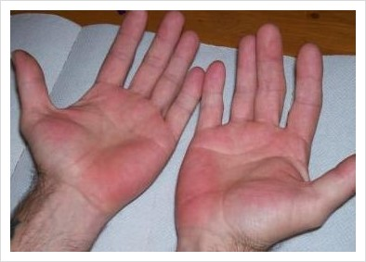
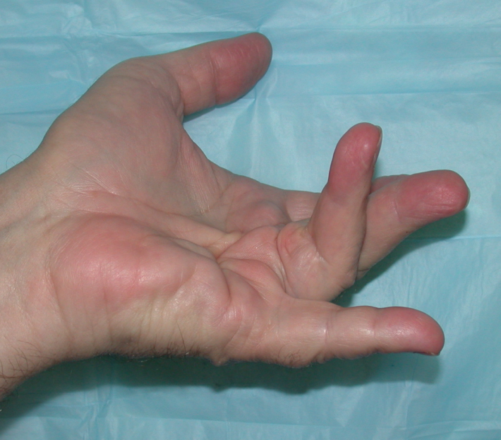
The examination – the order
Introduction
Inspection
Hands
Arms
Face and Eyes
Neck
Chest
Abdomen
Inspect
Palpate
Percuss
Auscultate
Completing the examination

Slide 12
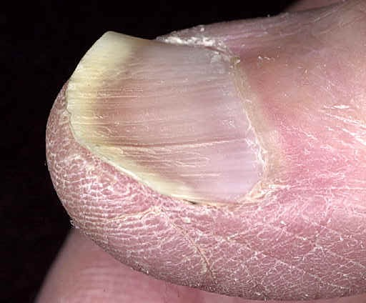
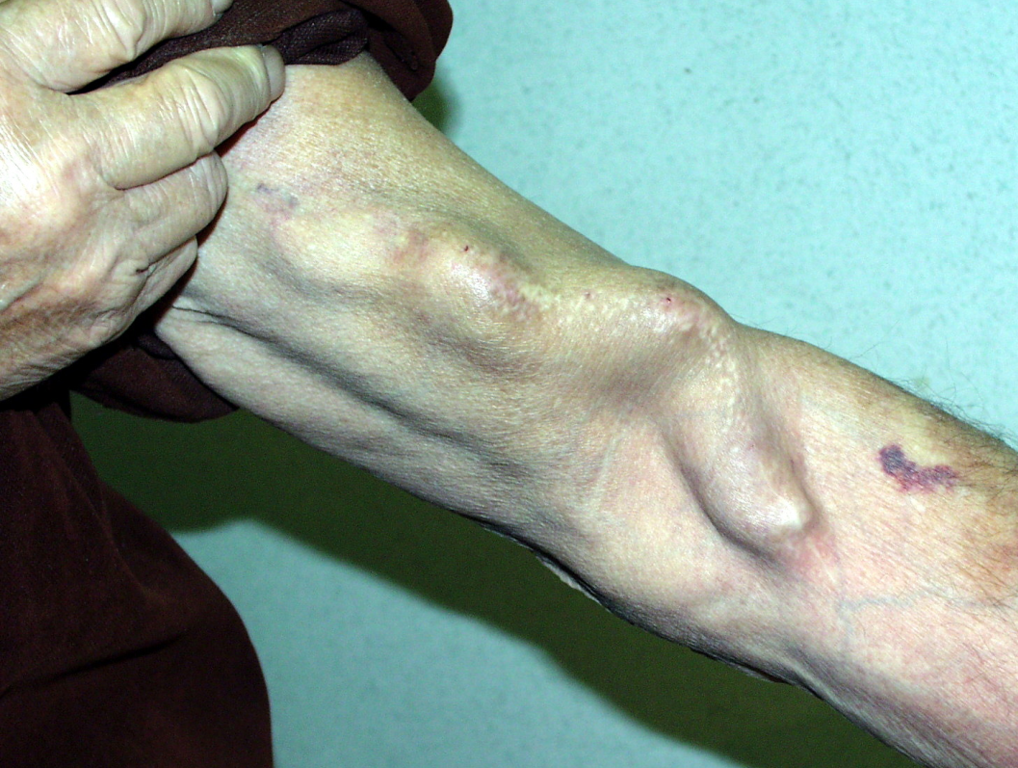
Inspection – Peripheral
Look at the nails:
Koilonychia
Leukonychia
Clubbing
Look at and feel the palms of the hands;
Dupuytrens contracture
Palmar erythema
Asterixis
On the Arms look for tattoos, piercings, signs of IVDU
AV fistulas

Slide 13
Inspection – Peripheral
Look at the nails:
Koilonychia (IDA)
Leukonychia (low albumin)
Clubbing (IBD, Ca, Cirrhosis)
Look at and feel the palms of the hands;
Dupuytrens contracture
Palmar erythema
(Both liver disease signs)
Asterixis– hepatic encephalitis
On the Arms look for tattoos, piercings, signs of IVDU – hepatitis B/C
AV fistulas

Slide 14
Asterixis

Slide 15
The examination – the order
Introduction
Inspection
Hands
Arms
Face and Eyes
Neck
Chest
Abdomen
Inspect
Palpate
Percuss
Auscultate
Completing the examination

Slide 16
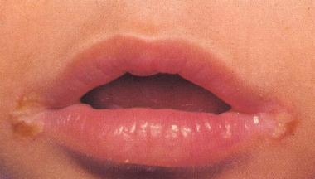
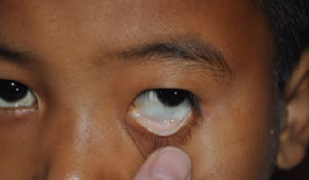
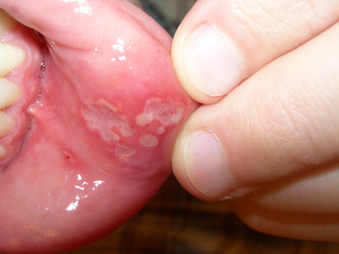
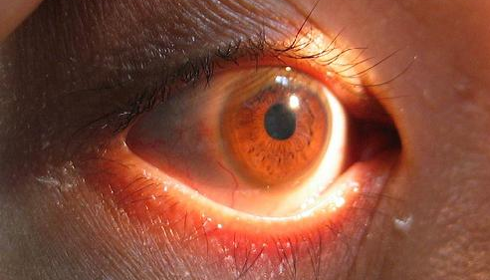
Face and eyes
Angular Stomatitis – IDA
Conjunctival pallor – IDA
Apthous ulcers – Crohn's
Kayser – Fleischer ring – Wilson’s Disease

Slide 17
Face and eyes
Also
Cushingoid appearance
Steroids/Cushing's
Parotid Hypertrophy
Cirrhosis (ETOH) bulimia malabsorption
Xanthelasma, Corneal Arcus
Hyperlipidaemia
Candida
Fetor Hepaticus
Portal hypertension
ETOH on the breath
Oral Candidiasis

Slide 18
The examination – the order
Introduction
Inspection
Hands
Arms
Face and Eyes
Neck – Lymph Nodes
Chest
Abdomen
Inspect
Palpate
Percuss
Auscultate
Completing the examination

Slide 19
Lymph node examination – Virchow's!
Don't sit the patient up at this point – it will waste time!
Leave it to the end, or mention you would examine the nodes.
However this lymph node in the left supraclavicular fossa is regarded as a sentinel node for gastric cancer, so you can palpate this while you're at the neck.

Slide 20
The examination – the order
Introduction
Inspection
Hands
Arms
Face and Eyes
Neck
Chest
Abdomen
Inspect
Palpate
Percuss
Auscultate
Completing the examination

Slide 21
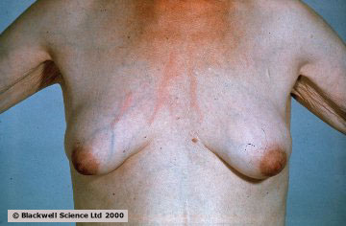
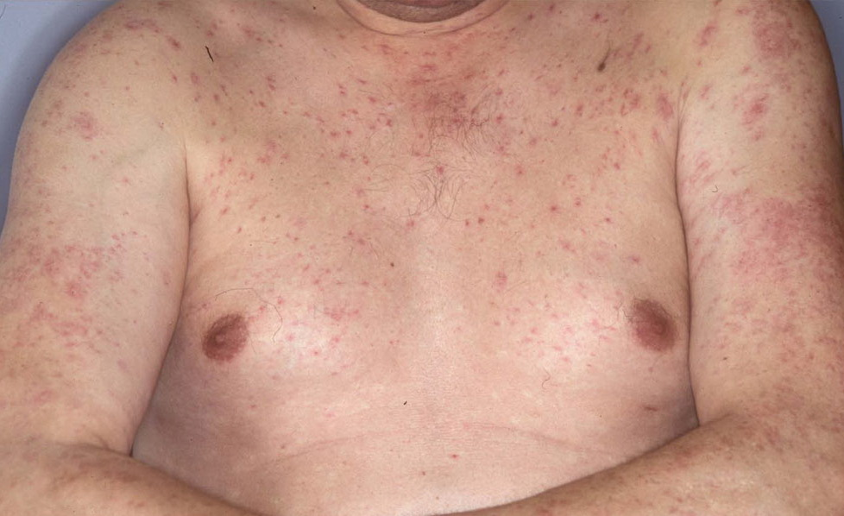
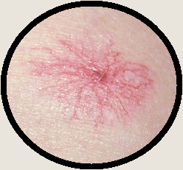
Chest
Look at the chest for signs of liver disease.
Gynaecomastia
Hair Loss
Spider naevi
SVC distribution
Jaundice (again)

Slide 22
The examination – the order
Introduction
Inspection
Hands
Arms
Face and Eyes
Neck – Lymph!
Chest
Abdomen
Inspect
Palpate
Percuss
Auscultate
Completing the examination

Slide 23
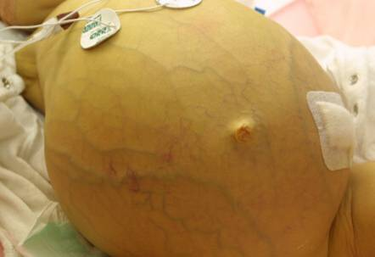
Inspection – Abdomen
Look for Scars
Remember to look at the back as well!
Drains
Obvious organomegaly
Distension
Caput medusae
Peristalsis
Body habitus
Notes:
1- Kocher's Incision
Biliary surgery e.g.. Cholecystectomy
Hepatic surgery (may also require a larger transverse incision for wider access: e.g.. Liver Transplant)
2 - Upper Midline laparotomy
Nissens fundoplication
observe: associated with Gastrostomy tube?
Upper GI surgery
2a - Lower / Long Midline Laparotomy Scars
Any major abdominal surgery
3 - Transverse Upper Abdominal Incision
Repair of congenital diaphragmatic hernia
Splenic surgery
4 - Ramstedt's Pyloromyotomy Scar
Ramstedt's Pyloromyotomy Scar - treatment of Pyloric Stenosis
5 - Grid-Iron Incisions at McBurney's Point
Appendicectomy
A non-inflamed appendix should always be removed once this scar has been made so that clinicians are not mislead in the future.
Called the 'Grid-Iron' incision due to the way the muscle layers are divided at operation.
McBurney's Point: the junction of the distal third and proximal two thirds of the line between the umbilicus and the anterior superior iliac crest.
6 - Umbilical / Sub-umbilical Scars
Hernia repairs
Gastroschisis repair
Exopthalmos
7 - Point incision marks
Laparoscopy port sites
Drain sites
Also consider abdominal wound sites for Ventriculo-Peritoneal shunts
8 - Inguinal Incisions
Inguinal hernia repairs
Vascular access scars
9 - Lateral Thoracolumbar Incision
Renal Surgery - e.g.. Nephrectomy
10 - 'Hockey-Stick' scar
Examine for orthotopic renal transplant

Slide 24
Peristalsis

Slide 25
Palpation
You have to palpate:
The 9 areas (Superficial and deep)
The Liver
The Spleen
The Kidneys
The Aorta (AAA)

Slide 26
Palpation – cont.
Kneel on the right of the patient (unless the bed is too high or you are too short!)
If patient has any localised pain – start in the opposite area
Palpate by passing your hand through each of the divisions – gently and carefully
BEND FROM THE MCP JOINTS – NOT THE IP JOINTS!
Now repeat the examination - palpating more deeply than before.
Note and define any masses and guarding.
Look at the patient’s face throughout – you are examining for tenderness!!

Slide 27
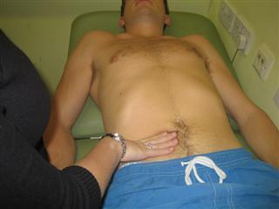
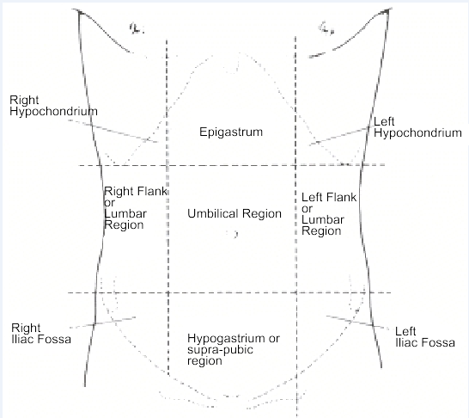
Hepatomegaly/Splenomegaly
Start in the right iliac fossa
Lay the border of your hand on the patients stomach
Ask them to take deep breaths in and out, push your hand in on inspiration – The liver/spleen is pushed down
Move your hand towards the right costal margin every time they expire
You should not feel a liver!
The spleen is the same technique; start in the RIF, but move across to the left side.
You should not feel a spleen!

Slide 28
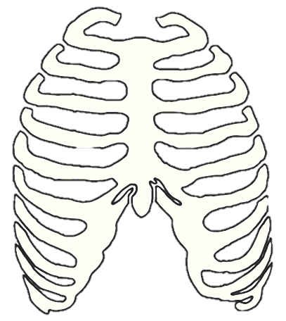
Your hand

Slide 29
Balloting the Kidneys
Place one hand under the patient, at the renal angle
Place the other over the top, pressing down firmly
Move the underneath hand, pushing the kidney into the top hand
Keep the top hand still!
Repeat on the other side
You may feel the kidneys in slim patients or if they are enlarged
This is also another test for tenderness – watch their face!

Slide 30
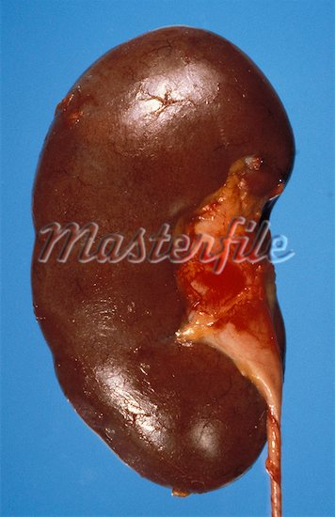
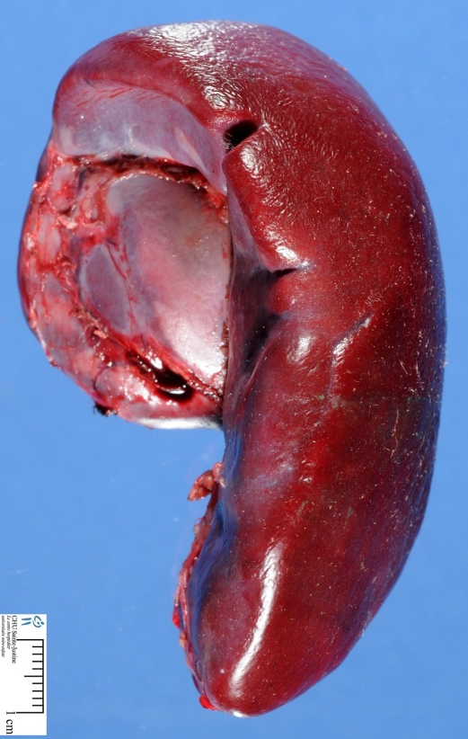
Kidney or Spleen?
You can’t get above the spleen
You can’t ballot the spleen
The spleen is dull to percussion
The spleen has a notch
The spleen moves down on respiration
Vs

Slide 31
Palpating the Aorta
This is to look for an aneurysm
A normal abdominal aorta may be palpable and pulsatile
The important difference is the expansile nature of an aneurysm
Place your hands either side of the umbilicus and push down
Your hands will be pushed up and out by an aneurysm. (fingertips will move apart)

Slide 32
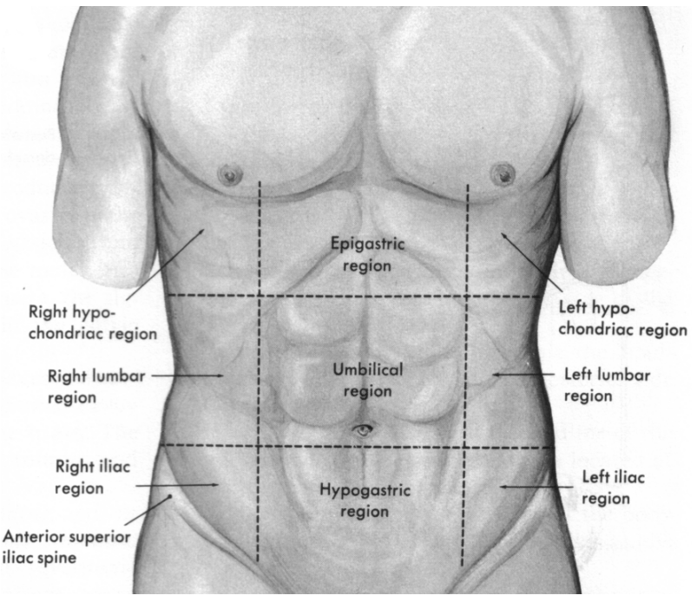
Percussion
Percuss the liver and spleen in the same areas that you palpated
You can also percuss down from the chest to find the upper border of the liver

Slide 33
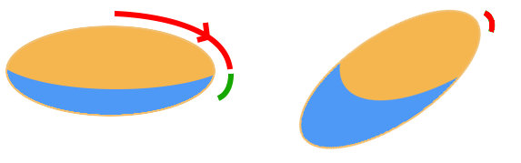
Percussing for Ascites
Shifting dullness
If you suspect ascites you can check for shifting dullness
Start percussing at the midline, and percuss away from yourself
When the percussion note becomes dull hold your hand there and ask the patient to roll towards you. Hold them there for 30 seconds
Percuss again. If there is shifting dullness, where was dull before, will now be resonant

Slide 34
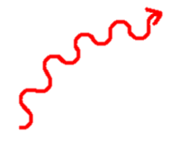
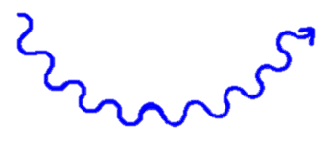
Percussing for Ascites - Continued
Patients Hand
Fluid Thrill
Ask the patient to lie their hand on the midline
Place your hand on one side of the abdomen and tap/flick with the other
If the fluid transmits the tap you should feel it in the other hand.
Your Hand

Slide 35
Auscultation
Listen with the diaphragm in the 4 quadrants of the abdomen
Bowel sounds are absent after you have listened for 5 minutes!
They may also be “tinkling”
Then listen for renal or aortic bruits with the bell
Be nice to your patient – warm your stethoscope

Slide 36
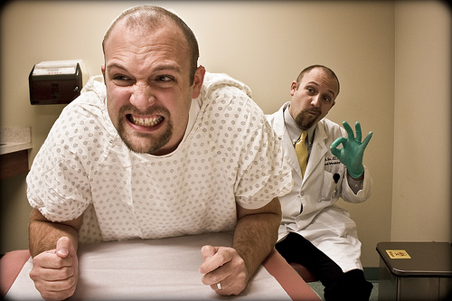
The examination – the order
Introduction
Inspection
Hands
Arms
Face and Eyes
Neck
Chest
Abdomen
Inspect
Palpate
Percuss
Auscultate
Completing the examination

Slide 37
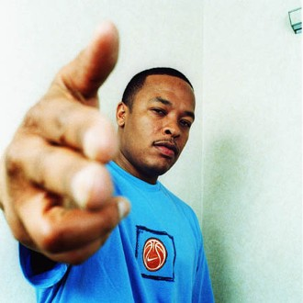
Thank the patient, Cover them up...
Wash your hands
Complete the examination, say you would..
DRE – “Don’t forget about DRE”
Examine the external genitalia
Examine the hernial orifices
(Lymph nodes)
Bedside tests
Urine dip – ALWAYS in women – why?
Investigations?

