Slide 1
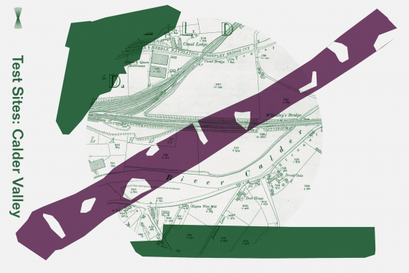
Test Sites is Arts Catalyst’s series of inquiries into matters of concern connected with environmental change – such as flooding, pollution, and species loss – and their impact on local culture and the health and wellbeing of our ecosystems and ourselves. At each site, we are involving local people in art-led co-inquiries, working with artists, scientists, and other experts

Slide 3
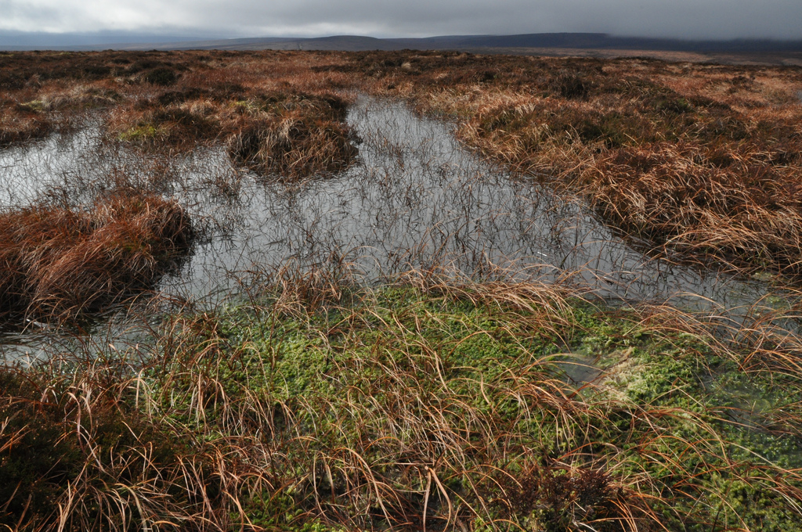
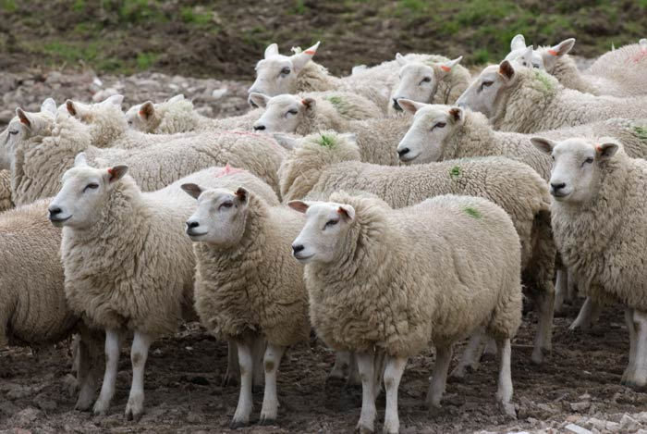
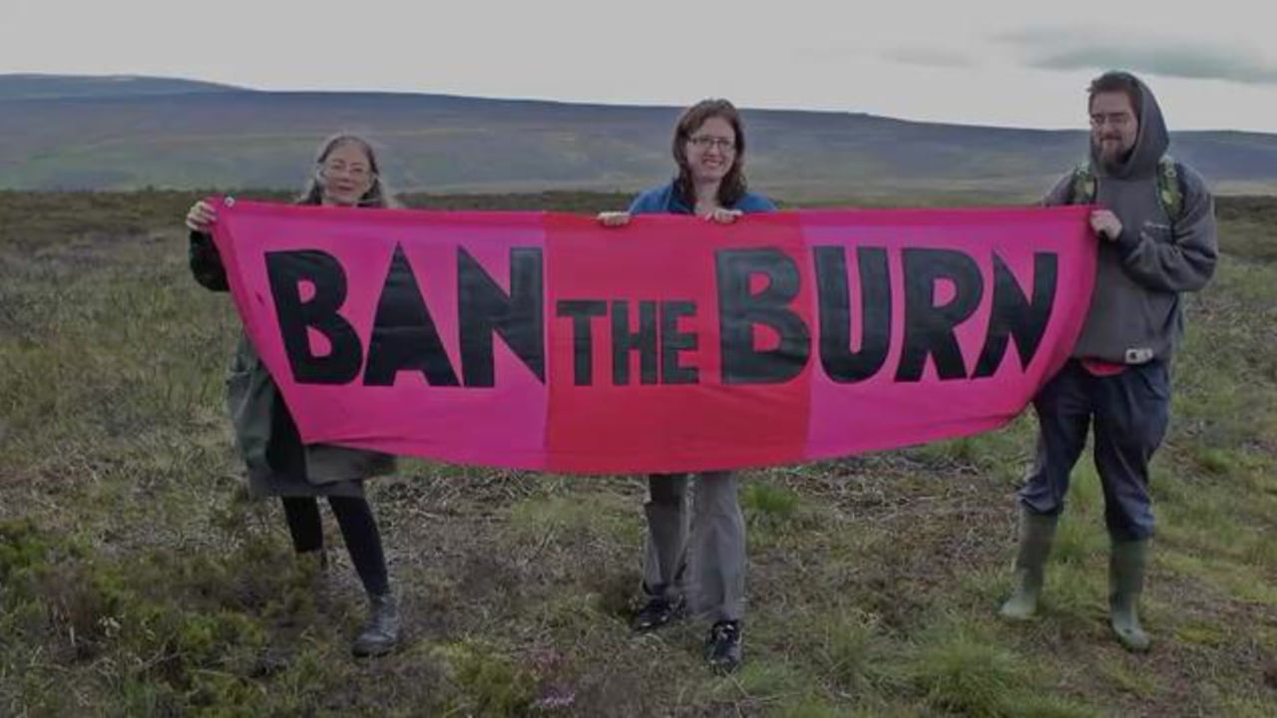

Slide 5
The wickedness of the Calder and its Catchment
…you’ve got this sort of bureaucratic infrastructure of how we go on as a society and an economy overlaid on a natural environment which comes and bites you on the bum if you neglect or abuse it
(Council employee, Calderdale)

Slide 6
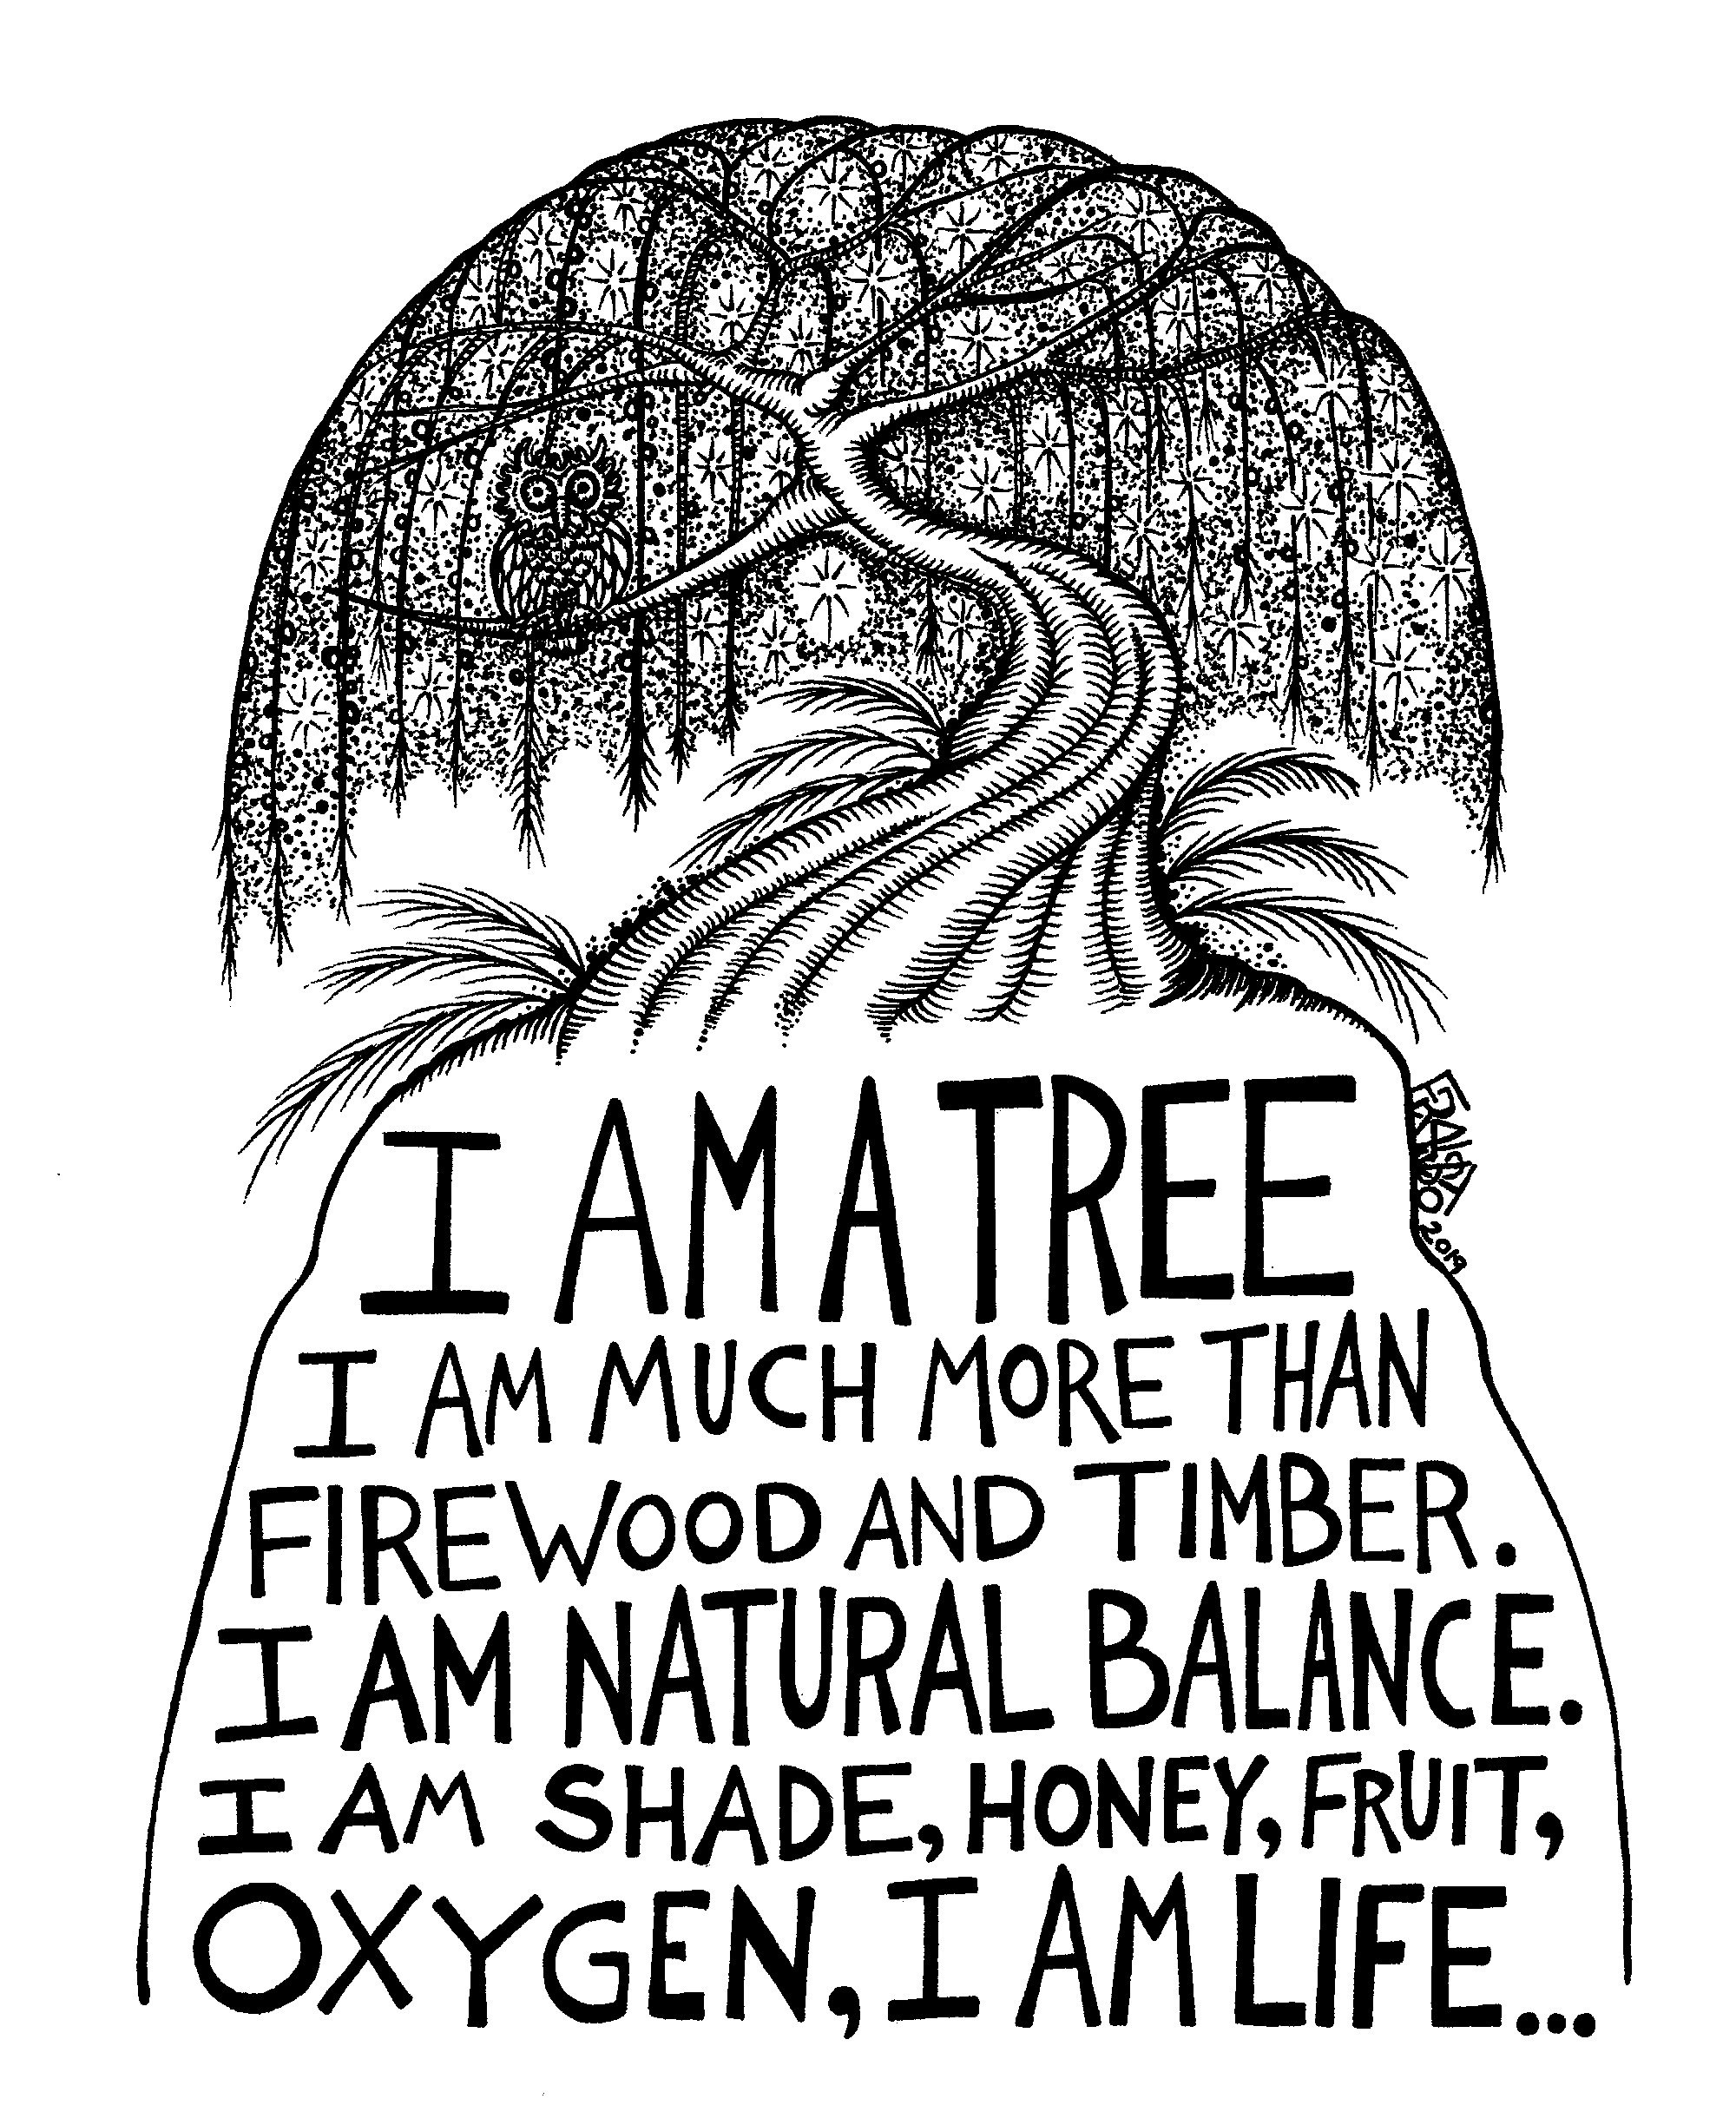
Theoretical underpinning to research
Care as politics: visibility and possibility
The many ways in which people resist the suffering wrought by systems of knowing and doing that are disassociated from ‘the specific problems, of specific individuals, in specific circumstances’
(Tironi et al 2017 also see Harraway, 1997, Puig de la Bellacasa, 2017 and Mol, 2008 )
Notes:
Agency is the process of making worlds – worlding or becoming with – the non-human others we share the earth with – speculative fabulation. A relationship which for too long has been denied and resulted in the Anthropocene/capitlocene (mindless extraction of resource for the purposes of producing a surplus)

Slide 7
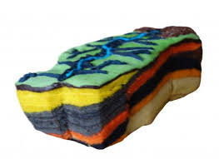
Theoretical underpinning to research
Alternative imaginaries of the Anthropocene
‘We argue that imaginaries provide ways of organizing that combine ideas and concrete practices, imagining organizational alternatives by enacting new forms of collective practice’
(Roux-Rosier et al, 2018)
Notes:
Agency is the process of making worlds – worlding or becoming with – the non-human others we share the earth with – speculative fabulation. A relationship which for too long has been denied and resulted in the Anthropocene/capitlocene (mindless extraction of resource for the purposes of producing a surplus)

Slide 9
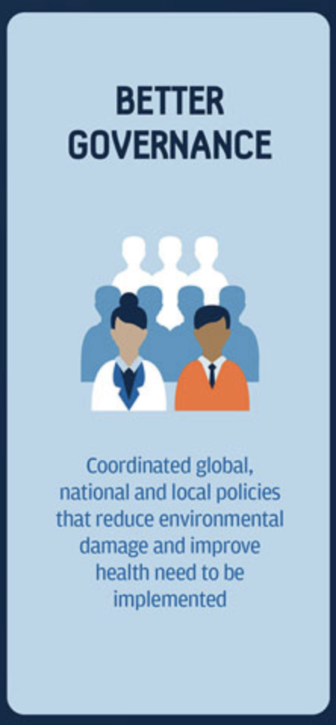
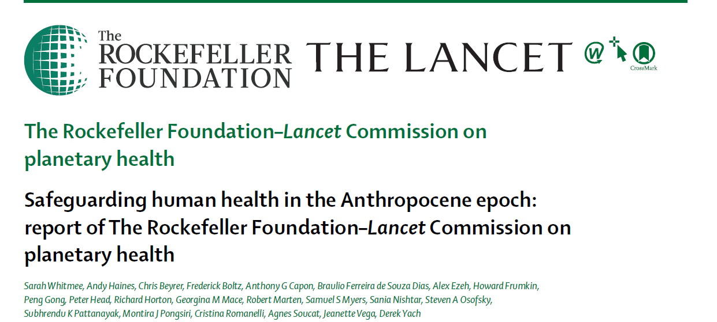
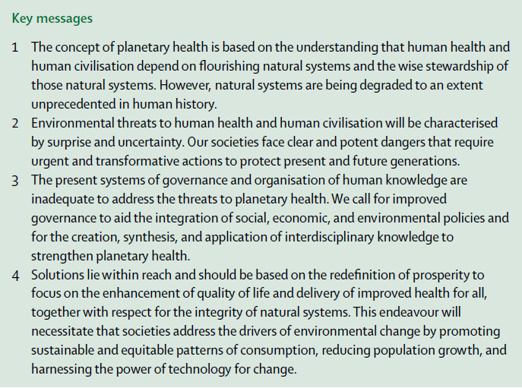
Changing times: human health depends on flourishing natural systems and wise stewardship
‘The engagement of civil society and community organisations to encourage polycentric governance that will increase capacity to steward environmental resources and protect health’

Slide 10
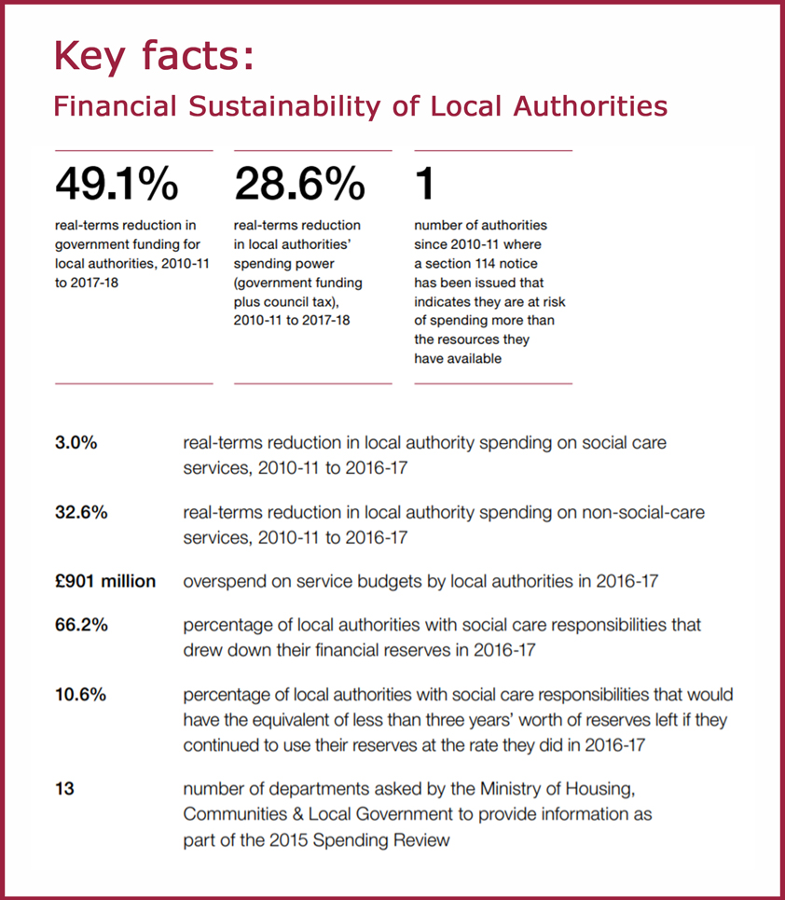
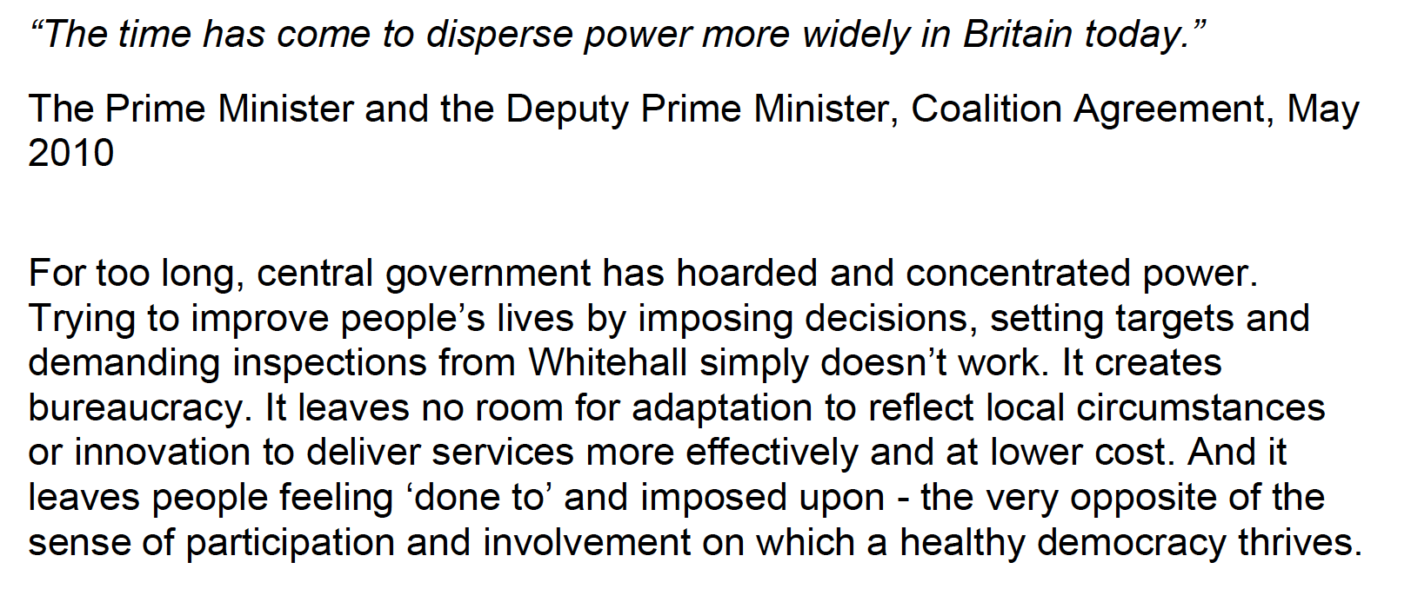
Changing times: having the ‘power’ but not the capacity for local government
…you know there’s like a whole continuum of services which are all working with people, and all ought to interlink. They’ve all been restructured in isolation and it feels like what we’ve got now is this sort of patchwork of duplication next to holes really. (Kirklees Council Worker)

Slide 11
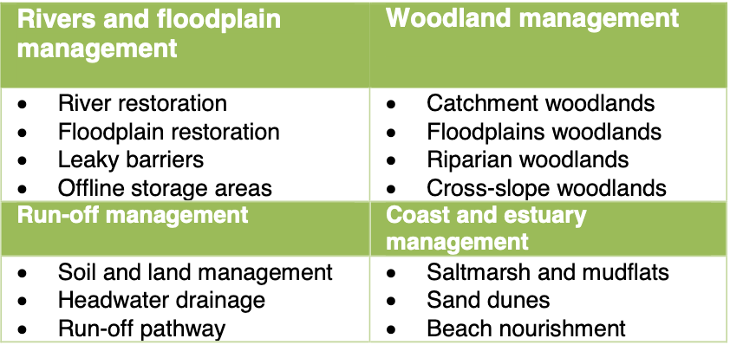
Resilient communities of stewardship: UK flood recovery and resilience

Slide 12
Resilient communities of stewardship: the local plan

Slide 13
…help to penetrate the clay soils we have around here and make them more porous so that when we have a heavy storm more of the water can infiltrate into the soil. Trees also build up the soil so there is more soil there with more leaf matter and everything in that will hold water, and they also suck up water from the soil so that there’s better soil with bigger capacity and also their leaves and branches catch some of the rainfall without it.
(Local NFM organisation)
Carbon sequestration
Biodiversity
Doing something local to address the global crisis

Slide 14
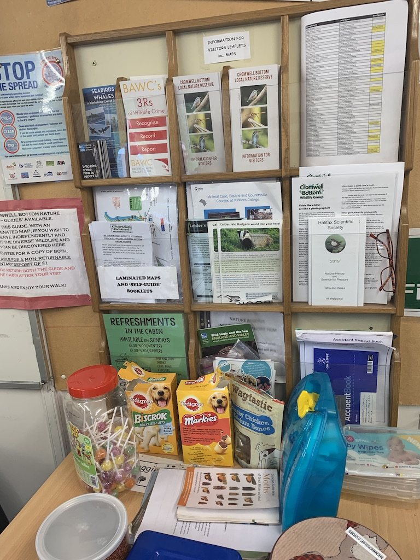
Conservation as exploitation/ tea as consciousness raising

Slide 15
The ghost of sustainability
…as time went on we eventually, from being this group of hippies starting it up got more respectable and we got funding from the regional development agency….We became part of their green infrastructure programme… and then the regional development agency got abolished... At that stage we thought how on earth are we going to manage to get through the 25 years when all our core funding is going.
Lead of local NFM group

Slide 16
Measuring away the meaning: abstracting effects
I can understand it from the funder’s point of view so they kind of have got to prove that they’re spending public money correctly...it’s much easier for the Environment Agency to, for example, fund a flood wall around the outside of a housing estate because they know how much the wall will cost. They know exactly how much it will save in terms of water. They can model it to the last minute and they can come to a really easy sum. Whereas with natural flood management it’s much more complicated.

Slide 17
Stewardship in a cold panic
…our guardians are responsible for the management of what one might call a cold panic, a panic that is signalled by the fact that openly contradictory messages are accepted: “keep consuming, economic growth depends on it” but “think about your carbon footprint”; “you have to realize that our lifestyles will have to change” but “don’t forget that we are engaged in a competition on which our prosperity depends.
(Stengers, 2015)
Notes:
According to Isabelle Stengers, our ‘guardians’, those tasked with managing populations, are aware that the world and, as a consequence, their practices have transformed in the wake of the imbricated economic and environmental crisis. However, in spite of the undeniable inequalities wrought by capitalism ‘one cannot interfere with the “laws of the market,” nor with the profits of industry’ (ref). What has then changed is the role of politics. Politics and the role of citizens has become that of ‘having to’ (as opposed to asking why and imagining otherwise). You ‘have to’ live with decreased levels of social welfare and rising rates of homelessness, even though it might kill you. You have to accept that there is never going to be enough money to fund the replacement of Victorian drainage systems that might help protect homes from the flooding we know is coming. You ‘have to’ carry on and look after your environment even though there we there are no resources to protect it in the long term and it makes you anxious. You are included in the solutions to these problems, what are you grumbling about? You are empowered and part of the solution!
‘Having to’ results in planetary health becoming a zero sum game – the continued imperative of reduced state spending and the belief that the gaps left will be plugged by communities and charities results in a fragmented and precarious system of stewardship

Slide 18
Permaculture: imagining a different world
Well, for us it’s very important to look after our volunteers. We think of ourselves as a permaculture project. Well, we are a permaculture project and a permaculturist would call us a permaculture project and one of the three main things of permaculture is people care. We think people care is just as important as land care. Hence all the feeding, which was brilliant.
Community NFM organisation
Ethical principles of permaculture
Care for people
Care for the earth
Set limits to consumption and reproduction, and redistribute surplus
Notes:
In the Calder work I have tried to make the costs of current local manifestations of stewardship visible vis a vie the labor conditions and the sustainability of stewardship projects, which create a painful relationship between human and natural systems
I would also like to make visible an approach embodied by some of the NFM groups ‘the specific problems, of specific individuals, in the specific circumstances of Calder.
The interdependency of care for people, care for the earth

Slide 19
The wickedness of the Calder and its Catchment
…you’ve got this sort of bureaucratic infrastructure of how we go on as a society and an economy overlaid on a natural environment which comes and bites you on the bum if you neglect or abuse it
(Council employee, Calderdale)

Slide 20
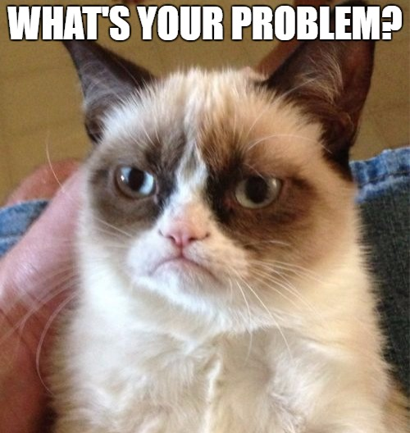
Seminar discussion
Based on the pamphlet ‘Understanding the Hebden Water Catchment’ and the lecture, prepare an answer to the following question:
Who is responsible for managing the water and how should this be done?
In your answers make sure that you include reflections and details on the following:
The nature of the problem and the factors and practices that have caused it
Possible solutions to the problems
Details on who will be negatively and positively affected by possible solutions
Who has the power to stop or enable possible solutions?
The values and concerns that you think should guide the management of the water in the Catchment
The kinds of knowledge and expertise that should be used in developing possible solutions?

