Slide 1
Supply-side reform
Lecture 9

Slide 2
The non-market/market distinction again: block grants and reimbursement
BLOCK GRANT
In non-market systems financial risks of ill-health are borne by the funder or government, not by the hospital or clinic, and allocation is based on historical costs plus estimates of need.
REIMBURSEMENT
In market systems (in which a purchasing function has been developed) payment mechanisms are designed to devolve varying degrees of financial risk on to the provider and are based on some calculation of sales value.

Slide 3
New public management
New public management (NPM) ideas have been influential in health system reform (lecture 10).
In Europe, two NPM reforms have been widely adopted. These are: semi-independently managed public firms and contracting out (Figueras, 2008:39).
Both involve a ‘purchasing’ function. Purchasing is ‘the allocation of pooled revenue to health service providers’ (Figueras, 2008: 40).
Health systems throughout the world have been experimenting with different systems of provider payment. The main purpose of reform has been to move away from retrospective reimbursement.
Purchasing requires the introduction of ‘firms’ or ‘commercialization’ (provision through a market).
Independent public firms are created when a purchaser-provider split is introduced to integrated systems (e.g. Estonia, Norway, Portugal, United Kingdom, Spain and Italy).

Slide 4
‘Technical efficiency’ is the basic intuition behind supply-side reform
‘Incentive strategies take advantage of the fact that every organization has to acquire financial resources to continue to operate. To change the behaviour of organizations, therefore, reformers can change what must be done to obtain such resources.’
‘Competition is desirable because it pushes sellers to keep down costs and prices and responds to customers in order to attract additional business. The managers of firms that might not survive have a powerful incentive to work hard and take risks. Indeed, firms managed by their owners are often more successful … exactly because managers have so much to lose, and gain, from their company’s success.’ (Roberts et al, 2004: 225-35)

Slide 5
How firms and commercialization are introduced
Corporatization - delegating power to providers by transforming services so that they are no longer integrated under geographic planning tiers serving the population on the basis of need
Service ‘unbundling’ - where services are split off for separate provision e.g. hospital departments like pathology
Privatization - transfer of ownership and/or control from the public to the private sector

Slide 6
Basic principles of market reimbursement
Insurers and providers with fixed budgets use financial incentives and reimbursement systems to reduce the risks and change the behaviour of providers, doctors and patients. Doctors are seen as the gatekeepers to care and resource use. Government or the insurer seeks to manage both financial and utilisation risk in various ways through the contracts they make with providers and staff. The contract determines how the supplier, provider or doctor is to be paid and in turn the sort of behaviour that results.

Slide 7
Payment mechanisms
Fee for service
Case payment (cost per case)
Capitation
Cost sharing (patient co-payments)

Slide 8
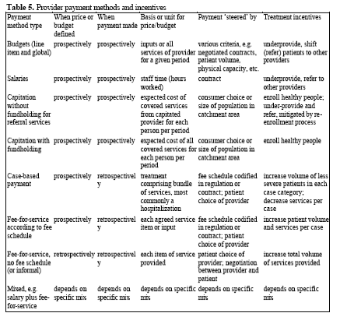
Provider payment methods and incentives (Kutzin, 2000)

Slide 9
Analysis
Reimbursement systems are often analysed in terms of their capacity to control aggregate costs in a health system. Liu has examined payment systems in five countries, the USA, UK, Canada, Germany and Japan.
In the USA 500 private insurance companies pay multiple providers using a variety of methods (salary, FFS or capitation for physicians, and per diem or DRG for hospitals) with payments coming from a variety of sources (various insurers, cost sharing and full payment by uninsured).
This unmanageable multi-payer system has been criticised for causing the high levels of expenditure in the USA without meeting population health care needs. Explanations vary.
The block grant system avoids this complexity but is subject to the NPM critique

