Slide 1
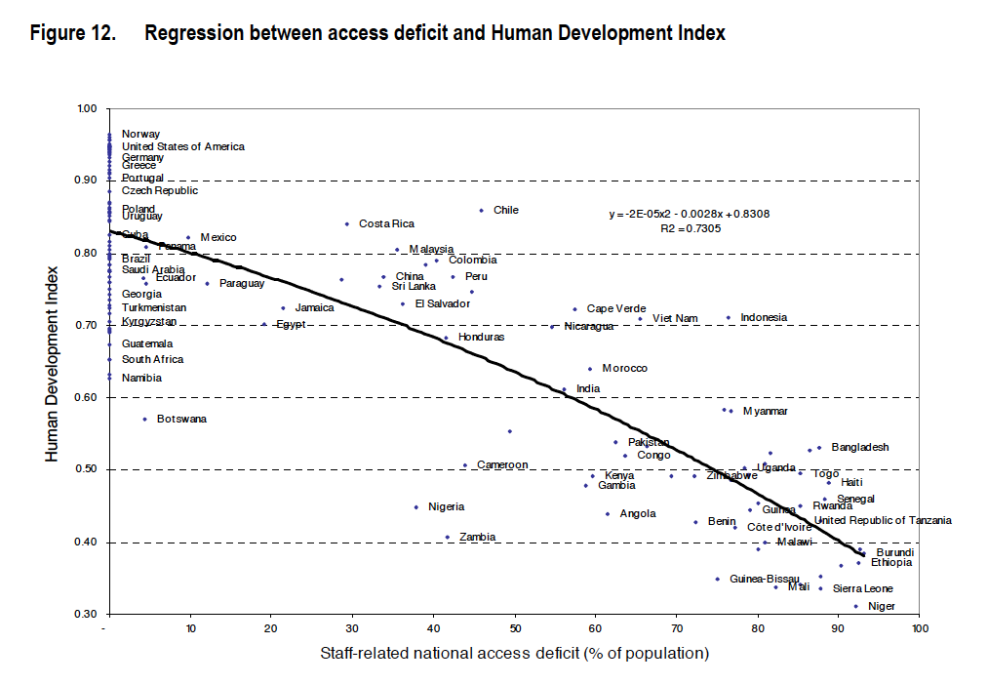
ILO 2007

Slide 2
ILO 2007

Slide 3
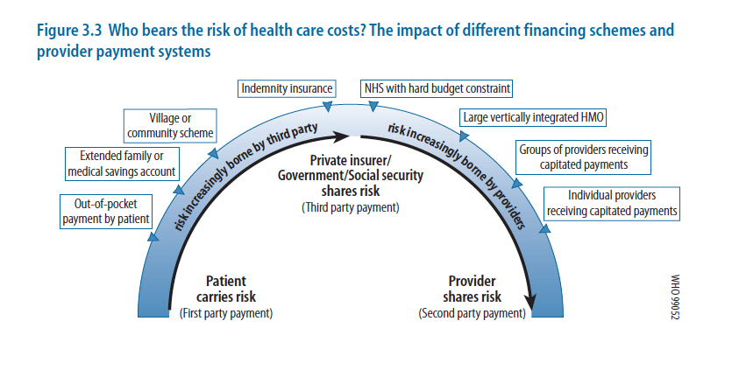
WHO Report 1999

Slide 4
WHO Report 1999
Most equitable of all in terms of the way the health financing burden is shared, and in allowing equal access to care for people with comparable need, are risk pooling systems based on tax revenue financing, such as in Canada, Cuba, Denmark, New Zealand, Norway, Spain, Sweden and the United Kingdom. The risk pool is the entire resident population, and the insurance function against the costs of health care is implemented by government, funded by taxes which, in a progressive system, take a larger share of income from the rich than from the poor.

Slide 5
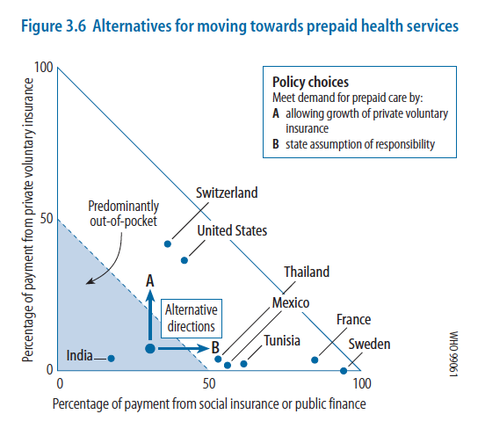
WHO Report 1999

Slide 6
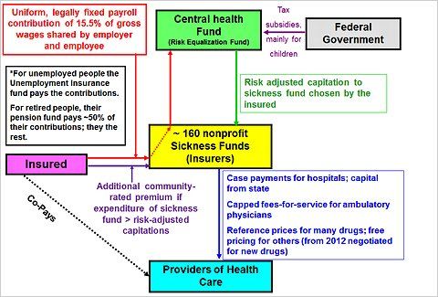
Germany’s SHI

Slide 7
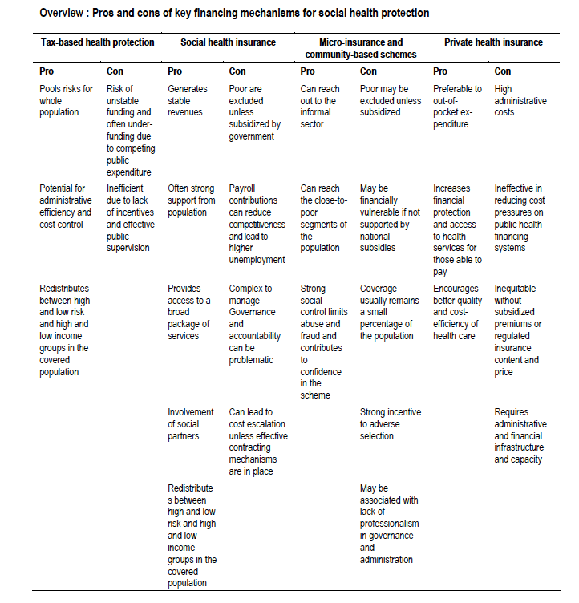

Slide 8
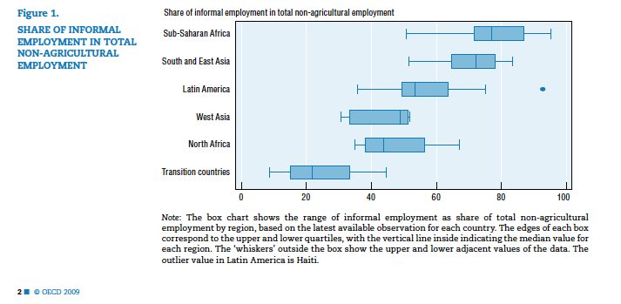
OECD 2009 Size of informal sector: “The prevalence of informal employment in the developing world is striking”

