Slide 1
Core Case 2
Weight loss

Slide 2
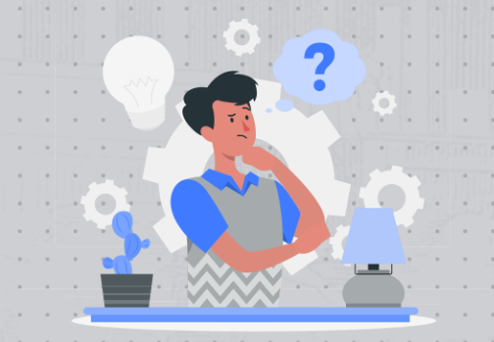
Learning Objectives
Clinical
Review causes of weight loss
New diagnosis of diabetes
Management of mental health and chronic disease
Ethics
Patient consent
OSCE
Mental health risk assessment
Breaking bad news - new chronic disease

Slide 3
Patient History
You are in clinic on Monday morning. You have been booked a telephone consultation with a relative regarding the patient Sharara Begum…..

Slide 4

EMIS consultation: Dr Jackson Patient name: Sharara Begum(F) Age: 16
Telephone consultation:
Call from relative – worried about Sharara
She is losing weight.
Worried she is physically unwell.
Asking you to urgently do tests to find out what is wrong
Her father died from Lymphoma and she worried Shahara has this.
Sharara not there to speak to currently – does not know that relative is making the call.

Slide 5
Discussion Point:
Patient confidentiality
What would be your plan?
What are you able to discuss over the phone with the patient’s relatives?
How may culture play a role in expectations of relatives regarding what information can be disclosed?
What further information would you like to know about the situation? do you have any concerns?

Slide 6
Discussion Point:
Weight loss
What are common causes of weight loss in the younger demographic?
How would you investigate weight loss?
How would your plan change if the patient was elderly?

Slide 7
EMIS consultation: Dr Jackson Patient name: Sharara Begum(F) Age: 16
F2F consultation
Brought in by relative - concern about weight loss.
Systemic review – feels well, no cough, no change in bowel habit, no night sweats.
Does not feel she has lost weight.
Is annoyed at being there – feels relative is making a big deal out of nothing.
Eats a big lunch at school and sometimes eats after school, then not hungry in the evenings.
School is going well, performing well in her exams, has lots of friends, prefers to go out as much as she can.
Feels tired but is busy with schoolwork.
PMHx:
Nil
DHx:
Nil

Slide 8
Discussion Point: Managing weight loss
Do you have anything else you would like to know?
What kind of examination would you do?
What bloods would you arrange and is there anything else you would add to the plan?
How should this patient be followed up?
What is your differential diagnosis?
Do you feel it is appropriate to see the patient with her relative?

Slide 9
Continuing management……..
You receive blood test results to your inbox.
Sharara’s bloods are amongst them......

Slide 10
EMIS consultation: Dr Jackson Patient name: Sharara Begum(F) Age: 16
FBC
Haemoglobin: 126 (120-150 g/L)
White Cell Count: 4.5 (4-10*9 g/L)
Renal
Sodium- 136 (133-149 mmol/L)
Potassium- 3.7 3.5-5.3 mmol/L)
Urea : 1.3 (2.5 - 7.8 mmol/L)
eGFR-: >90mL/min (no range)
Units mL/min/1.73sqm
Use with caution for
adjusting drug dosage
LFT
Alkaline Phosphatase: 100 (25-115 IU/L)
Alanine Transferase: 25 (5-40 IU/L)
gGT: 12 (0-32 IU/L)
!Fasting Plasma glucose : 9.4 (3.4-5.5mmol/L)

Slide 11
Discussion Point: Interpreting common blood test results
What is the diagnostic criteria and cut off values for DM, IGT and IFG?
What are your next steps based on these results?
What is the diagnosis & how would you confirm it?

Slide 12
EMIS consultation: Dr Jackson Patient name: Sharara Begum(F) Age: 16
HPC:
Blood test results received yesterday. Booked for face-to-face appointment today
FPG – 9.4 mmol/L.
Urine dip: Glucose ++
Diagnosis: Suspected Type 1 diabetes.
Plan: Discussed with Paeds SpR on call- advised to send patient in for review
Comment: Patient starts crying as her grandmother lost her vision due to diabetes. Asking why she has got diabetes. Eats a healthy diet as does not want to put on weight, asking if she should limit her sugar intake.

Slide 13
Discussion Point:
Type 1 Diabetes counselling
How would you explain the results to the patient?
What would you tell the patient will happen next?
Sharara goes into Paediatric A&E - what will they do?
What important advice should be given regarding her condition and management
Who will be involved in her ongoing care?

Slide 14
Continuing management……..
A few weeks have passed.
You proceed to call your next patient into the room........

Slide 15
EMIS consultation: Dr Jackson Patient name: Sharara Begum(F) Age: 16
PC:
Vomiting
Shahara seen with relative. Vomiting since 7 am today (it is around 10 am now) Very tired Requiring support when walking in
O/E:
Abdo tender in lower quadrants
Urine dip ketonuria and glycosuria
Comments
Pt refusing admission. Says forgotten to take insulin due to exam stress and not been eating and drinking as well as usual. Requesting medication to stop stomach pain and vomiting so she can study
Pt states "I cannot force her against her will to attend A&E".
Relative in agreement that she is unwell and needs admission

Slide 16
Discussion Point:
Consenting for care
What do you do in this situation?
What examinations and investigations would you do?
Does Sharara need to consent for admission
What does the GMC state regarding child consent to treatment?
Would your actions differ if this was an adult?
How could this affect the trust in doctor-patient relationship?

Slide 17
Continuing management……..
You are reviewing your documents and notice a discharge summary regarding Sharara

Slide 18
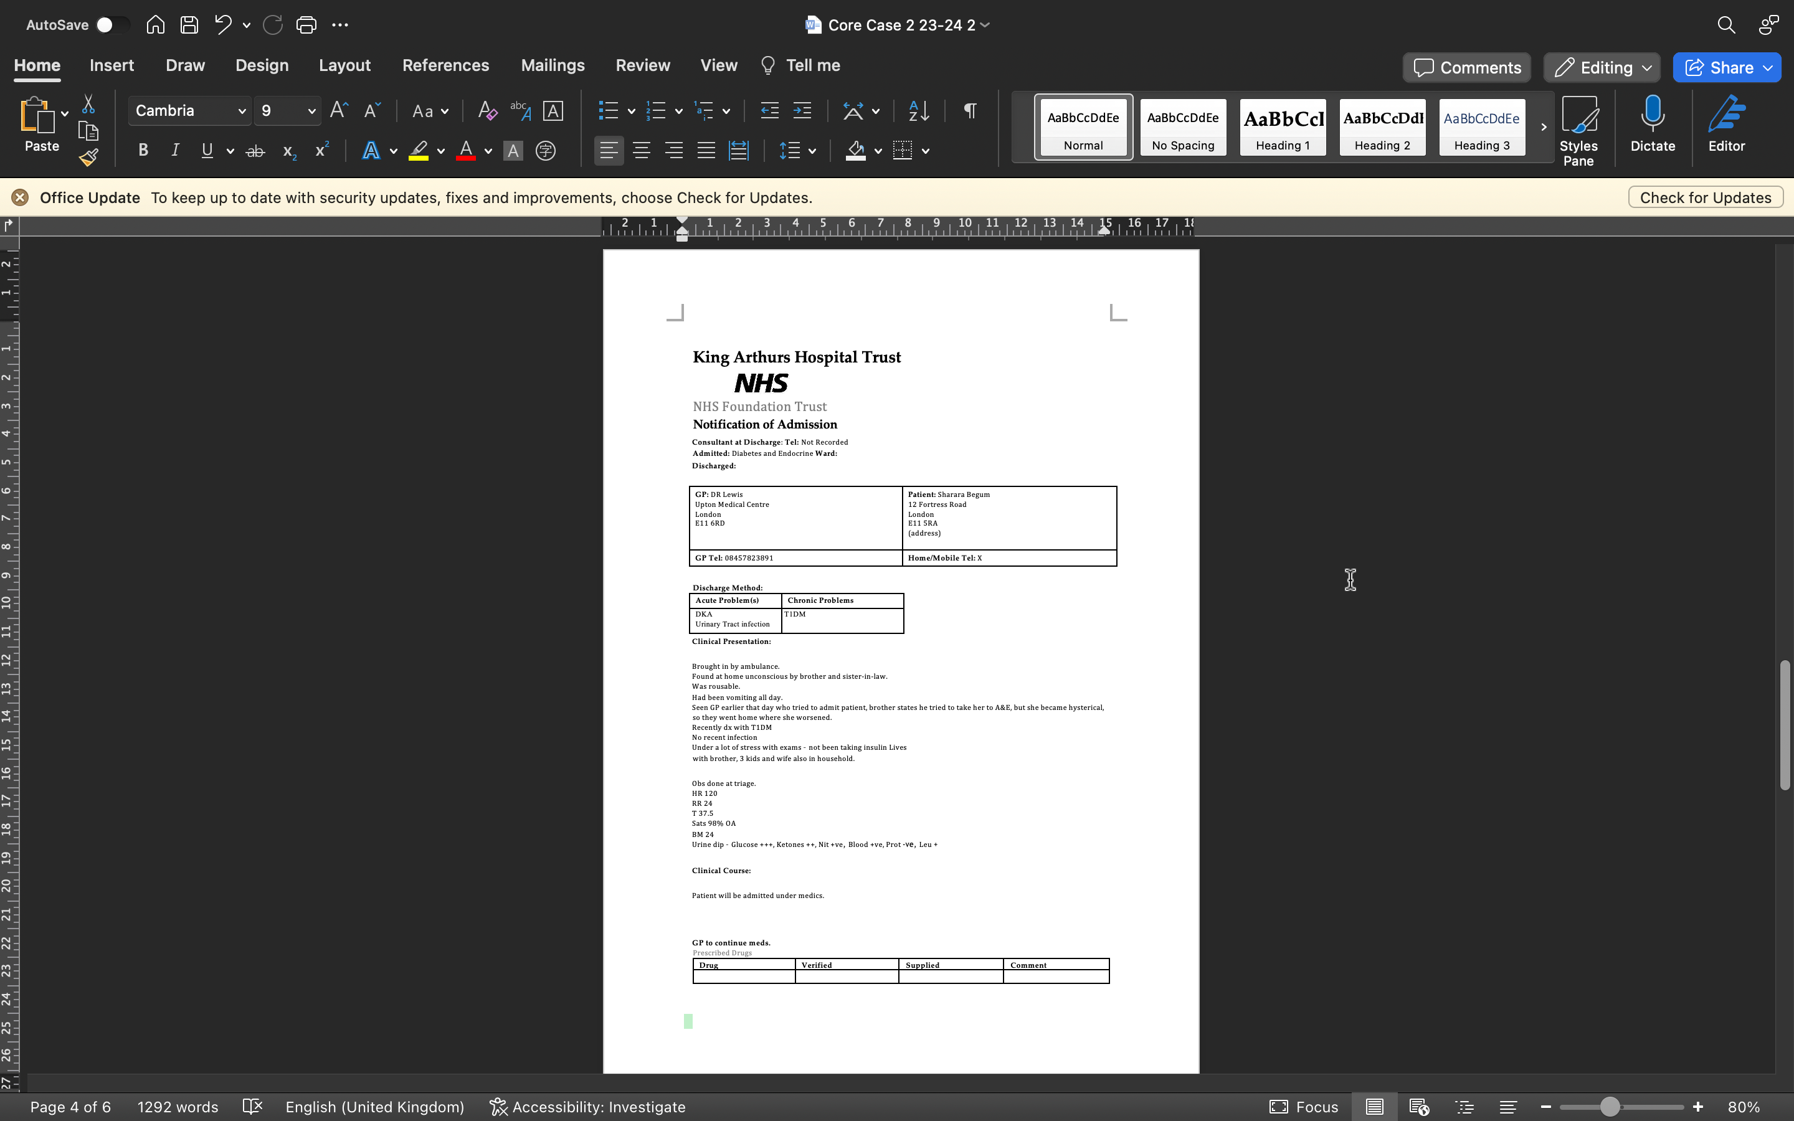

Slide 19
EMIS consultation: Dr Jackson Patient name: Sharara Begum(F) Age: 16
F/up consultation seen F2F with relative:
Recent admission with DKA.
Discharged 3/7 ago - no medical discharge summary on system yet
Relative feels pt is still unwell and asking me to check urine again.
O/E
Urine dip NAD, BM 5.3
Pt seems flat.
Limited eye contact, short answers.
Enquired about MH – says not sleeping much. Says mood is ok. Appetite low – not hungry as worried about exams.
Asked if could talk to pt alone, relative left room.
Admits struggling at home, feels restricted by relatives who don’t allow much independence.
Hates having to inject insulin every day.
Struggling to cope with Diabetes diagnosis. Family don’t understand. Begs you not to disclose anything to her family.

Slide 20
Discussion Point:
Supporting a new diagnosis of Diabetes
What are the difficulties of not receiving discharge summaries?
What plan would you put in place based on this consultation?
How would you support the patient with their new diagnosis?
How do you think an adolescent may feel when given this diagnosis?

Slide 21
EMIS consultation: Dr Jackson Patient name: Sharara Begum(F) Age: 16
F2F review: Seen alone
Ongoing issues – no better or worse.
No DSH. No suicidal thoughts.
Agree likely suffering from depression.
Has been missing school as cannot get out of bed. Has not told family as think they will be cross with her.
Discussed options ...
Referral to CAMHS
RV in 2w- sooner if worse or any concerns

Slide 22
Discussion Point:
Managing mental health and chronic disease
What would you be worried about in this case?
How would you manage Sharara’s mental health, would this differ from treating an adult patient?
What do you think about the plan in place here? Would you do anything differently?
If this patient declines referral – can you act without their consent?

Slide 23
Resources
Depression
https://gpnotebook.com/simplepage.cfm?ID=x20091123152205182440
https://gpnotebook.com/simplepage.cfm?ID=x20041224060809159860&linkID=72627&cook=no
https://elearning.rcgp.org.uk/mod/book/view.php?id=13115&chapterid=604
https://www.rcpsych.ac.uk/docs/default-source/members/supporting-you/managing-and-assessing-risk/assessmentandmanagementrisktoothers.pdf
https://www.rcpsych.ac.uk/members/supporting-your-professional-development/assessing-and-managing-risk-of-patients-causing-harm/assessing-risk
T1DM
https://cks.nice.org.uk/topics/diabetes-type-1/
https://www.diabetes.org/diabetes/type-1
https://www.healthline.com/health/type-1-diabetes-causes-symtoms-treatments
https://www.youtube.com/watch?v=maQM8NH4MSc (Type 1 diabetes – Diabetes UK)
Confidentiality
https://www.bma.org.uk/media/iurldd5z/core-ethics-guidance.pdf

Slide 24
End slide

