Slide 1
Core Case 1
Elderly care

Slide 2

Learning Objectives
Clinical
Managing multi-morbidity in primary care
Polypharmacy in elderly patients
Falls in the elderly
Role of the GP in Palliative care
Ethics
Decision making regarding end-of-life care, Lasting Power of Attorney and DNACPR
OSCE
Be able to have a conversation with family members about DNACPR

Slide 3
Patient History
You are in clinic on Friday afternoon. Your next patient is Mr Gareth Bates.
He is a new patient to your practice and was booked into your clinic by the HCA following his new patient health check.
You read the information available....

Slide 4

EMIS consultation: HCA Dorothy Patient name: Gareth Bates(M) Age: 87
PMHx:
- Psoriasis & psoriatic arthritis/ Rheumatoid arthritis- RF +ve, Anti- CCP +ve
- Age related Macular Degeneration- Intraocular Injections at QHF
- Abdominal Aortic Aneurysm repair- 2016- Under 6 monthly f/u by Vascular
- IHD- stent inserted 2014
- HTN
DHx:
- Atorvastatin 80mg nocte
- Eplerenone 25mg one tablet OD
- Co-codamol 30/500 2 tablets QDS
- Bisoprolol 5mg OD
-Omeprazole 20mg OD
-Ramipril 10mg OD
- Folic acid 5mg one tablet OD
- Rivaroxaban 20mg one tablet OD
Leflunomide 10mg- 1 tablet OD
Viscotears- 1 drop to affected eye(s) TDS
Methotrexate 2.5mg- four tablets once weekly

Slide 5
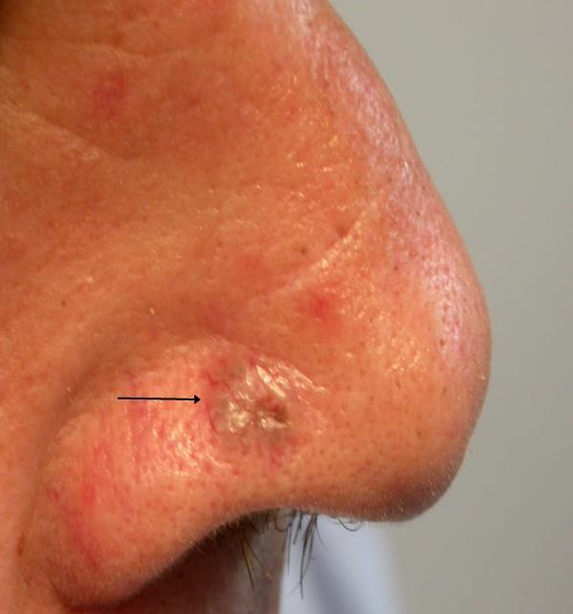
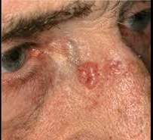
EMIS consultation: Dr Vardy Patient name: Gareth Bates(M) Age: 87
Patient reviewed F2F:
accompanied by daughter Claires Bates (CB)
HPC:
Lesion on L side of nose, increasing in size over last month
SHx:
Lives with wife Elizabeth Bates (EB)
Recently moved into sheltered accommodation
Supported by daughter Claire- works as a teaching assistant & son Jonathan Bates (JB)- works as a librarian
Both Claire and Jonathan have lasting power of attorney

Slide 6
Discussion Point: Managing medical complexity
Given this patient’s history and examination findings, what is your immediate management of this patient?
What may be contributing to the development of such skin lesions?
What other management and referrals are required during this first consultation?
What chronic disease management is required in General Practice in the longer term?

Slide 7
Discussion Point: Addressing polypharmacy
Can you see the rationale for all his repeat prescriptions?
Applying STOPP / START criteria, outline amendments to his prescription that you would advise; Explain your rationale for each.

Slide 8
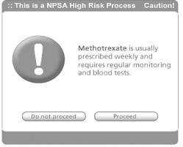
Discussion Point: Addressing polypharmacy
How would you write a methotrexate prescription to ensure it is safely prescribed?
How should methotrexate prescriptions be managed between primary and secondary care.
When may you decide not to prescribe?
How do you navigate patients who see private doctors as a one off and are initiated on medications which require specialist input?
Does your practice have a policy around this?

Slide 9
Continuing management……..
Mr Bates is reviewed in clinic 2 weeks later.....

Slide 10
EMIS consultation: Dr Vardy Patient name: Gareth Bates(M) Age: 87
Follow up appointment: Attended with daughter CB
Seen by Dermatology
Diagnosis: Basal cell carcinoma of the right side of the nose and clavicle
Management: radiotherapy
Today
Patient reports that he is feeling SOB and cannot walk very far
Impacting on ability to care for wife
Doesn’t think he has COVID- did a lateral flow which was –ve
Daughter very concerned and wants immediate referral for a CT chest
No hx of orthopnoea or PND No fever, No cough
O/E
Inspiratory creps mid and lower zones
T- 36.7
RR- 18
Sp02- 93% on RA
HR- 92

Slide 11
Discussion Point: Managing medical complexity
What is the differential diagnosis? What investigation is required to confirm the pulmonary diagnosis?
How do you discuss your plan with the patient and his daughter and manage their expectations?

Slide 12
Continuing management……..
Mr Bates is seen by the respiratory team a few months later and given a diagnosis.
He was advised to stop methotrexate and leflunomide and has been off the medications for 6 months.
He now has increased early morning stiffness, joint pains and back pain.
Unfortunately, he has not been reviewed by the Rheumatology team since stopping his medications.
His pain is stopping him from sleeping.

Slide 13
Discussion Point:
Pain Management
How would you manage his pain?
How could you manage his worsening Psoriatic/Rheumatoid Arthritis?
Are there any other members of the MDT that should be involved in his care?

Slide 14
Part 2
Mrs Elizabeth Bates

Slide 15
Email correspondence received…
A few months later, you receive an email from their son, Mr. JB. He states that he has power of attorney with his sister.
He reports that his sister thinks that his mother’s dementia is making her too unstable to make financial decisions, which concerns him.
He has requested that you telephone him so that these issues can be resolved.

Slide 16
Patient name: Elizabeth Bates(F) Age: 86
PMHx:
New diagnosis - Alzheimer’s Disease, seen by Memory Clinic in Romford, no recent letters from clinic.
2009 CABGs x 3
2008 Type 2 Diabetes Mellitus
DHx:
Atenolol 25mg OD
Aspirin 75mg OD
Candesartan 4mg OD

Slide 17
Discussion Point: Lasting Power of Attorney
How would you respond to this email?
What is LPA and what are the different types?
Under what circumstances may LPA be overridden?
What steps can you take if you suspect abuse or neglect (physical/financial etc) of an elderly patient?
What should be done as part of a carers assessment?
How would you access a social services package of care and what does this include?
What services/ organisations can the daughter be signposted to that will help her support her parent

Slide 18
Continuing management……..
Later that week you are on duty and asked to visit Mrs EB as she has had a fall.

Slide 19
Discussion Point:
Falls in the elderly
You visit the patient- what will you do?
What history do you need to elicit about the fall?
How would you investigate the fall?
Which medications may have contributed to the fall?
What are the most common complications following a fall?

Slide 20
EMIS consultation: Dr Vardy Patient name: Elizabeth Bates(F) Age: 86
HOME VISIT
PC:
Fall today
Husband states she tripped whilst trying to go to the toilet
Legs swollen and has been impacting mobility
Unable to mobilise now
PMHx
New diagnosis of Alzheimer's- awaiting documentation from clinic in Romford
O/E
Patient is lying on the floor
Patient is not lucid, lacks capacity
Tender ++ over R hip
SHx
Has had a carers assessment
No DNACPR on the system

Slide 21
Continuing management…
Mrs. EB was admitted to hospital as an inpatient.
She was found to have a fractured NOF.
On admission they found she was in acute heart failure and would not be a candidate for surgery.
Sadly, whilst in hospital she developed a hospital acquired pneumonia which did not respond to treatment and the medical team made a decision with the family that she would receive palliative care.

Slide 22
Discussion Point: End of Life care
When a palliative care patient is discharged from hospital, what are the next steps?
Who should be involved in looking after the patient?
What role does a GP have in palliative care?
How should practices monitor their palliative care patients?
There is no DNACPR decision in place – How should you approach making a DNACPR decision for this patient? Who else should be involved?
How do you complete a DNACPR form and what information do you need?
How are the DNACPR decisions recorded? How is it done in your practice?
How are primary and secondary care services informed?
What is your understanding of end-of-life decisions, best interest decisions; and Advance Directives

Slide 23
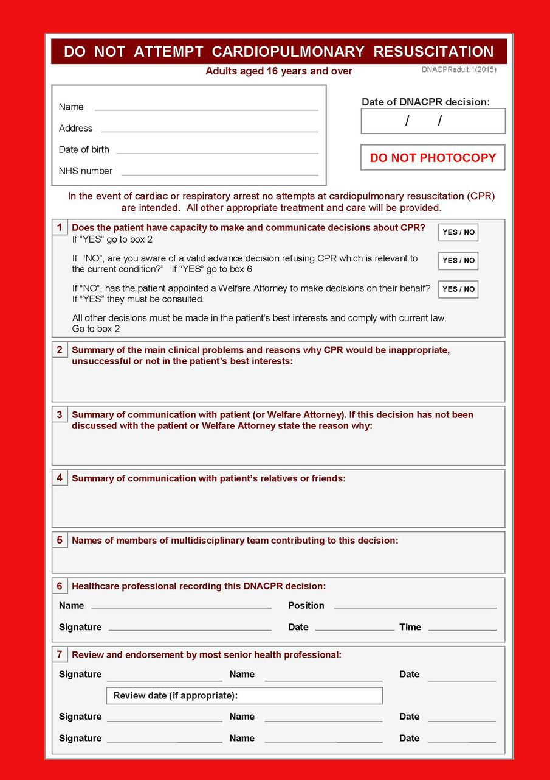

Slide 24
Resources
Skin Lesions
https://www.nhs.uk/conditions/non-melanoma-skin-cancer/
https://dermnetnz.org/topics
https://cdn.bad.org.uk/uploads/2021/12/29200247/Derm_Handbook_3rd-Edition-_Nov_2020-FINAL.pdf
Managing multi-morbidity & polypharmacy
https://www.bmj.com/content/350/bmj.h176
https://www.kingsfund.org.uk/insight-and-analysis/reports/polypharmacy-and-medicines-optimisation
https://www.gmc-uk.org/professional-standards/professional-standards-for-doctors/good-practice-in-prescribing-and-managing-medicines-and-devices/shared-care
Prescribing in the elderly | Medicines guidance | BNF | NICE
End of life care
https://www.nice.org.uk/guidance/ng31/resources/care-of-dying-adults-in-the-last-days-of-life-pdf-1837387324357
https://www.macmillan.org.uk/cancer-information-and-support/treatment/if-you-have-an-advanced-cancer/end-of-life
https://elearning.rcgp.org.uk/mod/book/view.php?id=12529

Slide 25
Resources
Falls
https://oxfordmedicaleducation.com/geriatrics/falls-assessment-management/
https://patient.info/doctor/prevention-of-falls-in-the-elderly-pro
https://cks.nice.org.uk/topics/falls-risk-assessment/
https://www.orthobullets.com/trauma/1037/femoral-neck-fractures
Neck of Femur Fractures & management
https://www.nice.org.uk/guidance/cg124/chapter/Recommendations#surgical-procedures
DNAR, Advanced directives, Lasting power of attorney, Best interest decisions
https://www.bma.org.uk/media/1816/bma-decisions-relating-to-cpr-2016.pdf
https://www.goldstandardsframework.org.uk/advance-care-planning
https://www.bma.org.uk/media/1850/bma-best-interests-toolkit-2019.pdf
http://thehearingaidpodcasts.org.uk/episode-1-6-capacity/

Slide 26
End slide

