Slide 1
Year 5 GP Assistantship Tutor Training
2023-2024
Dr Vidya Mistry
vidya.mistry@qmul.ac.uk
Dr Yan-Ling Wong (Ling)
y.l.wong@qmul.ac.uk
Dr Amru Ainine – ITP
Mahbuba Yasmin
m.yasmin@qmul.ac.uk

Slide 2
Recording
Recording will be started for the training
We will stop it for the Q&A

Slide 3
Introduction
Welcome to Year 5 GP Assistantship GP tutor training
Highlight any changes for this year
Group exercises – example timetable and standard setting

Slide 4
Aims of Assistantship
Immersive 8 week general practice placement (includes 1 central teaching week)
Teach generalism and complexity
Mentor and support students
Encourage careers in General Practice

Slide 5
Dates for the Year
Block 1:
Monday 4th September – Friday 27th October 2023.
Central teaching week: 4th – 8th September 2023.
Intro day 11th September 2023
Closing day 25th October 2023
Mock Prescribing exam 1st September 2023
Block 2:
Monday 30th October – Friday 8th December 2023 and Tuesday 2nd January – Friday 12th January 2024.
Central teaching week 30th October – 3rd November 2023.
Intro day 6th November 2023
Closing day 10th January 2024
Mock Prescribing exam 15th December
Mock Prescribing exam 12th January 2024 – optional for those who have missed the first 2
Block 3:
Monday 15th January – Friday 8th March 2024.
Central Teaching week 5th – 9th February 2023.
Intro day 15th January 2024
Closing day 6th March 2024
Safe Prescribing exam 2nd February 2024

Slide 6
What to expect
Intro session and induction
Regular Student Surgery sessions with feedback (3 – 4 per week): combining virtual and face-to-face patient contact, a minimum of 3-4 patients per session
Backroom practice work – Chronic Disease Reviews, Administrative work, Medication reviews and prescribing, and QOF follow-up
Professional shadowing – sitting in and assisting with GP and/or members of the MDT.
One GP-based Tutorial session per week - approximately 90 to 120 mins in length
Working as part of the Practice Team - attending appropriate meetings, learning from various team members
Self-Directed Learning sessions (2 per week) - to allow time for assessment work and general learning

Slide 7
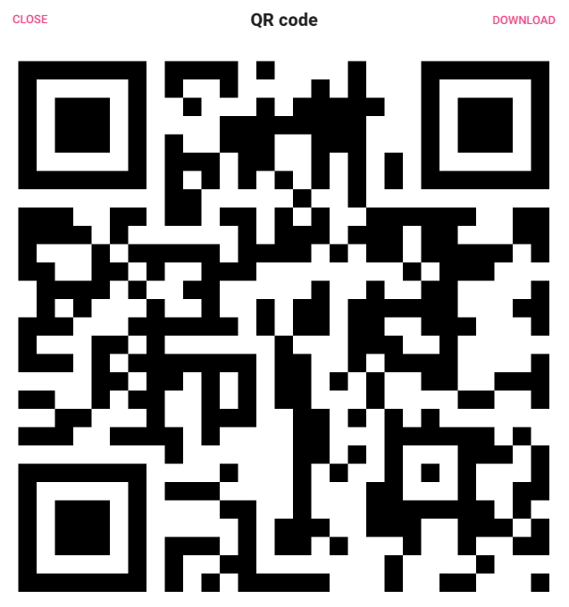
Timetable exercise
https://qmul-languagecentre.padlet.org/ylwong12/my-brilliant-padlet-tdasg0ik9qr0m2fr
Password: gp5
Breakout groups
Stop recording

Slide 8
Urgent and Unscheduled care
Restart recording
Pilot:
Urgent Treatment Centre
London Ambulance service - Fridays
Students to negotiate with practice and provider to attend a session.
Please offer time in lieu
Please offer experiences of Urgent and Unscheduled care in your practice – see outcomes in handbook

Slide 9
Central Teaching
Hospice day at St Joseph’s Hospice
Breaking Bad News – 1 day
Managing Conflict and Aggression
Doctors as Teachers/Educators
Ethical core cases (4) - running every 2 weeks – remotely (These will be shared with you and can be used as a basis for tutorials)
Closing Day – Ethics lecture Wednesday 25th October
Central teaching week

Slide 10
DATE
New for 23-24
Students will do a teaching activity in practice/placement
Encouraged to do in GP
Can present their practice project
But does not form GP sign off
Formative assessment, details in Appendix 2 and 3 of handbook

Slide 11
Assessment
Two MiniCEXs – one to be completed by week 4 and 2nd by week 8
5 x Patient feedback forms (reduced from 10)
Midway Assessment by Week 5 – to include 1 x MiniCEX and review of Patient feedback forms – Jot assessment form to be completed
Patient Case and Reflection on Professional Practice Principles
Practice Project (in pairs)
(1) Significant Event Analysis – written up and discussed as part of SEA meeting in practice
End of placement form on Pebblepad: Overall Tutor Assessment of Performance

Slide 12
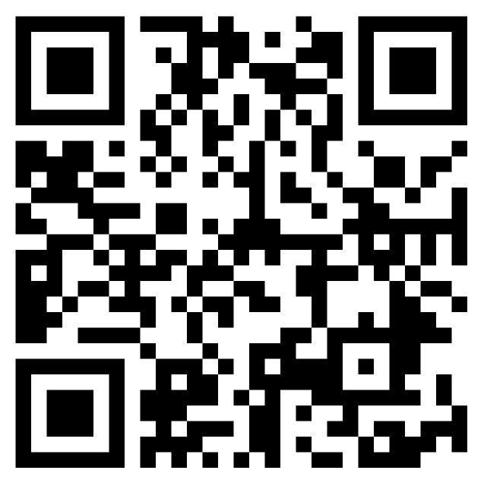
Assessment standard setting exercise
Overall Assessment of GP5
https://rb.gy/cj1oo
Password: GP5
Stop recording

Slide 13
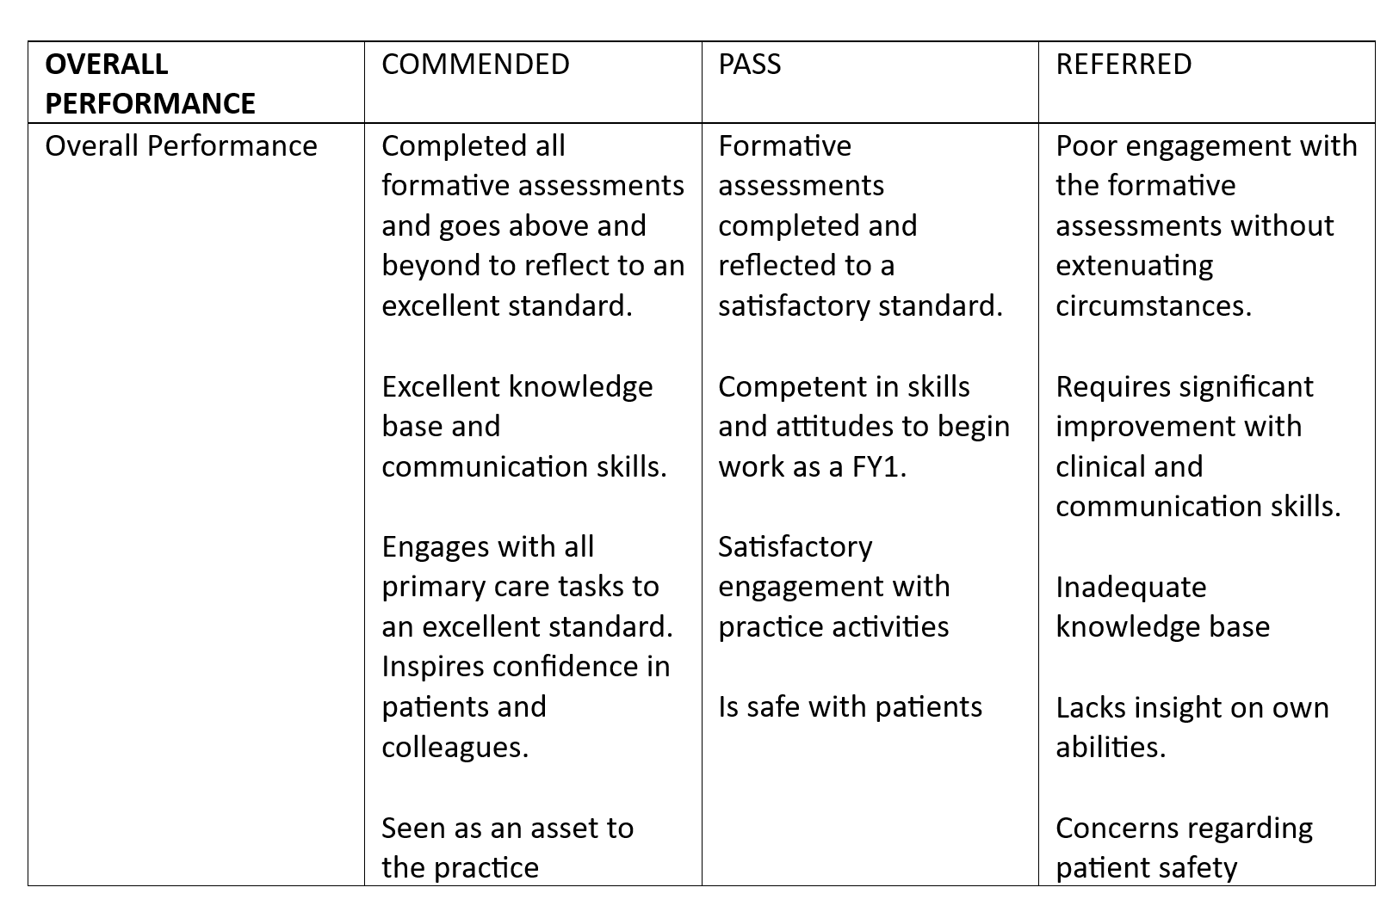
Assessment standard setting exercise
Overall Assessment of GP5
OVERALL PERFORMANCE | COMMENDED | PASS | REFERRED
Overall Performance | Completed all formative assessments and goes above and beyond to reflect to an excellent standard. Excellent knowledge base and communication skills. Engages with all primary care tasks to an excellent standard. Inspires confidence in patients and colleagues. Seen as an asset to the practice | Formative assessments completed and reflected to a satisfactory standard. Competent in skills and attitudes to begin work as a FY1. Satisfactory engagement with practice activities Is safe with patients | Poor engagement with the formative assessments without extenuating circumstances. Requires significant improvement with clinical and communication skills. Inadequate knowledge base Lacks insight on own abilities. Concerns regarding patient safety

Slide 14
Additional Information
Year 5 SSC Near Peer teaching
https://sites.google.com/view/near-peer-ssc/home
Year 5 RCGP GP prize
CBME Year 5 Elective Students

Slide 15
Student Feedback from 22-23
I was given the opportunity to tailor my learning needs with my tutor and we drew a plan to achieve them
We were made to feel like part of the team and challenged in a positive way to think like a doctor.
It is the first time during medical school that I felt I was treated like an adult. This massively enhanced my learning experience, as I genuinely wanted to go in / engage with the placement. I also really appreciated the autonomy we were trusted with in terms of speaking to / seeing patients. I believe it has really improved my history and examination skills.
We were made to feel like part of the team, and challenged in a positive way to think like a doctor.

Slide 16
What Students feel could be improved:
• Structured and organised induction (logins, expectations, timetables and responsibilities)
• Scheduled, planned and protected tutorial time
• Ensure clinics are fully booked to maximise patient exposure, 3-4 student led surgeries seeing between 3-4 patients per session.
Have a variety of remote and face to face consultations
Chance to practice OSCE style histories and examinations
Structured and organised induction to include logins, expectations, timetables and responsibilities including spending time with MDT Scheduled, planned and protected tutorial time Ensure clinics are fully booked to maximise patient exposure, 3-4 student led surgeries seeing between 3-4 patients per session. Have a variety of remote and face to face consultations to practice OSCE style histories and examinations

Slide 17
Stop recording
Any Questions?

