Slide 1
Week 9 Bodas de Sangre (Blood Wedding #2)
Dr Rachel Bryant Davies
COM507

Slide 6
Passages from Lorca’s Blood Wedding…

Slide 7
Picking up questions for discussion from Week 6:
Does Lorca’s Blood Wedding adhere to the rules of classical tragedy (ie. Aristotle’s Poetics)?
If so, how and to what effect?
If not, does it affect how you read/respond to the play?
How are love and passion presented in the play?
How would you characterize the roles of the gods/fate in the tragic action?
How does the play represent social status/nobility?
Discuss the play’s ending.
Now: consider Racine’s Phaedra and Euripides’ Bacchae? Are your answers the same? Where do you see similarities and/or differences?

Slide 10
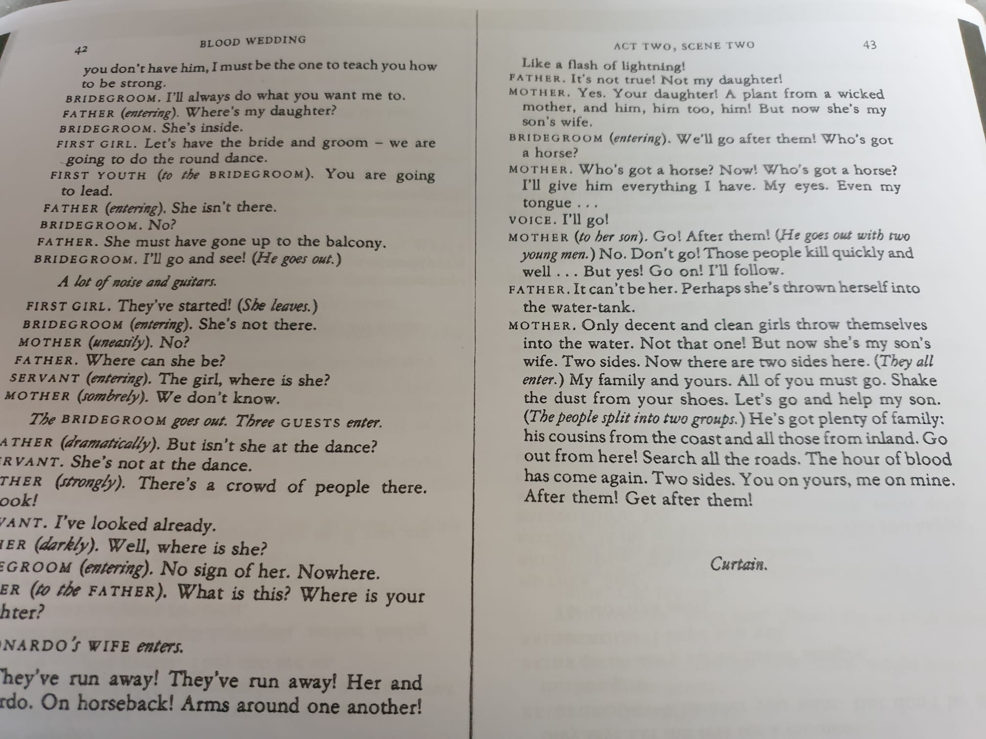
C. 52 mins

Slide 14
Endings…1.25 in production

Slide 15
Picking up questions for discussion from Week 6:
Does Lorca’s Blood Wedding adhere to the rules of classical tragedy (ie. Aristotle’s Poetics)?
If so, how and to what effect?
If not, does it affect how you read/respond to the play?
How are love and passion presented in the play?
How would you characterize the roles of the gods/fate in the tragic action?
How does the play represent social status/nobility?
Discuss the play’s ending.
Now: consider Racine’s Phaedra and Euripides’ Bacchae? Are your answers the same? Where do you see similarities and/or differences?

Slide 16
Reminder: Assignment 2 questions now available
For this assignment, you must write a comparative essay on at least two of the plays studied for the course.
Pick one of the following questions:
1. Discuss the role of any one of the following in relation to at least two of the plays studied for this module: time; gender; recognition; fate.
2. To what extent are the gods, or God, indispensable to an understanding of the tragic action in any two of the plays studied for this module?
3. Discuss the relationship between tragedy and social status in at least two of the plays studied for this module.
4. ‘‘Through the estrangement and the decomposition of the tragic protagonist we are brought face to face with the fragility of our identity, and the fragility of the languages through which we make sense of that identity.’ (Hammond) Discuss this quotation with reference to at least two of the plays studied for this module.
5. Discuss the treatment of ‘endings’ in at least two of the plays studied for this module.

Slide 17
Concepts of Tragedy: quotes and questions to revisit since Bacchae. Do you agree & why..?
‘Tragedy has always been modern.’
‘Tragedy may concern states of emergency; but we should recall Walter Benjamin’s point that such states are routine for the dispossessed, and that the fact that everything just carries on as normal is the crisis. Whether crisis and the commonplace are opposed depends largely on where you happen to be standing.’ (Eagleton, p. 75)
‘tragedy is that form of art which requires the intolerable burden of God’s presence. It is now dead because His shadow no longer falls upon us at it fell on Agamemnon or Macbeth or Athalie. Or, perhaps, tragedy has merely altered in style and convention.’ (George Steiner, The Death of Tragedy, London, 1961, 353).
‘at the very moment that God appears to man, then man ceases to be tragic. To see and hear God is to go beyond tragedy.’ (Lucien Goldmann, The Hidden God: A Study of Tragic Vision in the Pensées of Pascal and the Tragedies of Racine, Taylor and Francis 2013 edn, 37).
‘In all the great tragedies, tragedy is a joy to the man who dies; in Greece the tragic chorus danced.’ (W. B. Yeats, The Oxford Book of Modern Verse,1892—1935, Oxford: Clarendon, 1936, xxxiv.)
‘Perhaps the most important function of the tragic chorus is to open up the drama to non-linear possibilities that a strict narrative can inhabit or deny. […] Intermingling past, present, and future, the chorus also free tragedy from a strict temporal sequence.’ (Rush Rehm, Understanding Greek Tragic Theatre, 1992 revd 2016, 69).

Slide 18
Does ‘Tragedy’ mean different things…
to those who believe in a God or gods, compared to those who do not?
to those marginalised by their society, compared to those who make the rules?
to those directly involved in the events, compared to those who spectate? (this could be actors v protagonists)
Depending on the format in which it is presented?

Slide 19
In pairs: pick a term from the word map below.
How might you explore this theme in relation to Blood Wedding?
What word do you associate most with each play so far (Bacchae, Phaedra, Blood Wedding)
and why: can you explain the word association (maybe character, event, staging you saw…)?

