Slide 1
CLIMATE JUSTICE
DEBATES, ACTORS AND DEMANDS AT THE INTERNATIONAL LEVEL

Slide 2
OBJECTIVE FOR THE SESSION
Become familiarized with climate justice actors, theories and key demands at the international level.

Slide 3
https://app.wooclap.com/events/ZMRNXQ/0

Slide 4
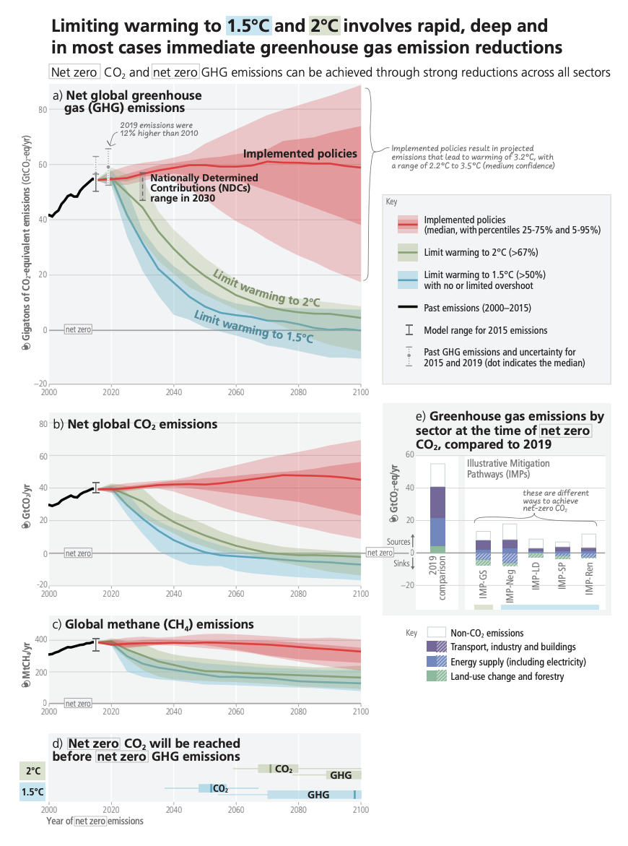
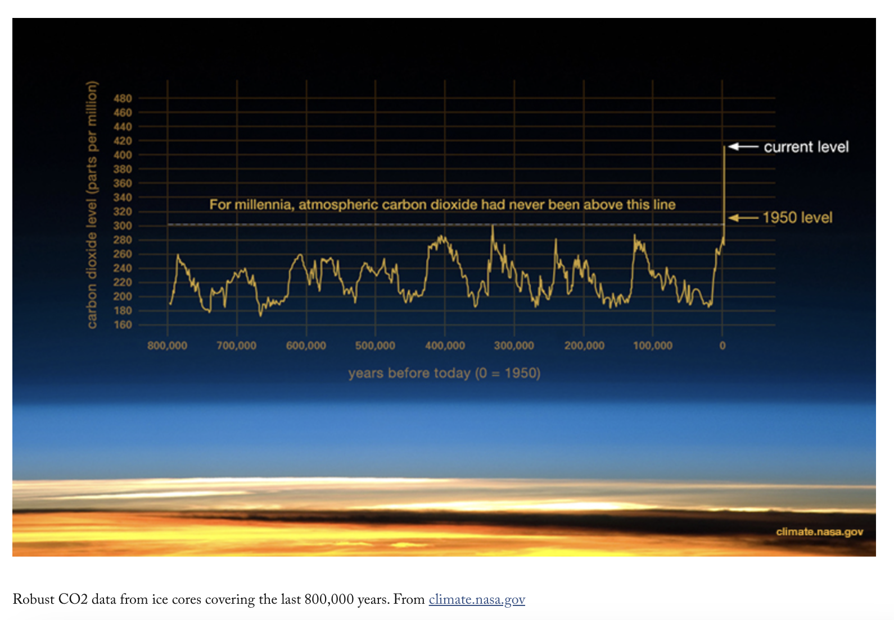
COEQ/ PPM CONCENTRATIONS/ PROJECTIONS

Slide 5
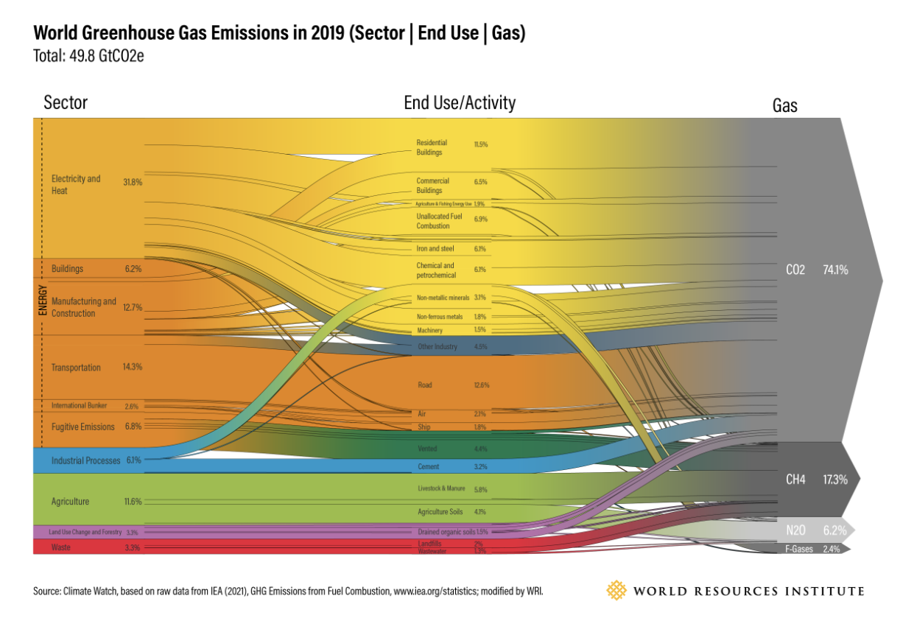
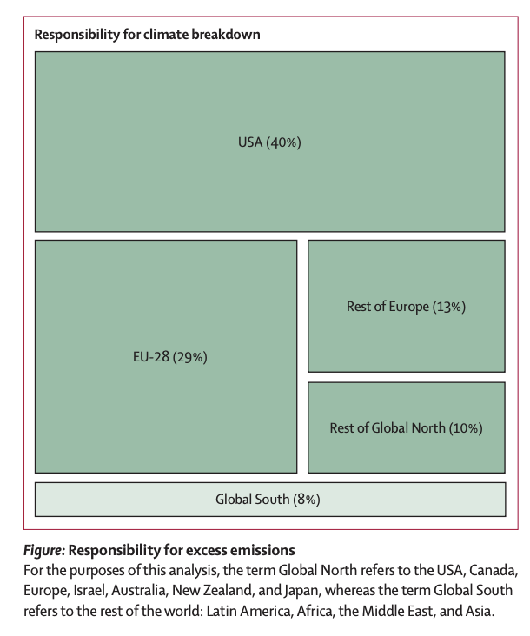
EMISSION SHARES (SECTOR, HISTORICAL RESPONSIBILITIES)
Notes:
Quantifying national responsibility for climate breakdown: an equality-based attribution approach for carbon dioxide emissions in excess of the planetary boundary, The Lancet, Jason Hickel

Slide 6
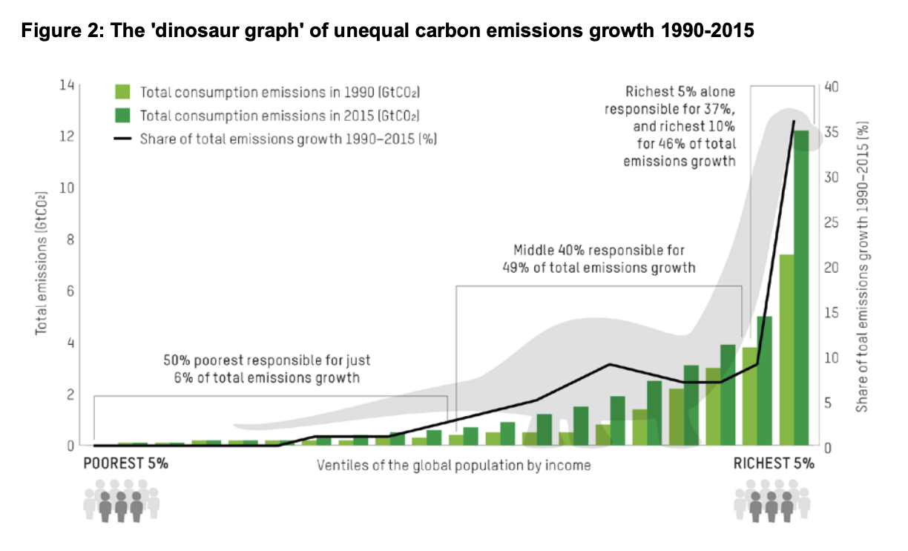
EMISSION SHARES (INCOME)

Slide 7
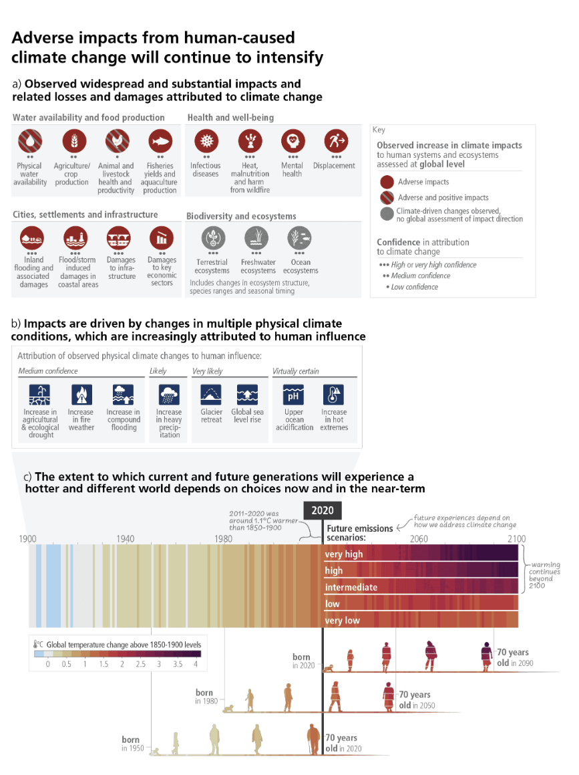
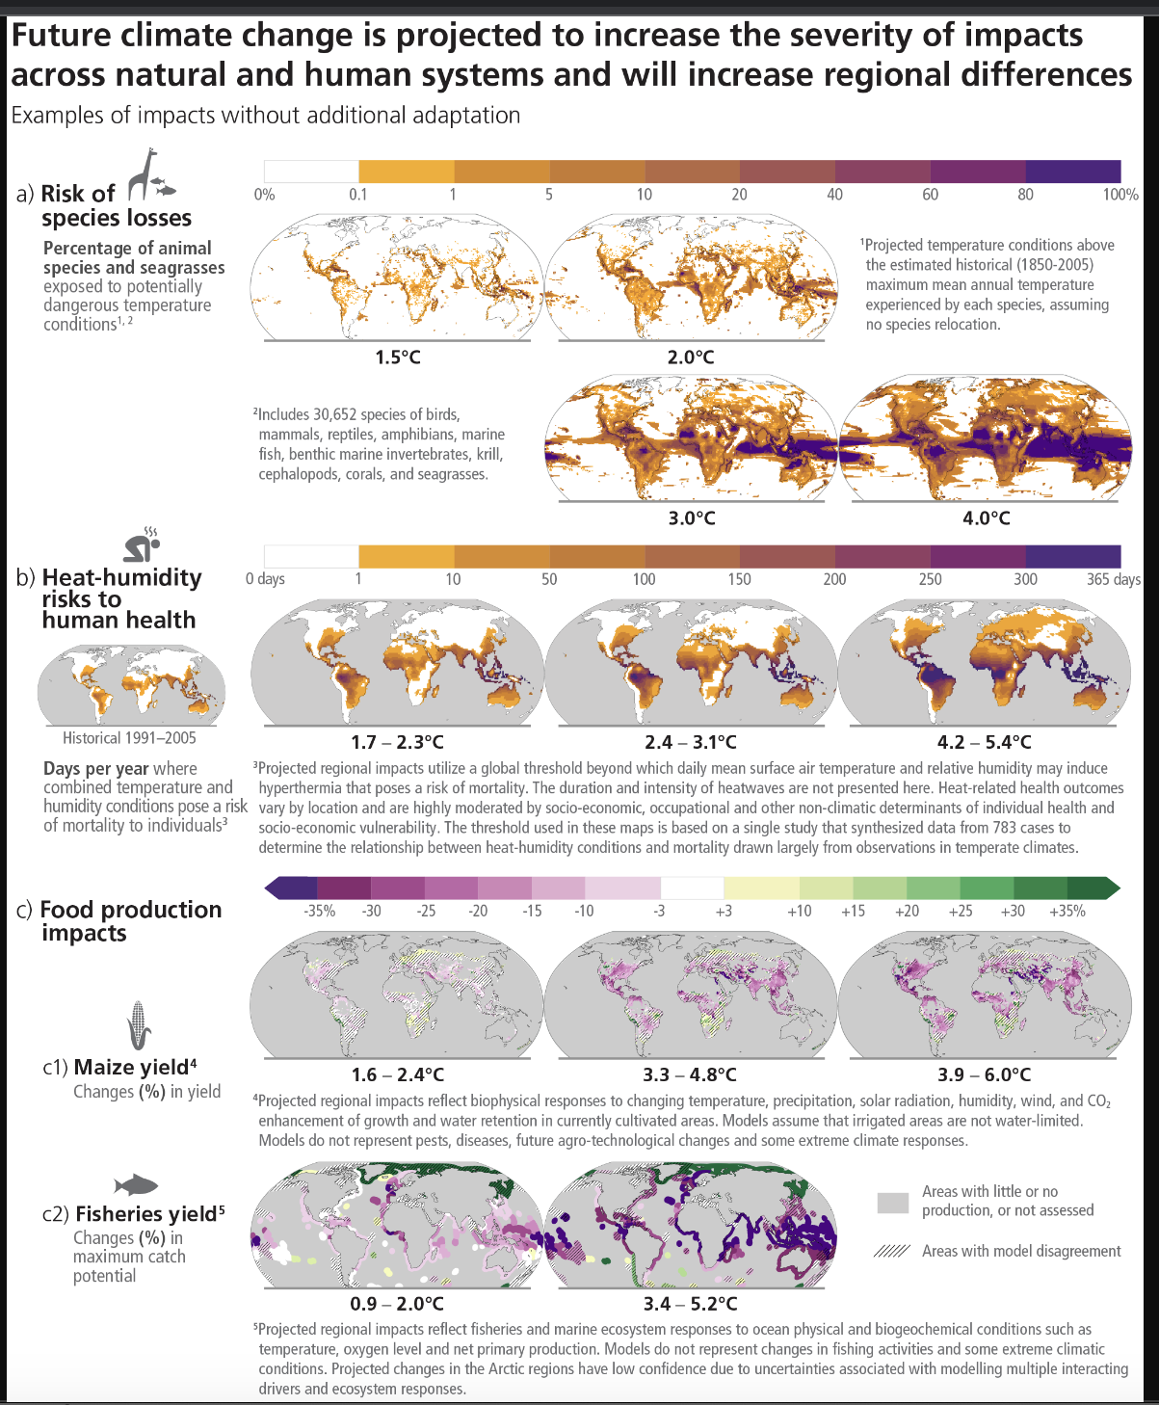
IMPACTS
Notes:
Slide 7
- WG2 impacts – snapshot of impacts

Slide 8
“EFFICIENCY” VS JUSTICE
Emissions and attempts to cut them can not be disconnected from the reality they come from
need to be thought holistically and in dynamic relationship with other variables defining societies (inequalities - N/S, intra), gender/ethnic/class oppressions, etc).
Ignoring the latter => climate policies additional driver of status quo =>legitimisation of those opposing climate action across the board.

Slide 9
UNFCCC: A BATTLEGORUND FOR CLIMATE JUSTICE
UNFCCC as a space for defining climate governance:
CBDR-RC ; Equity principles
Expanding coverage of issues
Relatively flexible (not without effort) to new constituencies
Aykut/Dahan “globalisation of the climate problem” : extension of jurisdiction of the climate arena, encompassing ever-growing number of problems
A “climatisation of the world”: climate lens applied to other issues according to dominant logics of the climate regime.

Slide 10
JUSTICE IN THE INTERNATIONAL REGIME (Orekeke, 2010)
Mitigation and Burden Sharing
Distribution of risks, cost, and benefits of burden of emission reductions among individual countries (ie equal entitlement for each country, polluter pays principle, historic responsibility, GDP, …)
Impact and Adaptation
Support vs compensation - idea that compensatory finance owed by the richest and highest-polluting nations to the most vulnerable communities and countries that are bearing the brunt of impacts of climate change. ie Loss and Damage debates now.
Procedural Justice
Connection between fairness of an outcome and the legitimacy of the process by which it is determined - important on the light of “minilateralism” developing in parallel with UNFCCC.
Systemic Injustices
Systemic bias in the international system (in terms of rules, access rights, terms of trade, etc.), which reflects historical patterns of inequity between the political North and South. Where are the big picture rules of the game decided? (debt, trade, IPRs)

Slide 11
ADDITIONAL JUSTICE DIMENSIONS
Gender justice
Indigenous peoples rights
Environmental justice/ human rights
Just transition/ labour rights
Intergenerational justice
…

Slide 12
SNAPSHOT KEY DEVELOPMENTS AT UNFCCC
Rio Conventions/ UNFCCC
Common but Differentiated Responsibilities (CBDR-RC) 1992
COP15/ Copenhagen
Aimed at bringing US back in/ blur lines btw North & South - Collapse - 100bn climate finance - GCF - 2009
COP26 - Glasgow Blurring the lines between announcements and negotiation - “VIP COP” - 2021
COP28 – Dubai
Focus back on negotiations
L&D Fund operational
No equity no FF phase out
Just Transition WP
Kyoto Protocol
Top-down targets + markets (“cost efficiency” of emission reductions in the South) - Annex 1 - US out - 1997
COP21 - Paris
Change operated - Bottom up, no distinction between countries - 2015
COP27 - Sharm el Sheikh
Loss & Damage Fund - 2022

Slide 13
WHO CARRIES DEMANDS?
Governments, through
COP Presidency
Negotiating groups:
Official: EU, G77+China, Umbrella group, African Group, AOSIS, SIDS, EIG
“Fluid”: LMDC, AILAC…
Ministerial level - High ambition coalition
Each one of those pushes a specific set of demands

Slide 14
NON-STATE ACTORS – HOW DO THEY INTERACT WITH THE UNFCCC SPACE?
Newell’s categories
Agenda-setting (activation of public concern, politicise/”create” an issue, an expectation, nurture “frames of interpretation”)
Negotiation-bargaining (lobbying - dependent on operating reach- “insiders”)
Implementation/enforcement (weak governance leads to embarrassment being lever for implementation) - “insiders” included in dialogue with institutions - “outsiders” marginalised in terms of access.

Slide 15
NON-STATE ACTORS/JUSTICE DIMENSIONS
Key constituencies:
Non governmental organisations – Climate Action Network (CAN) and Demand Climate Justice (DCJ, former Climate Justice Now)
Trade unions
Women and Gender
Indigenous Peoples
CBDR-RC
Equity within and between countries
Human rights
Intergenerational justice
Just transition / labour rights
Gender justice
Women rights
LGBTQ+ rights
Loss & damage
Impacts of false solutions (markets, geoengineering, etc)
Indigenous Peoples Rights
Rights of nature

Slide 16
https://app.wooclap.com/events/ZMRNXQ/0

Slide 17
LET’S THINK ABOUT SOCIAL-ENVIRONMENT TENSIONS

Slide 18
Recommended reading
Okereke, C. (2010), Climate justice and the international regime. WIREs Clim Change, 1: 462-474.
Newell, P. (2000). Conclusion: States, NGOs and the future of global climate politics. In Climate for Change: Non-State Actors and the Global Politics of the Greenhouse (pp. 154-172). Cambridge: Cambridge University Press.
Jen Allan: The new climate Activism - Chapters about Gender/Labour and climate justice
Buller, A. (2022). "Introduction". In The Value of a Whale. Manchester, England: Manchester University Press. Retrieved May 24, 2023, from https://doi.org/10.7765/9781526166036.0000
Civil Society Equity Review (2022) The Imperative of Cooperation: Steps Toward an Equitable Response to the Climate Crisis. Manila, London, Cape Town, Washington, et al.: Civil Society Equity Review Coalition.
Gabor, D. (2023, May 17). The (European) Derisking State. https://doi.org/10.31235/osf.io/hpbj2
Chancel, L. Global carbon inequality over 1990–2019. Nat Sustain 5, 931–938 (2022). https://doi.org/10.1038/s41893-022-00955-z
Aykut, Stefan, Edouard Morena and Jean Foyer (2020), ‘“Incantatory governance: global climate politics’ performative turn and its wider significance for global politics’, in International Politics, https://doi.org/10.1057/s41311-020-00250-8

Slide 19
Q&A
Notes:
Slide 10
Q&A and discussion

Slide 20
The example of a concept in dispute: Just Transition - Advocacy

Slide 21
FEEDBACK TO THE GROUP EXCERCISE

Slide 22
Methane emission reductions’ could have an impact on farmers income
CSOs positions could be influenced by their access to authorities
Many people’s incomes rely on highly polluting sectors
Green gentrification
Communities that rely on unsustainable heating/power sources (ie coal) can’t afford renewable energy sources
Workers in fossil sectors (pipelines, oil fields) need new jobs
Low and middle income families face difficulties to access more sustainable products due to high prices
Tensions between developed cooperation money going to global south, when those are perceived as getting richer
Indigenous Peoples losing their land and culture due to governments’ policies on climate
Not everyone can access new technologies due to inequalities
Impacts of emission reduction policies on farmers’ costs leading to food price increases

Slide 23
- Business-as-usual vs climate action - ‘Anti social’ mitigation - Tensions with other priorities - Continuation of an unjust Business As Usual May be others: N-S impacts, Gender, tensions with other priorities.

Slide 24
The barriers to climate justice are to be found both, on the pressures from those rejecting climate action as from those offering “solutions” that further us away from rights/justice-based approaches.

Slide 25
Thinking Climate Justice approaches
How can we think differently about solutions?
How to organise fair shares internationally?
How to think climate policies with a stronger justice lens domestically?

Slide 26
CONCERNS NEEDS IDEAS
Notes:
Slide 10
Q&A and discussion

Slide 27
LET’S THINK ABOUT CLIMATE POLICIES

Slide 28
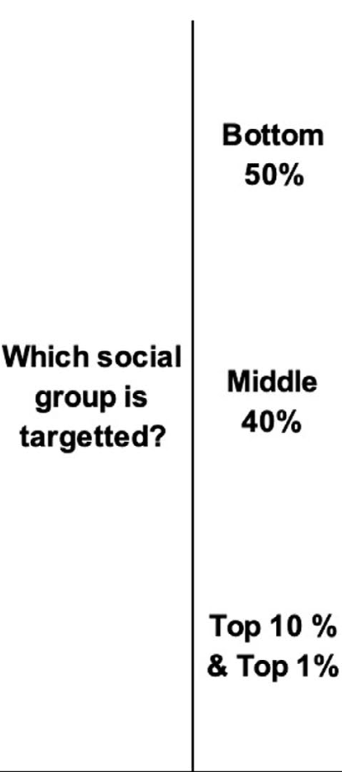
Placing Climate policies with an income-disaggregated lens

Slide 29
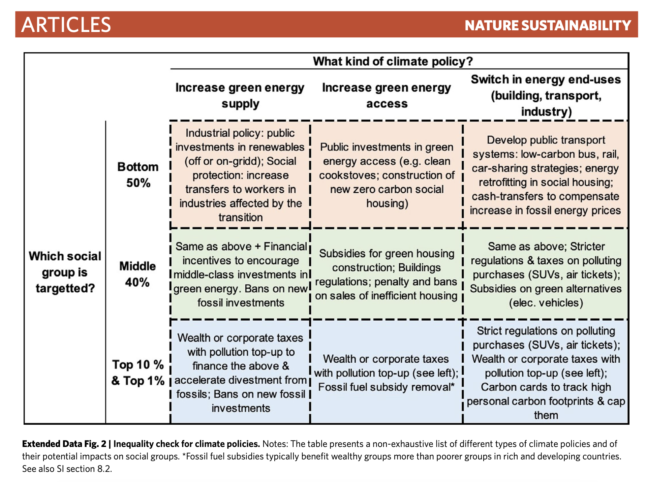
Chancel, Lucas

Slide 30
Genesis of ‘Just Transition’
The Just Transition concept was not the product of theoretical debate.
Developed by U.S. workers in response to ‘job blackmail’ in the late 1970s when the Oil, Chemical, and Atomic Workers Union, led by Anthony Mazzocchi, sought support for workers who where asked by their employers to choose between their jobs and their health.
In the 1990s the union pleaded for a ‘Superfund for Workers’’ to provide financial support and higher education opportunities for workers in affected industries. By the late 1990s, several U.S. and Canadian unions had endorsed the Just Transition as an approach.
In the late 1990s and early 2000s, as it began to forge alliances with labour movements, the environmental justice (EJ) movement took on the concept, calling for the allocation of funds to support the transition for workers and communities dependent on the fossil fuel industry. Their demands included calls for federal funding for worker training and community development based on sustainability and justice principles.
Notes:
Since its creation by U.S. workers in the late 1970s, the concept of Just Transition was taken up since COP3 in 1997 at the international level as a key driver for international trade union mobilisations around climate change. Its focus was on ensuring workers and communities dependent on sectors that needed to change in the fight against climate change will be recognised, listened to, their rights protected, and alternative, decent jobs and livelihoods would be secured for them.
Since the adoption by the ILO of its policy guidelines on Just Transition and the inclusion of Just Transition language in the Preamble of the Paris Agreement, the concept’s uptake grew considerably. This has resulted in an expansion of the concept in terms of its intended outcome, from achieving social justice/decent work to achieving a deeper transformation of the economy/systemic change, as well as the policy package it entails (i.e. ILO’s nine policy areas, economic planification, international cooperation, debt, trade, among others). Just Transition is also being applied to multiple areas, with the one more widely mentioned being energy, but application to other areas such as minerals, health, unpaid labour, agriculture, adaptation and biodiversity growing as well.
Beyond conceptual developments, several multilateral organisations and governments are deploying Just Transition strategies/plans on the ground, covering, to varying degrees, the different aspects presented above (see snapshot p.10).
In parallel to these developments, the Just Transition concept also progressed within the UNFCCC, notably in the context of Response Measures and the KCI, where it has been debated as one of two key priorities (along with economic diversification). That said, other areas of negotiation have also started incorporating Just Transition discussions (MWP, SCF, GST, among others).
There is convergence across all actors that Just Transition strategies must be diverse if they are to be relevant across very different circumstances. However, it is also important to note that current efforts are dispersed and could lead to the loss of the original intent of Just transition (such as the focus on workers’ rights and decent work, social justice for impacted communities or the need for strong participation and consultation in the design of Just Transition policies) and aggravate concerns over social impacts of climate action.

Slide 31
Genesis of ‘Just Transition’ II
At the international level, beginning with the Kyoto COP in 1997, national trade unions and the International Trade Union Confederation (ITUC) began including Just Transition wording in their stakeholder statements at global climate and sustainability conferences.
They also focused their advocacy efforts on both the recognition of the challenges for the world of work associated with climate-related policies, and the opportunities associated with the deployment of Just Transition approaches, especially in terms of securing greater public support towards climate action.
A word on why?

Slide 32
On climate policy, labour market impacts and inequalities (ILO)
(...) Without a set of supporting social and economic policy measures, unplanned and abrupt job losses in carbon-intensive and polluting sectors are likely. Some 78 million jobs may be destroyed, relocated or redefined, which highlights the need for strong policies to manage the transition. An additional 20 million jobs could be created through nature-based solutions.
Climate and environmental policies induce an economy-wide structural transformation within and across economic sectors such as energy, industry, transport, agriculture, marine and forestry, pollution management and recycling. These policies not only directly impact the sectors themselves but also indirectly affect the supplying industries. They therefore fundamentally alter the structure of countries’ economies, business environments and labour markets.
The labour market may be unable to transition to new industries and business models if the appropriate skills are not available, social protection is lacking and communities and regions are not supported through coherent structural, industrial and macroeconomic policies.
Climate policies also affect broader social equity, as global energy and income inequality are intertwined. The energy transition will require energy subsidy reform and carbon pricing policies. The resulting cost increase for households is regressive, meaning that low-income groups, and women in particular, are disproportionately affected, as they spend a larger share of their income on energy and related basic goods, notably food, housing and transport.
(...) The imperative of promoting social justice should underpin policies that protect poorer households and shift the burden of higher energy prices to high-income earners who are responsible for most emissions. Progressive carbon pricing could address the underlying income and energy inequality.
Notes:
Despite structural differences between countries, investments in nature-based solutions, renewable energy and other clean technologies create more jobs than fossil fuel investments. Due to a higher wage share in overall costs, they bolster the aggregate income and spending of workers, which has multiplier effects. Investing in energy-efficiency retrofits for buildings creates 2.8 times as many jobs compared to fossil fuels. Investing in ecosystem restoration creates 3.7 times as many jobs as oil and gas production per US$1 million of investment. 31 The relatively high job intensity of ecosystem restoration underscores the important role that nature-based solutions play in promoting both environmental sustainability and job creation.

Slide 33
Adoption at International level
The concept of Just Transition first made it into an official decision at the UN climate conference at COP16 in 2010 in Cancun (similar wording was included in the discarded draft of the AWG-LCA in COP15 in Copenhagen). There, Parties acknowledged that:
“[...] addressing climate change requires a paradigm shift towards building a low-carbon society that offers substantial opportunities and ensures continued high growth and sustainable development, based on innovative technologies and more sustainable production and consumption and lifestyles, while ensuring a just transition of the workforce that creates decent work and quality jobs”.
In 2015, the International Labour Organisation (ILO) published Guidelines for a Just Transition towards environmentally sustainable economies and societies for all, outlining a series of principles and policies to be deployed to support workers and companies in the transition.
And following years of efforts by labour and environmental organisations, COP21 (2015) incorporated Just Transition language in the Paris Agreement.
The Preamble to the 2015 Paris Agreement references the need to
"[Take] into account the imperatives of a just transition of the workforce and the creation of decent work and quality jobs in accordance with nationally defined development priorities [...]".

Slide 34
At a glance
A simple narrative: Just transition is needed for climate ambition - yes, there are job opportunities, but leadership must send a signal of commitment to working people on them not carrying the burden of the transition.
An unusual configuration of government support (from both G77 and developed countries) - Argentina + US and then some EU, other progressist G77 countries.
A cross-constituency block on human rights to get the others.

Slide 35
Context has fundamentally changed
Over the past few years, the concept got discussed and “embraced” at multiple levels, from the most progressist to quite conservative, leading often to confusion in terms of its systemic potential.
Even leaving supporters of the status quo aside, there are multiple and not always consistent initiatives named just transition being developed by think tanks, NGO, trade unions, philanthropy, often focused on the national and local level, each one with its checklists, tools, workshops, etc.

Slide 36
Narratives
From “Jobs vs Environment” to “Just Transition”
The international labour movement’s Just Transition these days
The narratives at the international level - multilateral organisations & businesses.

Slide 37
Some trends
Recurrent use of
“leave no one behind”
“Social dialogue”
“Participation”
Frame in the context of energy, and pointing out to workers in the sector
Narratives tend to frame Just Transition as a necessary evil to advance on climate - how do we feel about this and what does it mean to the importance of achieving justice overall?

Slide 38
A challenging context
Never the needs have looked bigger - pre-existing injustices, status quo of “solutions”, communities facing un-just transitions.
Never the multilateral system has looked in such a poor shape (both generally and at the UNFCCC)
Just Transition reduced to its minimal expression/ social washing risks

Slide 39
What to do? What is the opportunity?
Depends on where/who you stand for.
Reclaim and think big -
“Only a crisis - actual or perceived - produces real change. When that crisis occurs, the actions that are taken depend on the ideas that are lying around” Milton Friedman
Have been used against justice over and over - need to learn how to use it ourselves.

Slide 40
CONCERNS NEEDS IDEAS
Notes:
Slide 10
Q&A and discussion

Slide 41
WHAT DID WE DO?
Notes:
Slide 10
Q&A and discussion

Slide 42
RECLAIM CONCEPT
GROUND IT
ORGANISE A CONSTITUENCY
FIGHT FOR SYSTEMIC SOLUTIONS
BUILD THE SOCIETY WE NEED TO CONFRONT WHAT IS COMING

Slide 43
ADVOCACY Bilaterals/Engagements With G77, South Africa, Brazil, EU, Colombia, Chile,Canada, Argentina, US, Bolivia Circulation Of Text Analysis Interventions in the Contact Groups ECO Articles INTERNAL COORDINATION Regular in-person meetings Tried to coordinate representation of JTWG Members in other CAN WGs CROSS-CONSTITUENCY COLLABORATION Regular in-person meetings with representatives from different constituencies Joint analysis Aligning statements ACTION Joined The Cross Constituency Action On Just Transition For Workers And Communities COMMUNICATIONS Spokepeople on JT on CAN Panels + feeding lines to energy spokepeople Quotecards

Slide 44
UAE Just Transition Work Programme | Scope addresses the workforce and other socio-economic dimensions, discusses international cooperation and covers ongoing work on just transition outside the UNFCCC Acknowledgment of the importance of respecting human rights, social justice, gender equality, etc. Recognition of labor rights, social protection and social dialogue
 | No mandate to deliver operational decisions No new means of involvement for observers
Beyond official outcomes, CAN’s work defined what the debate on the JTWP was going to be (notably on securing a broader scope and adding international cooperation)

Slide 45
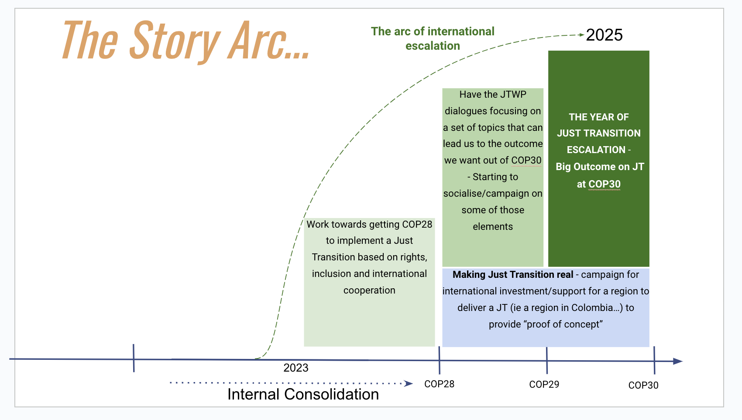

Slide 46
TO BE CONTINUED…
Notes:
Slide 10
Q&A and discussion

Slide 47
Recommended reading
Newell, P. and Mulvaney, D. (2013), The political economy of the ‘just transition’. The Geographical Journal, 179: 132-140. https://doi.org/10.1111/geoj.12008
Morena, Edouard & Krause, Dunja & Stevis, Dimitris. (2019). Introduction: The Genealogy and Contemporary Politics of Just Transitions.

Slide 48
Q&A
Notes:
Slide 10
Q&A and discussion

