Slide 1
Week 4: Local blockbusters, national sentiments and identities
Dr. Kiki Tianqi Yu

Slide 2
1990s Cinema
Films not popular enough to sustain Chinese industry
Piracy meant loss of revenue
State studio system collapsed
China looked to foreign blockbuster imports to save industry
10 Foreign Films imported per year from 1994 (20 from 2001, 34 from 2011)

Slide 3
The Opium War (1997)
Giant Film, Blockbuster
(zhuxuanlu da pian)
Most expensive Chinese film made up to that time
Released to coincide with Hong Kong handover (EVENT film)
National Humiliation Narrative
Seriousness of tone, not entertaining, unsuccessful

Slide 4
Titanic
“The Titanic Miracle”
Revealed “credibility crisis and lack of marketing sophistication in Chinese cinema”
Wan Jihong and Richard Krauss (2002)

Slide 5
New Genre Film – The New Year Comedy
Genre film: consumer-oriented cultural products
Subject to ongoing changes and redefinition
Between Christmas and Chinese New Year
Cinema season was previously scheduled for social convenience or political needs
To stimulate consumer spending during the lengthening holiday periods in China – so called ‘holiday economy’
Holiday film – national day films

Slide 6
The Chinese ‘Event’ Movie
Feng Xiaogang’s ‘New Year Comedies’
China film group and Huayi Brothers
Capitalised on Holiday Season – An EVENT
The Dream Factory (jaifang yifang)
Be There or Be Square (bu jian bu san)
Big Shot’s Funeral (Da Wan)

Slide 7
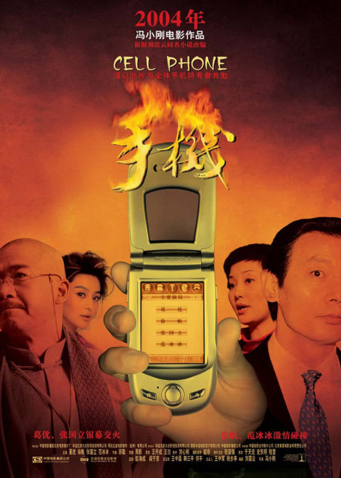
Feng Xiaogang’s commercial cinema
Use comedy to hint contemporary social issues arise during China’s fast social transformation:
Loyalty to friends, wife and families / Money worshiping
Local stars and local humous

Slide 8
“The Fifth Generation didn’t enter through the gates but broke in through the windows … the Sixth Generation dug up from underground … There was no longer any space for me inside. So I decided to build a side room … Now life in the side room is so exciting, even those who occupy the sacred hall want to come in … some have already popped their heads in”
- Feng Xiaogang, 2000

Slide 9
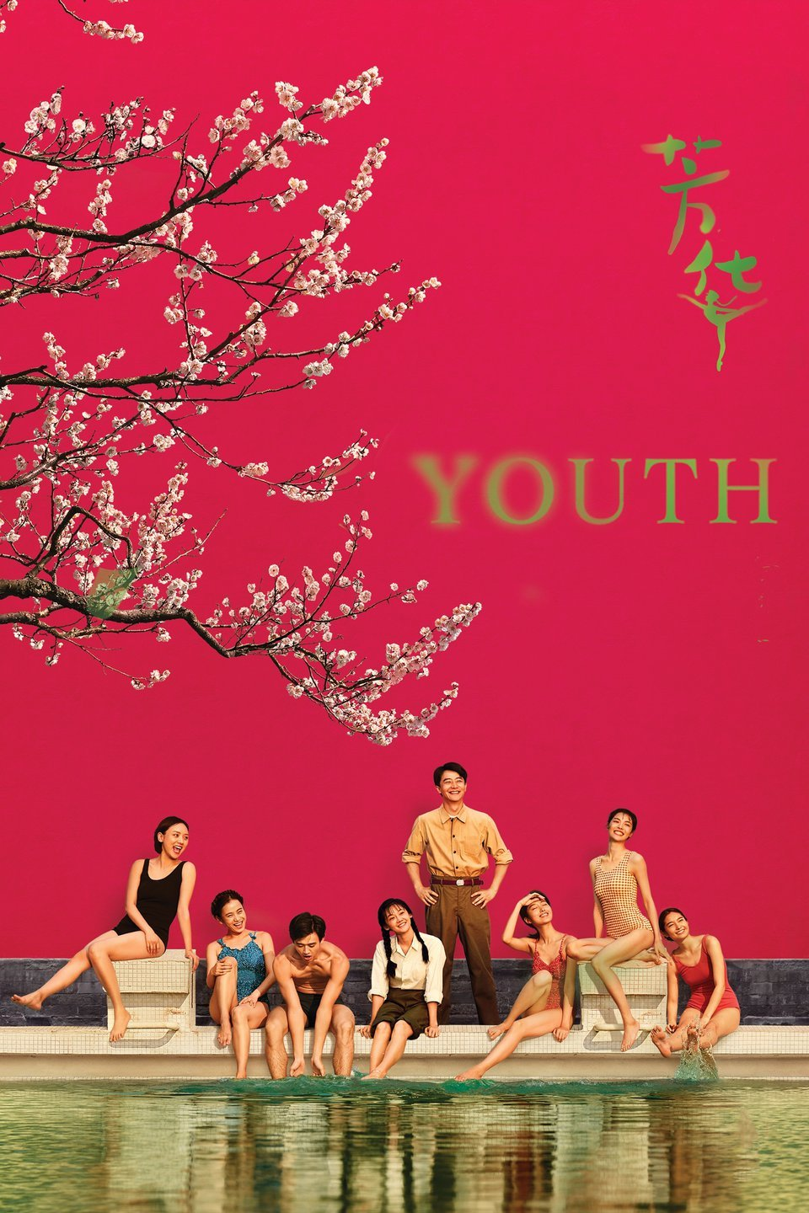
Historical memories, National sentiments – weepie films
Massive earthquake 1976
Great Famine in 1942
China’s submission to ‘best foreign language film’ in 2013
https://www.youtube.com/watch?v=_Zwc-rfdC8c
Personal life interrupted
by political changes
https://www.youtube.com/watch?v=n3U_ni90dxI

Slide 10
Aftershock

Slide 11
Huayi Brothers Media Corp. -
China’s largest private film conglomerate
Film studio, TV production company, talent agency, record label, cinema chain
Founded in 1994 by Wang Zhongjun and Wang Zhonglei
Produced many Feng Xiaogang’s films

Slide 12
World Trade Organisation Accession - 2001
Quota of foreign film imports doubles from 10 to 20
“Hollywood-style Chinese movies would be suicide”
Lu Xuechang
“ideological control has declined in an inversely proportional way to the control exerted by the market economy”
Jia Zhangke

Slide 13
WTO Accession
“Chinese cinema will be forced to develop and grow”
“Borrow the American experience”
“Commercialisation is the only way forward for the Sixth Generation”
Han Sanping – Head of China Film Group

Slide 14
Zhang Yimou at Cannes 1999
I cannot accept that when it comes to Chinese films, the West seems for a long time to have had just the one 'political' reading: if it's not "against the government" then it's "for the government".
Zhang Yimou

Slide 15
The Most Written About Chinese Film Ever
An ‘answer’ film?
China’s first real Blockbuster
Beijing Awarded Olympic Game
China’s economic power begins to be felt in the West
Controversial in China and the West for glorifying totalitarianism
Many public debates on internet
Failed to win 2002 Oscar

Slide 16
Wuxia Heritage
The Promise (Wu ji) dir. Chen Kaige
The Banquet (Ye Yan) dir. Feng Xiaogang
CCP declared Curse of the Golden Flower “bloodthirsty and hollow”
Assembly (Je jie hao) and The Warlords (Tau ming chong) have different historical perspective
Values of courage, bravery, brotherhood and loyalty
Harmonious Society (hexie shehui)

Slide 17
Red Cliff 1 and 2 (2008/9)
Hollywood director
John Woo = Semi-exiled
Made as a REGIONAL, not international, blockbuster
More successful than Titanic
Part 1 released just before the Olympic Games (EVENT movie)

Slide 18
Marketing Sophistication?
The highest level of capital operation is to stack stars. The strategy is to stretch the shooting period so that new capital can be accumulated throughout the entire shooting and post-production period, new stars can keep on joining the film, the film can be revised over and over again to satisfy new investors, and new plotlines can be added to accommodate the newly joined stars … [Red Cliff’s] shooting period was so long that they had to make the film into two parts otherwise they wouldn’t make any money
Zhang Xianmin, 2010

Slide 19
Beyond National Humiliation Nanjing! Nanjing! (2009)
Most objective film yet made about Nanjing
Director Lu received death threats for sympathetic depiction of Japanese soldiers
Well regarded in the West

Slide 20
Nanjing! Nanjing! trailer

Slide 21
The Founding of a Republic (2009)
PART of the PRC’s 60th Anniversary Celebrations
Sympathetic depiction of Chiang Kai-Shek (Jiang Jieshi) and Kuomintang
Over 100 Stars
A “film of famous faces”

Slide 22
Is that Jackie Chan?!? Oooh look! It’s Jackie Chan!!!

Slide 23
The Beginning of the Great Revival (2011)
Made for young people
‘Market oriented’
Sponsored by Cadillac
Not as successful as Founding

Slide 24
Handsome Liu, Handsome Mao

Slide 25
Fan BingBing – An Improbably Beautiful Empress Dowager Longyu

Slide 26
Soft Power Ambitions

Slide 27
Hu Jintao and Soft Power
Socialist Core-Values System
Harmonious Society
Exaltation of Traditional Culture
Innovation of Culture

Slide 28
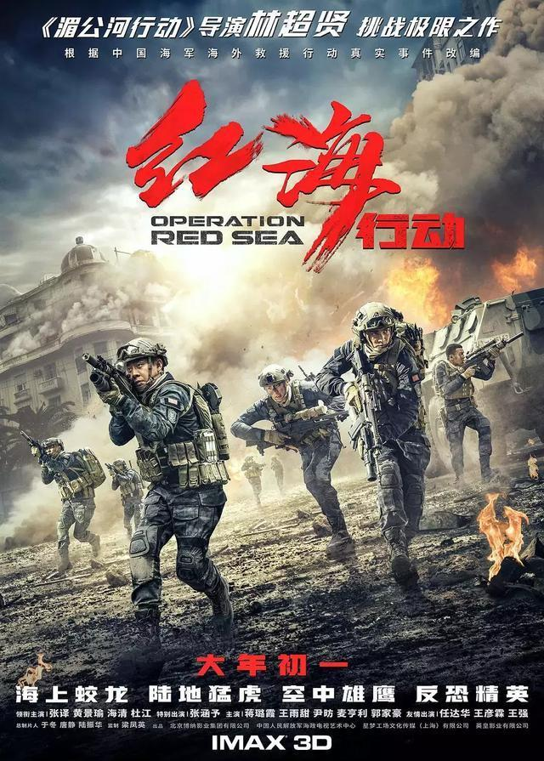
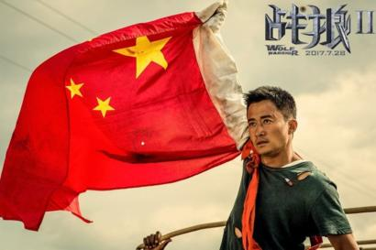
Xi’s leadership (2013 - ) China’s expanding international influence
Wolf Warrior 1 (2015) & 2 (2017)
https://www.youtube.com/watch?v=fkqGiPB2D8M
https://www.youtube.com/watch?v=btcJSvf3rt4

Slide 30
Belt and Road Initiative
Silk Road Economic Belt and the 21st-century Maritime Silk Road
a global development strategy initiated by the Chinese government in 2013 involving infrastructure development and investments in nearly 70 countries and international organizations across Asia, Europe, and Africa.
Alternative form of globalisation

Slide 31
National sentiments
Value building and moral education– responding to ‘lack of social ethics’ ‘money worshiping’ decade
Patriotism/Nationalism - Remember “who we are” – sense of proud
Remembering China’s recent Communist history
New aesthetics of propaganda film: Individual stories, individual perspective on China’s modern nation building project

Slide 32
https://www.youtube.com/watch?v=Img5Nmp9xzs
https://www.youtube.com/watch?v=7FSlJObXBUI&list=PLCS0DzoHY23C4ZvCKitm3RXbTj6JJo8SJ&index=4

Slide 33
what is reality and what is political

Slide 35
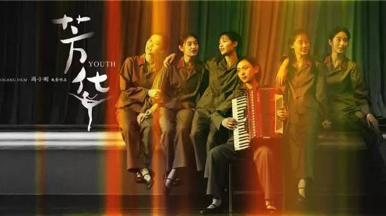
Youth: a sweeping coming-of-age melodrama set during the 1970s–1990s about the transformation of a Maoist military art and culture troupe.
“The film’s exuberant camerawork captures colourful costumes, revolutionary choreography and chorines familiar to a generation of youth coming of age during China’s Cultural Revolution”.

Slide 36
Largely eschews major political events to focus instead on the change of personal life of the young performers:
revolutionary songs and military uniforms.
“All of the songs in Youth have their origins in the Mao era, when personal sacrifices at the service of the nation were glorified. Many come from old revolutionary classics, the films that were popular in the 1960s”(Zhu 2020:13).
From the early 1980s, Taiwanese and Hong Kong pop music, and the fashionable outfits and hair styles they are drawn to
Personal transition against the pollical backdrop

Slide 37
Hymns to the Hero – revolutionary song
“Smoke billows from the beacon fire. I sing of a hero. The rings of mountains bend their ears. In the blue sky, thunder beats a golden drum. The ocean churns with waves singing in harmony. The people’s warriors drive out the predators, Laying down their lives to protect peace. Why is our battle flag as pretty as a picture? The blood of heroes has stained it red.” Played as the wounded hero’s death wish and his revenge fantasy as he hallucinates about the posthumous devotion of the girl who earlier spurned his overtures, the Hymns to the Hero song turns eerily haunting"

Slide 38
“Perhaps the deputy instructor was right. He didn’t want to live. He yearned to be a martyr. Only through sacrifice would his ordinary life become a hero’s tale, and his heroic story would grow and spread and travel far. Maybe it would be turned into a song with lyrics and a tune in the songbook of a female singer. A singer named Lin Dingding, who, in the end, would have to sing for him. And every time she sang, she would have to remember him.”

Slide 40
Censorship and public release
"Youth met resistance from the censors and its scheduled colossal rollout across China was halted amidst the Chinese Communist Party’s preparation for the national congress in October 2017, a political event staged every five years (Choi 2017). It turns out that veterans of the Sino-Vietnamese War, a group featured in Youth, had previously protested at the Congress, seeking better compensation and treatment. Some speculated that officials delayed the film’s release in fear of triggering a new round of protests at the 2017 Party Congress." p19

Slide 41
Nostalgia and Nostophobia
"Nostalgia for a collective socialist past when society was perceived to be less mercantile is palpable. But not all memories are associated with nostalgia. The darker moments in Youth easily trigger nostophobia, the fear of a bygone era." p18

Slide 42
The lyrics of Sumptuous Flowers become a metaphor for a past that is both innocent and traumatic:
“There is a beautiful flower in the world
The flower is youth, wonderfully fragrant
Strong and unyielding it blooms
And its petals are stained with blood
Sumptuous flower
Its sweet aroma all along the road up the mountain cliffs
In the world there is a heroic flower
The flower is growing youth
The flower bears its loved ones up the mountainside
To stand tall and proud and greet the sunlit clouds
Sumptuous flowers
Its sweet aroma all along the road up the mountains.”

