Slide 1
Cities in international climate politics
Week 9

Slide 2
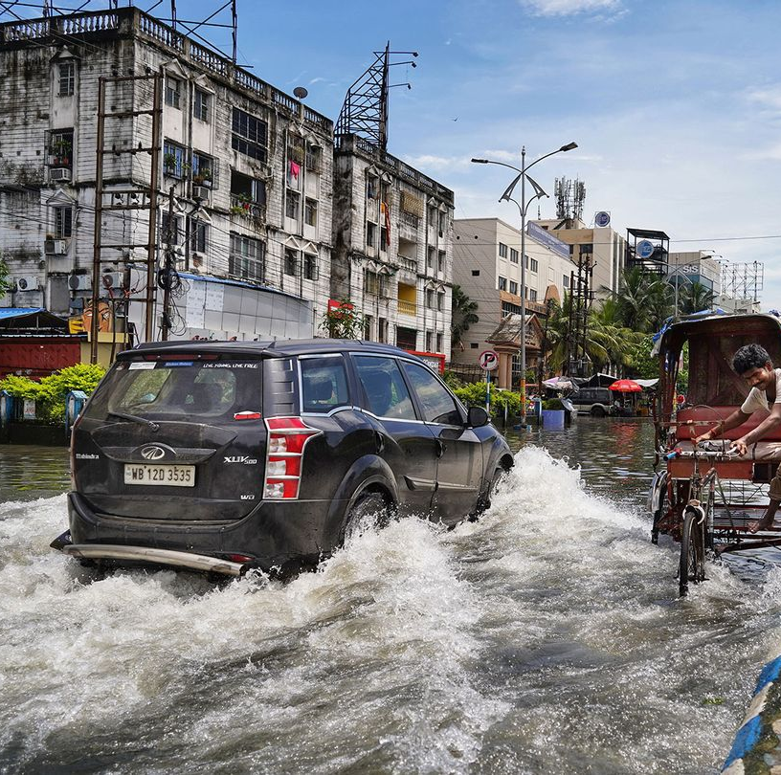
Aims of this session
Look at cities’ responsibility and vulnerability.
Focus on their role in international climate politics.

Slide 3
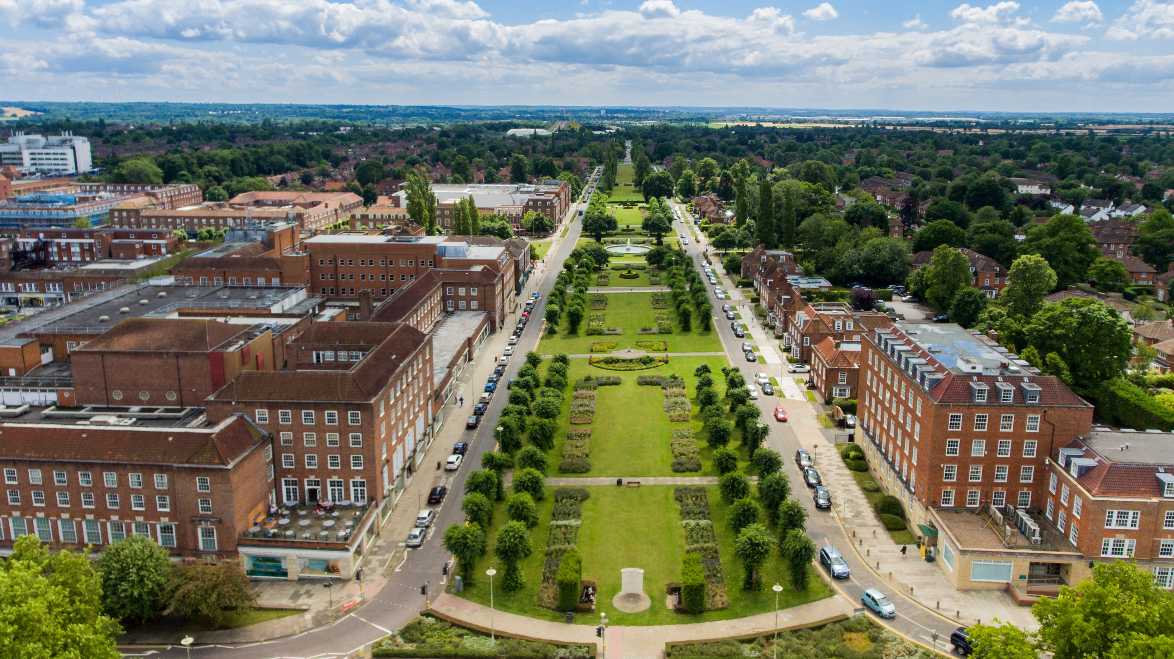
Introduction – When did we start to take an interest in cities and climate change?
Long history of focus on cities and environment: Effects on human health, quality of urban life, pollution…
Ebenezer Howard & Garden Cities (end of 19th century)
Le Corbusier (20th century)
New towns movement in UK (2nd half of 20th century)

Slide 4
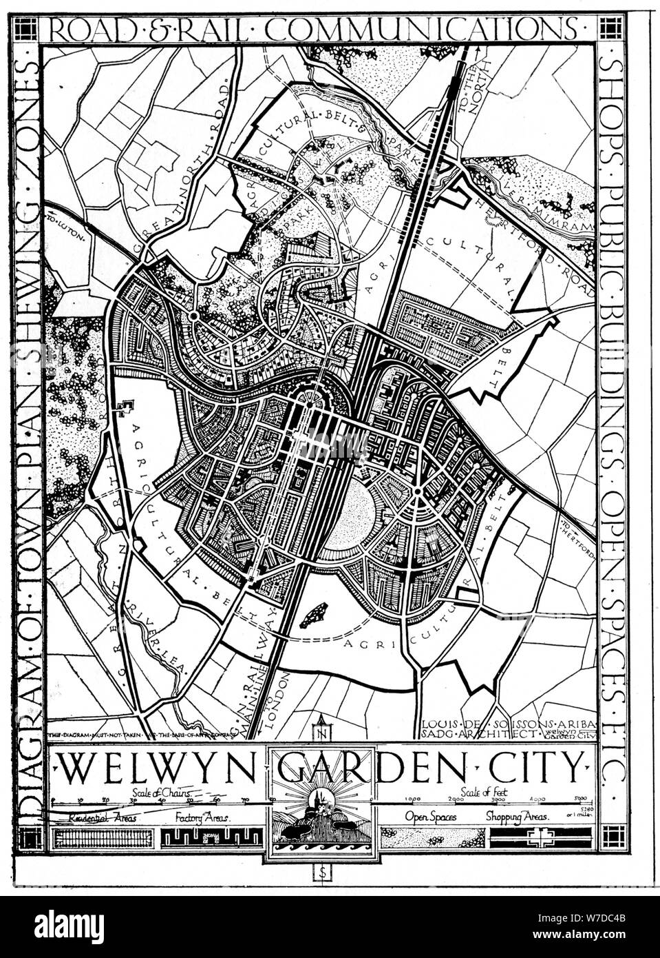
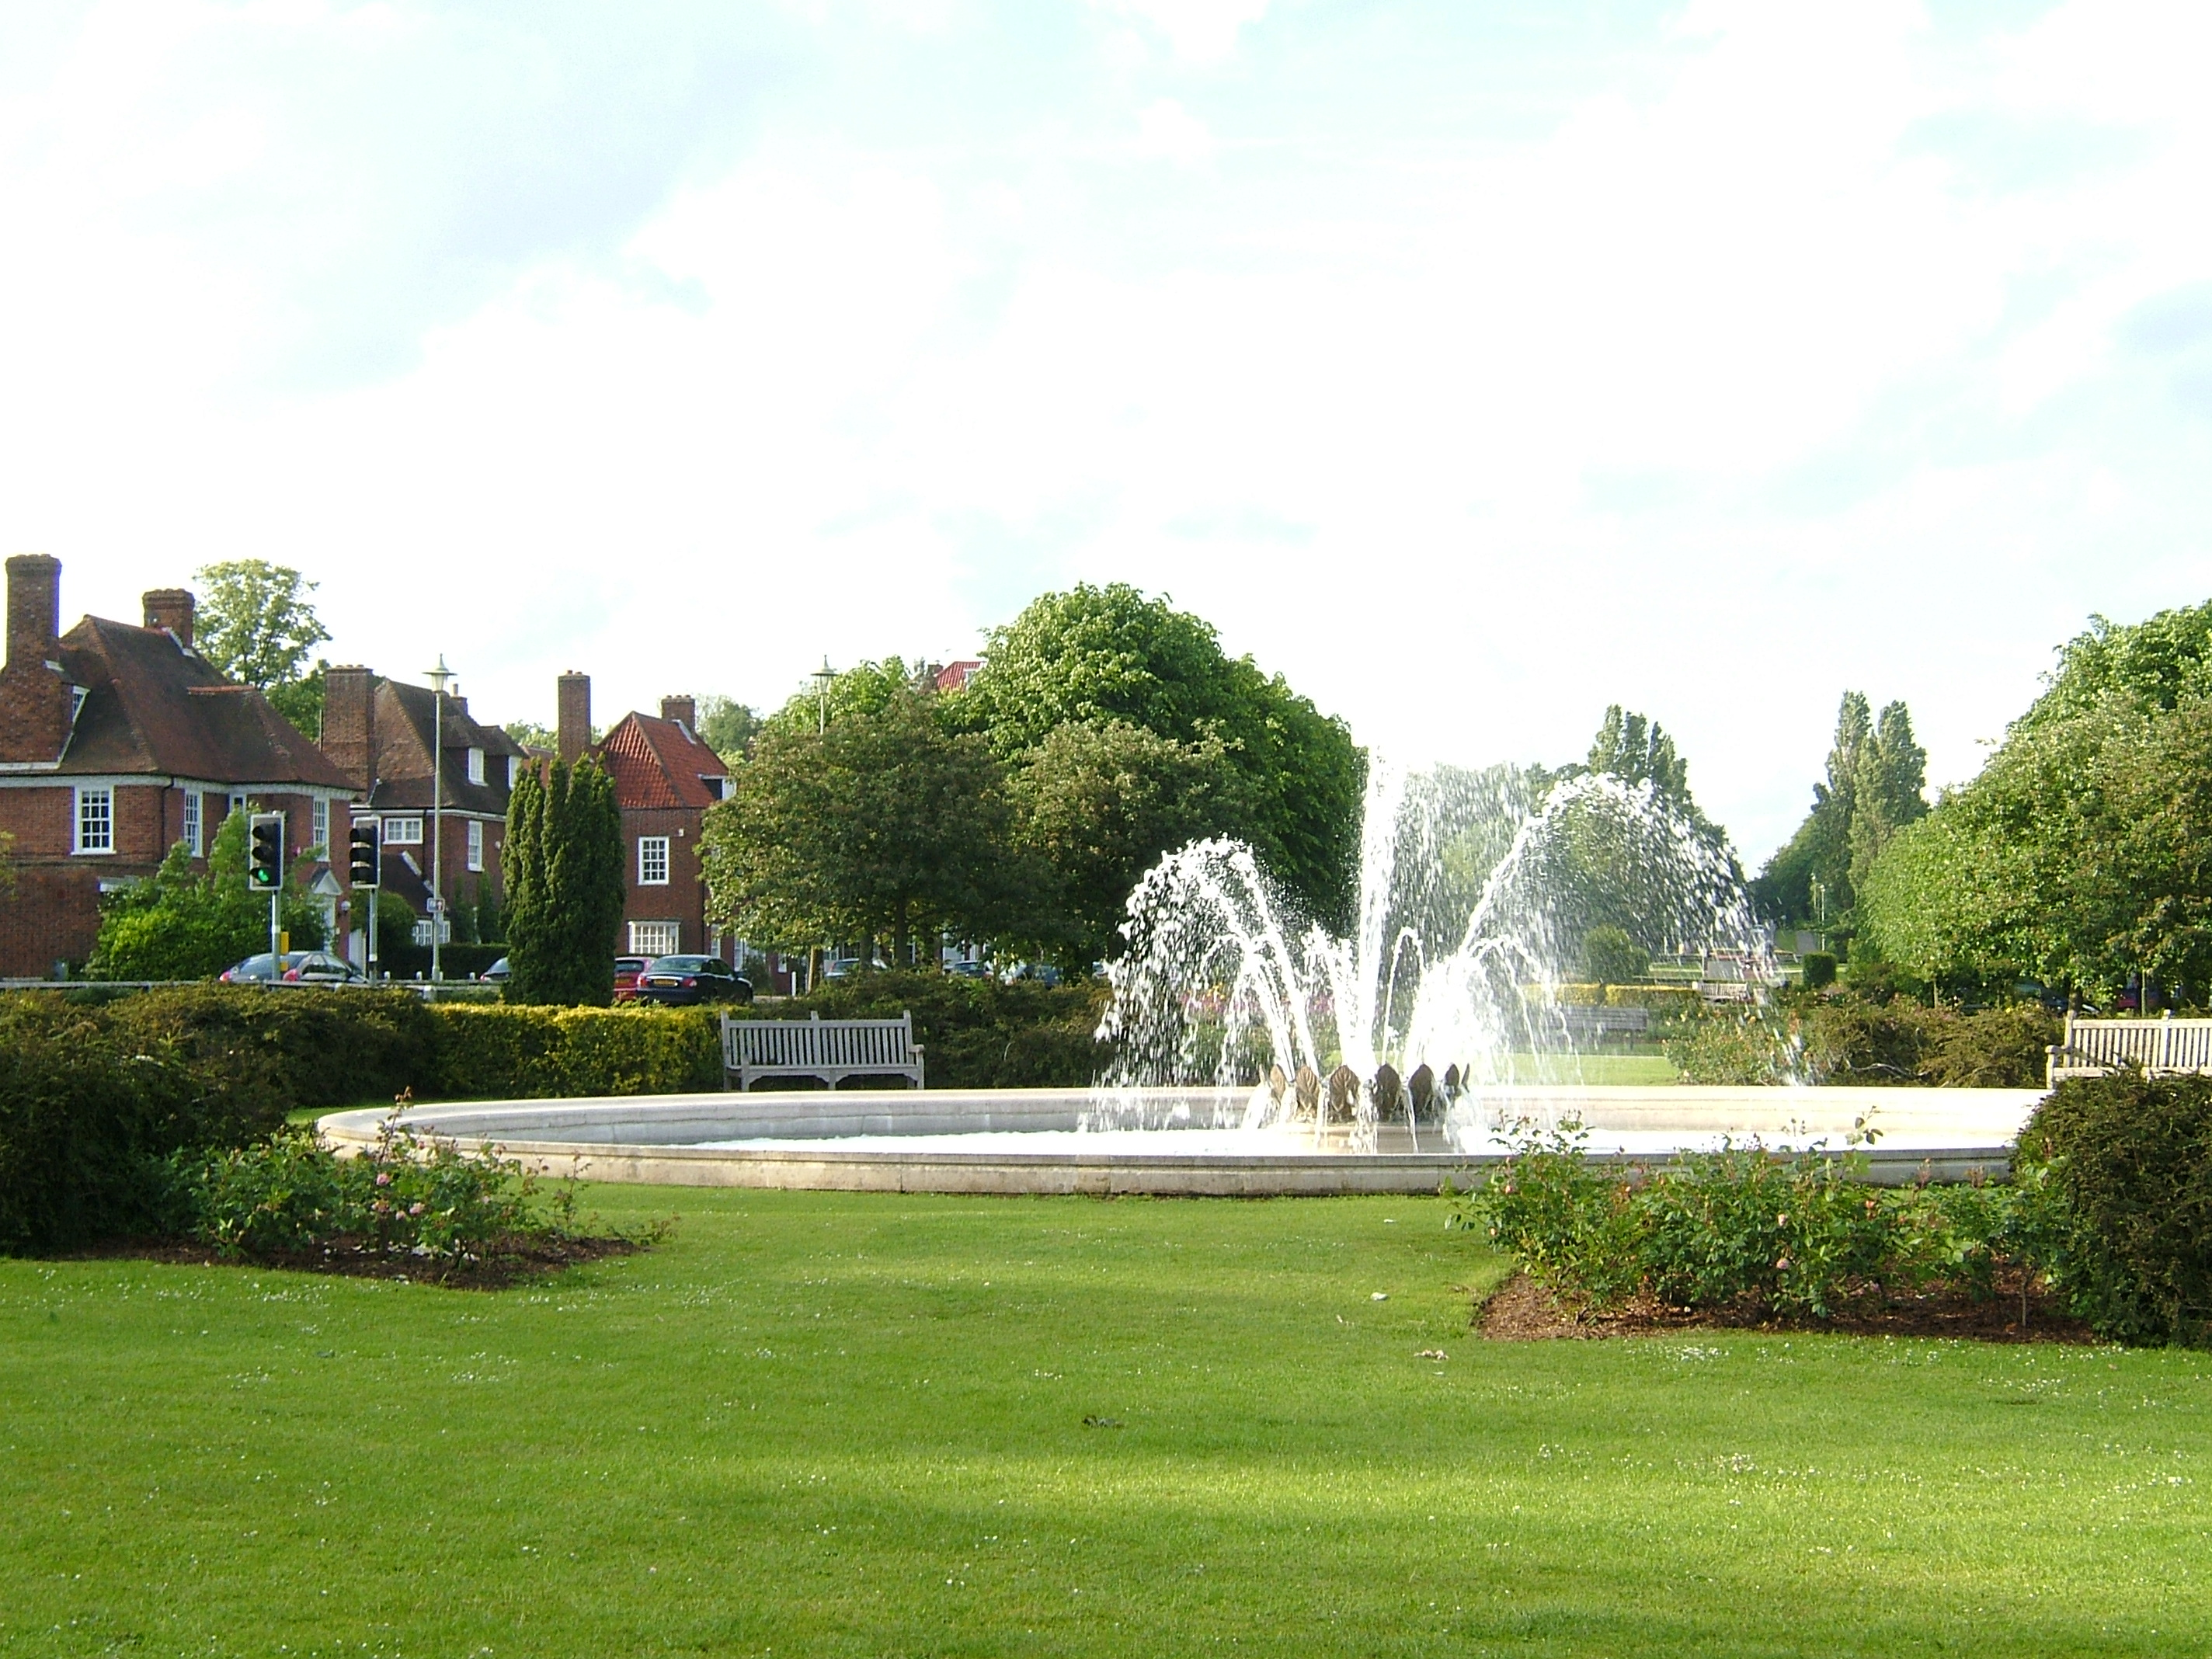

Slide 5
Haussman’s Paris

Slide 6
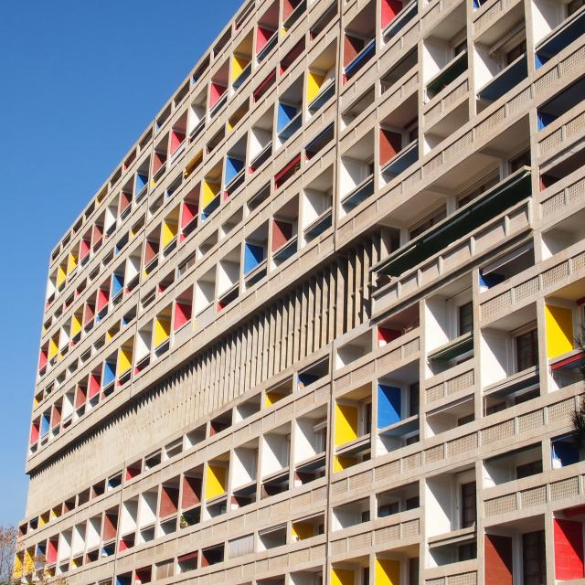
Le Corbusieur – Cité radieuse (Marseille)

Slide 7
Introduction – Contemporary debates
1970s: Debates (re)emerge out of multiple crises:
Economic
Ecological
Crisis of capitalism
Urban crisis
At international level:
UN Habitat Conference on Human Settlements (1976, Vancouver)
Challenges: provide clean water & sanitation; addressing poverty & homelessness (posed by shift from rural to urban centres)
City recognized as actor to address environmental change (1970s: émergence of environmental concerns).

Slide 8
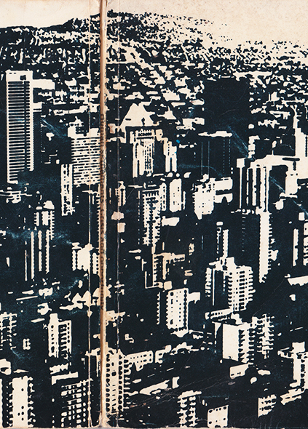
Introduction – Growing policy focus accompanied by growing academic focus
Many policy-oriented analyses
Trend: to frame sustainable urban development as a technical issue: socio-technical transition, new forms of policy and planning…
Little attention to political struggles + tendency to divorce local from other scales through which environmental governance is constructed (need for multilevel governance perspectives)
Growing critical scholarship (urban studies, urban political ecology, critical geography…)

Slide 9
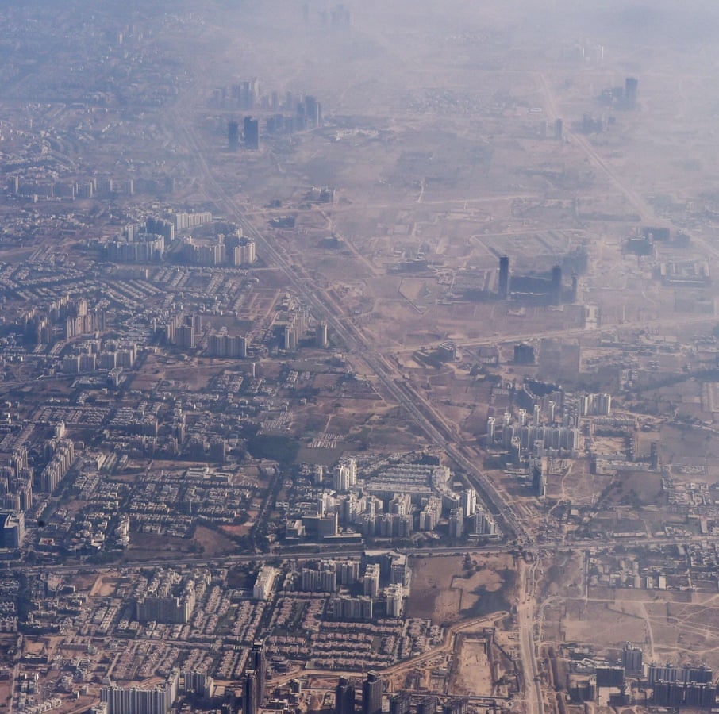
Vulnerability to climate change (1)
Urban areas concentrate:
Economic activities
Households (50% of world’s population)
Industries
Infrastructures (bridges, undergrounds, buildings, roads,…)
Hotspots for energy consumption + key sources of greenhouse gases

Slide 10
Vulnerability to climate change (2)
Extreme heat (Urban heat island effect)
Concrete, tarmac
Cities = 30% hotter than countryside
By 2050: more than 970 cities will experience average summertime temperature highs of 35°C (today: approximately 350 cities)
Urban population exposed to high temperatures will reach 1.6 billion by mid-century.
Cities in countries less used to dealing with extreme heat are especially vulnerable (2003 heatwave in Europe led to 70 000 deaths).
Pressure on essential services: energy, transport, health
Heatwaves are economic drain (lower levels of productivity)

Slide 11
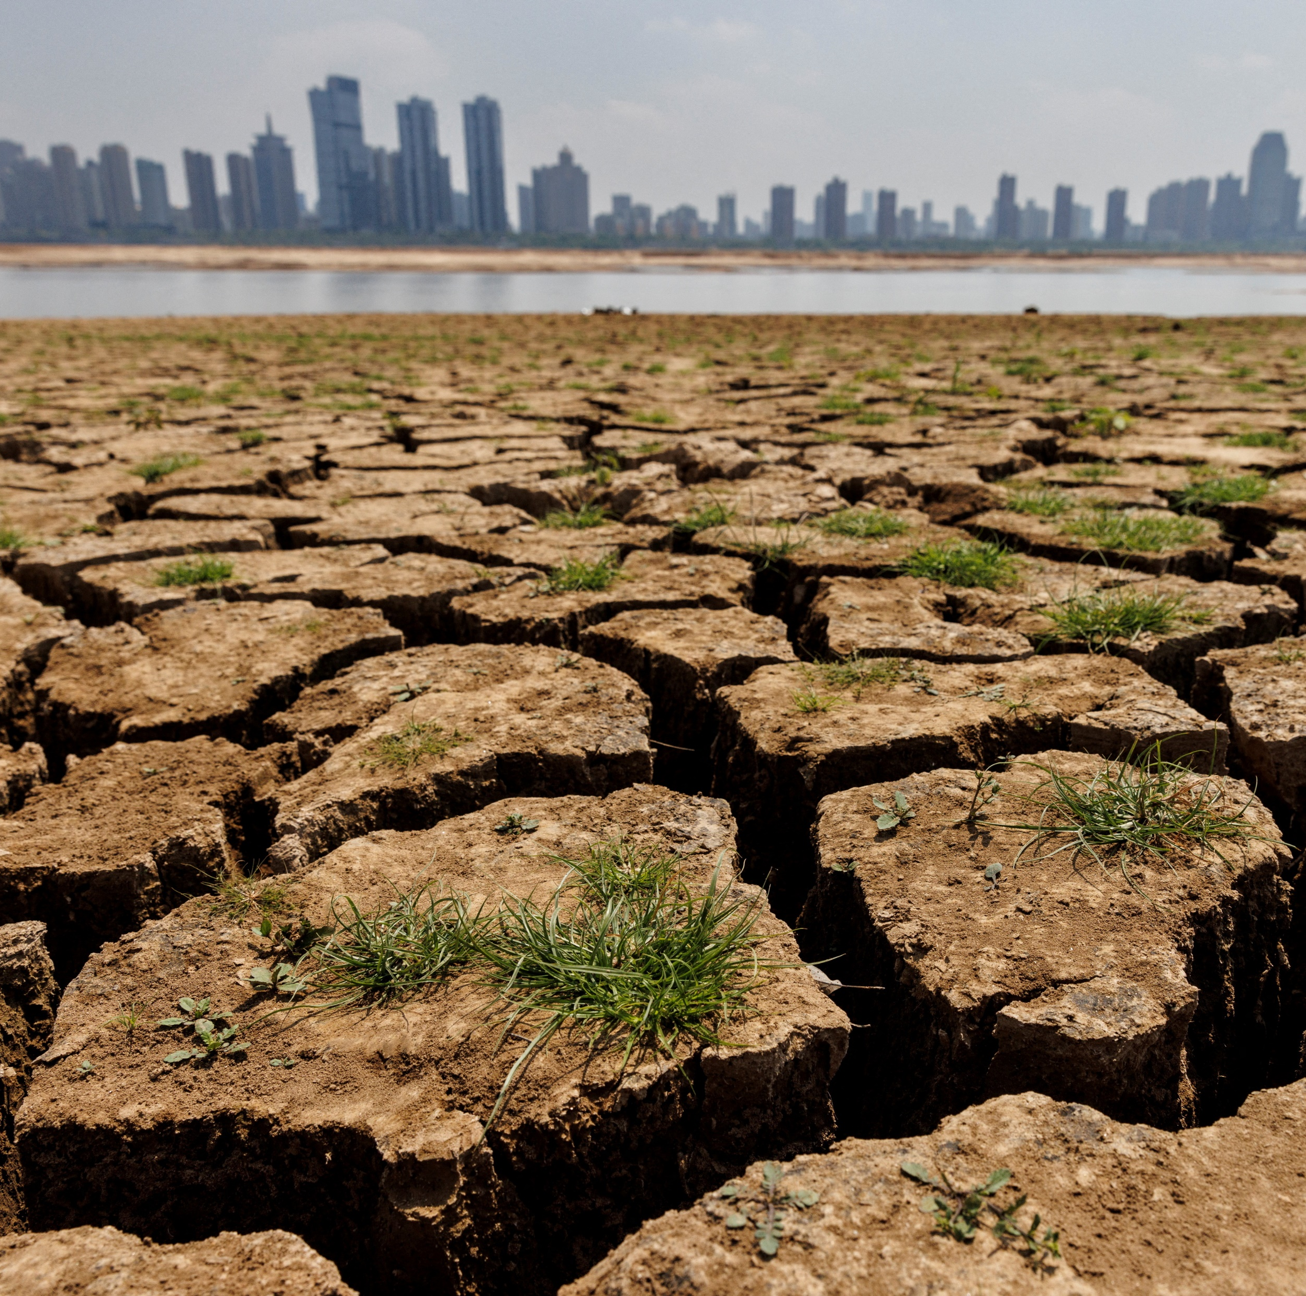
Vulnerability to climate change (3)
Water scarcity:
By 2050: 685 million people in cities will face decline in freshwater availability by at least 10% due to climate change
Water shortages + poor water quality = health problems
Food scarcity:
Reduction in crop yields (10% by 2050, impacting 2.5 billion people in 1600 cities)
Vulnerability to disruption of critical supplies (London: more than 80% of food imported from outside UK)

Slide 12
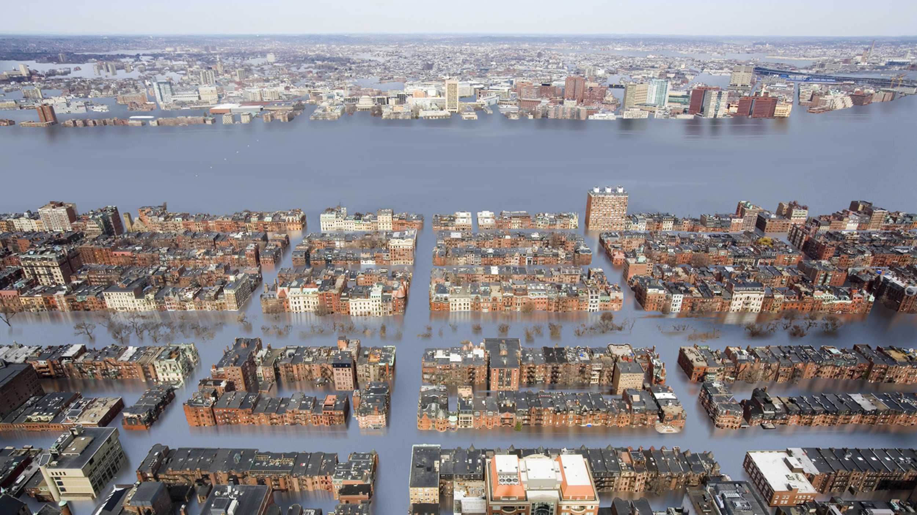
Vulnerability to climate change (4)
Coastal cities
Europe: 70% of largest cities are vulnerable to rising sea levels
15 of world’s 20 megacities are at risk from rising sea levals and coastal surges

Slide 13
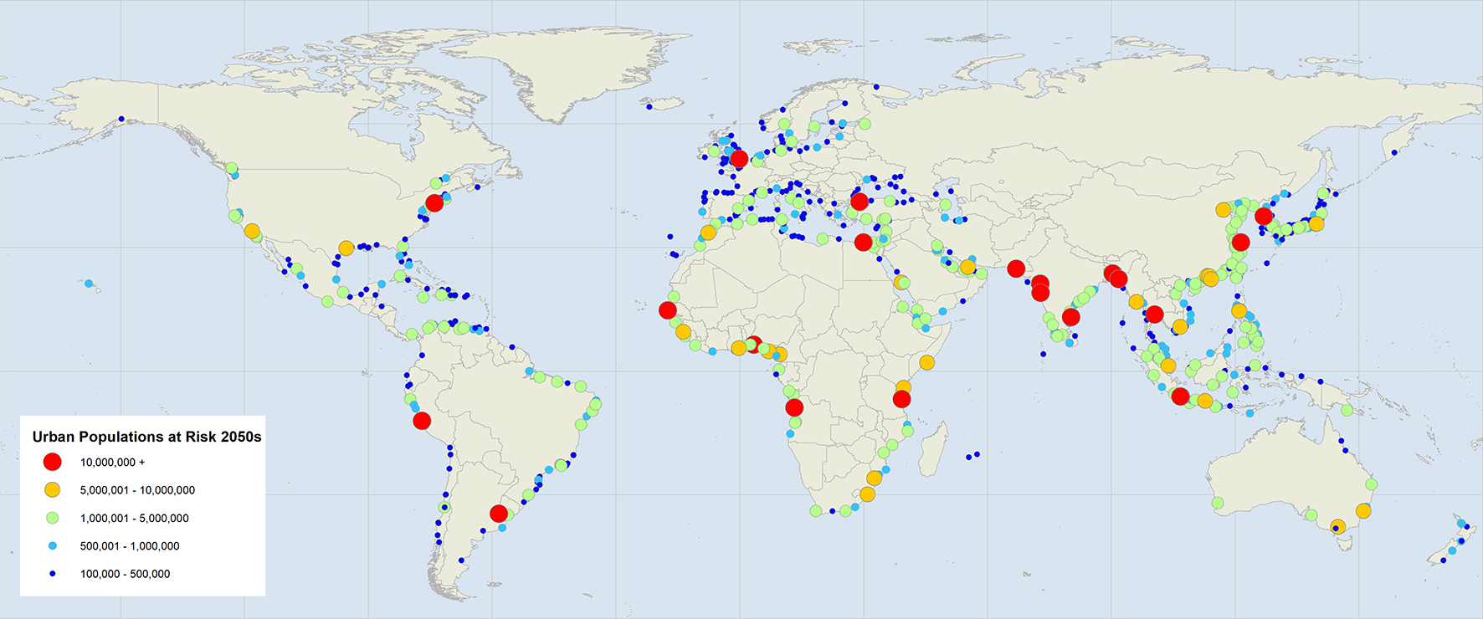
SOURCE: https://www.c40.org/what-we-do/scaling-up-climate-action/adaptation-water/the-future-we-dont-want/sea-level-rise/

Slide 14
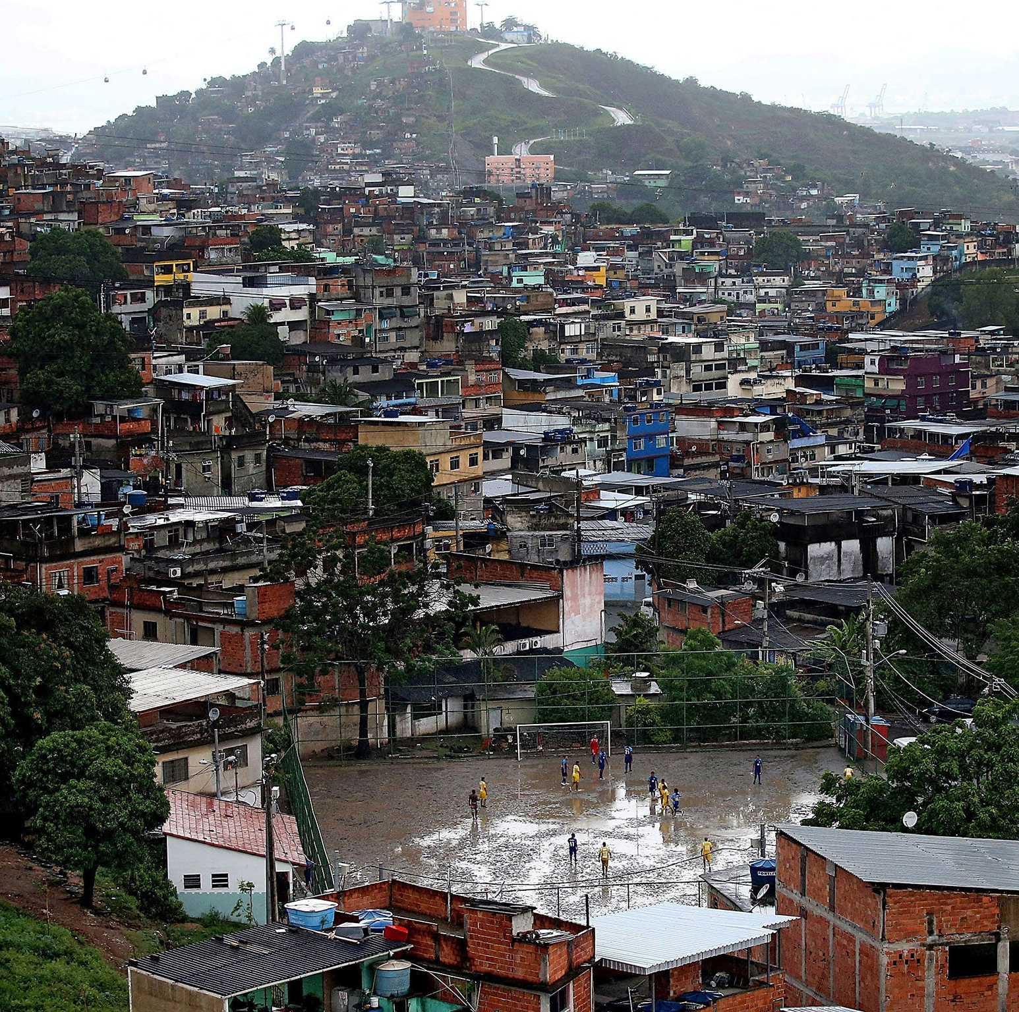
Vulnerability varies:
From one city to the next depending on:
Patterns of urbanization, economic development, physical exposure, urban planning, disaster preparedness…
Geographical local (Coastal vs. Inland, North vs. South…)
Within cities/urban areas:
Inequalities in terms of amount of GHG produced and vulnerability
Gender, race, income and location
Low-income groups = pushed in locations that are more prone to natural hazards (floods, landslides…) + polluting industries and infrastructures
1980s: poor people are 4 times more likely to be exposed to high noise levels

Slide 15
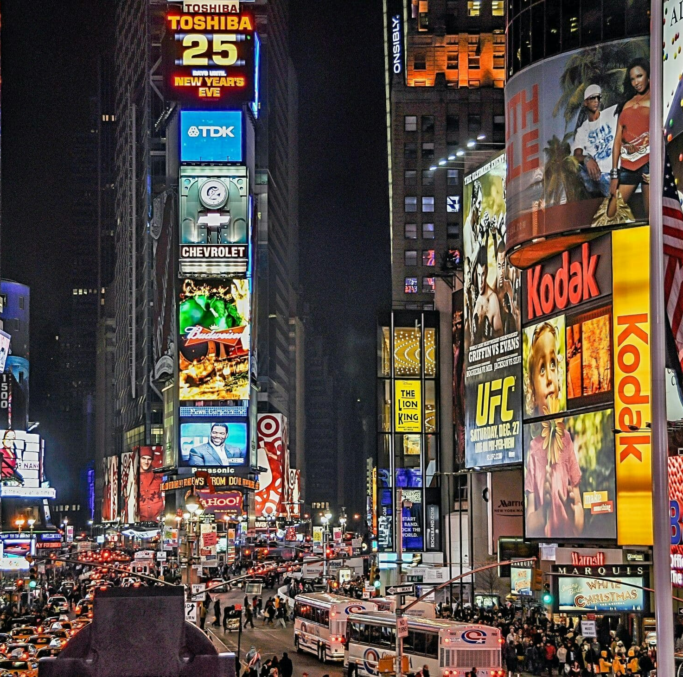
Cities’ responsibility in the crisis
Urban production of climate risk
« Urban world »: concentration of people, industries, energy, consumption…
Approximately 70% of global energy use
“Heating and cooling the urban built environment alone is responsible for an estimated 35 to 45 per cent of current carbon emissions, while urban industries and transportation contribute another 35 to 40 per cent. In a sense, city life is rapidly destroying the ecological niche – Holocene climate stability – which made its evolution into complexity possible” (Davis, 2010).

Slide 16
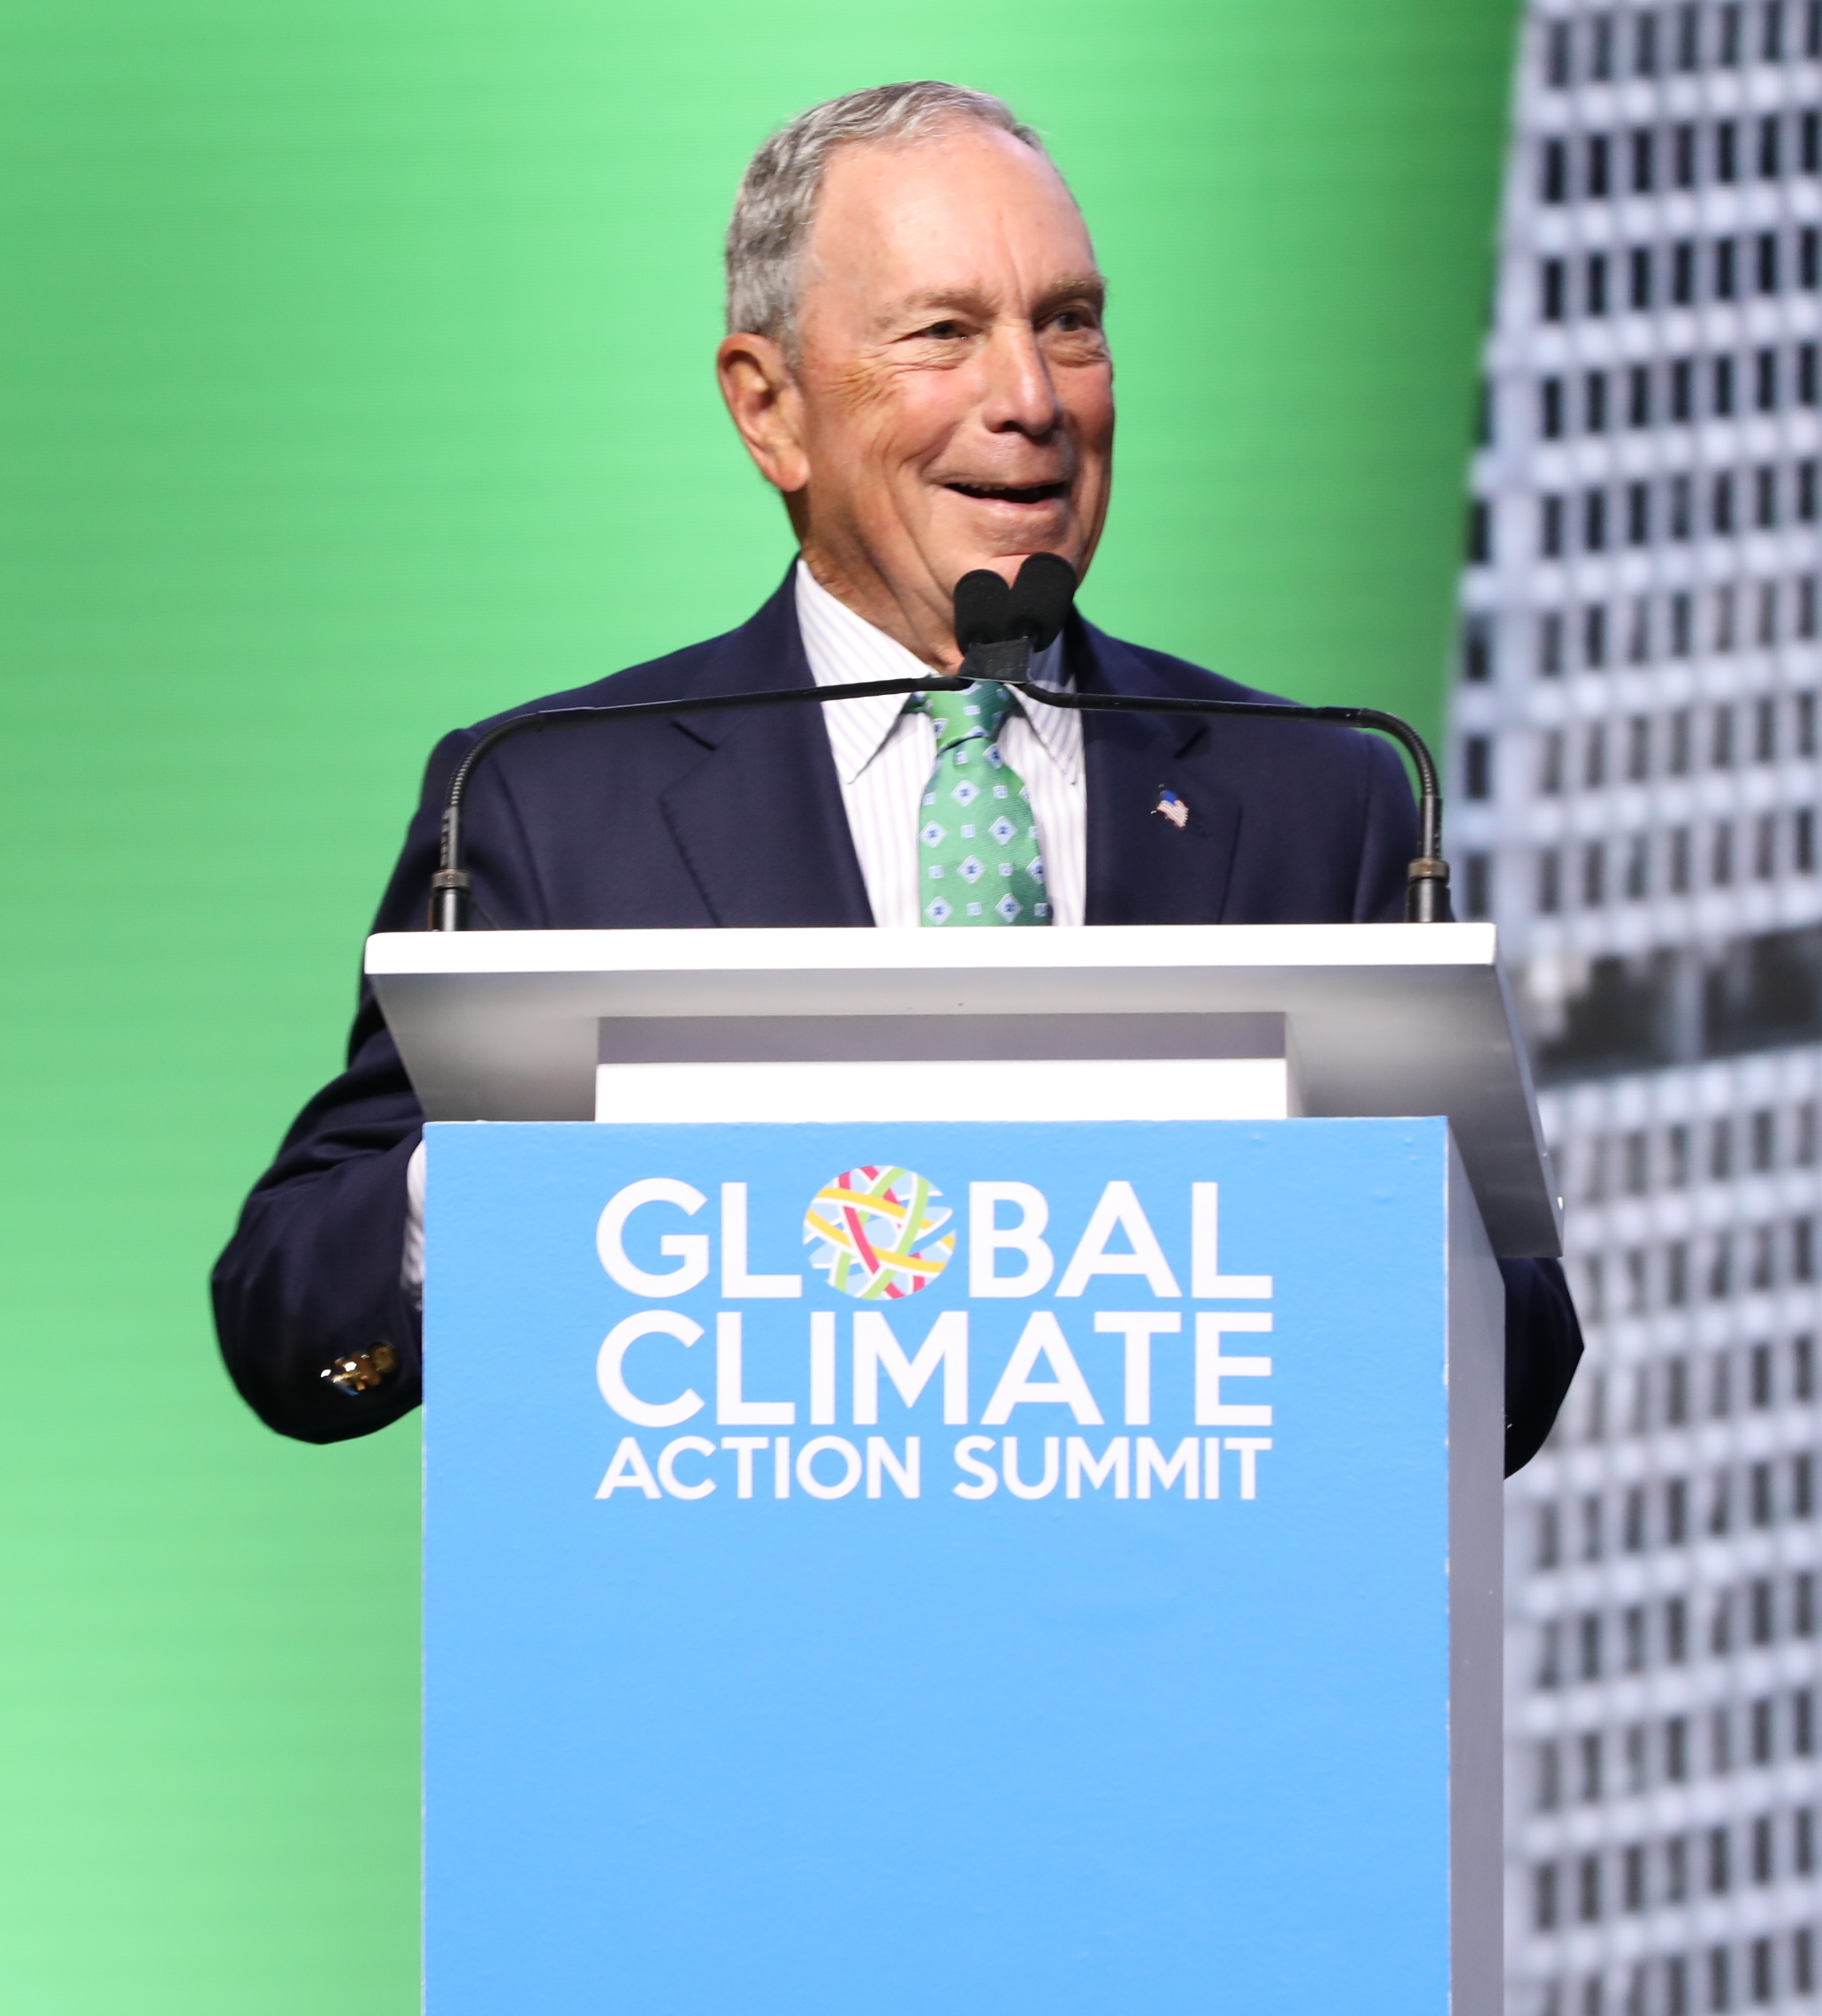
Dominant narrative
Since cities are part of the problem, they are also key part of the solution.
“Fifty percent of the world’s population lives in cities. In a couple of decades, 70 percent of the world’s population will be living in cities. Cities are where the problem is. Cities are where the solution is, where creativity exists to address the challenges and where they have most impact. […] Cities simply are the key to saving the planet” (Michael Bloomberg, 2017).
Michael Bloomberg

Slide 17
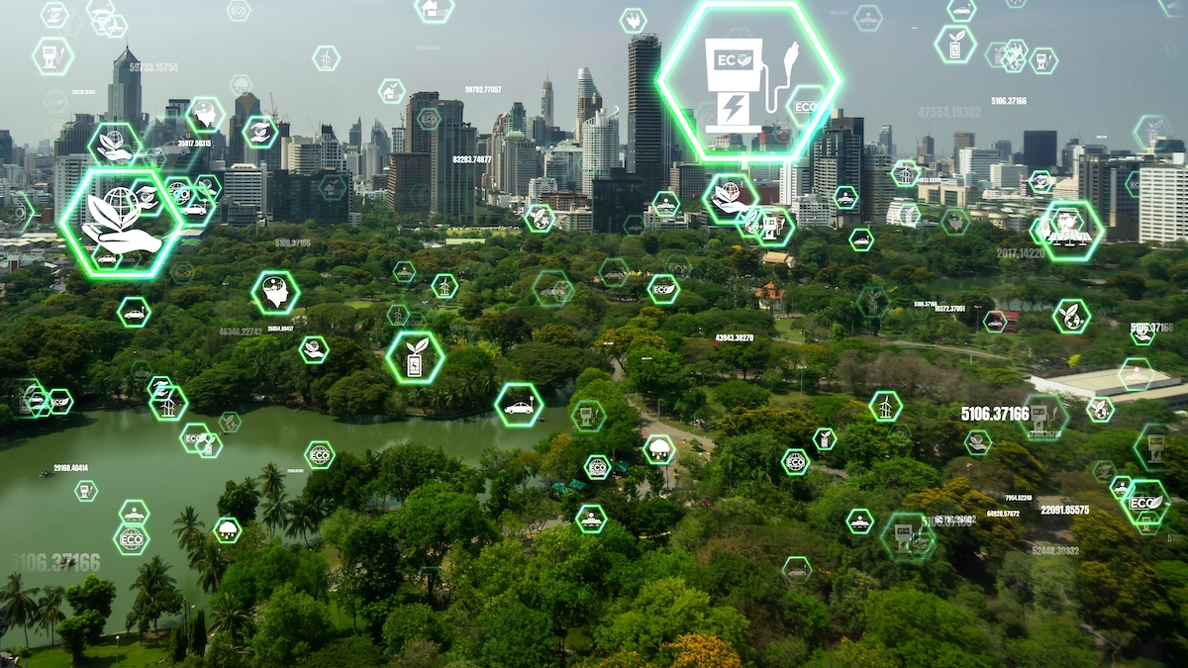
Cities as solution
Mitigation: Cities as more efficient than states
Comparative advantage: economies of scale, concentration of enterprises and innovation, and finance…
Promise of urban density: « hyper-urbanization »
Cities have potential to act as « fulcrums » of sustainability, driving more efficient and environmentally sustainable practices in the city and beyon (Yanarella & Levine, 2011).

Slide 18
Cities in international climate debate (1)
1990: ICLEI (International Council for Local Environmental Initiatives)
1500 cities, towns and regions
2005: C40 (Cities Climate Leadership Group)
Over 80 of biggest cities
600 million people
25% of global economy
2016: Global Covenant of Mayors (with support from C40 and ICLEI)
7100 Cities
8% of world’s population

Slide 19
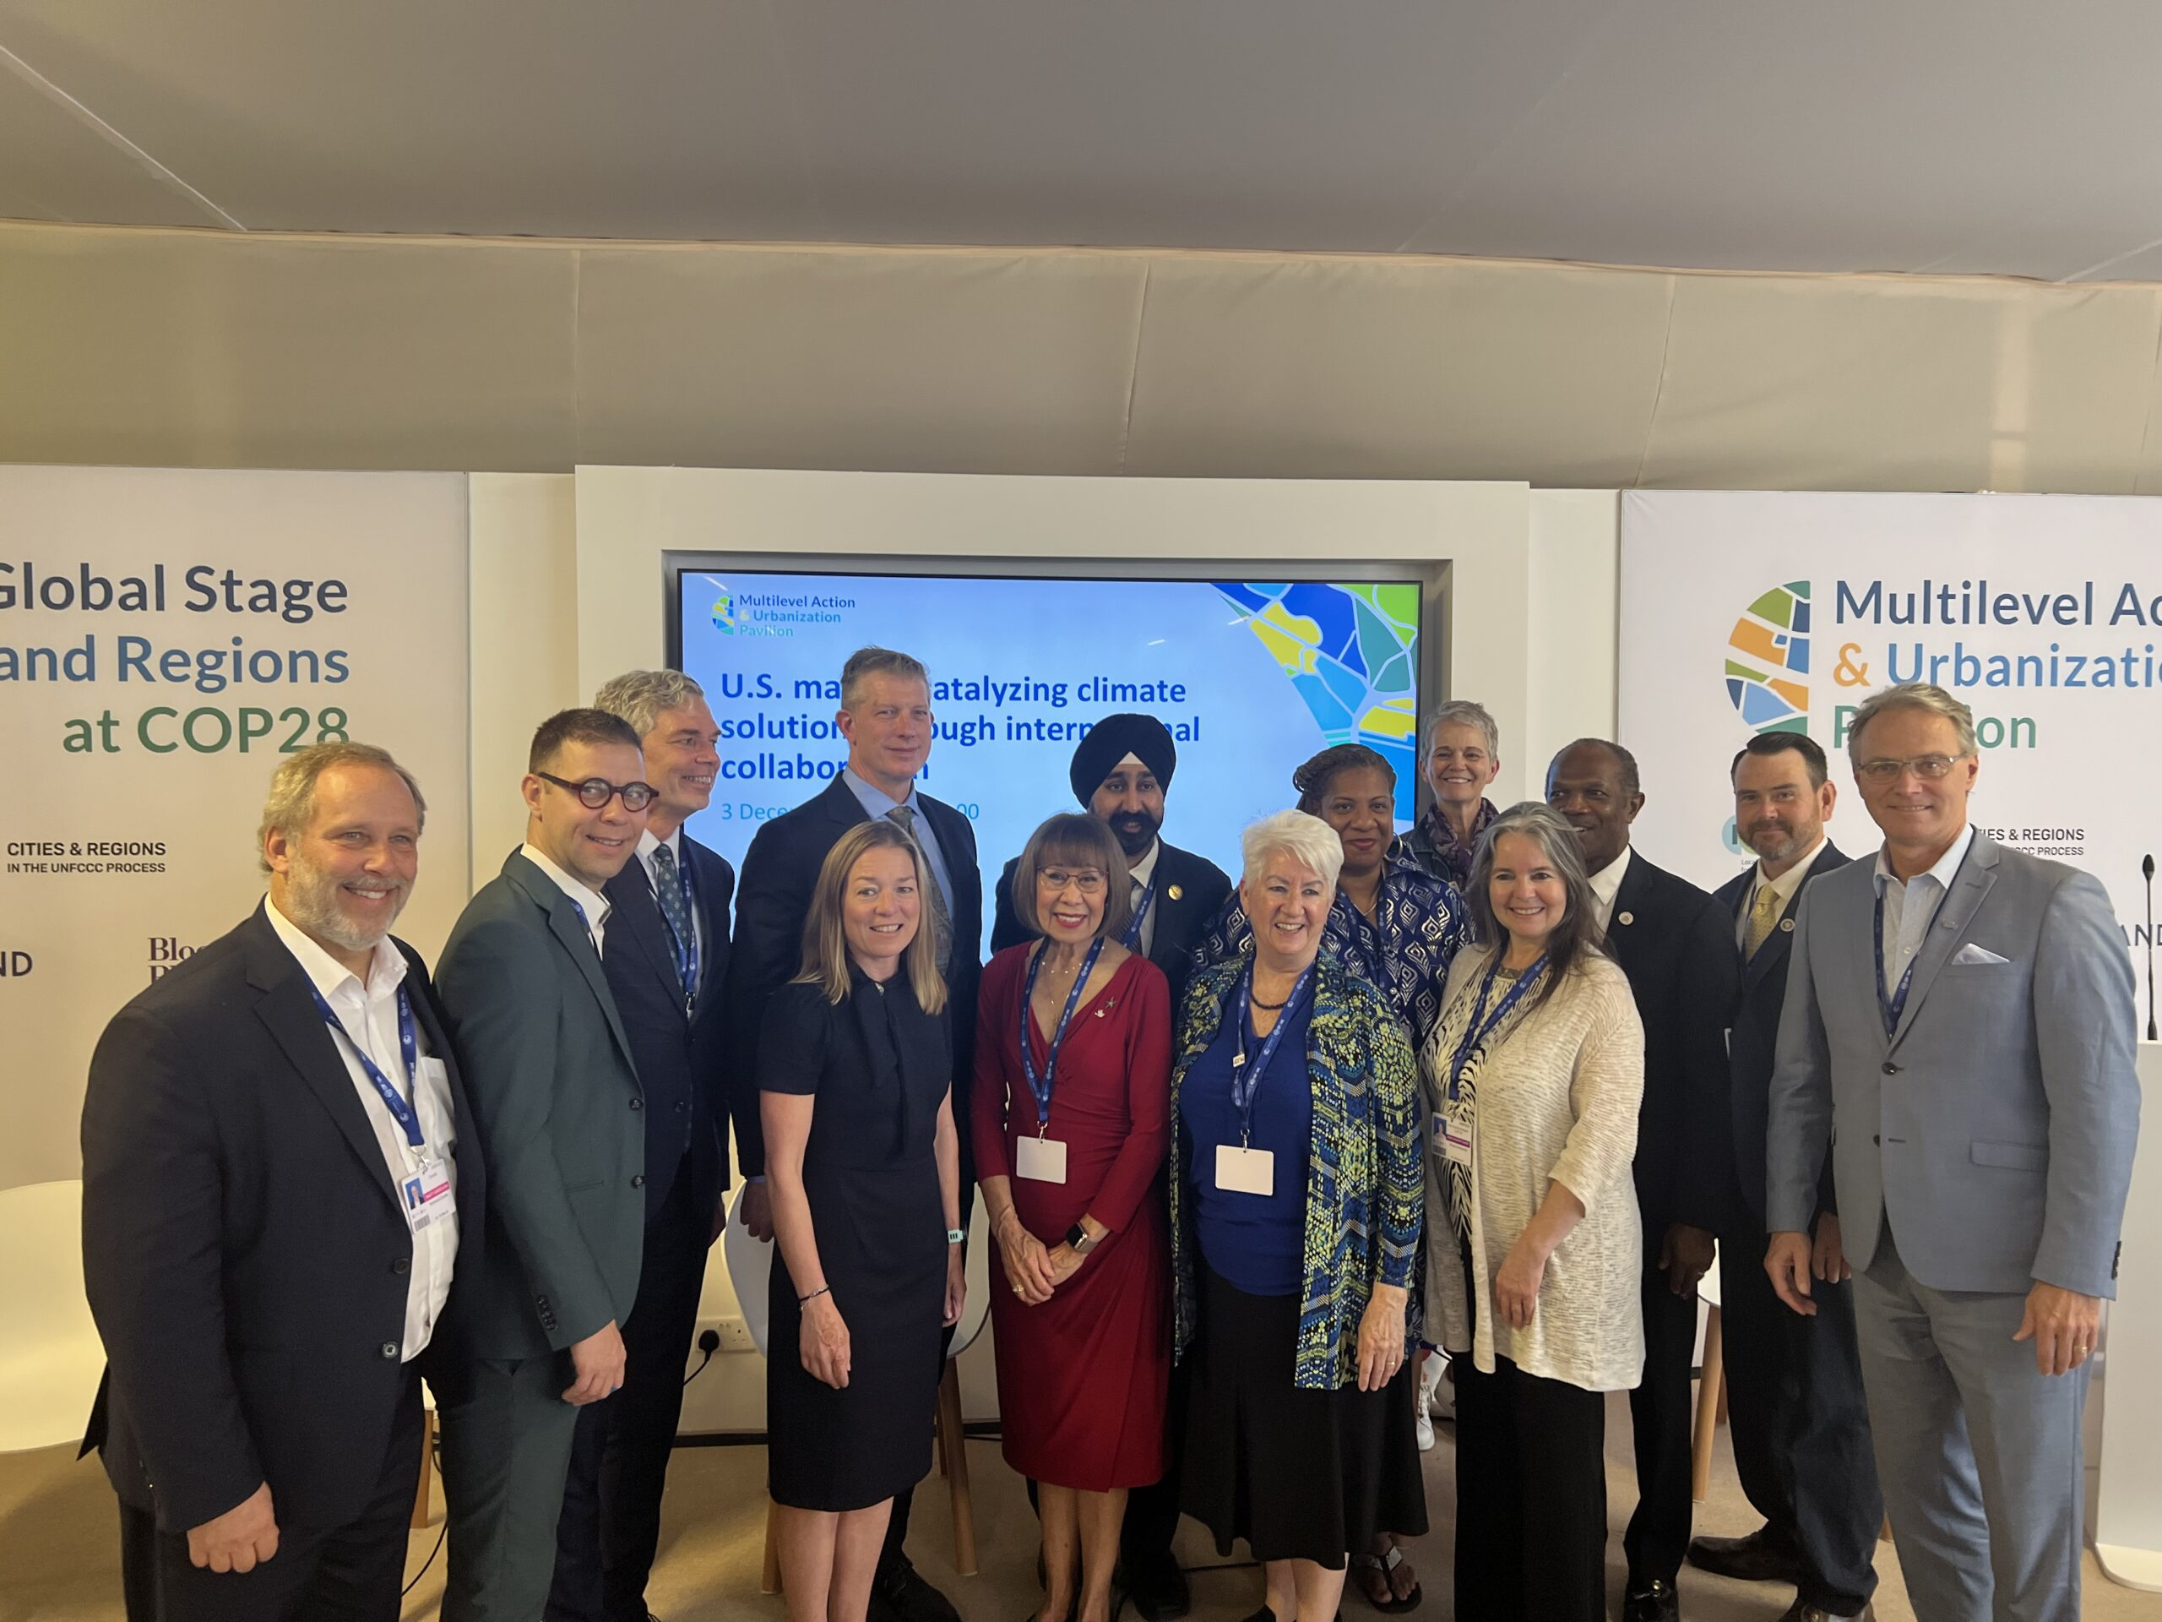
Cities in international climate debate (2)
What do these city networks do?
Policy advocacy
Awareness raising
Paradiplomacy
Dissemination of norms, knowledge, resources, best practices…
Link to broader evolution of international climate debate

Slide 20
C40 Cities – Early years
October 2005: Representatives of 18 large cities meet in London to discuss joining forces to tackle global warming and climate change.
Large Cities Climate Leadership Group (LCCLG)
August 2006: Bill Clinton and Ken Livingston announce partnership between LCCLG and Clinton Climate Initiative
Reduce carbon emissions
Increase energy efficiency in large cities
May 2007: C40 Cities Large Cities Climate Summit in NYC

Slide 21
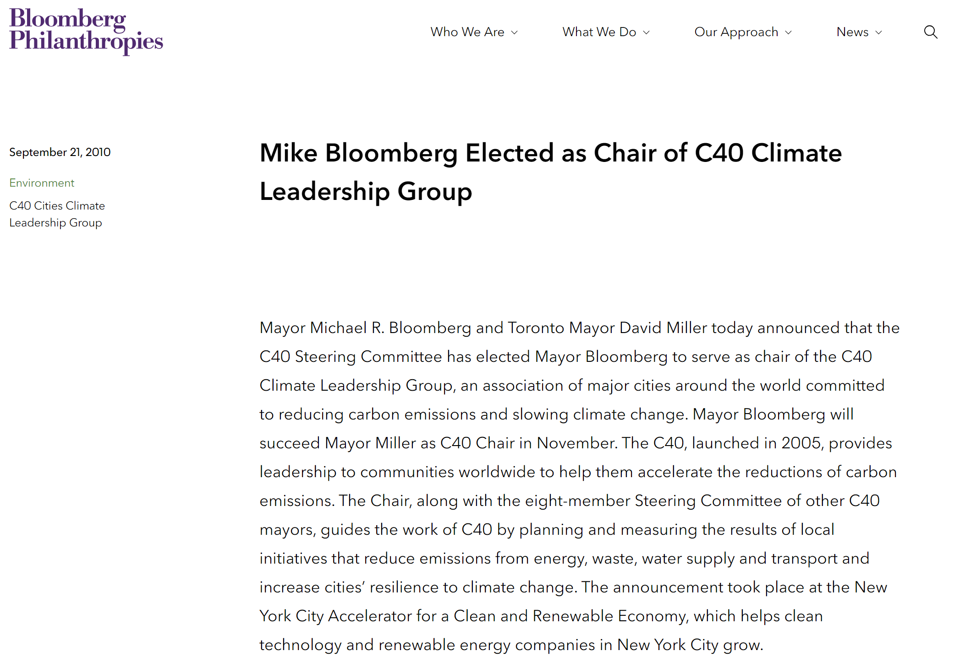

Slide 22
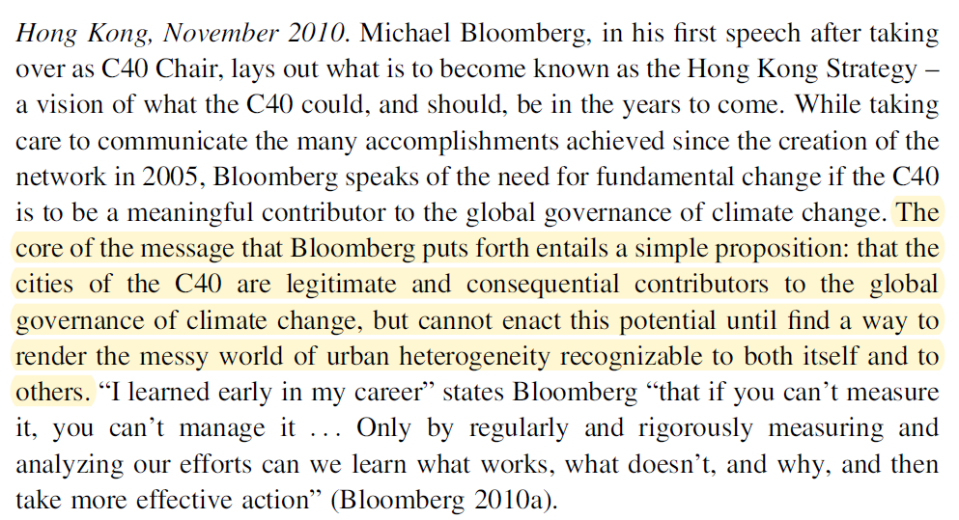
Gordon DJ. Cities on the World Stage: The Politics of Global Urban Climate Governance. Cambridge University Press; 2020 (p.139).
Notes:
Turns C40 into exclusive club. Conditions to enter.

Slide 23
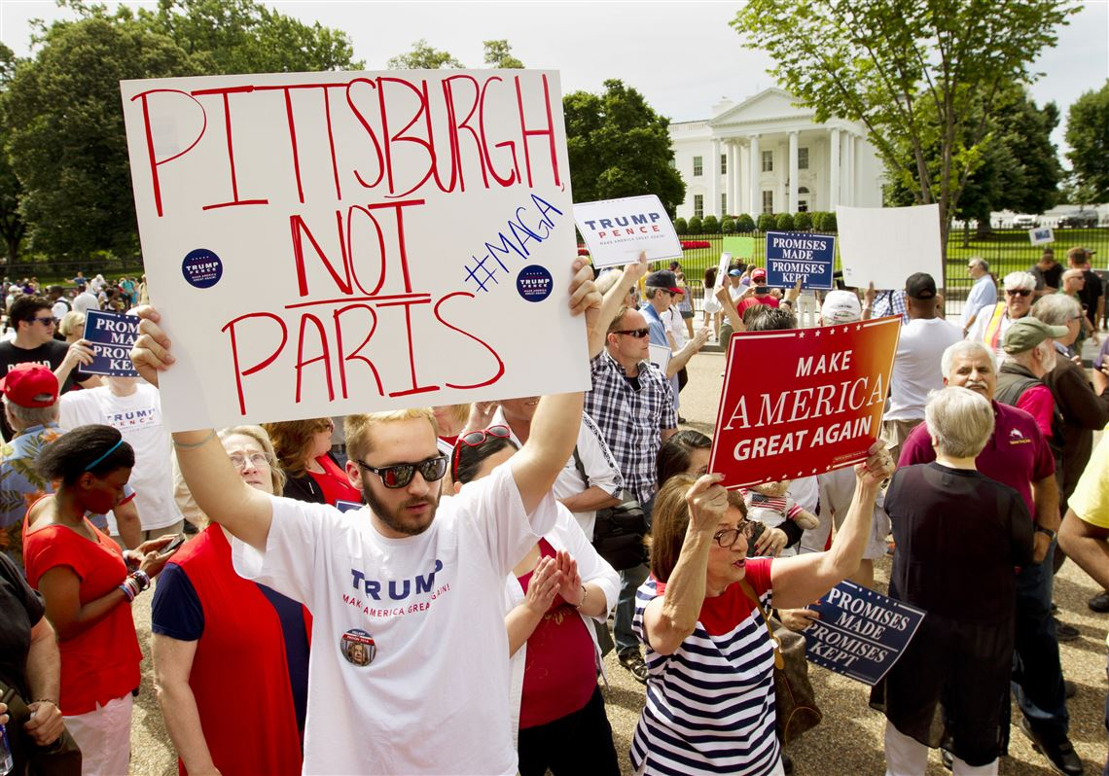
Link to evolution of international climate debate
Drivers & beneficiaries of change
Paris Climate Agreement (2015)
Bottom-up actors (not just States)
Article 118: Agreement “welcomes the efforts of non-Party stakeholders (including cities) to scale up their climate actions, and encourages the registration of those actions in the Non-State Actor Zone for Climate Action
Post-Paris: Trump election and exit from Paris Agreement
Further legitimizes non-State actors (including cities)

Slide 24
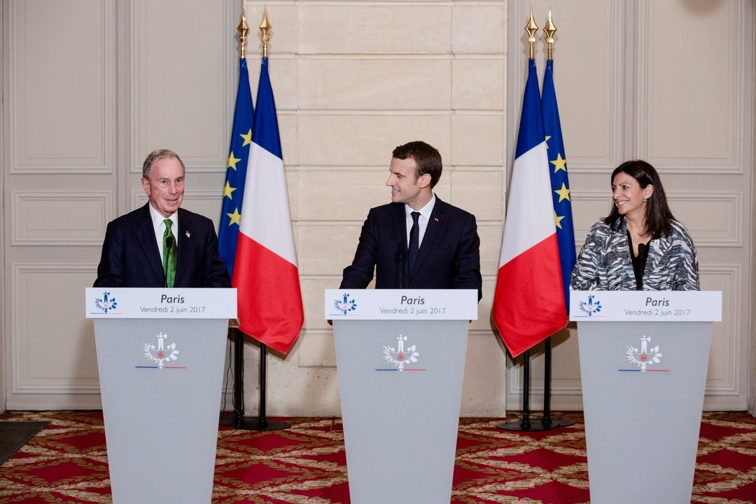
« Governments talk. Cities walk. »
Michael Bloomberg (2nd June 2017):
“The fact of the matter is: Americans don’t need Washington to meet our Paris commitment, and Americans are not going to let Washington stand in the way of fulfilling it. That’s the message mayors, governors, and business leaders all across the U.S. have been sending.”
“So today, we want the world to know: The U.S. will meet our Paris commitment, and, through a partnership among American cities, states, and businesses, we will seek to remain part of the Paris Agreement process. The American government may have pulled out of the Agreement, but the American people remain committed to it – and we will meet our targets.”

Slide 25
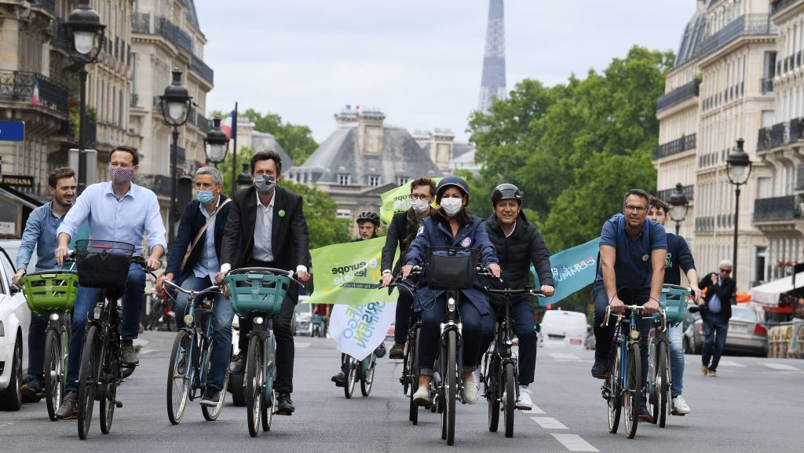
Why cities?
Arguments put forward:
Idea that city engagement in global climate politics reflects the inability of national governments to fulfil their responsibilities under Kyoto and Paris.
Cities bear responsibility.
Cities are able to “move more nimbly than national governments” (Spector 2015).
Cities are more familiar with local needs, issues, complexities and interests.
Uniquely placed to understand and address challenge of reducing emissions at urban scale.

Slide 26
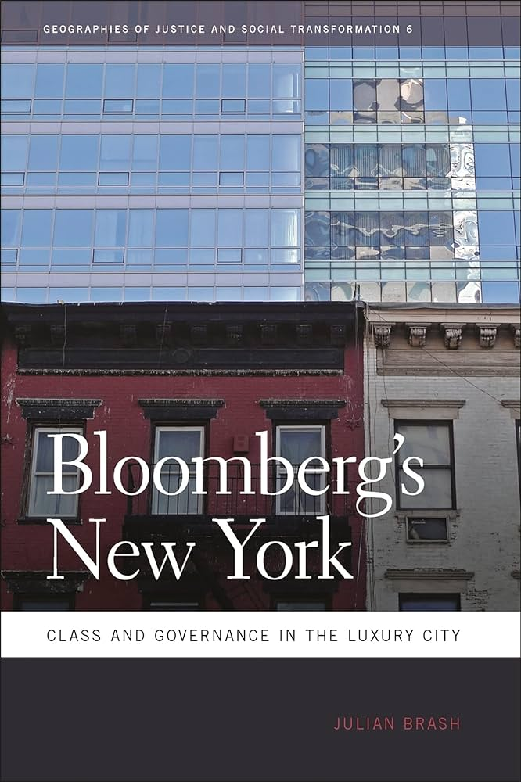
A particular approach to decarbonization & green urban development.
Bottom-up approach
“(Green) luxury city”
Global city “as a place of competition, elite sociality, cosmopolitanism, and luxury, populated by ambitious, creative, hardworking, and intelligent innovators” Julian Brash, Bloomberg’s New York (2011).
Professional managerial class (PMC)
City as luxury product: « Idea that, at least for the target market of high-valued-added companies in the media, finance, and business services sectors, the value inherent in a city location outweighed its high cost” (Brash, https://brooklynrail.org/2011/03/local/the-luxury-city, 2011).
Developing climate policies to make cities more attractive.
Competition between cities.

Slide 27
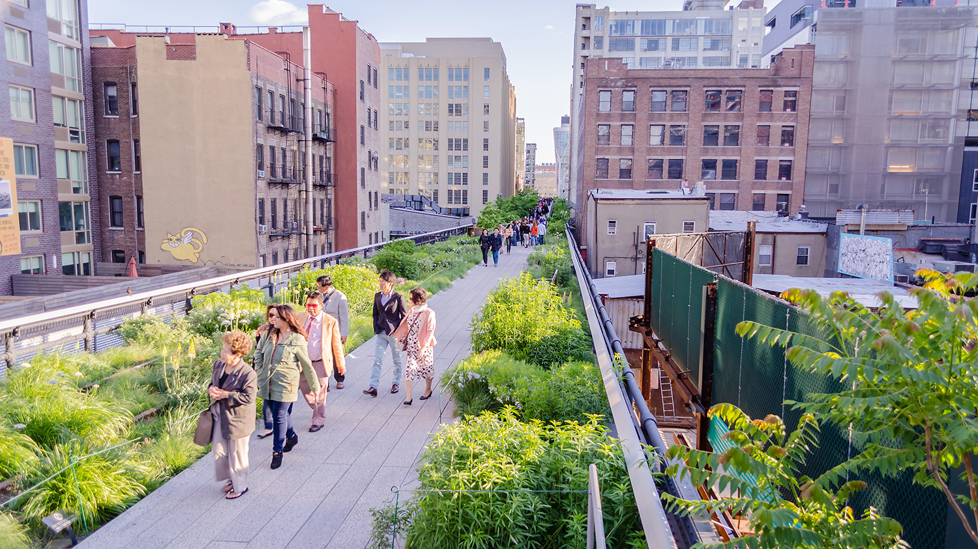
A particular approach to decarbonization & green urban development.
Rise of green neoliberal cities.
Focus on certain dimensions:
Density: higher density = lower carbon footprint
Factoring in certain emissions (relating to housing/buildings) and not others (consumer habits)
Focus on certain policies and neighborhoods:
Transport (N.B. Cars)
Buildings
Limited attention to social dimensions.

Slide 28
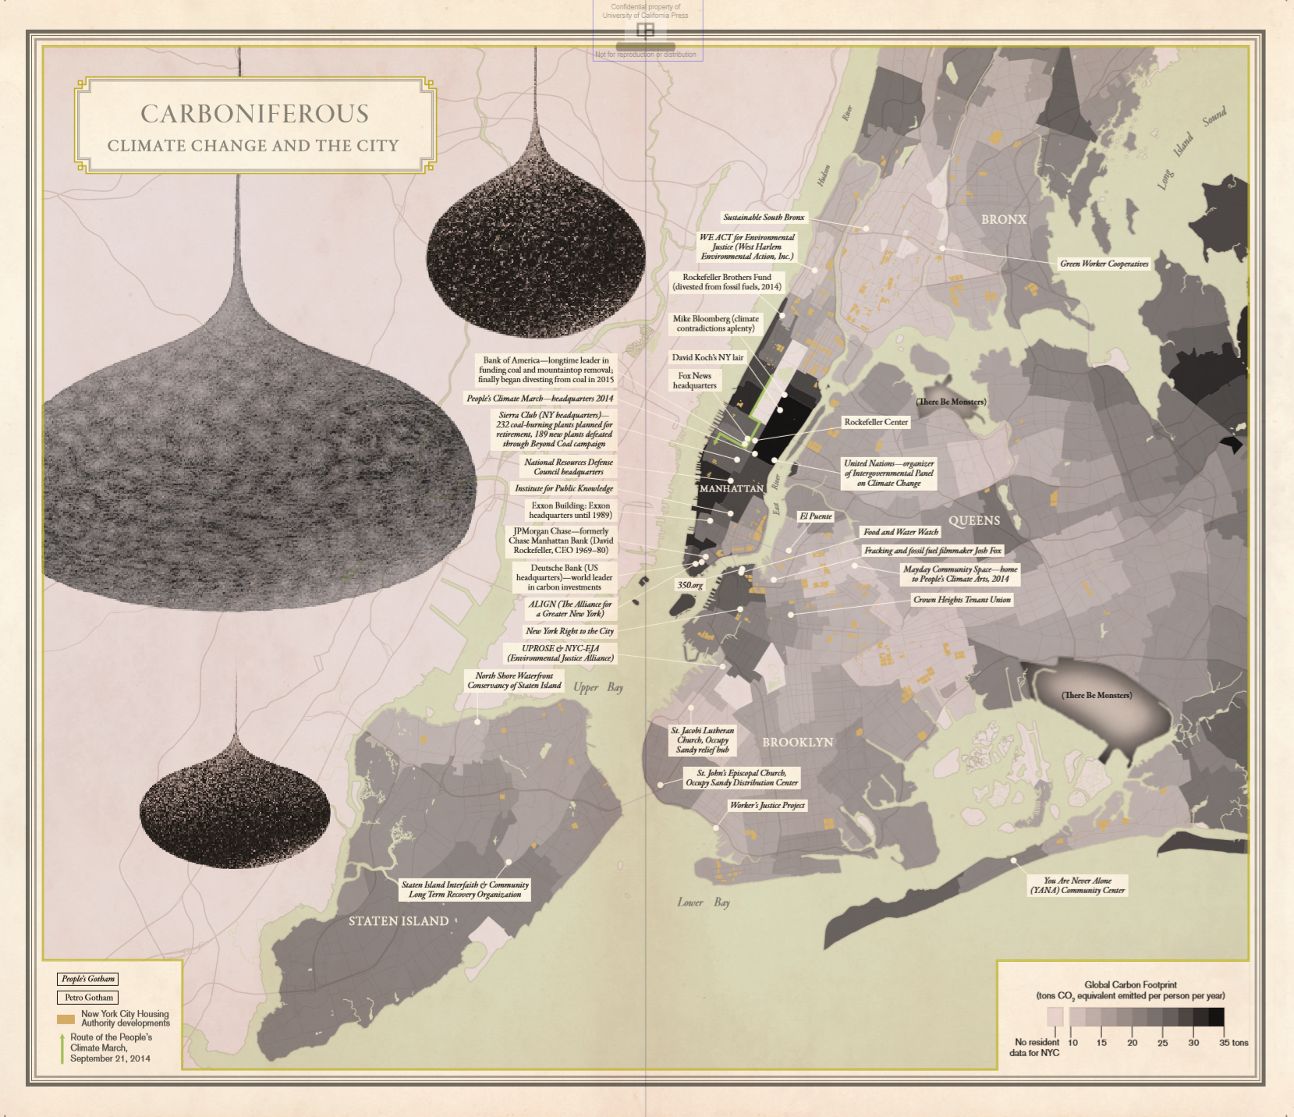
Aldana-Cohen (2016)

