Slide 1
GP tutors – Inspiring the next generation”
Implementing the Wass report

Slide 3
Thank you

Slide 4
Co-ordinated many inspiring and influential events.
Very enthusiastic and caring for students.
Great GP has always given a 100%! A great inspiration

Slide 5
Innovation & development of primary care education
Encouraging new graduates to choose GP as career
Ensure all graduates:
Are excellent doctors
Have deep & respectful understanding of general practice
Notes:
Not merely an instrumental intention -> GP career ...probalby lacks an evidence base (US data – different albeit converging - context)
Multi-morbity & uncertainty
Excellent physicians – means excellent generalist - type of integrative , problem based, complex problems solving & person-centred can be best learned – in the current health system in GP and/ or from GP
In the golden years – when there was considerable untapped resource s
takne for granted .......focus was those

Slide 6
A complex system
MBBS
(total 1500 over 5 years)
Physicians' Associates (total 22 students year 1 )
On the horizon
C18 - Barts revised curriculum
Increase interprofessional learning
MLA – medical licensing exam implemented fully in 2022
TEF – teaching excellence framework

Slide 7
Implementation - wider landscape
STP
Variability in care quality
Post SIFT
payments
GMC & MLA
Care Integration
Health-social
PHC + Hosp
Challenges
? New school on patch (Anglia Ruskin)
New service configuration
New models of primary care
Physical & social environment
Diversity, poverty, destitution
Notes:
with 13 of its 19 wards being within the least prosperous 3% of wards in England and Wales. I can’t go into detial but jsut want to flag up my awereness ofnthe wider landscape

Slide 8
Projections
Primary Care Provision Profiles: 2021
2016 Profile
2021 Profile
NON GP CLINICAL
ACTIVITY
45%
NON GP CLINICAL
ACTIVITY
40%
Total amount of activity
GP ACTIVITY
60%
GP ACTIVITY
55%

Slide 9
Notes:
Timely
Salient

Slide 10
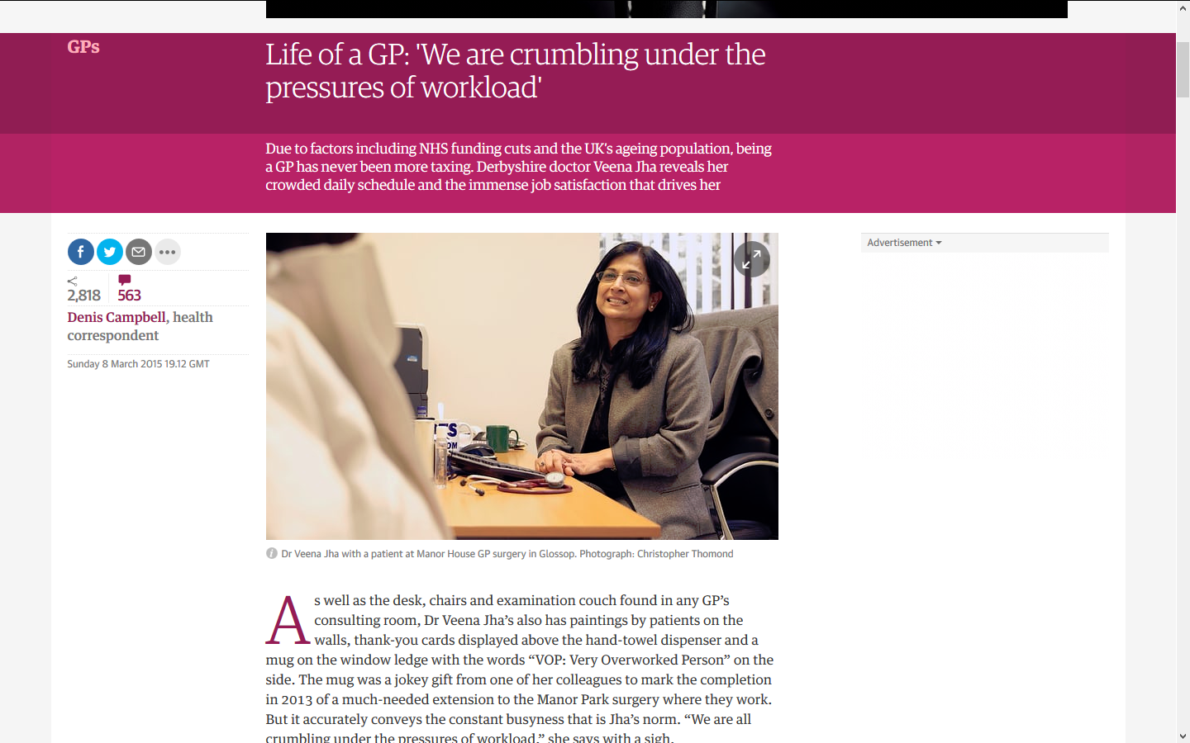
In the headlines Slump in GPs "disastrous"
Efforts to recruit more GPs are not bearing fruit
Numbers continue to decline.
“These figures clearly demonstrate that the crisis in general practice is getting worse, not better.”
26/01/2017

Slide 11
GP workload has grown : volume & complexity.
15 per cent overall increase in contacts
a 13 per cent increase in face-to-face contacts
63 per cent increase in telephone contacts
Retirement
Burnout
Work-life balance

Slide 12
Wass Report - 8 sections
1: Goals : to explore factors influencing general practice as a career choice.
2: Serious tensions at the primary – secondary care interface
3: Student experience before medical school entry
4: Influence of the formal curriculum
5: Influence of the informal curriculum
6: Influence of the hidden curriculum
7: External influences: the RCGP and SAPC
8: Student expectations on graduation

Slide 13
Section 4: the influence of the formal curriculum
Recommendation 5:
Revise curricula to reflect the patient journey & prepared for future health and care delivery.
Lead Responsibility: GMC review its Outcomes for Graduates in one year
Recommendation 6:
Students should recognise breadth and complexity of GP as intellectual challenge.
Lead Responsibility: Medical Schools
Supported by: GMC RCGP SAPC
Recommendation 7:
General practice should be recognised as a specialty
Lead Responsibility: GMC
Supported by: BMA RCGP

Slide 14
Section 5: the influence of the informal curriculum
Recommendation 8:
An increase in UG general practice placements must address improved quality, content, timing and variety.
Lead Responsibility: Medical Schools
Recommendation 9:
Positive and enthusiastic GP role models identified and made visible across all medical schools. Including near peers in training.
Lead Responsibility: Medical Schools

Slide 15
Section 6: the influence of the hidden curriculum
Recommendation 11:
Tackle undermining of general practice across medical schools (including by GPs )
(1) incorporating ANTI-“undermining” into Faculty development
(2) teaching students about the hidden curriculum
(3) developing student self-assertiveness to question denigration (BASHING)
(4) improved feedback mechanisms to enable students to report safely on any serious undermining whilst on placement
(5) create a professional positive culture of respect.
Lead Responsibility: Medical Schools
Supported by: All Medical Royal Colleges AoMRC GMC HEE MSC RCGP

Slide 16
Wass Recommendation 6 & 11:
Tackle undermining of GPs
Highlight intellectual challenge

Slide 17
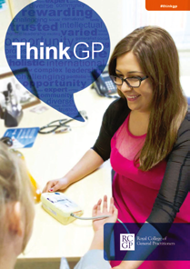
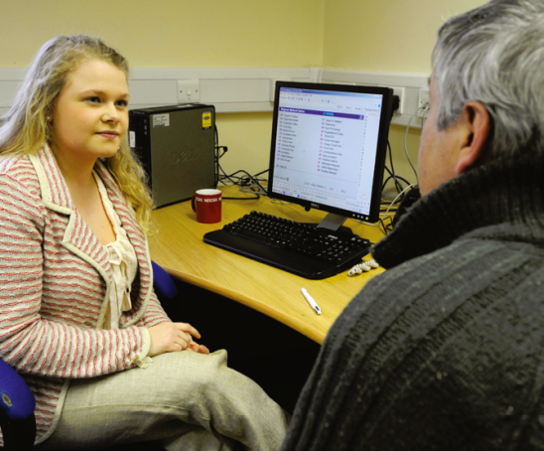
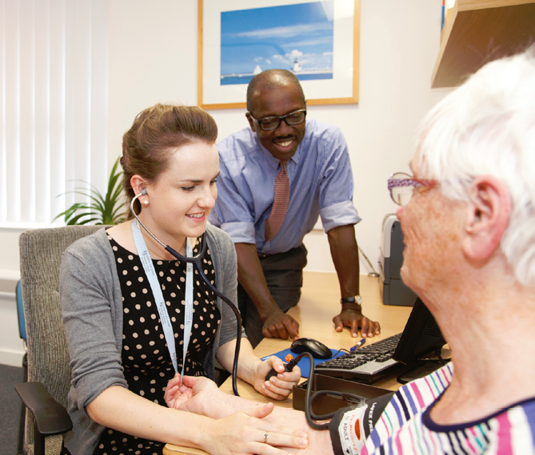
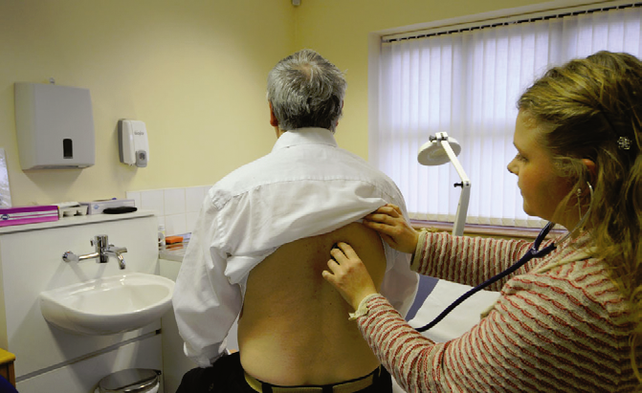
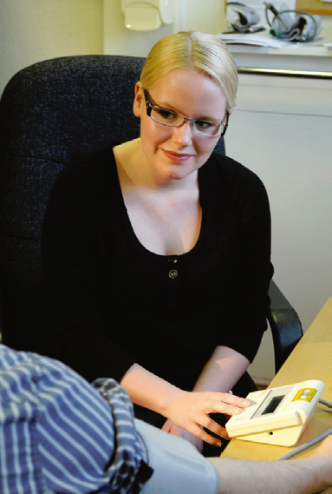
Intellectually under-stimulating
All images: Wass Report (By choice-not by chance , 2016)
Notes:
Com skiolls , coomunication , sclin skills - be careful how we frame our tasks – the subliminal messages - our stock in trade is NOT taking blood pressures all day – how do we ensure we do not represent our immense and often beautifully rewarding endeavours as intellutual limited - So we lack toys and technology

Slide 18
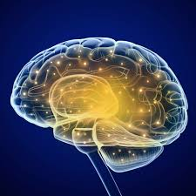
Notes:
Greatest kit is in between our ears out and proud

Slide 19
Unpack and share
Project pride, enthusiasm
Positive morale in general practice
Promoting scholarship
highlight intellectual basis
opportunity for innovation (students and GP tutors )

Slide 20
GP tutors – Inspiring the next generation”
Implementing the Wass report

Slide 21
What works ??
Placements
Curriculum choices & Expectations
Patients
Feedback
Rewards

Slide 22
Placements Evidence base
Volume of exposure – the more the better
Type of exposure – longer blocks better
Focus of exposure - “authentic” versus “specialoid”
Exposure of undergraduates to authentic GP teaching and subsequent entry to GP training: a quantitative study of UK medical schools
Hugh Alberti, Hannah Randles, Alex Harding and Robert McKinley
Influences on Students' Career Decisions Concerning General Practice: A Focus Group Study
S Nicholson et al. Br J Gen Pract 66 (651

Slide 23
Longer Placements in general practice – “authentic experience ”
Ursus Wehrli “Tidying Up Art”
Notes:
Integrated approaches to interventions both individual patients and to public health and population challenges
Drivers for integration practical and intellectual .....6 weeks is excellent – what about over 3 year? In a longitudinal POST hospital
GBD - Multimorbitidity & polypharmacy UK and local characteristic

Slide 24
Feedback Creating the virtuous cycle
Tutor feedback to student
Student feedback on tutors
questionnaires
alignment
Increase response rate
Change oriented

Slide 25
New pedagogic choices
Area 1: Curriculum innovation
Competency-based
Clarity for:
Learners
Assessments
Regulators
Measurable outcomes
Technical , procedural , reflective
Defines professional boundaries
Transformative
Promote critical reflection
Learning beyond facts & skills
Develop professional role
Advocacy
Agency
Promote epistemic & social justice
Professional working across boundaries

Slide 26
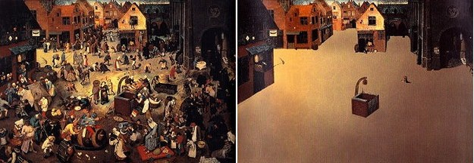
Population perspective & health inequalities
On-going inter-sectoral project
https://moodmoods.files.wordpress.com/2012/11/a-unique-art-of-restore-order-by-ursus-wehrli-023.jpeg
Notes:
Not just learning in “health system spaces” build on year 1 Medicine In Society community profile
I bring expertise in embedded SDH & health systems – Take for example child development and obesity – greatest health gain requires understanding impact of politics, policy, and health economics /health systems interventions : intersectoral advocacy projects focussing on transport, built environment , education, poverty

Slide 27
Clinical education – Apprenticeship / service learning
the system by which a person learning a craft is instructed by a master for a set time under set conditions
Learning by doing – REAL WORK !
Notes:
Proximity – look at the master’s face – generally active engagement
Sushi chef is an interesting exceptions and raising questions about what can be learned thru observation alone – they a re not allowed dot touch the tools for 3 months
Questions about merits of :
Observing
Performing observed
Performing alone
But note = associate with craft NOT profession – a bigger question – what are we doing – what make’s it
Profession
2. a university / academic pursuit

Slide 28
Patients

Slide 29
Deflected Gaze – observation
Teacher
Patient
Student

Slide 30
Patient-as-teachers
Teacher
Patient
Student

Slide 31
Cover: Human Traces, Sebastian Faulks
Patient as text

Slide 32
From patient as text to .....
talking book?

Slide 33
Rewards & Recognition

Slide 34
Wass Recommendation 6 & 11:
Tackle undermining of GPs
Highlight intellectual challenge

Slide 35
we do inspire the next generation !
They were both inspiring and made GP very interesting and enjoyable!
Probably the first placement that actually made me consider the potential of becoming a GP and not a hospital based doctor.
Had the best time being taught by these individuals.

Slide 36
Pessimism of the mind
Optimism of the soul
Be the best we can
Inspire the next generation

Slide 37
Gift
“Giving is an offering … it’s not just a donation – it’s an offering, and what you offer then comes back to you transformed…”
The Gift, Lewis Hyde
Notes:
Take the pandora’s box, accept the issues and find a way of progressing – embracing small steps and producing a report and a way forward
Lots more work to do

