Slide 1
DS2 Presentation
Week 12, 13th April 2020
5 small groups: 2 / 3
Choose a thinker, writer, or film-maker that we have studied and present on a theme that has interested you in relation to queer theory
Produce 6 – 8 PowerPoint slides, underpinned by key textual quotations and at least one theorist
Provide a bibliography at the end of the presentation

Slide 2
Abdellah Taïa (1973 – )
Queer diaspora and transnational French homosexuality

Slide 3
“I am for necessary battles. The war I wage with and against Morocco is useful”
Abdellah Taïa, Homosexuality explained to my mother (July 2012)

Slide 4
Today’s lecture
Abdellah Taïa biography
A transnational queer context
Tel Quel article 2006: ‘A homosexual, against all odds’
Taïa’s queer writing – engaged literature
Abdellah Taïa’s speech at the 2015 Olso Freedom Forum.
‘Homosexuality Explained To My Mother’, Abdellah Taïa
Sanctification of Jean Genet: Un Saint Marocain
Introduction to Salvation Army as a bildungsroman / directorial debut
Film analysis Part 1 (first half in Morocco, next week second half in Geneva)

Slide 5
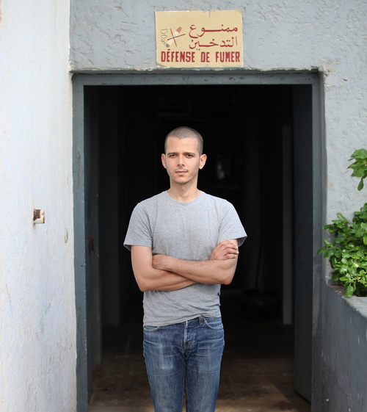
Biography
Born in public library of Rabat in 1973 where his father was the janitor and where his family lived until he was two years old
Grew up in Hay Salam, Salé, Morocco
Studied French literature at the University of Rabat, 1998 completed literary studies in Geneva and then Sorbonne in 2001.
Tel Quel interview 2006: made history in 2006 by coming out in his country, where homosexuality is illegal.
Challenging Enlightenment values: “I am permanently questioning.
Author of six novels, including Salvation Army and An Arab Melancholia, both published by Semiotext(e), and Infidels. His novel Le jour du roi, about the death of Morocco’s King Hassan II, won the 2010 Prix de Flore. He also directed and wrote the screenplay for the 2013 film adaptation of Salvation Army.

Slide 6
« Je ne suis qu’un Arabe. Qui parle bien le français » The French Protectorate in Morocco
In 1907, France invaded two cities in Morocco, Oujda and Casablanca, to establish colonial rule from 1912 – 1956.
This was known as the ‘French Protectorate in Morocco’ and was inspired by France’s conquest of other parts of North Africa: Algeria in 1830 and Tunisia in 1881.
The legacies and traumas of colonisation are still present in the French language that is commonly spoken in Morocco, much to the detriment of an Arabic heritage.
Yet, many contemporary Moroccan writers are tired of being defined by a relation to their colonial French past and have been campaigning for their literature to be recognized as part of the French canon.
Taïa defines himself in relation to and against a different ‘secular’ heritage that gets transmitted to new generations – namely, one of literary and cinematic figures and their respective transgressive acts.

Slide 7
Colonial dominance at play?
Oscar Wilde and André Gide in Biskra, Algeria. The first offering to the second an Arab boy and thus allowing him to experience his first homosexual encounter. This ultra-famous episode you’ve told me I don’t know how many times. In Morocco, blindly following your advice, I did a presentation on the subject at the University of Rabat. I dared to do that. You were proud of me. You spoke of this ‘significant political moment’, and I was proud to make you proud. The sexual emancipation of André Gide: at the time I lived it as though it had been my own. My mythical, literary and sexual identification with him was proof of my own intelligence [...] Later, I realised I had made an inexcusable omission. Me, Emmanuel’s queer Arab lover, I, in Rabat itself, had once again killed the boy who should be the true hero of this story. I should have served him as a voice, a lawyer, a friend, a distant brother. Still totally colonized in my head, I had spoken only about two writers pursuing Orientalist-sexual tourism in Algeria. I had recited what I had learned well.
Abdellah Taïa, Celui qui est digne d’être aimé, (Paris: Seuil, 2017), p.102.

Slide 9
Morocco – heterogenous and transnational
I write, I reveal myself by signing my real name, I reveal you with me, I come out of the shadows, I refuse this sterile Moroccan ideal, I spit, I’m scandalous, I’m the son of Marilyn Monroe, I’m a terrorist and a queer’.
Often cultural critics compare him to queer Moroccan writer, Rachid O. - both reference Genet the author and Genet the archteype when writing themselves into French literary traditions.
A conference organized on this work at the University of El-Jadida in May 2012 drew criticism from Moroccan conservatives who suggested that the ‘miscegenation’ of homosexuality with the pursuit of knowledge on a college campus would contaminate the minds of its students (Mantrach).
Taia provides a local political and poetic voice that imagines new queer temporalities and transfiliations for himself his family and his fellow Moroccans. (Provencher, 2017, 149)

Slide 10
Abdallah Taïa Oslo Freedom Speech
https://www.youtube.com/watch?v=THnQ9JmR_tk&t=108s
Watch from 3 mins 52 – 10 mins
How does Taïa

Slide 11
Jean Paul Sartre – littérature engagée
Post World War II – French existentialists revived the idea of artist’s serious responsibility to society.
Littérature engagée - a person defines himself by consciously engaging in willed action.
No room for self-involvement / Art for art’s sake (Proust, Flaubert, Wilde)

Slide 12
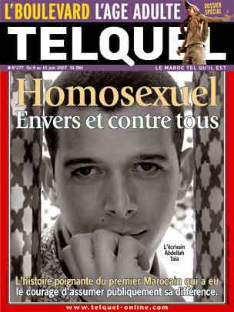
“Homosexuel, envers et contre tous” [Homosexual, against all odds].
“I did my coming out in the Moroccan media in 2006. I felt that the more I was speaking the more it was not heard. I was seen like someone outside society, not belonging to the same Morocco as the rest of Moroccan people,” he says. “And it’s not true: I come from the same world, with the same tastes as them, as my family, as my friends when I was in high school. I had to write this letter to say, again and again, that I am normal. Gay people are normal.”
“Today, I really don’t know if they got the message. If they changed their mind. To be a homosexual is to to accept you will be alone all your life ... I had this revelation when I was 15. I am today 41 and I am still saying and believing in the same thing.”

Slide 13
‘Jean Genet A Moroccan saint’, Nejma, 2011

Slide 14
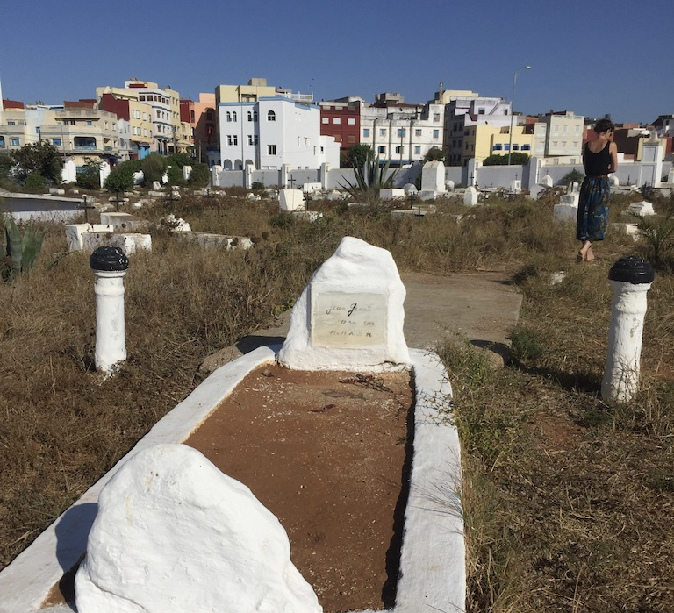
Jean Genet’s Tomb Larache, Morocco (photograph taken on my visit in 2018)

Slide 17
Abdellah Taïa, Preface to ‘Jean Genet un saint marocain’, Nejma, (Tangiers: Librairie des Colonnes, 2011), p.6.
Jean Genet, since the beginning, since he saw Tangiers for the first time in the thirties, is back home. Living. Dead. A spirit. A genie. […] I knew of him, well before reading his books. I knew him well before being impressed by his immense literary talent, his style, his depths. Far before deciding that I would also be his faithful servant, his friend, his tightrope walker, his lover, his poor Moroccan. My mother, M’Barka, knew of him. This woman from the back of beyond, who never learned to read or write, was in communion with him. Someone had spoken to her of this writer. It was she who wanted to bring me to visit his tomb. For good luck. It was she who put me on the path to Jean Genet. I simply followed her advice, and today, in Nejma, alongside other writers and photographers, I am celebrating this good and cruel man with the words of my mother, through her way of reinventing the rituals, overstepping the mark, and the gods.

Slide 18
Edward Said, on late style (2006) pp.55 – 56.
Does his love for the Palestinians nevertheless amount to a kind of overturned or exploded Orientalism? Or is it a sort of reformulated colonialist love of handsomely dark young men? Genet did allow his love for Arabs to be his approach to them, but there is no indication that he aspired to a special position, like some benevolent White Father, when he was with them or wrote about them […] In the context of a dominant Orientalism that commanded, codified, articulated virtually all Western knowledge and experience of the Arab/Islamic world, there is something quietly but heroically subversive about Genet’s extraordinary relationship with the Arabs.
Said, On Late style, 55 – 56.

Slide 19
Desiring Arabs and the entanglement of sexual-racial-national discourse
Fetishization of Arab sexuality (Todd Shepherd, Sex, France, and Arab Men, 1962–1979, 2017) or Mehammed Amadeus Mack, Sexagon Sexagon: Muslims, France, and the Sexualization of National Culture, 2017)
Western orientalism – Edward Said
Said exonerates Genet’s love of Arabs as his reason for entering into political coalition, while Ivan Jablonka argues that because ‘[H]e praised the erotic charge of the revolt and the beauty of the fighters [...] we no longer know if Genet’s support is political or sexual’, ‘Les vérités inavouables de Jean Genet (Paris: Seuil, 2004), p. 18.
‘Rex Wockner – Gay International seeks to stabilize the polymorphousness that confounds gay and straight sexual epistemology.

Slide 20
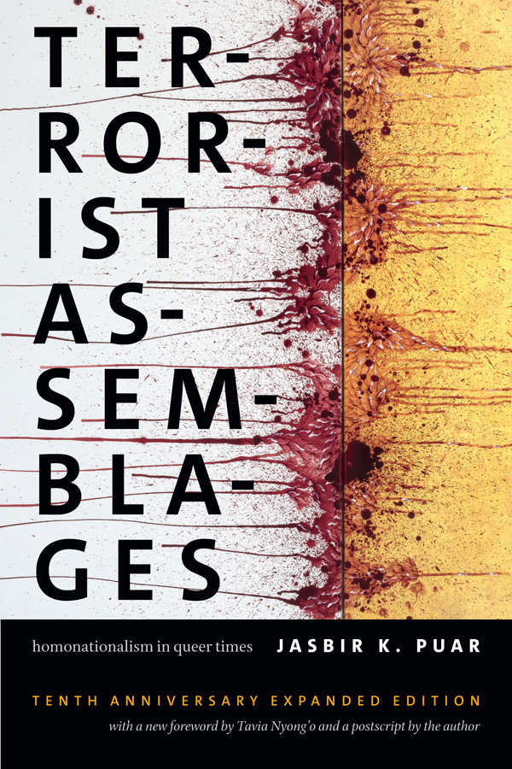
Jasbir Puar (2007)
Homonationalism is a form of sexual exceptionalism – the emergence of national homosexuality […] it becomes a regulatory script not only of normative gayness, queerness, or homosexuality, but also of the racial and national norms that reinforce these sexual subjects (Puar, 2007, p.2).

Slide 21
Homosexuality explained to my mother (July 2012)
I know I am scandalous. To you. And to those around you: neighbors, colleagues, friends, mothers-in-law... I know to what degree I'm involuntarily causing you harm, giving you worry. I expose myself by signing my real first name and my real last name. And I expose you along with me. I drag you along on this adventure, which is just the beginning for me and for people like me: To exist, finally! To come out of the shadows, head held high! To tell the truth, my truth! To be: Abdellah. To be: Taïa. To be both. Alone. Yet not alone at the same time.
How does Taia use literary fragmentation to speak violently?
How does he express a sense of self?
Is his minimalistic aesthetic important?

Slide 22
Literary fragmentation
The fragments are classic Taïa. He uses them to dig into the page and to get at something that smooth-rolling sentences can’t: “To tell the truth, my truth! To be: Abdellah. To be: Taïa. To be both. Alone. Yet not alone at the same time,” he tells his family, in “Homosexuality Explained to my Mother.” These fragments are everywhere in his novels and essays, and what can easily be a blunt tool—one that draws more attention to itself than to the job at hand—is instead a fine instrument

Slide 23
The importance of cinema
TAÏA: I first encountered movies on Moroccan television when I was a child. Egyptian films are very popular in the Arab world. I still love them a lot. When I discovered that I was homosexual and that there was no possibility to change, I understood that I had to hide this really impotent part of myself. Cinema helped me to deal with affliction and this killing of myself I was experiencing. When I was thirteen, cinema represented a space where I could be exist as Abdellah–teenager, homosexual–in silence.
The movie theaters I used to go to only showed popular films, melodramas from India and martial arts movies from Hong Kong. Although they’re not considered masterpieces, these films were, for me, the essence of cinema. They entered though my body not though my intellect. These films are still in my heart and they influence for sure my way of writing and being in life. To be faithful to them is like being faithful to my family and is something I found in myself as I started writing a text or a novel. I don’t think I am under the influence of movie directors like David Lean, Douglas Sirk, Fassbinder, or other great filmmakers. The cheap cinema is not cheap for me.
Later at seventeen, I fell in love with the French movie star Isabelle Adjani. She’s French but from an Algerian father and German mother. She is very beautiful in a strange and sublime way. When I first saw her images in movie magazines I told myself, she’s possessed like my sister. I can relate to that possession. Isabelle Adjani brought me the dream of Paris. I am not comfortable when I say I am a writer, my books seem to me like movies. They are filled with images and dreams coming from cinema and Isabelle Adjani.
Notes:
https://www.interviewmagazine.com/culture/abdellah-Taïa

Slide 24
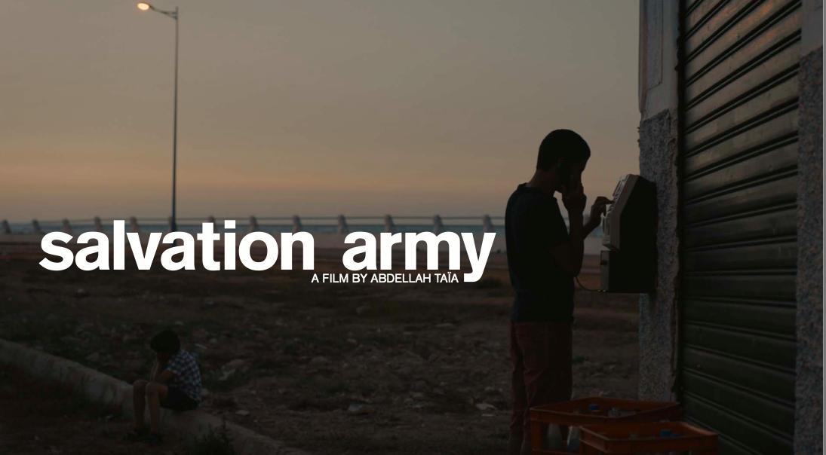
Abdallah Taïa and queer Morocco

Slide 27
First section of film – 35 mins
What vision of poverty and sexuality?
How does the language of the closet that is exploded in American queer theory return here?
What importance of the French language on ideas of mobility and enslavement?

Slide 28
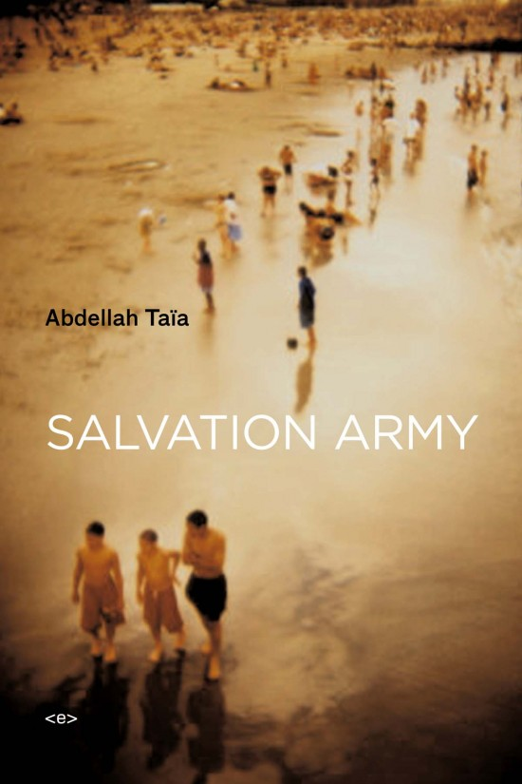
An autobiographical novel by turn naïve and cunning, funny and moving, this most recent work by Moroccan expatriate Abdellah Taïa is a major addition to the new French literature emerging from the North African Arabic diaspora. Salvation Army is a coming-of-age novel that tells the story of Taïa's life with complete disclosure—from a childhood bound by family order and latent (homo)sexual tensions in the poor city of Salé, through an adolescence in Tangier charged by the young writer's attraction to his eldest brother, to a disappointing arrival in the Western world to study in Geneva in adulthood. In so doing, Salvation Army manages to burn through the author's first-person singularity to embody the complex mélange of fear and desire projected by Arabs on Western culture. Recently hailed by his native country's press as “the first Moroccan to have the courage to publicly assert his difference,” Taïa, through his calmly transgressive work, has “outed” himself as “the only gay man” in a country whose theocratic law still declares homosexuality a crime. The persistence of prejudices on all sides of the Mediterranean and Atlantic makes the translation of Taïa's work both a literary and political event. The arrival of Salvation Army(published in French in 2006) in English will be welcomed by an American audience already familiar with a growing cadre of talented Arab writers working in French (including Muhammad Dib, Assia Djebar, Tahar Ben Jelloun, Abdelkebir Khatibi, and Katib Yasin).
A bildungsroman of his youthful dreams and indiscretions set in Rabat, Tangier, and Geneva. Along the way he introduces and confronts the figures that most affected his formative love-life: an elusive mother, an omnipotent brother, and a Swiss lover

Slide 29
Abdellah Taïa, Salvation Army (New York: Semiotexte, 2009), pp.94 – 95.
“I was confused, excited, I was immediately taken in […] it was so good to meet this man constructed of words […] a man who wasn’t dead even if the real world said he was”.

