Slide 1
ArctIc GeopolItIcs
Eda AYAYDIN

Slide 2
Realism
Pessimist point of view
Human nature is bad, the order is bad Thomas Hobbes (1588-1679)
Anarchical international arena
States are rational actors
States are for interests
Maximization of power
Self-help system
“I often observe the absurdity of dreams,
but never dream of the
absurdity of my waking thoughts.” , Leviathan-1671

Slide 3
Liberalism
Opposition of realism
International Cooperation
International organizations- non-governmental organizations
International trade
Interdependence
Democracy
Being all equal and independent,
no one ought to harm another in his life,
health, liberty, or possessions.
John Locke- (1632-1704)

Slide 4
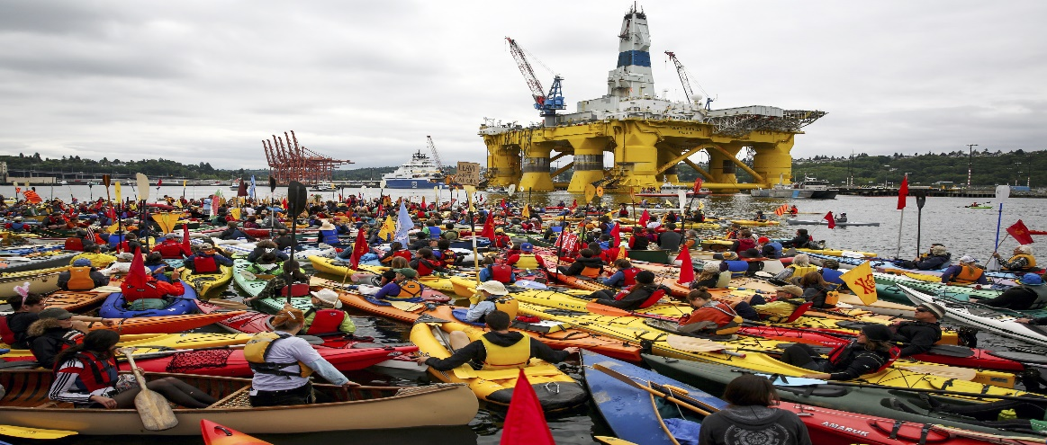
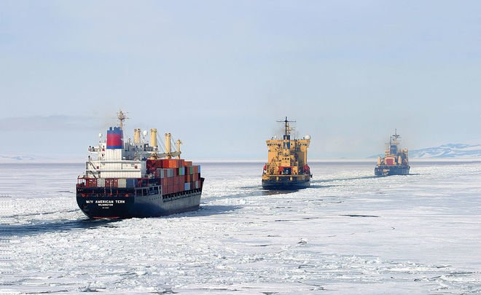
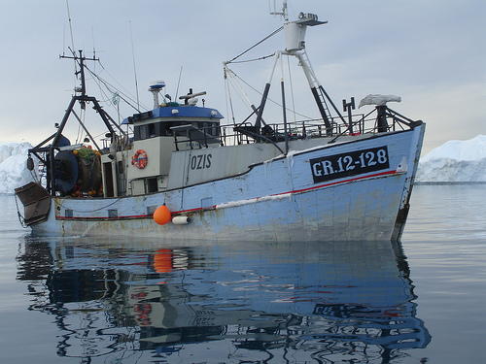
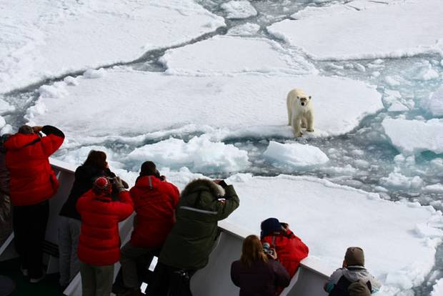
Arctic Geopolitics
Oil & gas production
Usage of shipping routes
Sovereignty of the passages
5 states, 5 different claims

Slide 5
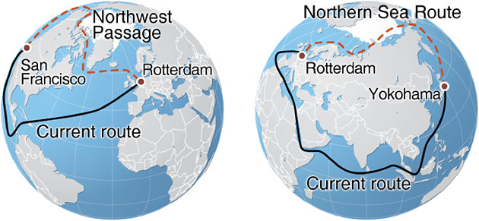
Claims of the A5
Canada’s Arctic Claim
Northwest Passage
Beaufort Sea
Lincoln Sea
Hans Island
Lomonosov Ridge

Slide 6
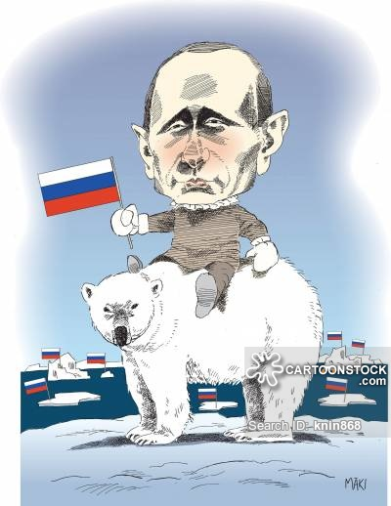
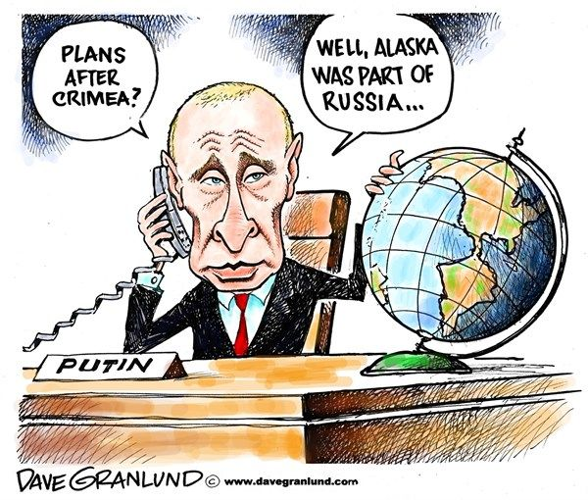
Russia’s Arctic Passion
«What is mine is mine, and what is yours is negotiable»
Titanium national flag in 2007- Created big discussions
Ambitious about the Lomonosov Ridge
Has sovereignty on Northern Sea Route

Slide 7
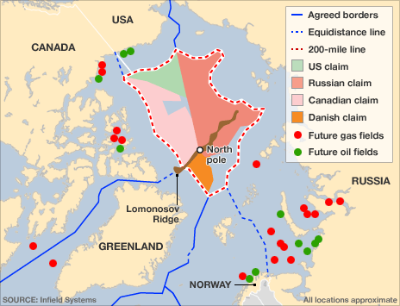
Denmark
Denmark is in the A5 thanks to Greenland
Lomonosov Ridge
Hans Island
Ellesmere Island

Slide 8
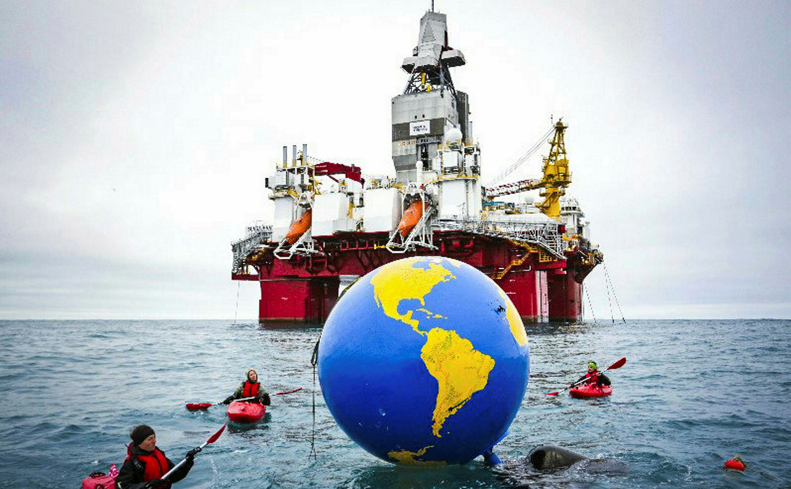
Norway’s Arctic Claim
Svalbard
Barents Sea
Western Nansen Basin

Slide 9
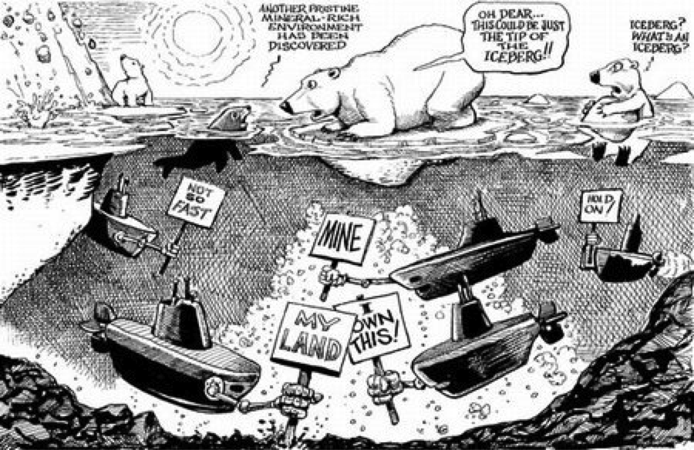
USA Arctic Claim
USA is in the Arctic 5 thanks to Alaska
USA does bilateral agreements in the Arctic as it didn’t ratifiy the UNCLOS.
Opposes to to the possession of Northwest Passage by Canada.
Has a dispute on Beaufort Sea with Canada.

Slide 10
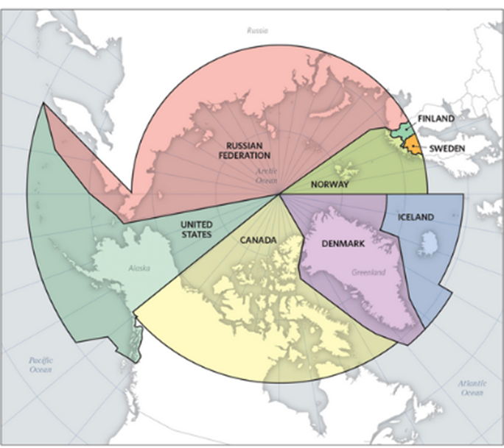
Measurement Techniques in the Arctic
Sector Principle
Pascal Poirier, Canada, 1907
Russia adopted in 1926
Norway, Denmark, USA objected
Created political tension

Slide 11
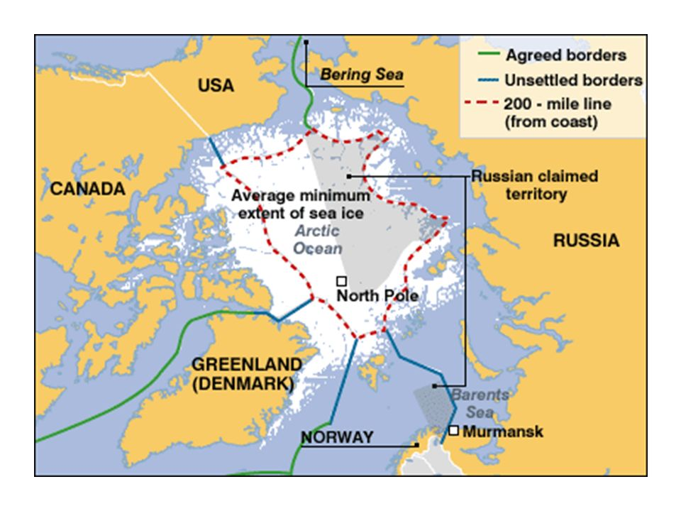
Median Line Principle & Basepoints
Basepoints are the outer limits of the states
Median line is equal to both countries basepoints

Slide 12
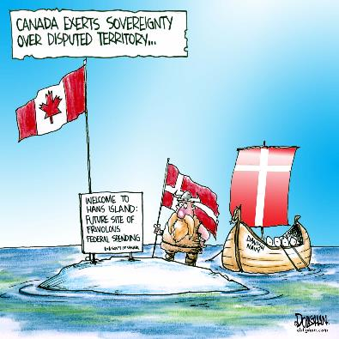
Acquisition of Sovereignty on the Ice?
Feasibility of the measurements by Climate Change?

Slide 13
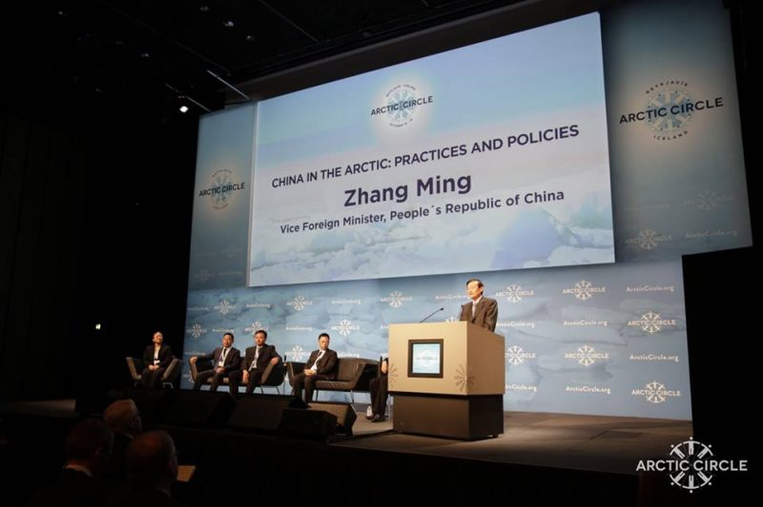
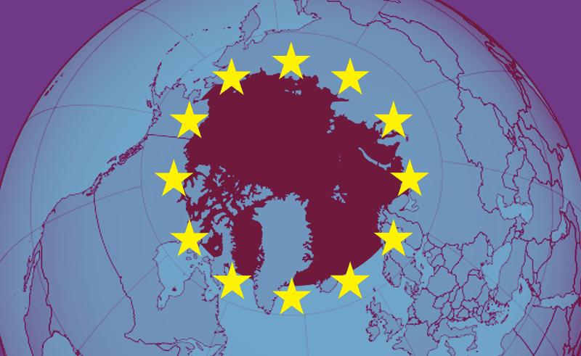
Non-Arctic States & Energy-Fishing Issues
NAS can penetrate to the region by bilateral agreements
NAS can gain observant status in the Arctic Council without any binding force
Chinese interest in the Arctic
Korean interest in the Arctic
EU interest in the Arctic

