Slide 1
COM6006 / FRE6006 Narrative in Theory and Practice: Analysing and Creatively Responding to French Literature Through the Ages
Dr Richard Mason
Office hour: Thursdays 9–10am, Arts One, 1.10
Alternatively, please email me to arrange a meeting: richard.mason@qmul.ac.uk

Slide 2
Key learning outcomes:
Understanding of techniques of ‘narratological analysis’
Familiarity with a range of French narrative texts [for COM6006: translated French narrative texts] produced between the 12th and the 19th centuries
Write creatively [for FRE6006: write creatively in French] to a given brief, and analyse writing decisions appropriately

Slide 3
What are we doing when we set out to analyze ‘narrative’? What kind of questions might we ask?
‘For a long time, I went to bed early. Sometimes, my candle scarcely out, my eyes would close so quickly that I did not have time to say to myself: “I’m falling asleep.’ And, half an hour later, the thought that it was time to try to sleep would wake me; I wanted to put down the book I thought I still had in my hands and blow out my light; I had not ceased while sleeping to form reflections on what I had just read, but these reflections had taken a rather peculiar turn; it seemed to me that I myself was what the book was talking about: a church, a quartet, the rivalry between François 1 and Charles V.’

Slide 4
‘For a long time, I went to bed early. Sometimes, my candle scarcely out, my eyes would close so quickly that I did not have time to say to myself: “I’m falling asleep.’ And, half an hour later, the thought that it was time to try to sleep would wake me; I wanted to put down the book I thought I still had in my hands and blow out my light; I had not ceased while sleeping to form reflections on what I had just read, but these reflections had taken a rather peculiar turn; it seemed to me that I myself was what the book was talking about: a church, a quartet, the rivalry between François 1 and Charles V.’
Who is speaking/narrating? Is this constant throughout?
What do we learn about character through this narrative? How do we learn about character through narrative?
Through whose eyes do we see events?
On what do they concentrate the reader’s attention? And what is not represented?
How much time has elapsed during this segment of narrative?
What is the nature of narrative time?
How are speech and thought represented in narrative?
How does a segment of narrative fit within a wider narrative structure?
.......

Slide 5
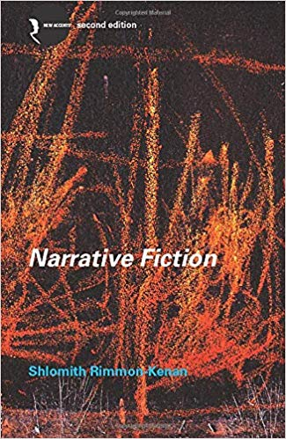
Shlomith Rimmon-Kenan (2002), Narrative Fiction: Contemporary Poetics (London: Routledge).
A classic overview of narratology, applied to narrative fiction
Narratology: ‘a humanities discipline dedicated to the study of the logic, principles, and practices of narrative representation’ The Handbook of Narratology (Huhn et al 2014: 623)
First published in 1983; please ensure that you have the second edition (2002)
‘On the one hand, I wish to present a description of the system governing all fictional narratives. On the other hand, I hope to indicate a way in which individual narratives can be studied as unique realizations of the general system.’ (Rimmon-Kenan, Narrative Fiction, p. 4)

Slide 6
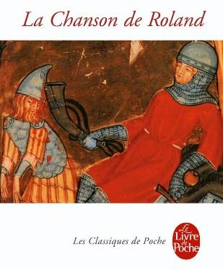
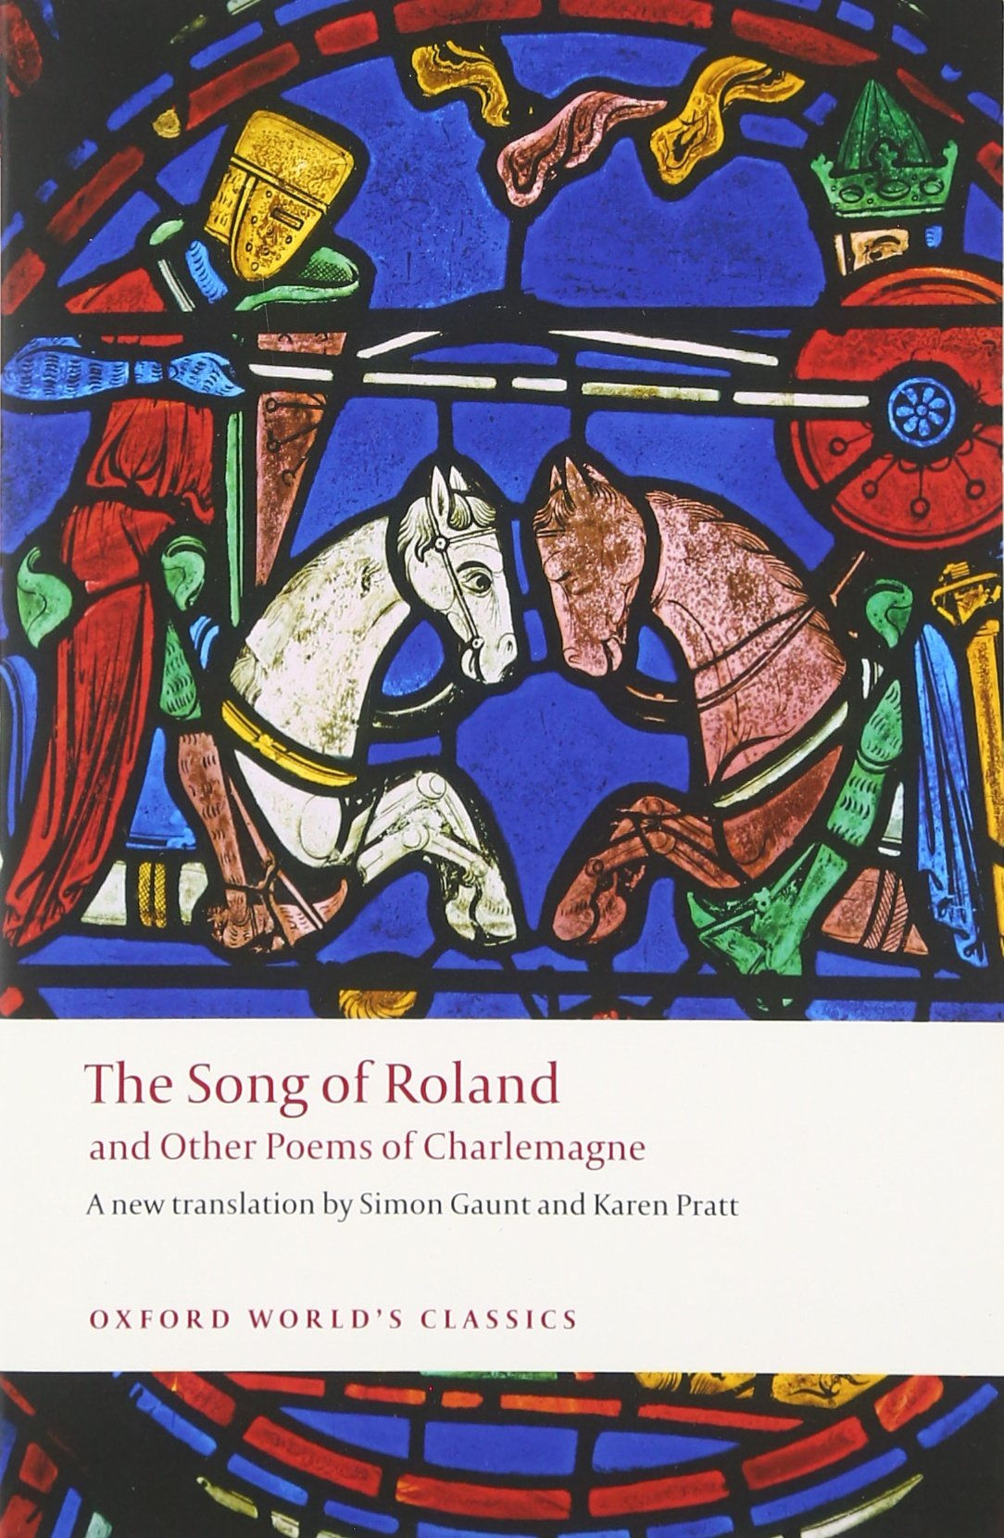
La Chanson de Roland, ed. and tr. Ian Short (Paris: Librairie Générale Française, 1997) [FRE6006 students, studied in modern French translation]
The Song of Roland and Other Poems of Charlemagne, ed. and tr. Simon Gaunt and Karen Pratt (Oxford: Oxford University Press, 2016)
An epic poem, probably composed at the turn of the eleventh and twelfth centuries, around the time of the First Crusade (1096-9)
Emerges from an oral tradition characteristic of pre-literary societies
Recounts battles claimed to have been fought by the Emperor Charlemagne (768-814) and his nephew Roland against the ‘pagans’

Slide 7
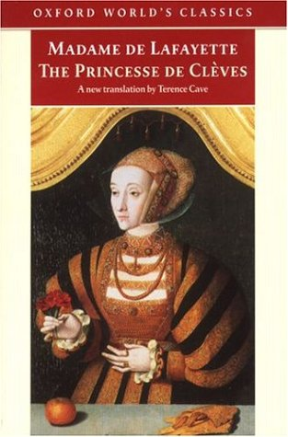
Madame de Lafayette, La Princesse de Clèves, ed. Jean Mesnard et al. (Paris: Garnier-Flammarion, 2009) [For FRE6006 students]
The Princesse de Clèves, ed. and tr. Terence Cave (Oxford: Oxford University Press, 1992)
First published in 1678 (court of Louis XIV)
A story of court intrigue and desire under the reign of Henri II (1519-1559)
Often considered to be the first ‘psychological novel’

Slide 8
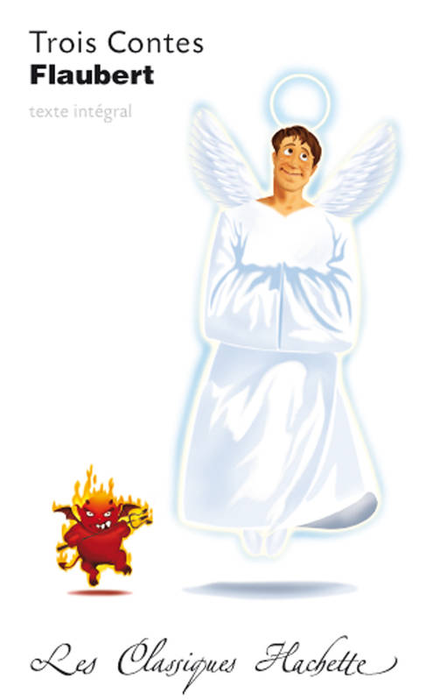
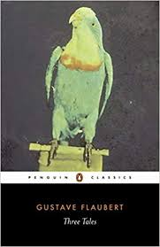
Gustave Flaubert, Trois Contes, ed. Hervé Alvado (Paris: Hachette, 2007) [FRE6006 students]
Three Tales, trans. Roger Whitehouse, ed. Geoffrey Wall (London: Penguin, 2005)
First published in 1877.
Contains ‘Un cœur simple’ (A Simple Heart), ‘La Légende de Saint Julien l’Hospitalier’ (The Legend of Saint Julian Hospitator) and ‘Hérodias’.
Meticulously crafted short stories connected loosely by themes of faith, suffering and desire.

Slide 9
Assessment
Assignment 1
1500-word narratological analysis (40%) due Sunday 14th November 23:55 (end of Study Week)
Assignment 2
2500-word creative exercise and reflective commentary (60%) due Sunday 9th January 23:55
FRE6006 students are required to write the creative exercise in French and reflective commentary in English.

Slide 10
Module schedule
First half of semester
La Chanson de Roland > La Princesse de Clèves > narratological analysis
Second half of semester
Trois contes (Three Tales) > creative writing sessions > creative response and reflective commentary (on any of the three texts studied, barring the one you wrote on for assignment 1)

Slide 11
Introductions: narrative in theory and practice Objectives of the lecture
Reflect on the meaning of ‘narrative’
Understand the origins of ‘narratology’
Consider literature’s resistance to narratology
Introduce the theoretical ‘backbone’ of the course: Shlomith Rimmon-Kenan’s Narrative Fiction: Contemporary Poetics
Prepare for next week

Slide 12
What do we mean by ‘narrative’?

Slide 13
Why is it that one of these is cast as ‘narrative’ whereas the other one is not?
‘There was a young lady of Niger
Who smiled as she rode on a tiger.
They returned from the ride
With the lady inside
And the smile on the face of the tiger.’
‘Roses are red
Violets are blue
Sugar is sweet
And so are you.’
(see Rimmon-Kenan 2002: 1)

Slide 14
Temporal succession
‘Descriptive or expository propositions […] are distinct from narrative ones in that they are thought of as simultaneously valid according to some spatial or logical principle which is relatively or ideally independent of temporality. […] [In the ‘Roses are red’ poem, all] four propositions are simultaneously true; there is no temporal succession in the ‘world’ represented by these statements, and hence no story.’
(Rimmon-Kenan 2002: 15)

Slide 15
The emergence of ‘narratology’, or the study of narrative: some useful reference points...
Ferdinand de Saussure’s ‘Course in General Linguistics’ (1906–1911)
Vladimir Propp’s Morphology of the Folk Tale (1928)
The emergence of structuralism (esp. 1950s and 1960s)
Gérard Genette’s Discours du récit (Narrative Discourse: An Essay in Method), or, literature’s resistance to structural or systemic description

Slide 16
Ferdinand de Saussure (1857–1913), Swiss linguist
‘Course in General Linguistics’ (1906-1911)
Attempt to arrive at a systemic or structural description of language
Meaning is conventional, not intrinsic to language
Meaning arises through relations of difference
Words are to be understood as ‘signs’ (semiology)
Sign systems: red, amber, green
Relevance to analysis of narrative fiction: attempt to map out systems/structures of meaning (adaptable to plots, narrative events etc.)

Slide 17
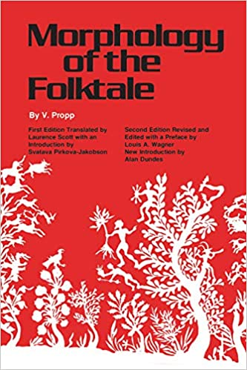
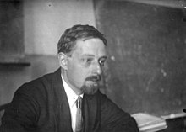
Vladimir Propp, Russian folklorist (1895–1970)
Morphology of the Folk Tale (1928)
Propp analysed a hundred Russian folk tales; decided on 31 basic narrative ‘functions’ typical to all fairy tales
Propp sought out underlying and generally applicable functions that determined how a particular narrative operates
Examples include ‘Interdiction’, where the hero is forbidden from doing something, and ‘departure’, where the hero leaves the home environment to undertake an action, etc.
Propp also identified seven abstract character types: villain, dispatcher, helper, princess/prize, donor, hero, false hero.
Effort to bring scientific rigour to the study of narrative, as to other areas of the humanities and human sciences

Slide 18
The emergence of structuralism (esp. in France 1950s–60s)
Roots of structuralism in Saussurian linguistics (though Saussure talked about ‘systems’)
‘The term “structuralism” applies to a very diversified phenomenon, which is more than a method and less than a philosophy. But is central core, its unifying centre, is the model of modern linguistics and the figure of Ferdinand de Saussure, presented as its founder. […] The heart of [Saussure’s] demonstration is to establish the arbitrariness of the sign, showing that language is a system of values established neither by content nor by experience, but by pure difference.’ Francois Dosse, History of Structuralism: The Rising Sign, 1945-1966, p. 44
Therefore: how does signification arise within different systems or structures? Including, of course, literature and narrative fiction....

Slide 19
‘Structuralism’ designates a range of intellectual endeavours, predominantly in the fields of anthropology, sociology, psychoanalysis, linguistics, literary theory, film theory…
‘during the fifties and sixties, the evolving definition of a total semiological program reaching beyond linguistics and encompassing all the human sciences in a common project, which was the great ambition of the period, was justified and encouraged by Saussure’s definition of semiology as the “science that studies the life of signs at the heart of social life.’ (Dosse, History of Structuralism, p. 45
‘Narratology’ emerged as a distinctive discipline and approach within the context of structuralism; attempts to draw up a structural account of how narratives work

Slide 20
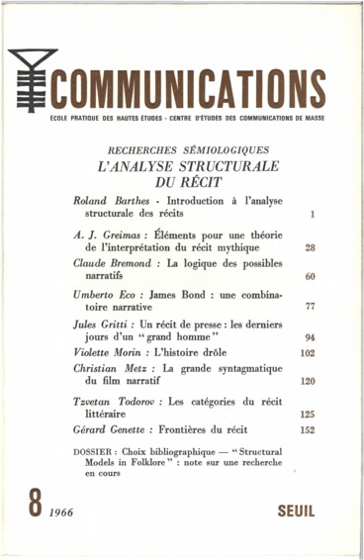
Narratology’s heyday: key publications
Communications, 8. (1966)
Journal published by the Institut interdisciplinaire d’anthropologie du contemporain (Centre national de la recherche scientifique CNRS / École des hautes études en sciences sociales EHESS).
Includes seminal articles by Roland Barthes, Algirdas Greimas, Claude Bremond, Tzvetan Todorov, Gérard Genette.
Barthes’s ‘Introduction à l’analyse structurale des récits’ could be considered a ‘mission statement’ for narratology (though the term had not yet been coined)

Slide 21
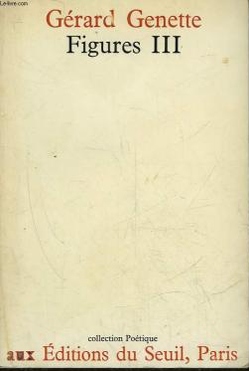
Narratology’s heyday: key publications
Gérard Genette (1930-2018)
French literary theorist
Figures III (Paris: Seuil, 1972)
Trans. Narrative Discourse: An Essay in Method (Ithaca: Cornell University Press, 1980)
Subtle and highly influential work of narratology, focusing on Marcel Proust’s A la recherche du temps perdu (In Search of Lost Time)
Order, frequency, duration, voice, mode

Slide 22
Literature’s resistance to structural description, or, Genette as poststructuralist…
Genette’s book filled a need for ‘a systematic theory of narrative’, and analysed ‘the basic constituents and techniques of narrative’ (Jonathan Culler, foreward to Genette’s Narrative Discourse, p. 7).
‘In various ways, as Genette says, ‘Proust upsets the whole logic of narrative representation.’ […] Genette’s work is testimony to the power of the marginal, the supplementary, the exception. It is as though his categories were specifically designed to identify as anomalous the most salient of Proust’s techniques, so that in a sense these marginal phenomena, these exceptions, in fact determine the norms; these cases which the system seems to set aside are in fact crucial to it.’ (Culler 1980: 12–13)
Genette is attentive to what escapes the various narratological frameworks and structures that theorists bring to literary texts. Genette’s use of A la recherche du temps perdu is exemplary in this regard: it is a foundational work of narratology that repeatedly shows how literature fails to fully conform to theory’s core concepts and interpretative frameworks.
The course, amongst other things, will get you to think further about tensions between narrative structure, literary specificity and reading and interpretation.

Slide 23
Shlomith Rimmon-Kenan, Narrative Fiction: Contemporary Poetics
The theoretical ‘backbone’ to the course
The object of analysis: ‘narrative fiction’
‘By ‘narrative fiction’ I mean the narration of a succession of fictional events. […] an event may be defined without great rigour as something that happens, something that can be summed up by a verb or a name of action (e.g. a ride – perhaps on a tiger).’ (Rimmon-Kenan 2002: 2)
A key classification taken from Genette’s Figures III (Narrative Discourse):
‘The foregoing definition of narrative fiction also gives rise to a classification of its basic aspects: the events, their verbal representation, and the act of telling or writing. In the spirit of Genette’s distinction between ‘histoire’, ‘récit’, and ‘narration’, I shall label these aspects ‘story’, ‘text’ and ‘narration’ respectively.’ (Rimmon-Kenan 2002: 3)

Slide 24
Shlomith Rimmon-Kenan, Narrative Fiction: Contemporary Poetics
‘Story’, ‘text’, ‘narration’ (histoire, récit, narration)
Story: events, characters
Text: time, characterisation, focalisation
Narration: levels and voices, speech representation

Slide 25
Next week’s lecture will draw on material from chapters 2 ‘Story: events’ and 3 ‘Story: characters’, which you should read in advance (some caveats: the section on ‘deep structure’ is a little opaque and not especially useful, so don’t worry if you don’t fully get it; personally, I have very little time for diagrams, be they Greimas’s or Bremond’s. Feel free to ignore these completely). This will generate questions that will guide our reading of the Song of Roland.

Slide 26
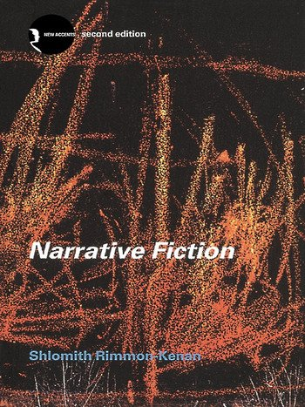
Preparation for next week
Read the introduction and first two chapters of Narrative Poetics, pp. 1-42
If you can, read La Chanson de Roland

