Slide 1
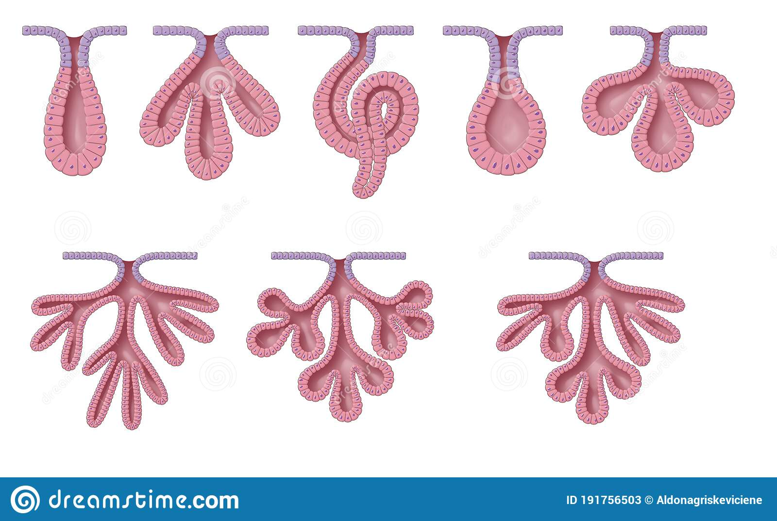
Exocrine and endocrine glands & glucose homeostasis
Dr Nyree Myatt
Ccfs feb 2023

Slide 2
Learning objective
“Students should be able to explain the difference between endocrine and exocrine glands. Students should be able to classify the different types of exocrine gland based on structural differences. Students should be able to describe the endocrine system, receptors hormones. Students should be able to describe blood glucose homeostasis ”

Slide 3
Lesson outcomes
After this lecture, you should be able to:
1. Describe the difference between endocrine and exocrine glands
2. Describe the classification of exocrine glands in terms of structure, location and function
3. Describe the endocrine system and different forms of hormones.
4. Describe the different types of hormone receptors and second messengers
5. Describe the action of insulin and glucagon in glucose homeostasis

Slide 4
Glands
The function of glands is secretion
Glands can be a single cell or a collection of cells
The secretion can be released directly into blood (endocrine gland) or released into a duct (exocrine gland) that then drains into a hollow organ (e.g. small intestine) or onto a surface (e.g. skin)

Slide 5
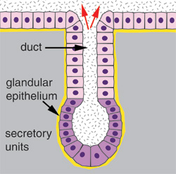
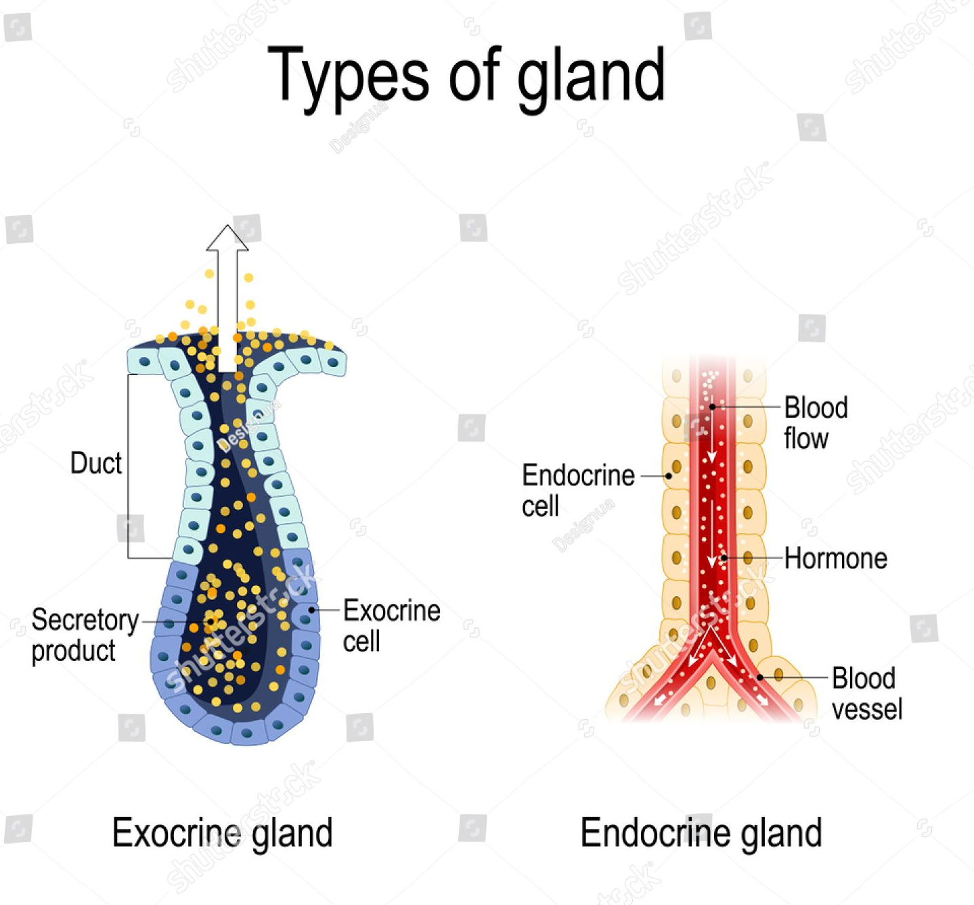
Exocrine gland

Slide 6
Classification of exocrine glands
Unicellular or multicellular
Unicellular – goblet cells – secrete mucus onto surface e.g. stomach, parts of respiratory tract
Multicellular glands have many cells and are categorised in two ways:
The are ducts branched or unbranched
The shape of the secretory part of the gland
Ducts that do not branch - simple glands
Ducts that branch - compound glands
If the secretory parts of the gland are duct-like, this is a tubular gland
If the secretory parts of the gland are rounded (like a berry), this is an acinar gland

Slide 7
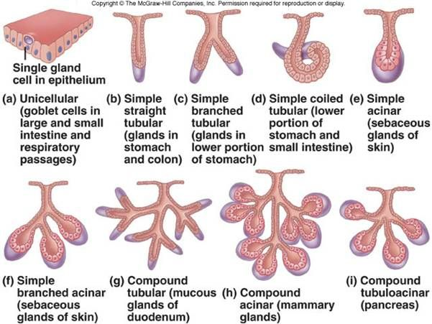

Slide 8
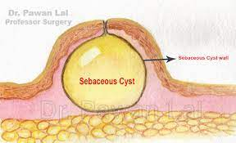
Exocrine gland products
Proteins
Enzymes
Mucus
Sebum (oil)
Look up sebaceous gland cyst and meibomium cyst (chalazion)

Slide 9
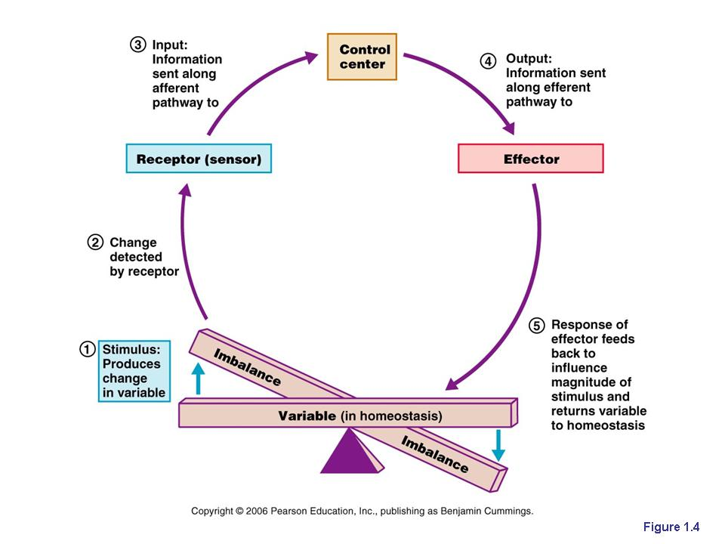
Homeostasis –
“Staying the same”
What examples
homeostasis can you
think of in the body?
Homeostasis – ability to maintain stable internal environment despite changes taking place externally or internally

Slide 10
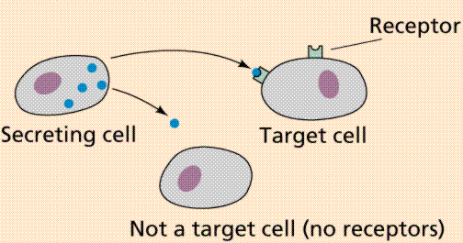
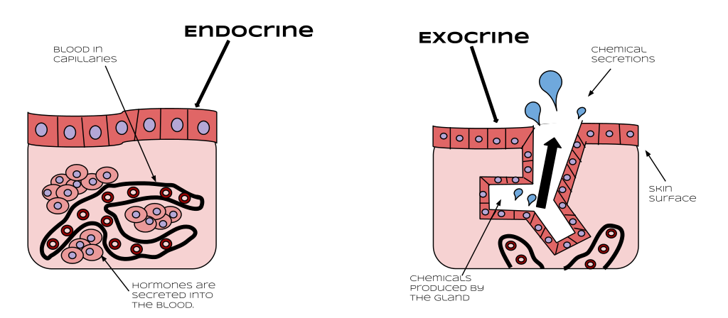
Endocrine system
Comprises endocrine glands and hormones
Hormones are chemical messengers and are released directly into the blood where they can exert their effects nearby or at a distance on a few cells or many cells (e.g. thyroid gland and thyroid hormone) as long as the target cell has the specific receptor
(Different to exocrine glands which release secretions via a duct (e.g. salivary glands))
Hormones can be proteins, peptides or steroids
They can be stimulated by another hormone or
by electrical impulse

Slide 11
Receptors and second messengers
Hormones are the “first “ messenger (1)
Once a hormone binds to its specific receptor, an enzyme (2) is activated (3) for example, adenylyl cyclase

Slide 12
Receptors and second messengers
Activated adenylyl cyclase catalyses the production of a second messenger, cyclic AMP, from ATP (4)
cAMP production leads to a cascade of events inside the cell and can cause e.g. glycogen breakdown into glucose

Slide 13
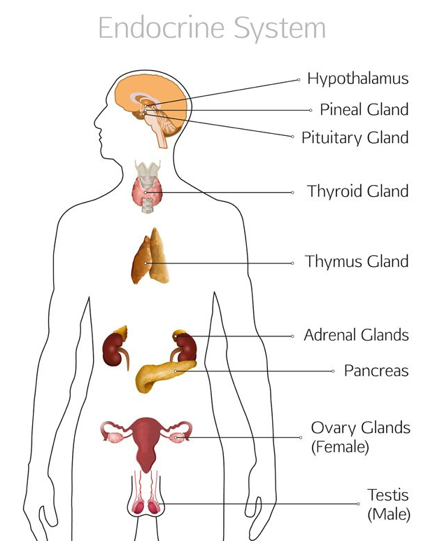
Which hormones do these endocrine glands produce?
Which ones are proteins, peptides or steroids?

Slide 14
Question time
What is the difference between an exocrine and an endocrine gland?
How are exocrine glands classified?
Name an organ that is both an exocrine and endocrine gland.
Which cells produce which hormones involved in glucose homeostasis?

Slide 15
Pancreas
Located below the stomach
Contains islets of Langerhans closely associated with blood vessels – why?
Two types of cell – α and β
α cells secrete glucagon
β cells secrete insulin
Blood glucose levels is usually around 90mg/100ml blood (5mmol/l)– why?
(Normal range is 4 – 7mmol/l but can go up to 8.8 – 9mmol/l up to 2 hours after eating a meal)
what is wrong with this diagram?

Slide 16
Glucagon – acts to increase blood glucose concs
Released in response to decreasing blood glucose levels and leads to higher blood glucose
Binds to specific receptors on liver cells and leads to glycogenolysis (breakdown of glycogen) and leads to glucose formation from glycerol and amino acids (gluconeogenesis)
Glucagon also leads to reduced rate of respiration in cells

Slide 17
Insulin – acts to reduce blood glucose concs
Released in response to increasing blood glucose levels and leads to lower blood glucose
Insulin binds to receptors on muscle and liver cells increasing cell membrane permeability so glucose is taken up via facilitated diffusion
In muscle cells, insulin causes the cells to use more glucose (increase respiration)
Insulin also leads to conversion of glucose to glycogen (glycogenesis)

Slide 18
Negative feedback
Produce a diagram that shows how blood glucose is kept within its normal range (4- 7mmol/l).
Use key terms and hormones and say where they are produced from.

Slide 19
Insulin release from beta cells
During periods of high blood glucose, glucose enters the beta cells by facilitated diffusion
The cell uses the glucose to produce more ATP
Increased ATP causes the potassium channels to close so potassium builds up inside the beta cell

Slide 20
Insulin release from beta cells
Inside the cell becomes less negative because of the build up of potassium ions and the cell membrane becomes depolarised
Depolarisation of the cell membrane causes voltage-gated calcium channels to open
Calcium ions enter the beta cell and cause insulin-containing vesicles to fuse with the beta cell membrane and release insulin by exocytosis

Slide 21
Summary
Homeostasis – “staying the same”
Endocrine system – comprises endocrine glands, hormones released directly in the blood, and receptors
Hormones bind to the receptor, second messenger activated, cascade of events takes place
Negative feedback
Blood glucose concentrations normally maintained in strict range by actions of insulin and glucagon, released from cells in the pancreas
Diabetes – type 1 and type 2
Lifestyle changes and /or drugs needed as treatment
Control of body temperature

Slide 22
Question time
What is the difference between an exocrine and an endocrine gland?
How are exocrine glands classified?
Name an organ that is both an exocrine and endocrine gland.
Which cells produce which hormones involved in glucose homeostasis?

Slide 23
Lesson outcomes
After this lecture, you should be able to:
1. Describe the difference between endocrine and exocrine glands
2. Describe the classification of exocrine glands in terms of structure, location and function
3. Describe the endocrine system and different forms of hormones.
4. Describe the different types of hormone receptors and second messengers
5. Describe the action of insulin and glucagon in glucose homeostasis

