Slide 1
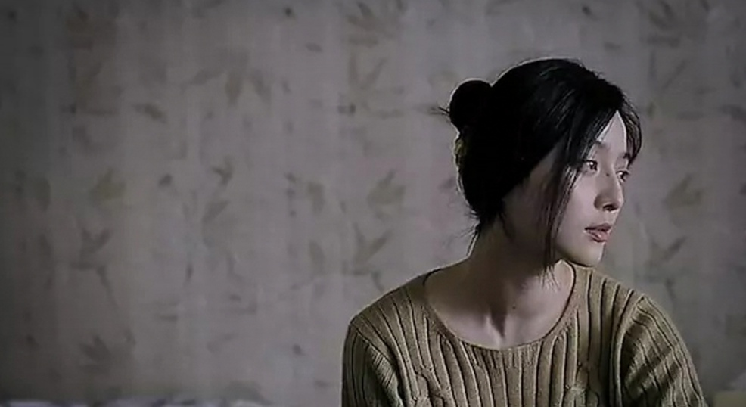
Chinese women’s Cinema
Dr Kiki Tianqi Yu

Slide 2
Key questions
Is women’s cinema in China feminist cinema?
What does feminist cinema constitute of?
How has the concept of feminism and feminist theories been received in modern China? What are the local forms of feminism?
What does feminism mean in contemporary China?

Slide 3
Observing the rise of women’s cinema in the late 1980s, Chris Berry writes that “Certainly, Chinese commentators are aware of Western feminisms, and some have also heard of feminist filmmaking. However, both the term “women’s cinema” and the films it refers to can only be accounted for by understanding the Chinese socio-political and cinematic context.” (1989)
What is China’s social-political context in understanding feminism and women’s movement?

Slide 4
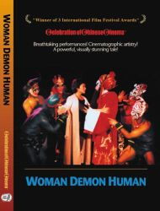
Woman, Demon, Human (Ren, gui, qing), dir. Huang Shuqin, 1987
A girl born in the “theatrical trunk” grows up under the lights of her parents’ Peking Opera Company. This complete immersion into theatrical life naturally leads her to the stage. She is trained by her father to play traditional roles. Her dream was to be the first woman to play the more significant male roles. This was completely against tradition. She suffers discrimination and humiliation, but in the end turns adversity into admiration when she becomes the first woman to play a great mythical hero in Peking Opera, defying all tradition and destroying all precedents.

Slide 5
the first feminist film produced in mainland china
the real-life career of beijing opera star Pei Yanling who plays her own stage character in the film.
Pei challenges gender norms to portray male characters on stage
Traumatised childhood
In China’s history of opera, males have played female roles in a very refined form of impersonation. It wasn't until the 1930s that women were allowed to perform at all
https://www.bilibili.com/video/av11492759/ full film

Slide 6
Army Nurse (Nüer lou), dir. Hu Mei, 1985
Typical role model of socialist working-class women
Narrated from female perspective

Slide 7
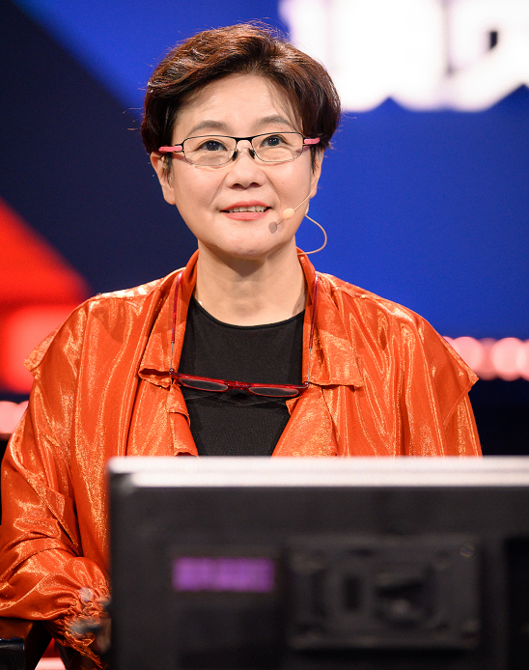
Blush (Hongfen), dir. Li Shaohong, 1994
Li Shaohong - The only women director of the 5th Generation filmmakers

Slide 8
A City Called Macau, dir. Li Shaohong, 2019
https://www.youtube.com/watch?v=6UQ_6MmNwJo

Slide 9
Perpetual Motion (Wu qiong dong), dir. Ning Ying, 2005
Ning Ying: Emerged at the same time as the 5th generation filmmakers

Slide 10
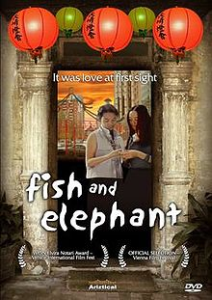
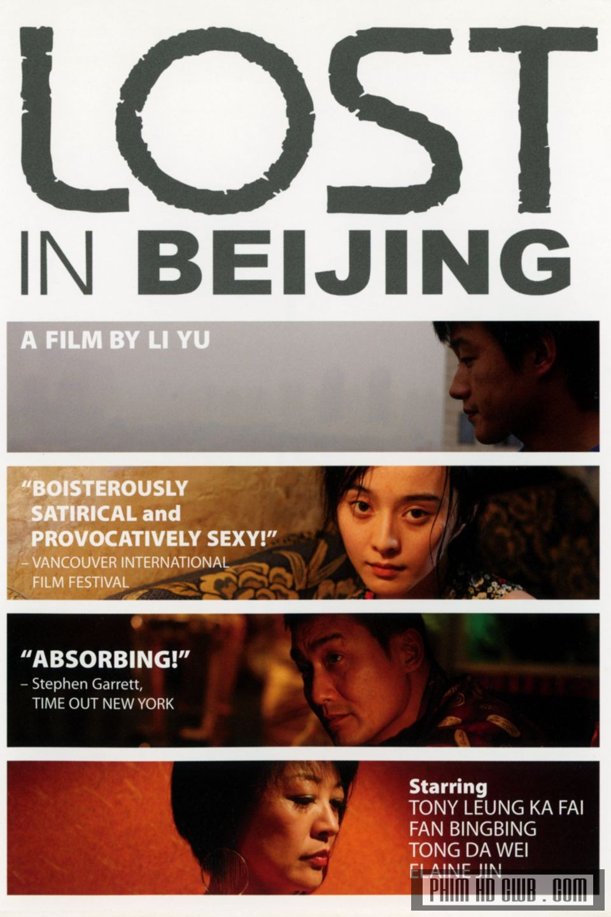
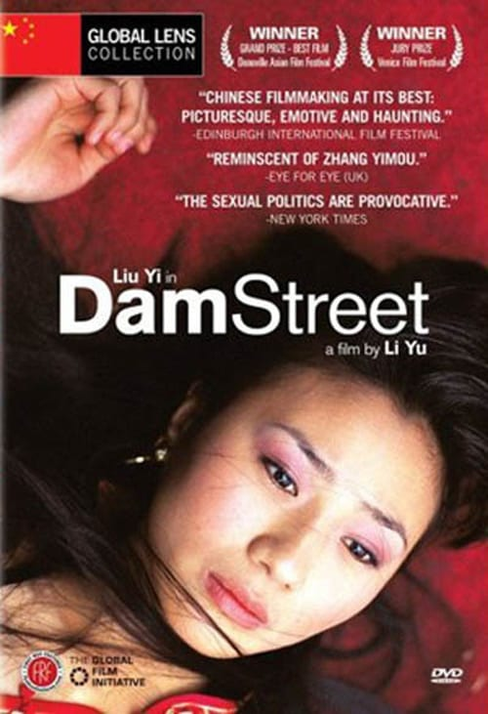
Li Yu’s trilogy: explore female sexuality
Fish and Elephant, 2001, “the first Chinese feature on a lesbian relationship, presents homosexuality against a heterosexual social-cultural environment.”
Dam Street, 2005, “search(ing) for female sexuality with a focus on the female body as a site of sociocultural punishment and sexual spectacle”
Lost in Beijing, 2007, “locates female sexuality against a commercial society in which the female body is commodified for its exchange value”.

Slide 11
What does feminist cinema constitute of?

Slide 12
What does feminist cinema constitute of?
Through a female perspective
A critique of the power structures - provoke the audience to think about political, cultural and economic oppressions that women faces in many societies.
Challenges the stereotypes of how women are presented in mass media and conventional narratives
Present the typical sextual objectifications, stock images of women (good mother, vamp, fallen girl)
Redefine women’s role in cinematic narratives and in society - promote experimental and avant-garde film practice to imagine radical alternatives
Present independent and strong women, or the awakening of awareness of being independent
Entering women consciousness of sexuality, and being independent
Portraits of women who take up the social roles that are historically reserved for men.
Does not need to be made by a women.

Slide 13
“Strictly speaking, the kind of revolutionary feminist movement which has taken place – with varying degrees of success – in the West has not taken place in the same ways in mainland China or Taiwan. In Japan, Western-style feminism did penetrate into domestic culture but seems to have had minimal impact on its film community. Emerging in this context, the practices of these women filmmakers present formidable challenges to the societies from which they emerge and suggest in part some alternative routes towards women’s empowerment beyond the models presented by Western feminism.” (Yu & Lebow 2020:3)
“If we take these women’s self-empowerment or empowering of others as a type of feminist inclination, we must nonetheless acknowledge that they are not necessarily or directly influenced by Western feminism but instead emerge out of their own specific local urgencies.” (Yu & Lebow 2020:3)

Slide 14
Chinese feminist filmmaking as part of ‘translational feminist practice’
Transnational feminist practice – vs. Western centred feminist approaches
Transnational feminist practice intends to “articulate the relationship of gender to scattered hegemonies such as global economic structures, patriarchal nationalisms, ‘authentic’ forms of tradition, religious fundamentalism, local structures of domination, and legal-juridical oppression on multiple levels.”(Wang 2011:64)
In the case of China, the theoretical frameworks of psychoanalysis, Marxism, and other feminist film theories are not readily applicable to the Chinese context of the 1980s and 1990s, although some specific concepts are useful for textual analysis

Slide 15
How has the concept of feminism and feminist theories been received in modern China?
Two common renditions of the English term ‘feminism’ in Chinese.
Feminism as nu ̈quan zhuyi - women’s rights or powerism, which connotes the stereotype of a man-hating he-woman hungry for power. Less popular in China
Feminism as nu ̈xing zhuyi - female or feminine-ism, ‘softer feminism’
less threatening.
Its popularity may stem from its semantic flexibility
It means an ideology promoting femininity and thus reinforcing gender distinctions

Slide 16
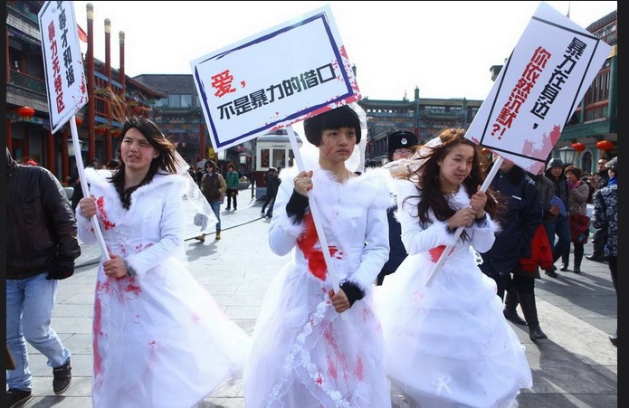
Repression of feminist activist movement on social media

Slide 17
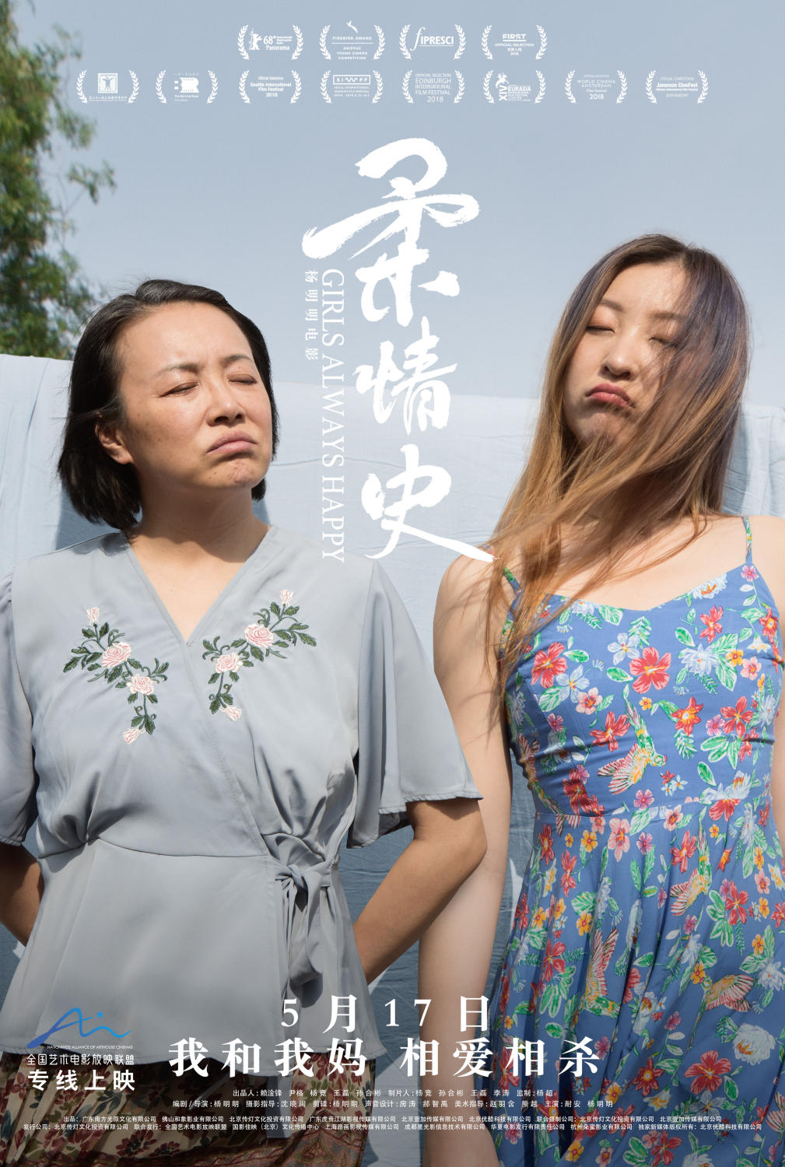
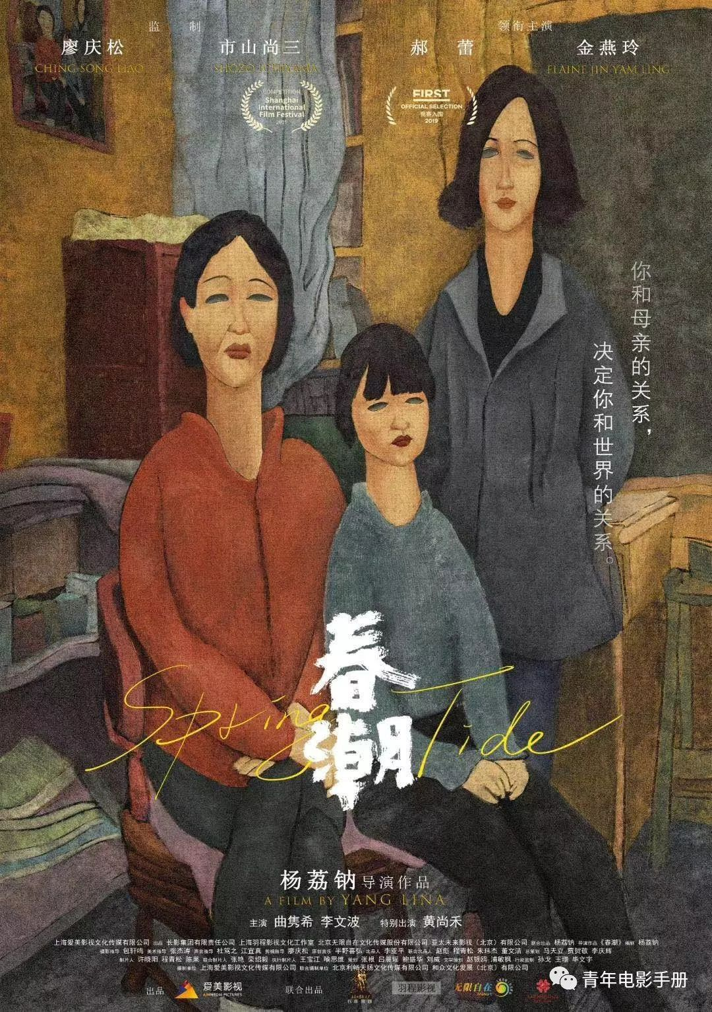
soft feminist cinema
Girls always Happy, 2018
Spring Tide, 2019
Send me to the clouds, 2019

Slide 18
The emergence/translation of ‘feminism’ concept in China
Feminism, as women’s rights– translated from Japanese ‘joken’ in the late 19th century.
It is a concept came from Euro-America through Japan.
a by-product of an overarching effort to modernise Qing’s legal codes and institutions
in the context of Chinese male reformers’ promotion of ‘people’s rights’ or ‘civil rights’, ‘human rights’ and ‘natural rights’
“The feminist project was implicated in a problematic nationalist scheme from the start. Although ‘women’s rights’ were supposedly rooted in the notion that men and women enjoyed ‘natural rights’, the goal for women’s rights in the eyes of its male Chinese advocates was to strengthen the nation.” (Ko and Wang, 2006:465)

Slide 19
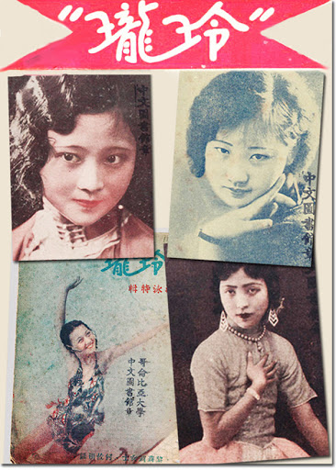
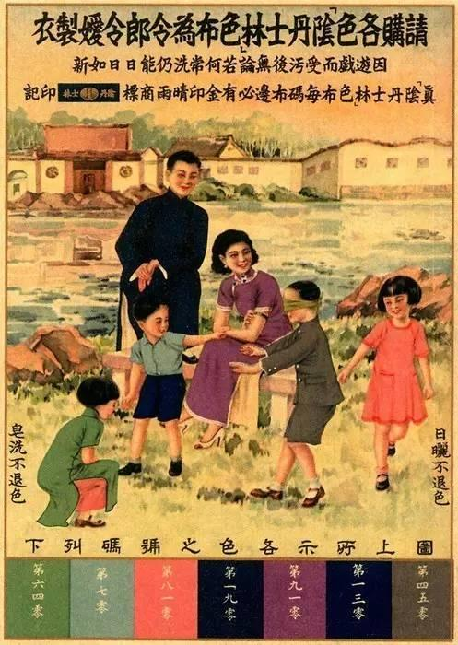
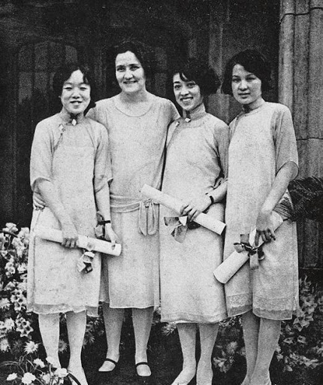
1920s-1940s China – Republic Era
The role of urban magazines in promoting notions of women’s rights and agency – from elititst discourse to a popular discourse
the ‘scientific’ promotion of motherhood, and ‘natural’ gender differences
Women’s rights were expanded to include sextual rights – the right to free choice of partners and the right to devoice.
Equal educational and employment opportunities – girls school, urban workers – financial independence
Performing men’s role in public - the rise of female intellectuals, writers, actors in the public

Slide 20
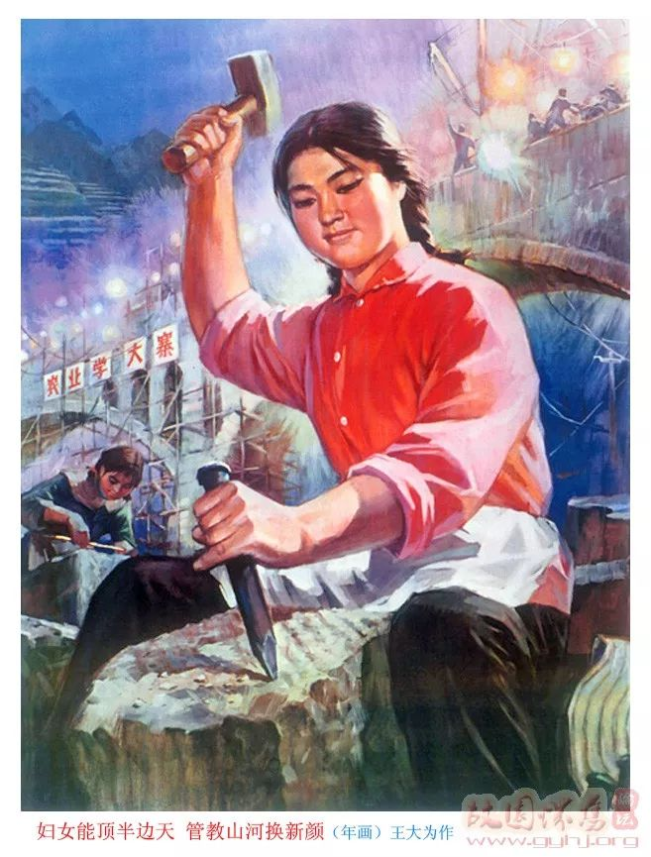
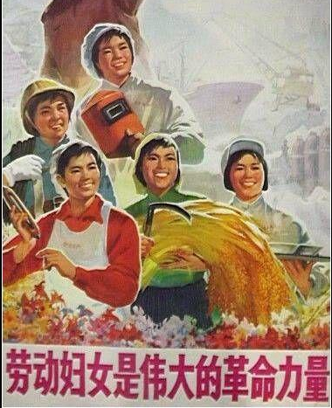
Mao’s China
Women were to be liberated from the federal system, capitalism and colonisation, and were treated equal to men, to join the labour force - serving the new socialist state.
the Women’s Federation, a mass organisation led by the Party
To advance the interests of rural and urban lower-class women in the socialist revolution.
It facilitated the birth of a new type of female role model – the working-class woman.
the socialist state empowered women but it demanded women’s self-sacrifice and identification with an implicitly masculine model.

Slide 21
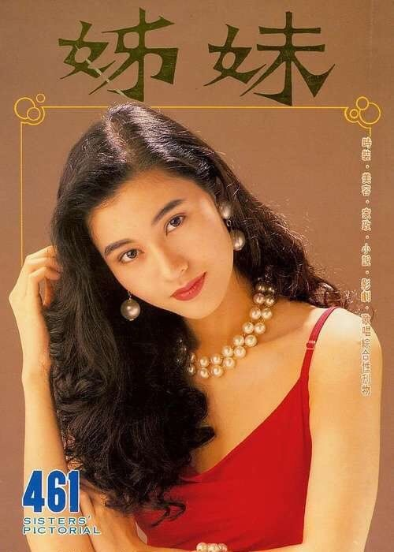
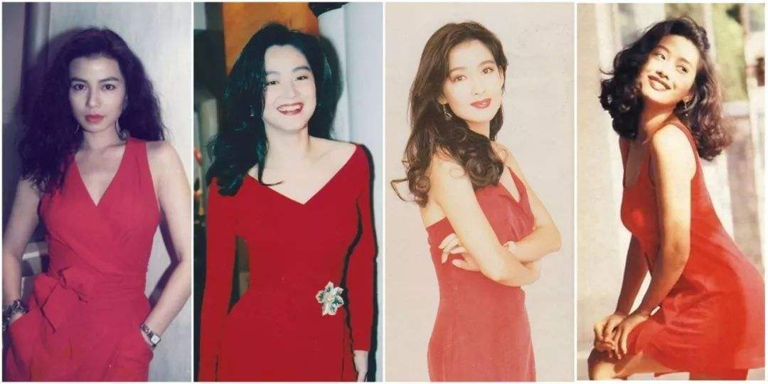
Post-socialist China
the female body has re-emerged as the locus of contemporary debates about modernity.
Criticise gender uniformity - The robust working-class body of the Iron Girl is scorned by the urban elites as the symbol of Maoist ultra-leftist gender policy that distorted women’s supposedly feminine nature and thereby masculinised women.
Promote a biologically determined notion of gender difference and femininity
engage in contemporary global circulations of discours天天非常人贩过程es including French feminism.
Feminism, now rendered primarily as nu ̈xing zhuyi (female or feminine-ism).

Slide 22
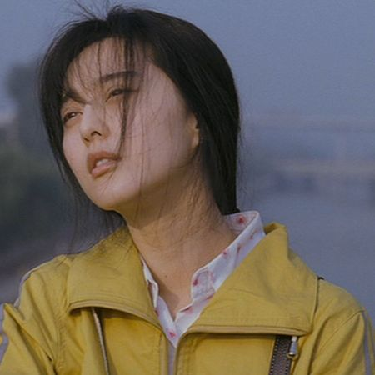
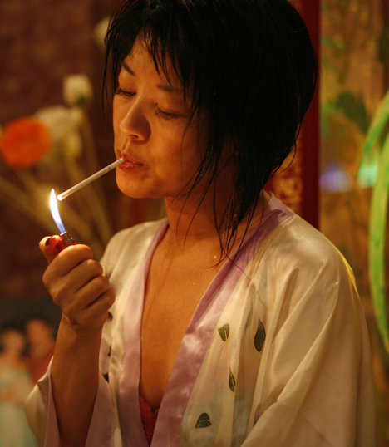
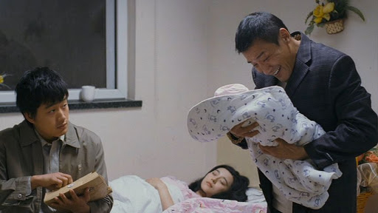
Discussion of Lost in Beijing
What’s the social position of the protagonist Pingguo?
What kinds of exploitation does she face?
Does the film present her agency?
How does she negotiate with the repressing powers in order to survive?
How does the film present the distorted personalities of other characters in the film?

