Slide 1
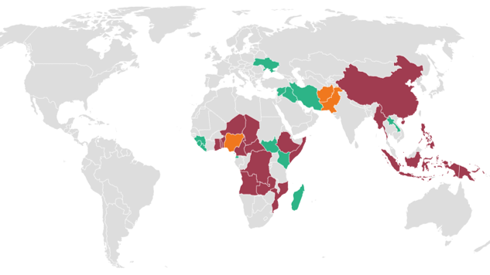
Private Actors and Polio
Ruby Hugh
Notes:
Picture source: The New Humanitarian https://www.thenewhumanitarian.org/maps-and-graphics/2019/10/24/polio-outbreaks-how-virus-spread-decades-eradication-efforts

Slide 2
Overview
Private philanthropies - criticisms
PPPs
Polio eradication controversy – Nigerian case study
Colonialism and polio eradication?

Slide 3
Private Philanthropies - Criticisms
Reductionist; disregard underlying causes of ill health
Lack of expertise
Bill and Melinda Gates Foundation (BMGF)
Lack of accountability; Chan-Zuckerberg Initiative
Top-down approach
Technological orientation
Emphasise visible successes; disease-by-disease focus

Slide 4
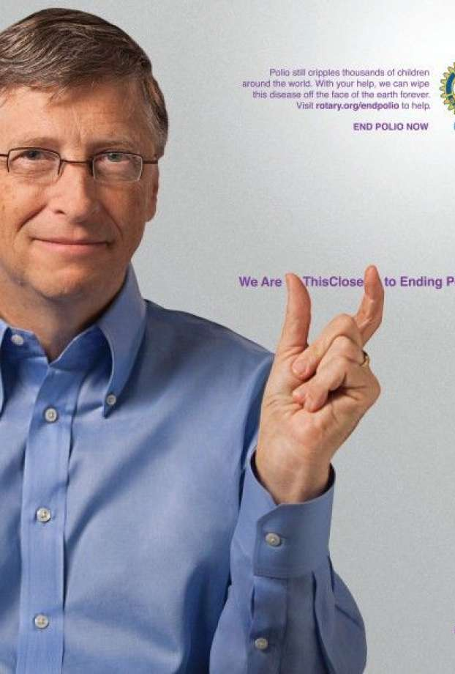
Public-Private Partnerships
1990s – Public-Private Partnerships (PPPs) formalised as central element of global health
Key levers of BMGF and other philanthropic foundations’ influence
Undermine WHO’s authority and functional ability
Global Polio Eradication Initiative (GPEI)

Slide 5
Case study - Nigeria
GPEI, 2003 – only 7 countries remained endemic, including Nigeria
Immunisation drive brought to a standstill in northern Nigerian states
Supreme Council for Sharia in Nigeria (SCSN)
After 16 months, the campaign was resumed

Slide 6
Case study - Nigeria
Other issues with the GPEI:
Impact on Nigeria’s primary health care system
Unavailability of vaccines
Centralised approach
Focus on polio rather than other diseases and general ailments

Slide 7
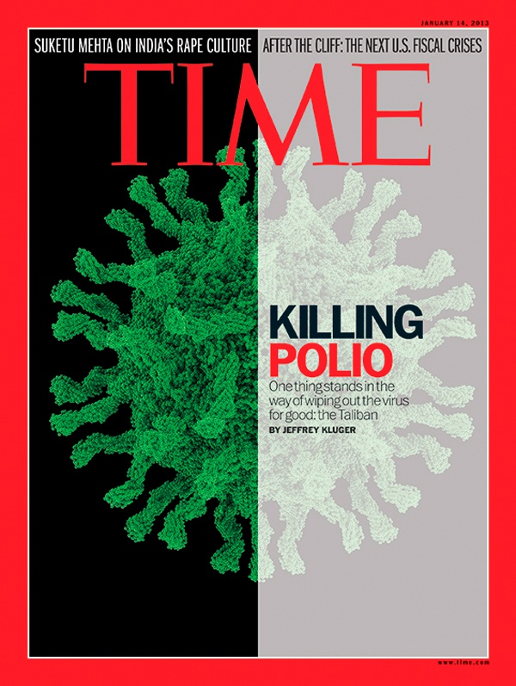
Colonialism and polio eradication?
Imperialist elements of philanthropic foundations; Rockefeller Foundation
Dismissal of the Nigerian boycott as ill-founded rumours; undermines genuine foundations for suspicion
1996 – meningitis vaccine malpractice
Alleged WHO and UNICEF involvement in development of anti-fertility vaccines

Slide 8
Questions?
What are some other links between colonialism and polio eradication?
Having discussed some criticisms of private actors in global health governance, can you think of any ways these could be avoided?

Slide 9
Bibliography
Arita, I., Nakane, M. and Fenner, F. (2006), ‘Is Polio Eradication Realistic?’, Science 312(5775); 852-852.
Aylward, B. and Heymann, D. (2005), ‘Can We Capitalise on the Virtues of Vaccines? Insights from the Polio Eradication Initiative’, American Journal of Public Health 95(5); pp.773-778.
Birn, A. E. (2014), ‘Philanthrocapitalism, Past and Present: the Rockefeller Foundation, the Gates Foundation, and the Setting(s) of the International/Global Health Agenda’, Hypothesis 12(1); pp.1-27.
Clark, J. and McGoey, L. (2016), ‘The Black Box Warning on Philanthrocapitalism’, The Lancet 338(10059); pp.2457-2459.
Nadeem, N. J. (2016), ‘The Global Polio Eradication Initiative (GPEI) in Pakistan’, Journal of the Pakistan Medical Association 66(11); pp.1466-1471.
Vessuri, H. (2017), ‘From Science as “Developmental Assistance” to “Global Philanthropy”’ in (ed.) Tyfield, D. The Routledge Handbook of the Political Economy of Science (London: Routledge).
Yahya, M. (2007), ‘Polio Vaccines – ‘No Thank You!’ Barriers to Polio Eradication in Northern Nigeria’, African Affairs 106; pp.185-204.

