Slide 2
Essay workshop

Slide 4
Marking Critera | 1st | 2:1 | 2:2 | 3rd | Fail
Analysis and contextualisation |  |  |  | `
Broad exploration of secondary texts and basic research
Development of own criteria and judgement
Logical and coherent argument

Slide 5
Primary sources

Slide 6
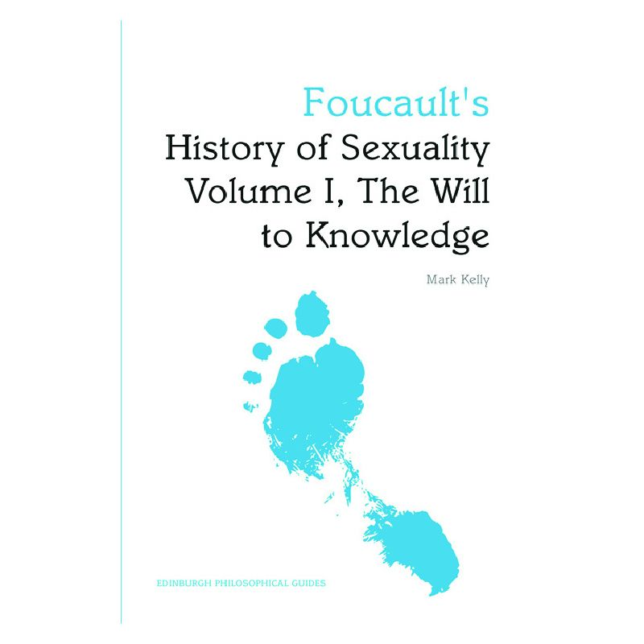
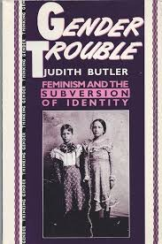
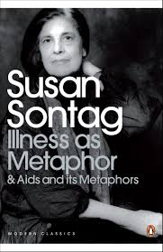
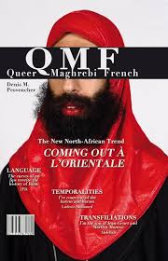
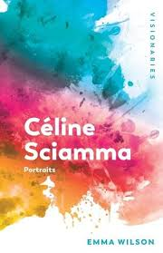

Slide 7
Planning
Corpus selection
Excerpt selection – cluster / triangulate examples
Which quotations?
How can you illuminate these with secondary reading?
Secondary criticism – which parts of the reader? Which critical framework?

Slide 8
Introductions
Contextualise your material: consider the historical, political, and social moment in which either textual or visual works are being produced and how this might affect the production of that creative output.
Repeal of the crime of sodomy 1791; emergence of homosexuality as disorder/pathology 19th century; Foucault on shift from activity to identity

Slide 9
Argumentation
Structure: Thesis, antithesis, synthesis. Remember to provide a clear, well-structured argument that pulls out three or four key issues from your primary sources.
Close Reading: produce a detailed analysis of the texts, films, photographs, or other visual artefacts studied for the course.

