Slide 1
Science-based Policies and the Arctic in the Climate Change Era
EDA AYAYDIN

Slide 2
History of Exploration in the Arctic
Motives:
Scientific
* International Polar Years (1882)
=> National
« Acquisition of terra nullius »
Shifting:
Nation State => Globalization

Slide 3
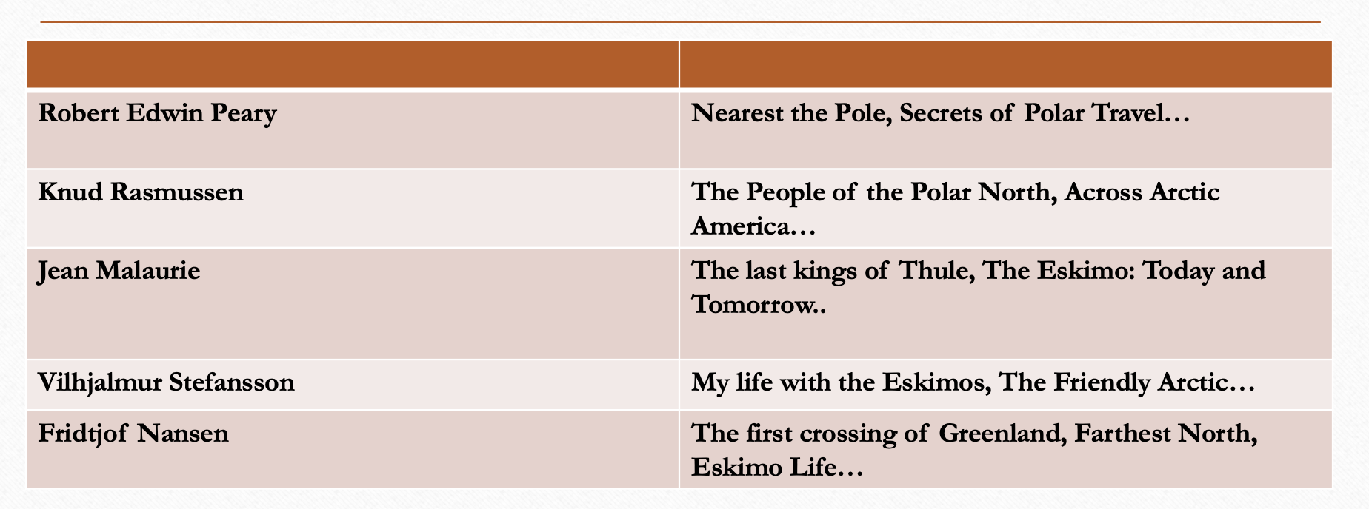
Exploration in the Arctic 20th centuries

Slide 4
Exploration in the Arctic 21th centuries

Slide 5
From National to Multinational
Characteristic traits of contemporary scientific and economic exploration
* The current international order is still based on the nation-state system BUT corporate and private continue to gain importance at international level.
* During the age of globalization, exploration is increasingly dominated by oil & gas companies which are the leading economic players in the Arctic.

Slide 6
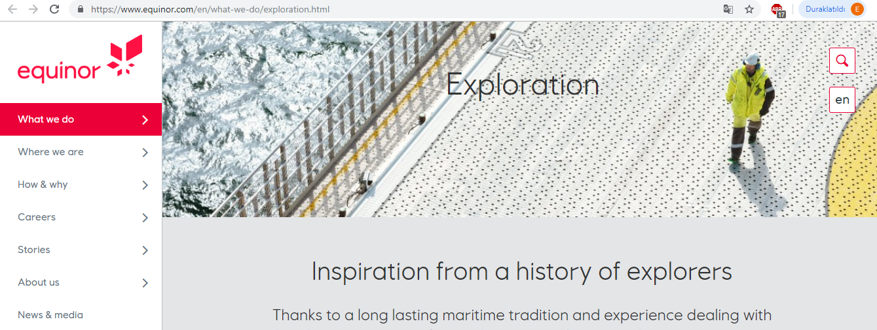
Partnership with:
Chevron-USA DEA-Germany
ConocoPhillips-USA ENI-Italy OMV-Austria

Slide 7
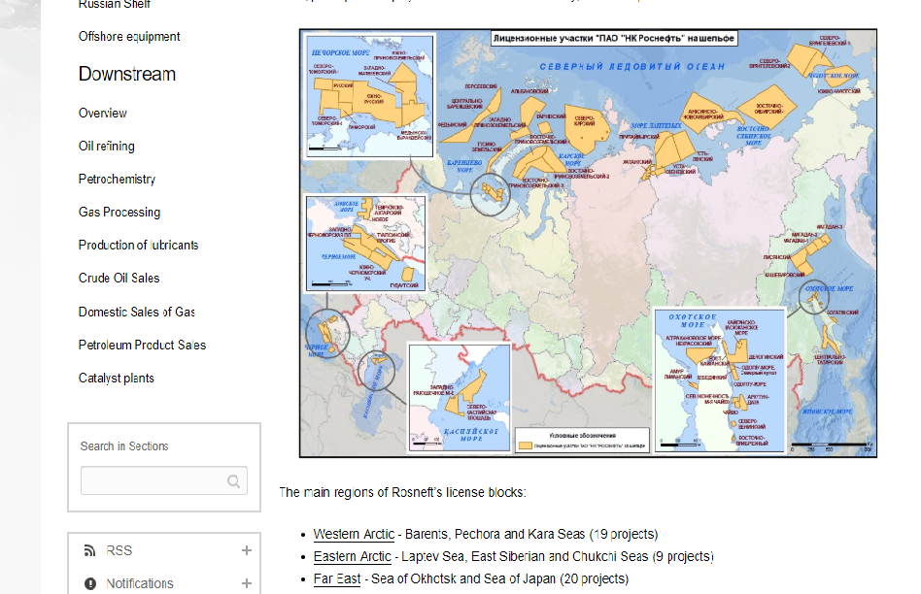
Rosneft- Arctic Exploration shelf

Slide 8
Russia: Actor of Energy Exploration
Alexey Miller, CEO of Gazprom: «No other country in the world has ever created anything like this in the Arctic. This project has no precedent in the history of the global gas industry.
By creating a brand new gas production centre beyond the Arctic Circle, Russia has proven its leadership in the Arctic.»

Slide 10
Territory of Dialogue
Arctic Council working groups continue actively working on science related climate and environmental research.
Indigenous knowledge and local communities are engaged in scientific arena.
Climate related scientific cooperation has been efficient.
They constructed environmental dialogue, territorial dialogue, economic dialogue. In the construcution, science played an importat role but to sustain it is more important.

Slide 11
Science for Science or Science for Society
The relation between Moscow and Oslo is different from the relation between Murmansk and Kirkenes.
The region has been an exceptional region in the international arena.
Political and economic cooperation augment but they are not separated from science.
In the era of climate crisis, science is needed more than before.
The way to the science-based policies is based in removing the iron curtain between science and politics.

Slide 12
Merci!
Спасибо!

