Slide 1
Prescribing in high-risk patient groups: Renal dysfunction, liver dysfunction and drug-drug interactions
Patricia McGettigan BSc(Pharm) MD FRCPI FRACP SFHEA FBPhS
Clinical Pharmacologist
Head of QMUL MBBS CPT Teaching

Slide 2
Objectives today
Understand
Impacts of organ impairment on drug handling in the body, the prescribing adjustments needed, drugs as causes of dysfunction
Renal dysfunction
Liver dysfunction
Concept of drug-drug interactions (DDIs)
Understand the practical relevance for your work
National Prescribing Safety Assessment (PSA), MBBS Finals, and FY1 work require this knowledge
Prepare: In your placements, use your CRS access to track & understand how clinical practice & prescribing must take account of organ function & DDIs
I include some practice questions with online BNF use today

Slide 3
Renal dysfunction

Slide 4
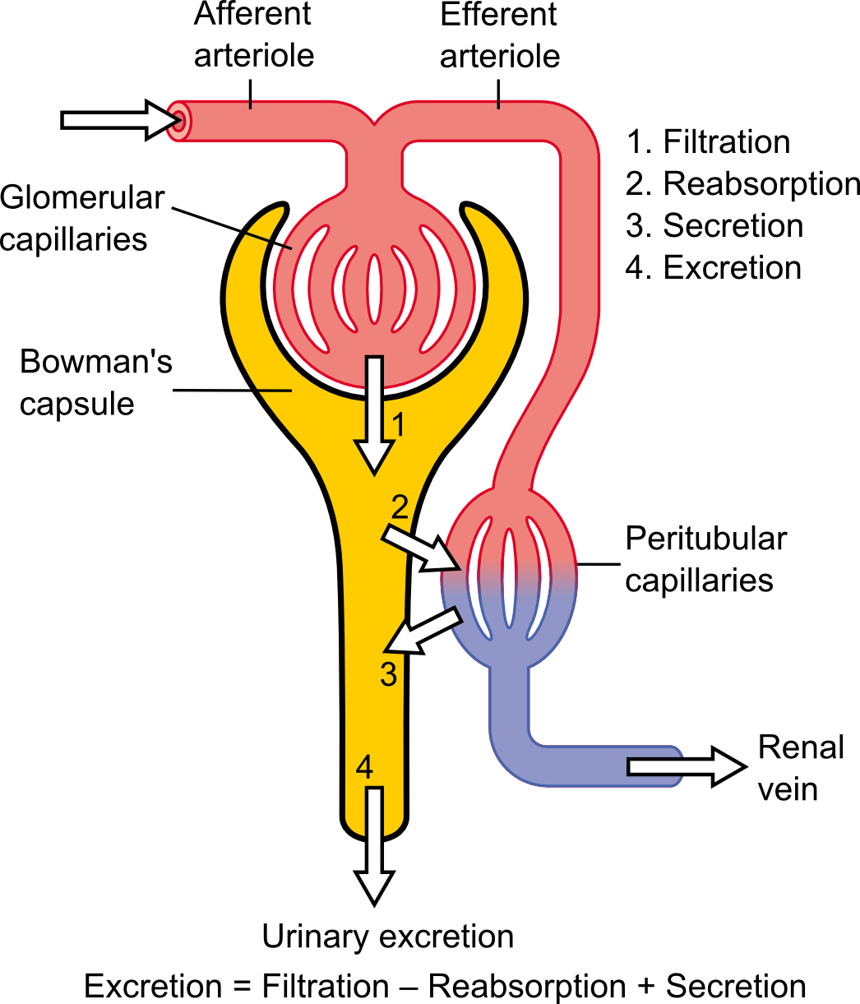
The kidney and drugs
Kidney has a role in handling many drugs
Excretion = Filtration – Secretion + Reabsorption
Drug handling may be affected by kidney health
Drugs, of themselves, may affect the health of the kidney
Common kidney health states relevant in CPT
Acute kidney injury (AKI)
Pre-renal, Renal, Post-Renal → reversible often →Revise causes
Drugs may be implicated – examples?
Chronic kidney disease (CKD)
Multiple causes → Revise causes
In both AKI and CKD, prescribing care ++ is needed

Slide 5
Kidney drug handling Excretion = Filtration – Secretion + Reabsorption
Filtration
Most drugs readily filtered, unless
Tightly bound to plasma protein (e.g. digoxin, warfarin)
Incorporated into red blood cells (e.g. chlorthalidone, cyclosporine)
Large (e.g. monoclonal antibodies)
While most drugs are filtered, overall renal excretion depends on tubule handling
About 10% of blood which enters glomerulus is filtered
But 90% of filtrate is reabsorbed
Clinical implication
For drugs excreted as unchanged drug: Good correlation between creatinine clearance and drug clearance
Reabsorption
Mainly passive
By the time the drug reaches distal tubule, water largely reabsorbed, so the concentration gradient is in the direction of reabsorption
Lipid soluble, non-polar drugs, small molecules reabsorbed
Polar drugs, e.g. alcohol, aspirin, are not reabsorbed (NB: hepatic metabolism renders some drugs more polar permitting renal excretion )
Polar (ionized) drugs, ↓renal reabsorption; urine pH
When urine is acidic, weak acids, e.g. aspirin, are more reabsorbed (weak base more excreted)
Alkaline urine, weak bases more reabsorbed
Clinical implication
Urinary alkalinisation (by IV sodium bicarbonate) used in aspirin/salicylate poisoning
Secretion
Active process
Requires transporter (e.g. OAT3) and supply of energy
Subject to competitive inhibition (e.g. penicillin and probenecid)
Saturable
Clinical implication
Active secretion is rate limited, e.g., one acid may saturate the secretion of another acid and delay its metabolism. Could be good (penicillin & probenecid) or bad (methotrexate & probenecid)

Slide 6
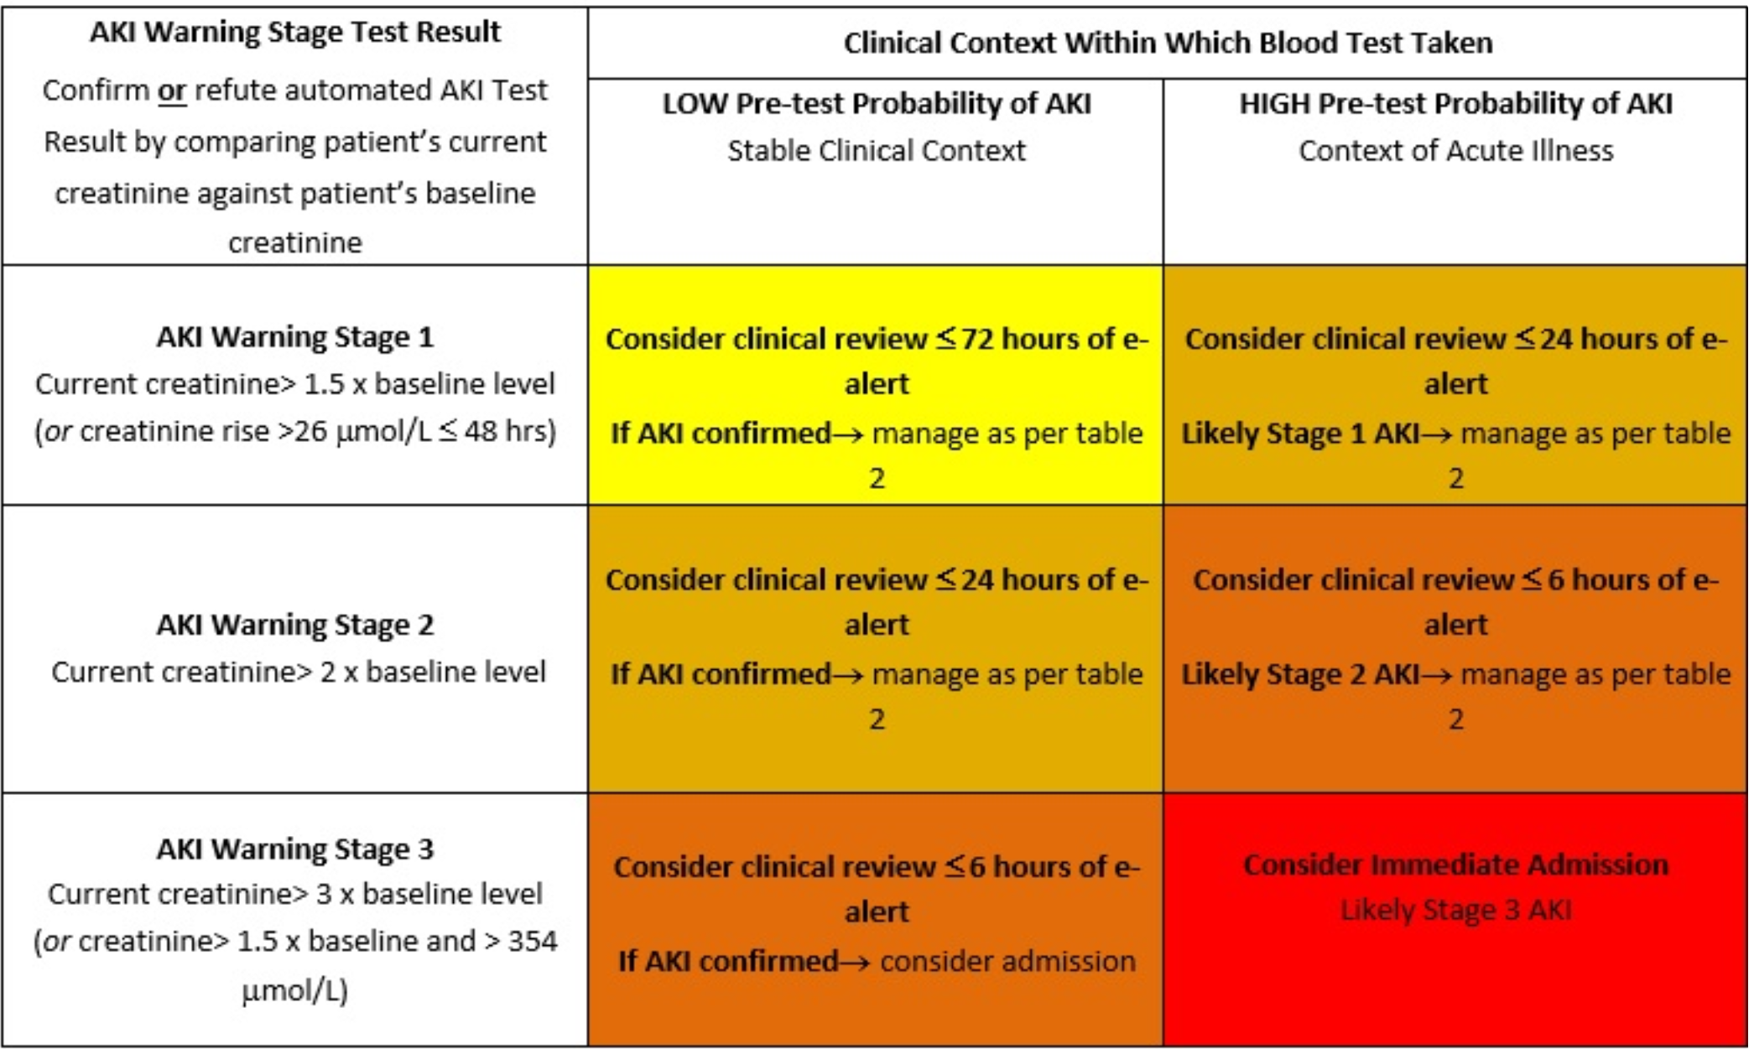
Kidney health: What is AKI?
A spectrum of kidney injury which can result from a number of causes which may co-exist.
Sudden decline in renal excretory function over hours or days; may result in fluid, electrolyte, & acid-base imbalances.
Diagnosis & staging are based on acute changes in serum creatinine &/or reduced urine output (oliguria).
https://www.coventryrugbygpgateway.nhs.uk/pages/acute-kidney-injury-aki/
https://cks.nice.org.uk/topics/acute-kidney-injury/

Slide 7
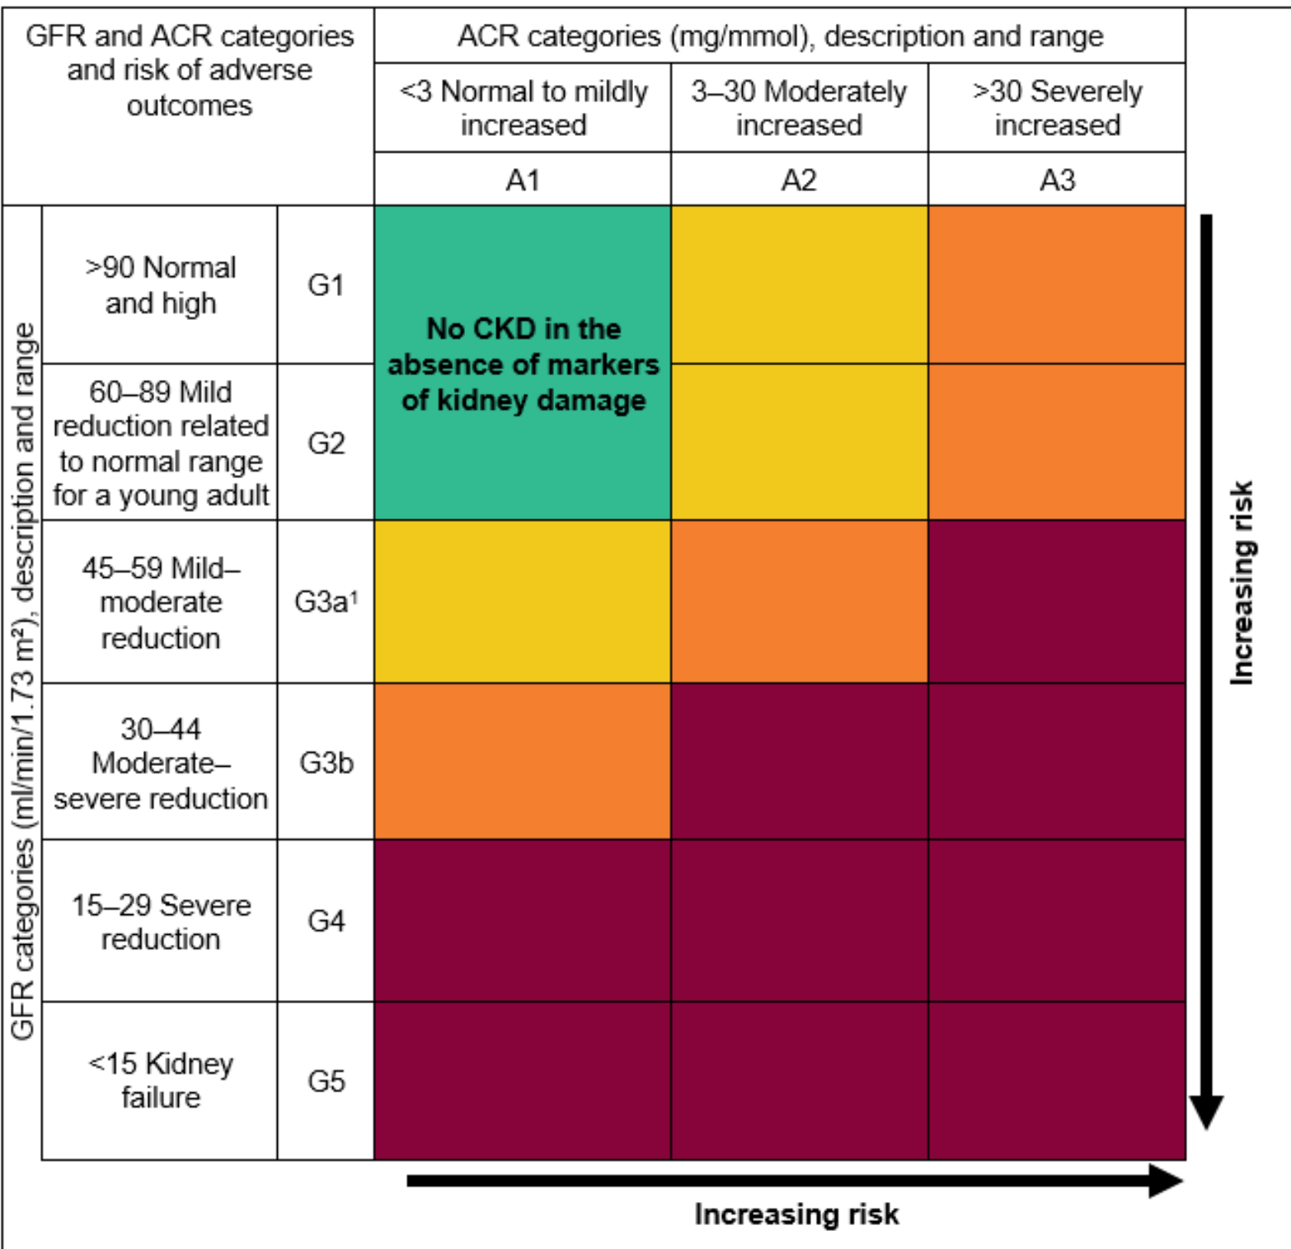
Kidney health: What is CKD?
CKD: a sustained reduction in the GFR &/or urinary abnormalities or renal tract structural abnormalities
Classified on eGFR & level of proteinuria - help risk stratify
Patients classified as G1-G5, based on the eGFR, and A1-A3 based on the ACR (albumin:creatinine ratio)
GFR: glomerular filtration rate
https://ukkidney.org/health-professionals/information-resources
https://cks.nice.org.uk/topics/chronic-kidney-disease/

Slide 8
Where do drugs come in?
Can cause AKI
Examples….
Worsen AKI
Examples….
Worsen CKD
Examples….

Slide 9
(35M) Admitted with sepsis, likely bacterial endocarditis with impaired LV function PMH: IVDU; well prior to this illness Investigations on Admission: Na⁺ 140 mmol/L (137–144), K⁺ 3.9 mmol/L (3.5–5.3), U 5.2 mmol/L (2.5–7.0) Cr 73 μmol/L (60–110); Weight 63Kg; BP 128/71mmHg Investigations 4 days later: Na⁺ 143 mmol/L (137–144), K⁺ 5.3 mmol/L (3.5–5.3), U 7.2 mmol/L (2.5–7.0) Cr 151 μmol/L (60–110); Weight 61Kg; BP 133/76mmHg Which of his current medicines is most likely associated with his pathology?
Amoxycillin 2G IV 4-hourly
Enoxaparin 40mg subcutaneously daily
Furosemide 40 mg orally daily
Bisoprolol 2.5mg mg orally daily
Gentamicin 300mg IV daily
Ramipril 5mg orally daily

Slide 10
(74M) Admitted for acute pulmonary oedema secondary to heart failure PMH: CKD stage III, type II diabetes mellitus, ischaemic left ventricular dysfunction Investigations: eGFR 20 (stable) [normal range >60 ml/min/1.73m² ] Select one prescription that should be stopped
Atorvastatin 20 mg orally daily
Candesartan 32 mg orally daily
Carvedilol 25 mg orally 12-hrly
Heparin 5000 units subcutaneously daily
Furosemide 50 mg intravenously twice daily
Metformin MR 1g orally twice daily

Slide 11
Kidney health (function) is especially important for drugs that are renally excreted
Renal excretion: many drugs – partly or fully
Revise physiology, metabolism
How do you stay safe & keep the patient safe when prescribing for people
with known renal impairment?
at risk of new / worsening impairment?
Wise to know some common red-flag drugs in your head
What drugs come to mind?
Wise to check: know how / where to check efficiently - vital in FY1 & PSA

Slide 12
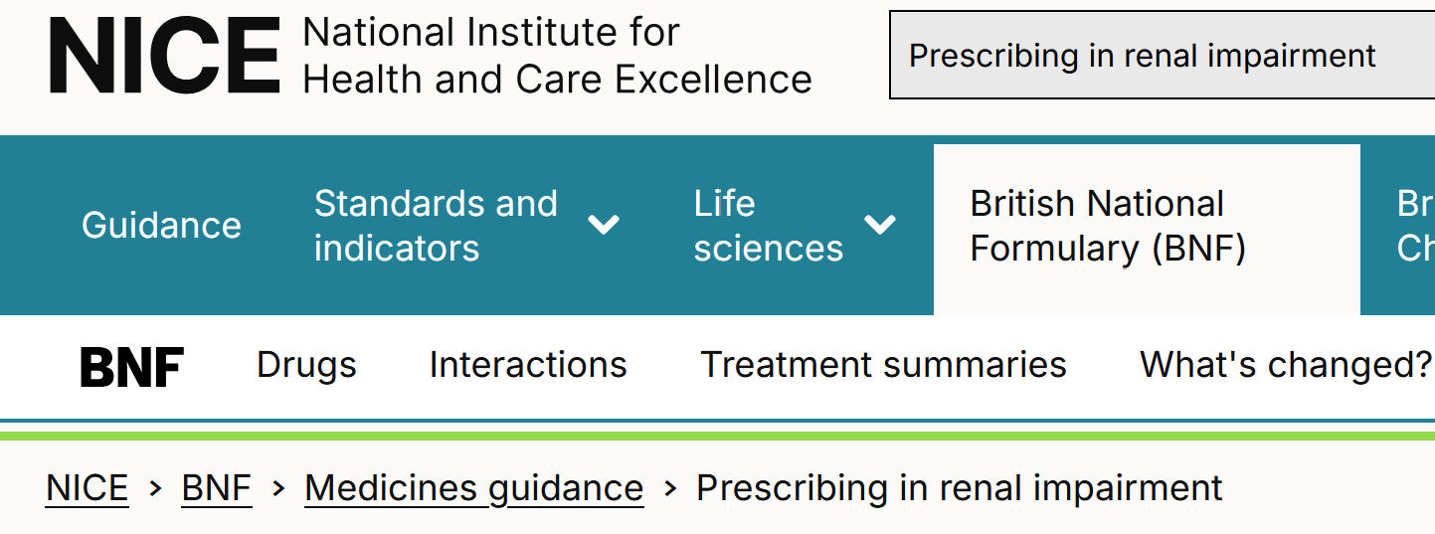
NICE CKS and BNF are very useful in MBBS Year 5 You already know core physiology & pathology These resources now help you apply your knowledge clinically
https://cks.nice.org.uk/topics/acute-kidney-injury/
https://bnf.nice.org.uk/medicines-guidance/prescribing-in-renal-impairment/

Slide 13
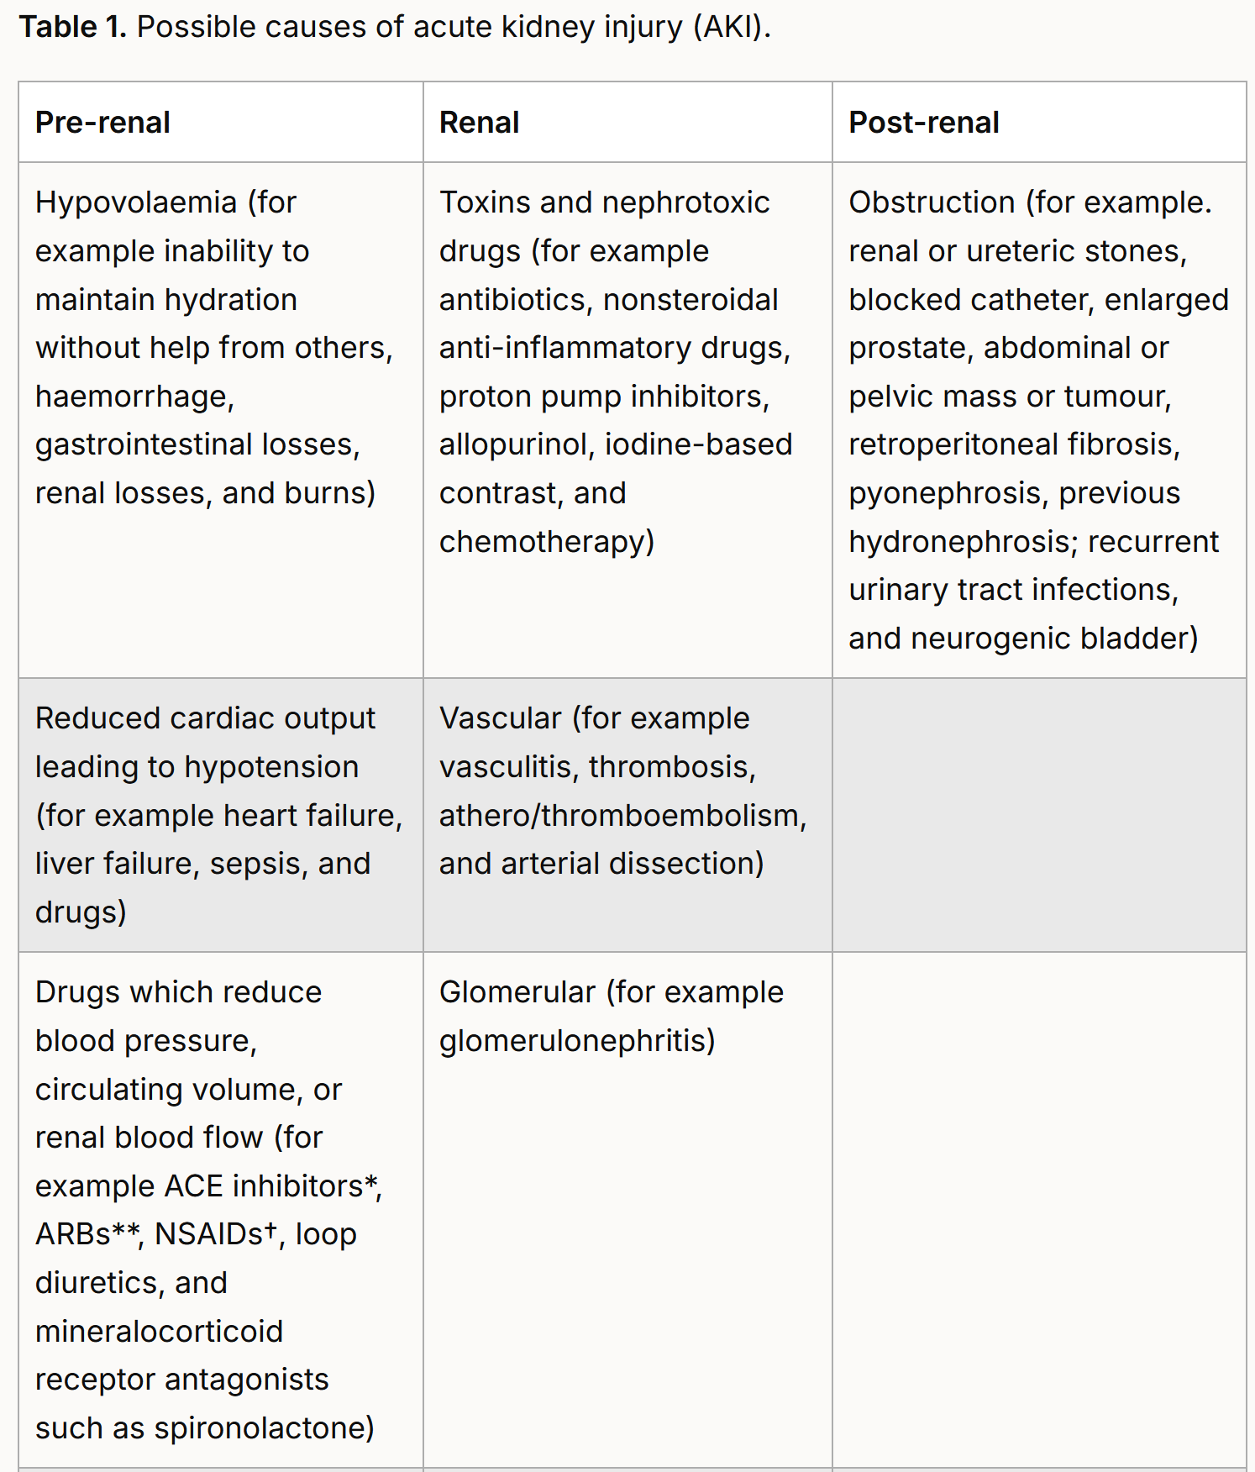
Back to my earlier Q - Drugs
Acute kidney injury (AKI)
Pre-renal, Renal, Post-Renal → reversible often →Revise causes
Drugs may be implicated – examples?
The more you think about these matters
For the patients you see on placement → The better you embed the knowledge = you think swiftly & well on your feet
This clinical practice is essential
Remember
The PSA rewards clinical practice
For FY1: MBBS clinical practice = a huge headstart
https://cks.nice.org.uk/topics/acute-kidney-injury/background-information/causes/

Slide 14
Acute kidney injury / nephrotoxins
Non-exhaustive list of common (potential) nephrotoxins
“POTENTIAL” is important – they can, but not always
This is a non-exhaustive list
Diuretics, especially loop diuretics
ACEi/ ARB/ mineralocorticoid antagonist
NSAIDs
Anti-infectives (rarely when oral)
Aminoglycosides such as gentamicin
Vancomycin
Some penicillins and cephalosporins
Certain IV anti-fungals such (e.g. amphotericin B), IV antivirals (e.g. acyclovir)
Aspirin and paracetamol in overdose
Statins and fibrates (with rhabdomyolysis)
Radiocontrast agents
Lithium in overdose
Certain immunosupressants and chemotherapy
Of course, not all AKIs are drug-related
Common drug culprits

Slide 15
Where do you find out about a drug’s renal handling profile? In the Summary of Product Characteristics - The SPC A high value resource for every drug; BNF is a good summary but it’s often v brief
Ramipril: Compare BNF
https://bnf.nice.org.uk/drugs/ramipril/#renal-impairment
with SPC
https://www.medicines.org.uk/emc/product/7104/smpc#gref
Amlodipine: Compare BNF
https://bnf.nice.org.uk/drugs/amlodipine/
with SPC
https://www.medicines.org.uk/emc/product/4717/smpc#gref

Slide 16
Renal dysfunction and prescribing
Usually either frequency or at times, dose, of the medication may need to change in presence of renal impairment.
Check how it happens with co-amoxiclav
https://bnf.nice.org.uk/drugs/co-amoxiclav/

Slide 17
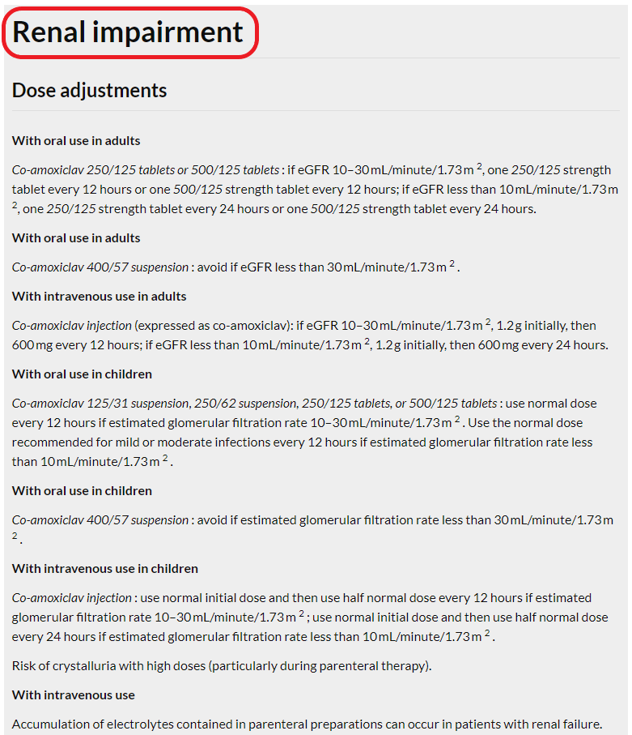
BNF (NICE)
https://bnf.nice.org.uk/drugs/co-amoxiclav/

Slide 18
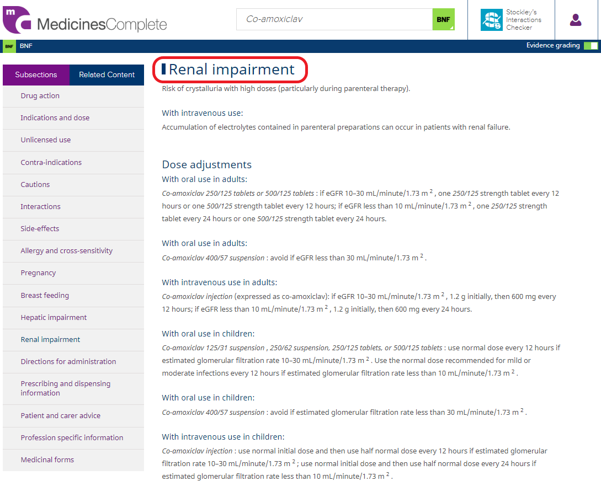
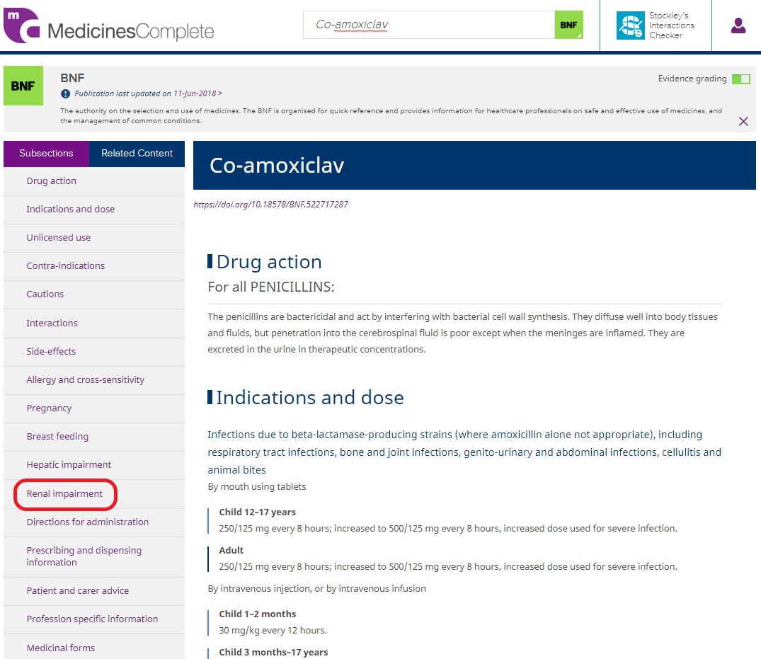
BNF (Medicines Complete)

Slide 19
Prescription Review Item
ID
REVxxx
(CLO-REV015)
This item is worth 2 marks
You may use the BNF at any time
Case presentation
A 70-year-old man attends his community day hospital for a multi-morbidity check up. He has no symptoms suggestive of hypotension or hypoglycaemia.
He says his exercise tolerance is not as good as a year ago, now needing to rest after 200 meters.
PMH. Type II Diabetes, hypertensive heart failure, gout, osteoporosis, CKD stage 4. DH. Listed on table.
Examination
BP 130/82 mmHg, pulse 71 bpm.
Chest clear, no peripheral oedema
Investigations.
Na⁺ 141 mmol/L (137–144), K⁺ 4.1 mmol/L (3.5–4.9)
eGFR 25 mL/min now; two years ago, eGFR 47 mL/min (>60)
HbA1c 41mmol/mol (20–42)
Serum cholesterol mmol/L 4.1 (<5.2), serum LDL cholesterol 3.1 mmol/L (<3.36), serum HDL cholesterol 1.0 mmol/L (>1.55)
CURRENT PRESCRIPTIONS
Drug name | Dose | Route | Freq. |  | A
Alendronic acid | 70 mg | ORAL | Weekly
Allopurinol | 100 mg | ORAL | Daily
Amlodipine | 2.5mg | ORAL | Daily
Atorvastatin | 20 mg | ORAL | Nightly
Bisoprolol | 2.5 mg | ORAL | Daily
Furosemide | 40mg | ORAL | Daily
Metformin | 500 mg | ORAL | 8-hrly
Paracetamol | 1000 mg | ORAL | 8-hrly
Ramipril | 2.5 mg | ORAL | Daily
Question A
Select the TWO prescriptions that should be stopped at this review.
(mark them with a tick in column A)

Slide 20
Liver dysfunction

Slide 21
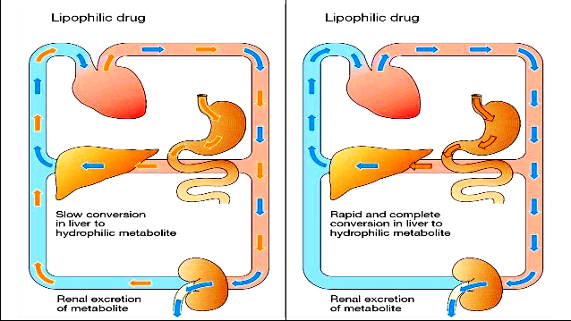
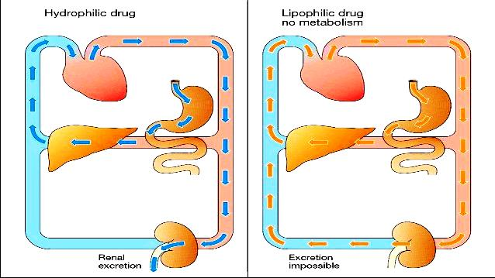

Slide 22
Hepatic metabolism
Acute liver dysfunction reduces metabolism and excretion
Chronic dysfunction - cirrhosis may increase absorption/bioavailability (↓ first pass metabolism) and alter distribution (↓plasma protein binding)
Reduction of first pass effect of oral drugs
Oral drugs metabolised by the liver may need reduced doses, e.g. midazolam
Also need to consider pro-drugs – e.g. codeine may not be metabolised to its pharmacologically active product, morphine
Clinical categorization (Child-Pugh score) sometimes used to determine mild/moderate/severe to allow for dose adjustment – not always helpful

Slide 23
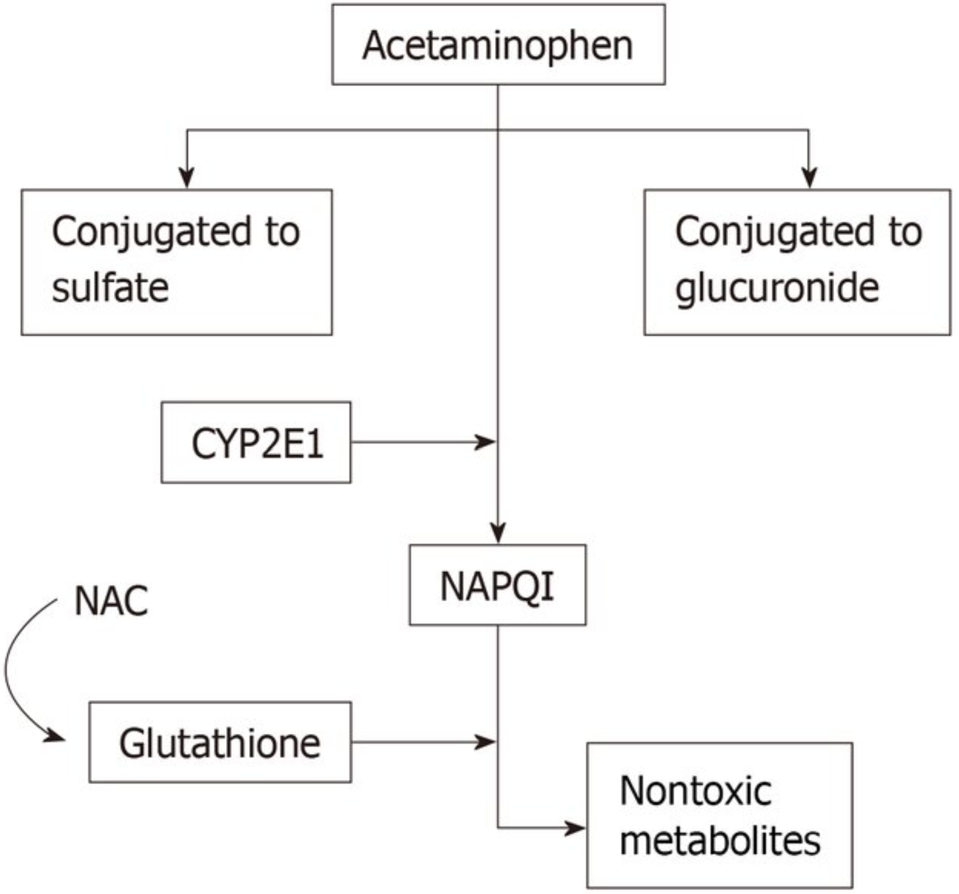
Liver dysfunction: are LFTs representative?
Paracetamol metabolism - cytochrome P450 2E1. N-acetyl-p-benzoquinone imine (NAPQI) is produced when the other two conjugation pathways become over-saturated. NAPQI is converted into nontoxic metabolites by glutathione, which is regenerated by n-acetylcysteine (NAC).
No endogenous markers to use as a guide to prescribing /dosing
Bilirubin – no direct correlation, but can displace drugs from protein-binding sites
ALT / AST / AlkPhos – no direct correlation
Albumin / protein – no direct correlation, but influences protein binding of drugs
Reduced protein binding → ↑ quantity of free drug, ↑ peak levels, onset of drug action, and adverse effects (e.g. phenytoin / prednisolone)
Clotting (and platelets)
Reduced synthesis of clotting factors: Anticoagulants may be contraindicated, or used with specialist guidance
Metabolism
Paracetamol – reduced glutathione synthesis - toxicity
BNF rarely very helpful for prescribing in liver dysfunction
E.g., “Manufacturer advises caution. Avoid oral preparations in acute impairment; for injectable preparations—consult product literature.”

Slide 24
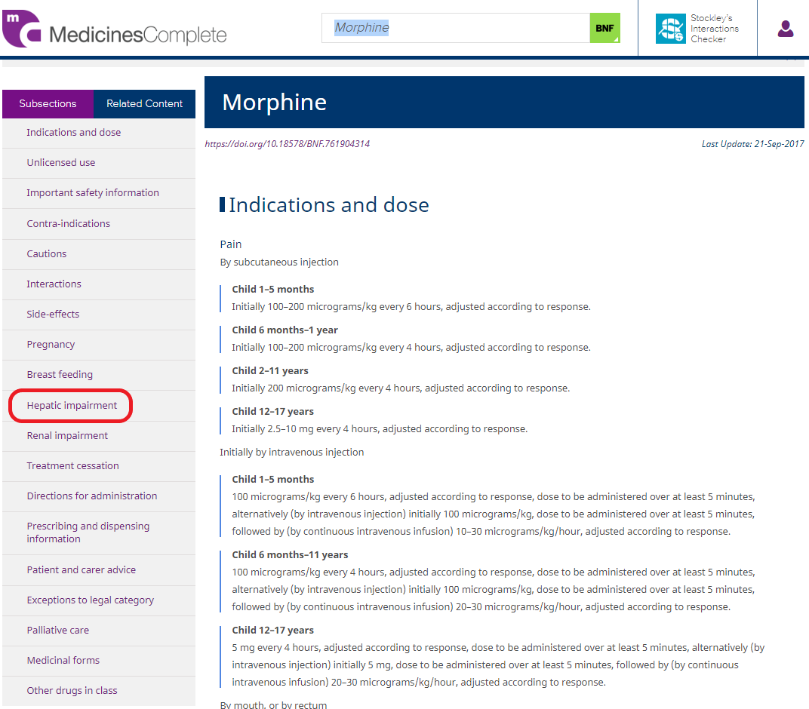
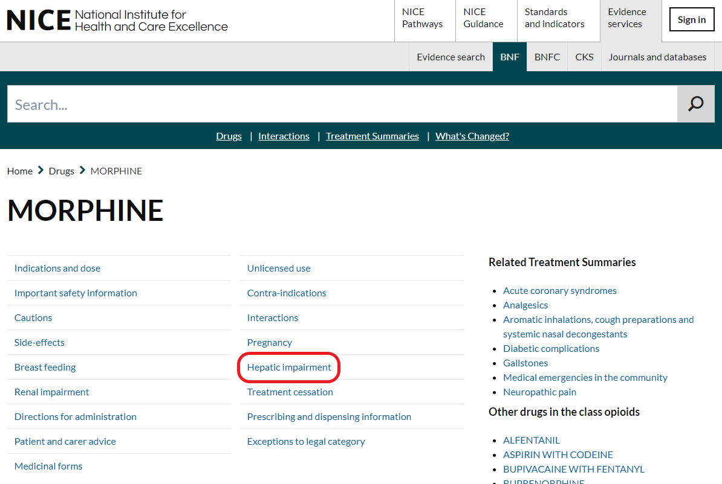
BNF (NICE)
BNF (Medicines Complete)
https://bnf.nice.org.uk/drugs/morphine/#hepatic-impairment

Slide 25
Prescription Review Item
ID
REVxxx
This question item is worth 2 marks
You may use the BNF at any time
Case presentation
A 64-year-old woman presents to Emergency Department complaining of abdominal distension and pain. PMH. She has suffered from alcoholic cirrhosis, alcoholic cardiomyopathy and chronic obstructive pulmonary disease.
Examination
Mildly jaundiced, temperature 38.2C
Moderate ascites with generalised abdominal tenderness
Investigations
Hb 134, WBC 14.5, Neut 13.1, Plt 245
Na 141, K 4.1, eGFR 78
INR 2.3, Bili 61, ALT 121, AlkPhos 108
ECG sinus rhythm 82/min.
Ascitic tap sent for MC+S
She has been started on lactulose and tazosin. You have been asked to review her drug chart by the ward pharmacist.
CURRENT PRESCRIPTIONS
Drug name | Dose | Route | Freq. |  | A
Bisoprolol | 2.5 mg | ORAL | daily
Fostair® 100/6 (100 micrograms beclomethasone + 6 micrograms formoterol per puff) | Two puffs | INH | 12-hrly
Furosemide | 80 mg | ORAL | daily
Lactulose | 30 ml | ORAL | 8-hrly
Omeprazole | 20 mg | ORAL | daily
Piperacillin with tazobactam | 4.5 g | IV | 8-hrly
Ramipril | 5 mg | ORAL | daily
Spironolactone | 50 mg | ORAL | daily
Tiotropium | 18 micrograms | INH | daily
Zopiclone | 7.5 mg | ORAL | nightly
Question A
Select ONE prescription that may need dose adjustment or cessation due to her hepatic dysfunction.
(mark it with a tick in column A)

Slide 26
Commonsense applies for 1) Prescribing in hepatic impairment & 2) In thinking about causes of hepatic impairment
Prescribing in hepatic impairment
Care ++ with medications that can result in:
Drowsiness / sedation; Bleeding; Constipation; Further impairment / dysfunction
Think twice & avoid if possible
Causes: Beware Drug Induced Liver Impairment (DILI)
Think of DILI with new liver dysfunction & no obvious cause
Distinct from paracetamol toxicity arising from glutathione depletion
Typically an idiosyncratic response to various drugs, e.g., flucloxacillin; nitrofurantoin; co-amoxiclav; azathioprine, others
Genetic predisposition in some people, e.g., HLA-B*5701 carriers are at increased risk of flucloxacillin-associated DILI (also abacavir-associated TEN / Stevens Johnson Synd)
Pattern: Hepatocellular / cholestatic / mixed LFT derangement
Excellent information @ https://www.bsg.org.uk/web-education/drug-induced-liver-injury

Slide 27
Drug-drug interactions

Slide 28
Drug-drug interactions (DDIs) The effect of a drug is altered by another drug
Multiple categories of DDI
Many DDIs relate to
Pharmacokinetic (PK) interactions - common
Changes in absorption, distribution, metabolism or excretion, e.g. tetracyclines poorly absorbed if Ca / Mg / Fe ions present – form complexes; multiple CYP-driven interactions affect metabolism – many inducer & inhibitor drug lists (next slide) https://www.ncbi.nlm.nih.gov/pmc/articles/PMC3897029/
Pharmacodynamic (PD) interactions – less common
Synergism, antagonism, altered cellular transport, effect on receptor site, e.g., probenecid inhibits/slows flucloxacillin excretion, increasing exposure - useful https://www.sciencedirect.com/science/article/abs/pii/S0163445319302750 ; https://www.ncbi.nlm.nih.gov/pmc/articles/PMC6529235/
- Review your SCRIPT modules
- BNF has a good overview of interactions plus multiple tables (variously helpful): https://bnf.nice.org.uk/interactions/appendix-1-interactions/

Slide 29
Commonly prescribed inducers/inhibitors Be familiar with common drugs (usually class effect too), and check others
Inducers
Carbamazepine
Rifampicin / ritonavir
Alcohol (chronic)
Phenytoin / phenobarbitone
Griseofulvin / Fluconazole
St John’s Wart
Isoniazid (CYP2A1)
Inhibitors
Clarithromycin / azithromycin / erythromycin
Amiodarone
Dexamethasone
Valproate
Metronidazole
Cimetidine
Ciprofloxacin
Isoniazid (CYP1A2)
Grapefruit juice
Ketoconazole
Ritonavir
Verapamil / Diltiazem
Alcohol (acute)

Slide 30
How to check for interactions? Hard to remember interactions accurately So know how to check swiftly

Slide 31
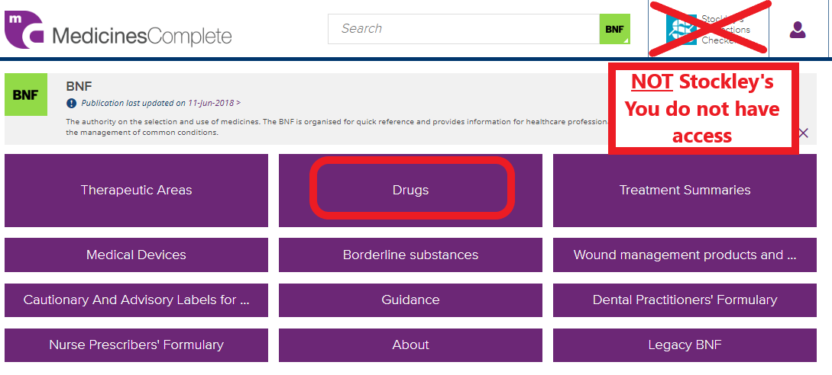
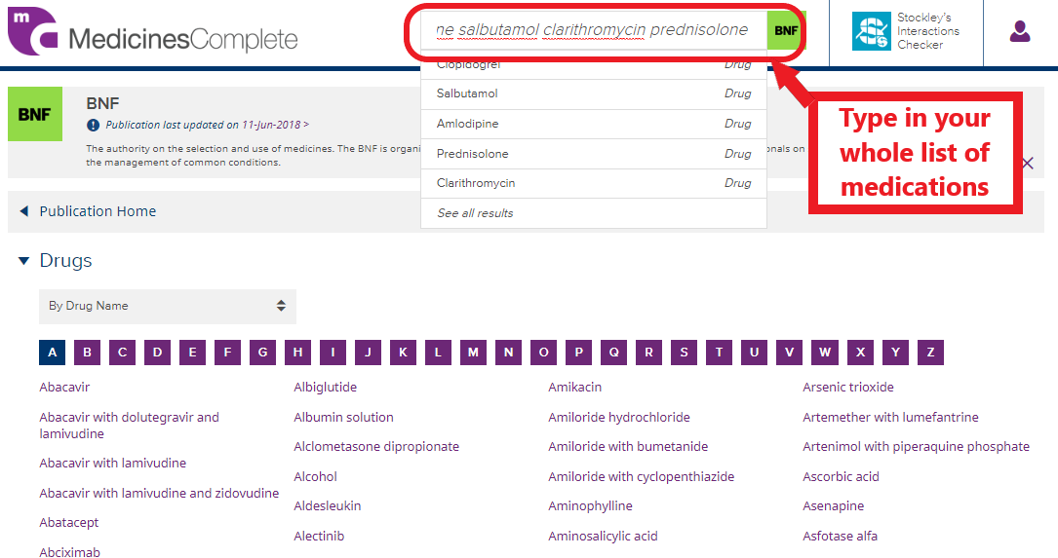
How to check for interactions? (Medicines Complete) (1/2)
STEP 1
STEP 2

Slide 32
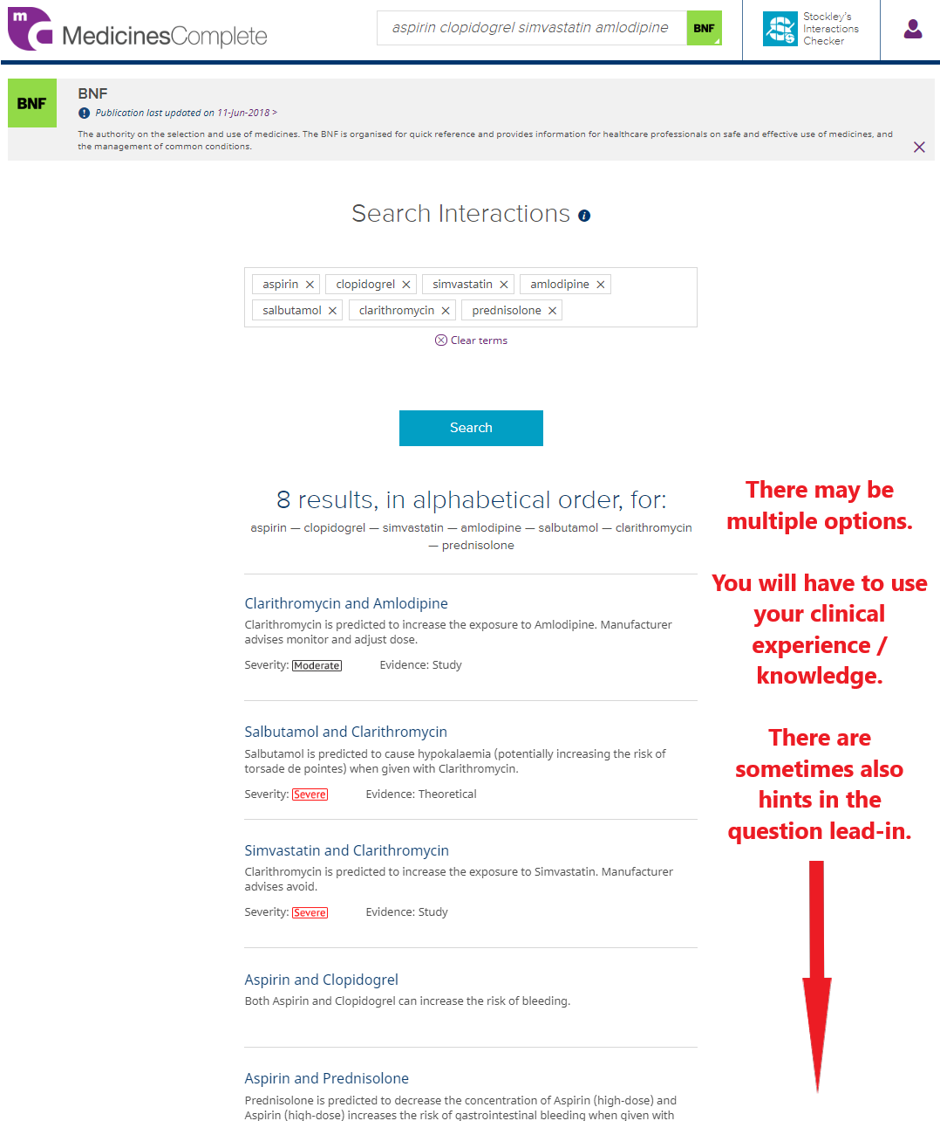
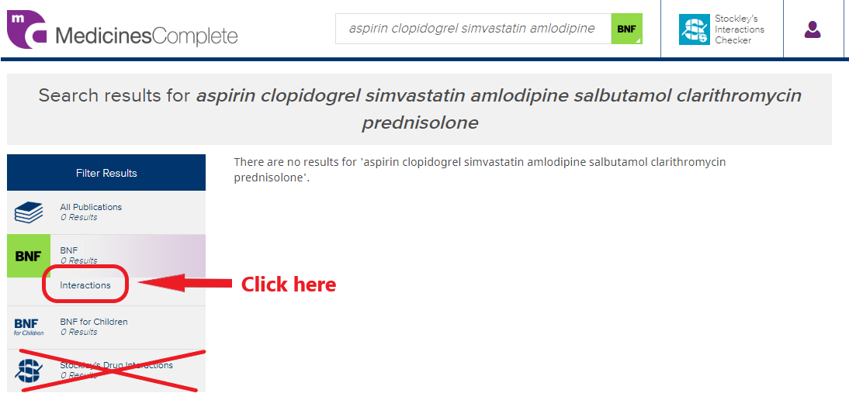
How to check for interactions? (Medicines Complete) (2/2)
STEP 4
STEP 3

Slide 33
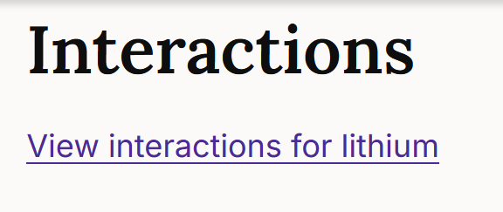
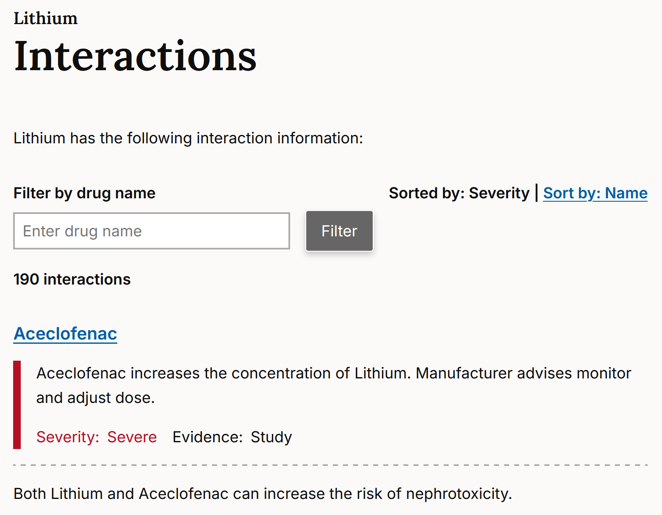
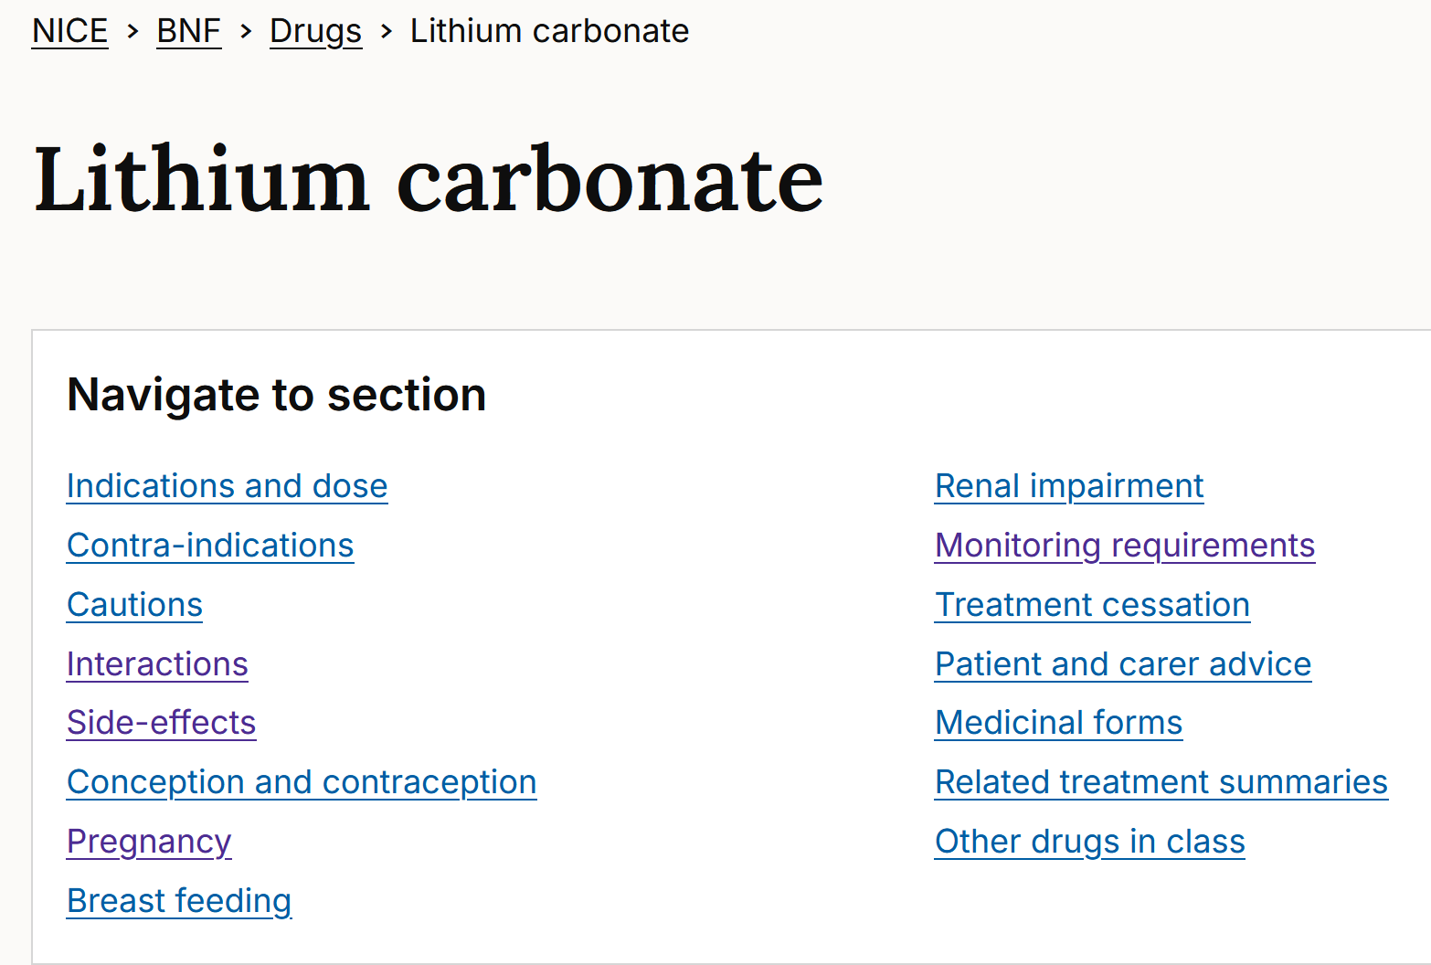
How to check for interactions? (NICE)
STEP 2
STEP 1
I prefer BNF NICE for DDI-checking!

Slide 34
Prescription Review Item
ID
REVxxx
This question item is worth 4 marks
You may use the BNF at any time
Case presentation
A 64-year-old woman presents to ED with abdominal distension and pain. PMH. She has alcoholic cirrhosis, cardiomyopathy, atrial fibrillation and chronic obstructive pulmonary disease.
Examination
Mildly jaundiced, temperature 38.2C
Moderate ascites with generalised abdominal tenderness
Investigations
Na 141, K 4.1, eGFR 18
INR 2.3, Bili 61, ALT 121, AlkPhos 108
ECG atrial fibrillation, ventricular rate 82/min.
Ascitic tap sent for MC+S
She has been started on lactulose, tazosin and apixaban. You have been asked to review her drug chart by the ward pharmacist.
CURRENT PRESCRIPTIONS
Drug name | Dose | Route | Freq. |  | A |  | B
Apixaban | 2.5 mg | ORAL | 12hrly
Bisoprolol | 2.5 mg | ORAL | daily
Digoxin | 62.5 micrograms | ORAL | daily
Furosemide | 80 mg | ORAL | daily
Lactulose | 30 ml | ORAL | 8-hrly
Omeprazole | 20 mg | ORAL | daily
Piperacillin with tazobactam | 4.5 g | IV | 8-hrly
Spironolactone | 50 mg | ORAL | daily
Tiotropium | 18 micrograms | INH | daily
Question A
Select the TWO prescriptions that most likely requires dose adjustment, or to be discontinued due to her renal dysfunction. (mark them with a tick in column A)
Question B
Select the ONE prescription that is contraindicated due to her hepatic dysfunction. (mark it with a tick in column B)

Slide 35
Appendix slides

Slide 36
The effect of urinary pH on the drug elimination

Slide 37
Drugs acting within nephron
For example
Diuretics
Either ineffective, or sometimes (with specialist input) requires increased doses
Some glycosuric agents (e.g. dapagliflozin)
Uricosuric agents – such as probenecid - no longer commonly used

Slide 38
Drugs that require dose-adjustments (Page 1/3)
Non-exhaustive list (1-3)of medications that require dose adjustment or stopping with renal dysfunction
 | Renal dosing adjustment / stopping / contraindicated | Non-specific guidance (Low starting dose / caution / increased monitoring / “avoid in severe”) | Typically no adjustment
Analgesics | NSAIDs, Opiates, neuropathic pain meds
Gastric acid secretion suppressants | H2 antagonists |  | PPIs
Immunosupressants | Most immunosuppressants such as methotrexate, aminosalicylates, azathioprine, sulfasalazine
Antiplatelets / anticoagulation | LMWH, direct oral anticoagulants | Warfarin | Antiplatelets
Antibiotics | Most antiniotics, most antivirals, most antifungals | Most antimalarials

Slide 39
Drugs that require dose-adjustments (Page 2/3)
 | Renal dosing adjustment / stopping / contraindicated | Non-specific guidance (Low starting dose / caution / increased monitoring / “avoid in severe”) | Typically no adjustment
Renin-antgiotensin-aldosterone axis | ACEi, ARBs, beta-blockers, mineralocorticoid antagonists
Other cardiovascular medications | Digoxin, hydralazine, most statins, fibrates
Antidepressants | Most SNRIs | Most SSRIs | Most TCAs
Antipsychotics / anti-mania | Amisulpride, Lithium | Most antipsychotics
Sedatives | Benzodiazepines, z-drugs
Anti-epilepsy drugs | Most (but not those for status epilepticus)

Slide 40
Drugs that require dose-adjustments (Page 3/3)
 | Renal dosing adjustment / stopping / contraindicated | Non-specific guidance (Low starting dose / caution / increased monitoring / “avoid in severe”) | Typically no adjustment
Anti-diabetic drugs | Metformin, DDP4 inhibitors (-gliptins), SGLT2 inhibitors (-flozins), GLP1 agonists (e.g. semaglutide) | Sulfonylureas
Hypo- / hyper-thyroid medications | Propylthiouracil |  | Levothyroxine, carbimazole
Gout (acute / chronic) | NSAIDs, colchicine, allopurinol, febuxostat |  | Steroids
Asthma/COPD medications |  |  | (Most)
Osteoporosis | Bisphosphonates

Slide 41
Dialysis
Removes drugs which are mainly
Water soluble
Not tightly bound to plasma protein
Low molecular weight (e.g. <500 daltons)
Small apparent volume of distribution (i.e. not extensively stored/distributed)
Complex and specialist area
Clinical implications
Sometimes used to treat drug overdoses (usually only when severe)
Salicylates, theophylline, atenolol, phenobarbitol, lithium, valproate
Methanol, ethylene glycol, isopropanol
Drug-dosing is complex for patients undergoing dialysis

Slide 42
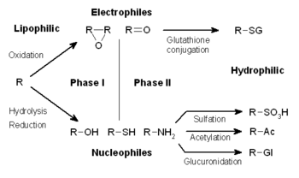
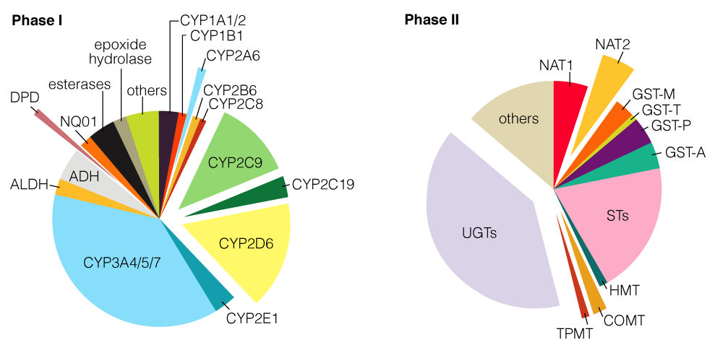
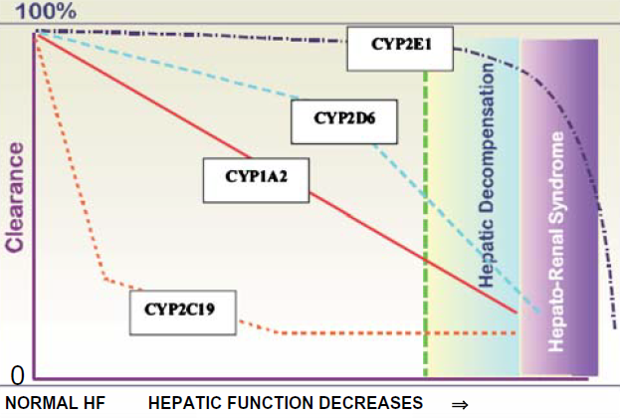
Drug metabolising enzymes
Multiple pathways for Phase I and II hepatic metabolism
Results in more water-soluble (less lipid soluble) metabolite
Multiple different drug metabolising enzymes with varying roles
Impacted at different rates with liver dysfunction
Difficult to appropriately adjust doses in hepatic dysfunction
BNF guidance (and optimal clinical practice) sometimes/often unclear

Slide 43
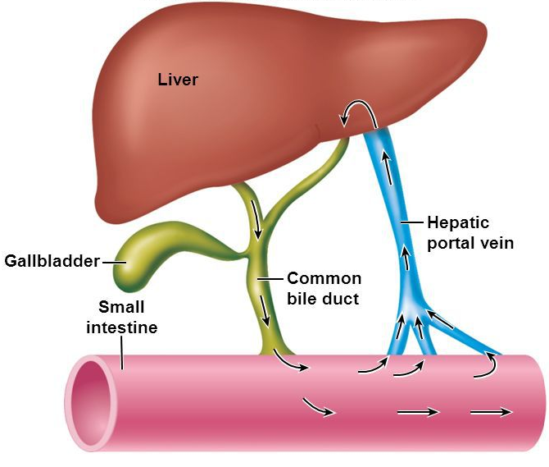
Enterohepatic circulation
Some drugs also excreted in bile
Can involve enterohepatic circulation
Liver secretes 0.25 – 1 L of bile each day
Breakdown of glucuronide conjugate or deacetylation in intestine allows reabsorption
Examples include indomethacin and rifampicin
Rarely changes dosing / clinical decision

Slide 44
Drug-drug interactions - pharmacokinetics
ADME | Examples
Absorption | Altered gastric pH wary when antacids, histamine receptor antagonists and PPIs used (note: antifungals to be taken 2hrs before) Chelation of compounds particularly with magnesium- / aluminium-based antacids (with quinolones, penicillamines and tetracyclines) iron (with tetracycline) Altered gastric emptying and intestinal motility Prokinetic agents e.g. metoclopramide may increase transit time, may decrease digoxin and theophylline absorption (and increase alcohol / aspirin tetracycline / levo-dopa absorption) Altered active and passive intestinal transport Altered intestinal cytochrome P450 isozyme activity

Slide 45
Drug-drug interactions - pharmacokinetics
ADME | Examples
Absorption (continued) | Altered intestinal P-glycoprotein activity P-gp opposes the absorption of unchanged drug by transporting lipophilic compounds out of enterocytes back into the gastrointestinal lumen broad substrate specificity classically inhibited by verapamil, macrolides and PPIs may be sufficient to influence drugs with low therapeutic index
Distribution | Displacement (usually competitive) of protein-binding sites
Metabolism | See later – most common cause of drug-drug interactions
Excretion | Competition between drugs for active transport secretion in PCT e.g. methotrexate and salicylates; penicillin and probenecid Tubular reabsorption not typically clinically influenced by drug-drug interactions

Slide 46
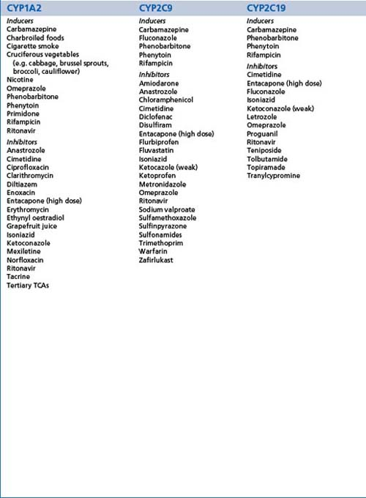
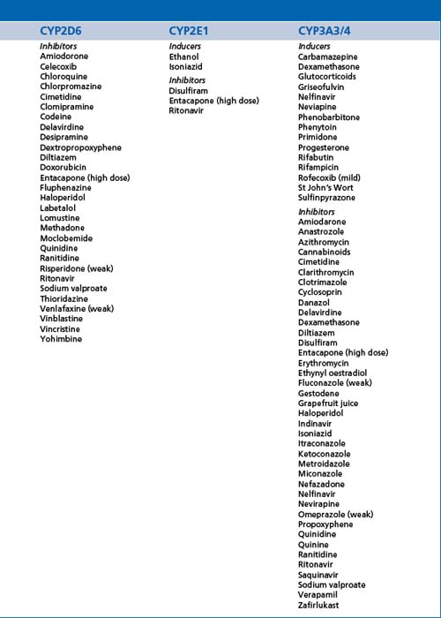
Inducers/inhibitors
Don’t memorise the whole list! (And this is already shortened)
Complicated by different drugs being substrates for differing enzymes!
Be familiar with common drugs (usually class effect too), and check others

