Slide 1
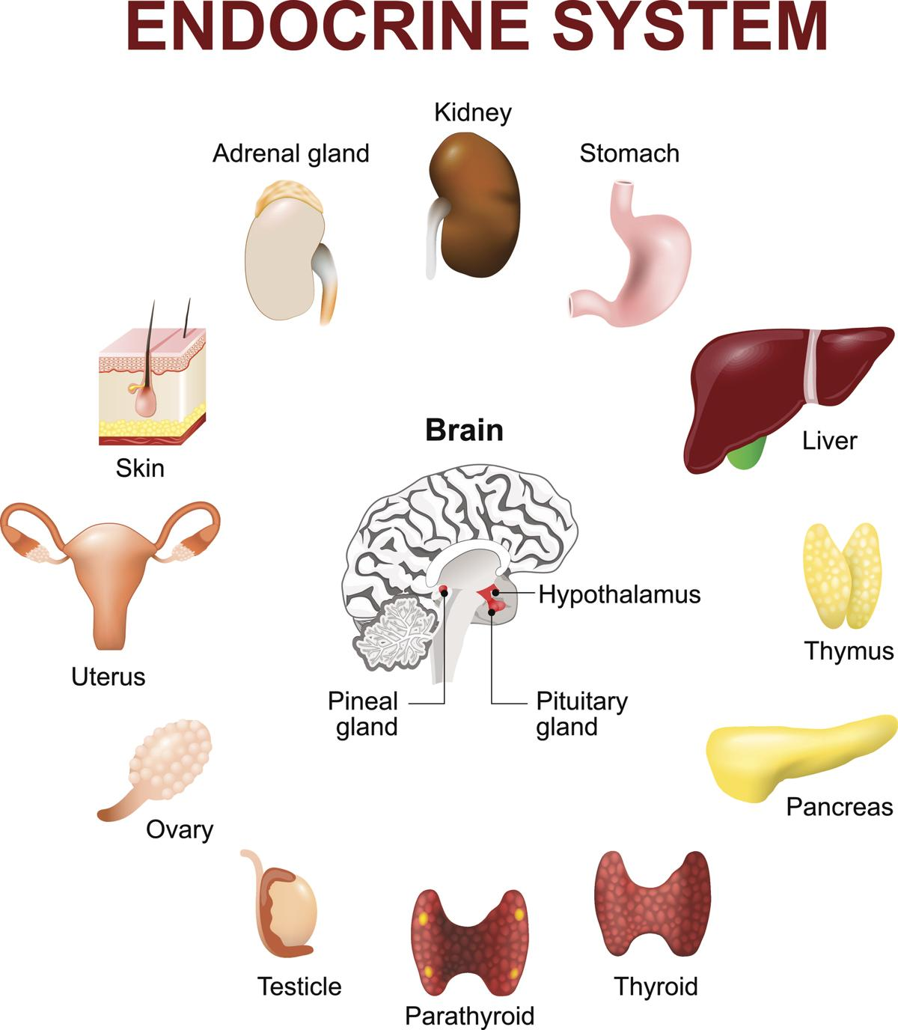
The Pancreas
Continued from the endocrine lecture
Dr Nyree myatt

Slide 2
Learning objective
“Students should demonstrate an understanding of the endocrine system, including how receptors and second messengers are involved. Students should understand how insulin and glucagon are involved in the homeostasis of blood glucose concentration and what happens with Type 1 and Type 2 diabetes and how they may be treated.

Slide 3
Lesson aims
By the end of the lesson, students will be able to:
1. describe receptors and second messengers.
2. describe the hormones produced by the pancreas
3. describe glucose homeostasis, type 1 and 2 diabetes and treatment

Slide 4
Receptors and second messengers
Hormones are the “first “ messenger (1)
Once a hormone binds to its specific receptor, an enzyme (2) is activated (3) for example, adenylyl cyclase

Slide 5
Receptors and second messengers
Activated adenylyl cyclase catalyses the production of a second messenger, cyclic AMP, from ATP (4)
cAMP production leads to a cascade of events inside the cell and can cause e.g. glycogen breakdown into glucose

Slide 6
Pancreas
Located below the stomach
Contains islets of Langerhans closely associated with blood vessels – why?
Two types of cell – α and β
α cells secrete glucagon
β cells secrete insulin
Blood glucose levels is usually around 90mg/100ml blood (5mmol/l)– why?
(Normal range is 4 – 7mmol/l but can go up to 8.8 – 9mmol/l up to 2 hours after eating a meal)
what is wrong with this diagram?

Slide 7
Glucagon – acts to increase blood glucose concs
Released in response to decreasing blood glucose levels and leads to higher blood glucose
Binds to specific receptors on liver cells and leads to glycogenolysis (breakdown of glycogen) and leads to glucose formation from glycerol and amino acids (gluconeogenesis)
Glucagon also leads to reduced rate of respiration in liver cells cells (reduces glycolysis in ………what are the specialised cells called in the liver?)

Slide 8
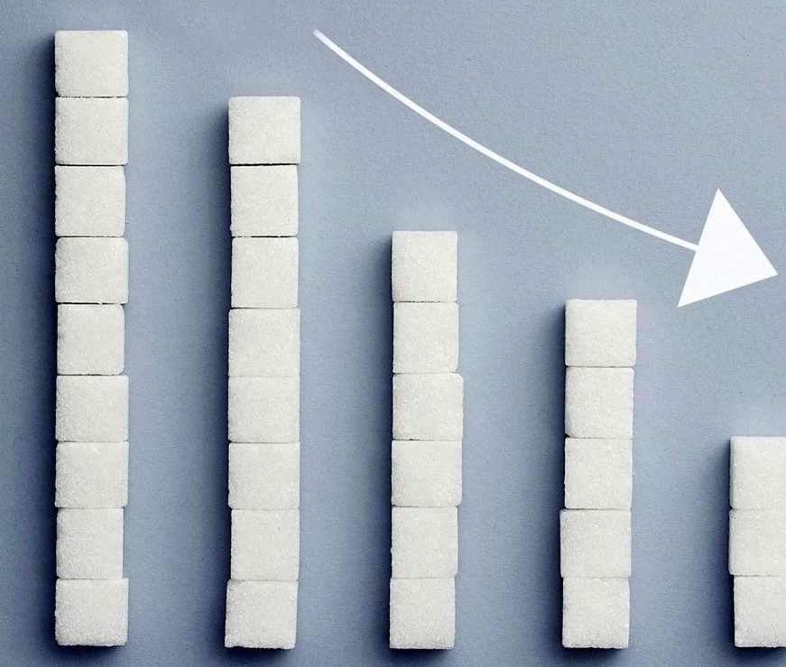
Insulin – acts to reduce blood glucose concs
Released in response to increasing blood glucose levels and leads to lower blood glucose
Insulin binds to receptors on muscle and liver cells increasing cell membrane permeability so glucose is taken up via facilitated diffusion
In muscle cells, insulin causes the cells to use more glucose (increase respiration)
Insulin also leads to conversion of glucose to glycogen (glycogenesis)

Slide 9
Negative feedback
Produce a diagram that shows how blood glucose is kept within its normal range (4- 7mmol/l).
Use key terms and hormones and say where they are produced from.

Slide 10
Insulin release from beta cells
During periods of high blood glucose, glucose enters the beta cells by facilitated diffusion
The cell uses the glucose to produce more ATP
Increased ATP causes the potassium channels to close so potassium builds up inside the beta cell

Slide 11
Insulin release from beta cells
Inside the cell becomes less negative because of the build up of potassium ions and the cell membrane becomes depolarised
Depolarisation of the cell membrane causes voltage-gated calcium channels to open
Calcium ions enter the beta cell and cause insulin-containing vesicles to fuse with the beta cell membrane and release insulin by exocytosis

Slide 12
Recap time
Take a few moments to recap how insulin is released from beta cells of the pancreas
Include the terms:
Beta cells, glucose transporters, facilitated diffusion, potassium channels, depolarisation, voltage-gated calcium channels, calcium ions, insulin-containing vesicles

Slide 13
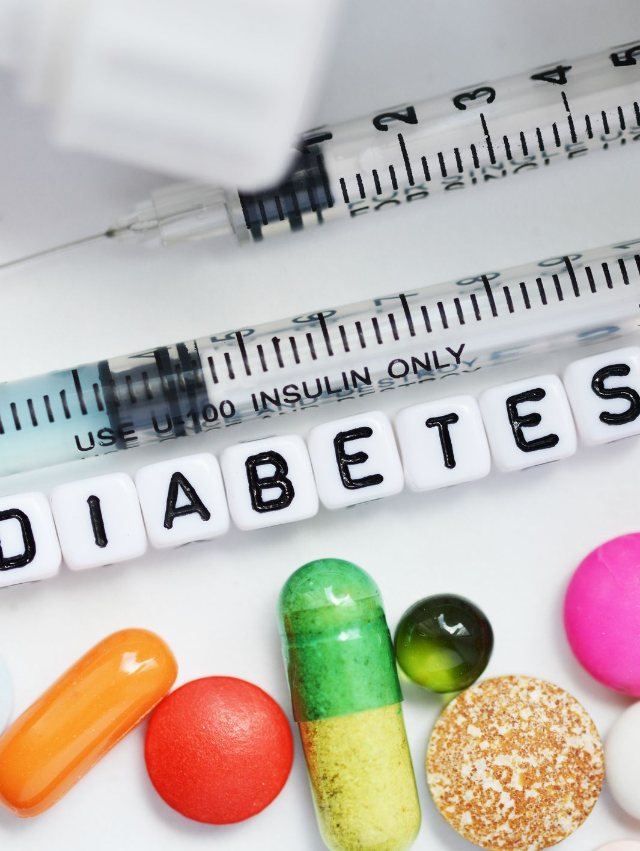
Diabetes - blood glucose concs are not controlled
Diabetes mellitus - (mellitus = “sweet, of honey”: what is the other type of diabetes?)
Diabetes type I – autoimmune disorder – what does autoimmune mean?
Beta cells in the islets of Langerhans in pancreas are destroyed by the body’s immune system
Insulin is NOT produced in type I diabetes
Following eating, glucose is absorbed into the blood but blood glucose levels remain high
Kidneys cannot reabsorb all the glucose from the filtrate so some of it is lost in the urine
Mostly (but not always) develops in young children or young adults
May be an increased risk if there are family members with it
May result in death if not treated

Slide 14
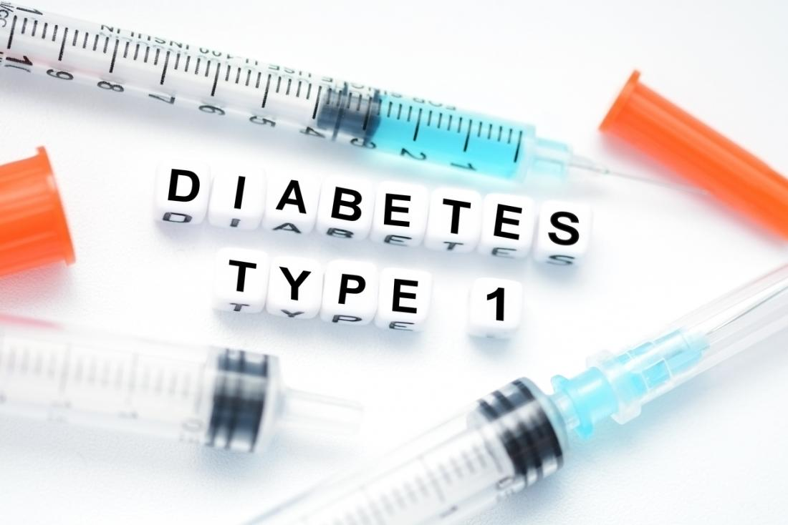
Symptoms of type I diabetes
Increased thirst
Feeling tired
Need to wee/pee a lot
Feel very hungry but losing weight
Blurred vision
(Symptoms of hyperglycaemia)
Poor wound healing
Symptoms appear over a short period of time

Slide 15
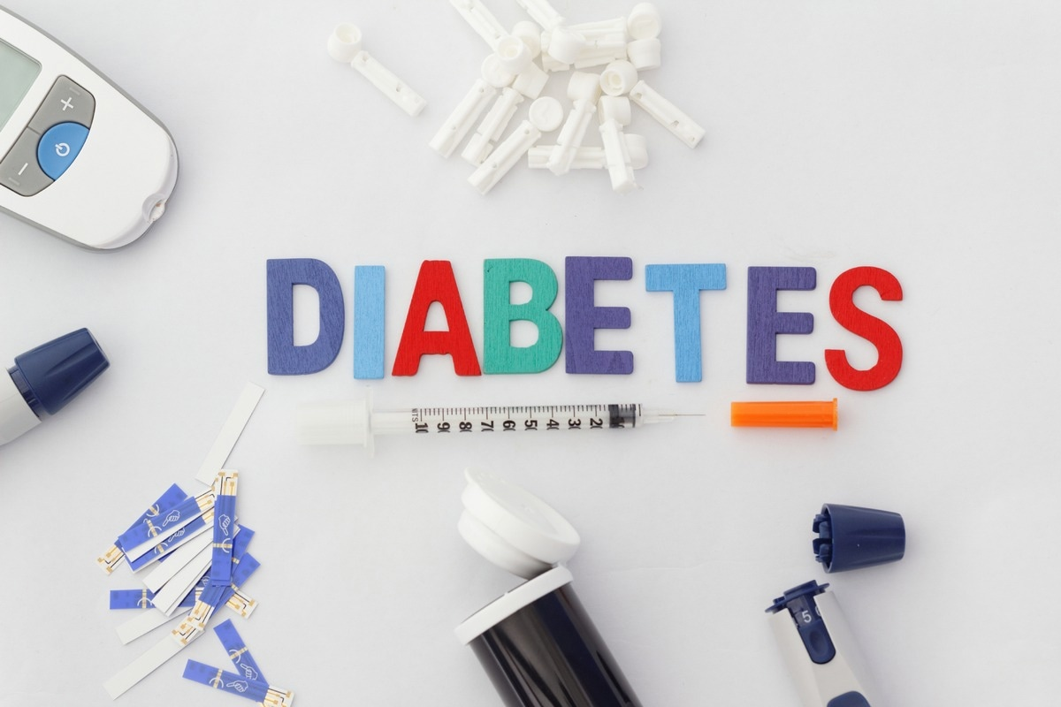
Treatment for type I diabetes
Regular insulin injections (why must insulin be injected?) throughout the day
Insulin may be delivered continuously by pump into a tube under the skin
[Islet cell transplantations have been successful (but are not always a cure for diabetes)]
People with Type I diabetes need to monitor blood glucose concentrations regularly, eat a healthy diet and know roughly how much glucose they are taking in, and exercise regularly
Hypoglycaemia – low blood glucose, can happen if taken too much insulin, not eaten enough carbohydrates, too much exercise

Slide 16
Sodium-dependent glucose transporters
Sodium-glucose transporters found in proximal (what does proximal mean?) tubule of nephron
Contribute to glucose reabsorption
Usually all glucose is reabsorbed from the filtrate but in hyperglycaemia, glucose is lost into the urine (glycosuria) as sodium-dependent glucose transporters are overwhelmed
Sodium-glucose transporters are an example of a co-transport protein: as sodium ions are transported passively across the proximal tubule membrane, this provides energy to transport glucose across the membrane too: against a glucose concentration gradient

Slide 17
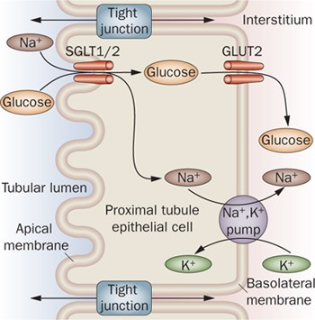
Lumen of nephron -
Filtrate (its not quite urine at this point) containing glucose passes along tubule
Glucose is normally reabsorbed
Eventually filtrate forms urine
SGLT1/2 inhibitors??
Interstitium side –
kidney cells
Glucose
eventually
returns to blood

Slide 18
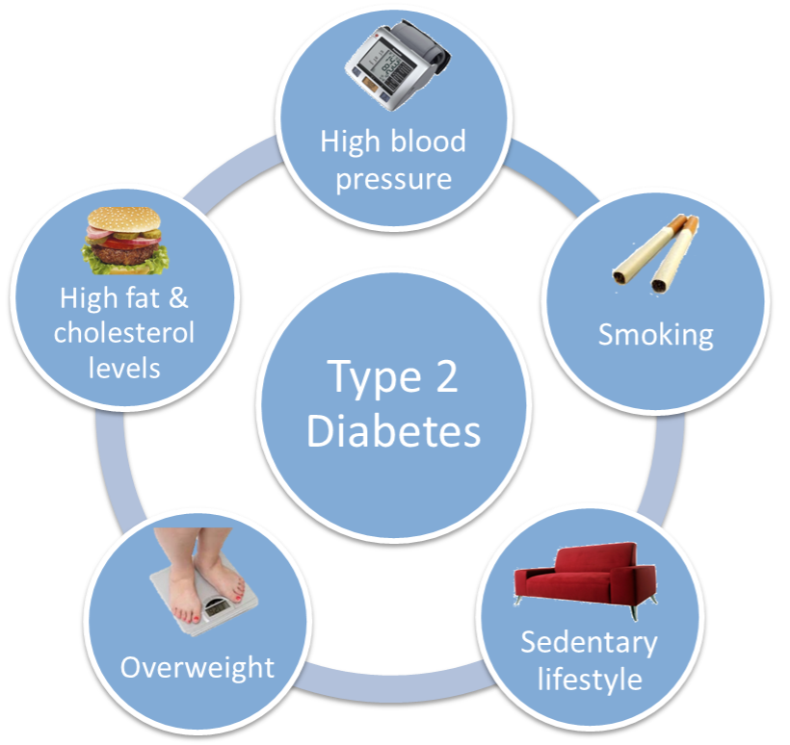
Type 2 Diabetes
Linked to obesity
Beta cells do not produce enough insulin or the body’s cells do not respond to insulin properly as the receptors do not work correctly
Usually develops later in life (middle age onset) and risks groups include some groups from e.g. African or Asian backgrounds or close family history

Slide 19
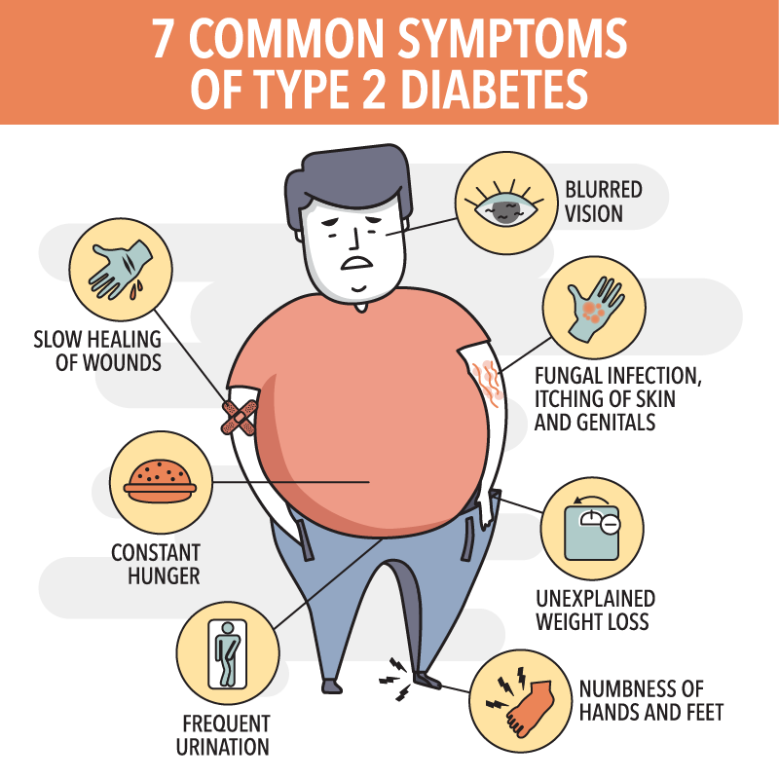

Slide 20
Treatment of type 2 diabetes
Lifestyle changes – what might these be? Look it up and make a list
Medication:
Metformin – acts on hepatocytes to reduce the amount of glucose they make. Also increase sensitivity of cells to insulin so more glucose can be taken up by them
Sulfonylureas – e.g. glicazide; stimulates the pancreas to produce more insulin
Thiazolidinediones (“glitazones”) – make body cells more sensitive to insulin
Sometimes, insulin is also needed

Slide 21
Recap
Recap the slides on both type 1 and 2 diabetes
What causes them, what are the symptoms and what treatment options are available?

Slide 22
Question
A glucose tolerance test can determine if someone has diabetes. The patient is required to fast for 12 hours and then given a glucose-containing drink. Blood tests are carried out to determine the blood glucose concentration.
Which person (A or B) on the graph is the diabetic?
Give two pieces of evidence to support your answer.
This person produces insulin but can’t control blood glucose
What type of diabetes do they have and why can they not control their blood glucose levels?
What would happen if the test was repeated after treatment with metformin had started?

Slide 23
Summary
Homeostasis – “staying the same”
Endocrine system – comprises endocrine glands, hormones released directly in the blood, and receptors
Hormones bind to the receptor, second messenger activated, cascade of events takes place
Negative feedback
Blood glucose concentrations normally maintained in strict range by actions of insulin and glucagon, released from cells in the pancreas
Diabetes – type 1 and type 2
Lifestyle changes and /or drugs needed as treatment

Slide 24
Lesson aims
By the end of the lesson, students will be able to:
1. describe the endocrine system, and the involvement of receptors and second messengers.
2. describe the hormones produced by the pancreas
3. describe glucose homeostasis, type 1 and 2 diabetes and treatment

