Slide 1
Climate politics

Slide 2
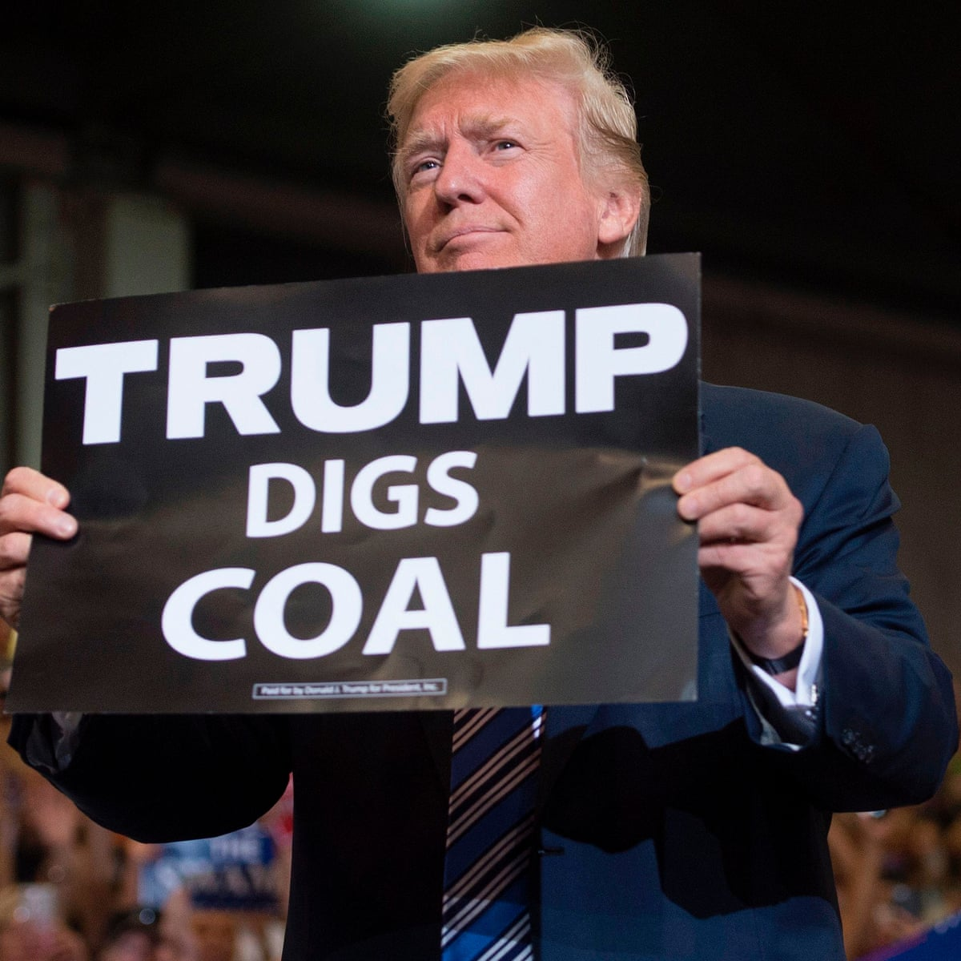
Module info
Structure:
Week 1: Introduction to climate politic (Dr. Edouard Morena)
Weeks 2, 3, 4 & 5: Deep dive 1- Arctic politics (Dr. Eda Ayaydin)
Weeks 7 & 8: Deep dive 2 - Just transition (Anabella Rosemberg)
Weeks 9, 10, 11 & 12: Deep dive 3 – Cities and climate change (Dr. Edouard Morena)
Assessment:
Podcast (40%)
Essay (60%)

Slide 3
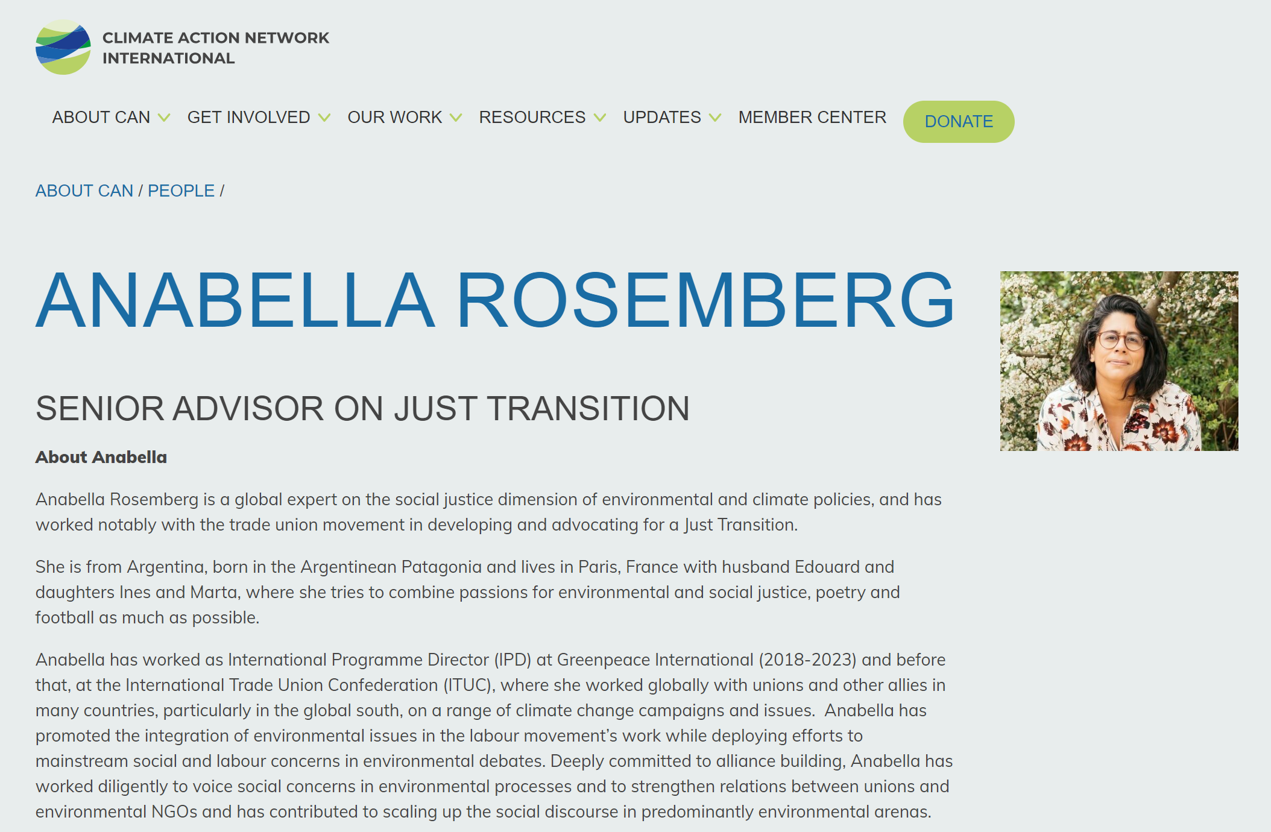

Slide 4
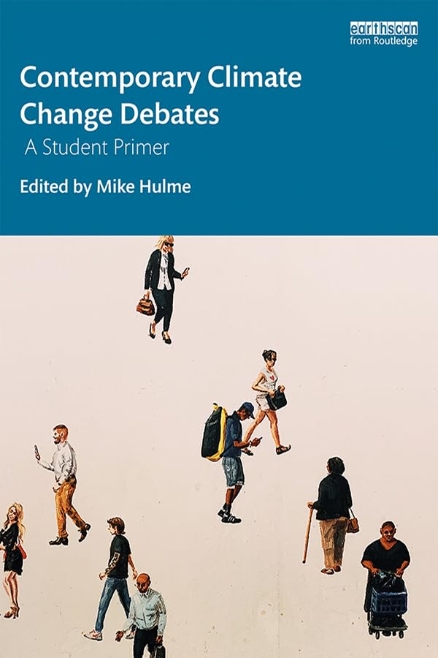
Resources
Hulme, Mike (ed.) (2019), Contemporary Climate Change Debates: A Student Primer, London: Routledge.
Academic journals.
Podcasts: The Break Down (Adrienne Buller), Outrage + Optimism (Cristiana Figueres)…
Newspapers: The Guardian (climate crisis section)…
Specialist websites: Climate Home, Climate News, Carbon Brief…
X/Bluesky: Ketan Joshi, Farhana Sultana, Chris Lang, Ed King, Megan Darby, Matt Huber, Kate Aronoff, Jason Moore…

Slide 5
What is climate politics?

Slide 7
What is the first image that comes to mind when you think of climate change?

Slide 8
Notes:
Example of polar bears on shrinking iceberg. Climate change associated with ice melting.

Slide 9
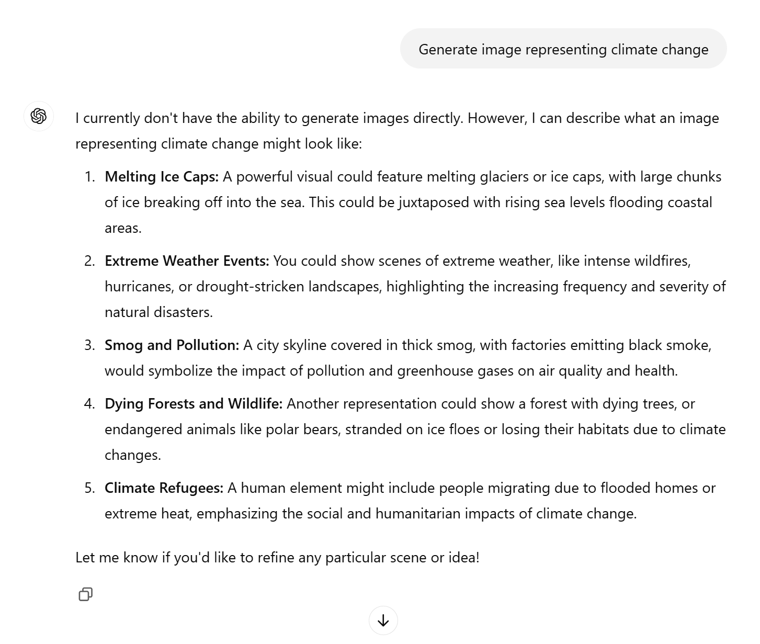

Slide 10
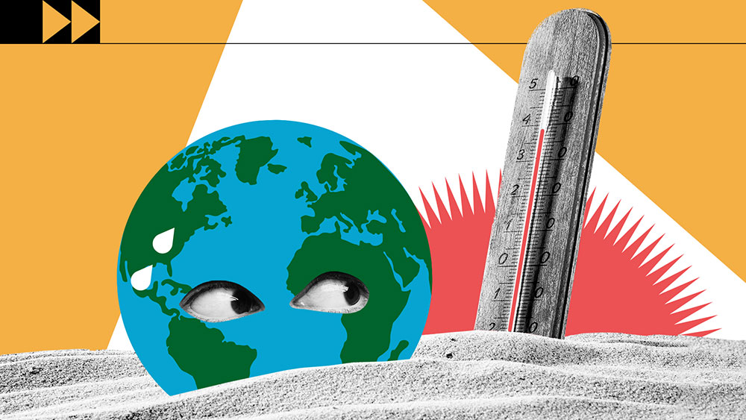
https://www.un.org/en/climatechange/what-is-climate-change

Slide 11
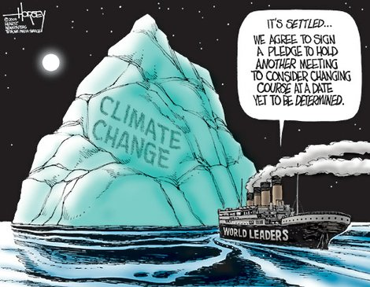

Slide 12
Notes:
Video of Jeff Bezos at COP26. World from space. Dominant perceptions of the problem have a history.

Slide 13
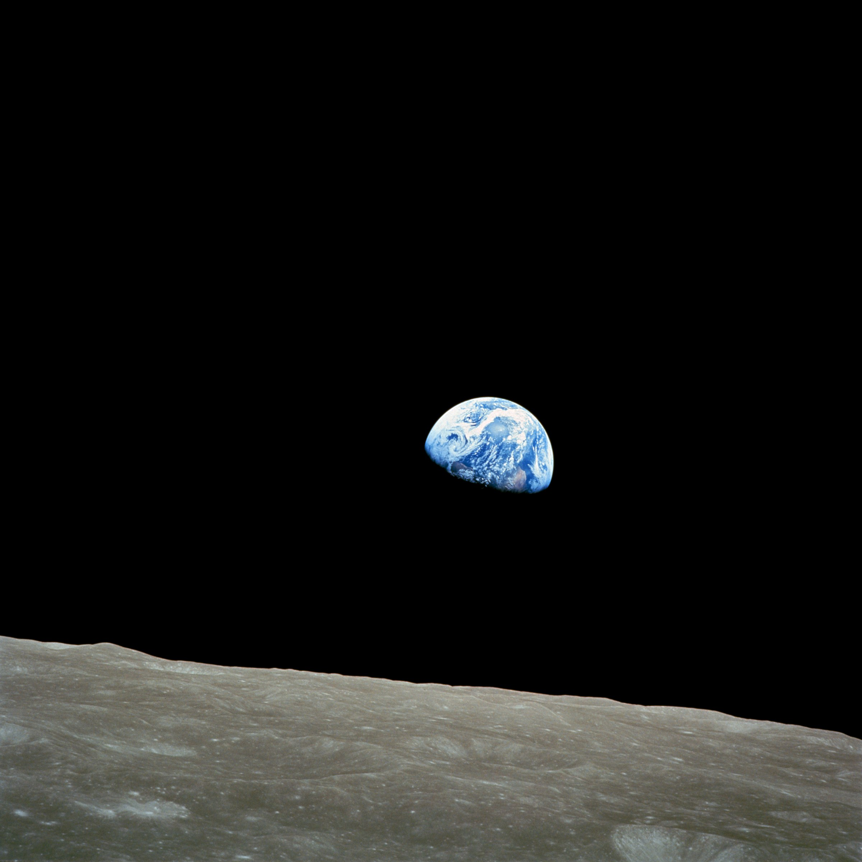
Earth rise: William Anders on December 24, 1968, during the Apollo 8 mission.
Notes:
Picture of Earth from space will profoundly affect how we approach planetary problems such as climate change.

Slide 14
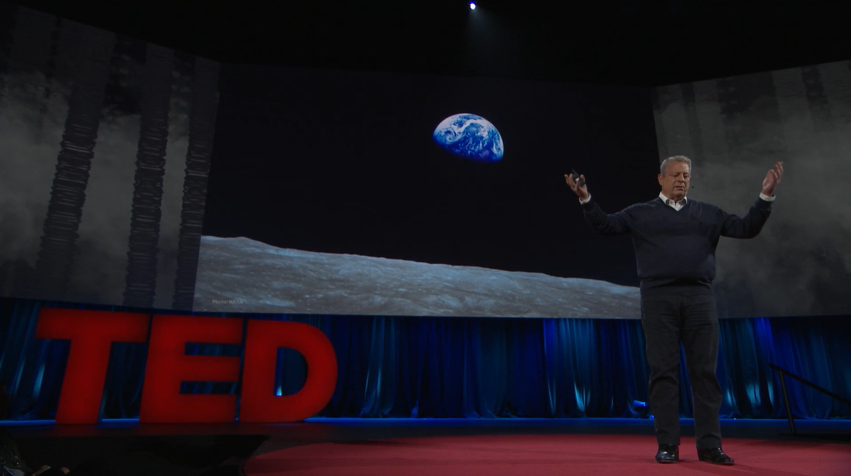
Al Gore
“The Apollo Mission, among other things changed the environmental movement, [it] really launched the modern environmental movement 18 months after this Earthrise picture was first seen on earth, the first Earth Day was organized. And we learned a lot about ourselves looking back at our planet from space. And one of the things that we learned confirmed what the scientists have long told us. One of the most essential facts about the climate crisis has to do with the sky. As this picture illustrates, the sky is not the vast and limitless expanse that appears when we look up from the ground. It is a very thin shell of atmosphere surrounding the planet. That right now is the open sewer for our industrial civilization as it’s currently organized.” (Al Gore, The case for optimism, TED Talk, 2016)

Slide 15
Seuil, 2014

Slide 16
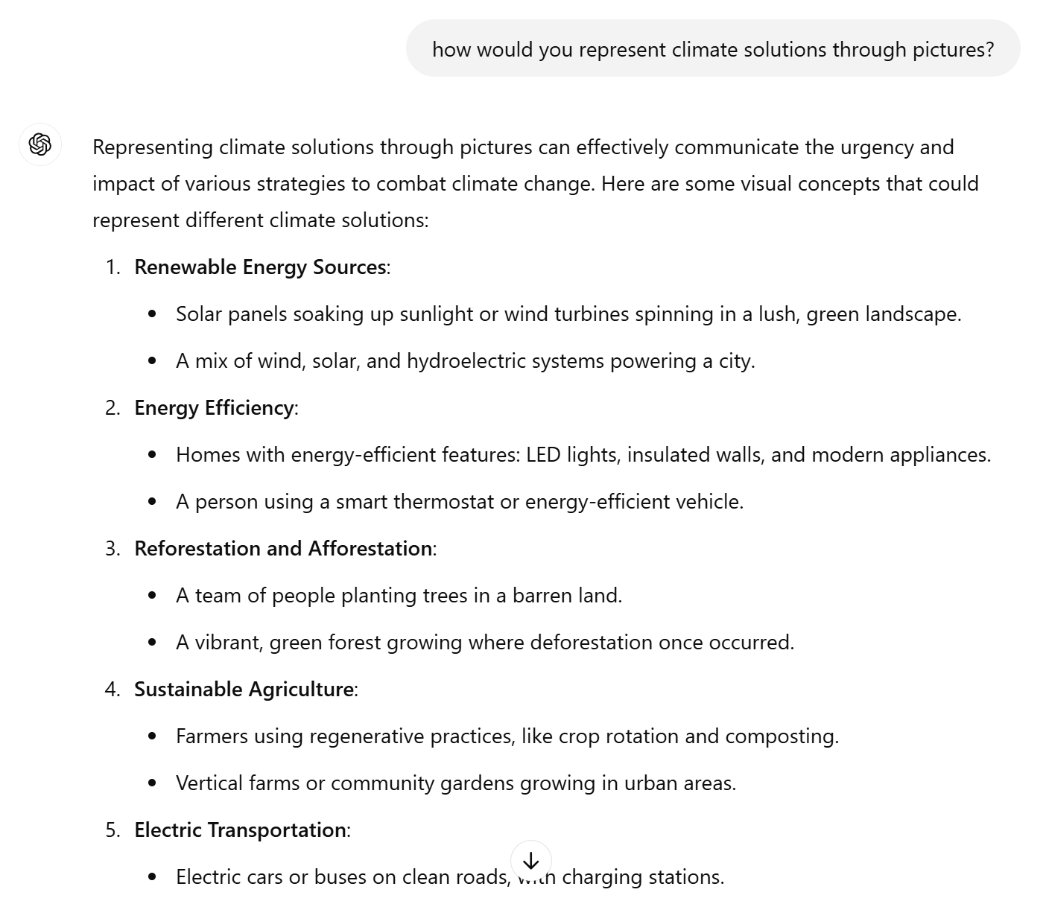

Slide 17
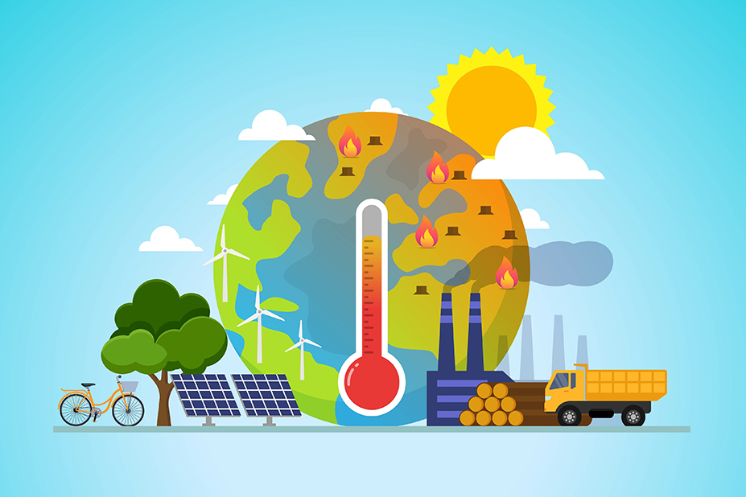

Slide 18
How we frame, visualize & communicate the climate issue (& solutions) is political.
Notes:
Intended to make us interpret the problem in a particular way: a global problem, « we are all in this together », « spaceship Earth ». Role of communication and narrative building.

Slide 19
The Blue Marble is a photograph of Earth taken on December 7, 1972, by either Ron Evans or Harrison Schmitt aboard the Apollo 17 spacecraft on its way to the Moon.
Notes:
Question to class: In what can Bezos’s and Gore’s use of the « Blue Marble » image (Earth from space) be considered as political?

Slide 20
Why is the use of the ‘blue marble’ picture not politically neutral?
Notes:
Idea of control: the Earth as a system. « spaceship Earth ».
Equalizing effect: we are all in this together. We are all on the same boat... From Bezos’s perspective. NEED TO LOOK AT WHO IS USING IT AND WHY.
Global problem. Everyone is affected in the same way. Global temperature.

Slide 21
Not just images but also numbers…

Slide 22
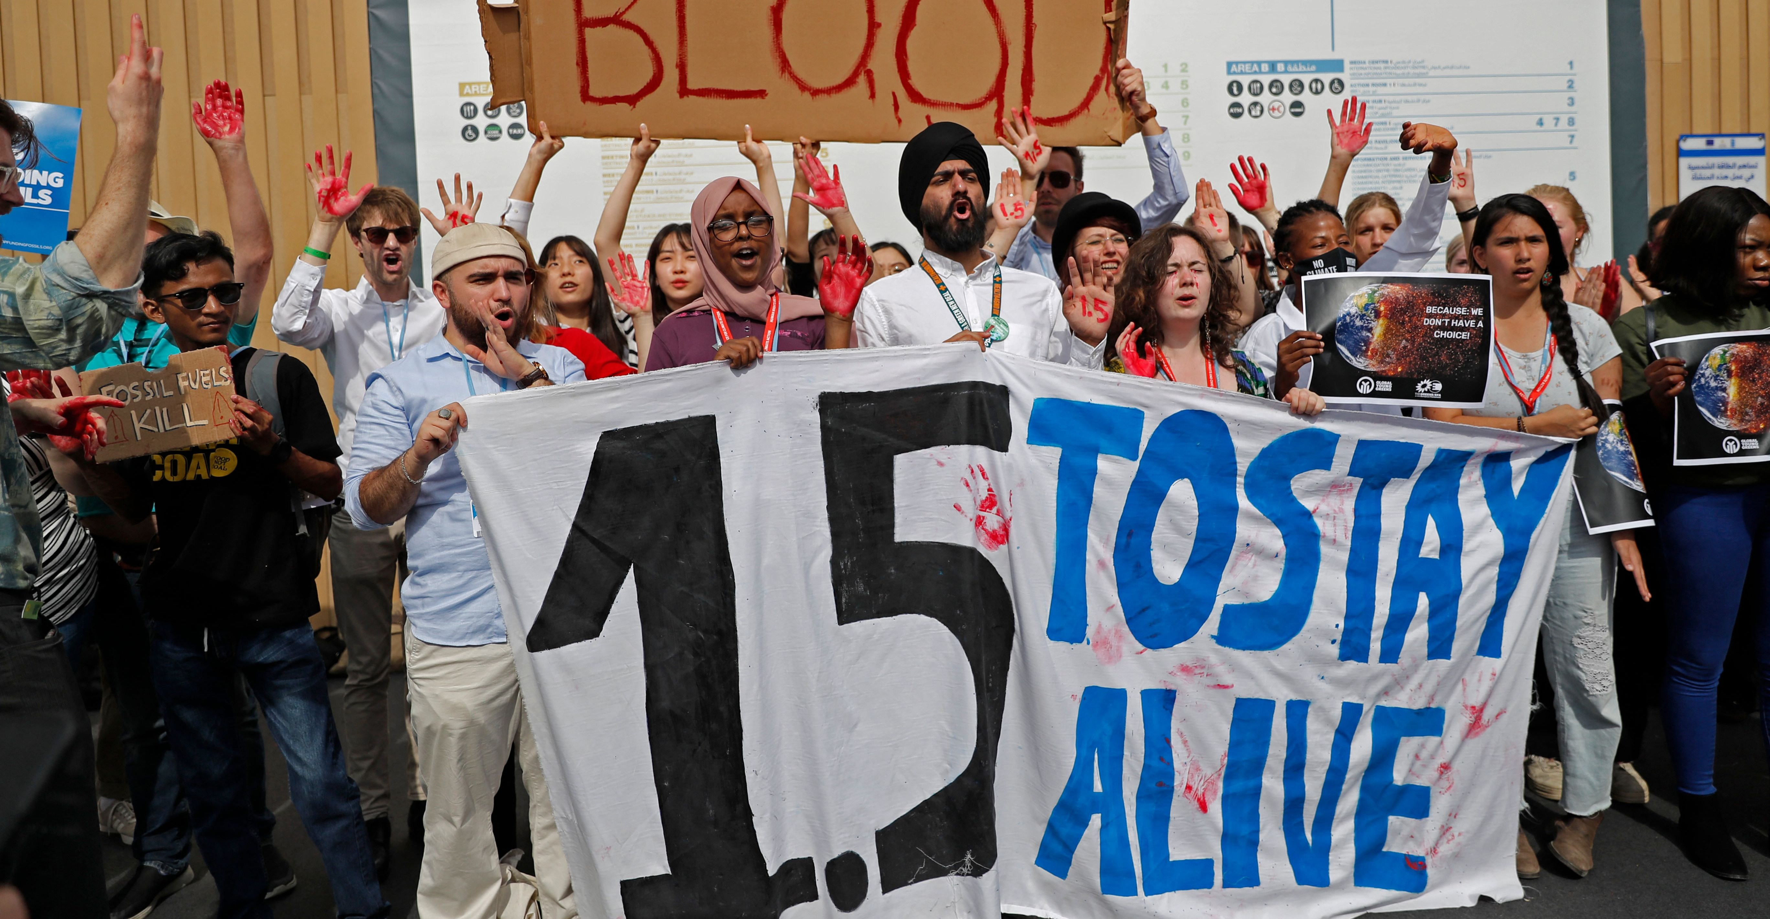

Slide 23
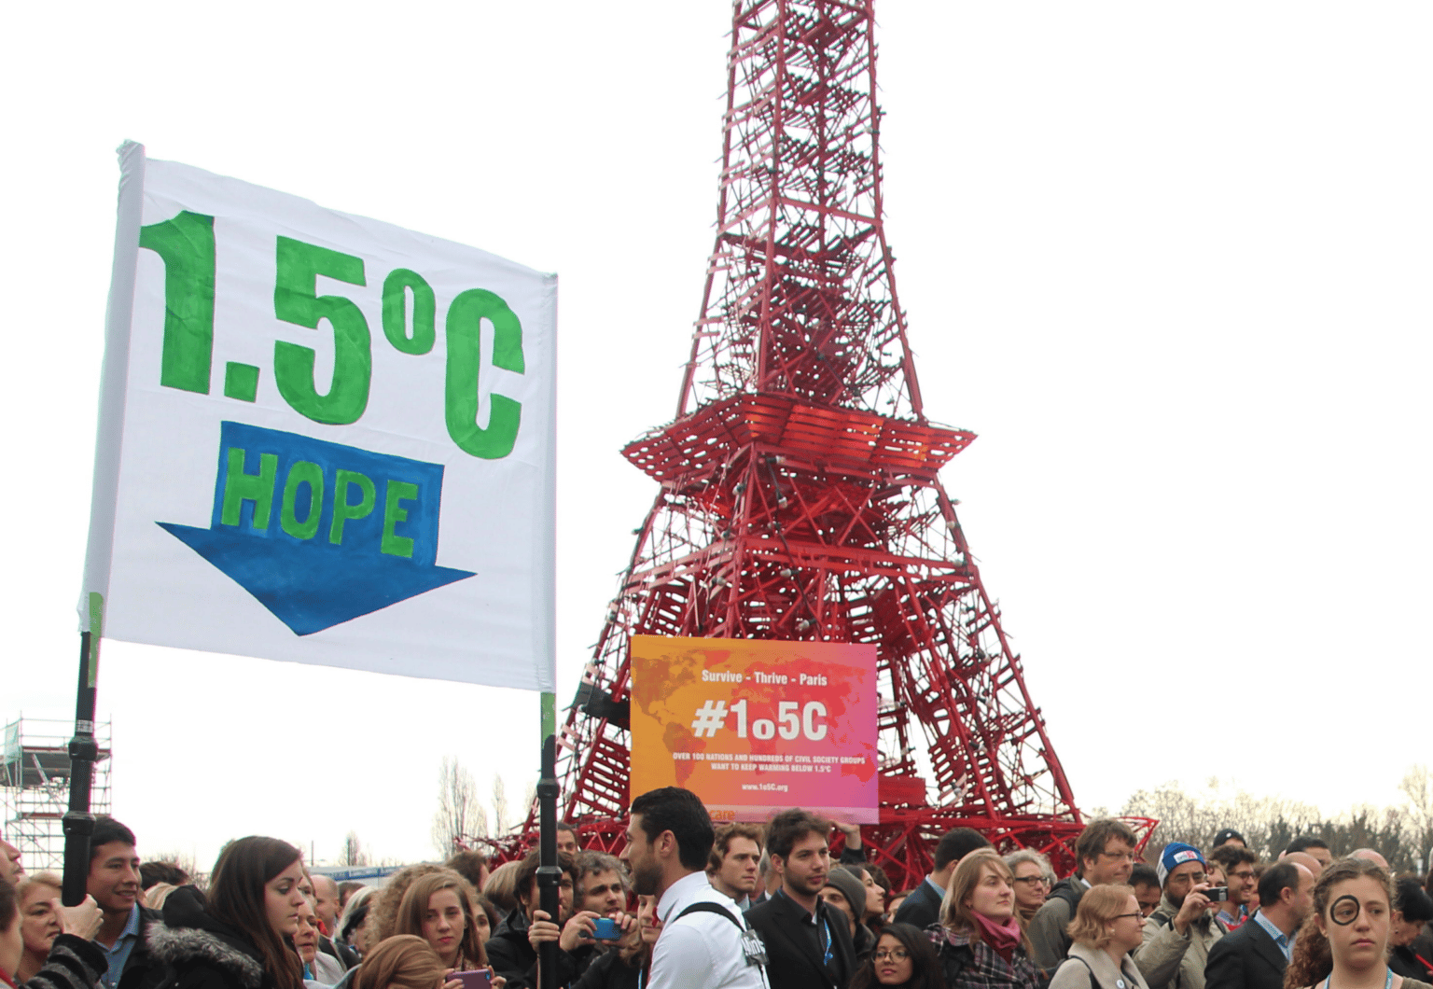
The politics of the global temperature target
Hulme, Mike (2012), ‘On the “two degree” climate policy target’, in Edenhofer,O., Wallacher,J., Lotze-Campen,H., Reder,M., Knopf,B, and Müller,J. (eds.), Climate change, justice and sustainability: linking climate and development policy, Springer, pp.122-125.
“this single index of climate performance – collapsing the 1 complexity and diversity of weather and climate around the world into global temperature – has gained powerful iconic and cultural status” (Hulme, 2012).

Slide 24
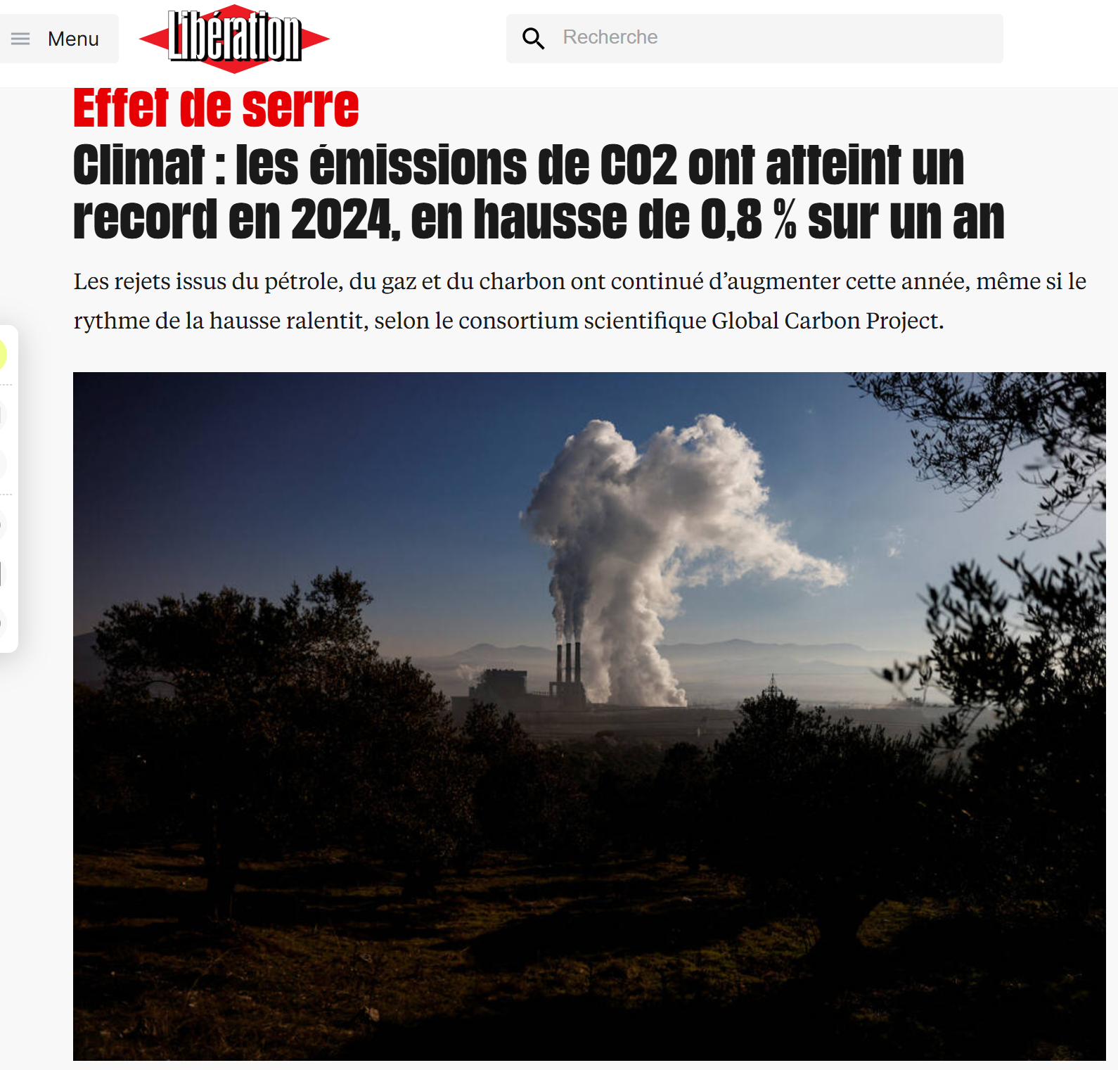
The politics of global emissions
Lohmann, Larry (2016), ‘Neoliberalism’s climate’, Springer, Simon, Kean Birch & Julie MacLeavy (eds.), Handbook of Neoliberalism, London: Routledge.
Agarwal, Anil & Sunita Narain, (1991), Global Warming in an Unequal World, New Delhi: Centre for Science and Environment.
“It is only when they (for example) distinguish “survival emissions” from ‘luxury emissions’ (Agarwal and Narain 1991) – two entities that refuse to stay on either side of the nature/society divide – that they recognize that climate cannot be defined by climatologists and policymakers alone.”

Slide 25
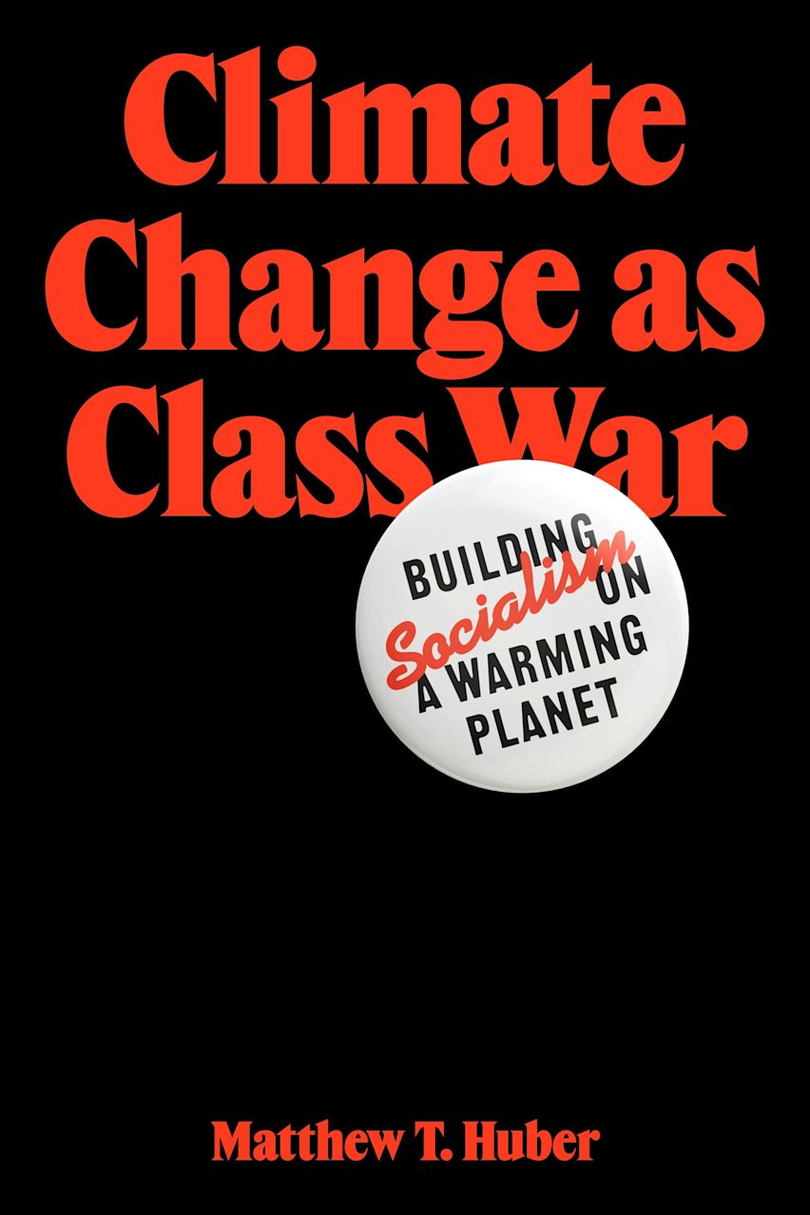
Such a framing erases differentiated responsibilities...
“Developed” vs. “developing” countries.
Rich vs. Poor.

Slide 26
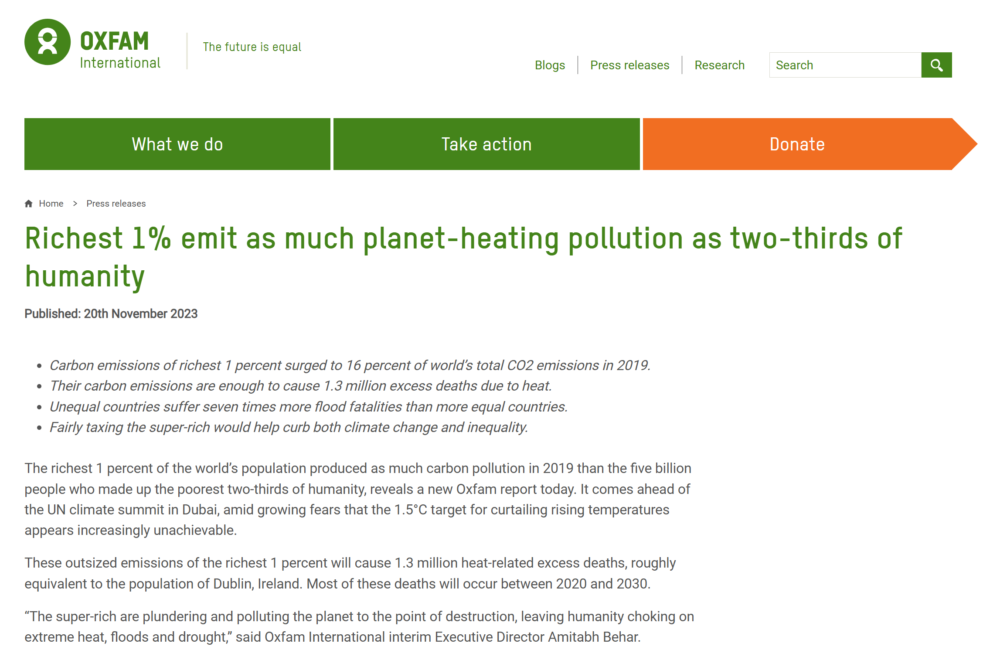
https://www.oxfam.org/en/press-releases/richest-1-emit-much-planet-heating-pollution-two-thirds-humanity

Slide 27
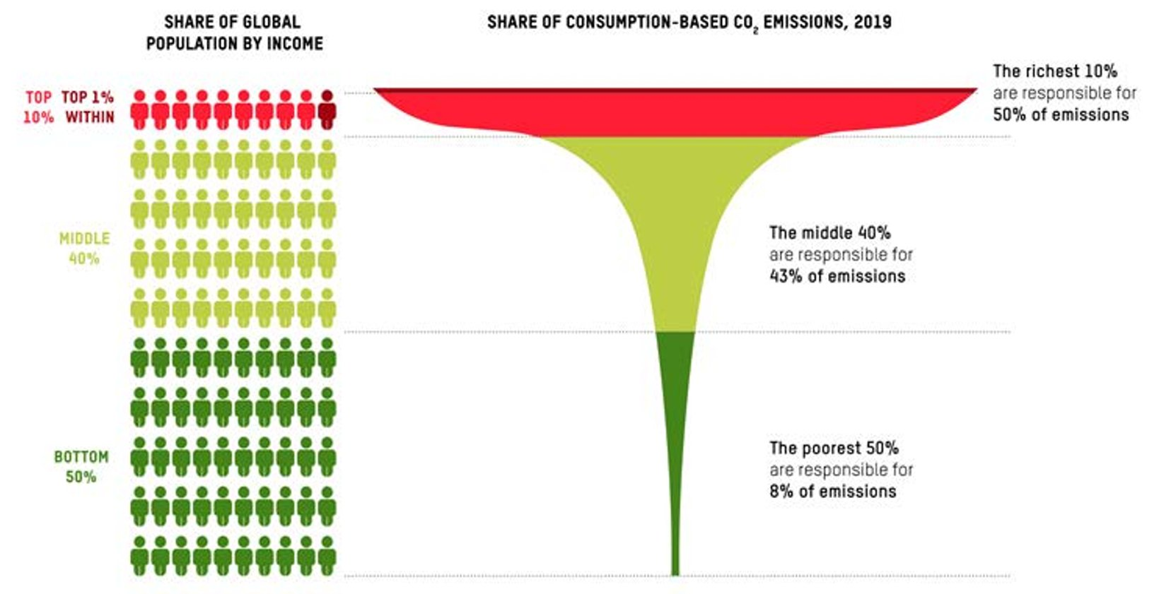
Source: https://oxfamilibrary.openrepository.com/bitstream/handle/10546/621052/mb-confronting-carbon-inequality-210920-en.pdf?sequence=1&isAllowed=y

Slide 28
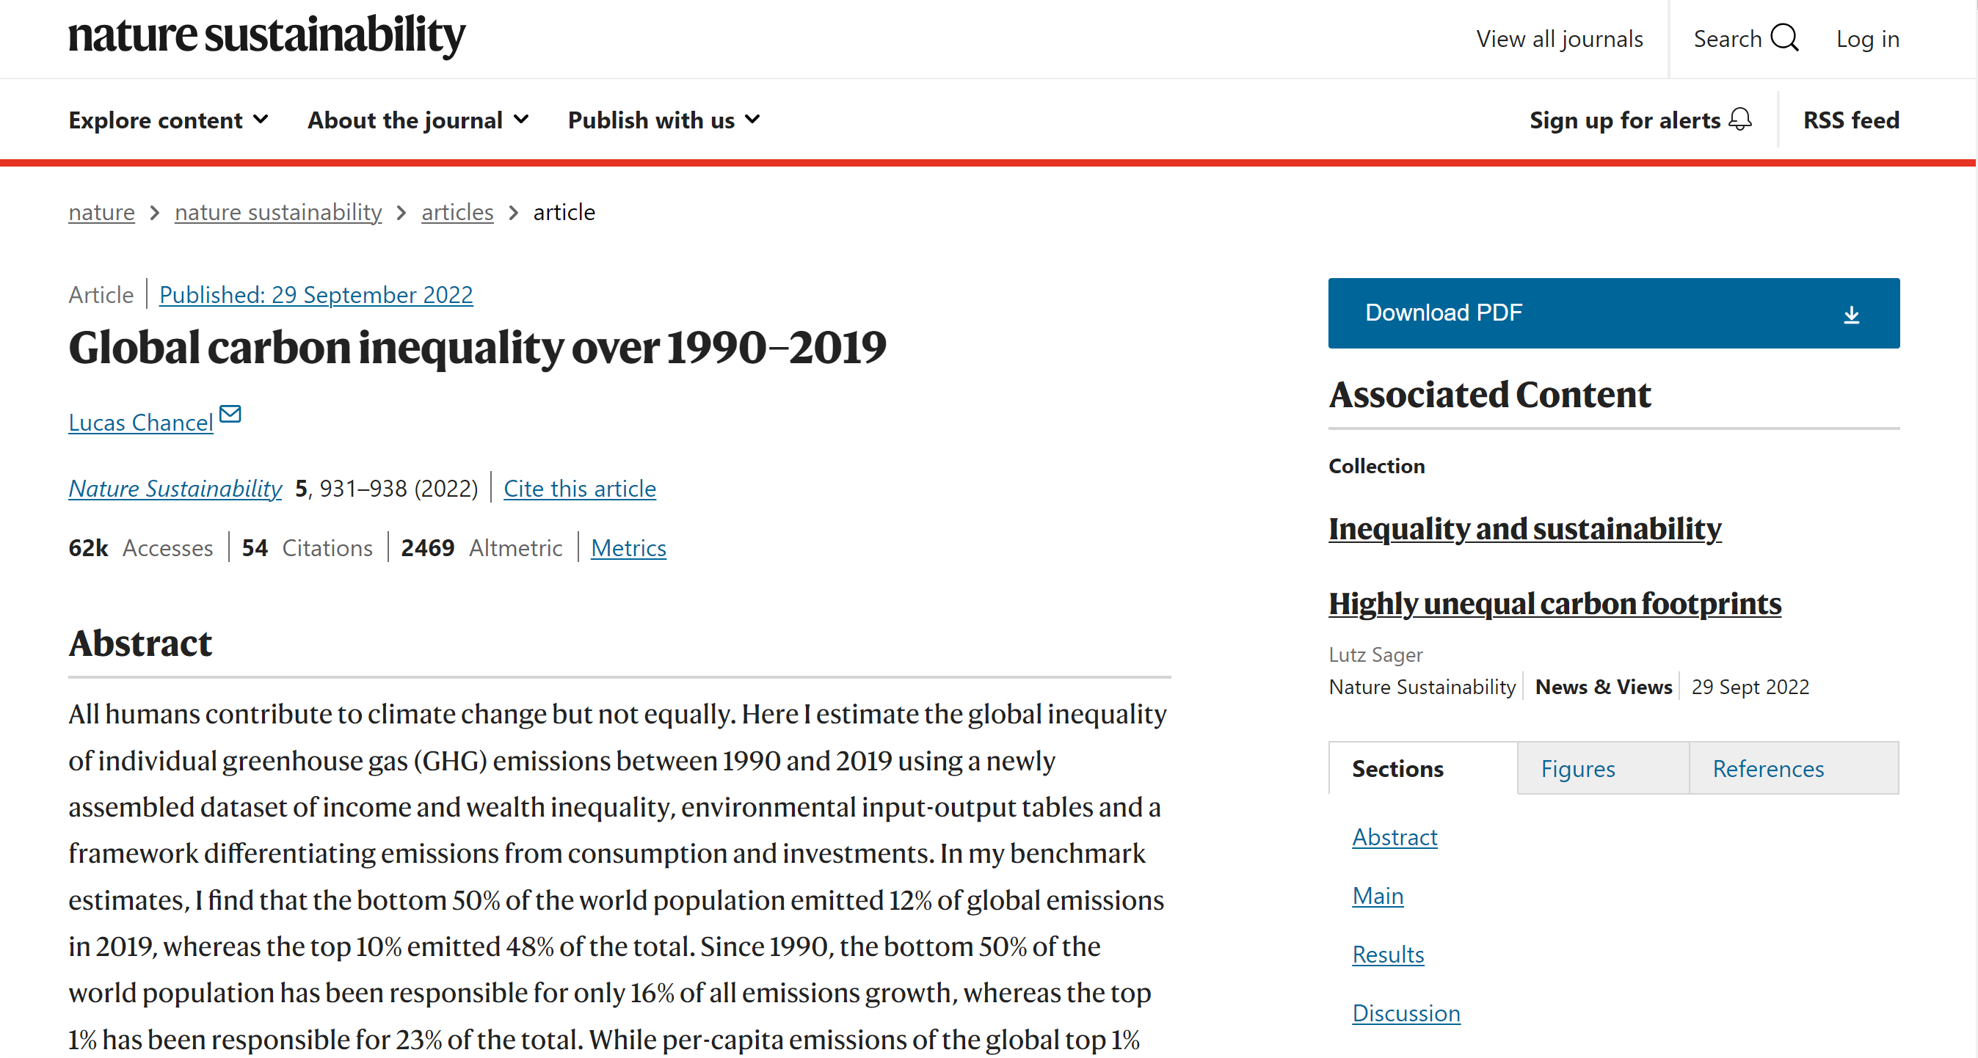

Slide 29
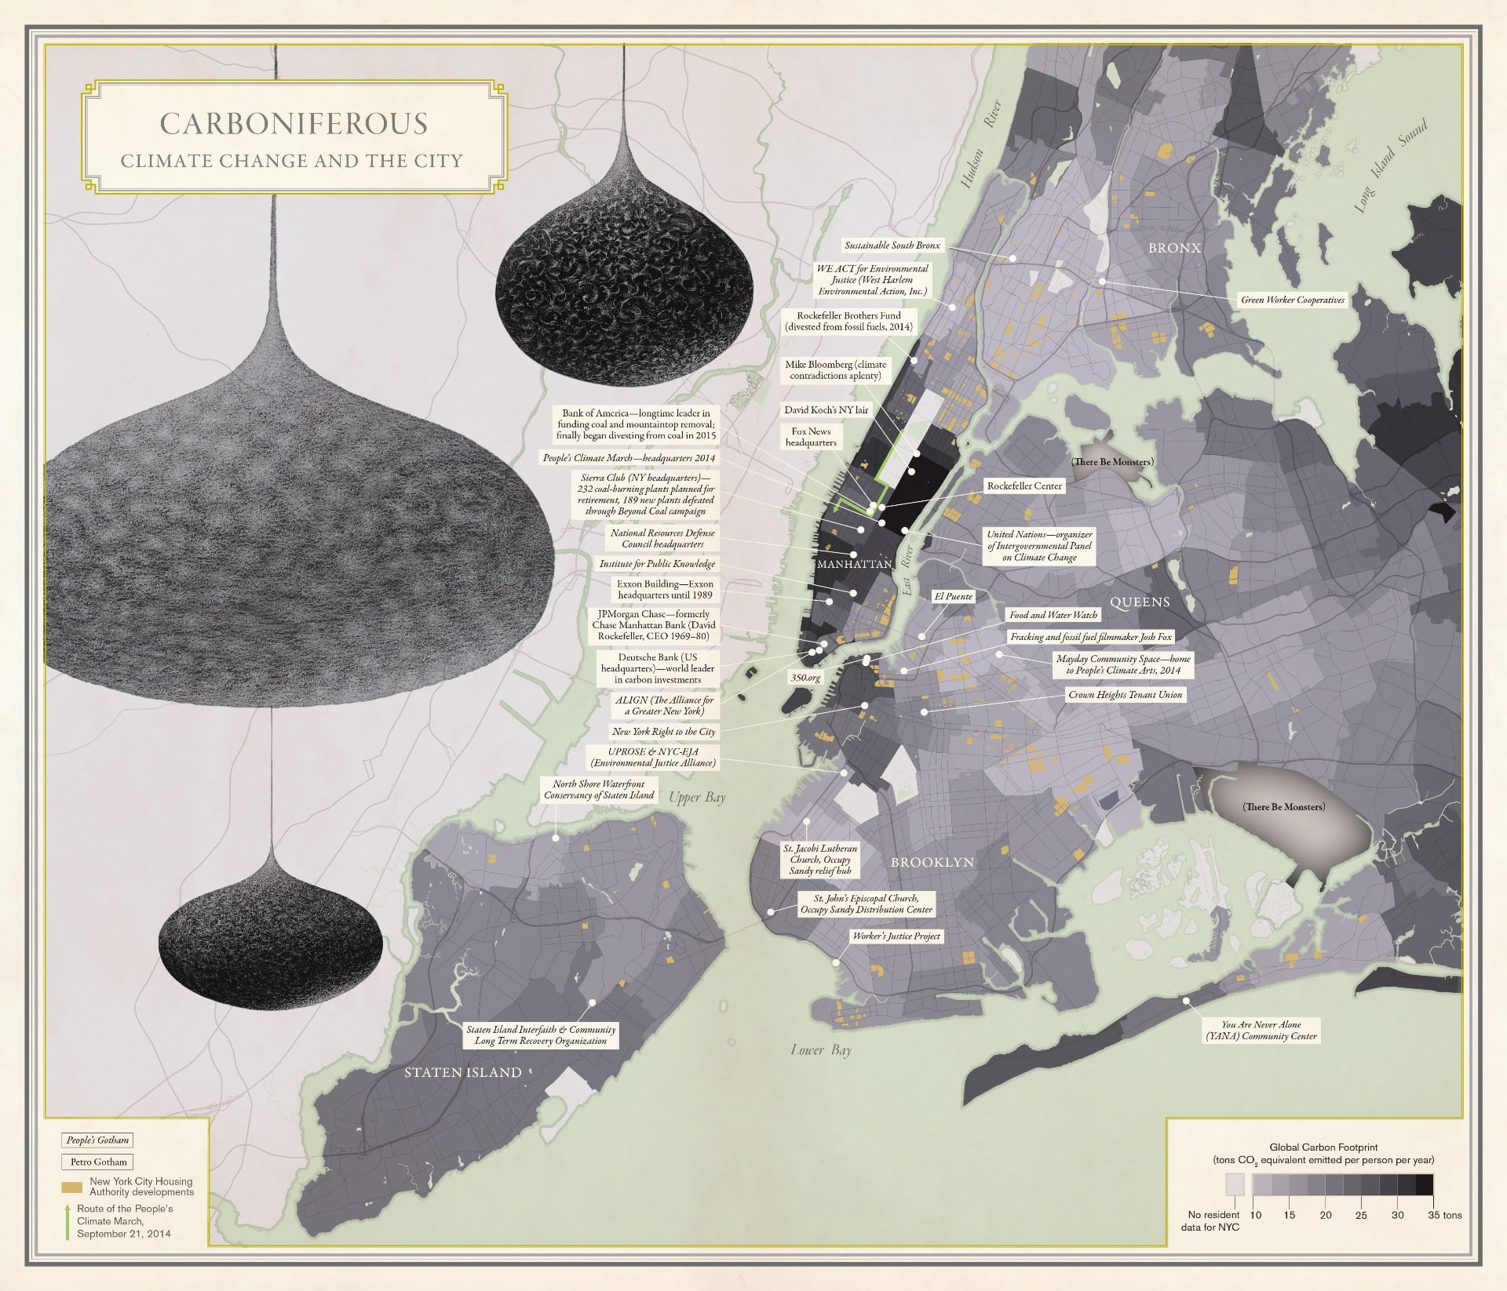
Aldana-Cohen 2016 (Image credit: University of California Press)

Slide 30
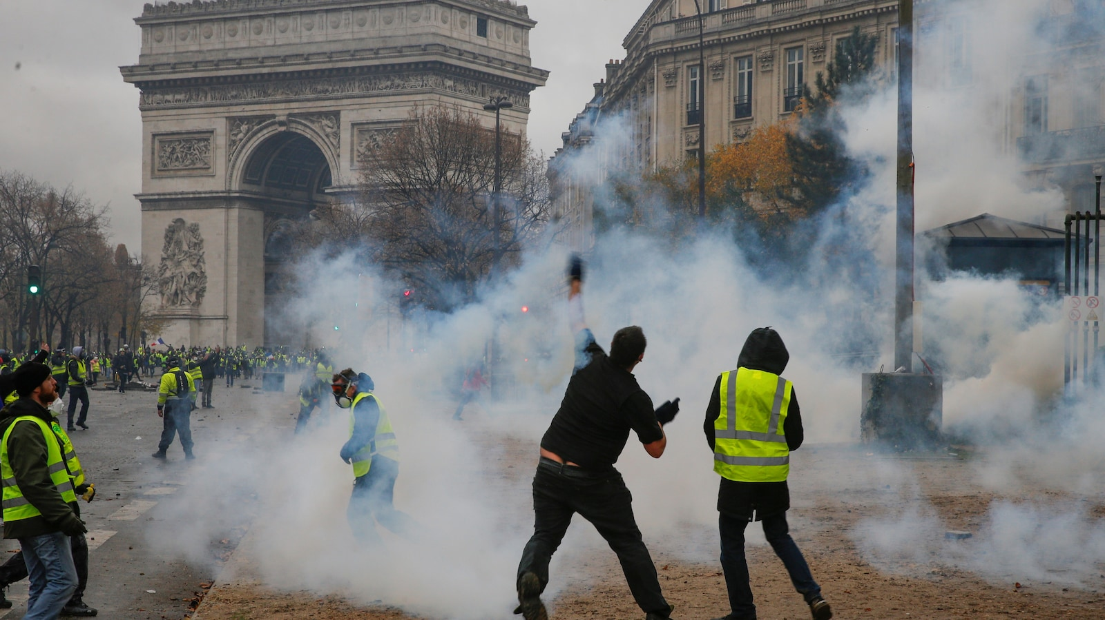

Slide 31
The politics of climate science
de Pryck, Kari (2023), ‘Why the IPCC can’t escape climate politics’, European Green Journal, https://www.greeneuropeanjournal.eu/why-the-ipcc-cant-escape-climate-politics/
“The challenges the IPCC has faced have less to do with a lack of information, and more to do with disagreements over how to interpret scientific findings and turn them into policy.”
“The idea that a consensus could return discussions to a rational basis is illusory — in the end, politics always rears its head again, even at the IPCC.”

Slide 32
Notes:
Linear connection between science and policy. BUT multiple policies are possible. Multiple solutions.

Slide 33
In what way can the “follow the science” slogan have a “depoliticizing” effect?
Notes:
Creates a linear connection between science and action. And avoids debates about what type of policies and their relavtive strenghts and weaknesses.

Slide 34
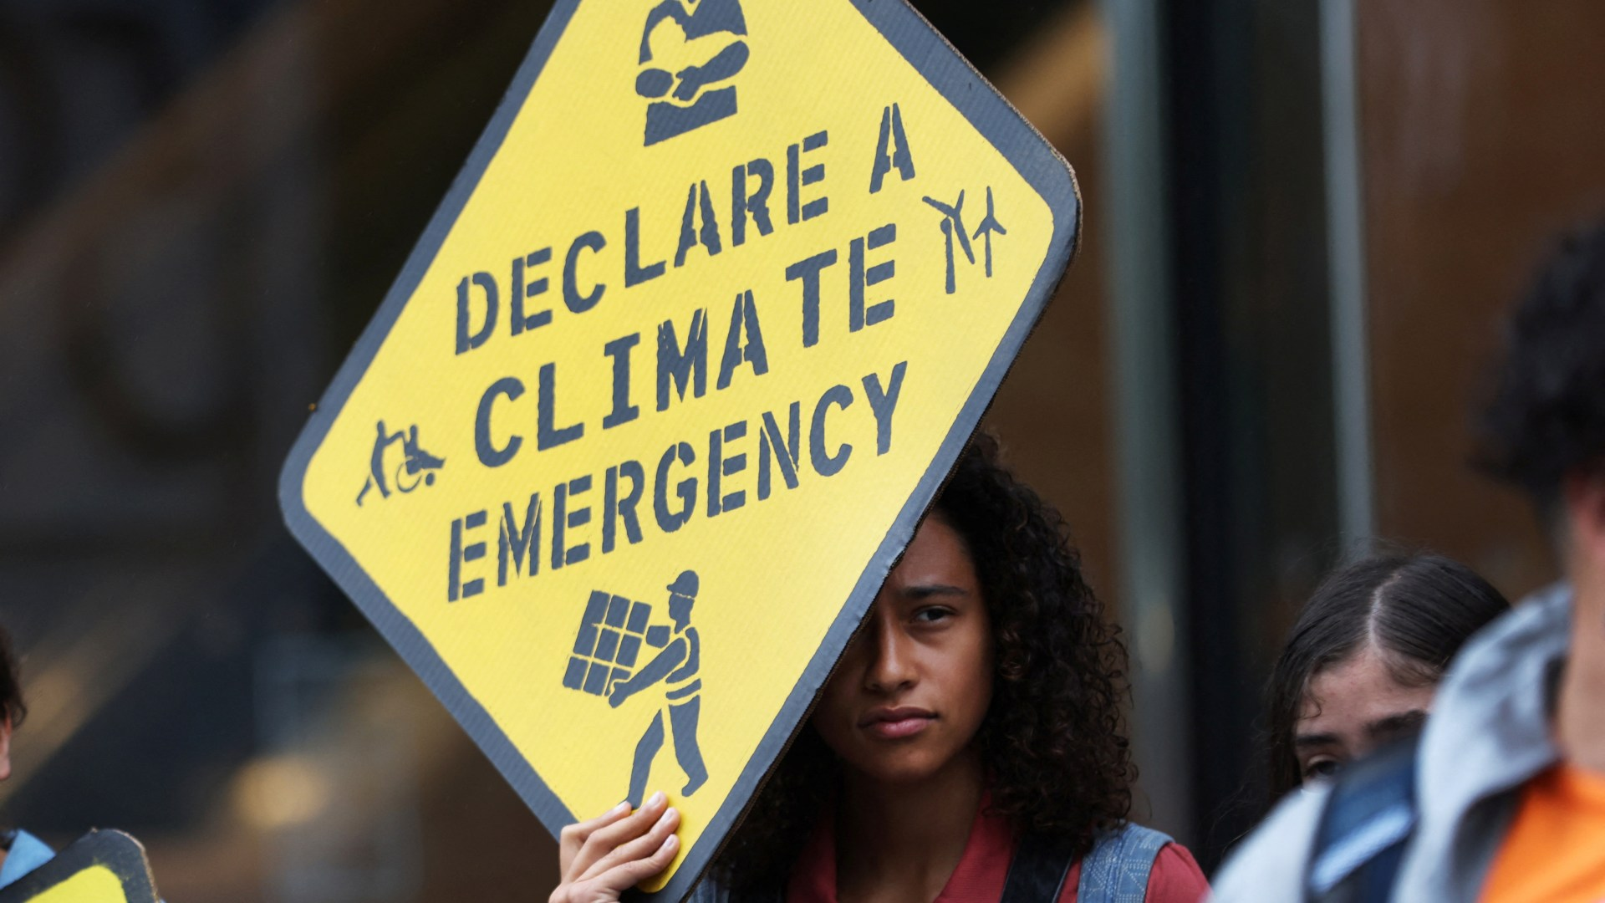
The politics of climate science
Urgency: “Climate emergency” therefore “no time for politics”,
Weaponizing the science to promote a one-size-fits-all approach.
Creates linear connection between climate science and climate action.
Notes:
Asset manager capitalism. Wall Street Consensus. Interests of asset managers (BlackRock) or/and Silicon Valley.

Slide 35
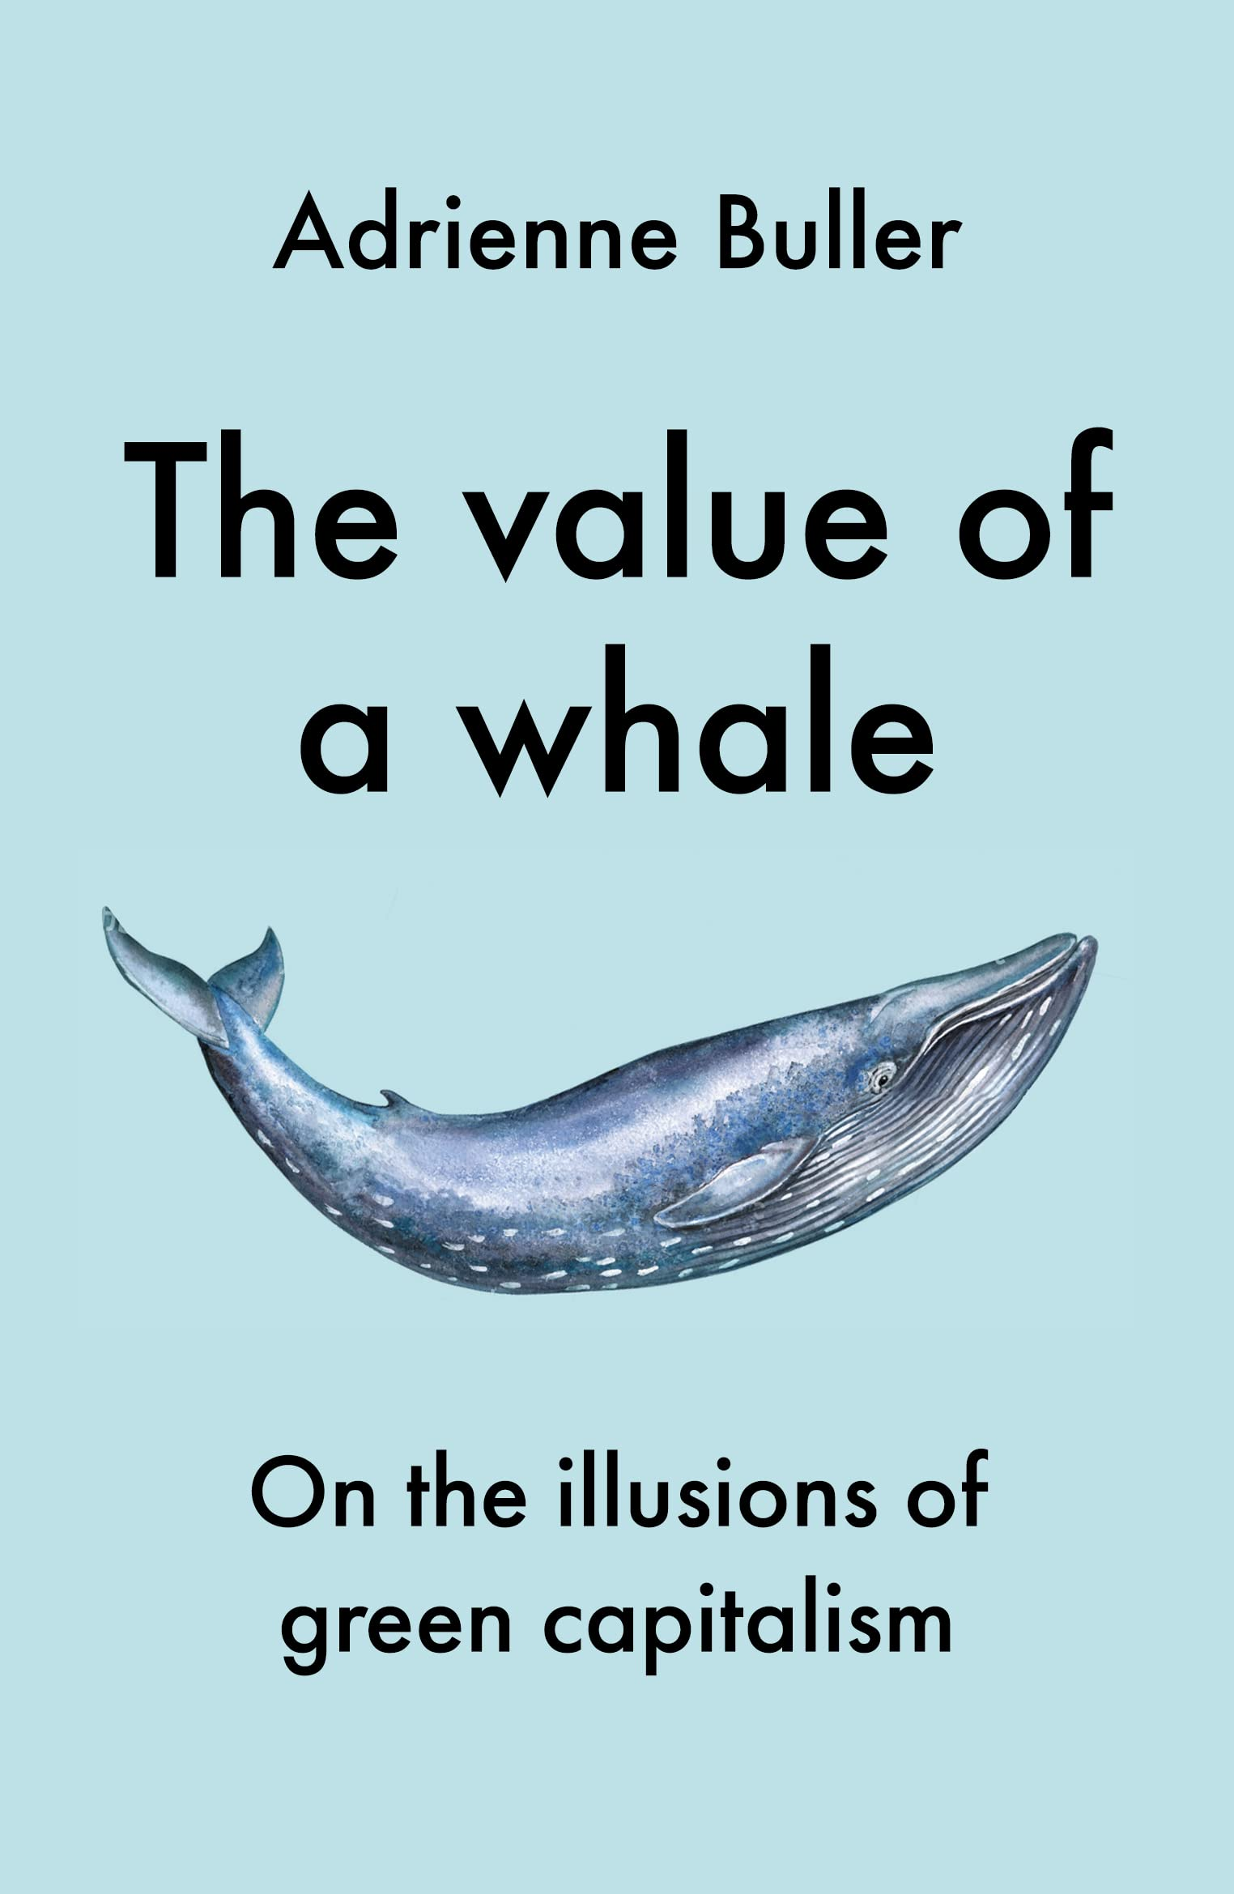
Green capitalism or the Big Green state?
Buller, Adrienne (2022), The value of a whale: On the illusions of green capitalism, Manchester University Press.
Christophers, Brett (2024), The Price is Wrong: Why Capitalism won’t save the Climate, London: Verso.
Gabord, Daniela (2023), ‘The (European) derisking state’, SocArXiv hpbj2, Center for Open Science.
Climate policies as a reflection of capitalist class interests.
Public funds are mobilized but the priority is “de-risking” private investments.
Notes:
Asset manager capitalism. Wall Street Consensus. Interests of asset managers (BlackRock) or/and Silicon Valley.

Slide 36
The Inflation Reduction Act (2022)
“The bulk of its $394 billion in energy and climate funding is dispersed through tax credits, with additional funds provided via loans and grants. McKinsey estimates that $43 billion of those tax credits are directed toward consumers through discounts on clean energy and energy-efficiency upgrades. Recently released data on the IRA finds that 3.4 million Americans have claimed $8 billion worth of consumer-side tax credits to install things like heat pumps and solar panels. Wealthier filers, though, who are better able to afford the still considerable cost of such upgrades, were much more likely to take advantage of those discounts. Renters are also generally excluded from using those incentives.”
“The majority ($216 billion) of IRA tax credits are expected to flow toward corporations.”
https://newrepublic.com/article/184910/ira-worked-harris-climate-inflation

