Slide 1
Geographies of Impact
GEG7120 Geographical Thought and Practice
I Introduction
II Human Geography: ‘relevance’ and ‘impact’
1. Debates about relevance in human geography: ‘the politics of relevance’
2. The context of the recent ‘impact’ agenda and debate
III Discussion of the reading
IV Research impact and the wider impact of universities
1. Research impact at Queen Mary
2. Civic engagement and impact
V Concluding thoughts, comments and questions

Slide 2
I Introduction
The United Nations Academic Impact (UNAI) is an initiative that aligns institutions of higher education with the United Nations in supporting and contributing to the realization of United Nations goals and mandates, including the promotion and protection of human rights, access to education, sustainability and conflict resolution.
Since 2010, UNAI has created a vibrant and diverse network of students, academics, scientists, researchers, think tanks, institutions of higher education, continuing education and educational associations. There are over 1400 member institutions in more than 147 countries that reach over 25 million people in the education and research sectors around the world representing a global diversity of regions and a thematic wealth of disciplines.
Source: https://academicimpact.un.org/
So why has academic impact been the focus on considerable debate?

Slide 3
I Introduction
Aims of the seminar
To critically examine arguments about the relevance and impact of academic research
To consider the key dimensions of debates about the relevance of geography
To consider relevance in relation to the social context of knowledge production and the relationships between the academy and wider society
To understand research impact in relation to the wider impact of universities.
Changing political-economy of higher education and research
Conceptual and political issues about the nature and meaning of relevance and the value of academic knowledge

Slide 4
Key issues for our discussion
What criticisms are raised about the emphasis on impact in government higher education policy? Why are many academics critical of the focus on the economic and social usefulness of research? What accounts of the value of academic knowledge are articulated in these criticisms?
2) What is the value and what are the tensions in efforts to rework the meaning of impact through the practice and perspectives of participatory geographies?
3) What can be the effects of research policy on impact developed in one context on the conduct and potential outcomes of research in another place? How can we think about the geography of impact policy? (this question particularly relates to the paper by Williams 2012)
4) How does research impact connect with and/or differ from the wider impact of universities, including through their civic work?

Slide 5
1. Debates about relevance in human geography
II Human Geography: ‘relevance’ and ‘impact’
1960s and into the 1970s - reactions to spatial science tradition
Concern about ‘relevance’ linked to wider context of political activism and radicalism
Development of activist and applied (policy) geography
Intense debates about the relationship between geography and society, or more specifically geography, politics, capitalism and the state
Return of relevance debate in late 1990s and into early-mid 2000s
Sense of geography being overlooked despite government emphasis on ‘evidence-based policy’

Slide 6
What do we think of as relevance?
What criteria do we find ourselves using when judging the relevance of academic research?
e.g. direct applicability (‘applied research’),
contemporary focus,
scale of the issue,
significance of the issue?
What might be the problem with these criteria?
Group exercise: evaluating relevance

Slide 7
the politics of relevance
‘What makes research relevant? How do we know relevant research when we see it? While these are empirical and practical questions, they are also clearly – and perhaps primarily – political questions. The issue of what makes research relevant cannot be easily separated from the question of for whom it is (or meant to be) relevant, and the issues of relevance cannot be separated from the person making the evaluation. […] later users of research – other scholars, students, lay people, politicians and bureaucrats, and workers in near and distant fields – decide what is and is not valuable to their own projects, needs, and questions. And what is available to be used is a function, inter alia, of structures and institutions in the academy, in publishing and the media, and in funding organizations. The determination of relevance, in other words, is a social as well as political process’ (Staeheli and Mitchell, 2005, 357).

Slide 8
Relevance cannot be simply judged in terms of one methodological or theoretical approach over another
What counts as relevant research? Audiences and beneficiaries – who are they? Are some more important than others?
What are the roles of partnerships and collaborations in shaping research relevance?
‘Any consideration of the sociology and politics of relevance, therefore, requires consideration of why research should be relevant, how research becomes relevant, the goals of research including political goals), and the intended audiences and beneficiaries of research’ (Staeheli and Mitchell, 2005, 357)

Slide 9
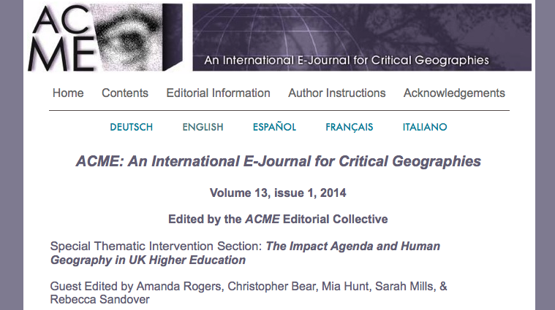
2. The context of the recent ‘impact’ agenda and debate
Questions of relevance, usefulness and impact are not new but have been foregrounded by new approaches in the UK to assessing the quality of academic work and funding academic research (Research Council funding and REF 2021 assessment)
The focus of recent and ongoing debate: e.g. http://www.acme-journal.org/volume13-1.html

Slide 10
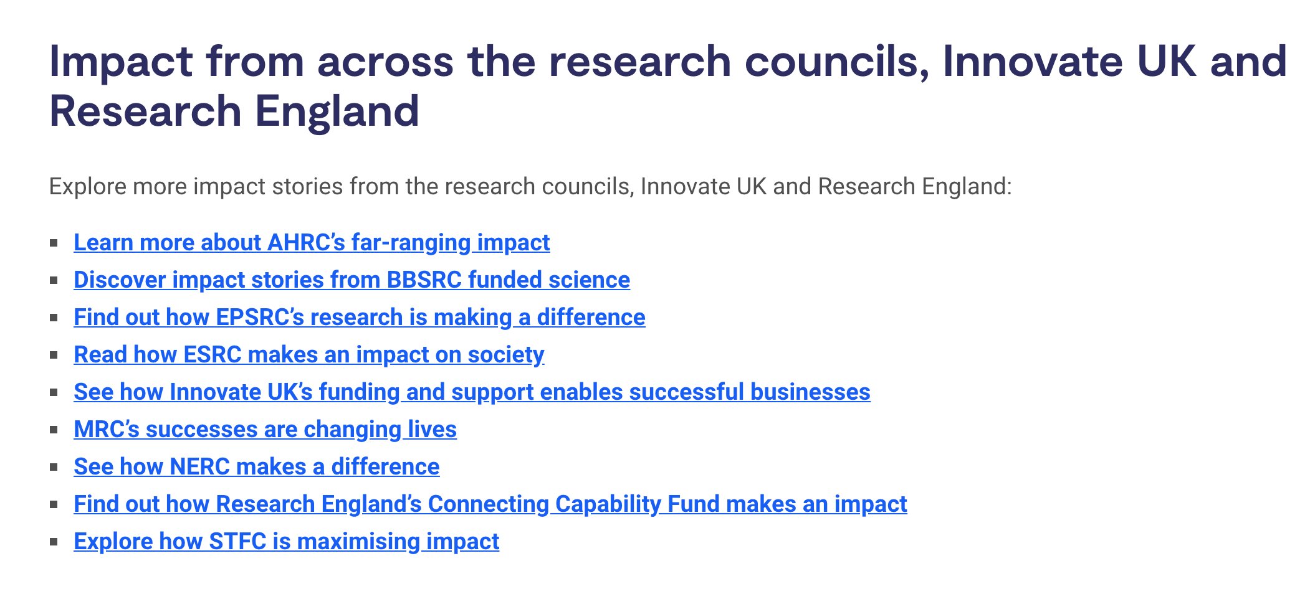
https://www.ukri.org/our-work/delivering-economic-impact/

Slide 12
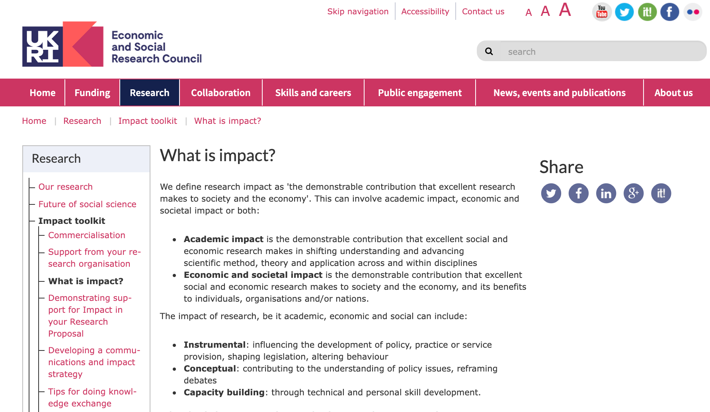
www.esrc.ac.uk

Slide 13
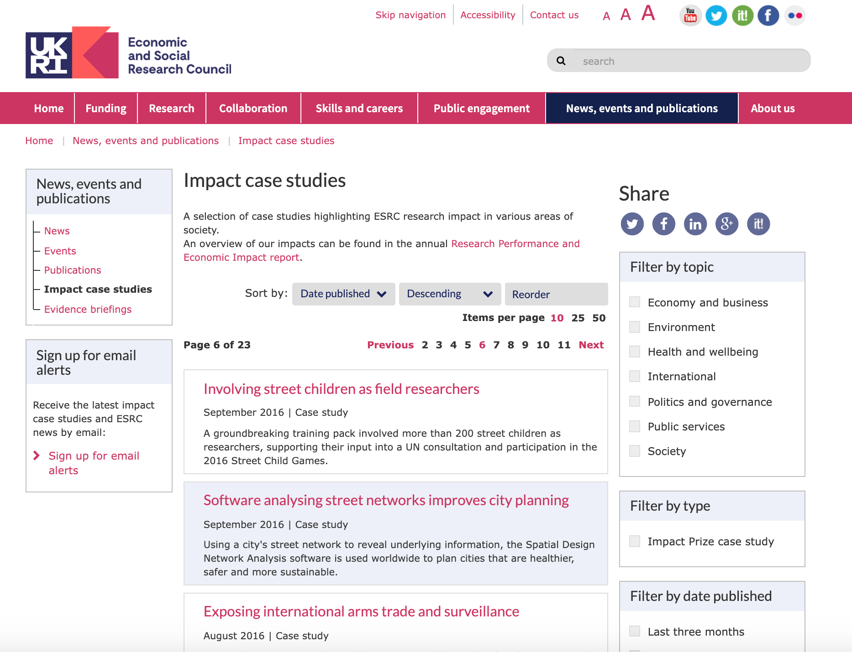

Slide 14
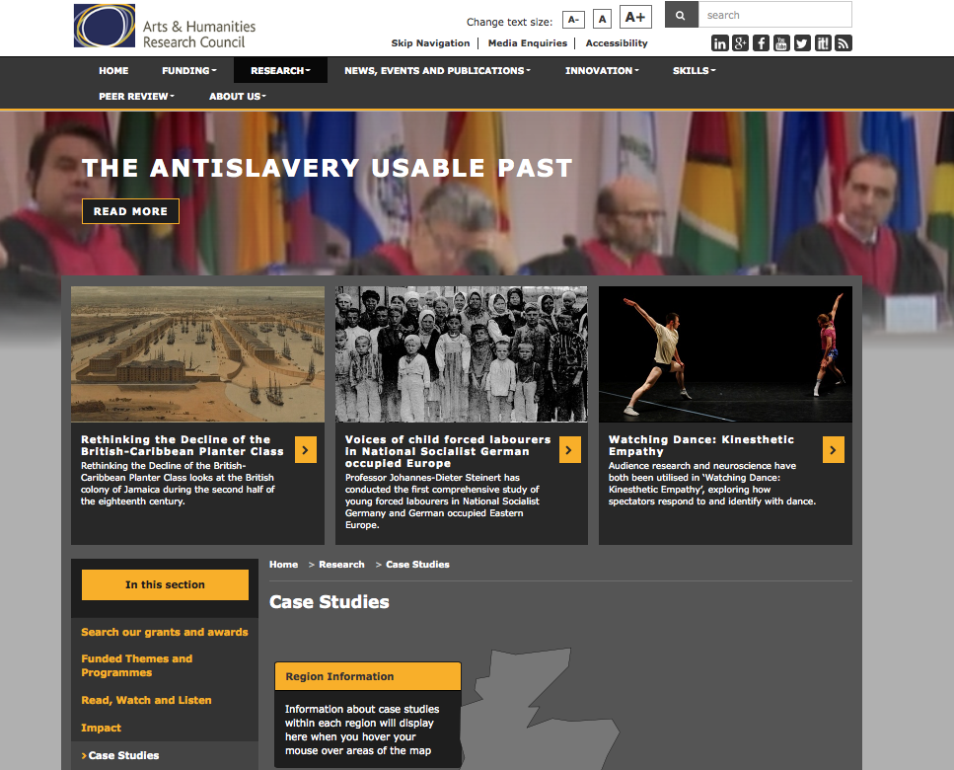

Slide 15
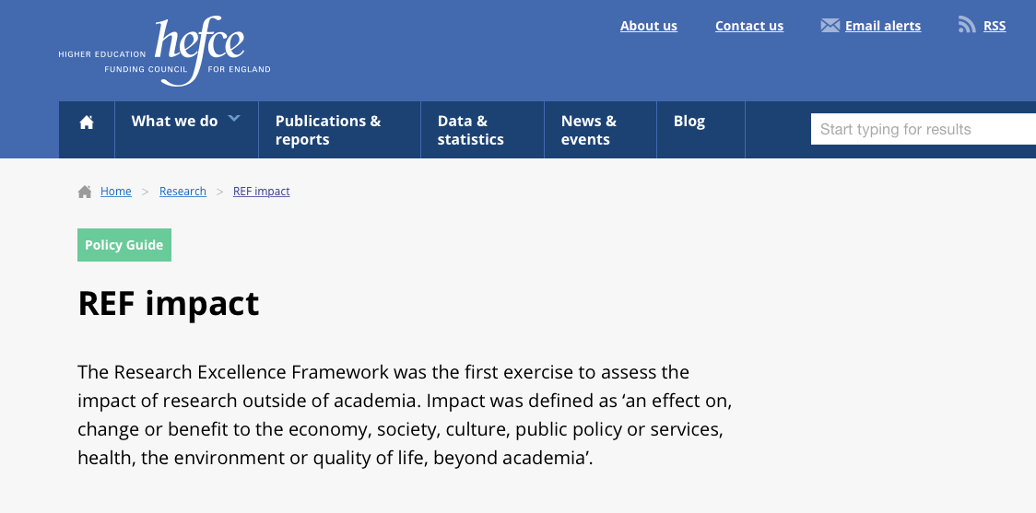
Higher Education Funding Council for England (HEFCE) now assesses research (Research Excellence Framework or REF) quality partly through impact outside of academia:
20% of score in 2014
25% of score in 2021
Likely to change to ‘impact and engagement’ in 2028

Slide 16
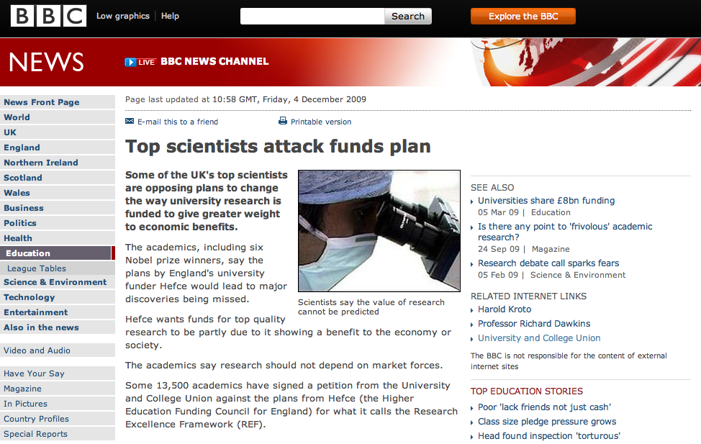
Widespread protest by academics and academic organisations including the University and College Union when the REF impact policy was first announced.

Slide 17
Critical responses in geography
Viewed as part of a neoliberal policy of making higher education institutions compete with each other: the ‘instrumentalisation’ and ‘marketisation’ of research
Extension and deepening of ‘target culture’ / ‘audit culture’ ; implies lost of trust in academics
Curtails academic autonomy and independence
Threat to creative or experimental approaches to research - 'blue skies thinking’

Slide 18
Taking this further…
Pain, Kesby and Askins versus Slater Area (2011)
Points for discussion:
What did you think of the initial argument and counter arguments being proposed by Pain, Kesby and Askins?
How did you respond to the key points being raised by Slater?
What do you feel is useful or less helpful from both perspectives? Did you feel more attuned to one side of the debate over the other?
How do the pieces make you think about research in human geography, your own research plans and interests and about higher education more widely?

Slide 19
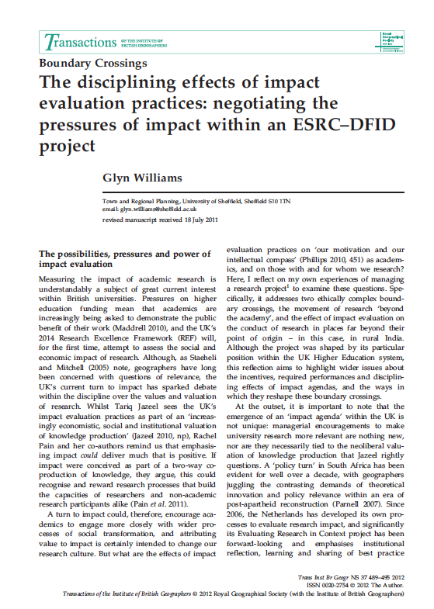
One case study of the difficulty of ‘impact evaluation’ in practice
Glyn Williams (2012) on poverty alleviation strategies in the Global South
Case of the effect of the UK higher education research policy on local research context e.g. rural India
What did this case suggest about:
Problem of valuing ‘high profile’ users over others
Ethics of high-profile validation e.g. by politicians
Problem of valuing measurable outputs and reach (e.g. national and international impact) over the process (e.g. number of media interviews versus work with rural communities and ‘genuine engagement’)
Problem of potentially constraining critical academic work on public policy

Slide 21
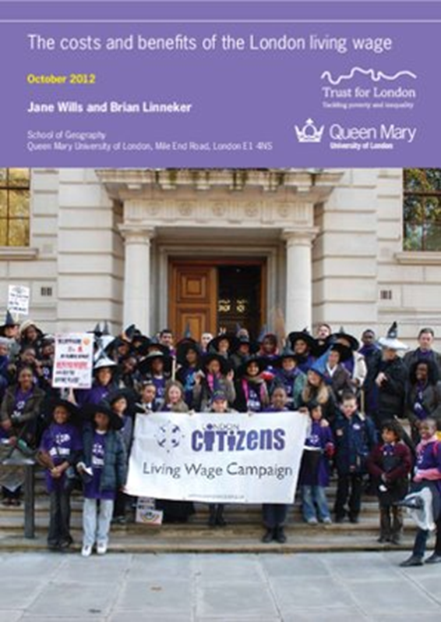
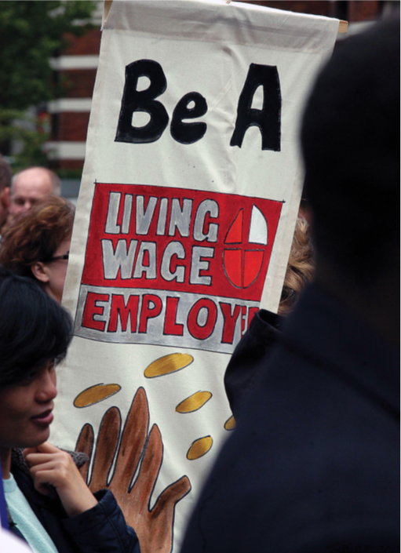
The evidence for the real Living Wage campaign, led by Jane Wills working with TELCO (East London Citizens). In 2006, QM became the first university in the UK to be Living Wage accredited. QM is also a founding partner of the Living Wage Foundation. REF 2014 Impact Case Study based on the impact of research by staff and students at QM providing the evidence base for the real Living Wage.

Slide 22
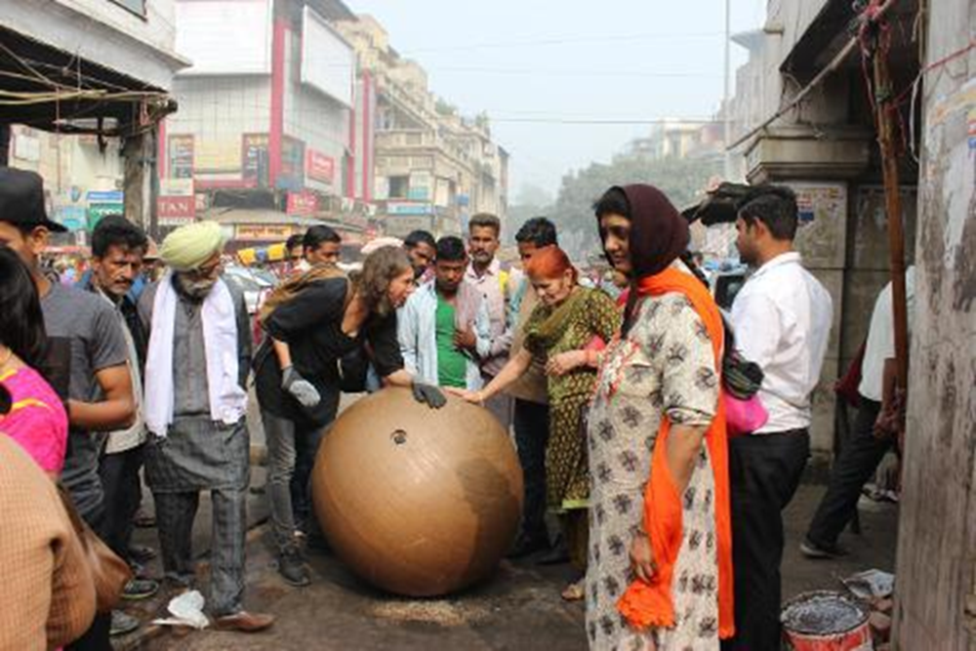
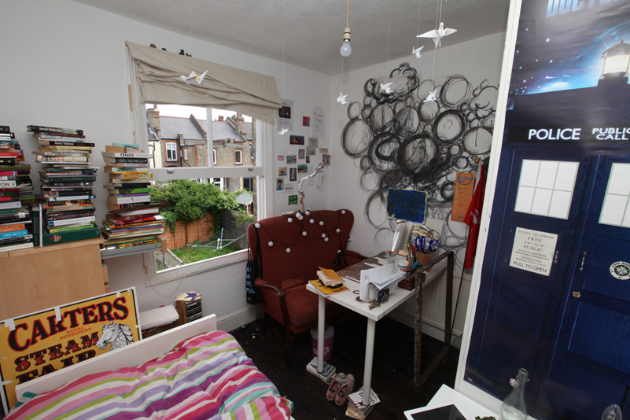
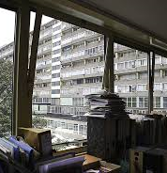
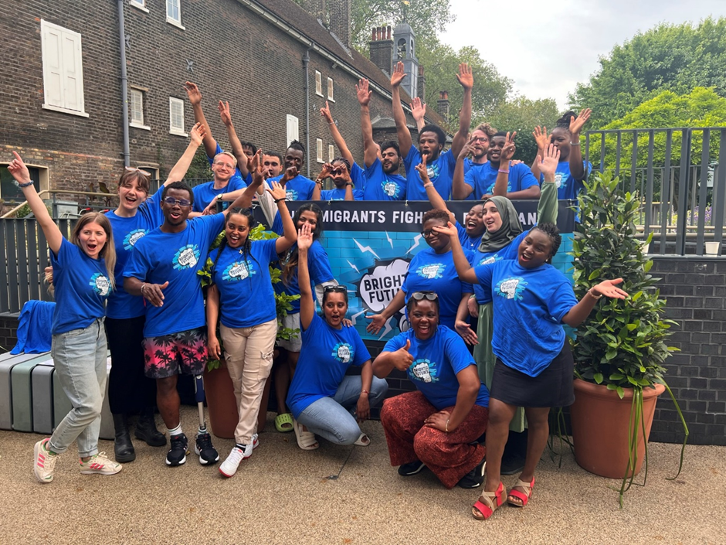
A partnership between QM and Museum of the Home to deepen and diversify public and academic understandings of home. Impact Case Study in REF 2021: broadening and deepening MoH’s strategic direction, remit and scope; diversifying MoH’s exhibitions and collections strategy; strengthening MoH’s engagement with its locality and local residents.

Slide 23
Queen Mary’s Research Impact Strategy
Embed a research culture where impact, enterprise, innovation, and engagement are an innate part of all research activity
01
Support innovation, development, and entrepreneurship to deliver impact to address global, national, and local challenges.
02
Build on our culture of engaged research practice, working with the public, patients, and communities to shape and conduct research, and to share the results
03
Become a UK leader in the measurable impact of licenses and spinouts from our research community
04
Raise our reputation for impact and bring it in line with the quality of our research outputs in preparation for the next Research Excellence Framework
05
2 Deputy Vice Principals for Impact: Culture, Civic & Community; Enterprise & Commercial Innovation
Impact forum; impact funding; policy secondment scheme

Slide 24
Research Impact and the wider impact of universities e.g. Civic University Agreements in the UK
The UPP Civic University Commission (2018-19) asked what it means to be a ‘civic university’ in the 21st century.
Recommended development of Civic University Agreements by universities, to focus civic activity based on the needs of the local community.
More than 60 UK universities have since committed to create a Civic University Agreement.
Civic University Network (led by Sheffield Hallam University) launched in 2020.
National Civic Impact Accelerator programme (led by SHU, with QM, Birmingham, NCCPE, ICS and OECD) from 2023-26. QM is leading a strand of work on equitable partnerships.

Slide 25
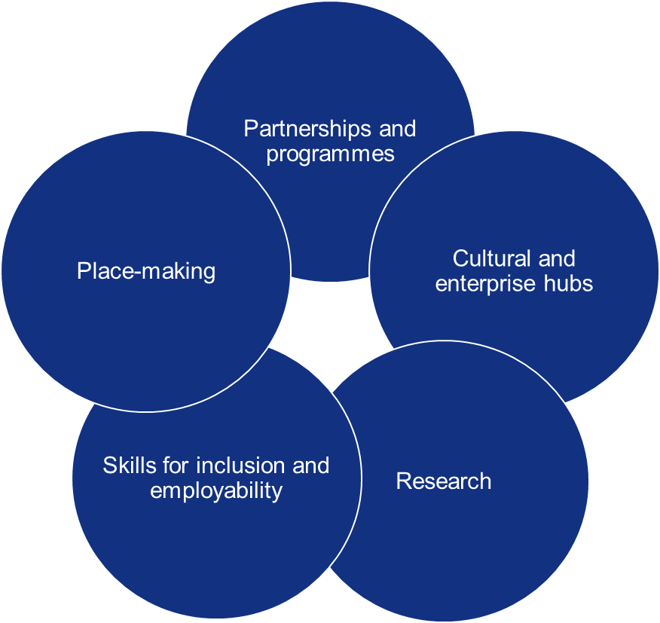
Civic University Agreements
Respond to local priorities related to the local area and community needs
Form a guiding strategy for partnership, in support of a shared mission
Often linked strongly to priorities for how the local area will develop or change
Seek to unite and possibly refocus many existing university-community activities, in order to scale their impact
Can have social, economic, health and welfare, educational and democratic (participation building) elements.

Slide 26
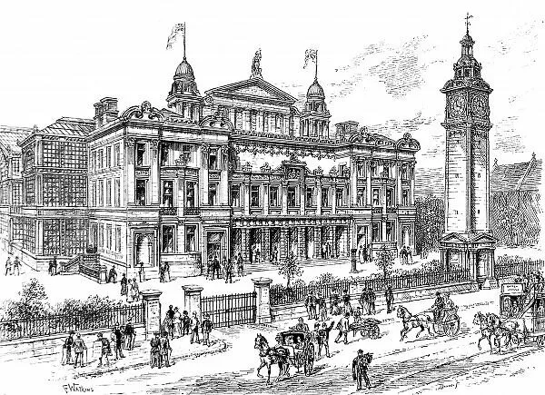
The People’s Palace – opened in 1887

Slide 27
QM’s Civic University Agreement: five priority areas
Inclusive place-making
A healthy and sustainable future
Pathways for life
A cultural hub for east London
Enabling civic practice
Convene local champions
Support innovation and enterprise
Access to QM space
Student volunteering
East London Research Network
Strengthen health equity
Partner on Tower Hamlets HDRC
Lived experience at the heart of research
Focus on climate and sustainability
Local student recruitment
New education and employment opportunities
Lifelong education
London City Institute of Technology
Celebrate local heritage and history
Provide spaces and support to local arts and cultural organizations
Access to arts and culture
Fair local employer
Equitable partnerships
Procurement policy
Apprenticeship levy transfer
Connect and align with others, including as partner on CUN and NCIA
East London Research Network
https://www.qmul.ac.uk/about/community/civic-university-agreement/

Slide 28
QM’s strategic civic partners

Slide 29
Geography and the civic agenda
Place-based research, including with partner organizations and communities.
Civic engagement and impact: addressing local challenges.
Civic teaching and learning, including through co-designed programmes / modules / fieldwork.
Place as a strategic priority for UKRI – major funding programmes e.g. Strength in Places; ESRC Local Policy Innovation Partnerships programme; local authority led NIHR Health Determinants Research Collaboration programme.

Slide 30
Tower Hamlets Health Determinants Research Collaboration
Introduction and overview

Slide 31
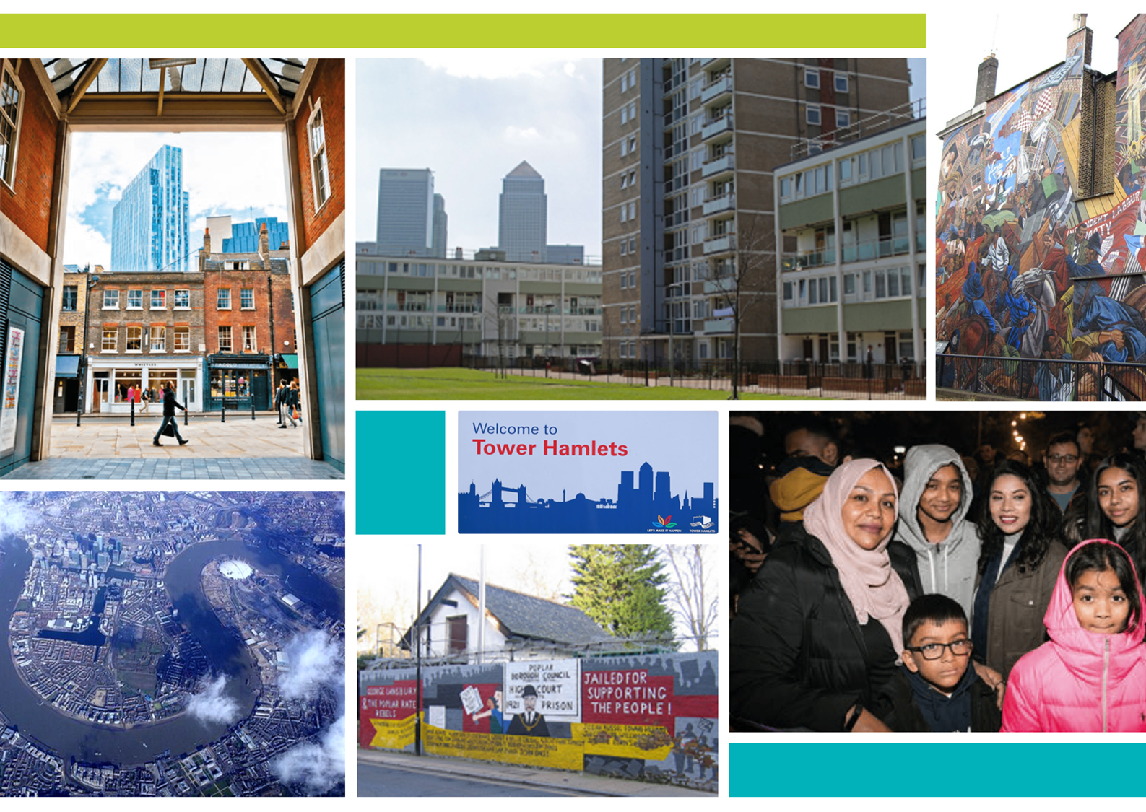
Long-term benefits
Council decisions and programmes will be based on evidence of what is shown to work
Residents will benefit from better services and policies based on what matters to them and robust evidence of what works
Researchers in universities, voluntary sector and community organisations and the Council will find it easier to carry out and measure impactful research

Slide 32
The value of human geography depends on its relevance to and impact on wider society
Arguments for and against, or qualifying, the motion?

Slide 33
IV Concluding thoughts, comments and questions
an expansive model of relevance what might that be?
Ruth Machen 2019

Slide 34
IV Concluding thoughts, comments and questions…
an expansive model of relevance what might that be?
‘Our conclusion may seem paradoxical: we argue that relevance may best be thought of as an attitude and a set of practices intended to produce research that will be useful in some way – large or small, in public or private venues, or even in changing ways of thinking or conceptualizing issues – that may not be manifest in any particular policy or outcome. From this perspective, relevance is not easily measured, and it may not be directly observable. While this perspective may be at odds with the performance or productivity-based outcomes of research, we argue that our approach recognizes the ineluctably political nature of relevance and the diverse goals that we, as a community of scholars, promote. Our approach also highlights the role of academics as educators of students, of policy makers, of the public, but it is a particular view of education that involves listening, critical analysis, and capacity building, as much as recommending particular actions’ (Staeheli and Mitchell, 2005, 357-8)

