Slide 1
Independent Learning at Master’s level
Arcadia Woods
Senior Academic Skills Adviser
September 2022

Slide 2
Session outline:
Independent learning
Self-reflection and Skills audit
Plagiarism and academic integrity
Support that’s available

Slide 3
Studying at Masters level
Studying at postgraduate level is different to:
Work-based learning
Undergraduate studying
Working
How is it different?
What does independent learning mean to you?
Small groups (2-4):
Introduce yourself
Are you new to QMUL?
If not, where have you joined from?
Discuss in your groups:
What does “independent learning” mean to you?
What is different about learning at Masters level?

Slide 4
What does it mean to be an Independent Learner?
Let’s hear from you – visit Menti.com and enter code 8171 3332

Slide 5
What’s different about learning at Masters level?
Let’s hear from you – visit Menti.com and enter code 8171 3332

Slide 6
Independent learning
Independent learning means:
More responsibility for organising your time, and your workload
More self-directed learning
Developing your skills
Developing your own identity as a learner
Opportunity to learn in different ways, settings, locations, times
Independent learning does not mean:
You are on your own
You can’t ask for help
No-one is interested or invested in your progress

Slide 7
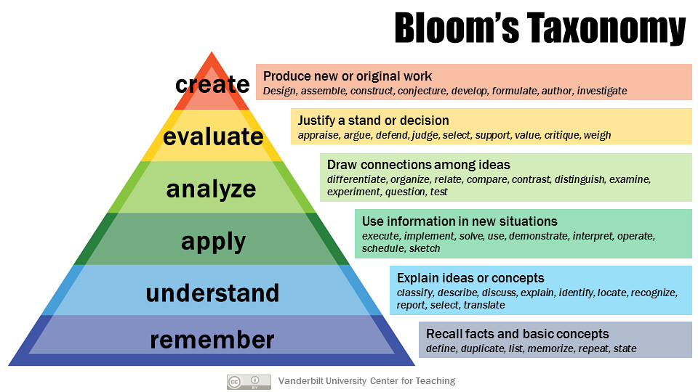
What’s different about Master’s level study?
Higher Order Thinking Skills (HOTS)

Slide 8
What’s different about Master’s level study?
Timeline, self-management and independence

Slide 9
What’s different about Master’s level study?
Outside of your studies:
New institution, new city, new country
Work-life balance
Next steps – balancing studies and preparing for career

Slide 10
Skills for Masters level
Academic Skills
Reading
Research and information skills
Finding resources
Using Library Search
Referencing information
Personal development
Time management
Organisation
Note-taking
Academic writing
Referencing and plagiarism
Revision

Slide 11
Support available for you
I want to… get support with developing my academic writing, research and reading, referencing, organisation and time management, maths and statistics
Teaching and Learning Support team - https://www.qmul.ac.uk/library/academic-skills/
Workshops, one-to-one tutorials and self-help resources
I want to…speak to someone about how to develop my academic writing
Royal Literary Fund Fellows - https://www.qmul.ac.uk/library/academic-skills/rlf/
One-to-one tutorials to discuss your academic writing with a professional writer
I want to… access advice and guidance with my academic writing quickly
Smarthinking online tutoring - https://www.qmul.ac.uk/library/academic-skills/smarthinking-online-tutoring/
Access expert advice and guidance from online tutors within 24 hours

Slide 12
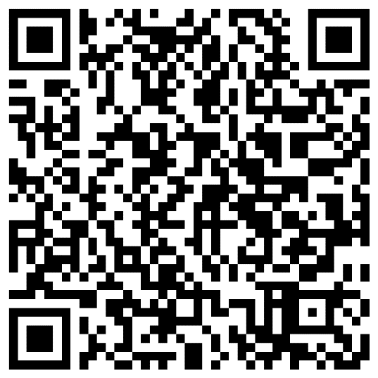
Tools for independent learning – Self-reflection
Independent learning → taking responsibility for your own self-development
Taking opportunities for feedback
Reflecting on What Works, and what doesn’t
Reflecting on own skills – are there areas where I need development?
If so, how can I take proactive steps to work on these?
Activity – Academic and research skills audit
Visit https://forms.office.com/r/4LqcEUqPK4
5 minutes to complete the Skills Audit
Remember to tick the option to email the results to yourself
QR code for the skills audit

Slide 13
Next steps:
Reflection activity – identified any areas for development?
Anything that’s changed as you start/continue Master’s level study?
Explore the support, advice and guidance available to help you find next steps

Slide 14
Academic Integrity, plagiarism and referencing
Academic integrity at QMUL: Honesty, trust, fairness, responsibility and courage
Encompasses:
Academic misconduct
Plagiarism
Referencing
Collusion
Contract cheating
Visit menti.com and enter code 3343 4563 (new code)

Slide 15
Any questions?
Raise hand, or use the Menti.com and use code 8171 3332

