Slide 1
PSA Masterclass 1 Prescription review (REV) questions plus tips
13th September and 4th October 2024
Patricia McGettigan
Head of QMUL CPT MBBS teaching

Slide 2
SPE 1 Results 2024
SPEs are a guide as to your relative standing in the cohort for CPT, your strengths & weaker areas. Masterclass work will greatly assist in honing skills for the PSA in January
Listen to Dr Kapil’s excellent SPE 1 review with answer explanations and discussion of therapy choice, question scoring and BNF use
https://qmplus.qmul.ac.uk/mod/kalvidres/view.php?id=2681959

Slide 3
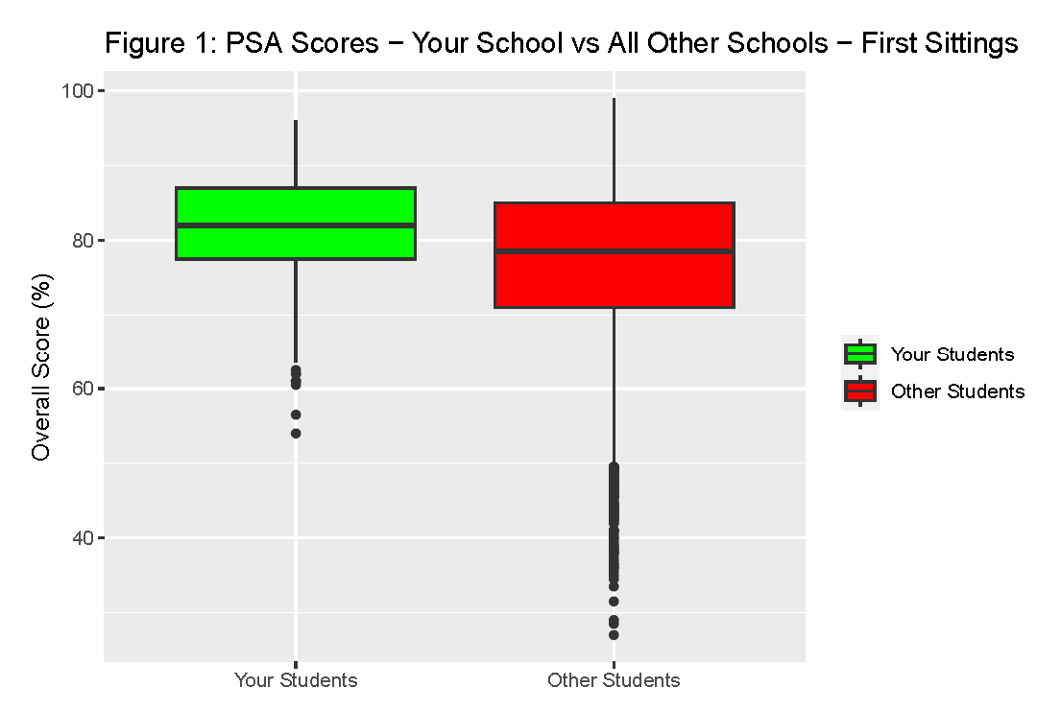
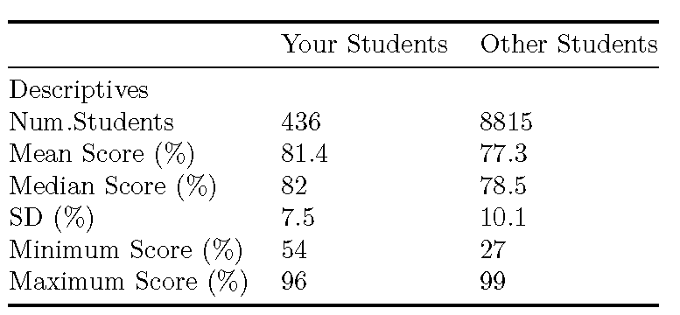
QMUL students had a fantastic 2024 PSA 436 students: 433 (99.3)% passed at first-sit All passed second-sit
PSA Pass Score, 2024
59% - 61% depending on the paper
Every PSA question is standard set individually

Slide 4
Review (REV) questions in the PSA
We begin our Masterclasses with REV because everyone has had some prescription / medication review practice in clinical placements, hospital and GP, since Year 3
High value PSA Q: 4 marks
Official description
Presents a prescription for review – that was written by someone else
Reasoning and judgement
You are asked to decide which components of the prescription are inappropriate, wrong / error, unsafe or ineffective
So: this requires you to spot
Important drug / other interactions
Serious dosing errors – dose, time, route
Caution/CI, e.g., allergy, renal impairment, pregnancy, medical hx
Dose adjustments – kidneys, weight, child
Side effect risks for this particular patient
Total list of medicines for each question item ≥6.
Some knowledge of common effects, adverse reactions and interactions assumed - format provides flexibility to examine practical CPT as it applies often in clinical practice

Slide 5
REV QUESTION VISUAL Read the PSA blueprint document On QM+ Y5 CPT area very useful as you prepare
Prescription Review Item
ID
REV000
This question item is worth 4 marks
You may use the BNF at any time
Case presentation
A [age]-year-old [man/woman/child] presents to [location and situation] complaining of [symptom that might be used as the focus for one of the questions] etc. PMH. She/he has suffered from …. [describe any past medical history relevant to the scenario]. DH. She/he normally takes …. [list any current prescriptions]. SH. [include any relevant social history] His current regular medicines are listed (right).
[Authors should try to adhere to this general layout but there is room for flexibility – the presentations should be fairly brief]
CURRENT PRESCRIPTIONS
Drug name | Dose | Route | Freq. |  | A |  | B
Drug 1 | xx mg | IV | daily |  | ☐ |  | ☐
Drug 2 | xx mg | ORAL | 12-hrly |  | ☐ |  | ☐
Drug 3 | xx mg |  |  |  | ☐ |  | ☐
Drug 4 | xx mg |  |  |  | ☐ |  | ☐
Drug 5 | xx mg |  |  |  | ☐ |  | ☐
Drug 6 | xx mg |  |  |  | ☐ |  | ☐
Drug 7 | xx mg |  |  |  | ☐ |  | ☐
Drug 8 | xx mg |  |  |  | ☐ |  | ☐
Drug 9 | xx mg |  |  |  | ☐ |  | ☐
Drug 10 | xx mg |  |  |  | ☐ |  | ☐
Use between 5 and 10 rows to create the list of drugs that will form the focus of Questions A and B
Question A
Select the [ONE/TWO prescription/prescriptions] that [is/are] [most likely to be a cause of/contains a serious dosing error/interact/is contra-indicated, etc.].
(mark [it/them] with a tick in column A)
Identify the correct answer(s) on columns A and B and justify in the answer box below
Question B
Select the [ONE/TWO prescription/prescriptions] that [is/are] [contra-indicated/most likely to be a cause of/contains a serious dosing error/interact/, etc.].
(mark [it/them] with a tick in column B)
Answer box
Question A | Marks per correct tick | [1 or 2]
Write a brief justification in this box
Question B | Marks per correct tick | [1 or 2]
Write a brief justification in this box
Prescribing Skills Assessment – Prescription Review Question Item Example

Slide 6
Masterclass 1 – format today
Questions today
Give each question a go – Don’t worry if you get it wrong
Often you learn more
Today is for exposure to REV style & getting a sense of what is being asked
Not a knowledge test
Little time to use BNF in the PSA
PSA: 60 Q in 120min
A REV Q has 2 sub-sections & each can ask about 1, 2, or 3 drugs; up to 4 drugs to consider in the whole Q; = time tight!
Work through the questions using the BNF (web version as per PSA) as reference
Unrefined questions today – not the PSA visuals format
Limited, bare bones case presentation
Some lists of medications may be ‘unexpected’ combinations (owing to patient’s PMH conditions)
Slides with Q + answers & notes will be on QM+ after the second running of Masterclass 1 on 4th October - plus extra slides for practice https://qmplus.qmul.ac.uk/course/view.php?id=2594

Slide 7
After today remember, CPT & prescribing integrates across all placements
Don’t consider CPT & prescribing in isolation – this is not what the PSA intends – it aims to benefit FY1 practice & patient care
Rewards familiarity with actual clinical practice, in the clinic / on the wards with your teams
Make sure to review notes & resources from your clinical placements in both Year 4 & Year 5, e.g.,
Year 5 GP – Sessions on prescribing in primary care; Core cases / discussion forum
Year 4 – Specialty placements, especially those that will feature in the PSA
Elderly Care, Ob/Gyn, Paeds, Psych

Slide 8
Drug dose, timing, frequency, route

Slide 9
(84M) PMH: Asthma, atrial fibrillation, benign prostatic hypertrophy, hypothyroidism Investigations: Normal renal and liver function Select the prescription with a prescribing error
Apixaban 25 mg orally twice daily
Digoxin 125 microg orally daily
Finasteride 5 mg orally daily
Fostair NEXThaler® 200/6 (200 micrograms beclomethasone, 6 micrograms formoterol) two inhalations twice daily
Levothyroxine 75 micrograms orally daily

Slide 10
(54M) PMH: Hypertension, type I diabetes, benign prostatic hypertrophy Investigations: Normal renal and liver function Select TWO prescriptions that contain a prescribing error
Amlodipine 10mg orally daily
Bisoprolol 5mg orally daily
Digoxin 125 micrograms orally daily
Humalog (insulin lispro) 20 units at night
Levemir (insulin detemir) 10 units with each meal
Tamsulosin 400 micrograms orally daily

Slide 11
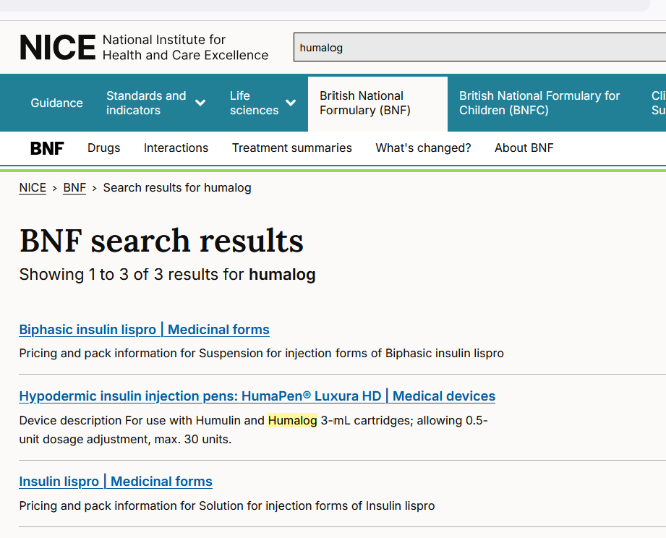
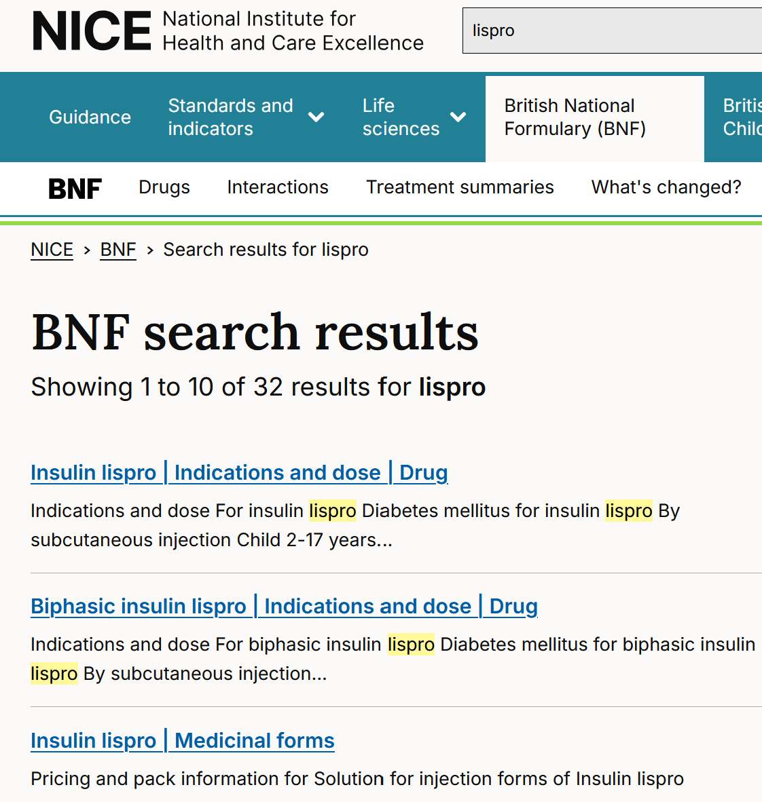
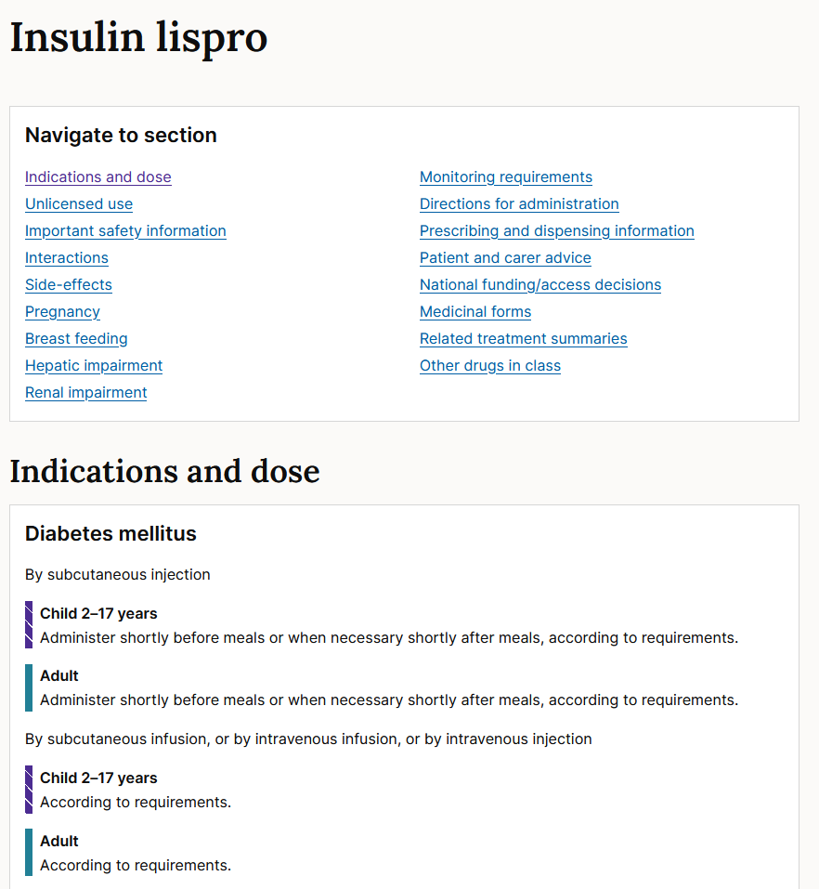
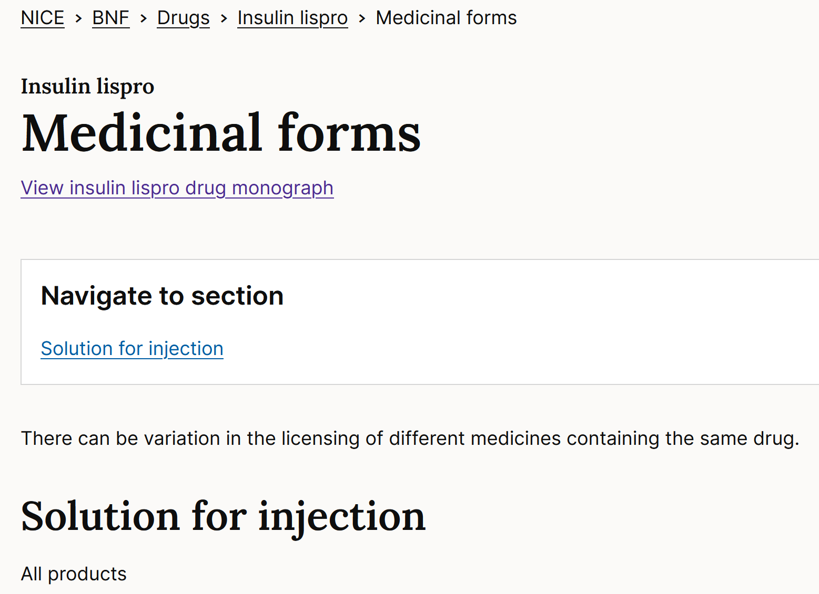
Can’t remember the difference between Humalog and Levemir? Lispro vs Detemir? Aspart? Degludec? Humulin M3? Search BNF using any of the names in the Q Safe swift practice; Simplifies (your) life;
May find the information via
‘Indication & Dose’ route if ‘Medicinal Forms’ is not helpful
Or
Via ‘Medicinal Forms’ route if Indication & Dose info is not helpful (next slide)

Slide 12
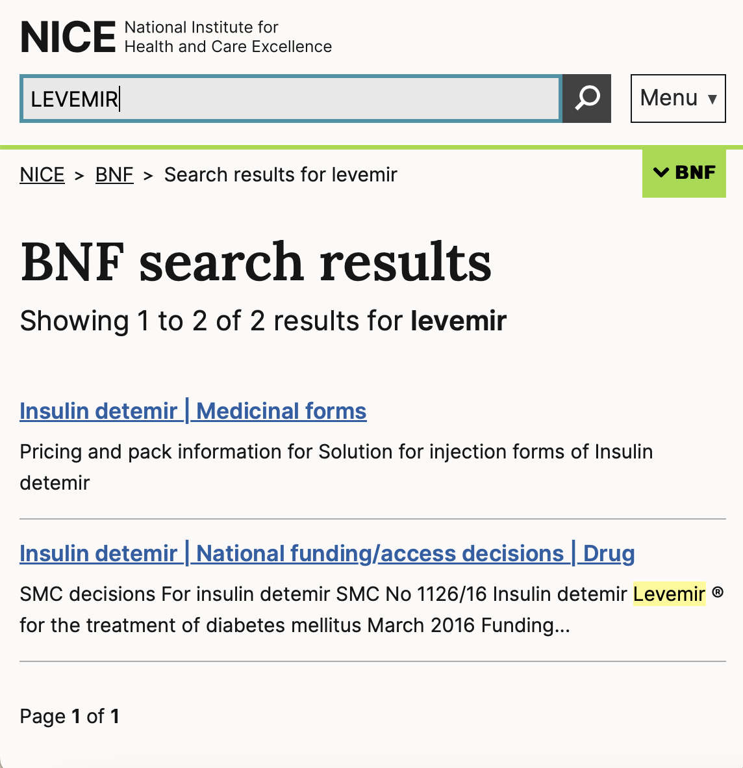
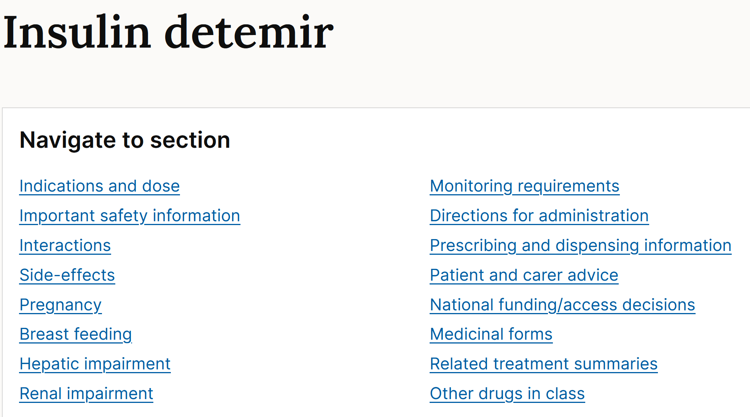
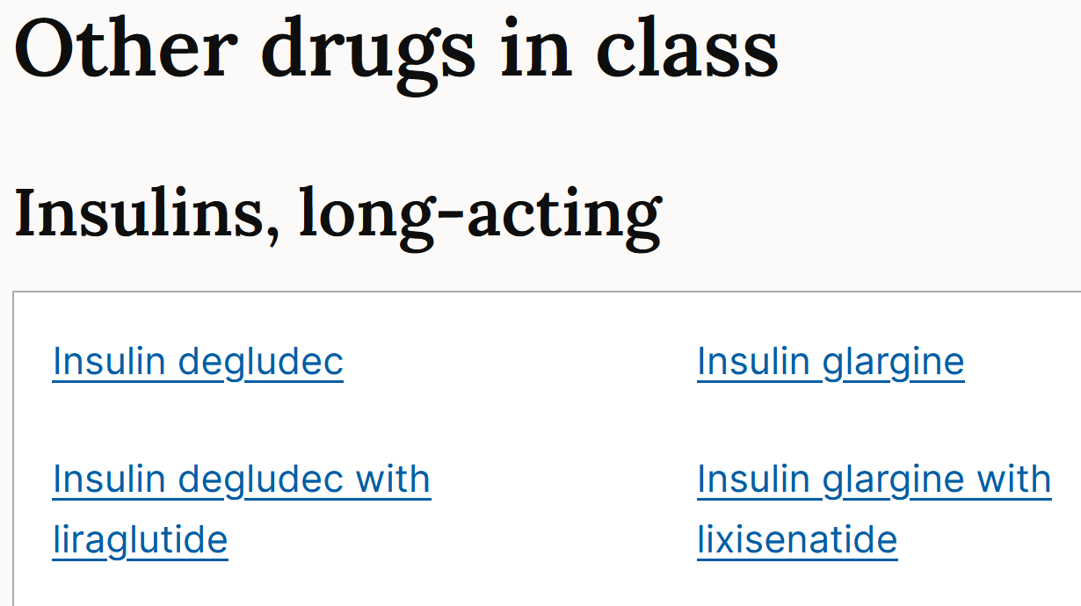
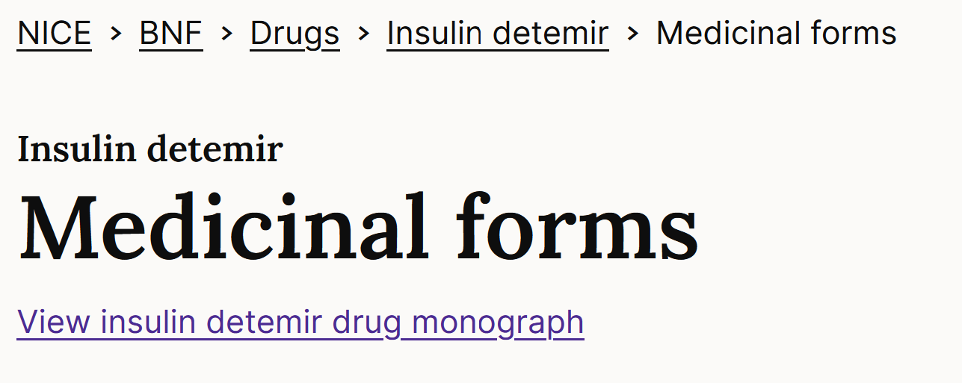
Can’t remember the difference between Humalog and Levemir? Lispro vs Detemir? Aspart? Degludec? Humulin M3? Insulin I?

Slide 13
(65F) Admitted with systemic fungal infection PMH: Hypertension, GORD, bipolar disease, osteoporosis Investigations: Mg²⁺ 0.4 mmol/L (0.7-1.0) Select THREE prescriptions that are most likely to increase the risk of hypomagnesaemia
Alendronic acid 70 mg orally weekly
Amlodipine 5 mg orally daily
Amphotericin 60 mg intravenously daily
Indapamide 2.5 mg orally daily
Lansoprazole 30 mg orally daily
Olanzapine 20 mg orally daily
Senna 15 mg orally nightly

Slide 14
(82M) Called back to GP because routine blood results show hyponatraemia PMH: Atrial fibrillation, depression, hypercholesterolaemia, hypertension, type II diabetes Select TWO prescriptions that are most likely to increase the risk of hyponatraemia
Amiloride 5 mg orally daily
Amlodipine 10 mg orally daily
Atorvastatin 80 mg orally daily
Citalopram 20 mg orally daily
Digoxin 62.5 micrograms orally daily
Indapamide MR 1.5 mg orally daily
Metformin MR 1 g orally twice daily
Valsartan 80 mg orally daily
Warfarin 3 mg orally daily (INR 2-3)

Slide 15
(78M) Carers note persistent cough, more breathless than usual PMH: AF, Anxiety, COPD, GORD, Recurrent UTIs Exam: Marked tremor; mild ankle oedema; persistent cough; bilateral inspiratory crackles Select the three prescriptions most likely to be associated with his tremor
Beclomethasone inhaler 400microg inhaled twice daily
Digoxin 125microg orally daily
Furosemide 20mg orally daily
Haloperidol 1.5mg orally at night
Nitrofurantoin 100mg orally at night
Omeprazole 20mg orally daily
Salbutamol 2.5mg nebulised as needed
Theophylline 200mg orally twice daily

Slide 16
(78M) Carers note persistent cough, more breathless than usual PMH: AF, Anxiety, COPD, GORD, Recurrent UTIs Exam: Marked tremor; mild ankle oedema; persistent cough; bilateral inspiratory crackles Select the one prescription most likely to be associated with his respiratory symptoms
Beclomethasone inhaler 400microg inhaled twice daily
Digoxin 125microg orally daily
Furosemide 20mg orally daily
Haloperidol 1.5mg orally at night
Nitrofurantoin 100mg orally at night
Omeprazole 20mg orally daily
Salbutamol 2.5mg nebulised as needed
Theophylline 200mg orally twice daily

Slide 17
Renal and hepatic dysfunction

Slide 18
(74M) Admitted for acute pulmonary oedema secondary to heart failure PMH: CKD stage III, type II diabetes mellitus, ischaemic left ventricular dysfunction Investigations: eGFR 40 (stable) [normal range >60 ml/min/1.73m² ] Select ONE of his admission prescriptions that needs dosing review
Atorvastatin 80 mg orally daily
Canagliflozin 300 mg orally daily
Candesartan 32 mg orally daily
Carvedilol 25 mg orally 12hrly
Enoxaparin 40 mg subcutaneously daily
Furosemide 80 mg intravenously twice daily
Metformin MR 1g orally twice daily
Paracetamol 1g orally as required (max 4g/day)
Spironolactone 25 mg orally daily

Slide 19
(74M) Admitted for acute pulmonary oedema secondary to heart failure PMH: CKD stage III, type II diabetes mellitus, ischaemic left ventricular dysfunction Investigations: eGFR 20 (stable) [normal range >60 ml/min/1.73m² ] Select TWO prescriptions that should be stopped
Atorvastatin 20 mg orally daily
Candesartan 32 mg orally daily
Carvedilol 25 mg orally 12-hrly
Heparin 5000 units subcutaneously daily
Furosemide 80 mg intravenously twice daily
Metformin MR 1g orally twice daily
Paracetamol 1g orally as required (max 4g/day)
Spironolactone 25 mg orally daily

Slide 20
(54M) Admitted with spontaneous bacterial peritonitis PMH: Hepatitis C cirrhosis, neuropathic pain Investigations: Hb 134, WBC 19.5, Neut 17.1, Plt 245 Na 141, K 4.1, eGFR 78 INR 2.3, Bili 61, ALT 281, AlkPhos 108 Select ONE prescription that should be stopped
Omeprazole 20 mg orally daily
Paracetamol 1 g orally 6hrly
Pregabalin 50 mg orally 8hrly
Spironolactone 50 mg orally daily
Tazocin® (tazobactam/piperacillin) 4.5 g intravenously 8hrly

Slide 21
(54M) PMH: Arthritis, atrial fibrillation, stroke, depression, neuropathic pain, nose bleeds Investigations: Hb 13.4 (11.5-17); WCC 5.2 (3-10); Plt 247 (150-400); Na 137 (132-139); K 4.3 (3.5-5.3); PT 21 (9-14); APTT 41 (23-37) Which of the options below, at usual therapeutic doses, is most likely to explain the abnormalities observed?
Aspirin
Clopidogrel
Fluoxetine
Gabapentin
Naproxen
Paracetamol
Tranexamic Acid
All of A-G contribute
None of A-G explain

Slide 22
Pregnancy and breastfeeding

Slide 23
(33F) seeking GP pre-conception advice re: drugs and pregnancy PMH: Dilated cardiomyopathy, asthma, type II diabetes mellitus, depression Select Two prescriptions that are most important to stop while trying to conceive
Bisoprolol 5 mg orally daily
Enalapril 10mg orally twice daily
Fostair® 200/6 (200 micrograms beclomethasone / 6 micrograms formoterol) one puff twice daily
Lansoprazole 30 mg orally daily
Metformin 850 mg orally three times a day
Salbutamol 200 micrograms inhaled as required
Sertraline 50 mg orally daily
Warfarin orally daily dose as per INR (Target 2-3)

Slide 24
Comorbidities - Contraindication & cautions

Slide 25
(64F) Review in Neurology Clinic with new diagnosis of Parkinson’s disease Other PMH: Gout, hyperthyroidism, bipolar disorder, hypertension, rheumatoid arthritis Select two prescriptions that are most likely to worsen the symptoms of her Parkinson’s disease
Allopurinol 100 mg orally daily
Carbimazole 15 mg orally daily
Felodipine 10 mg orally daily
Folic acid 5 mg orally weekly
Haloperidol 5 mg orally daily
Methotrexate 5 mg orally weekly
Metoclopramide 50 mg orally as required (max 8hrly)

Slide 26
The specialist pain team recommends Mr XY, 44y, should be commenced on gabapentin for neuropathic pain. Other PMH: Type 2 diabetes Which of the following is the most appropriate factor to consider in his background history when judging the benefit – risk balance of gabapentin for Mr XY.
He declines to be vaccinated for Strep pneumoniae
He has type 2 diabetes
He often takes ibuprofen for back pain
He was heroin dependent in his early twenties
He was treated for bacterial meningitis 15y ago

Slide 27
(82M) PMH: Heart failure, ischaemic heart disease, type II diabetes mellitus, depression, chronic back pain Select TWO prescriptions that are most likely to increase the risk of acute heart failure
Aspirin 75mg orally daily
Atorvastatin 40mg orally daily
Bisoprolol 10mg orally daily
Codeine phosphate 30mg orally as required (max 6hrly)
Eplerenone 50mg orally daily
Ibuprofen 400mg orally 8hrly
Metformin 1G orally twice a day
Paracetamol 1g orally 8hrly
Pioglitazone 30mg orally daily
Valsartan 80mg orally daily

Slide 28
QT prolongation

Slide 29
(62M) Admitted for community acquired pneumonia PMH: Dilated cardiomyopathy, depression, epilepsy, gout, opioid dependence Investigations: ECG QTc 540ms Select THREE prescriptions that are most likely to increase the risk QT prolongation
Allopurinol 100 mg orally daily
Bisoprolol 5 mg orally daily
Carbamazepine 100 mg orally 12hrly
Co-amoxiclav 1.2 g intravenously 8hrly
Citalopram 40 mg orally daily
Clarithromycin 500 mg orally 12hrly
Enalapril 20 mg orally daily
Methadone 60 mg orally daily

Slide 30
(62F) Attends hypertension clinic. PMH: Depression, GORD, hypertension, rheumatoid arthritis, type II diabetes mellitus, Select THREE prescriptions that are most likely to contribute to her elevated blood pressure
Amlodipine 5 mg orally daily
Gliclazide 80 mg orally daily
Ibuprofen 400 mg orally three times daily
Indapamide 2.5 mg orally daily
Lansoprazole 30 mg orally daily
Metformin 500 mg orally three times daily
Methotrexate 7.5 mg orally weekly
Prednisolone 20 mg orally daily
Ramipril 10 mg orally daily
Venlafaxine 75 mg orally 12hrly

Slide 31
(62F) Attends GP for yearly diabetes (type II) review. Reports symptoms consistent with hypoglycaemia PMH: GORD, hypertension, type II diabetes mellitus, schizophrenia Select TWO prescriptions that are most likely to increase the risk of hypoglycaemia
Amlodipine 5 mg orally daily
Canagliflozin 200 mg orally daily
Glibenclamide 10 mg orally daily
Indapamide 2.5 mg orally daily
Lansoprazole 30 mg orally daily
Metformin 500 mg orally three times daily
Olanzapine 10 mg orally daily
Senna 15 mg orally nightly

Slide 32
(82F) Attends falls clinic. PMH: Hypertension, GORD, neuropathic pain, osteoporosis, rheumatoid arthritis, type II diabetes mellitus Select the prescriptions that are most likely to increase the risk of falls
Alendronic acid 70 mg orally weekly
Amlodipine 5 mg orally daily
Amitriptyline 25 mg orally in evening
Doxazosin 8 mg orally 12hrly
Metformin 500 mg orally three times daily
Methotrexate 7.5 mg orally weekly
Omeprazole 40 mg orally daily
Prednisolone 20 mg orally daily
Zopiclone 7.5 mg orally nightly

Slide 33
Pregnancy risks

Slide 34
(34F) seeking GP pre-conception advice re: drugs and pregnancy PMH: Acne, hypothyroidism, rheumatoid arthritis, depression, cold-induced wheezing Select TWO prescriptions that should be ceased while trying to conceive
Folic acid 5 mg orally weekly
Isotretinoin 15 mg orally 12hrly
Levothyroxine 100 micrograms daily
Methotrexate 10 mg orally weekly
Omeprazole 20 mg orally daily
Salbutamol 200 micrograms inhaled as required
Sertraline 50 mg orally daily

Slide 35
(54M) PMH: Benign prostatic hypertrophy, depression, hypertension, neuropathic pain, Type II diabetes mellitus. Investigations: Normal renal and liver function Select the prescription with a prescribing error
Gabapentin 300 mg orally three times a day
Indapamide MR 1.5 mg orally daily
Metformin MR 1 mg orally twice daily
Paracetamol 1 g orally as required (max 4 g/day)
Tamsulosin 400 microg daily

Slide 36
(65F) PMH: Diabetes, GORD, hypercholesterolaemia, hypertension, schizophrenia Investigations: Normal renal and liver function Select the prescriptions with a prescribing error
Atorvastatin 40 mg orally once nightly
Felodipine 5 mg orally once daily
Metformin MR 1 g orally twice daily
Olanzapine 20 mg orally daily
Omeprazole 200 mg orally daily

Slide 37
(54M) PMH: Osteoporosis, chronic hip pain, type II diabetes Investigations: Normal renal and liver function Select the prescription with a prescribing error
Alendronic acid 70 mg orally weekly in morning
Atorvastatin 40 mg orally nightly
Fentanyl 12micrograms/hr patch transdermally, replace every 7 days
Metformin MR 1 g twice daily with meals
Ramipril 5 mg orally daily

Slide 38
(74M) PMH: Asthma, atrial fibrillation, benign prostatic hypertrophy, hypothyroidism Investigations: Normal renal and liver function Select the prescription that contains a prescribing error
Apixaban 2.5 mg orally twice daily
Levothyroxine 75 mg orally once daily
Montelukast 10 mg orally once in evening
Salbutamol 200 micrograms inhaled as required
Tamsulosin 400 micrograms orally daily

Slide 39
(65F) PMH: Epilepsy, hypercholesterolaemia, hypertension, type II diabetes mellitus Investigations: Normal renal and liver function Select the prescription with a prescribing error
Atorvastatin 20 mg orally once nightly
Carbamazepine 10 mg orally twice daily
Felodipine 5 mg orally once daily
Gliclazide 80 mg orally twice daily
Metformin MR 1 g orally twice daily

Slide 40
(54M) PMH: Ischaemic heart disease, type II diabetes Investigations: Normal renal and liver function Select the prescription with a prescribing error
Atorvastatin 80 mg orally nightly
Bisoprolol 5 mg orally daily
Furosemide 80 mg orally nightly
Metformin MR 1 g twice daily with meals
Ramipril 5 mg orally daily

Slide 41
(54F) PMH: Depression, iron-deficiency anaemia, rheumatoid arthritis, type II diabetes mellitus Investigations: Normal renal and liver function Select ONE prescription that contains a prescribing error
Alendronic acid 70 mg orally once weekly
Ferrous fumarate 210 mg orally three times a day
Folic acid 5 mg orally weekly
Gliclazide 120 mg orally twice daily with meals
Methotrexate 7.5 mg orally daily
Omeprazole 20 mg orally daily
Prednisolone 5 mg orally daily
Sertraline 50 mg orally daily

