Slide 1
Paris: A green luxury city?
Week 10

Slide 2
Plan
The Paris Climate Plan.
A reflection of particular green urban imaginaries.
Why ‘green’ a city like Paris?

Slide 3
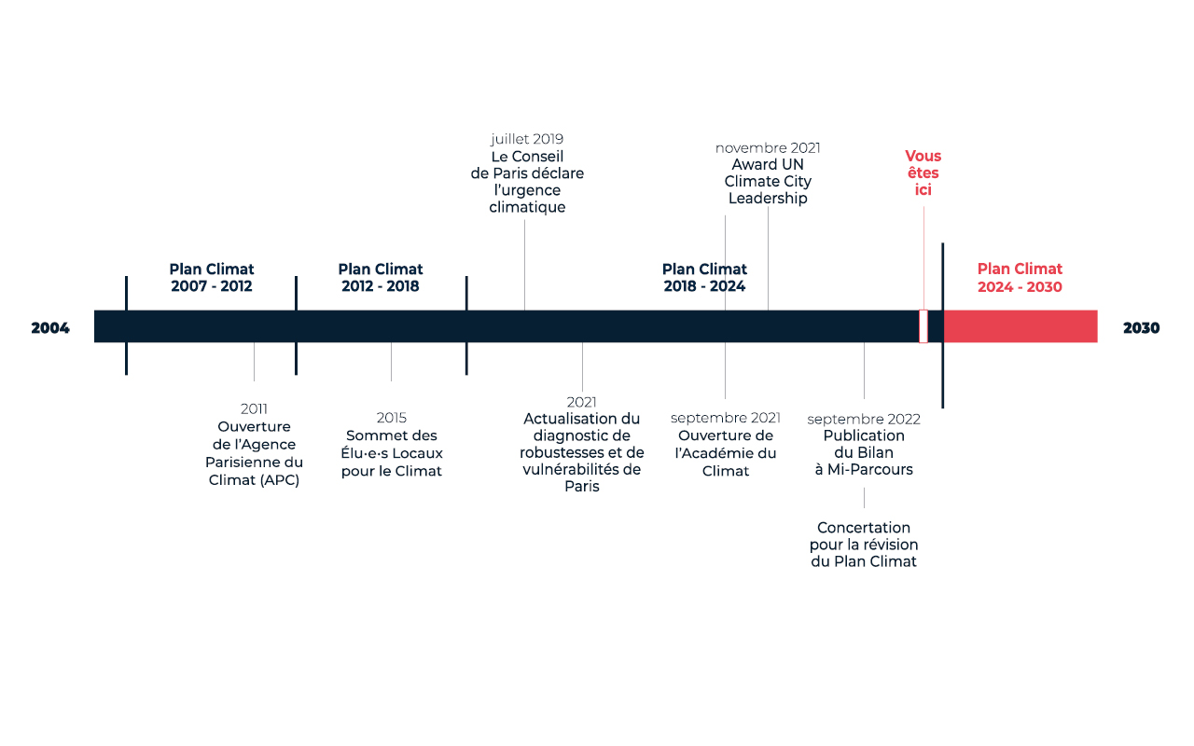
Why ‘green’ cities like Paris?
Responsability.
Vulnerability (heat island effect, lack of green spaces, droughts...).

Slide 4
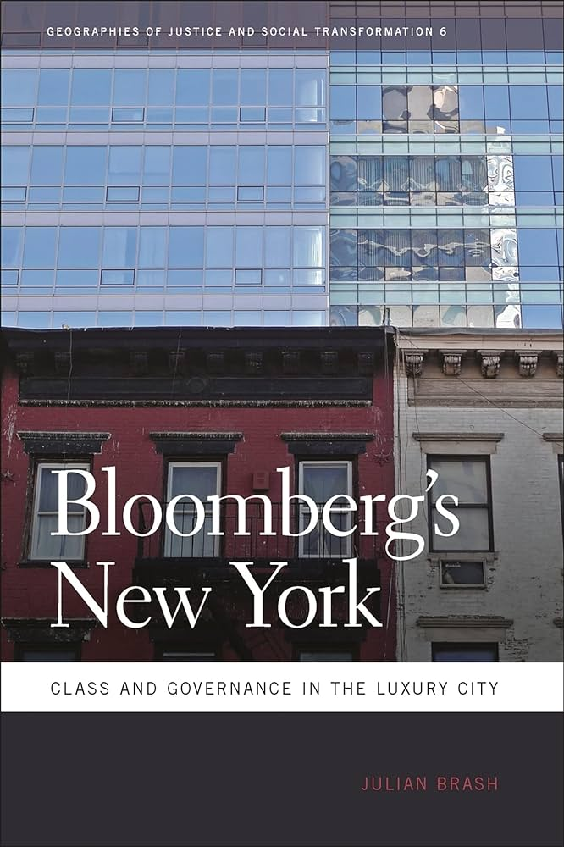
Because ‘greening’ adds value.
Global city “as a place of competition, elite sociality, cosmopolitanism, and luxury, populated by ambitious, creative, hardworking, and intelligent innovators.” Julian Brash, Bloomberg’s New York (2011)
“As media, financial, and business services have come to dominate global cities, there has emerged a ‘postindustrial elite’ made up of high-level professionals as well as […] executives and owners of global businesses”
“This postindustrial elite has absorbed the great part of the wealth generated in the city.” (Brash, https://vanishingnewyork.blogspot.com/2011/03/bloomberg-way-i_29.html, 2011).
Professional-managerial class (Brash, 2011)

Slide 5
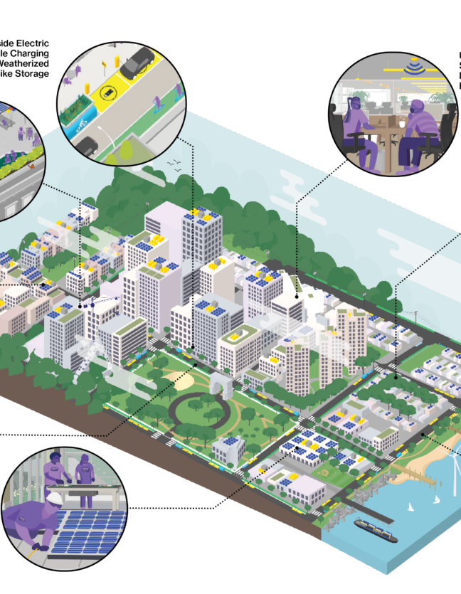
Green urban branding
Competing for the ‘sustainability edge’.
Miriam Greenberg: “Ultimately, the ‘winners’ and ‘losers’ in this race are determined less by scientific indicators, such as a reduction in greenhouse gases, than by market indicators, such as an increase in popularity, stock price, or real estate value” (Greenberg, 2015:116).
“If you are going to be moving big businesses with all of their upper level employees, you have to show them that their kids will be provided for, that they’re going to be able to breathe clean air, ride their bikes somewhere. . . It works really well for us, in everything we do, to have this kind of reputation.” (EDC official in Greenberg, 2015:122).
Notes:
Greenberg M. “The Sustainability Edge”: Competition, Crisis, and the Rise of Green Urban Branding. In: Isenhour C, McDonogh G, Checker M, eds. Sustainability in the Global City: Myth and Practice. New Directions in Sustainability and Society. Cambridge University Press; 2015:105-130.

Slide 6
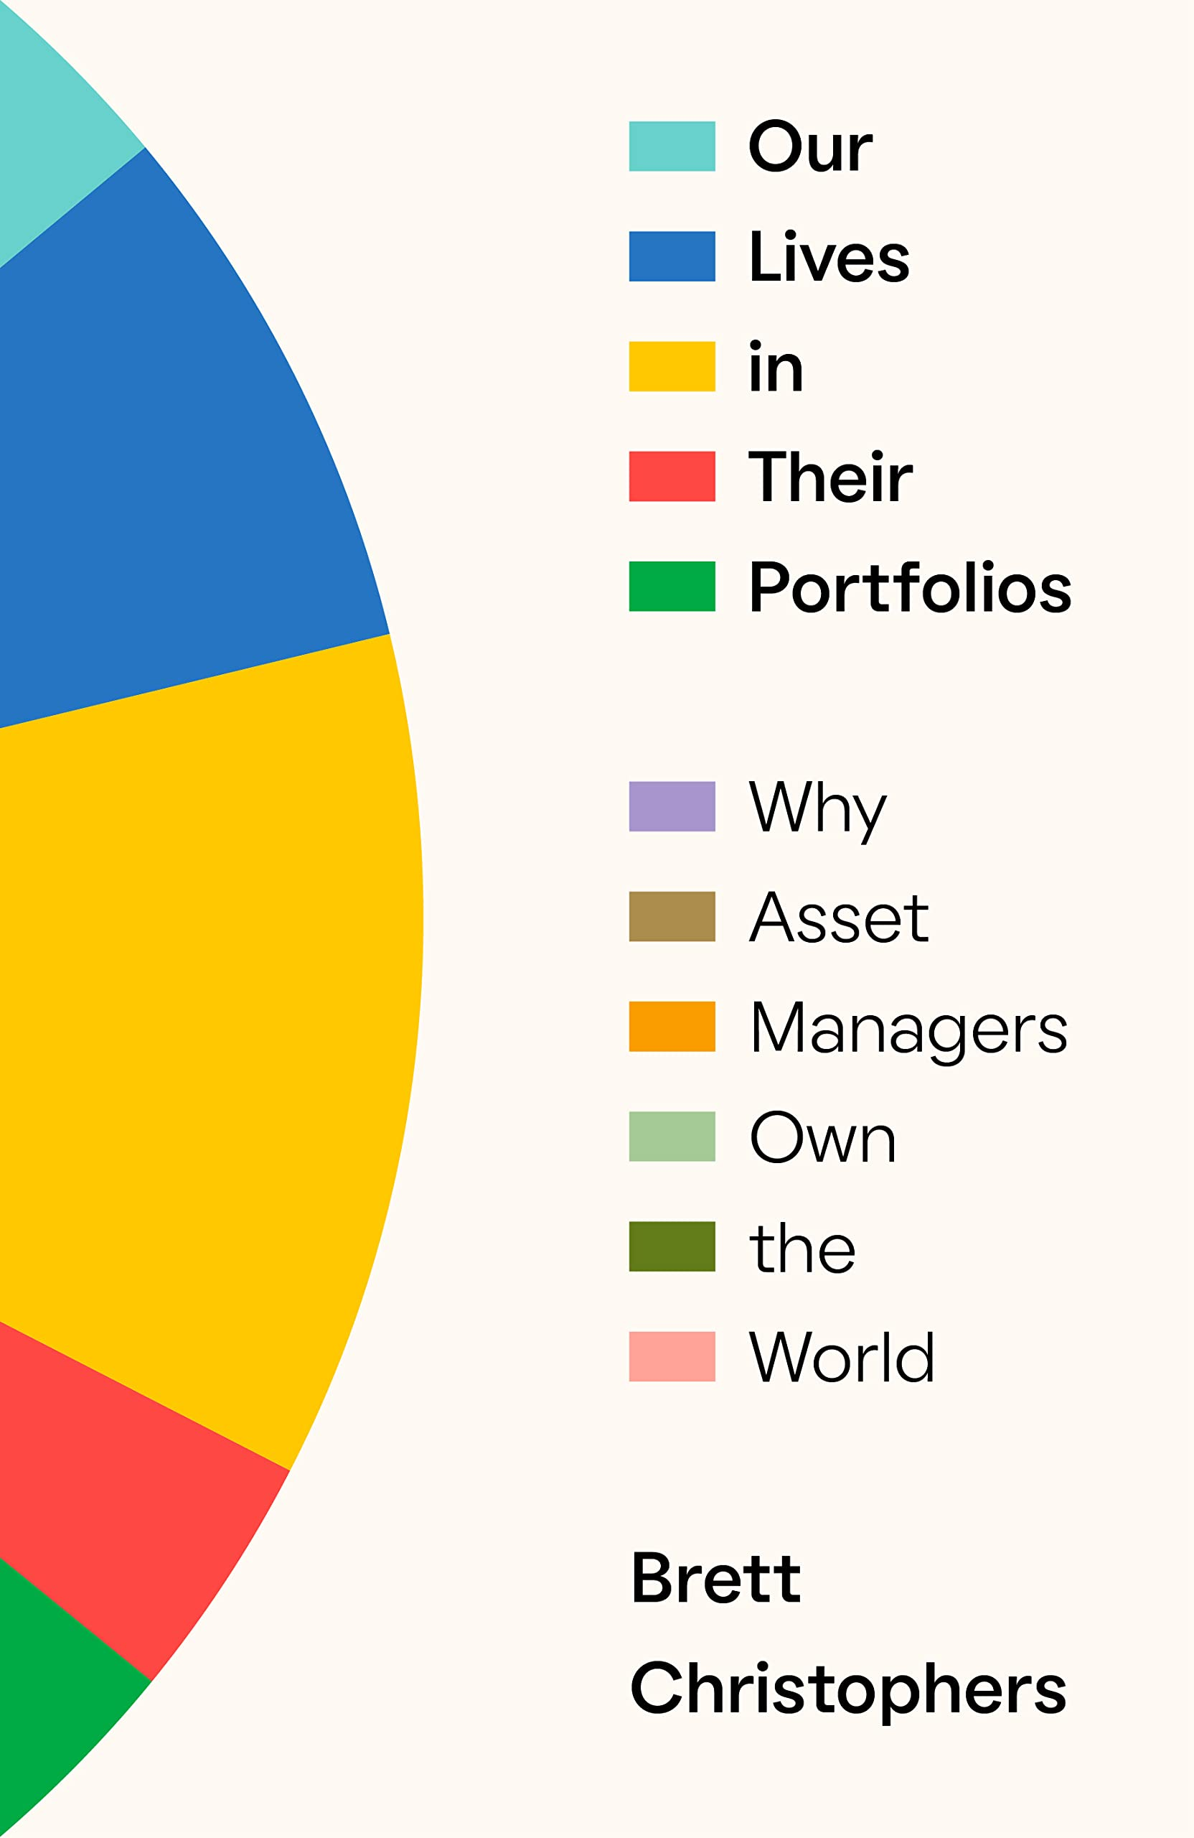
Cities as drivers & beneficiaries of financial capitalism
Transformations in capitalism are reshaping cities:
Replacement of industry by financial services + tech.
Office buildings & who occupies and owns them (Knuth, 2015)
« Asset manager society » (Christophers, 2023), « Asset manager capitalism » (Braun, 2021)
Not just financial assets but also physical assets: roads, pipes, farmland, energy systems, hospitals, schools, & real estate (homes, offices)… swell asset managers’ investments portfolios.

Slide 7
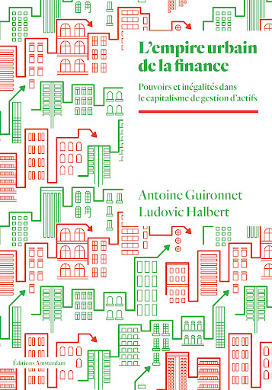
Asset managers/owners & the low-carbon city
David Harvey: The « Urbanization of capital » (1985)
“The ownership of land [becomes] from all standpoints (including psychological) simply a matter of choosing what kinds of assets to include in a general portfolio of investments” (Harvey, 1985:97).
« Urbanisation is for finance a way of extending its empire beyond factories: indifferent to the origin of value as long as it can be appropriated – unlike industrialists confined to the field of production –, financial capital replaces the different property owners, just as it replaces captains of industry by managers under its control » (Guironnet & Halbert, 2023: 23-24)
Cities as financial products (buildings, infrastructure…)
“Green” buildings as profitable asset class + Green urban policies as drivers of real estate growth.

Slide 8
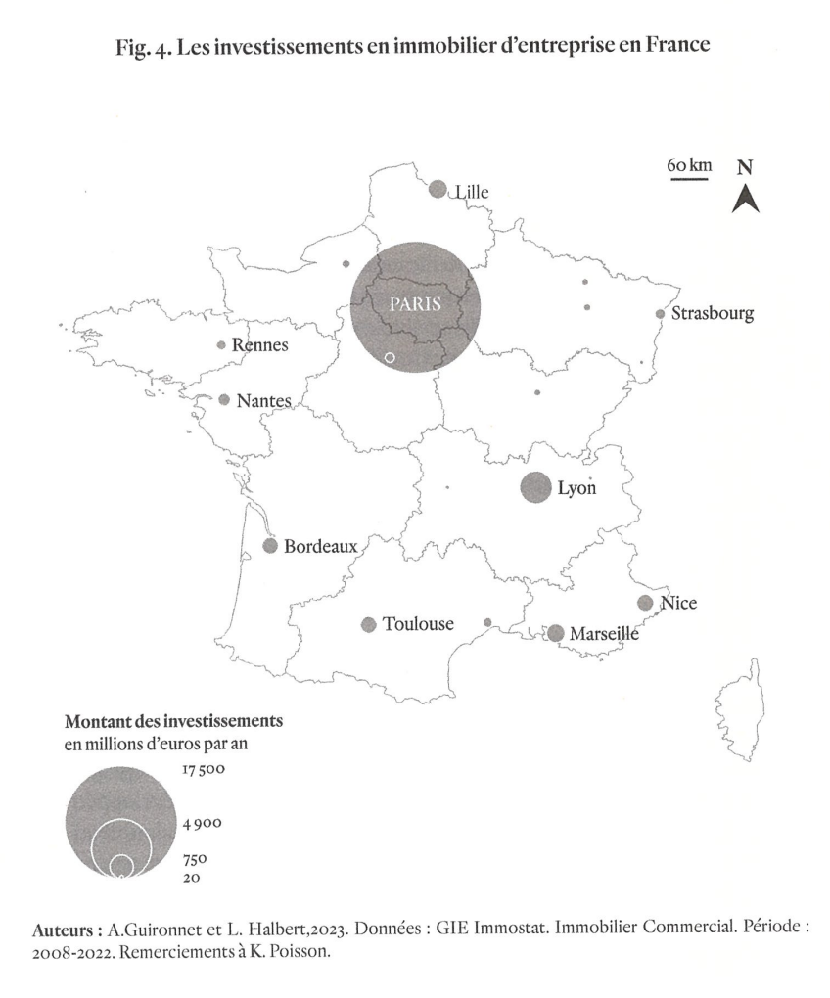
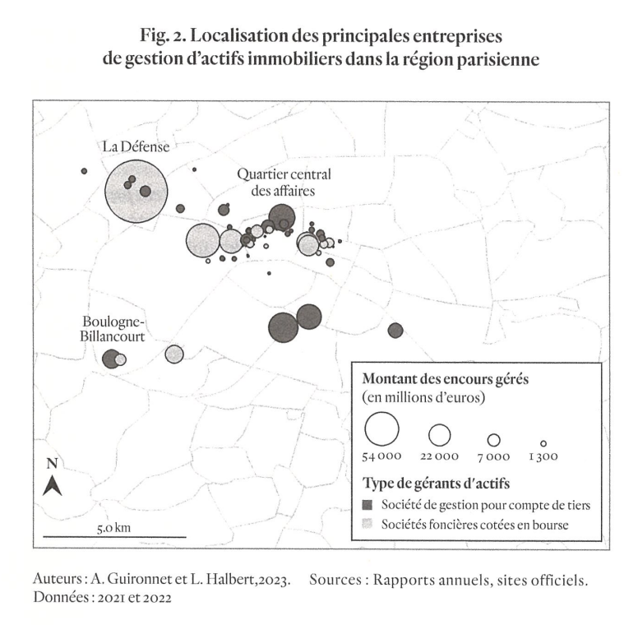
Financialization as situated (not de-territorialized)

Slide 9
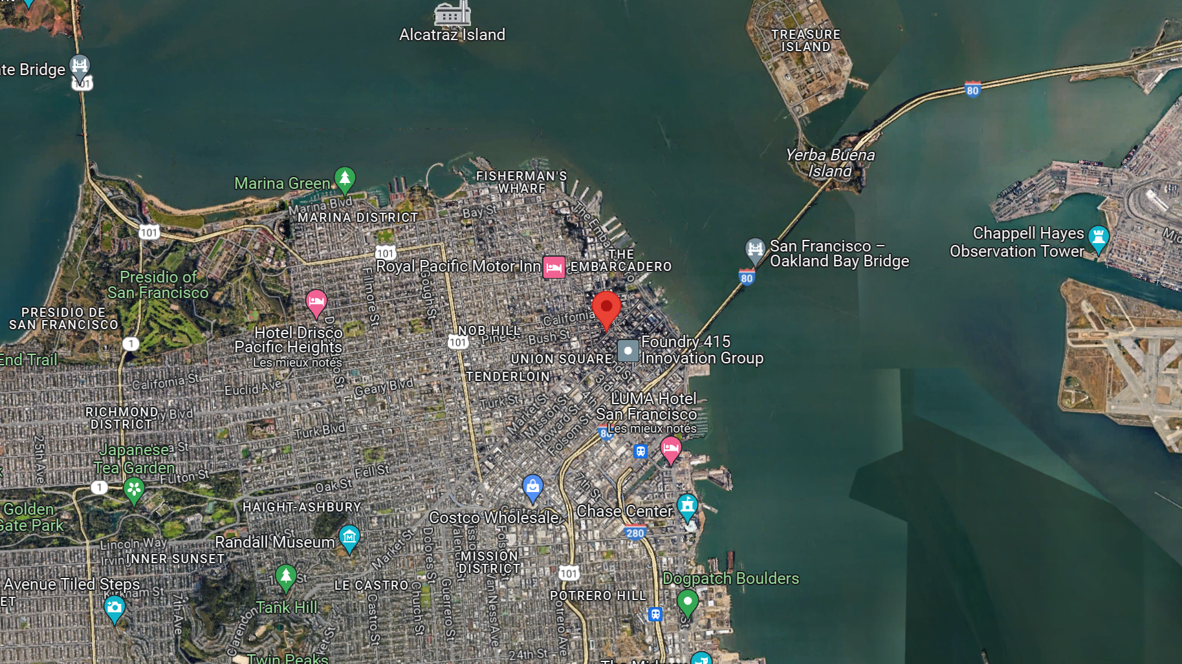

Slide 10
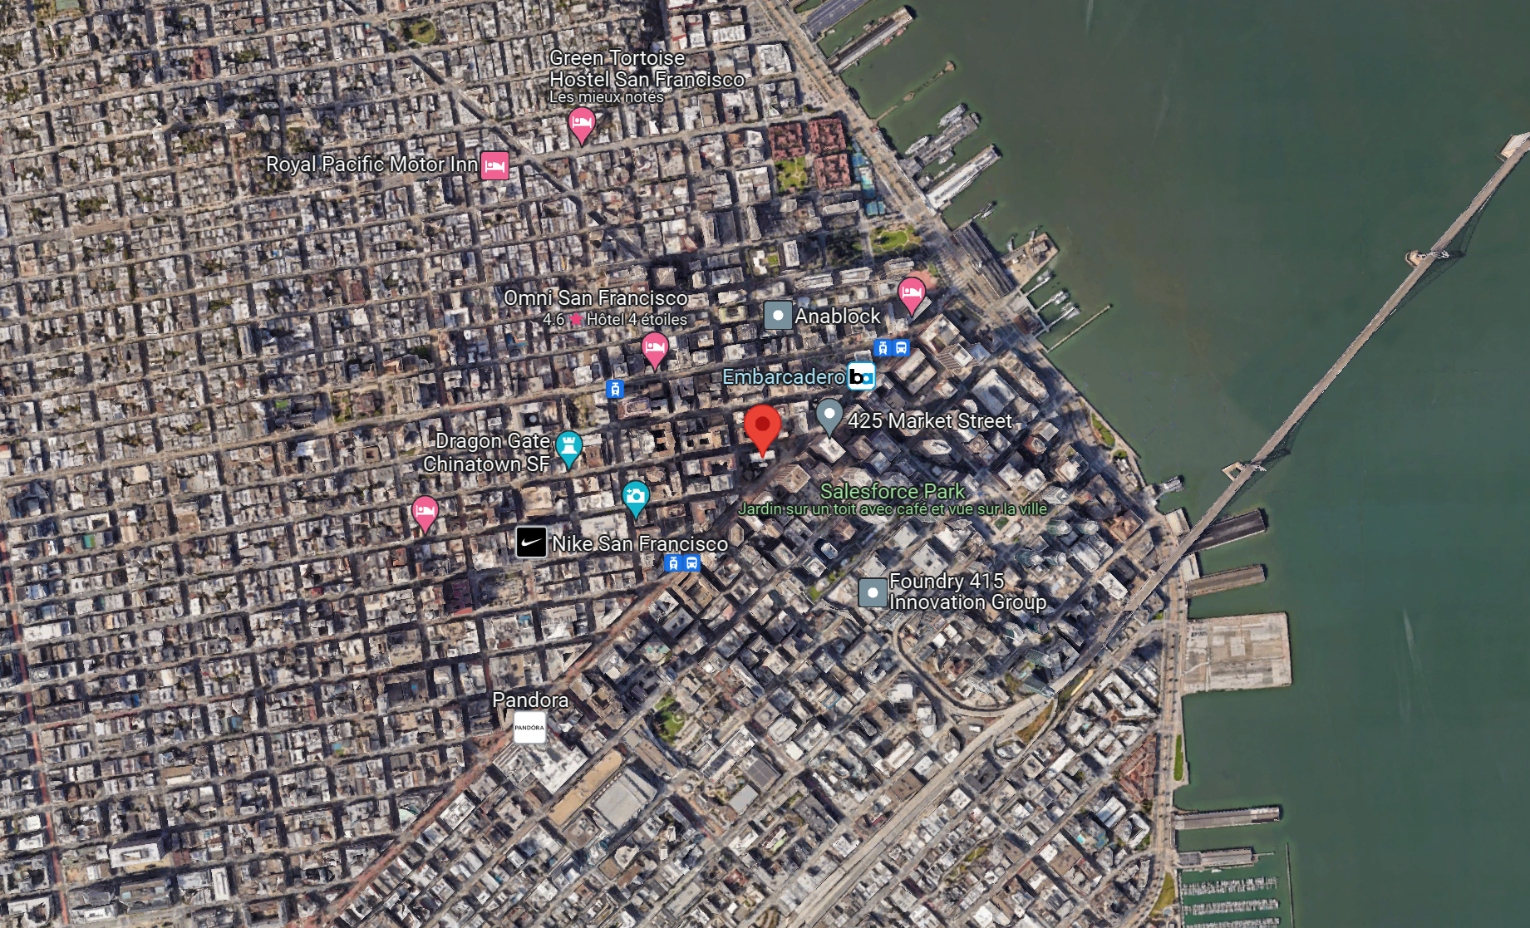

Slide 11
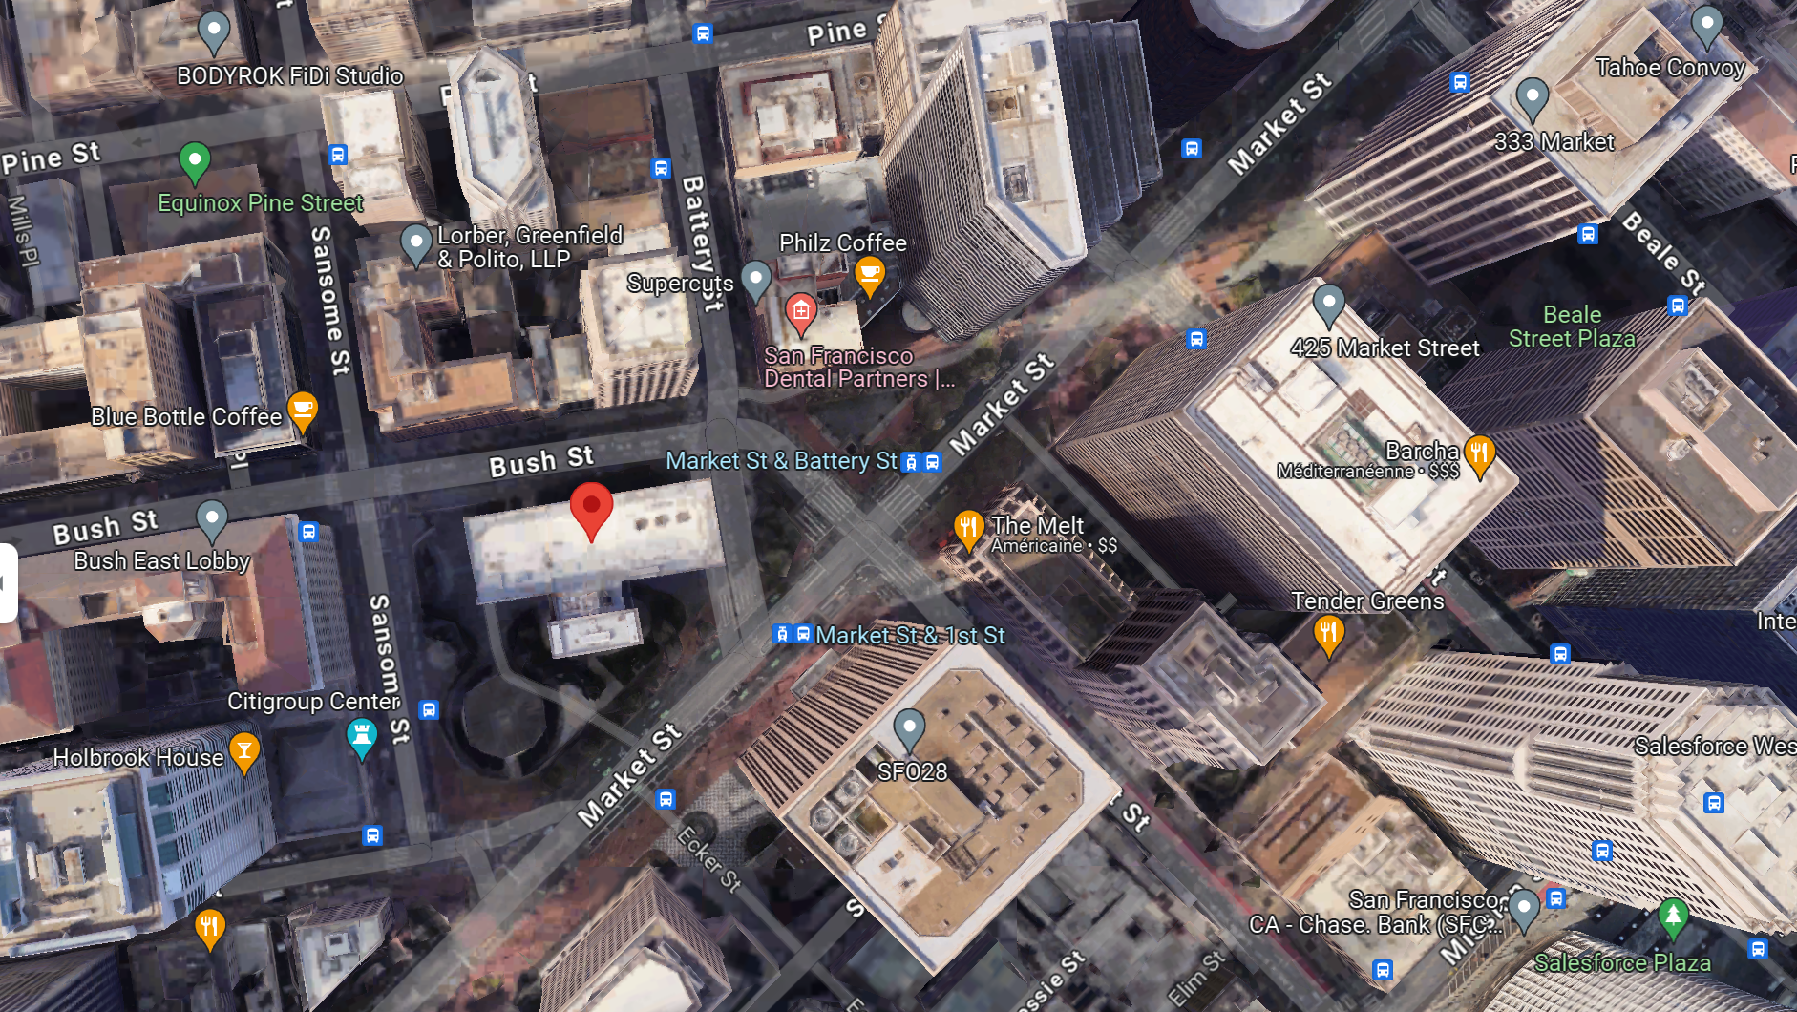

Slide 12
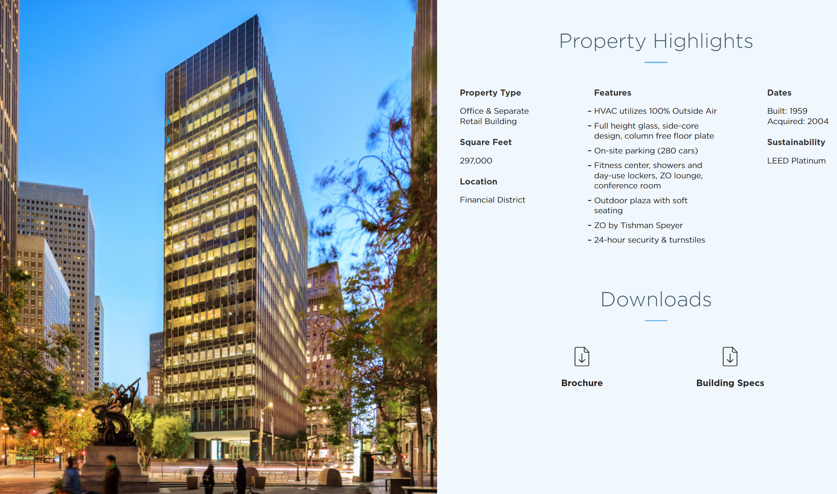
One Bush Plaza (San Francisco)
Tishman Speyer website

Slide 13
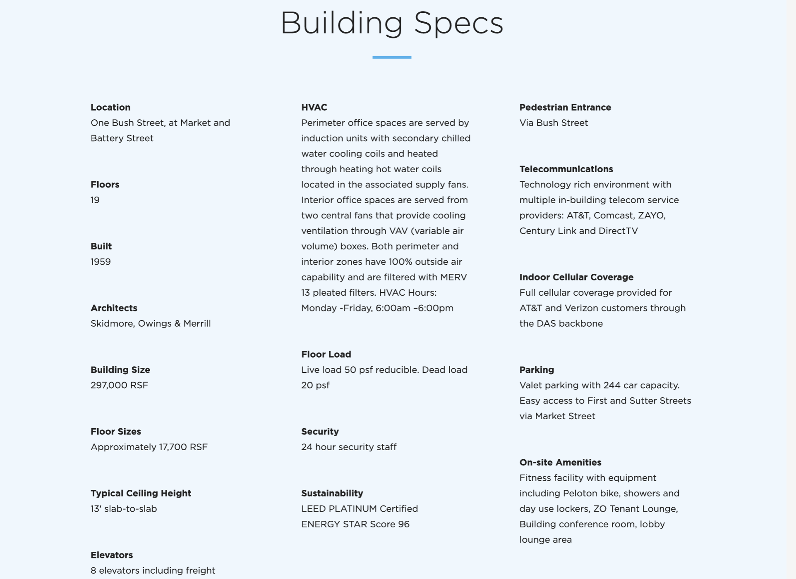

Slide 14
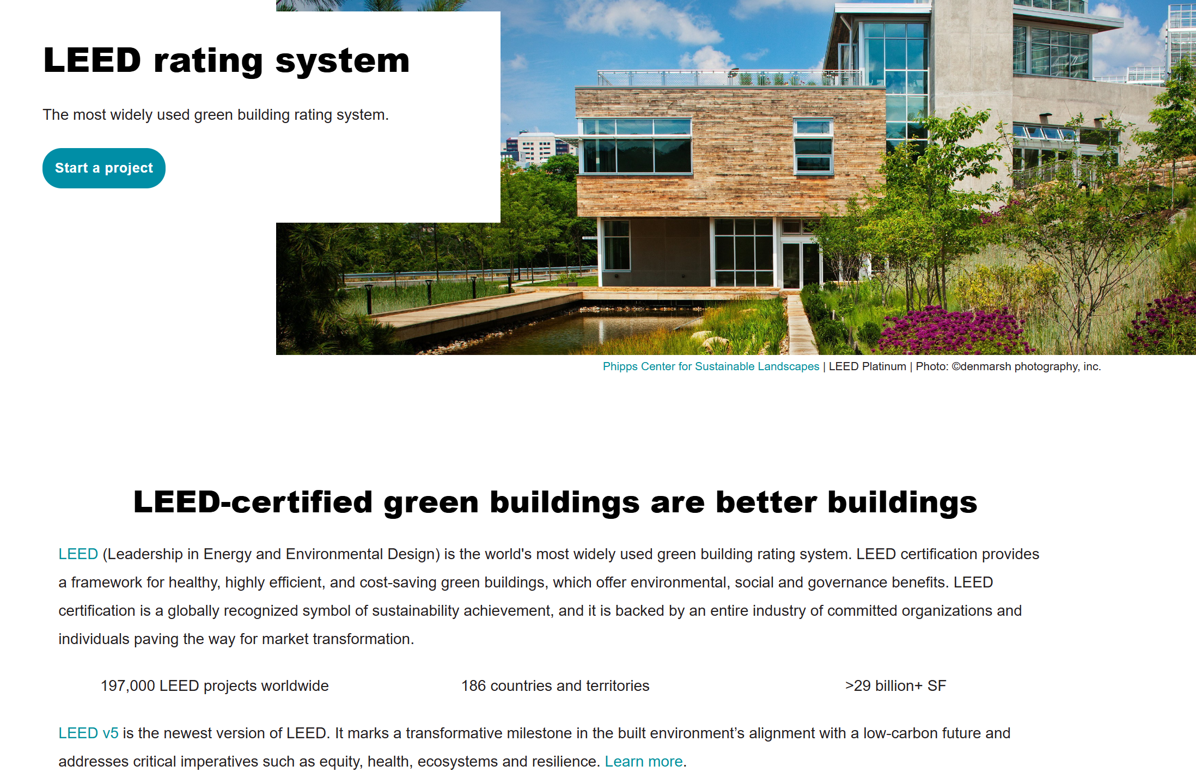

Slide 15
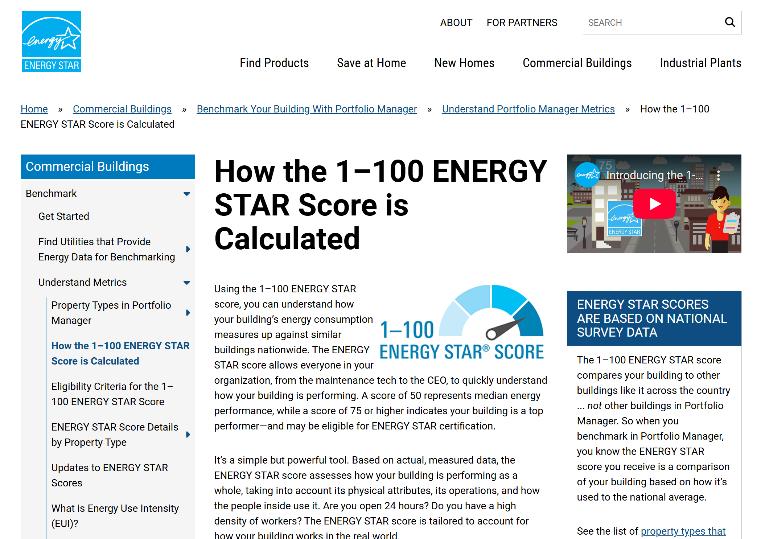

Slide 16
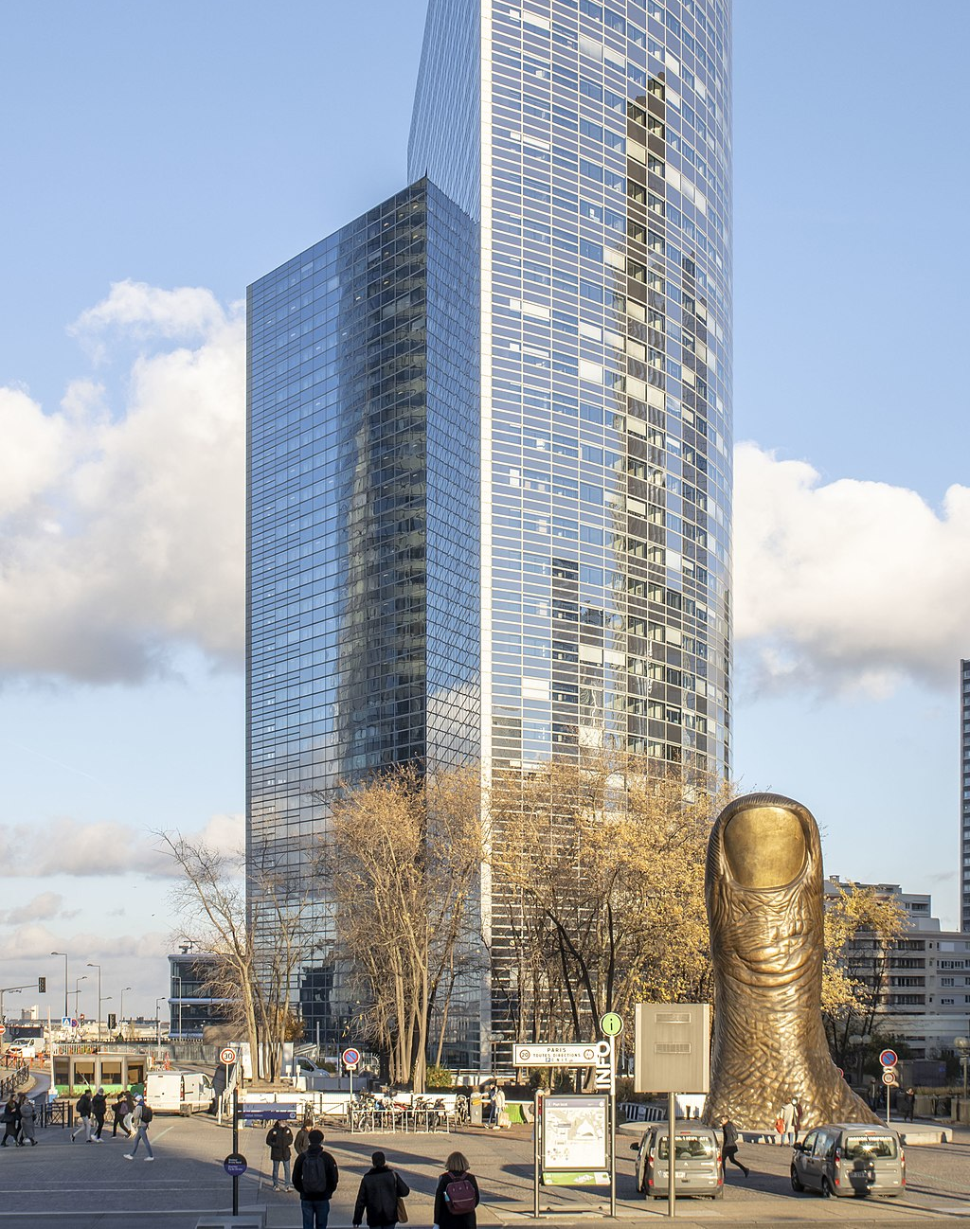
Tour Sequoia (formerly Tour Esplanade)
Notes:
Tishman Speyer

Slide 17
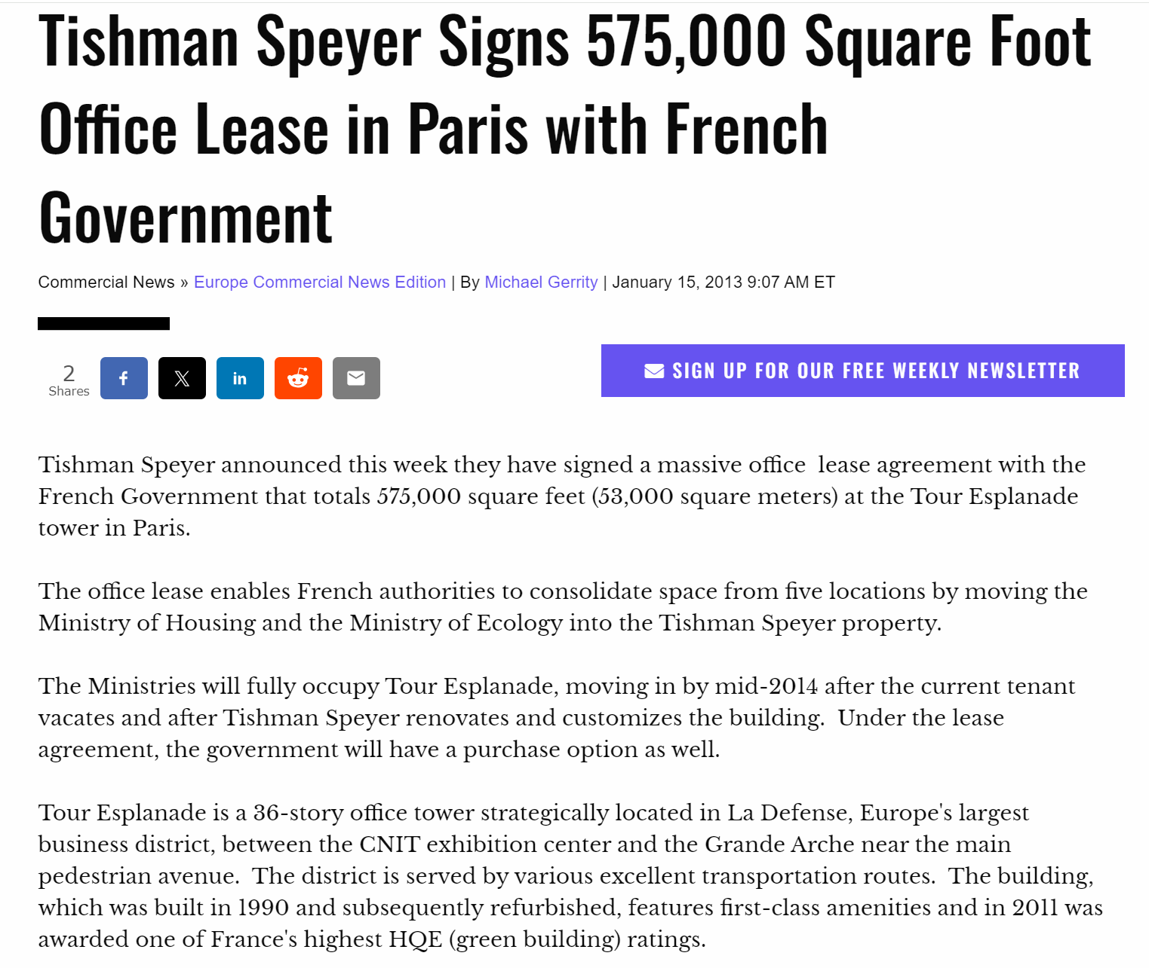

Slide 18
Other Paris projects
Tour Cristal (Paris)
Carré St Germain (Paris): https://www.b-p.fr/project/tishman-speyer-carre-saint-germain-2214/
Paris Bourse/119 R: http://www.nomad-conseil.fr/new-website/project/1206/
Home (Villejuif): https://www.home-villejuif.com/en/
Campus (Boulogne Billancourt): https://www.investpsp.com/en/news/tishman-speyer-and-psp-investments-acquire-espace-lumiere-in-boulogne-billancourt/
Magasins Généraux (Pantin)

Slide 20
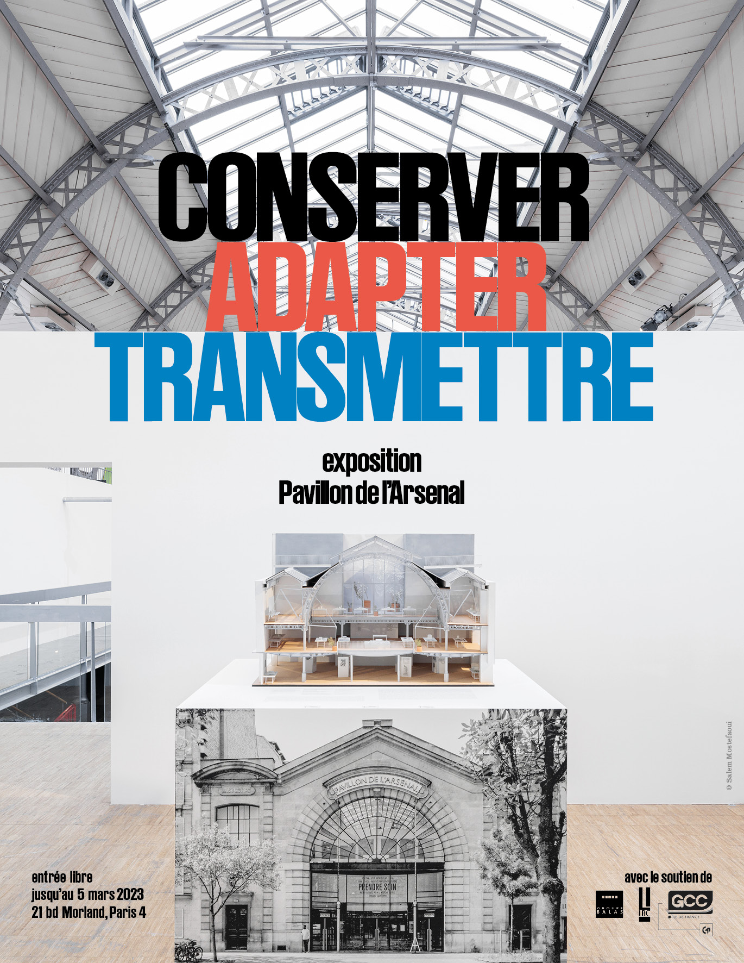
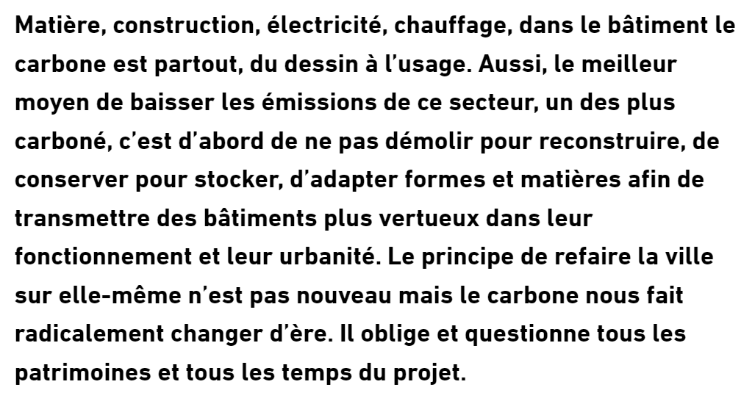

Slide 21
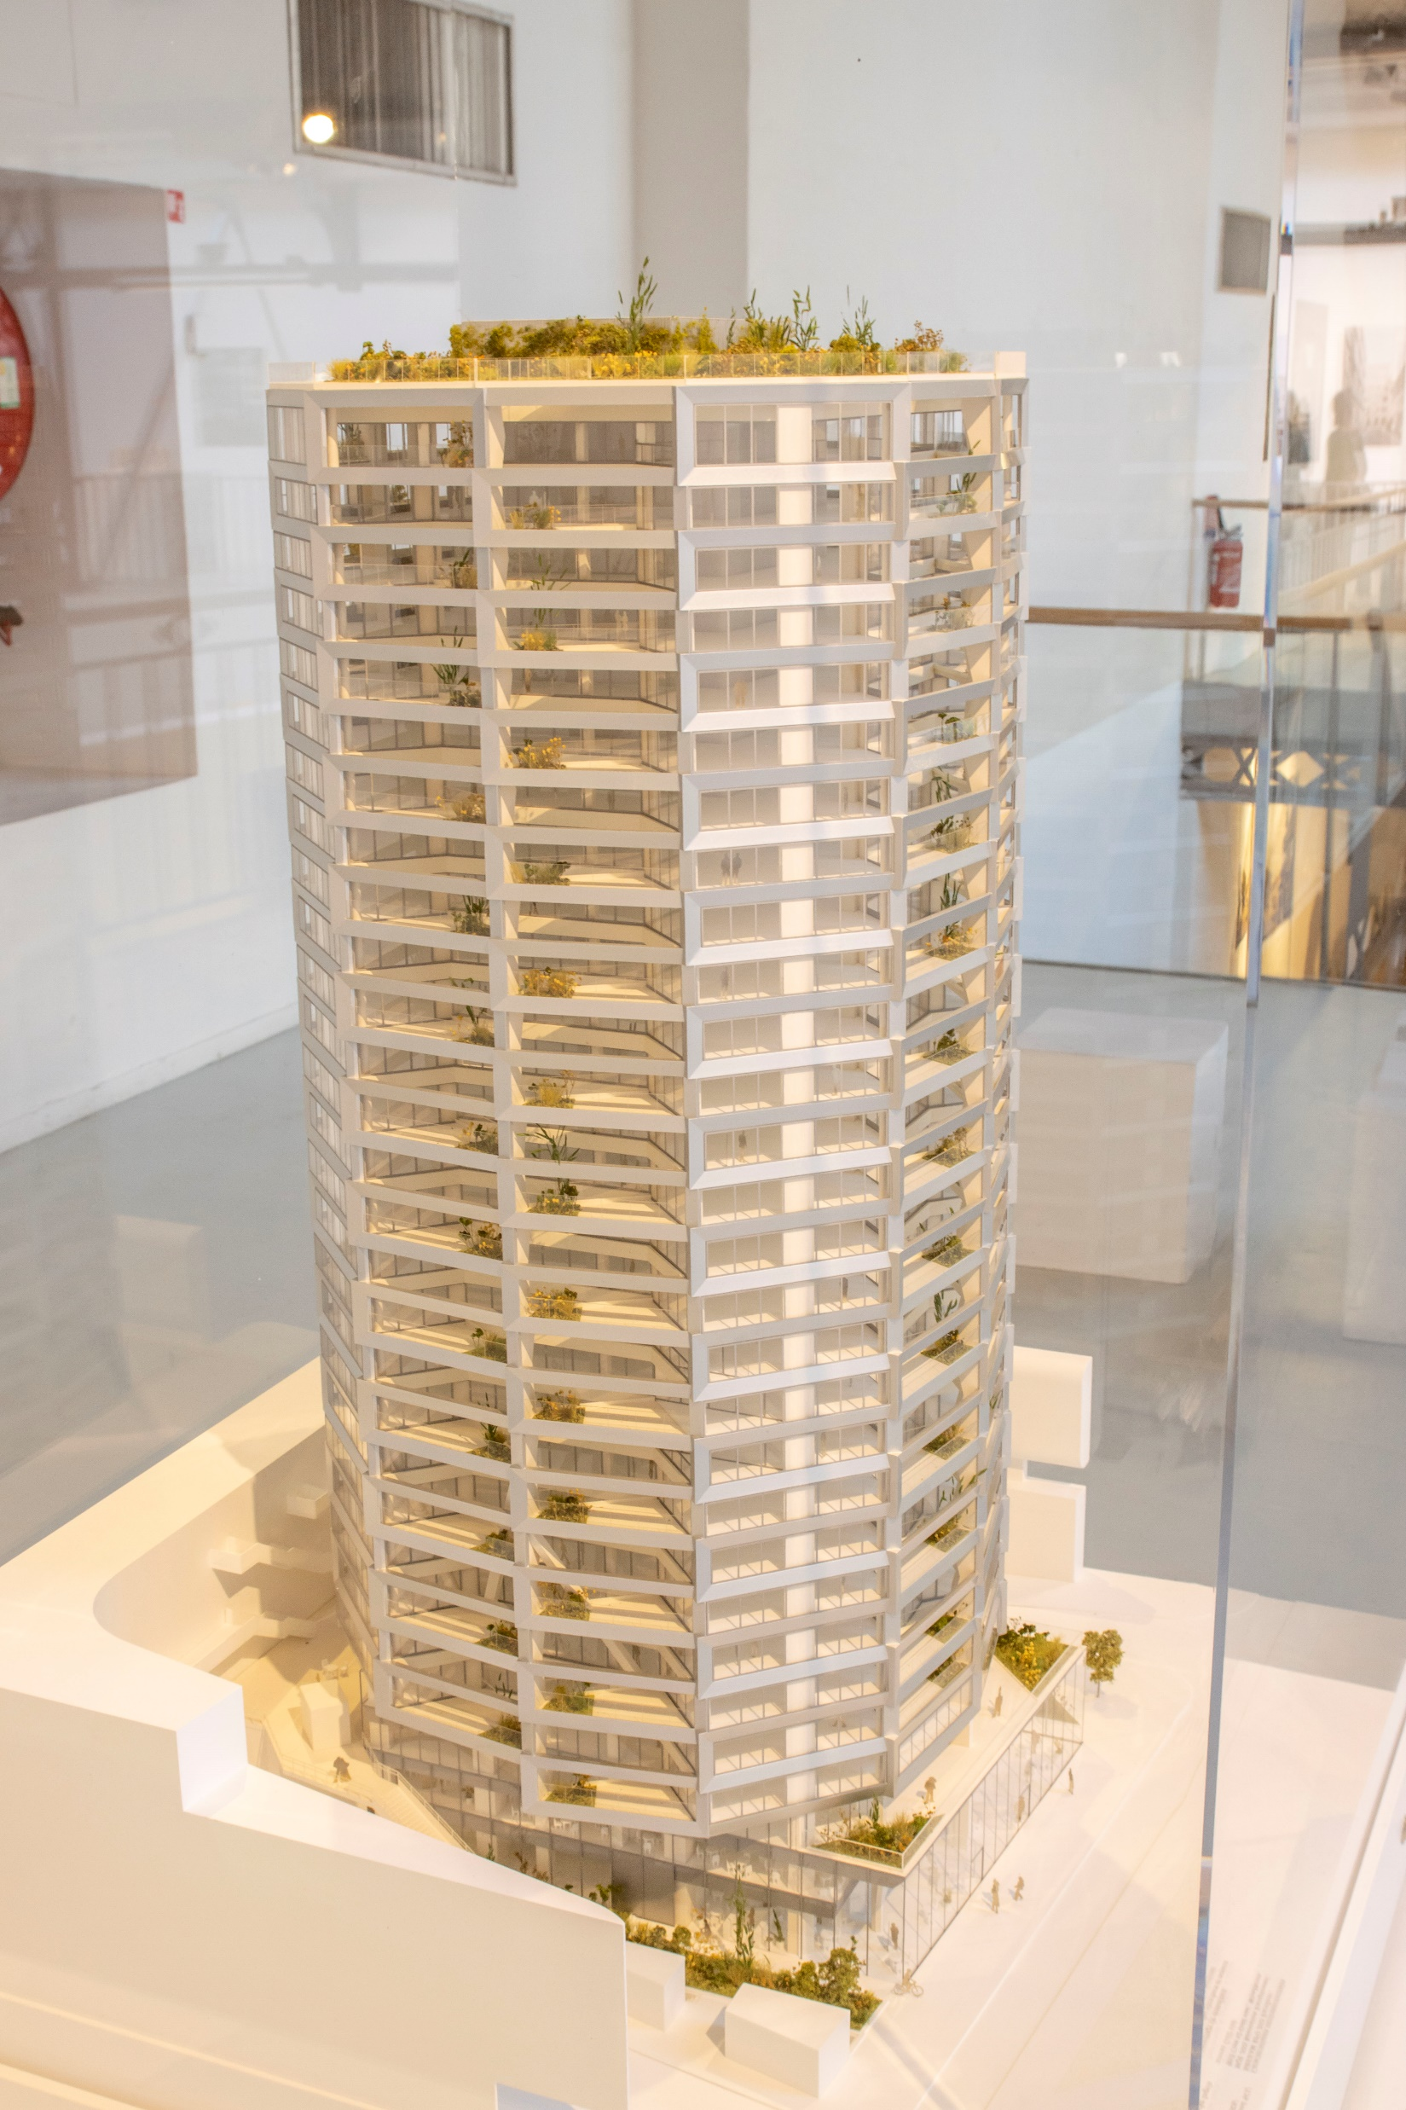
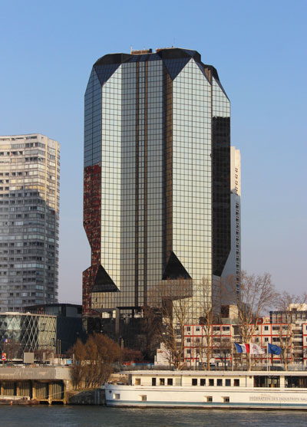
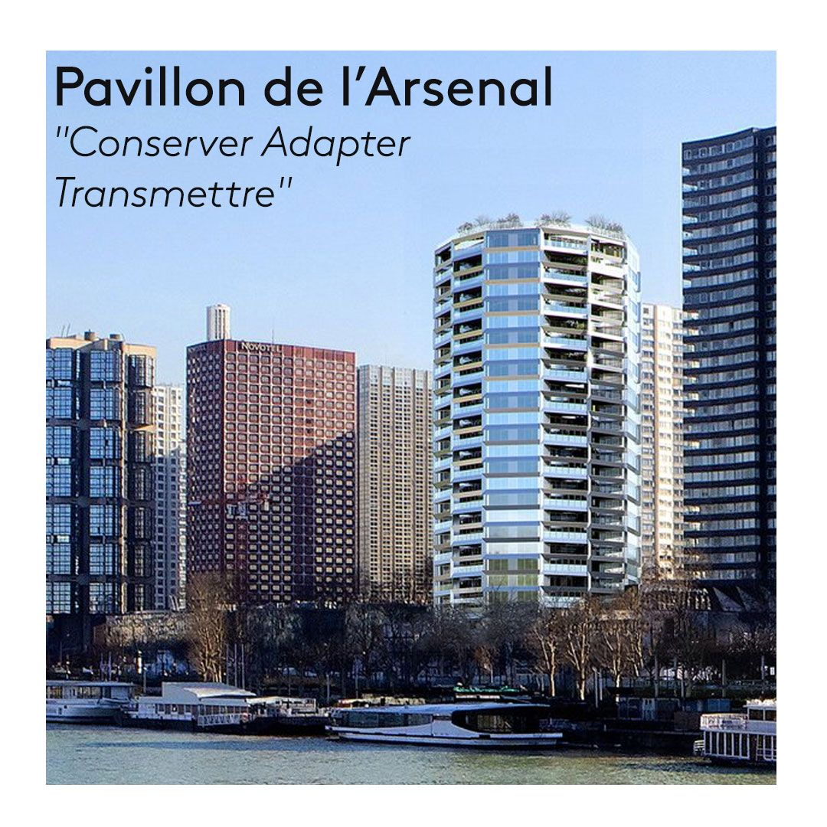

Slide 22
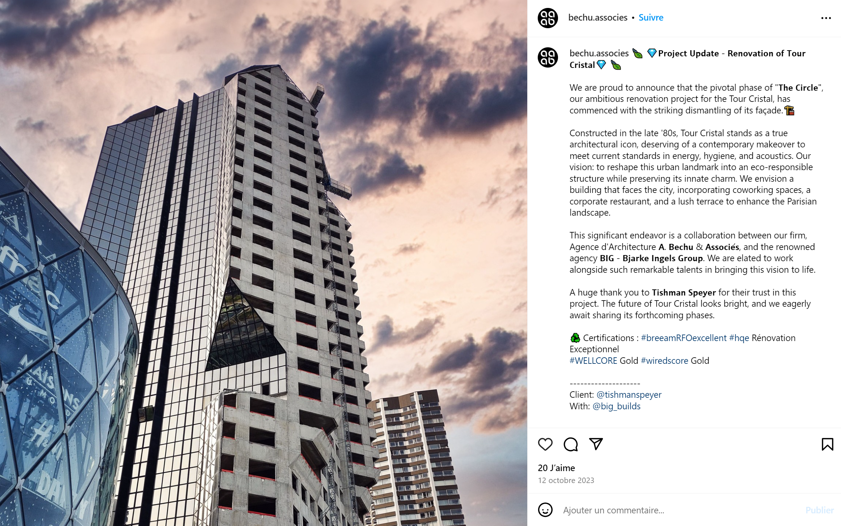

Slide 23
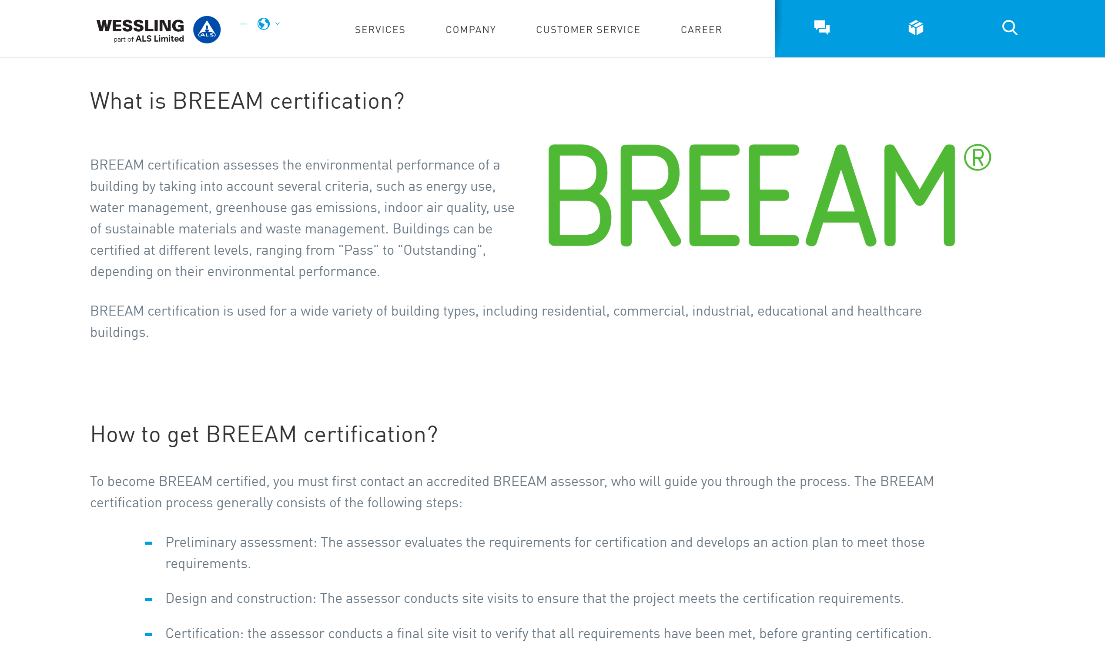

Slide 24
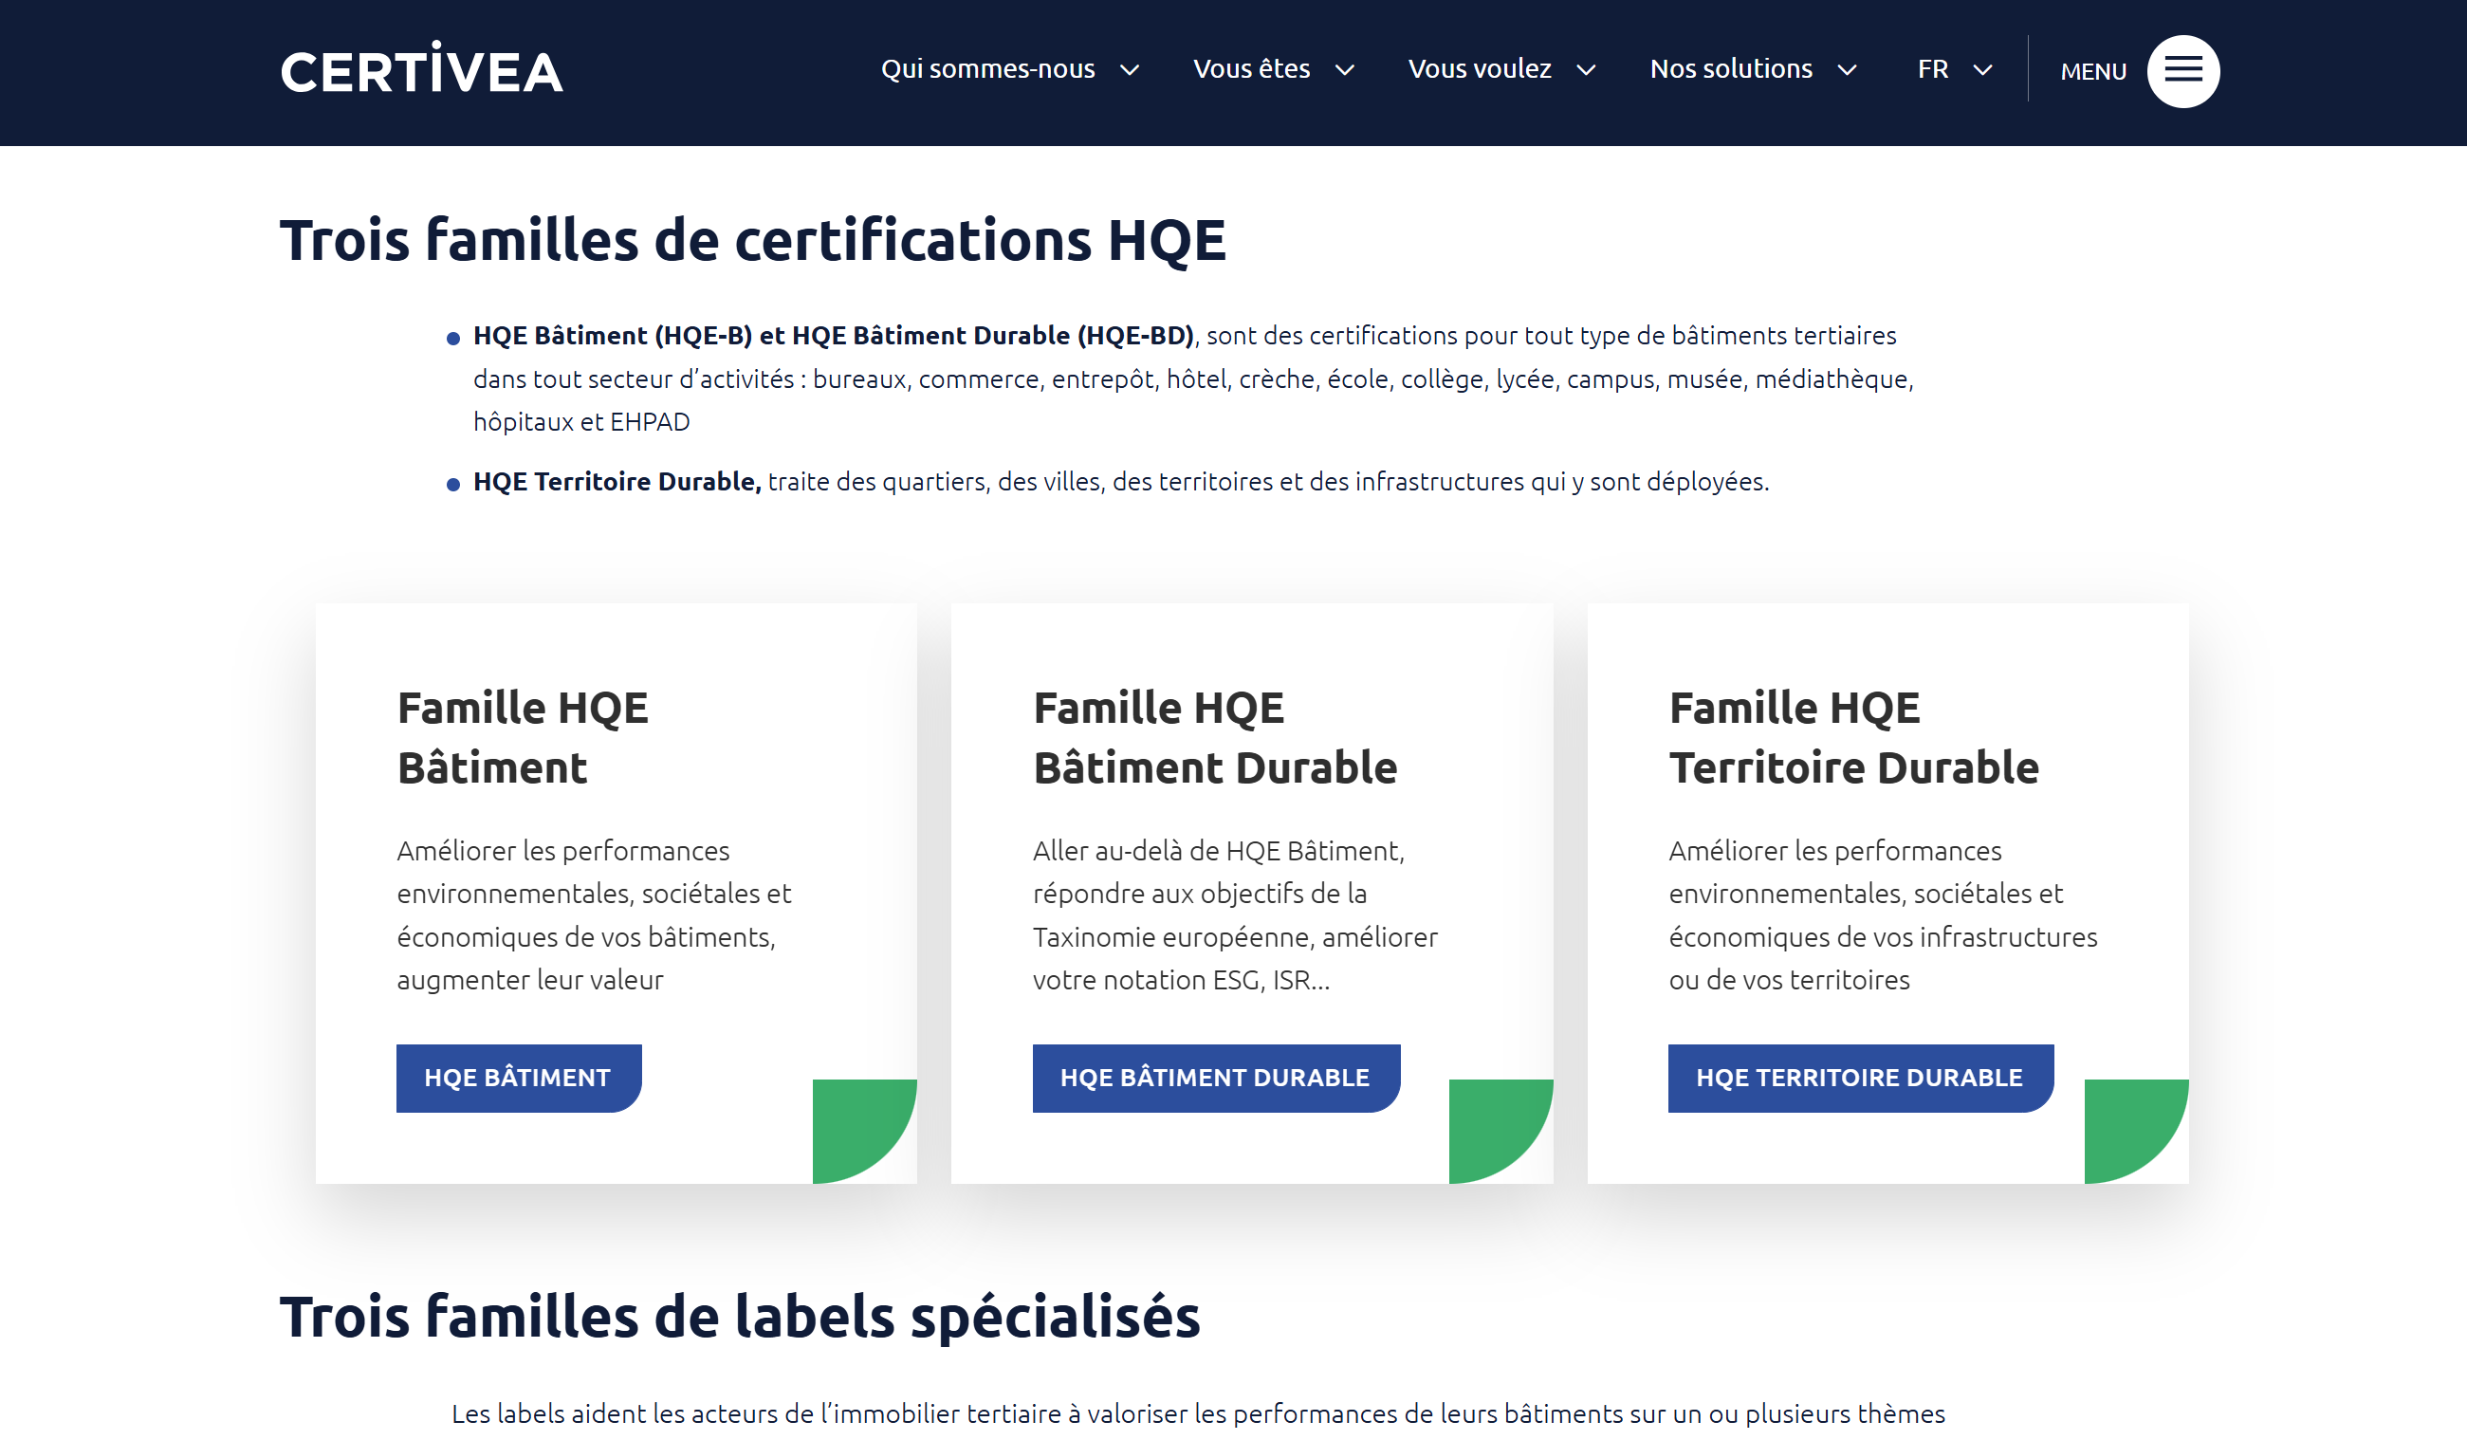

Slide 25
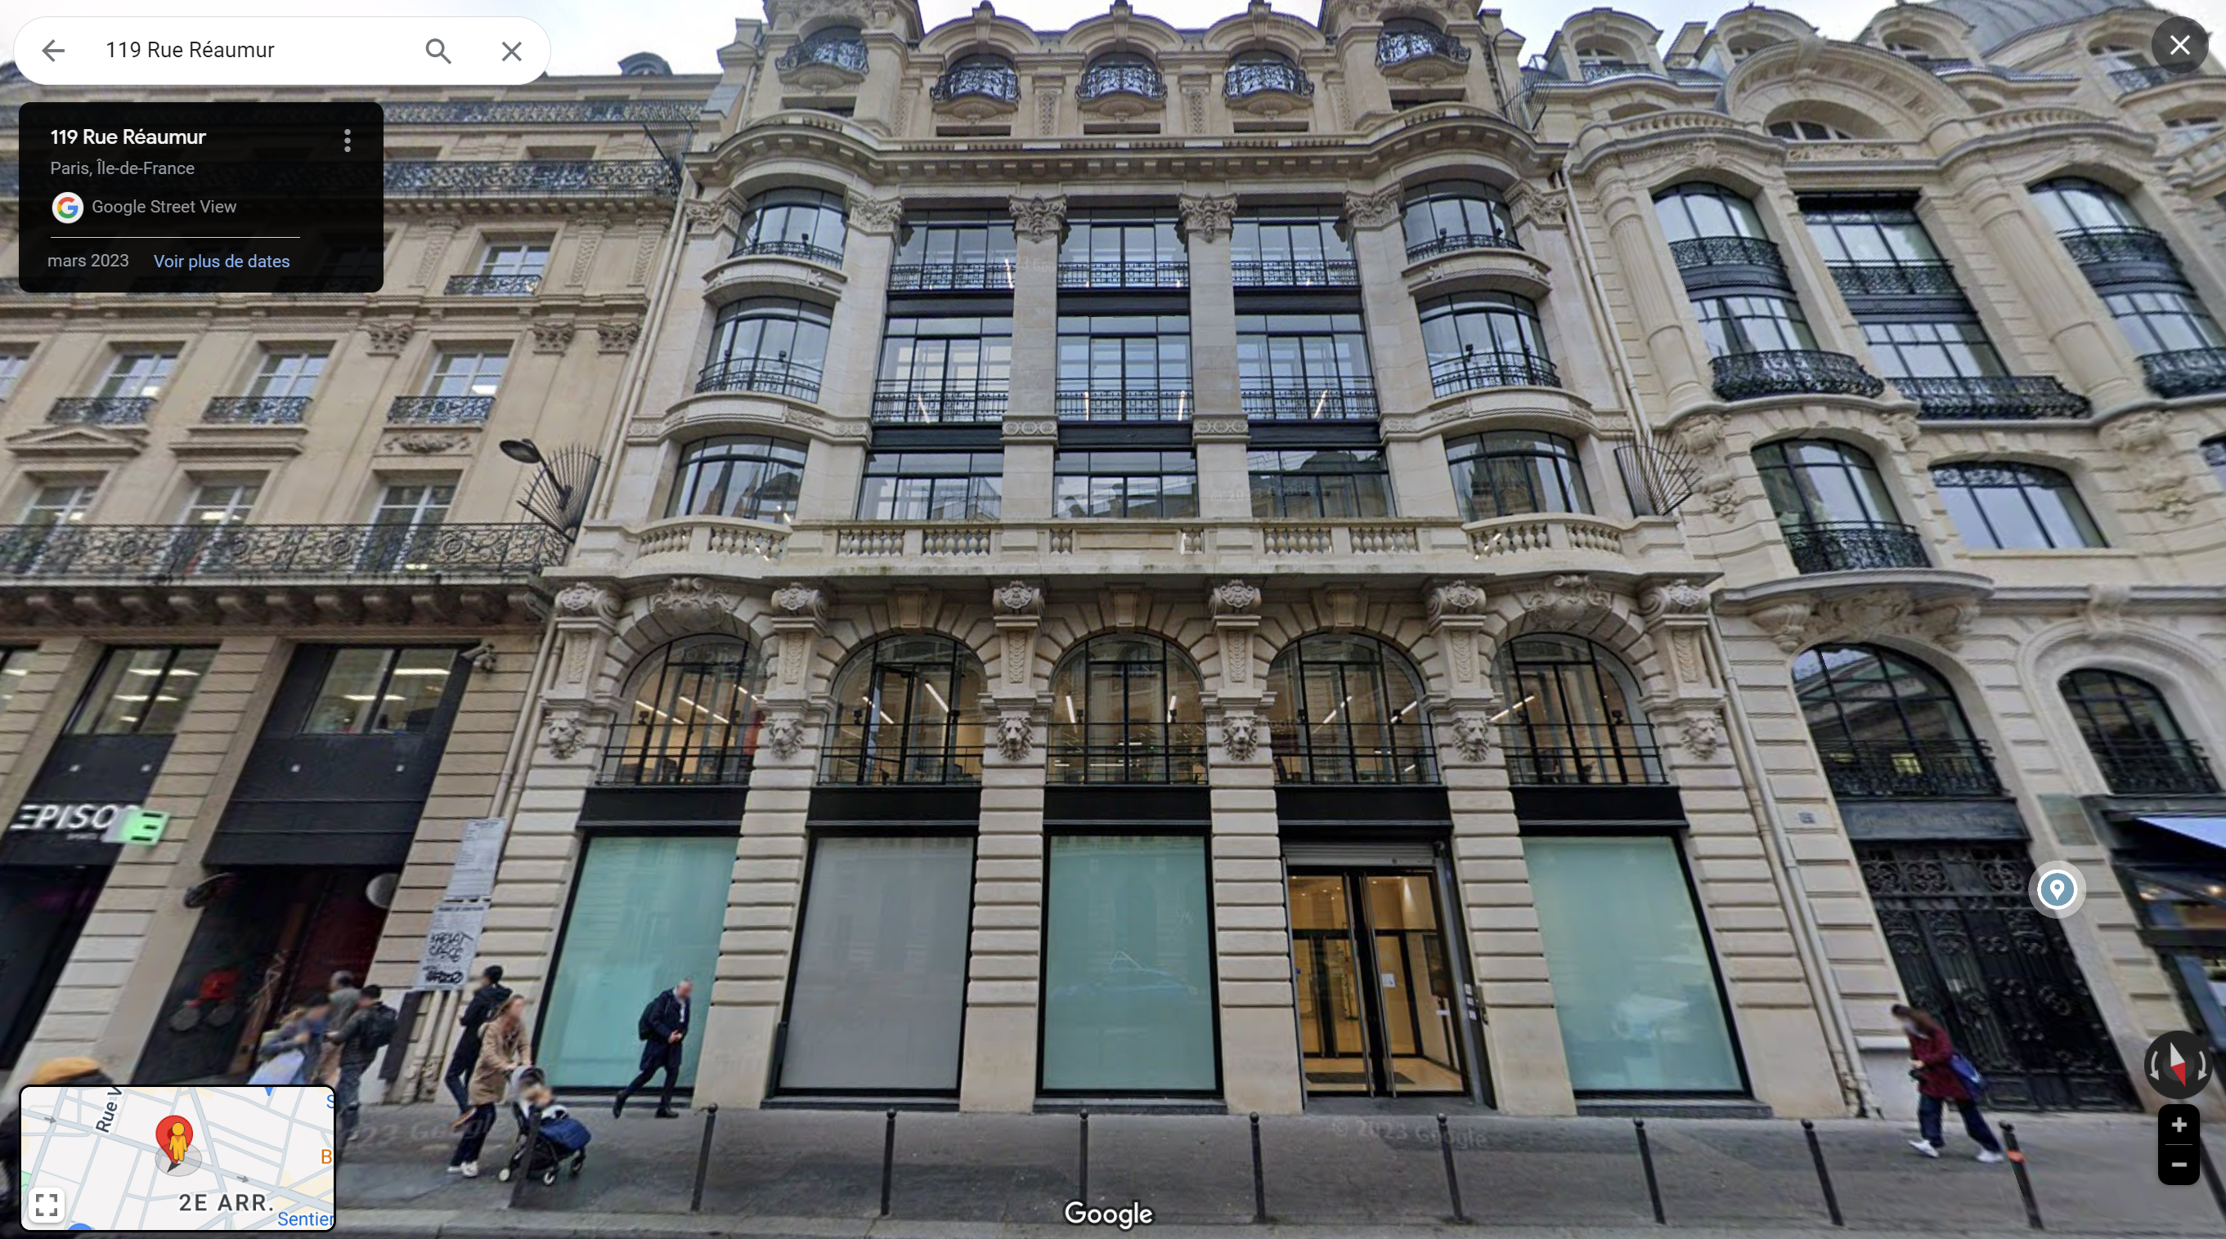
119 Rue Réaumur – 119 R

Slide 26
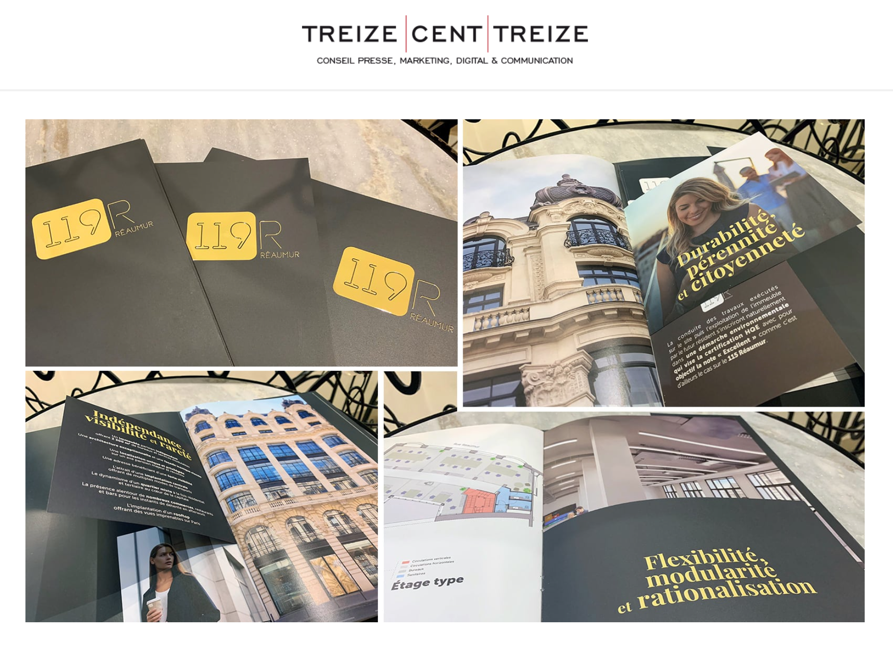

Slide 27
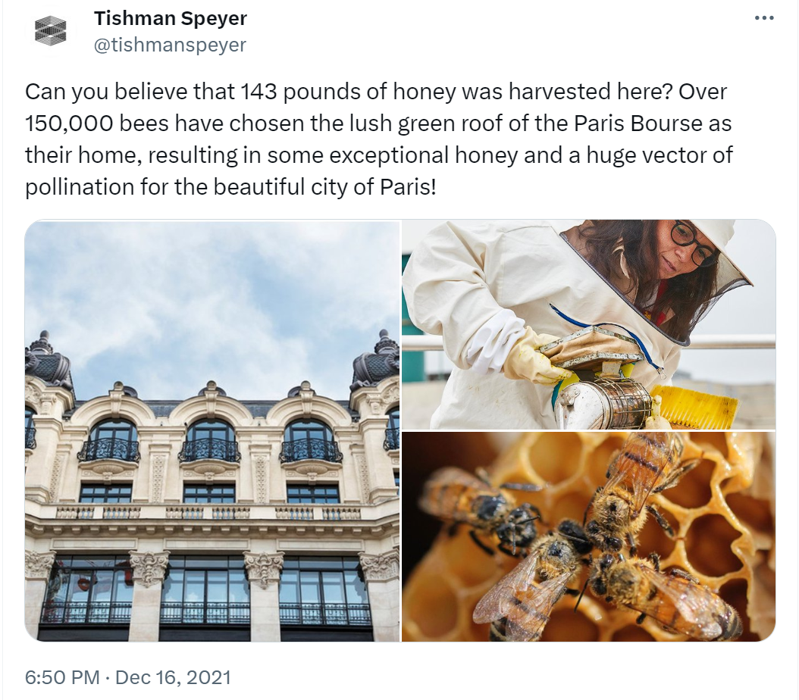

Slide 28
Consequence: Green luxury city
City as luxury product: “Idea that, at least for the target market of high-valued-added companies in the media, finance, and business services sectors, the value inherent in a city location outweighed its high cost” (Brash, https://brooklynrail.org/2011/03/local/the-luxury-city, 2011).

Slide 29
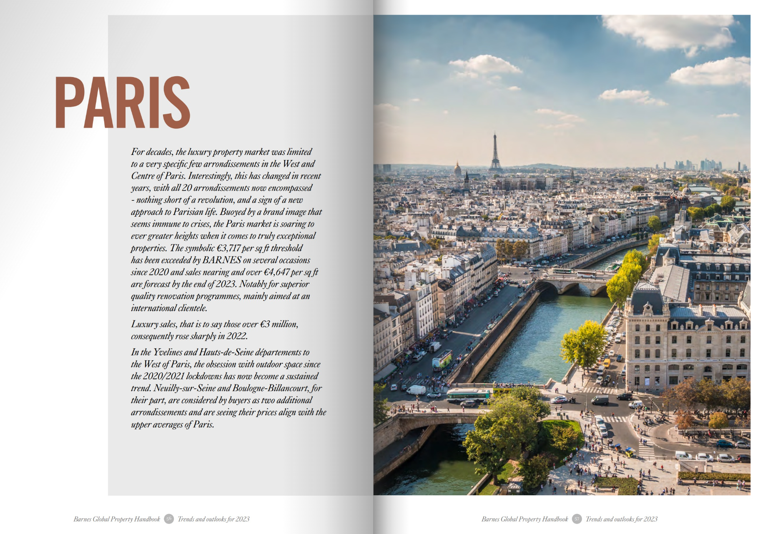
Notes:
Barnes Luxury real estate company

Slide 30
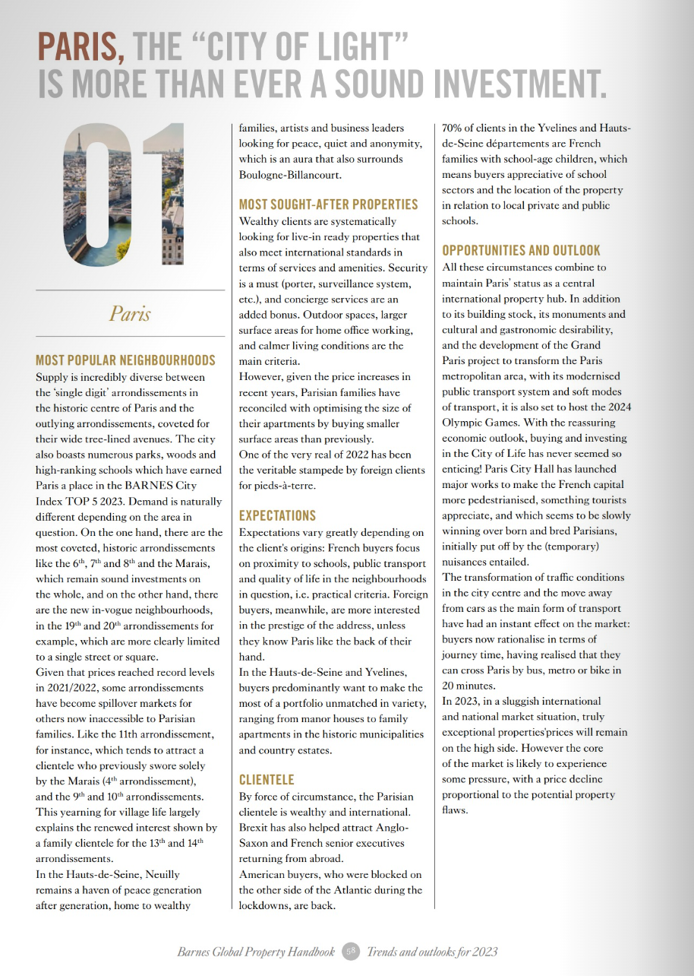

Slide 31
