Slide 1
PSA Masterclass 3 Prescription Writing PWS questions 15th November & 6th December 2024
Patricia McGettigan
Clinical Pharmacologist
Head of MBBS CPT teaching

Slide 2
PWS-1: Hospital once-only
Case 1: A 72y old woman is having cardiac pacemaker insertion today.
Q: Prescribe an appropriate drug to be administered as prophylaxis against infection in advance of the procedure.

Slide 3
Case 2: An 88y old man admitted with a LRTI and commenced on IV antibiotics, usually well and living independently, has developed infection-associated delirium.
This has not improved with non-drug therapy; he has pulled out his IV cannula and is hypoxic on room air (90%); he refuses oral medicines and inhaled oxygen.
Q: Prescribe a once-only initial therapy to help his situation and facilitate his care.

Slide 4
Case 3: A 6-month old baby girl, 7Kg, in the Paediatric A&E unit, is to be admitted for treatment of moderately severe croup. She is refusing feeds and oral fluids.
Q: Prescribe an initial therapy to be given now to help treat her condition.

Slide 5
Case 4: A 46y old man admitted with a large upper GI bleed has just had endoscopy that found a small gastric ulcer with evidence of recent bleeding; Post-procedure he is stable, on IV fluids and remains fasting.
Q: Prescribe one drug for initial treatment to his reduce gastric acid secretion

Slide 6
PWS-2: Hospital regular prescription
Case 1: A 72y woman has recurrent COPD exacerbations requiring oral steroids and antibiotics. Her current inhaled therapy is aclidinium 340 micrograms/formoterol 12 micrograms/dose (Duaklir Genuair®) (Dry Powder inhaler, DPI) 2 INH 12-hrly; salbutamol 200 micrograms, 1 INH as required.
It is agreed to step-up her preventer therapy and commence an inhaled corticosteroid. She wishes to have a single preventer inhaler only.
Q: Prescribe a suitable product for her

Slide 7
Case 2: A 55y old man has just been diagnosed with pulmonary embolus. He requires anti-coagulation but does not want to have frequent blood tests, if possible. He is stable clinically.
Q: Prescribe suitable anti-coagulation therapy for him to commence now.

Slide 8
Case 3: A 57y old man with alcoholism accidentally overdosed on narcotics. His GCS was 8 and capillary glucose 3.0 on admission. He had naloxone and glucose infusions with good effect and is well and alert with stable glucose and is able to eat. Chlordiazepoxide prn has been prescribed in anticipation of alcohol withdrawal symptoms.
Q: Prescribe an appropriate further medication to minimise his risk of cerebral harm.

Slide 9
Case 4: A 40y man with ulcerative colitis is admitted with 48h of profuse bloody diarrhoea; already commenced on IV fluids. Regular Tx: Mesalazine orally daily – adherent. He has no allergies.
Q: Prescribe appropriate initial therapy to manage his relapse

Slide 10
PWS-3: IV fluids
Case 1: A 70y old patient with CKD-4 and IHD is referred to A/E by his GP with K+ of 6.4mmol/L. He is stable clinically. His ECG is shown.
Q: Prescribe appropriate therapy for immediate administration

Slide 11
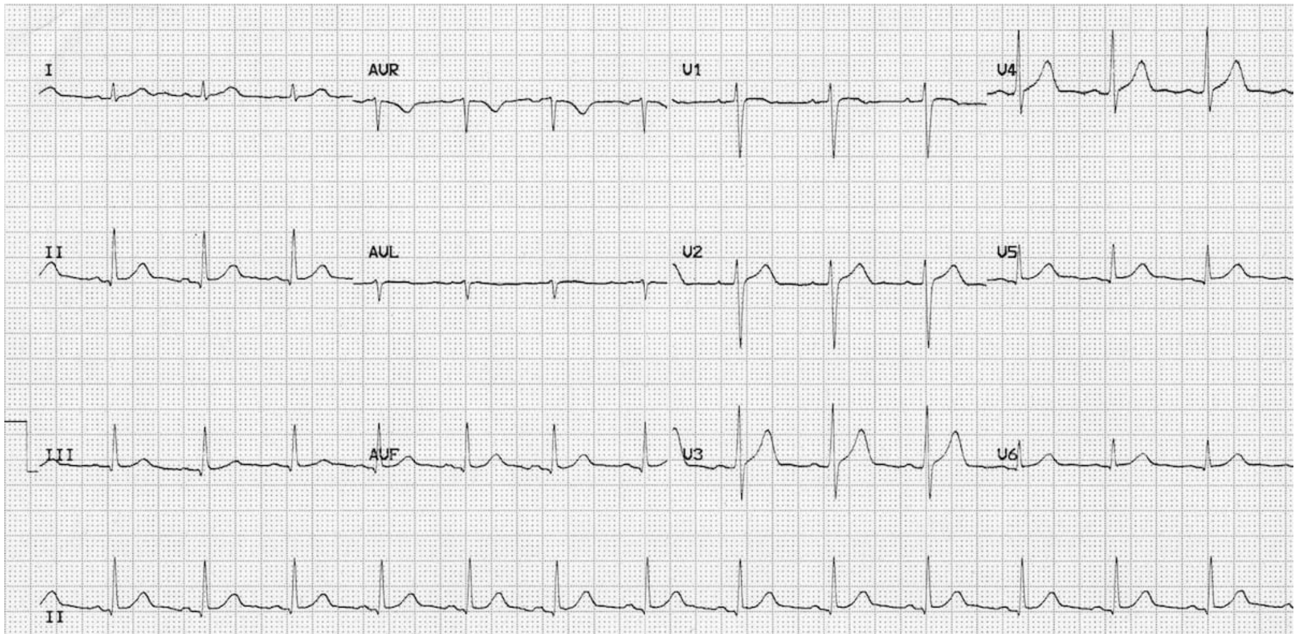
PWS-3: IV fluids
Case 1 alternative: A 70y old patient with CKD-4 and IHD is referred to A/E by his GP with K+ of 6.4mmol/L. He is stable clinically. His ECG is shown.
Q: Prescribe appropriate therapy for immediate administration.

Slide 12
Case 2: A 66y old man admitted after a fall is found to have generalised muscle weakness. He is alert; His BP is 105/74 mmHg; K+ is 2.5 mmol/L; ECG in SR shows new T-wave inversion across most leads.
Q: Prescribe a suitable initial IV fluid to help manage his situation.

Slide 13
Case 3: A 55y old patient with well-controlled diabetes taking regular sc insulin is scheduled for a short elective surgery; a variable rate intravenous insulin infusion (VRIII) has been commenced; His obs are all stable; His bloods, including current capillary glucose are fine.
Q: Prescribe a suitable IV fluid to run alongside the VRIII during the procedure.

Slide 14
PWS-4: General Practice
Case 1: A 24y old man is diagnosed with OCD. He discusses therapeutic options with his GP. It is agreed to commence drug therapy. He has no drug allergies.
Q: Prescribe a suitable drug for him.

Slide 15
Case 2: A 10y old boy is found to have scabies (care, may be shown a photo which you need to diagnose, not told the dx).
Q: Prescribe a suitable therapy for him.

Slide 16
Case 3: A 18y old woman attends her GP requesting emergency contraception. Sexual intercourse was approx. 36h ago. She does not wish to have a copper IUD; She has no drug allergies. Her cycles are regular 28 days. LMP began 8 days ago.
Q: Prescribe suitable drug therapy for her
Case 3 Alternative: A 18y old woman attends her GP requesting emergency contraception. Sexual intercourse was approx. 36h ago. She has no drug allergies. Her cycles are regular 28 days. LMP began 18 days ago.
Q: Prescribe suitable drug therapy for her

Slide 17
Case 4: A 22-month old boy is brought to the GP for review. He has a barking cough for 2 days; his father says it is worsening; temp 37.2C; eating and drinking ok; Weight 12Kg.
Q: Prescribe one drug to minimise his risk of clinical deterioration

Slide 18
Case 5: A 55y old woman with distressing menopausal symptoms has discussed the therapeutic options with her GP and it is agreed to commence hormone replacement therapy (HRT). She does not wish to have withdrawal bleeds.
Q: Prescribe a suitable HRT product for her.

