Slide 1
Arctic Geopolitics
Climate Change, Ukraine War, Cooperation
Eda Ayaydın
University of London Institute in Paris

Slide 2
Geopolitics
Classical Geopolitics
Geography- politics- international relations
Determinism, environmental determinism
« Geography is destiny »
Critical Geopolitics
« La géographie ça sert d’abord à faire la guerre » Yves Lacoste
Geography is primarily used to wage war
The process of decolonization of information

Slide 3
Arctic Geopolitics
Classical
Michel Rocard: « deuxième Moyen Orient » 2013
New scramble- Borgerson- 2008
Gold rush- Reuters- 2007
Polar silk road- 2019
Critical
Which Arctic, when, how?
Performance (when, where), conception, practice (how).

Slide 4
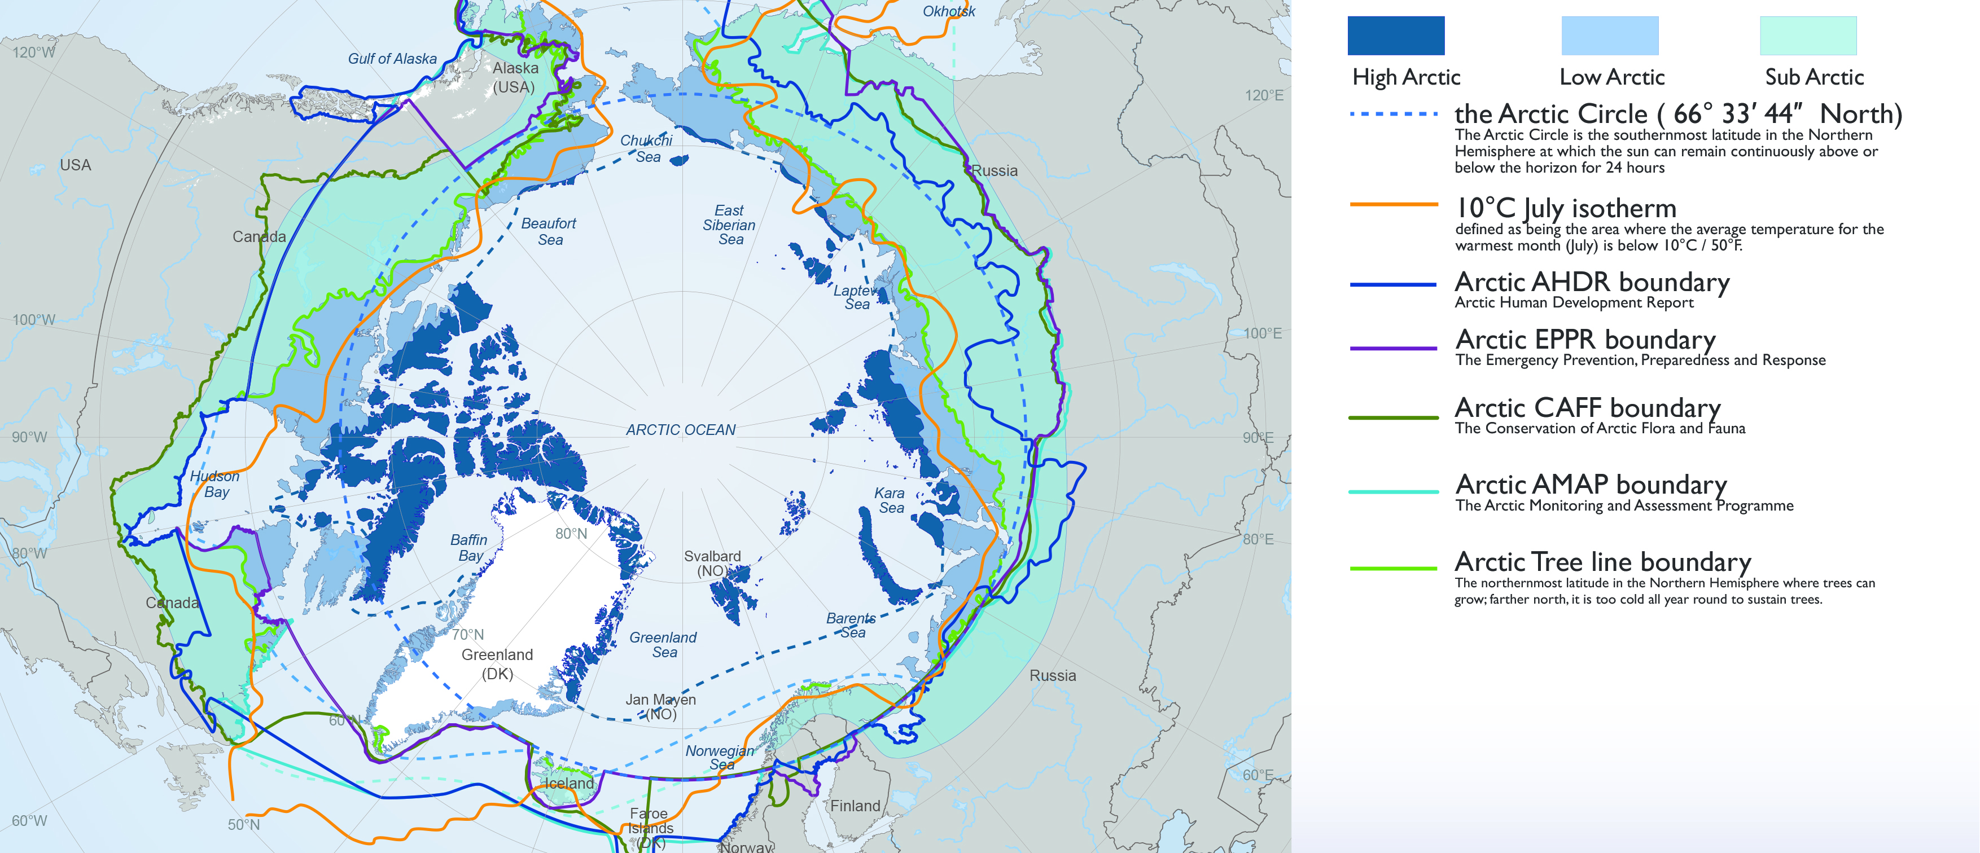

Slide 5
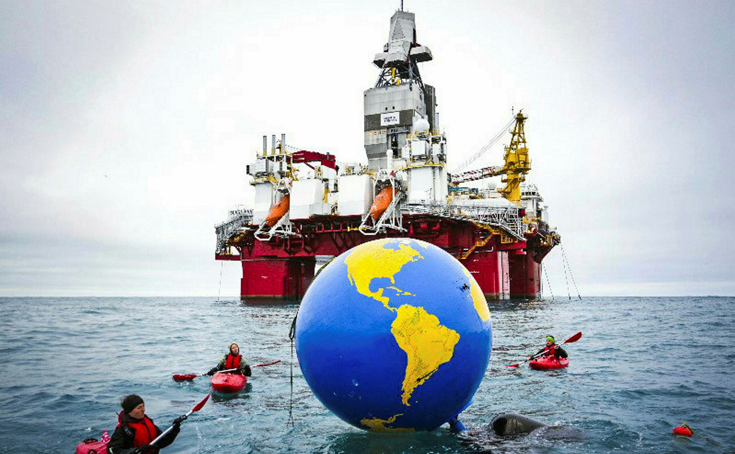
Geopolitics in the context of climate change
30% undiscovered gas and 13% undiscovered oil resources. (USGS)
Geopolitical impact, any resource war?

Slide 6
Geopolitics in the context of climate change

Slide 7
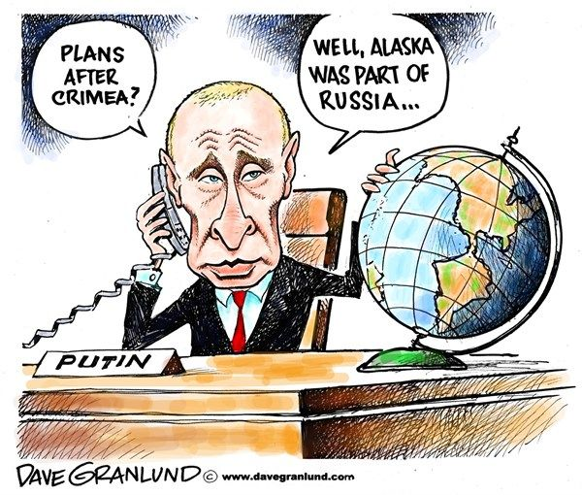
Which Arctic, which country?
8 different Arctic states, different Arctic conceptualization.
Nordområdene, High North,
Global Arctic
Territoy of Dialogue
International Media
Russia- 2007
Titanium Flag

Slide 8
Cooperation
Arctic Council
8 + 13
UNCLOS
Sea boundaries
Claims, overlaps

Slide 9
By February 2022
March 2022- The Arctic council stops its functions.
June 2022: Arctic Council announces it will continue without Russia.
October 2023: The Arctic Council stated that it would involve Russia in scientific projects.
February 2024: Arctic Council decided to continue with 8 Arctic states model through virtual meetings.
Bilateral cooperation with Russia in the Arctic.
NATO expansion in the Arctic

