Slide 1
Health Equity – Y4
Community Based Medical Education
Dr Dev Gadhvi and Dr Rohini Sabherwal

Slide 2
Day 1 – Health Equity – PM

Slide 3
Welcome and Introductions
Welcome
Introduce yourselves e.g. ICE breaker
What prior knowledge (before this morning) did you have on these ideas?
What do you hope to get out of today? 3 things (your learning needs)

Slide 4
Ground Rules
Safe, confidential space and appropriate space (no recording)
Cameras and mics on.
(This is a professionalism issue.)

Slide 5
Psychologically safety
Discussions today may be emotional, please be sensitive to your own emotional needs and of others.
If you feel upset, or in danger of feeling overwhelmed, please feel free to take a 5 min breather and re-join when possible. It is not unusual to feel disheartened about the scale of these issues.
Please feel free to discuss any issues with your tutor but also be aware the tutor may discuss these with you privately and/or follow up any concerns with the CBME Y4 leads.
We can facilitate discussions around ideas for change but part of the process is sitting in that frustration, the feeling of overwhelm and sometimes anger. This is called Transformative learning. We do this in hope to allow for evolution into compassionate and considered Doctors.

Slide 6
Holding dissenting views is not forbidden, maintaining respect for each other and keeping good lines of communication is paramount.
We hope for open freewheeling discussion and not a closed over factual debate.
As Educators we are very aware of our own BIAS when creating material like this and we have worked hard to try and include all points of view. We really do welcome further suggestions for other types of articles/resources and exercises. Please do get in touch (names and details found in Title slide) for any suggestions.

Slide 7
Aims and Objectives
Understand what Health Equity means
Consider what Health Equity looks like from a variety of settings;
National
Local
Individual – (Social history as a tool to explore/understand health equity)
How do we measure (research) Health Equity?
How do influence change in Health Equity?
Be able to demonstrate how difficult healthcare delivery is for marginalised groups in UK society
Be able to take a social history that addresses the challenges of health equity

Slide 8
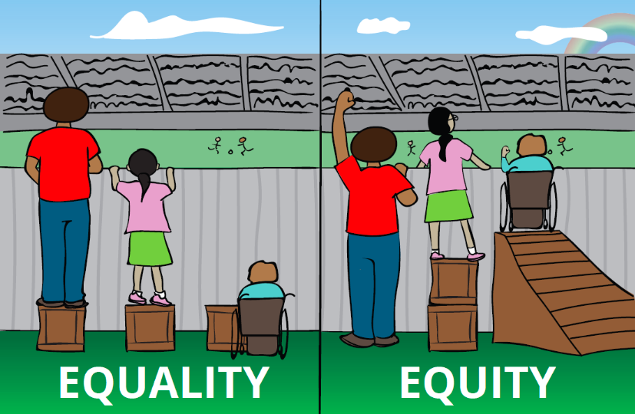
Exercise 1 - Define Health Equity
What were your thoughts on Health Equity
before and after this video?
What is your lived experience of health equity?
What is Health Equity and Why does it matter?
Notes:
https://www.youtube.com/watch?v=CwBEkGurMiY

Slide 9
Health Equity
What would the benefits be of a truly equitable health system? What would that look like ?
What might be some of the disadvantages be to a society with an equitable health system?
How can we overcome these challenges?

Slide 10
Exercise 2 - Understanding the data
What did you think of Hans Rosling’s talk from this AM?
What factors determine/influence “poverty”?
Have a look at: Life Expectancy V Income
Notes:
https://www.ted.com/talks/hans_rosling_new_insights_on_poverty?referrer=playlist-the_best_hans_rosling_talks_yo&language=en
https://www.gapminder.org/answers/how-does-income-relate-to-life-expectancy/
….

Slide 11
Exercise 3 - Health System in UK
Marmot – Guardian – Studying Health Inequalities has been my lifes work
Sir Michael Marmot: Social Determinants of Health (2014 WORLD.MINDS) – YouTube
Thoughts on these resources?
What does it tell you about health equity in the UK today?
Social Determinants of Health - an introduction - YouTube
Notes:
https://www.theguardian.com/commentisfree/2022/apr/08/health-inequalities-uk-poverty-life-death
https://www.youtube.com/watch?v=h-2bf205upQ
https://www.youtube.com/watch?v=8PH4JYfF4Ns

Slide 13
Exercise 4 - Access to healthcare
TASK
Think about when you move to a new address and need to register with a GP. How would you find a GP?
Why do we concentrate on community access so much?

Slide 14
Access to Healthcare
Primary/Community care need to…
Understand their population
Think about patient pathways
Think about improving access
What difficulties do you think primary care has in East London, with “understanding their population”?
What difficulties especially in East London do we have with access?

Slide 15
Exercise 5 - Social History
The social history is a an often an overlooked area of the clinical history
We would like you to take a deeper look at this aspect of exploring a patient’s life
What do you think the social history should include?
In light of what you have been considering this morning how could we use social history more effectively?
What else should be added?

Slide 16
Exercise 6 - Understanding the Benefits System
Understanding, what is available, even at a rudimentary level is useful so we can signpost and guide our patients
Financial assistance may be far more powerful then medical assistance
In many cases Social Prescribers are taking on the role of benefits advisers – you should try to sit in with one if your practice has one

Slide 17
CABA – Understanding the Benefit System
What did you learn?
What are the barriers?
What do you do if you do not speak English?
What do you do if your residency status is up in the air?
Notes:
https://www.caba.org.uk/financial/benefits-advice/understanding-uk-benefits.html

Slide 18
Discuss
What are you thoughts on benefits as a concept?
Does any one have any idea where the idea of benefits came from?
How do we support the poorest and most vulnerable in our society?
What does the gap between the poorest and the richest in our society have to do with this problem?

Slide 19
Cost of Living Crisis – a short review
What are the main contributors to the cost of living crisis?
How important is this to the national economy?

Slide 20
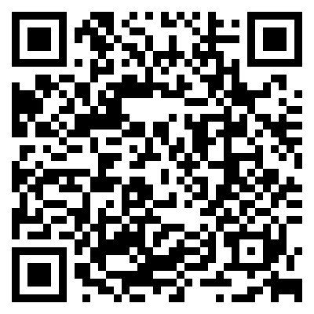
Closing
Discuss one thing you are going to take from todays’ session.
Between now and the 2nd session, look out for anything in news with a patient where the impact of health inequality is noticeable. Have you antennae out…..
https://form.jotform.com/222062931211341

Slide 21
Additional Information
Marmot
Health Equity in England_The Marmot Review 10 Years On_executive summary_web.pdf
Hans Rosling https://www.ted.com/speakers/hans_rosling?language=en&referrer=playlist-the_best_hans_rosling_talks_yo
Every Breath Matters (Trailer) : Sir Michael Marmot and Sir Stephen Holgate in conversation
https://www.youtube.com/watch?v=UxiZID_fk_k
Does despair really kill? USA - https://ajph.aphapublications.org/doi/full/10.2105/AJPH.2019.305016
Poverty medicine: General practice and vulnerable patients
https://abetternhs.net/2016/12/21/poverty-medicine-general-practice-and-vulnerable-patients/

Slide 22
Additional Information
Book - Tackling Causes and Consequences of Health Inequalities: A Practical Guide
bjgp.org/content/70/696/352
Book - The Exceptional Potential of General Practice: Making a Difference in Primary Care
bjgp.org/content/70/690/32.1
BJGP Podcast Julian Hart
https://www.bmj.com/content/377/bmj.o896
Commercial Determinants of health and its impact
https://www.who.int/news-room/fact-sheets/detail/commercial-determinants-of-health
Worsening GP shortages disproportionally in disadvantaged areas
https://www.cam.ac.uk/research/news/worsening-gp-shortages-in-disadvantaged-areas-likely-to-widen-health-inequalities

Slide 23
The Deep End Project
https://www.gla.ac.uk/researchinstitutes/healthwellbeing/research/generalpractice/deepend/
Access to healthcare – Be careful what you wish for?
https://bjgp.org/content/69/687/517.full

Slide 24
Day 2 – Air Pollution– PM
With collaboration and input from Dr. Anna Moore Resp Teaching Fellow Barts

Slide 25
Brief Summary of Session 1
- Thoughts about previous session? And/or thoughts since?

Slide 26
AIMS/Objectives
To understand how health policy, health systems impact on health equity.
To understand the ethical dimension to tackling health equity
To critically appraise material related to health equity – journal articles, policy papers, opinion editorials etc.

Slide 27
AIMS/Objectives
Sustainable Healthcare
Principles of Sustainable Healthcare
Why the climate crisis is a health crisis?
How does the healthcare system contribute to carbon emissions and other pollution?
What can I do? Personally, professionally and politically?

Slide 28
Ground Rules
Safe, confidential space and appropriate space (no recording)
Cameras and mics on.
(This is a professionalism issue.)

Slide 29
Psychologically safety
Discussions today may be emotional, please be sensitive to your own emotional needs and of others.
If you feel upset, or in danger of feeling overwhelmed, please feel free to take a 5 min breather and re-join when possible. It is not unusual to feel disheartened about the scale of these issues.
Please feel free to discuss any issues with your tutor but also be aware the tutor may discuss these with you privately and/or follow up any concerns with the CBME Y4 leads.
We can facilitate discussions around ideas for change but part of the process is sitting in that frustration, the feeling of overwhelm and sometimes anger. This is called Transformative learning. We do this in hope to allow for evolution into compassionate and considered Doctors.

Slide 30
Holding dissenting views is not forbidden, maintaining respect for each other and keeping good lines of communication is paramount.
We hope for open freewheeling discussion and not a closed over factual debate.
As Educators we are very aware of our own BIAS when creating material like this and we have worked hard to try and include all points of view. We really do welcome further suggestions for other types of articles/resources and exercises. Please do get in touch (names and details found in Title slide).

Slide 31
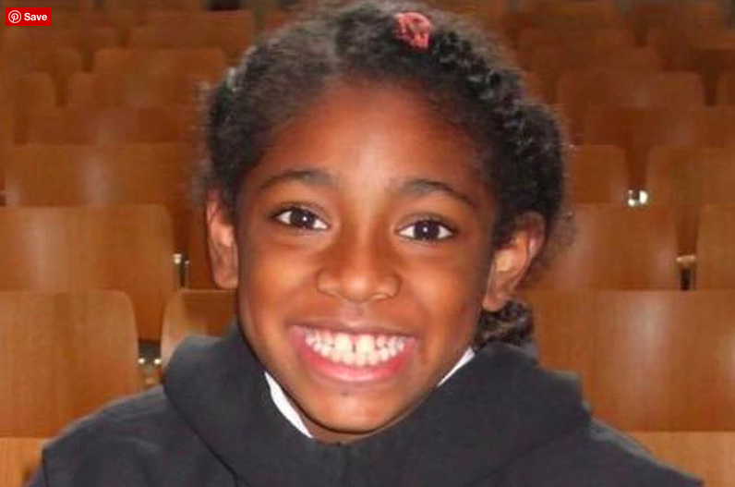
Exercise 1
Death of Asthmatic Child – London
Mothers Voice
Notes:
https://www.bbc.co.uk/news/uk-england-london-56801794
http://ellaroberta.org/aiovg_videos/the-healthy-london-partnership/

Slide 32
Exercise 1
What were your thoughts? How does this make you feel?
A 2nd inquest was requested to discuss the specific impact of air pollution surges at the time of Ellas’ death from the South Circular road. The 2018 paper on Air pollution by Professor Stephen Holgate squashed the initial inquest and hence a 2nd was requested. She lived 25-30m from this road.
1st ever death to have Pollution recorded as a contributing factor, discuss how this is significant? and possible future implications?

Slide 33
Take Ella –
Multiple attendances/Ambulances/Appointments /Inhaler use ……
….. this illness cycle –…..adds to Air Pollution and with the climate crisis it adds to her and others injustice and health inequality

Slide 34
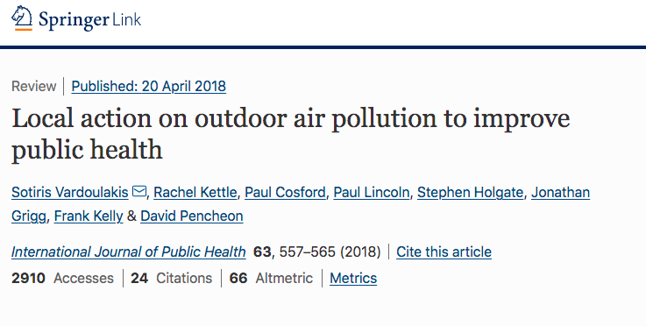
Exercise 2
What are we doing in the UK/London to improve air quality?
Local action on outdoor air pollution to improve public health
Notes:
https://link.springer.com/content/pdf/10.1007/s00038-018-1104-8.pdf

Slide 35
Exercise 2
What kind of paper is this? Name other types?
How does pollution affect CV health?
Who are the “stakeholders” and why are they important?
What was the criteria selection and protocols used to select studies for review?
What did you find interesting?

Slide 36
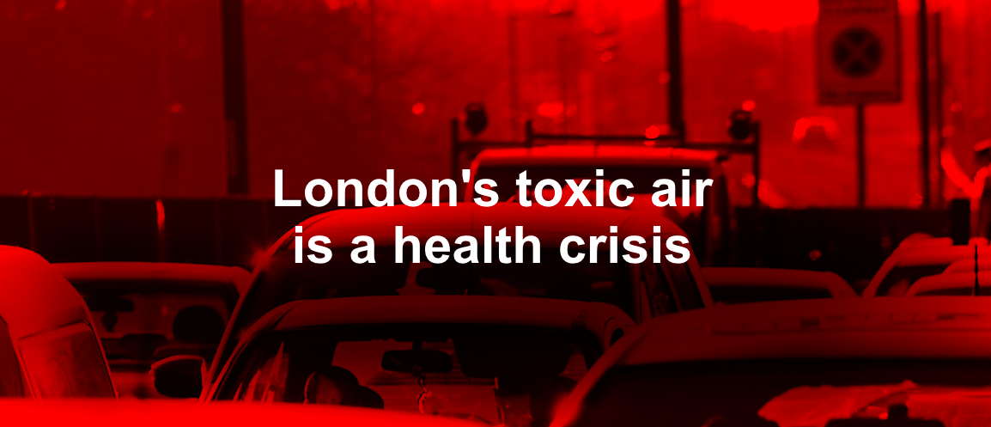
Exercise 2
NICE/PHE Recommendations
Sadiq Khan
Discuss?
Notes:
https://www.gov.uk/government/publications/health-matters-air-pollution/health-matters-air-pollution
https://www.london.gov.uk/sites/default/files/shorthand/clean_air/

Slide 37
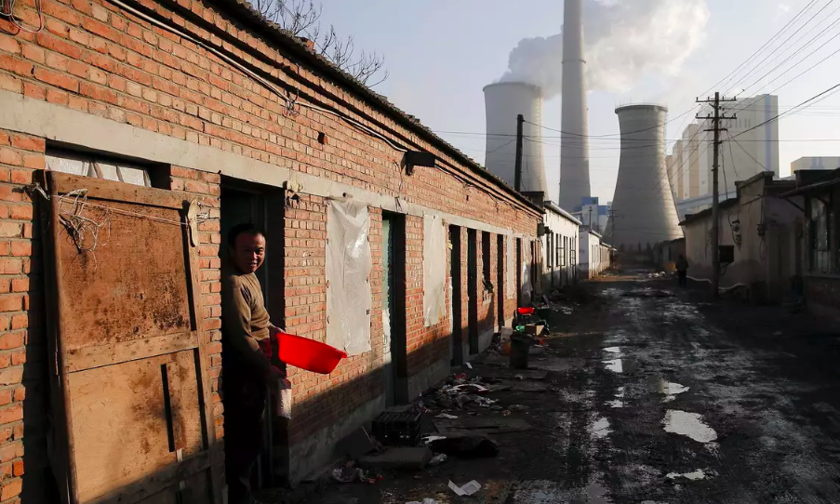
Exercise 3
- Thoughts on this video
WORLD ECONOMIC FORUM
- Healthy Inequality
What HCPs are doing?
Newham and Tower Hamlets are well established as some of the poorest areas of the UK.
Notes:
https://www.weforum.org/agenda/2020/07/what-is-environmental-racism-pollution-covid-systemic/
https://www.theguardian.com/uk-news/2021/jan/20/silvertown-tunnel-assault-health-locals-warn-doctors-london

Slide 38
What do you understand about the term Environmental Racism?

Slide 39
What do you understand about the term Environmental Racism?

Slide 40
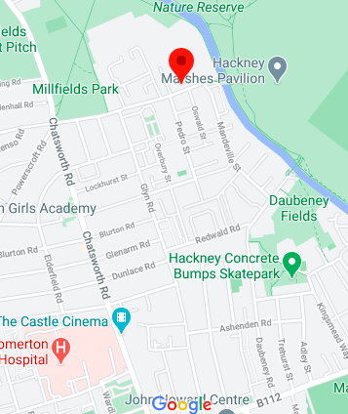
Happens locally…
Millfields Road Waste Depot – Hackney Council – see red dot
Just East of Chatsworth Road is one of the most deprived areas of East London.

Slide 41
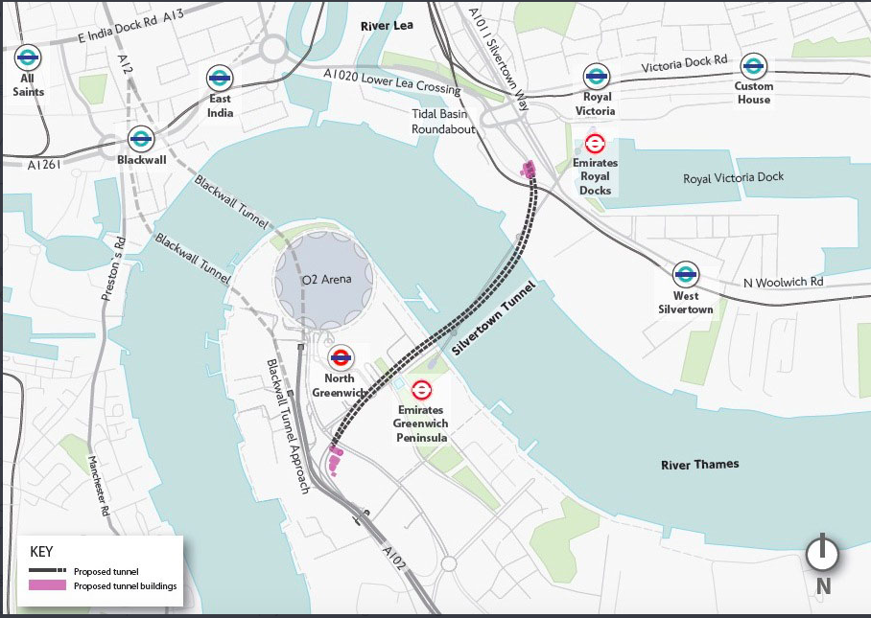
Exercise 4
Silvertown Tunnel Project
What do you think the pros and the cons are of this scheme?
Notes:
https://tfl.gov.uk/travel-information/improvements-and-projects/silvertown-tunnel#on-this-page-0

Slide 42
Pros | Cons
- Air quality is due to significantly get worse around Blackwell Tunnel if not implemented. Due to change in infrastructure of Stratford, Barking, Greenwich etc | - Air quality around Silvertown Tunnel will deteriorate due to increase road traffic (esp freight vehicles) in the area. The debate is by how much.
- Payment for use will go towards cost and any surplus back into Public Transport | - Cost especially for local residents and businesses (some additional support has been made available to help support)
- Increase transport links help boost local economy and by increasing spending in the area – creates jobs. | Impact of construction until 2025
- Area will have ULEZ restrictions to aid reduction in pollution | - Building more roads does not help with Climate emergency, just increases capacity and hence in time more cars etc on the road.
 | - Cost of the scheme itself (approx. £2billion)

Slide 43
Exercise 5
Sustainable Healthcare – Learning Objectives
Why the climate crisis is a health crisis?
How does the healthcare system contribute to carbon emissions and other pollution?
Principles of Sustainable Healthcare
What can I do? personally, professionally (with patients) and politically?

Slide 44
Notes:
20180912_Health_and_Social_Care_NRF_web.pdf (sustainablehealthcare.org.uk)

Slide 46
Exercise 5
What is good health v no illness?
What things would/could have helped a child like Ella? A 9 year old with poorly controlled/brittle asthma?

Slide 47
Sustainable Healthcare Framework

Slide 50
Task before Session 3
During GP4 module – part of your sign of assessments is to talk to a pregnant women and reflect specifically on her social history and any health inequalities she may face.
Summarise in 5 mins this patient and prepare to discuss further in Session 3 of Health Equity module.

Slide 51
Closing
Discuss one thing you are going to take from todays’ session.
https://form.jotform.com/222062931211341

Slide 52
Additional Reading
Climate justice can't happen without racial justice | David Lammy
https://www.youtube.com/watch?v=EkIpeO1r0NI
Center for Sustainable Healthcare
https://sustainablehealthcare.org.uk/courses/introduction-sustainable-healthcare
Get Involved...

Slide 53
Additional Reading
Social prescribing - https://www.youtube.com/watch?v=mZufTLi_6g0
The Drive for Sustainable Healthcare must be led by students and junior doctors
https://www.bmj.com/content/377/bmj.o896

Slide 54
Day 3 – Marginalised Groups – PM

Slide 55
Ground Rules
Safe, confidential space and appropriate space (no recording)
Cameras and mics on.
(This is a professionalism issue.)

Slide 56
Psychologically safety
Discussions today may be emotional, please be sensitive to your own emotional needs and of others.
If you feel upset, or in danger of feeling overwhelmed, please feel free to take a 5 min breather and re-join when possible. It is not unusual to feel disheartened about the scale of these issues.
Please feel free to discuss any issues with your tutor but also be aware the tutor may discuss these with you privately and/or follow up any concerns with the CBME Y4 leads.
We can facilitate discussions around ideas for change but part of the process is sitting in that frustration, the feeling of overwhelm and sometimes anger. This is called Transformative learning. We do this in hope to allow for evolution into compassionate and considered Doctors.

Slide 57
Holding dissenting views is not forbidden, maintaining respect for each other and keeping good lines of communication is paramount.
We hope for open freewheeling discussion and not a closed over factual debate.
As Educators we are very aware of our own BIAS when creating material like this and we have worked hard to try and include all points of view. We really do welcome further suggestions for other types of articles/resources and exercises. Please do get in touch (names and details found in Title slide).

Slide 58
TASK
Think back to the last session – what did you learn? How did it make you feel?
Pick one/two of the patients from the group to discuss from their written task and discuss further.
What were the causes behind the causes?

Slide 59
Aims and Objectives of Session 3
To be able to define race, ethnicity, culture, multiculturalism and inequalities of access to health care
To understand the contributing factors that have led to BAME women being nearly 5 times more likely to suffer from maternal mortality

Slide 60
Exercise 1
You were asked to read
Passport checks considered for pregnant NHS patients
Maternity Action
Caring for LGBTQ+ patients in the NHS
Notes:
https://www.bbc.co.uk/news/health-37621239
https://maternityaction.org.uk/advice/residence-rules-and-entitlement-to-nhs-maternity-care-in-england/
https://www.bmj.com/content/366/bmj.l5374?hwshib2=authn%3A1622715629%3A20210602%253Acada7438-2ddd-49bc-a4a0-a3ee264b5a02%3A0%3A0%3A0%3A7mt8YEFlNUhKo6sMzhCy7Q%3D%3D

Slide 61
Exercise 1
What are your thoughts?
Can you think of other marginalised groups on society that may have similar issues?
Can you think of any experiences or observations you have had of marginalised groups in society having problems with access?
Thoughts on how why this is and how to improve this?

Slide 62
Exercise 2
How do you answer the following questions?
Where are you from?
What is your racial origin?
What is your ethnic background?
How do these type of questions make you feel?

Slide 63
Definitions

Slide 64
What is multi-culturalism?

Slide 65
What is multi-culturalism?
The Oxford English Dictionary offers a broad definition of multiculturalism as the "characteristics of a multicultural society" and "the policy or process whereby the distinctive identities of the cultural groups within such a society are maintained or supported".

Slide 66
Exercise 3
Watch
The Black Maternity Scandal – 25 mins
Thoughts?
Notes:
https://www.channel4.com/programmes/the-black-maternity-scandal-dispatches

Slide 67
Exercise 3
Read Saving Lives, Improving Mothers’ Care
Please read i, ii, iii and for interest iv,v,vi,vii but note this is a lot of clinical detail which is more postgraduate level.
- What percentage of maternal deaths could have possibly been prevented with improvement of care?
- What was the 2nd leading cause of maternal death by a direct cause of pregnancy?
Notes:
https://www.npeu.ox.ac.uk/assets/downloads/mbrrace-uk/reports/MBRRACE-UK%20Maternal%20Report%202019%20-%20WEB%20VERSION.pdf

Slide 68
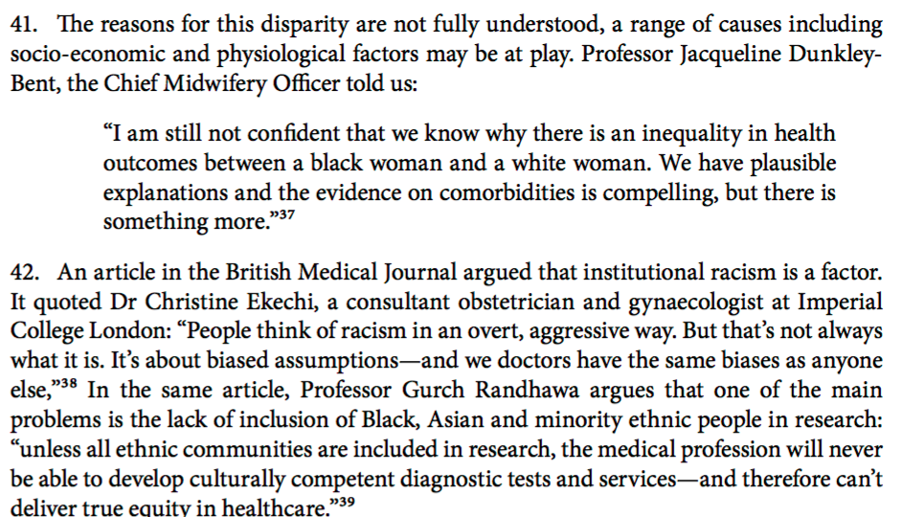
Black people, racism and human rights
Notes:
https://committees.parliament.uk/publications/3376/documents/32359/default/

Slide 69
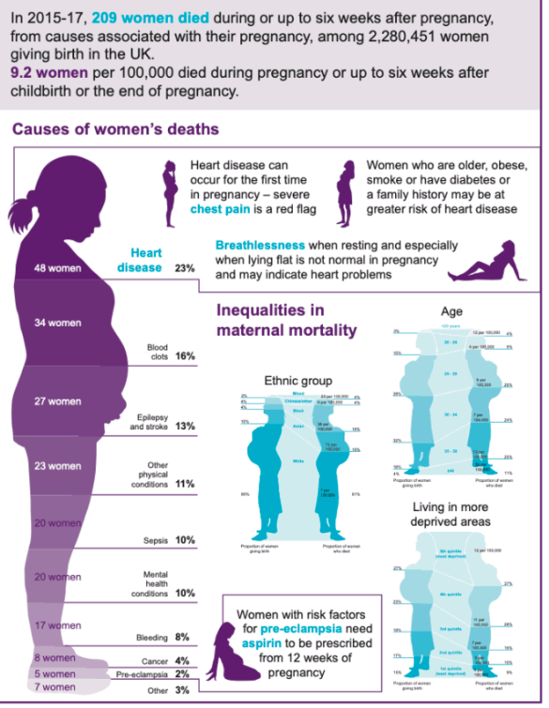

Slide 70
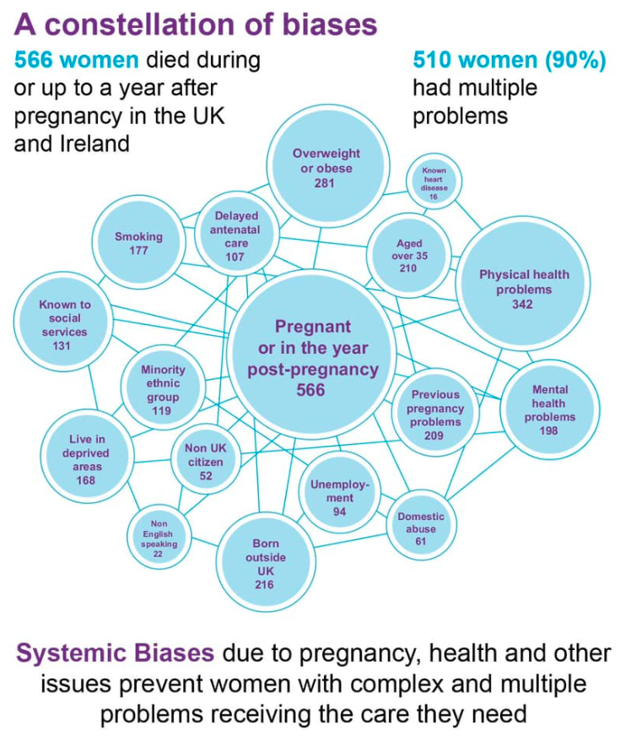

Slide 71
Improvements?
1. Better Births March 2020 and NHS Long Term plan 2019 – is one of the only places where there is a pledge that ¾ of BAME women/deprived women during antenatal period should have the same midwife by 2024.
2. Okenden Report - The review of Shrewsbury and Telford NHS Trust, led by Donna Ockenden, examined cases involving 1,486 families and 1,592 clinical incidents. The review found that 201 babies and nine mothers could or would have survived if they had received better care.
3. Ethnic Inequalities in Healthcare – A Rapid Review - Looked at a handful of key areas Inc. MH services and Maternal health

Slide 72
Improvements?
4. FIVEXMORE – Charity took matters into their own hands and surveyed 1300 Black women to look into the maternity experiences - Inc. mortality but also serious pregnancy complications
5. NHS Level up Maternity Care and tackle disparities (DOH) - Explore reasons/drivers for disparities in maternity care and address poor outcomes for women from ethnic minority communities and those living in deprived areas
Notes:
https://www.longtermplan.nhs.uk/online-version/chapter-3-further-progress-on-care-quality-and-outcomes/a-strong-start-in-life-for-children-and-young-people/maternity-and-neonatal-services/
https://www.gov.uk/government/publications/final-report-of-the-ockenden-review/ockenden-review-summary-of-findings-conclusions-and-essential-actions
https://www.nhsrho.org/publications/ethnic-inequalities-in-healthcare-a-rapid-evidence-review/
https://www.fivexmore.com/blackmereport
https://www.gov.uk/government/news/new-taskforce-to-level-up-maternity-care-and-tackle-disparities

Slide 73
What can we do professionally to improve outcomes now and near future?
.

Slide 74
What can we do professionally to improve outcomes now and near future?
Explore your reactions to different circumstances, start to look at your own unconscious bias
Speak up – bystander intervention - see link in Additional Resources
Be kind – remember the stress, anxiety, uncertainty that comes with having a baby especially for the first time. LISTEN to your patient and/or their partner and what they are telling you. Think about their risk of mental health issues as well as possible health disparities.
Think about possible deprivation of your patient and what you could do to help or signpost them to. Ask your local midwife team if not sure (often there is a public health midwife who can help).
Aid in policy making to ensure departments have education on this (especially if you end up working more rurally) and help in making sure there is continuity in care.

Slide 75
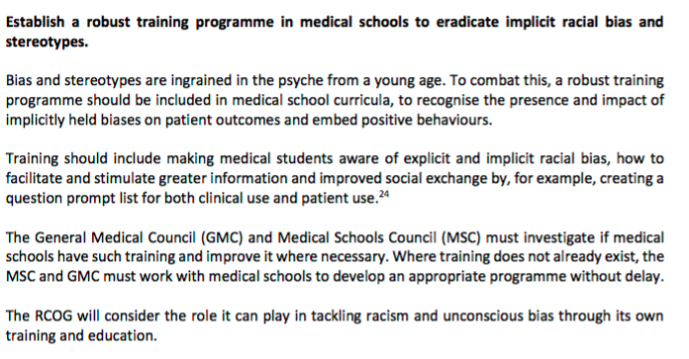
Why are you important as medical students….
RCOG Position Statement: Racial disparities in
Women’s healthcare
March 2020
Notes:
https://www.rcog.org.uk/globalassets/documents/news/position-statements/racial-disparities-womens-healthcare-march-2020.pdf

Slide 76
Closing
Discuss one thing you are going to take from todays’ session.
https://form.jotform.com/222062931211341

Slide 77
Summary
We hope you have enjoyed these sessions.
Our intention was to broaden your understanding of health inequity in a number of different settings.
We strongly feel that understanding healthy equity is a critical aspect of modern medical practice.
More than anything we hope this will foster an interest and engagement with these topics in your
future careers.

Slide 78
Future Participation
If you are interested in helping us developing these sessions further please do not hesitate to get in touch with Y4 LEADS Dr. Dev Gadhvi and Dr Rohini Sabherwal.
We are particularly looking for a wide range of view points….
Thank you

Slide 79
Additional Information
Adverse Child Events
https://www.londonaceshub.org/racial-justice
Mrs Bibi Syndrome
https://mediadiversified.org/2018/09/14/mrs-bibi-syndrome-the-medical-stereotype-undermining-elderly-asian-women/
Louis Theroux - Mothers on the Edge - Perinatal MH
https://www.bbc.co.uk/programmes/m00052dk

Slide 80
Additional Information
Black patients less likely to be offered pain relief V white counterparts
https://www.theguardian.com/science/2016/aug/10/black-patients-bias-prescriptions-pain-management-medicine-opioids
https://journals.plos.org/plosone/article?id=10.1371/journal.pone.0159224
Speaking up – University of Leeds
https://equality.leeds.ac.uk/support-and-resources/becoming-an-active-bystander/
Take the Harvard Implict Bias test
https://implicit.harvard.edu/implicit/takeatouchtestv2.html

Slide 81
Ethnic Inequalities in Healthcare – A Rapid Review
https://www.nhsrho.org/publications/ethnic-inequalities-in-healthcare-a-rapid-evidence-review/
Ockenden Report
https://www.gov.uk/government/publications/final-report-of-the-ockenden-review/ockenden-review-summary-of-findings-conclusions-and-essential-actions
FIVEXMORE
https://www.fivexmore.com/blackmereport
RACISM IN NHS WORK FORCE BMJ - some stats
https://www.bmj.com/content/377/bmj.o1456

Slide 82
Level up Maternity Care and tackle disparities - DOH
https://www.gov.uk/government/news/new-taskforce-to-level-up-maternity-care-and-tackle-disparities

