Slide 1
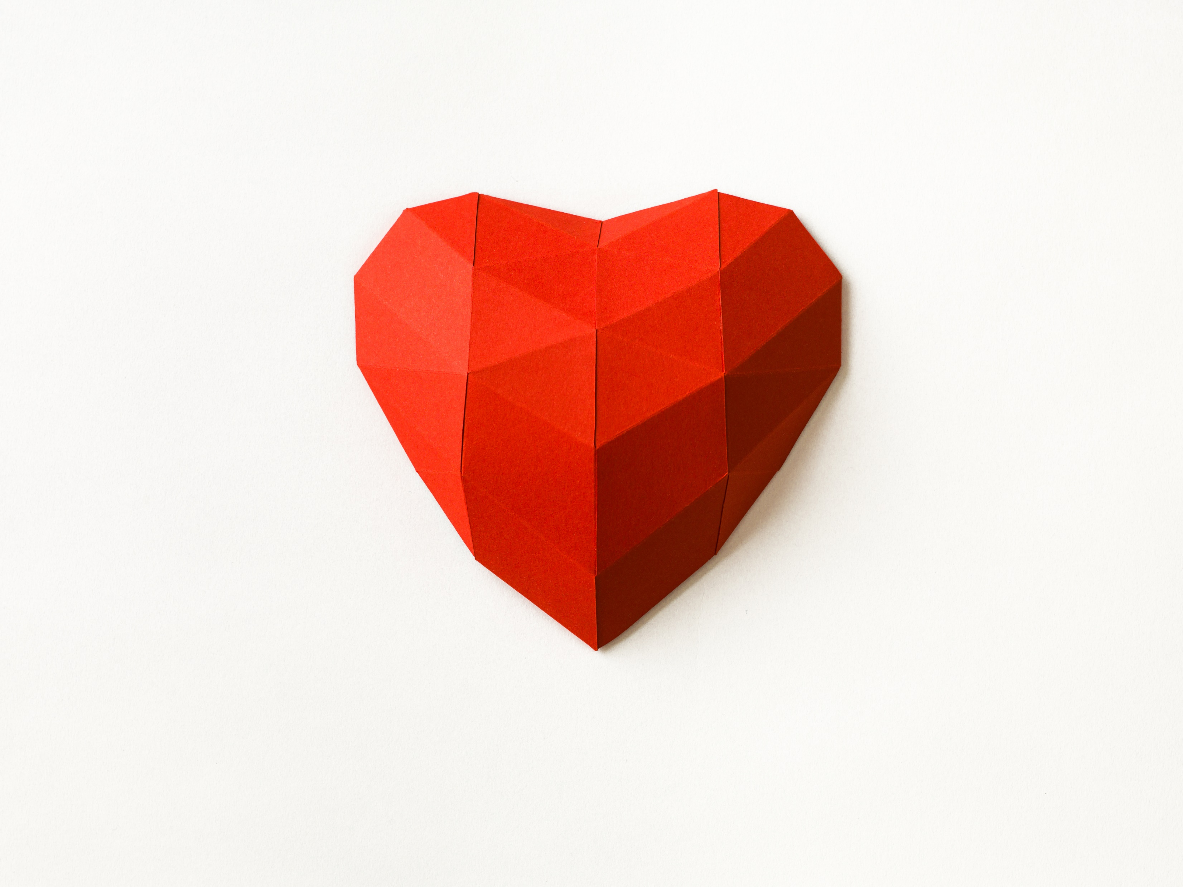
Cardiovascular system I

Slide 2
Learning objective
“Students should demonstrate an understanding of the mammalian circulatory system, basic heart and blood vessel anatomy and the cardiac cycle. Students should demonstrate an understanding of the lymphatic system and how tissue fluid is formed.”

Slide 3
Lesson aims
By the end of the lesson, students will be able to:
Describe the mammalian circulatory system, basic heart and blood vessel anatomy
Describe the cardiac cycle
Describe the differences between blood, tissue fluid and lymph

Slide 4
Circulatory system
Multicellular organisms like us need a transport system that provides e.g. oxygen, glucose, removes waste etc very quickly
Mammals have a double circulatory (what does “double” mean in this context?) system which uses blood to transport substances
Blood passes through the heart twice in one complete circuit of the body

Slide 5
Circulatory system
The mammalian heart has two separate halves – left and right
The right side of the heart pumps blood to the lungs to pick up oxygen – the pulmonary system
The left side of the heart pumps the oxygenated blood around the body – the systemic system

Slide 6
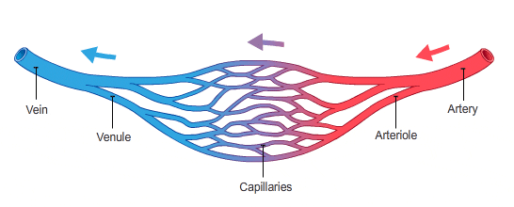
Circulatory system and blood vessels
We (vertebrates) have a closed circulatory system – what does this mean?
The heart pumps the blood into the arteries
Arteries are big blood vessels
They decrease in size to become arterioles
Arterioles decrease further to become capillaries
Capillaries connect to venules
Venules increase in size to become veins

Slide 7
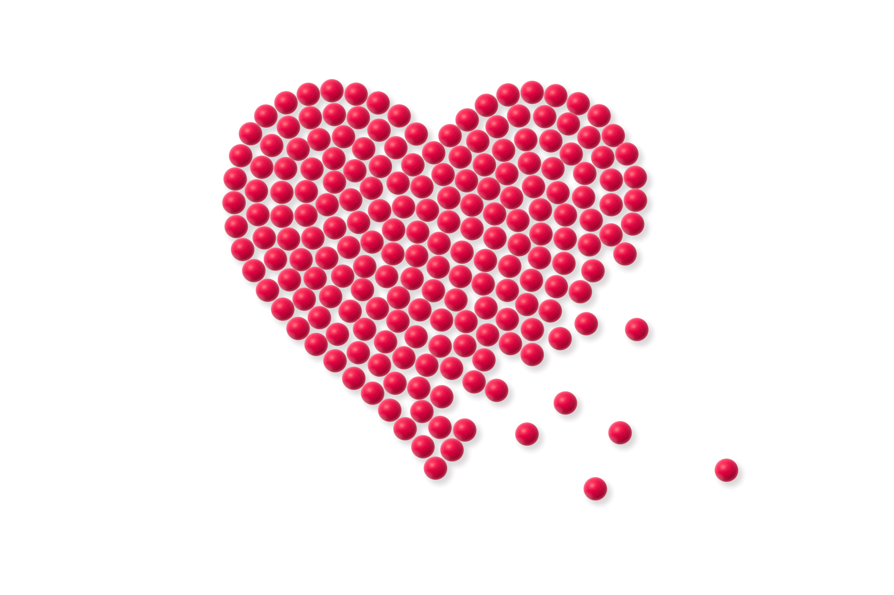
A few quick questions
Why do multicellular organisms need a circulatory system?
Mammals have a double circulatory system – what does this mean?
Where does the right side of the heart pump to?
Where does the left side of the heart pump to?
Name the 5 types of blood vessel.

Slide 8
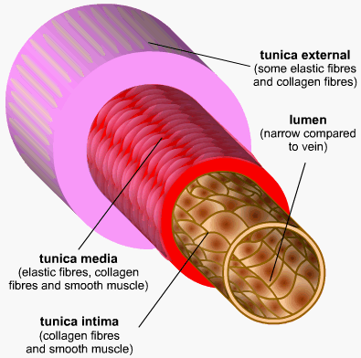
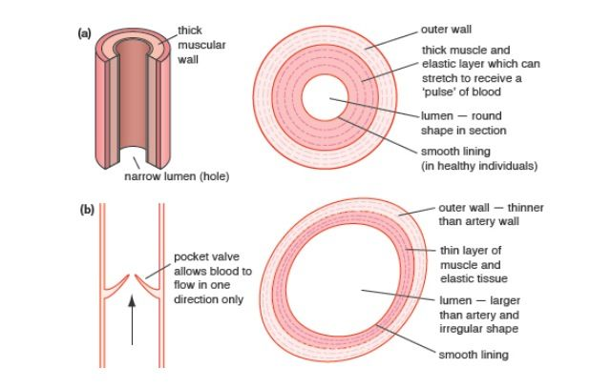
Blood vessels - arteries
Arteries – carry blood from the heart.
Have thick walls containing smooth muscle and elastic tissue
Elastic tissue allows the artery to expand and recoil
with each heart beat. This helps to maintain blood pressure
Inner lining (endothelium) of artery is folded,
allowing for the artery to expand, but the inner surface is
smooth – why?
Carry oxygenated blood (except pulmonary artery)

Slide 9
Arteriole
Arteries branch into smaller vessels called arterioles
Arterioles are smaller than arteries
Have a wall of smooth muscle to allow them to expand and contract
This means they can govern how much blood is received by tissue
Arterioles have little elastic tissue – why?

Slide 10
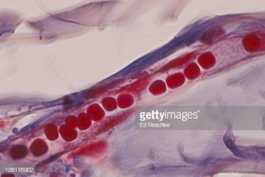
Capillaries and venules
Capillaries are the smallest blood vessels but there are loads of them
Capillaries are adapted for diffusion and are one cell thick
Have smooth inner surface – why?
Exchange of substances take place here
Capillaries connect to venules
Venules have thin walls but with some smooth muscle cells

Slide 11
Veins
Veins – take blood back to heart
Low pressure in veins
Wider lumen than arteries
Much less elastic and muscle tissue than arteries
Contain valves to stop blood flowing backwards. Blood flow is helped by movement (contraction) of muscles around them
Carry deoxygenated blood (except pulmonary vein)

Slide 12
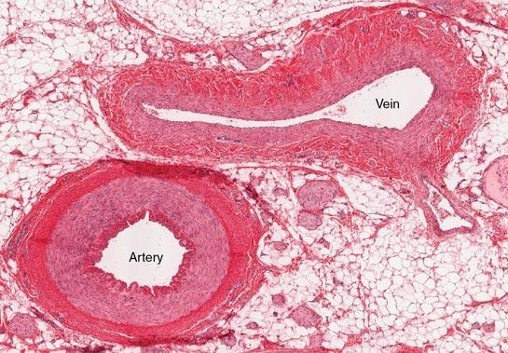
Note the difference in
wall thickness between
the vein and artery

Slide 13
Recap time
Briefly summarise the differences in the 5 types of blood vessel in 5 bullet points

Slide 14
Atherosclerosis
High triglycerides and cholesterol are associated with atherosclerosis (narrowing of arteries)
Atherosclerosis predispose to coronary heart disease (CHD) and strokes
Look up the risk factors for coronary heart disease and atherosclerosis

Slide 15
Role play – doctor and patient
One of you is the patient and one of you is the doctor
Your patient’s parent recently suffered a heart attack and your patient is concerned that they might end up experiencing a heart attack in the future.
What advice can you offer to your patient about the risks associated with coronary heart diseases?
Once you have played the role of doctor and patient, swap roles with another pair of students so everyone plays both roles at some point.

Slide 16
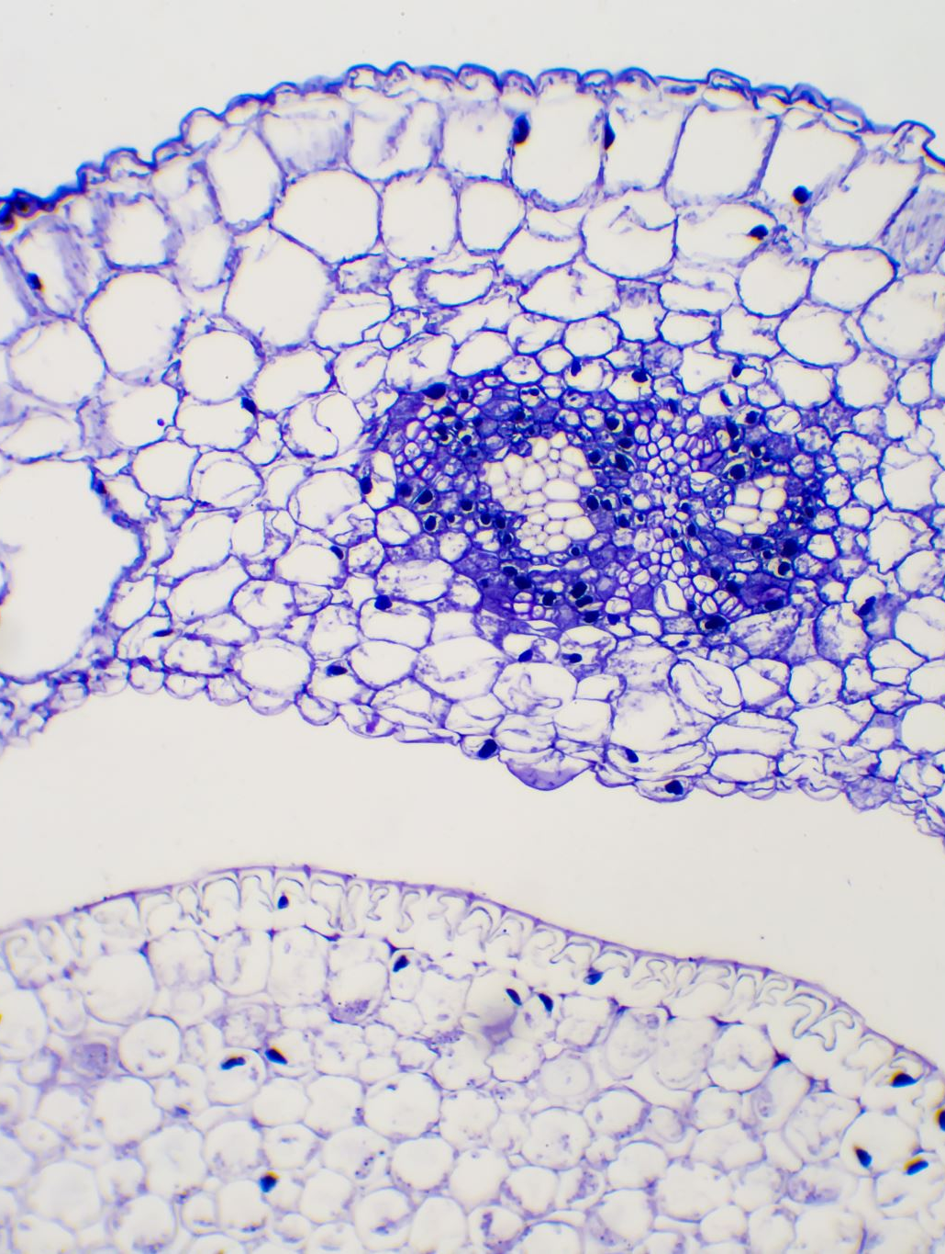
Tissue fluid
Tissue fluid surrounds cells – called interstitial fluid
Fluid forced out of capillaries by pressure filtration
Composed of oxygen, water, glucose, ions
Does not contain cells or large proteins as they are too large to easily leave the capillary
At arteriole end of capillary, hydrostatic pressure is relatively higher in the capillary than in the tissue itself so fluid is forced out of capillary – net movement of water = out
As fluid leaves the capillary, hydrostatic pressure is reduced in the capillary so at the venule end of the capillary, hydrostatic pressure is lower.
Also at the venule end of the capillary, the water potential is lower than in the tissue because of the plasma proteins in the capillary

Slide 17
Tissue fluid
Venule end of the capillary, the water potential is lower than in the tissue because of the plasma proteins in the capillary
This generates high oncotic pressure (osmotic pressure)
The high oncotic pressure and lower water potential lead to some water re-entering the capillary at the venule end
Net movement of water = in
Click here for tissue fluid video https://www.bing.com/videos/search?q=Tissue+Fluid+a+Level+Biology&&view=detail&mid=682D558BD27B38AEC877682D558BD27B38AEC877&&FORM=VRDGAR&ru=%2Fvideos%2Fsearch%3F%26q%3DTissue%2BFluid%2Ba%2BLevel%2BBiology%26FORM%3DVDMHRS

Slide 18
Lymph fluid
Not all the fluid that was forced out of the capillary re-enters it
Some fluid drains into the lymphatic system – made up of lymph vessels and lymph nodes
This fluid is now termed lymph
Lymph fluid flows through lymph nodes and vessels (containing valves to prevent backflow) up to the chest and empties back into the blood via the thoracic duct

Slide 20
Recap time
Briefly summarise how lymph fluid forms including the key terms arteriole end, venule end, hydrostatic pressure, oncotic pressure, water potential, net movement of water out, net movement of water in

Slide 21
Differences between blood, tissue fluid and lymph fluid
 | Blood | Tissue fluid | Lymph fluid | comment
Red blood cells | Yes | No | No | RBCs too big to leave capillary
White blood cells | Yes | Very few | Yes | Only enter tissue during infection
Platelets | Yes | No | No
Proteins | Yes | Very few | Antibodies | Most are too big to leave capillary
Water | Yes | Yes | Yes
Dissolved solutes | Yes | Yes | Yes | Solutes can move freely

Slide 22
Question time – you know you love it!
Is blood pressure highest in veins or arteries?
Which row shows the most appropriate diameter for the vessels?
At the arteriole end of a capillary bed the hydrostatic pressure is 5.1kPa in a capillary and 0.13kPa in the space around the cells. Explain the effect this has on the movement of fluid between the capillary and the cell space.
 | Artery | Arteriole | Capillary | Vein
A | 13mm | 8µm | 2cm | 200µm
B | 8µm | 2cm | 200µm | 13mm
C | 200µm | 13mm | 2cm | 8µm
D | 2cm | 200µm | 8µm | 13mm

Slide 23
The Heart

Slide 24
The Heart – two muscular pumps
The right hand side of the heart pumps deoxygenated blood to the lungs
The left hand side pumps oxygenated blood around the body
Valves in the heart prevent blood flowing back the wrong way – why is this essential and what happens if valves fail?
Atrioventricular valves separate the atria from the ventricles and stop blood passing back into the atria from the ventricle – the tricuspid on the right hand side between the atrium and ventricle, the mitral (bicuspid) valve on the left hand side between the atrium and ventricle
Semi-lunar valves stop blood flowing back from the pulmonary artery and aorta into the ventricles
Valves open one way depending on pressure

Slide 25
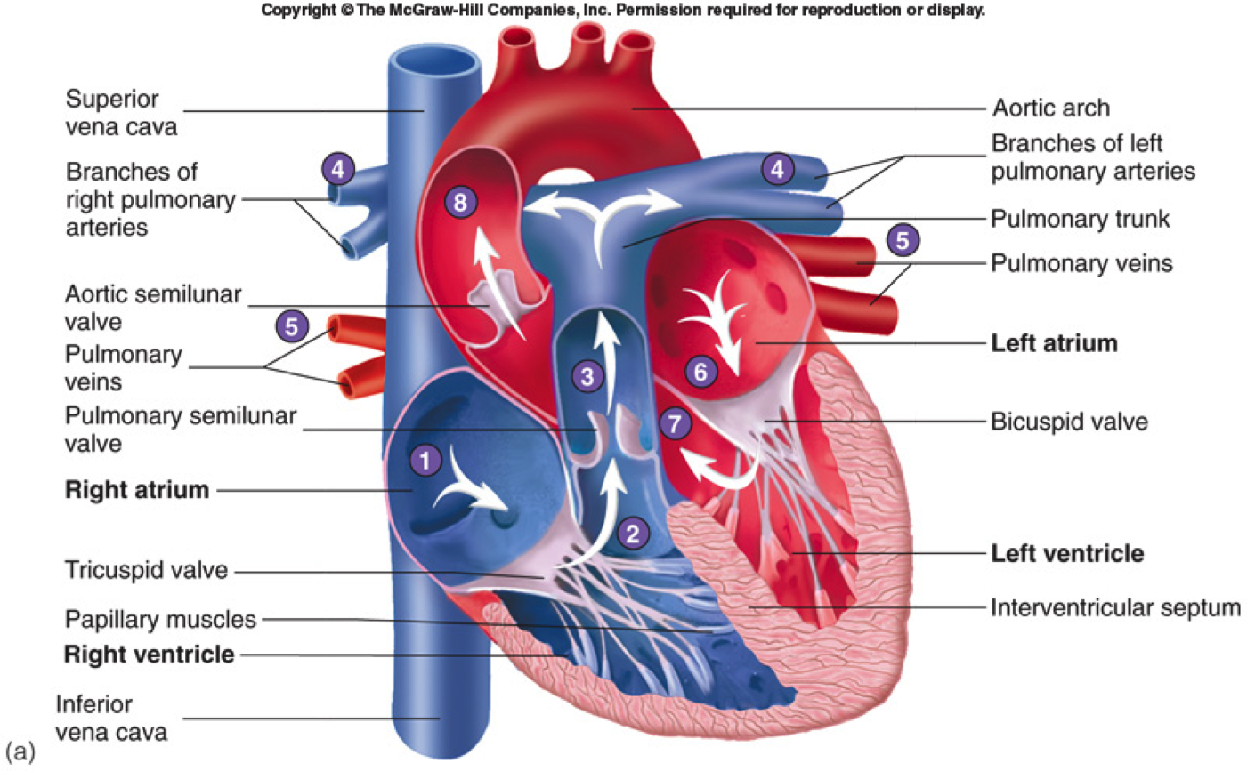

Slide 26
The cardiac cycle
Sequence of contraction and relaxation of atria and ventricles to keep blood circulating around the body
Volumes in atria and ventricles change during relaxation and contraction so pressures change too
Pressure changes lead to valves opening and closing
Involves the atria relaxing, then atrial contraction, followed by ventricular contraction

Slide 27
Atria and ventricles relax
At start, atria and ventricles are relaxed, heart valves are briefly all closed – Diastole
Blood starts to enter atria, then atria contract (systole) and push blood through open atrioventricular valve into ventricle
Pressure and volume in ventricles increase

Slide 28
Ventricles contract, atria relax
Atria relax once blood is in ventricles
Ventricles then start to contract leading to increase in pressure and decrease in volume
Atrioventricular valves snap shut so no backflow of blood into atria
Semilunar valves in pulmonary artery and aorta open so blood is ejected into them

Slide 29
Ventricles and atria relax
Once blood has been ejected into arteries, ventricles relax
Semilunar valves snap shut to prevent backflow of blood into ventricles
Atrioventricular valves are still shut
Atria are still relaxed and blood flows into them from vena cava and pulmonary vein
Atria start to contract and cycle starts again
Left ventricle wall is thicker than right – why?

Slide 30
Cardiac cycle video
https://www.youtube.com/watch?v=cKHASGk-_6o

Slide 31
Time for a recap
In 4 bullet points, summarise what happens during atrial diastole, atrial systole, ventricular diastole and lastly ventricular systole.

Slide 32
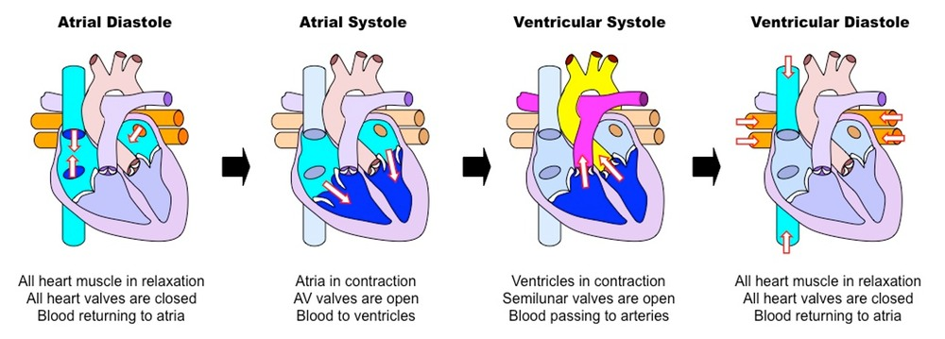

Slide 33
Pressure changes graph
Atrial pressure does not change much over the cycle
Pressure in ventricles changes dramatically
Pressure in arteries varies between around 80 mmHg and 120mmHg on average
3rd heart sound may be heard in children but can indicate heart failure in adults
Normal heart sound
https://www.bing.com/videos/search?q=Normal+Heart+Sounds&&view=detail&mid=46CBBD647CD509E70A1C46CBBD647CD509E70A1C&&FORM=VRDGAR&ru=%2Fvideos%2Fsearch%3F%26q%3DNormal%2BHeart%2BSounds%26FORM%3DVDMHRS

Slide 34
Cardiac pressure and volume changes video
https://www.youtube.com/watch?v=On12SvJ1IPU

Slide 35
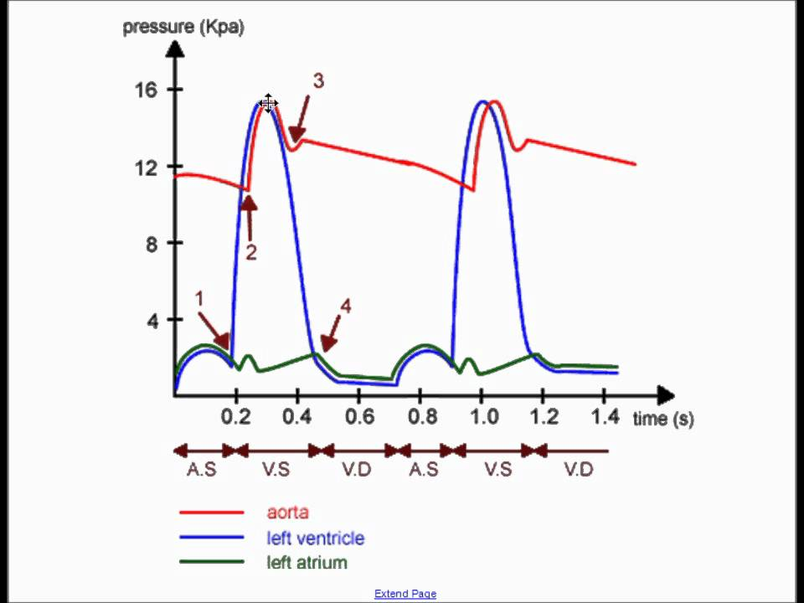
Question time
1. Which chamber of the heart receives blood from the lungs?
2. How many valves are there in the heart and what are they called?
3. Label 1 – 4 on the diagram to the right
4. Cardiac output is the volume of blood ejected by the
heart in ml/min and is calculated by the formula:
Cardiac output = heart rate x stroke volume
Stroke volume is the volume of blood ejected with
each heart beat. What is the cardiac output with a
heart rate of 70bpm and a stroke volume of 80ml?

Slide 36
Lesson aims
By the end of the lesson, students will be able to:
Describe the mammalian circulatory system, basic heart and blood vessel anatomy
Describe the cardiac cycle
Describe the differences between blood, tissue fluid and lymph

