Slide 1
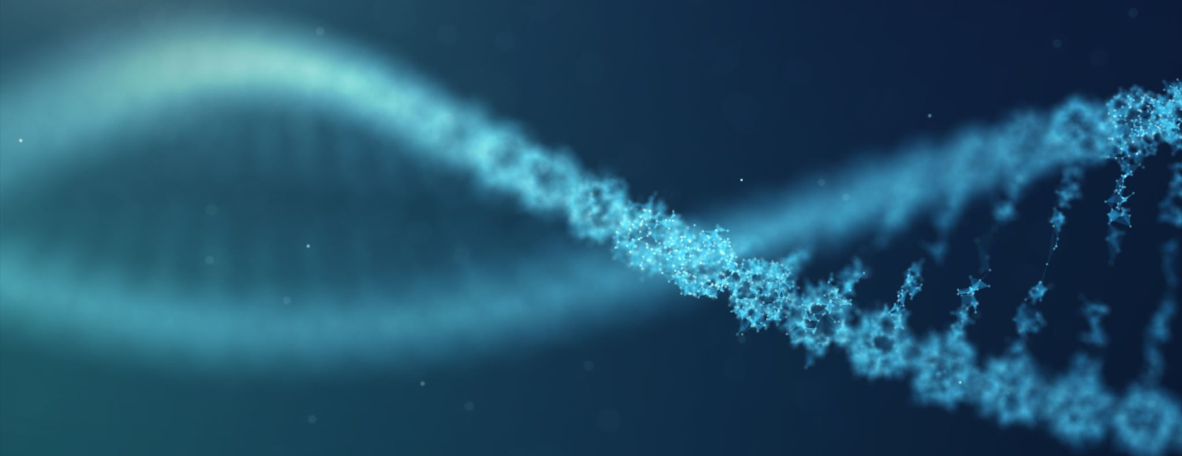
Nucleic Acids and DNA Replication
Queen Mary University of London CCFS
Dr Nyree Myatt

Slide 2
Learning objective
“Students demonstrate an understanding of DNA including DNA bases, pentose sugars, nucleotides and nucleosides. Students should demonstrate an understanding of the structure of DNA and how DNA replicates using the semi-conservative replication method”

Slide 3
Lesson aims
By the end of the lesson, students should be able to:
1. List DNA bases and how they pair up in DNA
2. Describe the difference between nucleotides and nucleosides
3. Describe how DNA replicates using the semi-conservative method

Slide 4
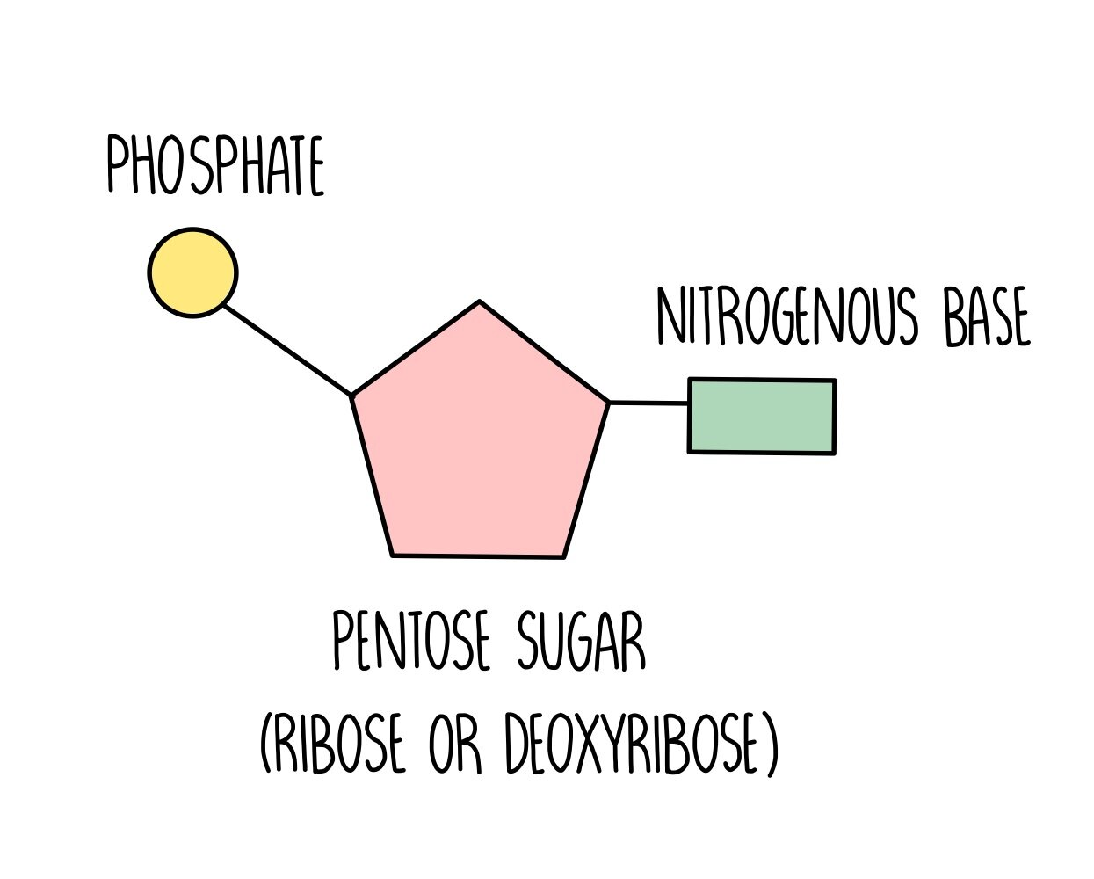
Nucleic acids – let’s get the basics right!
Nucleic acids - DeoxyriboNucleic Acid or DNA and RiboNucleic Acid or RNA
Nucleic acids are made from nucleotides
Nucleotides are biological molecules and are made up of:
A pentose sugar (sugar made with 5 carbons)
A nitrogenous base
A phosphate group
So all nucleotides contain C, H, O, N, P
DNA - holds genetic information
RNA – uses instructions from DNA to
make proteins

Slide 5
Sugar – ribose or deoxyribose
Both DNA and RNA contain ribose, a pentose sugar (– 5 carbons)
For DNA, it is deoxyribose
For RNA, it is ribose
Carbon 2 is missing the oxygen on deoxyribose

Slide 6
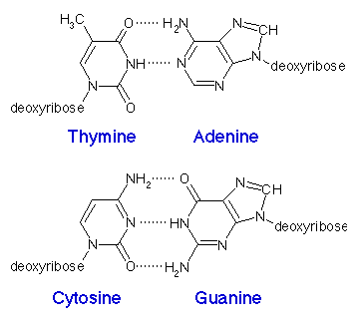
Bases - A, T, C, G
4 bases in DNA;
Adenine, thymine, cytosine and guanine.
Contain nitrogen
Adenine and guanine are purines
Cytosine and thymine are pyrimidines
Purines have 2 joined carbon-nitrogen rings
Pyrimidines have a single carbon-nitrogen ring
As Pure as Gold
2 hydrogen bonds
3 hydrogen bonds

Slide 7
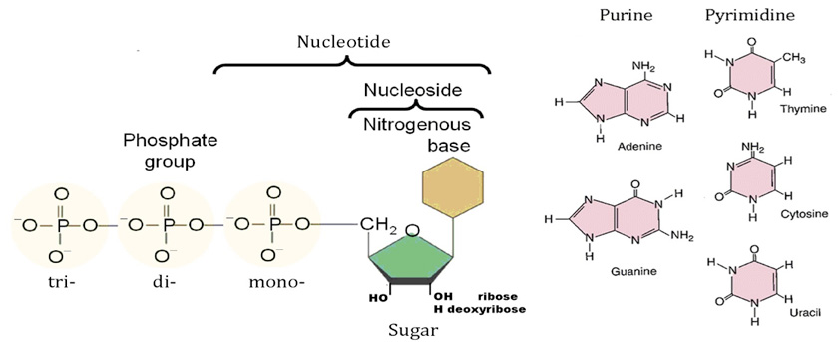
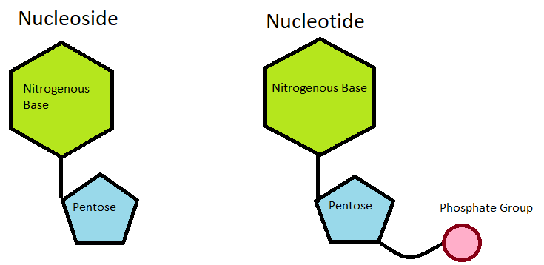
Nucleosides versus nucleotides
Nucleoside = sugar + base
Nucleotide = Sugar, base and phosphate

Slide 8
ADP and ATP
Nucleosides can have phosphate groups added to them to become nucleotides
Up to three phosphate groups can be added
An example of this is with adenosine diphosphate and adenosine triphosphate (ADP and ATP)
ATP is the energy currency for cells
ATP provides chemical energy for cells when the last phosphate group is released

Slide 9
Question time
Which bases pair up and how many hydrogen bonds are between them?
Which bases are purines and which ones are pyrimidines?
Which sugars are in RNA and DNA, and how do they differ?

Slide 10
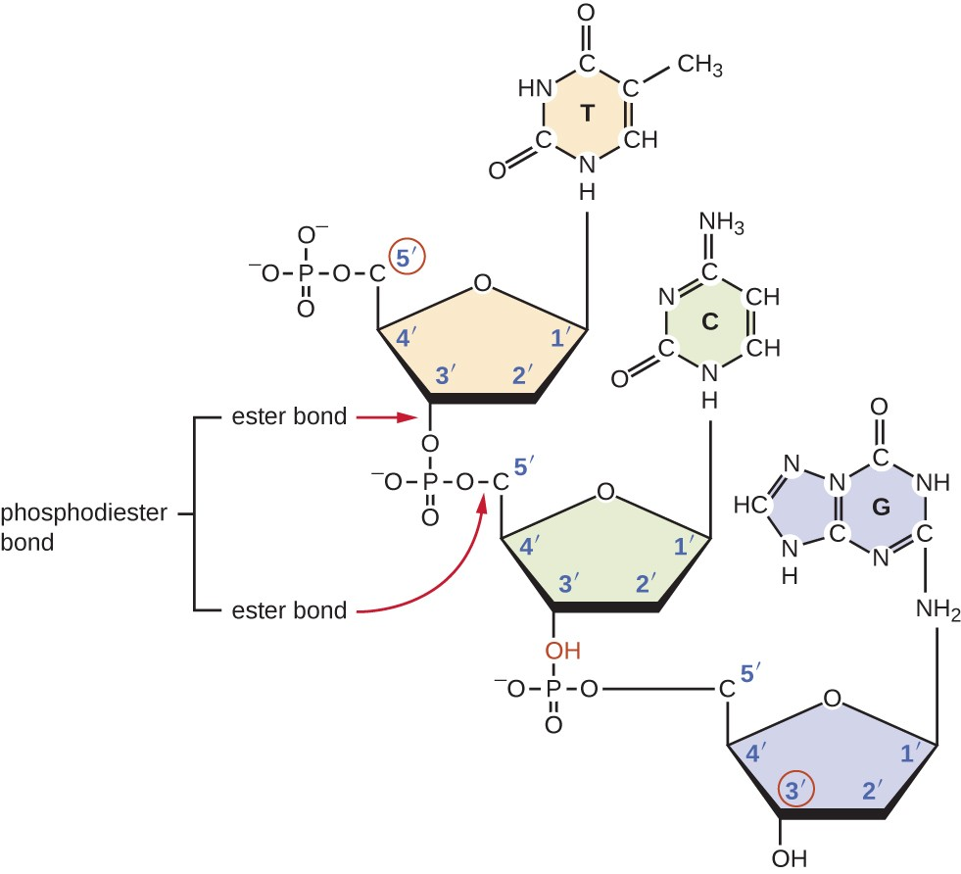
Nucleotides and DNA
Nucleotides join together to form polynucleotides and ultimately, DNA
Nucleotides join each other to form a phosphodiester bond via a condensation reaction
The phosphate group on one nucleotide joins to the sugar group on a neighbouring nucleotide
A phosphodiester bond is a phosphate group and two ester bonds between the sugar parts on the nucleotide
Forms a sugar-phosphate backbone

Slide 11
The double helix
Two polynucleotide strands join together and form a double helix
The polypeptide strands are held in place by hydrogen bonds between complementary bases
Adenine pairs with thymine - always
Cytosine pairs with guanine – always
How many H bonds between pairs?
The polynucleotides run in opposite directions – antiparallel
They twist to form the DNA double helix

Slide 12
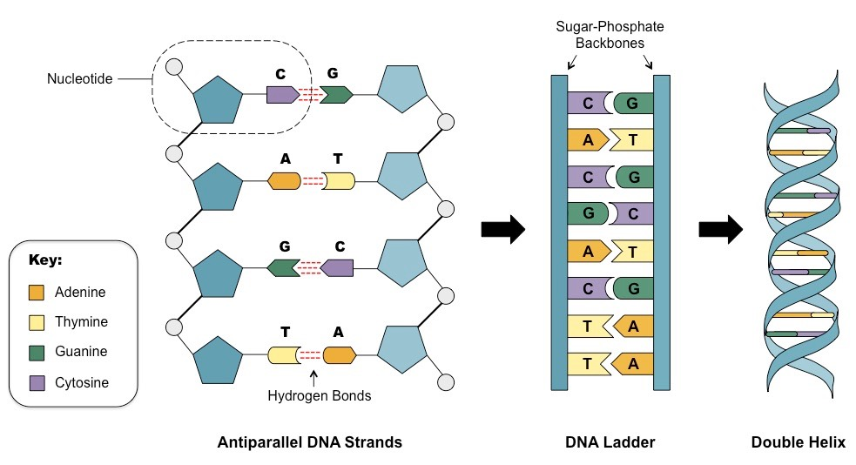
5’
3’
5’
3’
3’
5’
3’
5’
3’
5’
5’
3’

Slide 13
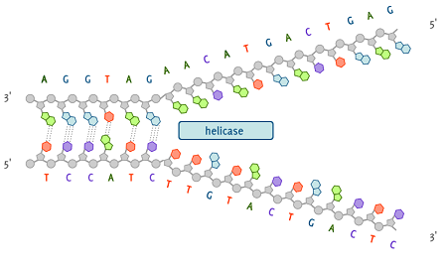
DNA and self-replication
Before a cell can divide, it must copy its DNA, and it must copy it correctly – why?
The first step is to separate DNA into the two strands – “unzip”
DNA helicase breaks the hydrogen bonds between bases that holds the two strands together

Slide 14
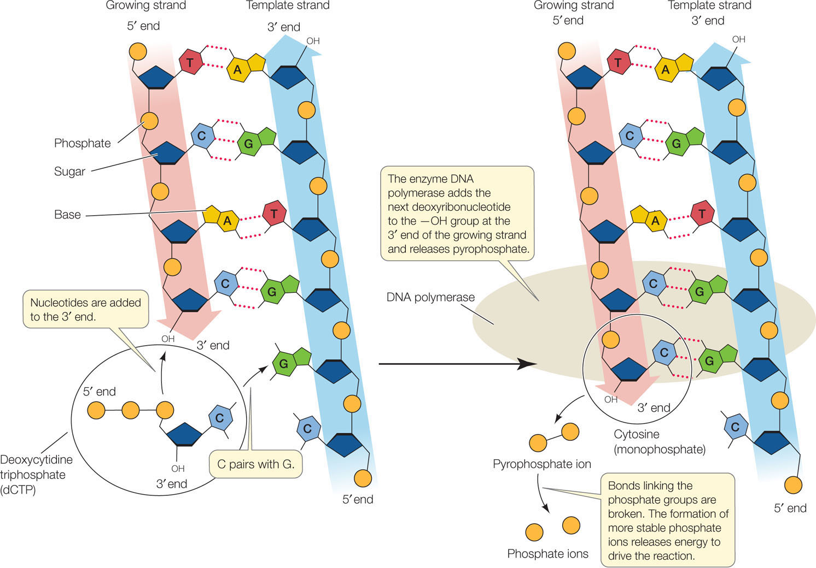

Slide 15
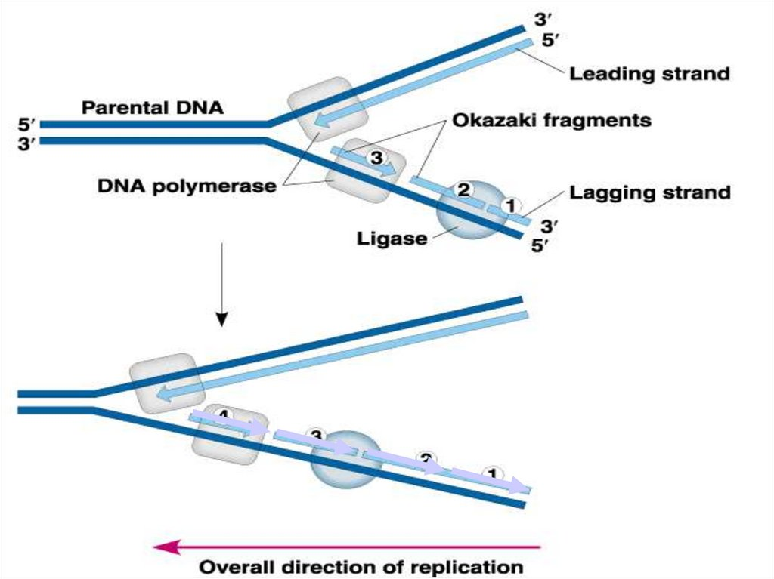
DNA replicates in the 5’ to 3’
direction using DNA polymerase.
This means that one strand
will “lag” behind.
The lagging strand is built in fragments
which are then joined together by a
ligase enzyme

Slide 16
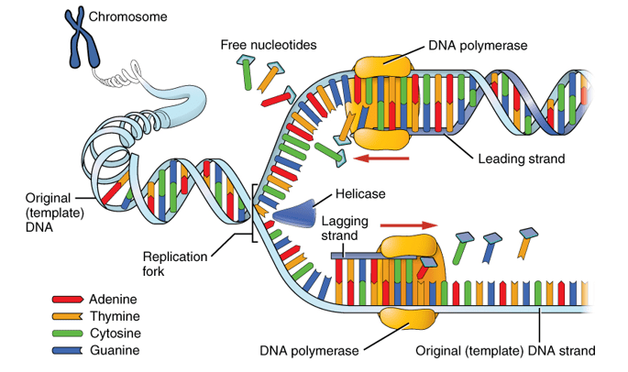
DNA and self-replication
As the DNA is “unzipped”, the bases are exposed and each strand of DNA will act as a template for a new strand
Nucleotides are paired with the bases on the existing strand – A to T, and C to G – using DNA polymerase
A new sugar – phosphate backbone forms as a new strand takes shape, and hydrogen bonds form between the bases
Each strand is built from 5’ to 3’
The new double-stranded DNA molecule twists into a double helix

Slide 17
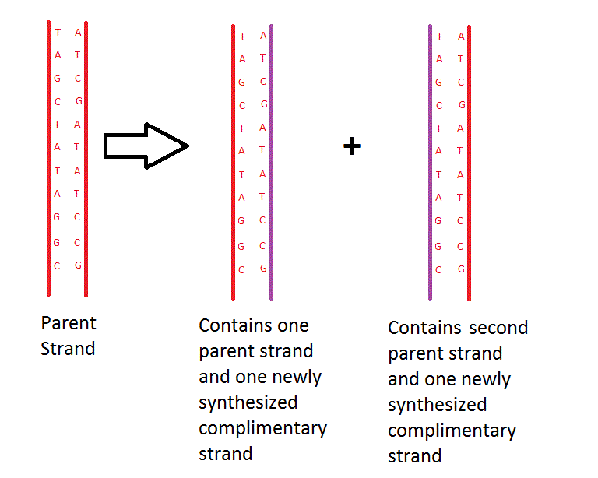
Semi- conservative replication
One double-stranded DNA molecule is replicated to produce two double-stranded DNA molecules.
Each new double-stranded DNA molecule has one original (parent) strand of DNA and one new DNA strand
This is called semi-conservative replication

Slide 18
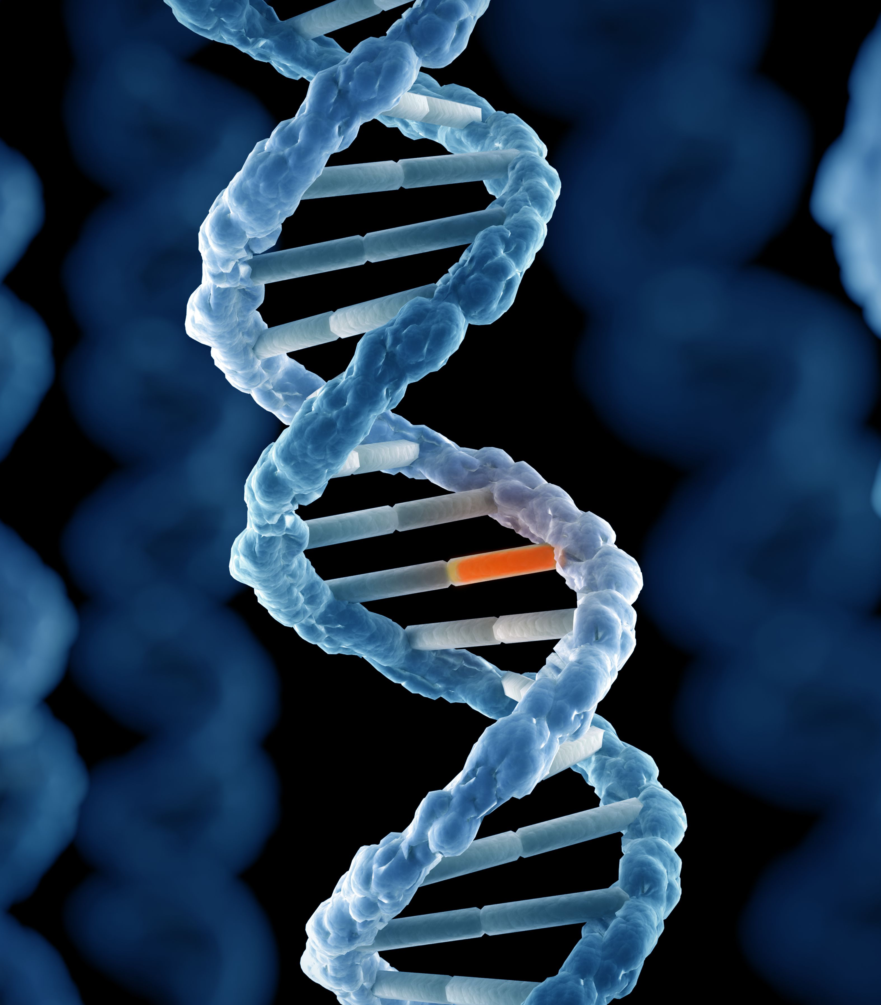
DNA replication – needs to be done accurately!!
Every time DNA is copied, it has to be done accurately – why?
If it goes wrong, it can lead to mutations
A mutation is a change to the DNA base sequence
Sometimes, there is no effect if this happens but…
…The wrong base can lead to faulty proteins being made
The faulty protein may work as well as the normal one, or it may not work in the right way

Slide 19
Time for some questions
How are nucleotides joined together in DNA?
Briefly describe semi-conservative DNA replication
Look up what different factors can cause mutations

Slide 20
Anti-cancer drugs
Cells normally check their DNA when it is copied to make sure it has been copied correctly
If there are mismatches in the DNA, the cell will try to correct them before mitosis (cell division) takes place
If the damage to the DNA is too severe and cannot be repaired, the cell will take the decision to die by apoptosis (cell suicide)
However…
Sometimes, the proteins that control this are mutated and do not work properly
Cancers arise from mutations in genes that control cell growth (either positively or negatively) and lead to cells dividing out of control
When cancer cells divide, their DNA is copied and the faulty DNA goes into the daughter cells
Further, new mutations can develop in the DNA as the DNA is copied

Slide 21
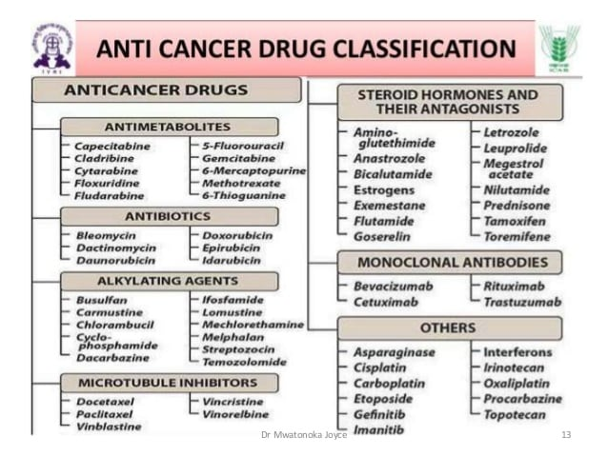

Slide 22
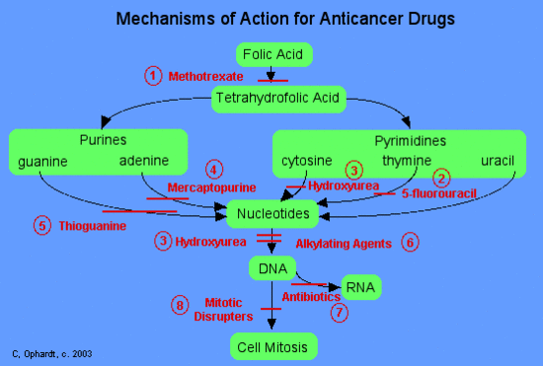

Slide 23
Summary
Nucleotides = base + pentose sugar + phosphate group
Bonds between nucleotides = phosphodiester bonds, produced by condensation reaction
DNA is a double helix and has anti-parallel strands (5’ to 3’ and 3’ to 5’)
DNA is produced by semi-conservative replication
Helicase unzips DNA into two separate strands which are then used a templates to make new strands with DNA polymerase and free nucleotides
New DNA molecule is one half of the original (parent) strand and a freshly made new strand
Cancers arise from mutations (changes in DNA bases) and no longer respond to normal cell growth signals

Slide 24
Lesson aims
By the end of the lesson, students should be able to:
1. List DNA bases and how they pair up in DNA
2. Describe the difference between nucleotides and nucleosides
3. Describe how DNA replicates using the semi-conservative method

