Slide 1
Globalisation and the revival of French exceptionalism?
Week 10

Slide 2
Covid-19 and globalisation
Covid 19 and the limits of globalisation
Steven Altman (2020): "The pandemic has prompted a new wave of globalisation obituaries"
Ian Goldin (2020): "Globalisation is not dead"
"Covid-19 will not kill globalisation. Rather, it will accelerate underlying trends, compressing into 2020 a transformation in flows across national borders that would have taken years to emerge. As individuals and companies move online, national borders become less relevant. Virtual meetings are substituting for travel and physical meetings, with their greater efficiency leading to higher levels of engagement."

Slide 3
Origins of debate
1990s: activists and politicians, journalists and academics observed the spread of economic liberalization, the rise of new informational organizations and technologies
New form of interconnectedness
Emergence of a multi-layered, multilateral system of “global governance”
Transform international politics
Transnational integration of the world to form a single social space
Rise of new patterns of ‘de-territorialized’ social relations enabled by new means of communication
Growing interconnectedness and its impact on social change

Slide 4
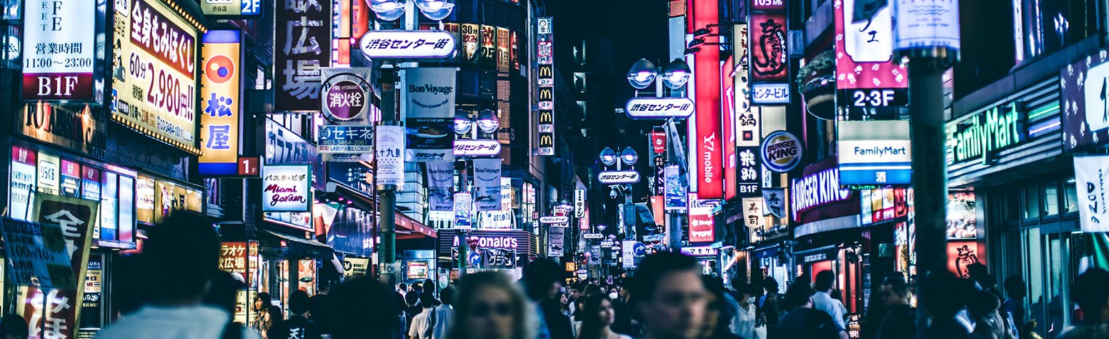
Globalization theory (1)
Anthony GIDDENS, Ulrich BECK, David HELD and Tony McGREW, Manuel CASTELLS and Zygmunt BAUMAN
Main arguments:
Globalization was producing a fundamental shift in the spatio-temporal constitution of human societies
In the Information Age (1996), Castells talks about the “space of flows” and the “time of time” or “timeless time”
To describe a new type of space that allows distant synchronous, real-time interaction
Idea being to “reconceptualize new forms of spatial arrangements under the new technological paradigm.”

Slide 5
Globalization theory (2)
Profound consequences of this shift.
Revealed a basic lacuna in the classical tradition of social theory: that it did not focus on categories of space and time.
Epochal transformation:
Martin ALBROW (1996): “the supplanting of modernity by globality”.
Social change of epochal dimensions
Jan Aart SCHOLTE: “a paradigm shift in social analysis.”
Michael MANN: “the human sciences seem full of enthusiasts claiming that a new form of human society is emerging.”
Consequences of these shifts = a global restructuring
Reconfiguration of global governance. Global civil society (Mary KALDOR, Helmut ANHEIER LSE)
David HELD and Anthony McGREW (1998): “geo-political forces will come to be socialized into democratic agencies and practices.”

Slide 6
Globalization theory (3)
Theory vs. Reality
Global balance of power has not shifted and globalization has not led to a radical transformation (Empire by Antonio NEGRI and Michael HARDT (2000):
Nation-state has given way to Empire, a group comprising the USA, the G8 and international organisations such as NATO, IMF, WTO; an oligarchy of multinational corporations and nation-states; a democracy of NGOs and UN.
Simple stage in capitalist development
Justin ROSENBERG (2000, Folies of Globalization Theory): “Perhaps, in the end, the temporary but real ascendancy of this belief marks the only sense in which an ‘age of globalization’ could undeniably be said to have existed.”

Slide 7
France and the debate on globalisation
After 1980s context marked by the spread of “neo-managerial” discourses
Growing social inequalities (rising unemployment, for first time since WW2, social inequalities were rising).
Negative effects of “globalization” were being felt
Washington Consensus
Thatcher and Reagonomics

Slide 8
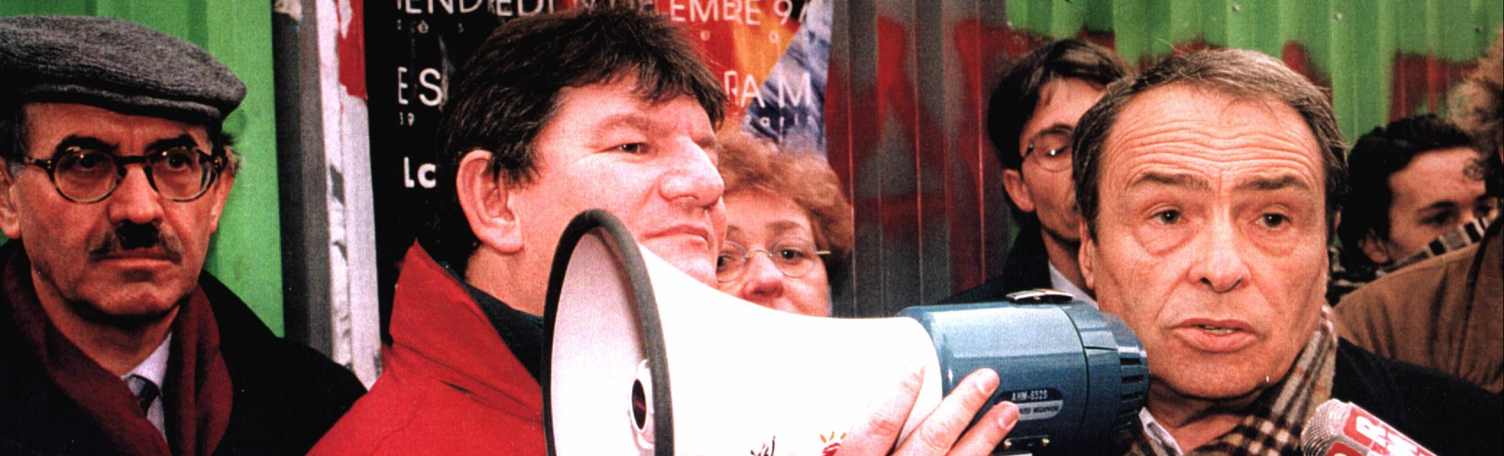
Intellectual response (1)
Revival of leftwing intellectuals / social question can be seen as contributing to the formalization of globalization as a political issue.
Isabelle Sommier (2003): "le retour de l'engagement des intellectuels."
From the 1990s onwards, French intellectuals have been at the forefront of a national and international movement of opposition to neo-liberal globalization
Books, newspaper articles
Social movement activism
New intellectual clubs and think-tanks

Slide 9
Intellectual response (2)
A number of key polemical texts written by Pierre Bourdieu (Contre-Feux 1 et 2, 1998), Viviane Forrester (L’Horreur economique, 1999), Ignacio Ramonet (Nouveaux pouvoirs, nouveaux maîtres du monde, 2003) and Emmanuel Todd (L’illusion économique, 1999)
Books gave shape and representation to a process that seemed otherwise distant
Found considerable resonance in French public opinion
Forrester: best-seller status
How was globalization presented in these texts? What were the dangers that globalization was seen to represent?

Slide 10
Intellectual response (3)
Neo-liberal globalization not presented as a piecemeal economic reform or a market transformation
BUT as a broad civilizational threat
At stake: not economic calculus, market competition or trade position
BUT the defense of an entire “civilization” with its roots in the French Revolution
Defined by social gains (“acquis”) and by immutable collective principles.
Not a conventional interpretation of globalisation
GLOBALISATION PRESENTED IN CIVILISATION TERMS
Bourdieu gives speech at Gare de Lyon (1995): “Je suis ici pour dire notre soutien à tous ceux qui luttent depuis trois semaines, contre la destruction d’une civilization, associée à l’existence du service public.”
Forrester: “Quand prendrons-nous conscience qu’il n’y a pas de crise, ni de crises, mais celle, très brutale d’une civilisations?”

Slide 11
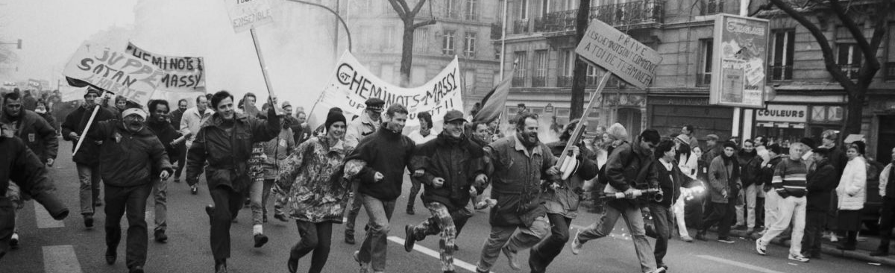
Intellectual response (4)
Books imbued with a sense of urgency
Belief that France was facing a profound external threat.
Globalisation portrayed as profound danger, horror, impending disaster or cataclysm
“Invasion néo-libérale” (Bourdieu)
“Horreur économique” (Forrester)
Increased political activism of leftist thinkers
Particularly visible during the December 1995 public sector strikes
Role of intellectuals: offered a new analytical framework through which to make sense of transformations in French society.
Even if this meant perpetuating an essentialist vision of globalization which saw this as the product of a stereotypicial “Anglo-Saxon world”.
Oppositional myth of "anglo-saxon other"

Slide 12
Intellectual response (5)
Brings us back to the awkward question of the relationship towards the Republican model
Are they opposed to it?
Or on the contrary calling for the reestablishment of the Republican State which is threatened by globalization?
A permanent ambiguity

Slide 13
Social movement struggles (1)
1995-2005: Rise of the altermondialiste movement
Creation of intellectual clubs and think-tanks (at the border between activism and popular education):
Raisons d’Agir
Fondation Copernic (1998): set up to challenge right-wing Fondation Saint-Simon
Attac (1998) linked to Monde Diplomatique (Bernard Cassen)
Popular education: spread knowledge, arguments and ideas in the public domain and thereby create the conditions necessary for political opposition
Alternative media: Diplo, Politis, Alternatives économiques, Mouvements, Multitudes, Contretemps
Helped shape broad public perceptions of globalization and contributed to what some have called a wave of ‘globalophobia’ that gripped French society during this period.

Slide 14
Social movement struggles (2)
Movements contributed to link up globalisation to set of power relations at the international level
MNCs
International organisations (IMF, WTO, World Bank)
European Union
Focus on an "anglo-saxon" other (associated with globalisation)
An imported phenomenon
Link with republican discourse (US stands for multiculturalism, mass consumerism, consumer culture…)
Judit Bodnar (2003): “Roquefort vs. Big Mac”

Slide 15
Paradox
Much of the attacks against globalization emerged in the late 1990s, a time when the French economy was flourishing
Strong economic growth
Lowering unemployment
Tends to support idea that critique of globalisation is primarily grounded on identity politics
Loss of identity rather than material hardship
E.G.: Rather than being framed as a question of free trade versus protectionism, the trade debate has been recast as “Anglo-Saxon globalization” vs. preservation of France’s national and cultural values.

Slide 16
A political tool: Globalisation as threat to French identity / culture (1)
Globalisation becomes a common discursive tool whose vagueness enables a variety actors to cling on to it.
Including mainstream political actors
Rhetoric on the need to “maitriser la mondialisation”
Despite the fact that France has adapted remarkably well to globalization
Philip Gordon and Sophie Meunier: Globalisation poses a particular threat for France for three main reasons:
France’s statist, dirigiste political and economic tradition:
Difficult for country where people are used to strong centralized state
French look to the state to ensure their well-being

Slide 17
A political tool: Globalisation as threat to French identity / culture (2)
Threat to France's status in the world
Globalization threatens French influence and tends to reinforce USA.
Threat to French culture
France more susceptible to foreign cultural influences
Link to identity crisis
Defensive approach: protect French culture, identity, model
"Cultural exception"
Whereas in economic field there is debate on whether to embrace or contain globalization
In cultural field, there is a broad and strong consensus on need to defend France’s identity, way of life, and cultural heritage

Slide 18
A political tool: Globalisation as threat to French identity / culture (3)
Explains the popularity and widespread support for certain movements opposed to neoliberal globalisation
Confédération paysanne and its dismantlement of a half-built McDonald's restaurant in Millau (Aveyron)
Charismatic leader José Bové
Defense of French "good taste"/food/culinary culture/diversity vs. US fast-food culture ("malbouffe").

Slide 19
Concluding remarks
We can ask ourselves whether in effect resistance to globalisation has not effectively reinforced the idea of a French exception
Idea that French national identity is first and foremost built in opposition to others/external threats
Early 19th century: Napoleonic wars
Late 19th – early 20th century: anti-German sentiments
1990s: globalisation which is associated with external forces/threats (Americanisation, multiculturalism...)
Not surprising, then, to see that there is a broad political consensus on the need to fight the excesses of globalisation

