Slide 1
The Sixth Generation filmmakers
Dr. Kiki Tianqi Yu

Slide 2
Film industry in Mainland China in transition
The Sixth Generation of Chinese filmmakers
Key concepts
Post-socialism
Underground/Independent
Censorship
Case study – the cinema of Jia Zhangke

Slide 3
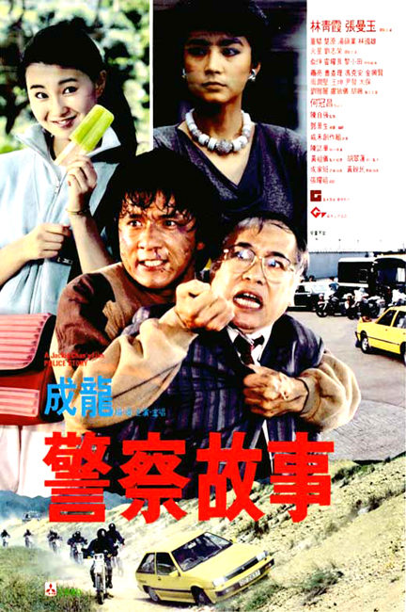
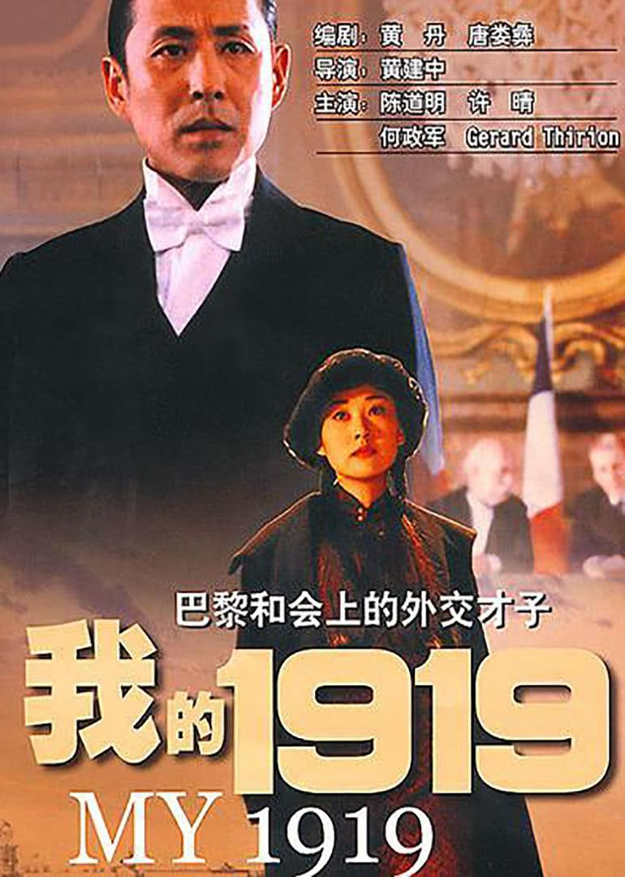
The marketisation and globalization of film industry in mainland China since the late 1980s

Slide 4
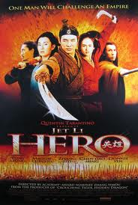
The international and domestic success of the 5th Generation of filmmakers.
the 5th generation in the 2000s: a strong ‘oriental’ theme, showing typical Chinese codes of martial arts, ancient empire stories
delicate production design, beautiful cinematography and classical Chinese music.

Slide 5
In the 80s, the fifth generation filmmakers were real heroes: they managed to break Chinese cinema out of its closed little mould and try something new. But they’ve changed a lot: in their current films, you’re no longer seeing the experience of life in China. While my way of filming allows me to describe Chinese reality without distortion.
--- Jia Zhangke, 2002

Slide 6
The Sixth Generation
born in the 1960s and 1970s.
they graduated from the Beijing Film Academy and Central Drama Institute in the late 1980s and 1990s.
Key filmmakers: Wang Xiaoshuai, Lou Ye, Lu Xuechang, Zhang Yuan, Li Xin and Jia Zhangke.
No female filmmakers

Slide 7
June 4th, Tiananmen Square 1989

Slide 8
Youth and Student Problems

Slide 9
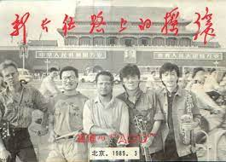
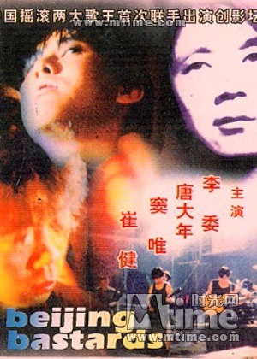
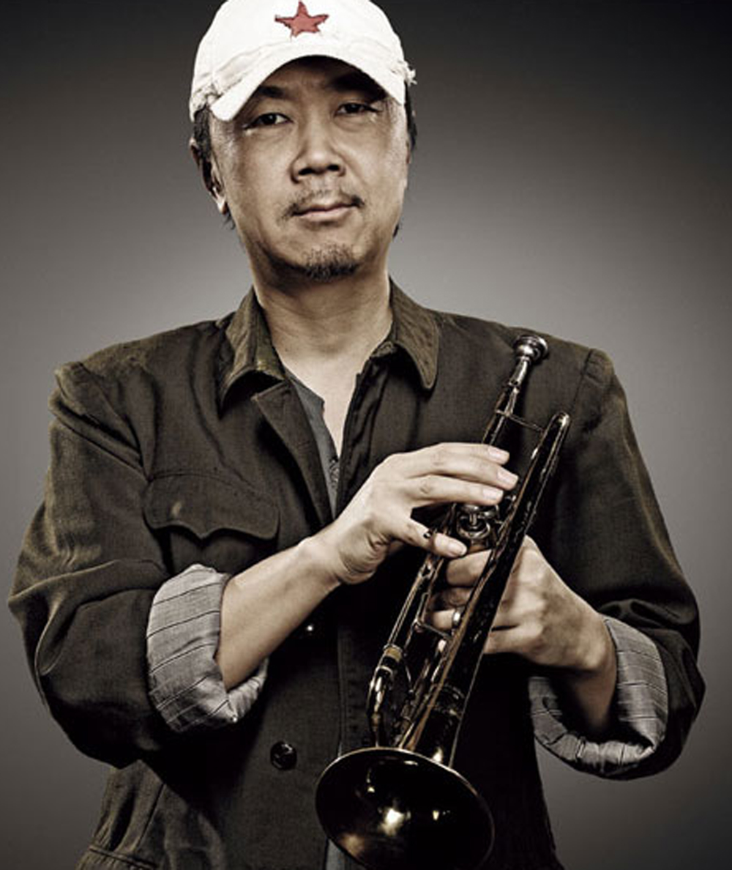
Zhang Yuan
Esteblished the Sixth-Generation style
Beijing Bastards (1993, Zhang Yuan) - representative piece of new urban cinema in the early 1990s.
Cui Jian: God father of Chinese rock ‘n’ roll
https://www.youtube.com/watch?v=fM678l8mbCc
Zhang Yuan’s Mama and East Palace, West Palace, Seventeen Years;
Wang Xiaoshuai’s The Days, Frozen, Shanghai Dreams,
Zhang Ming’s Rainclouds over Wushan Jia Zhangke’s Xiao Wu,
Lou Ye’s Suzhou River.

Slide 10
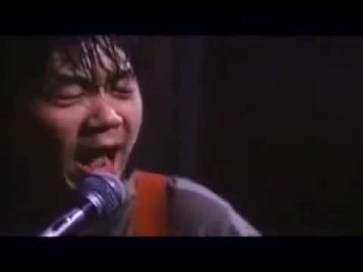

Slide 11
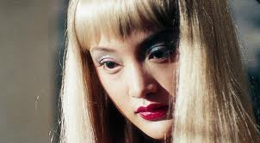
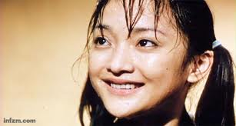
Suzhou River, LOU Ye, 1999
https://www.youtube.com/watch?v=-kuuKGhXy08

Slide 12
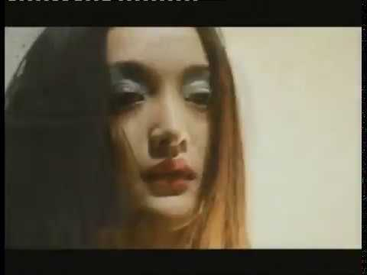

Slide 13
Features
marginal (urban) characters,
semi-underground life style, avant-garde scene that they are part of
low budget,
non-professional actors
improvised script
influenced by the French New Wave
personal – aesthetic strategy and political position
‘underground’ without passing the censorship

Slide 14
Urban Generation
Themes: fewer obsessions with subjects overt linked with ‘China’, less allegory, but an increasing consciousness showing contemporary Chinese society: marginalised subjectivities, socio-economic transitions, urbanisations, mass migration, social inequalities, contradictions, psychological world of people who are experiencing the change..

Slide 15
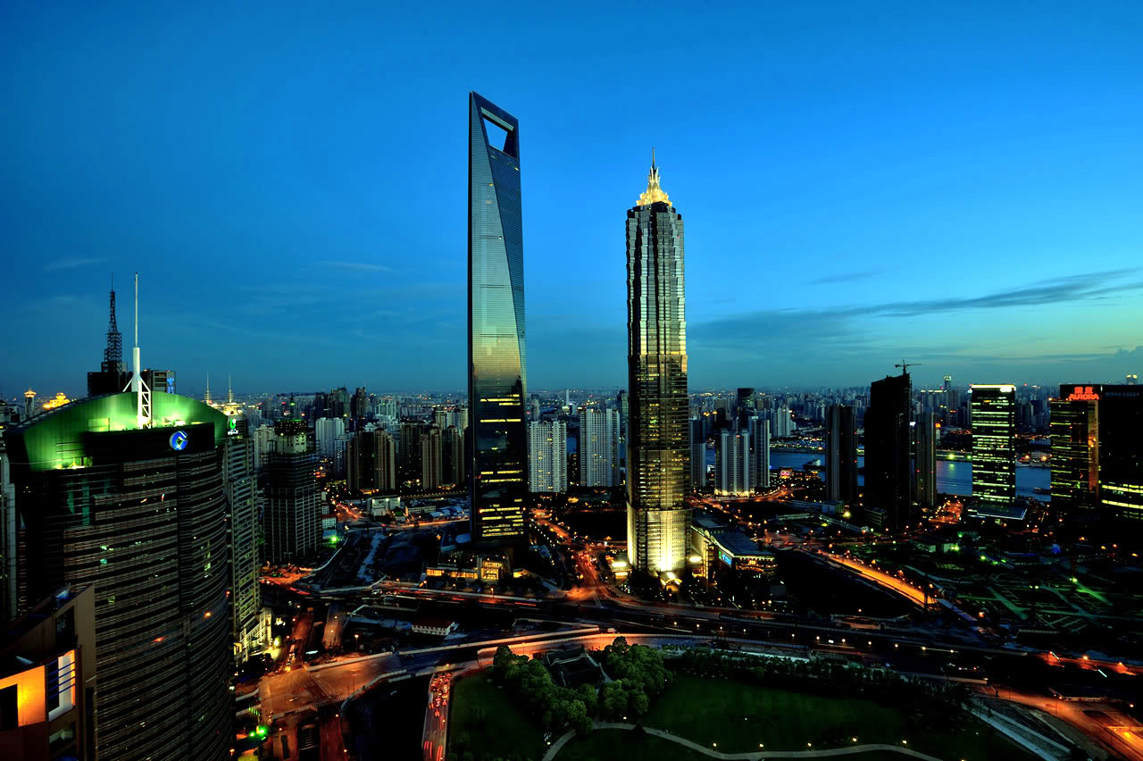

Slide 18
Beijing Bicycle, Wang Xiaoshuai, 2001
https://www.youtube.com/watch?v=wpHgZgFBfJ0

Slide 19
Semi – autobiographical
Reflects the filmmaker’s own upspring
Shanghai Dreams, Wang Xiaochuai, 2005

Slide 20
China at the turn of new century
mass immigration, demolition, globalisation
autobiographical
Documentary techniques – realistic style

Slide 21
post-socialism
First coined by Arif Dirlik.
Describe the political system and social period since the economic reform
Paul Pickowicz proposes post-socialism as a periodising label to characterise China since the late 1970s, and a regime of political economy called socialist market economy, or the so-called ‘socialism with Chinese characteristics’.
“the ideological counterpart of postmodernism”, a parallel framework illuminating Chinese culture since the 1980s, which “contained the vestiges of late imperial culture, the remnants of the modern or bourgeois culture of the Republican era, the residue of traditional socialist culture, and elements of both modernism and postmodernism”
Pickowicz, “Huang Jianxin and the Notion of Postsocialism,” 58 & 80.

Slide 22
Underground / Independent
the socio-political conditions of both feature and documentary films made by the sixth G
films that could not have official theatrical release domestically
have received significant international acknowledgement.

Slide 23
Pickowicz concludes two features of the ‘underground cinema’: its illegal status and its politically illicit gestures.
They use private funding, but not in the sense of profit-driven economic entrepreneurs, but more like “artistic, cultural, and political enterpreneurs”.
“The filmmakers want greater freedom of expression, including freedom from oppressive and restrictive political and bureaucratic controls, more than they want vast sums of money.”
Pickowicz, “Social and Political Dynamics of Underground Filmmaking in China,” 4.

Slide 24
Filmmakers identification
Zhang Yingjin observes that for political reasons, most young directors refuse the term ‘underground’.
“If not entirely independent of state institutions, at least independent of official ideology. Their ‘independent’ status, accordingly, is defined not in relation to the private sources of their funding (increasingly from overseas, which means they are not truly financially independent) but with reference to their lack of approval by the government.”
Zhang, “My Camera Doesn’t Lie?”, 26.

Slide 25
Film policy
Berry observes that: “In July 1996 the government passed a new film law that explicitly made illegal any film production other than that done within the state-owned studio system. This means that although would-be independent feature filmmakers might not think of themselves as underground or subversive, they have been defined as such by the government.”
This law is soon updated, allowing private companies to collaborate with state own film studios, then in the early 2000s, private companies are allowed to make films on their own – but submit the censorship before the production (sometimes have to submit the whole film after the production. )
Berry, “Getting Real: Chinese Documentaries, Chinese Postsocialism,” 128.

Slide 26
Censorship
execute ideological control of the industry through political censorship.
The restrictions are not only on graphic violence and sexual acts, but also the adverse portrayal of the Communist Party and criticism of government policies. The state’s censorship is usually very subjective.
China’s film censorship is not a classification system, therefore if a film passes censorship it is intended for universal viewing.

Slide 27
“I cannot accept that when it comes to Chinese films, the West seems for a long time to have had just the one 'political' reading: if it's not "against the government" then it's "for the government". The naïveté and lack of perspective [lit. "one-sidedness"] of using so simple a concept to judge a film is obvious. With respect to the works of directors from America, France and Italy for example, I doubt you have the same point of view.”
—Zhang Yimou

Slide 28
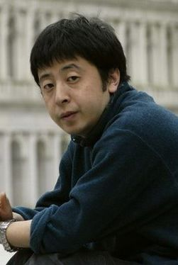
JIA Zhangke
a leading figure
watching Yellow Earth was a “Life-changing experience” for Jia Zhangke and convinced him to be a director
Majored in film theory at Beijing Film Academy
An interview with Jia Zhangke

Slide 29
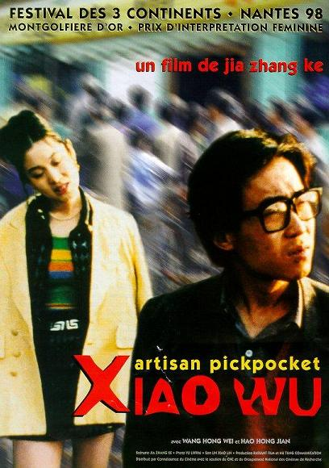
hometown triology
The Pickpocket (Xiao Wu) (1997), Platform (2000), and Unknown Pleasure (2002).
Shanxi
Use of pop music, location shooting, marginal characters, migrant workers

Slide 30
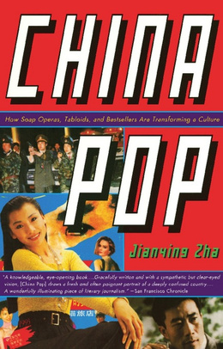
Post-Socialism Pop Culture
“As a teenager, I saw Lenin in October about ten times. Not until 1988, did I see a film that offered no socialist uplift: it ws an Indian movie, a romantic tearjerker that, for the first time, had us all crying profusely over something other than a revolution”
- Jia Zhangke

Slide 31
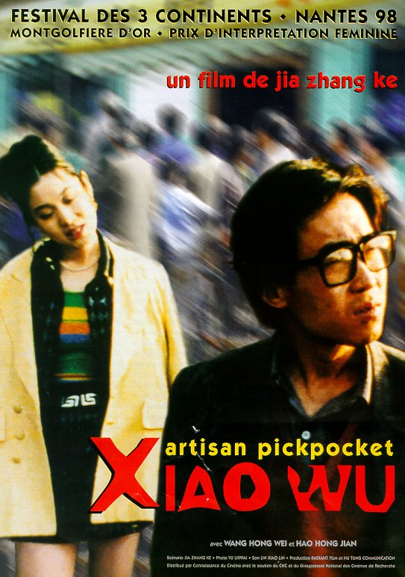
Martin Scorsese
On Jia Zhangke
“[Jia makes] the finest, toughest, most vitally alive work in modern moviemaking.”
On Xiao Wu
"This was true guerrilla filmmaking, in 16-millimeter format, and it reminded me of the spirit in which my friends and I had begun, back in the 1960s”

Slide 32
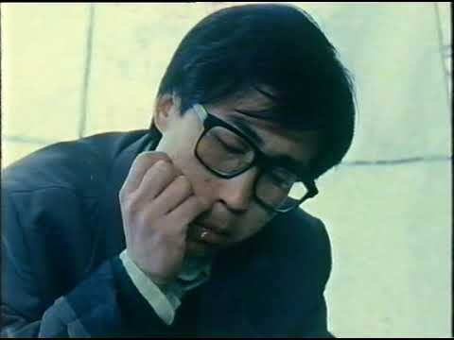
Xiao Wu, 1997
xxiXxiaoxiaowu xx

Slide 33
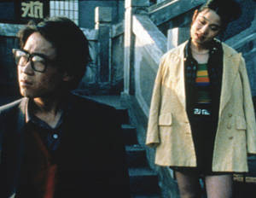
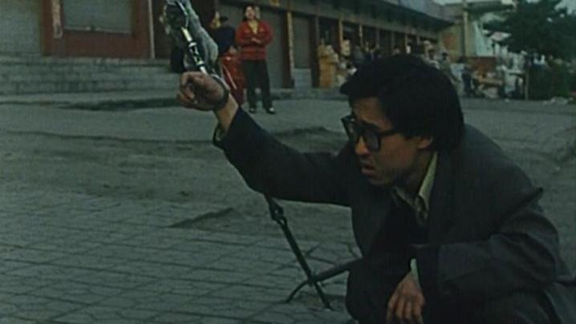
“What I like most in a long take is that it preserves real time” - Jia Zhangke
Passengers of Post-socialism

Slide 34
Non-professional Actors
References Russian writer, philosopher Dostoyevsky
Influenced Taxi Driver

Slide 35
The World (2004) marks his status as an officially acknowledge filmmaker
"rising to the surface”
A co-production of domestic private, government (Shanghai Film Group), and foreign investment.
a relatively high budget for of $1 million

Slide 38
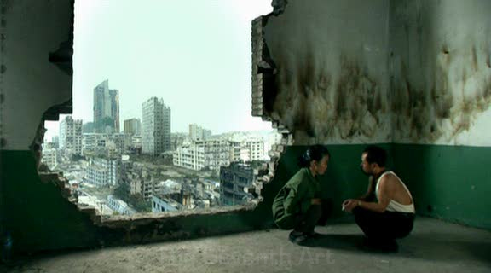
Still Life, JIA Zhangke, 2006

Slide 39
https://www.youtube.com/watch?v=qc1ZKyhMG6o

