Slide 1
Meiosis, Mutations and stem cells

Slide 2
Learning objective
“Students should demonstrate an understanding of the sequence of events in meiosis. Students should understand the what stem cells are and how they are essential to life. Students should understand the types of mutations, how mutations can arise and what this can lead to.”

Slide 3
Lecture aims
After this lecture you should be able to:
Describe the sequence of events in meiosis and how this differs from mitosis
Describe what stem cells are and why they are important
Describe how mutations can arise, types of mutations and what they can lead to

Slide 4
Meiosis – produces gametes
Gametes – egg cells and sperm cells
Join together - fertilisation – to produce a zygote
Meiosis - cell division, takes place in ovaries and testes to produce the gametes
Meiosis involves Reduction Division. Cells start with full chromosomal numbers but end with half the normal chromosomal numbers

Slide 5
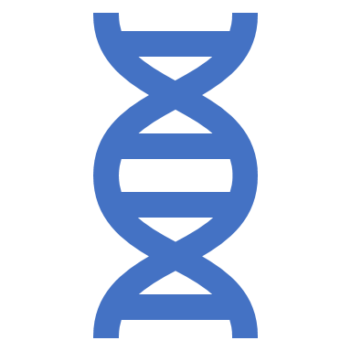
meiosis
Cells with only half the normal number of chromosomes are called haploid (what are cells called with the regular number of chromosomes?)
Cells (or gametes) produced by meiosis are all genetically different
Each gamete has a different combination of chromosomes
If meiosis didn’t exist, fertilisation would result in a cell with double the regular number of chromosomes

Slide 6
Meiosis – two divisions
Two divisions – meiosis I and meiosis II
Meiosis I – reduction division - this is the part where chromosome numbers are halved
Both meiosis I and II are split into Prophase, Metaphase, Anaphase and Telophase
Start with interphase where DNA uncoils, replicates and produces sister chromatids (just like mitosis)

Slide 7
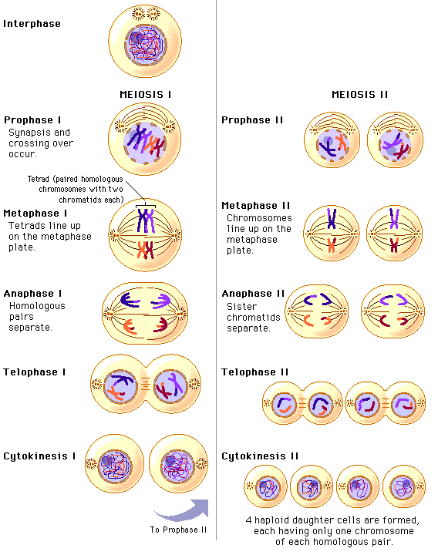
overview
Two stages – meiosis I and II
Prophase I and II, Metaphase I and II, Anaphase I and II, Telophase I and II
Genetic variation takes place during meiosis

Slide 8
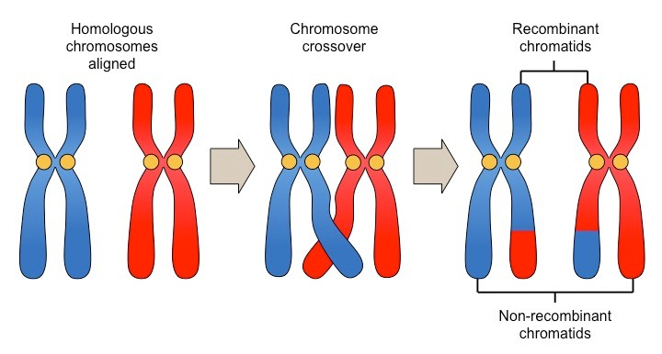
Homologous chromosomes
46 chromosomes in humans
(Which cells don’t have chromosomes?)
One from mother and one from father
So two chromosome 1, two chromosome 2, two chromosome 3 and so on
Homologous chromosomes have same genes on them in the same position

Slide 9
Crossing over
In Prophase I, homologous pairs of chromosomes pair up.
Each chromosome is made up of two chromatids (– remember this!)
Chromatids coil round each other, break off and join up with other chromatid
Process leads to swapping of genes (alleles)

Slide 10
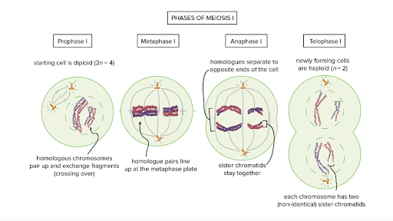
Prophase I
Chromosomes get short and fat
Homologous chromosomes pair up
Crossing over takes place
Centrioles move to opposite ends of cell
Nuclear envelope breaks down

Slide 11
Metaphase I
Homologous pairs of chromosomes line up across middle of cell attached to spindle fibres at the centromere
(what was the other name for centromere?)

Slide 12
Anaphase i
Spindles contract
Homologous pairs are separated
One chromosome goes into each half of the cell

Slide 13
Telophase i
The nuclear envelope forms around each group of single chromosomes (remember – each chromosome is made up of two chromatids)

Slide 14
End of meiosis I
Cytokinesis – (what was this?) – two daughter cells are formed.
The two cells are haploid – chromosome number is halved
Reduction division
Daughter cells are not identical – why?

Slide 15
Meiosis ii
The two daughter cells undergo the second division – meiosis II
Cells go through prophase II, metaphase II, anaphase II and telophase II
In anaphase II, sister chromatids are pulled apart (one from each chromosome)
End up with 4 genetically non-identical gametes.

Slide 16
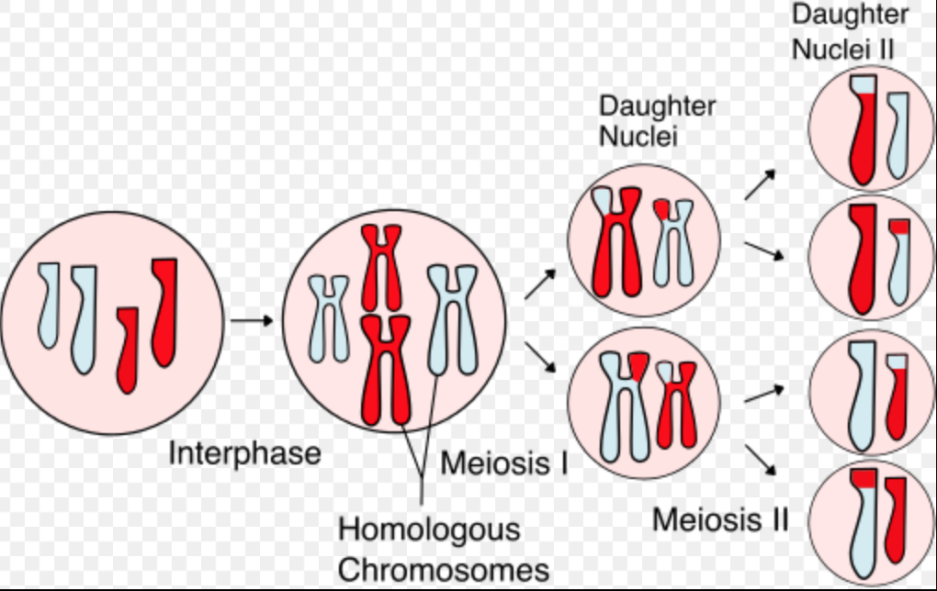
Independent assortment
Homologous chromosomes – one is from your mum (maternal) and one is from your dad (paternal)
When homologous chromosomes pair up in metaphse I, it is random which chromosome ends up in which daughter cell.
Gametes produced by meiosis have mix of maternal and paternal chromosomes and some will have gone through crossing over – leads to variation in offspring

Slide 17
Play time
Use the wool to make two homologous chromosomes (one bigger than other, use different wool colours)
Use paper clips to make centromeres
Demonstrate meiosis I and II
Demonstrate how variation happens (remember – two methods to get variation)

Slide 18
Question time
Explain the terms haploid, diploid, homologous, maternal and paternal
What happens to homologous pairs of chromosomes during meiosis I?
How is variation introduced in offspring?
Extend yourselves- what is Downs Syndrome?
How do you think it might arise?

Slide 19
summary
Meiosis- two divisions
First is reduction division – end up with non-identical daughter cells (haploid)
Crossing over takes place at prophase I
Second division – results in different chromatids going into gametes – non-identical
Variation of offspring comes from crossing over and independent assortment

Slide 20
Stem cells
Multicellular organisms are made from loads of different cell types
Use your phones to find examples of cells types - as many as you can in two minutes
These cells are specialised for their function
They all come from stem cells
Stem cells are unspecialised

Slide 21
Stem cells
All multicellular organisms have stem cells
Humans – stem cells found in embryos and can develop into any type of human cell
Also found in adults but will only develop into a limited number of cells – can you think of an example?

Slide 22
differentiation
Stem cells can divide and produce a copy of themselves or
Divide and produce specialised cells – differentiation
Humans – stem cells produce e.g. new skin or blood cells

Slide 23
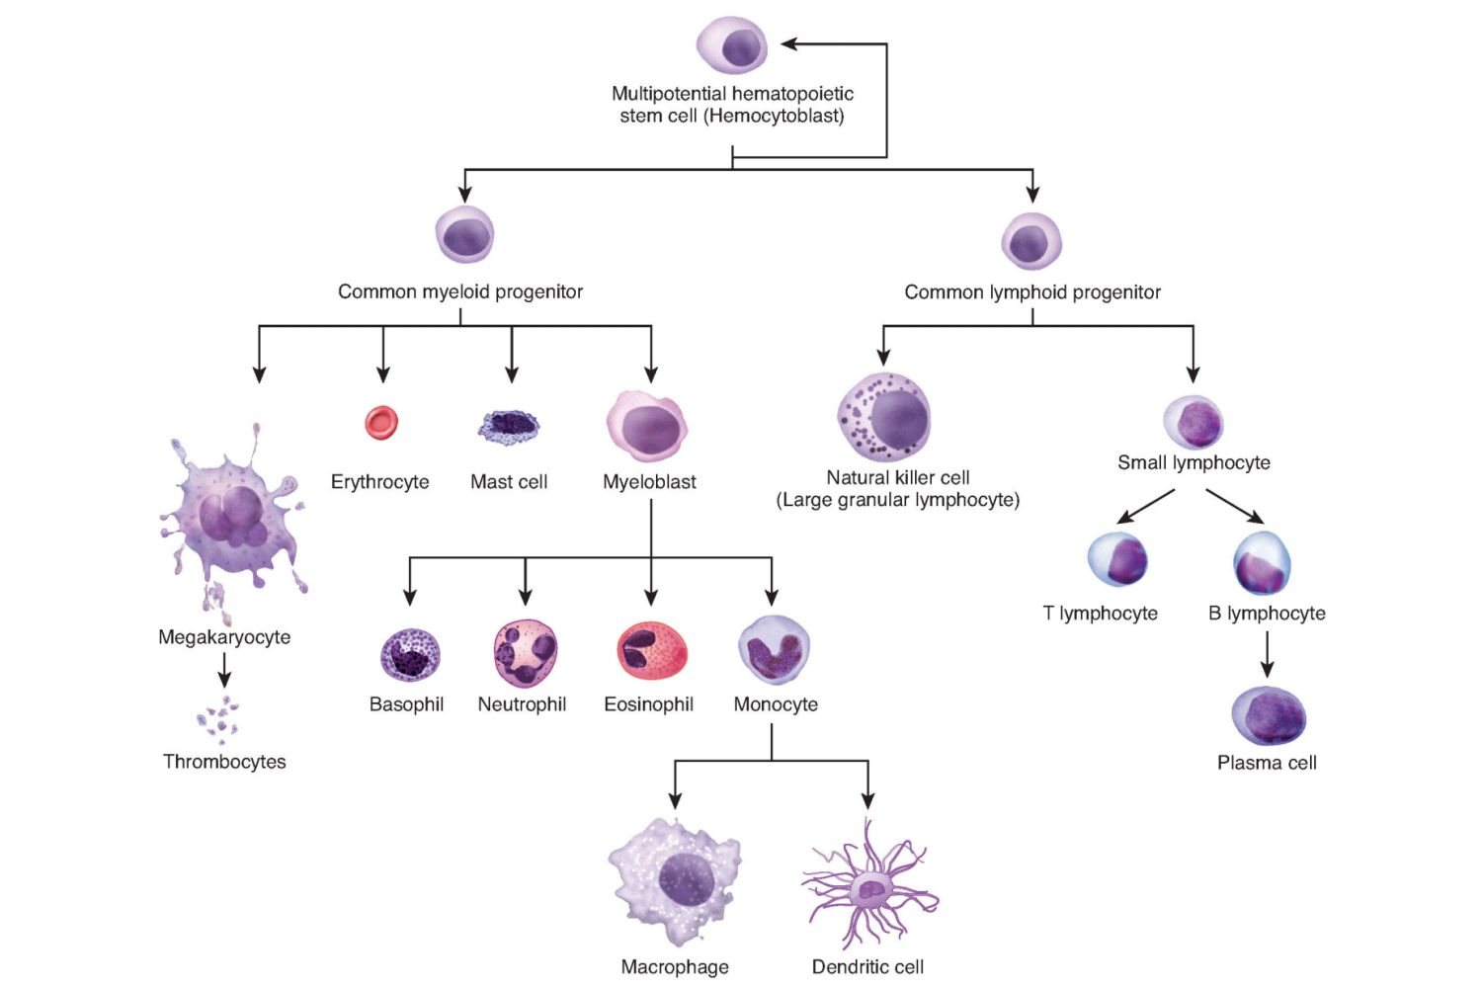
Stem cells
Blood cells are made in the bone marrow
Bones contain nerves, fat and blood vessels
Also contain bone marrow
Blood stem cells live in bone marrow, divide and produce blood cells
What could possibly go wrong??

Slide 24
Mutations
Any change to DNA base sequence
Can occur as the result of damage by e.g. chemicals, radiation, inherited or arise spontaneously
Can lead to difference in sequence of amino acids in protein
May have no effect or it may be devastating – protein no longer functions

Slide 25
Types of mutation
Substitution – one or more bases are swapped for another e.g. ATGCCT becomes ATTCCT
Deletion – one or more bases are removed e.g. ATGCCT becomes ATCT
Insertion – one or more bases are added e.g. ATGCCT becomes ATGACCT
Changes in DNA sequence can alter sequence of amino acids in protein – primary structure is altered

Slide 26
Effects of mutations
Change in primary structure can lead to changes in folding and shape of protein – e.g. active site on enzymes is disrupted
mutations may change base in triplet but the amino acid that the triplet codes for doesn’t change (remember – some amino acids are coded by several triplets)
The mutation leads to a triplet that codes for a different amino acid but the protein is unaffected as the new amino acid is chemically similar

Slide 27
Effects of mutations
The mutation could lead to a new amino acid incorporated at a site that does not alter the amino acid – no affect on active site, or binding to another protein
Some mutations are advantageous – e.g. increased survival against antibiotics in some bacteria
Disadvantageous mutations – e.g. cystic fibrosis – three base deletion in CFTR gene (CF transmembrane conductance regulator). Fold incorrectly so gets broken down. Leads to increased build up of mucus affecting lungs. Use your phones to discover some more inherited disorders
Protein might not be produced at all if mutation affects binding of RNA polymerase

Slide 28
Summary
Stem cells – undifferentiated cells
Give rise to a another stem cell or produces specialised, differentiated cells
Used in bone marrow transplants
Could be used in future for e.g. neurological disorders

Slide 29
summary
Mutations – arise spontaneously or after damage by e.g. chemicals, radiation, inherited, spontaneous
Lead to substitution, deletion or insertion of DNA base(s)
Affects protein – may be beneficial, not lead to a problem or may cause problem

Slide 30
Lecture aims
After this lecture you should be able to:
Describe the sequence of events in meiosis and how this differs from mitosis
Describe what stem cells are and why they are important
Describe how mutations can arise, types of mutations and what they can lead to

Slide 31
Nondisjunction

