Slide 1
COM6006 / FRE6006 Narrative in Theory and Practice: Analysing and Creatively Responding to French Literature Through the Ages
Dr Richard Mason
richard.mason@qmul.ac.uk

Slide 2
Week 5: Mme de Lafayette, La Princesse de Clèves
Objectives (lecture and seminar):
Overview of the novel: context, characters, characters
Carry out close readings to deepen understanding of aspects of ‘text’ (e.g. time, characterization, focalization)

Slide 3
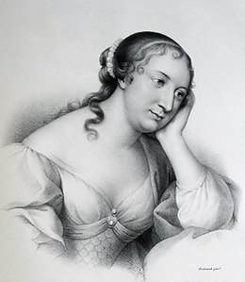
Madame de Lafayette (1634–1693)
Born and died in Paris
Reign of Louis XIV (1643–1715)
Maid of Honour to Anne of Austria
Attendance of literary salons (e.g. Madeleine de Scudéry)
Anonymous publication of La Princesse de Montpensier (1662)
Close friendship with La Rochefoucauld, author of Maximes (1664) and Mme de Sévigné
Anonymous publication of La Princesse de Clèves (1678)

Slide 4
La Princesse de Clèves (1678)
roman historique/roman d’analyse/roman psychologique
Set between 1558–1559, at the court of Henri II (then François II)
Historical figures : Catherine de’ Medici (Queen), Diane de Poitiers (Duchesse de Valentinois), Mary Stuart (La Reine Dauphine), Duc de Guise etc…

Slide 5
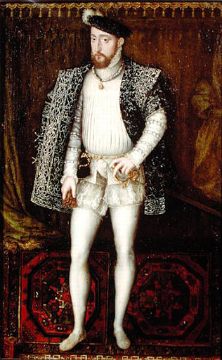
Opening tableau: the court of Henri II
‘La magnificence et la galanterie n’ont jamais paru en France avec tant d’éclat que dans les dernières années du règne de Henri second. Ce prince était galant, bien fait et amoureux ; quoique sa passion pour Diane de Poitiers, Duchesse de Valentinois, eût commence il y avait plus de vingt ans, elle n’en était pas moins violente, et il n’en donnait pas des témoignages moins éclatants.’ (Lafayette 1980: 75)
‘Never has France seen such a display of courtly magnificence and manners as in the last years of the reign of Henri II. The king was chivalrous, nobly built, and amourously inclined; although his passion for Diane de Poitiers , the Duchesse de Valentinois, had begun more than twenty years earlier, it was none the less violent and he advertised it no less openly.’ (Lafayette 1992: 3)

Slide 6
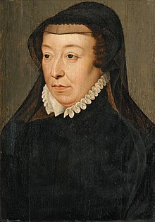
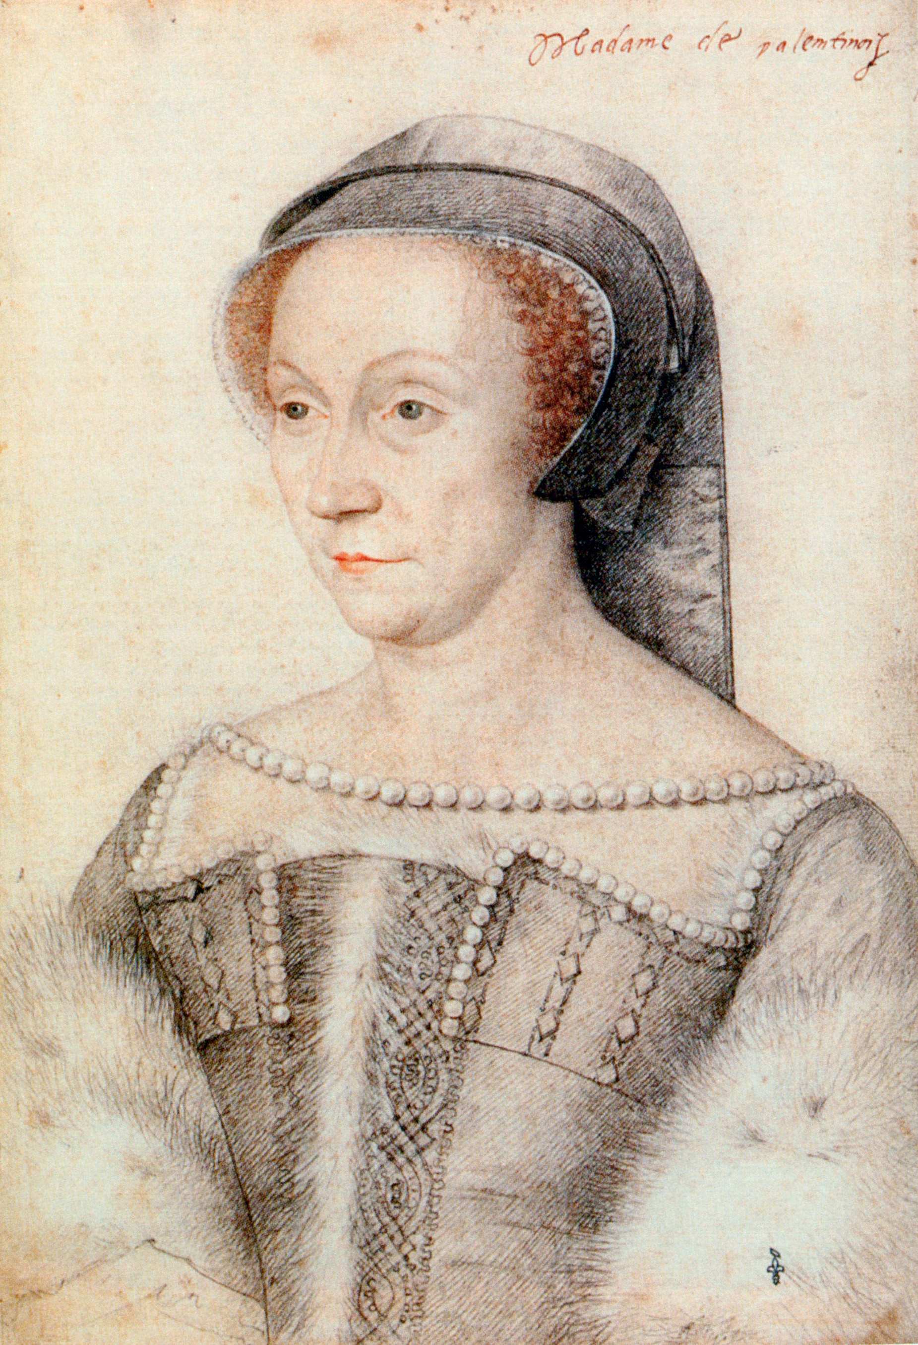
Jealousy, power, appearance
‘L’humeur ambitieuse de la Reine lui faisait trouver une grande douceur à régner ; il semblait qu’elle souffrit sans peine l’attachement du Roi pour la Duchesse de Valentinois, et elle n’en témoignait aucune jalousie ; mais elle avait une si profonde dissimulation qu’il était difficile de juger de ses sentiments, et la politique l’obligeait d’approcher cette duchesse de sa personne, afin d’en approcher le Roi.’ (Lafayette 1980: 75–6)
‘The Queen had an ambitious nature and delighted in her royal rank. She seemed to suffer the King’s attachment to the Duchesse de Valentinois lightly, and she never showed any jealousy, but she had such a profound capacity for dissimulation that it was difficult to guess her true feelings; political self-interest obliged her to keep Mme de Valentinois close to her person in order to draw the King himself closer.’ (Lafayette 1992: 3)

Slide 7
Mlle de Chartres (La Princesse de Clèves)
‘Il parut alors une beauté à la Cour, qui attire les yeux de tout le monde, et l’on doit croire que c’était une beauté parfait, puisqu’elle donna de l’admiration dans un lieu où l’on était si accoutumé à voir de belles personnes.’ (Lafayette 1980: 82)
‘There appeared at court in those days a young woman so beautiful that all eyes turned to gaze upon her. Peerless indeed her beauty must have been, since it aroused wonder and admiration in a place where the sight of beautiful women was commonplace.’ (Lafayette 1992: 9)

Slide 8
Stories about love and its dangers
‘La plupart des mères s’imaginent qu’il suffit de ne parler jamais de galanterie devant les jeunes personnes pour les en éloigner. Madame de Chartres avait une opinion oppose ; elle faisait souvent à sa fille des peintures de l’amour ; elle lui montrait ce qu’il a d’agréable pour la persuader plus aisément sur ce qu’elle lui en apprenait de dangereux ; elle lui contait le peu de sincérité des hommes, leurs tromperies et leur infidélité, les malheurs domestiques où plongent les engagements ; et elle lui faisait voir, d’un autre côté, quelle tranquillité suivait la vie d’une honnête femme, et combien la vertu donnait d’éclat et d’élévation à une personne qui avait de la beauté et de la naissance.’ (Lafayette 1980: 82–3)
‘Most mothers imagine that one need only avoid speaking about amourous entanglements in front of young girls in order to preserve them from contamination. Mme de Chartres believed the opposite. She often gave her daughters descriptions of love; she impressed upon her how attractive it can be in order to convince her more easily of what she said about its dangers; she spoke to her of men’s insincerity, of their deceptions and infidelity, of the disastrous effects of love affairs on conjugal life; and she painted for her, on the other hand, the tranquility that a woman of good reputation enjoys. She told her how much brilliance and distinction virtue bestows on a woman who is beautiful and well-born’ (Lafayette 1992: 9–10)

Slide 9
François de la Rochefoucauld, Réflexions ou sentences et maximes morales (1665)
‘Il est du véritable amour comme de l’apparition des esprits, tout le monde en parle, mais peu de gens en ont vu.’
‘True love is like ghosts, which everyone talks about and few have seen.’
‘Si on juge de l’amour par la plupart de ses effets, il ressemble plus a la haine qu’à l’amitié’
‘If we are to judge of love by its consequences, it more nearly resembles hatred than friendship.’

Slide 10
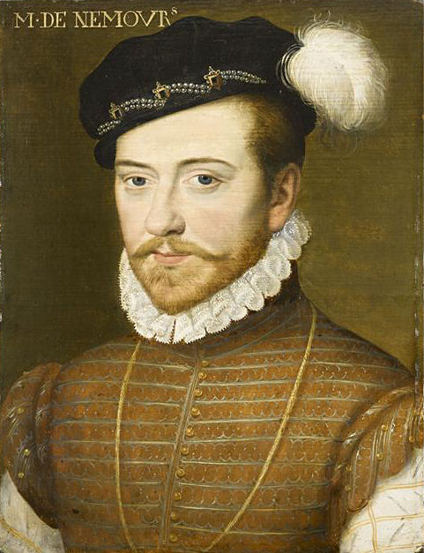
M. de Nemours
‘Elle se tourna et vit un homme qu’elle crut d’abord ne pouvoir être que Monsieur de Nemours, qui passait par-dessus quelque siège pour arriver où l’on dansait. Ce prince était fait d’une sorte qu’il était difficile de n’être pas surprise de le voir quand on ne l’avait jamais vu, surtout ce soir-là, où le soin qu’il avait pris de se parer augmentait encore l’air brillant qui était dans sa personne’ (Lafayette 1980: 98)
‘She turned and saw a man who she felt at once could be no other M. de Nemours stepping over a chair to make his way to where the dancing was. He had such a presence that it was difficult not to be taken aback on seeing him when one had never seen him before, especially that evening, when the care he had taken to dress elegantly added still more lustre to his appearance’ (Lafayette 1992: 23)

Slide 11
Desire
‘Madame de Clèves entendait aisément la part qu’elle avait à ces paroles. Il lui semblait qu’elle devait y répondre et ne pas les souffrir. Il lui semblait aussi qu’elle ne devait pas les entendre, ni témoigner qu’elle les prît pour elle. Elle croyait devoir parler, et croyait ne devoir rien dire. Le discours de Monsieur de Nemours lui plaisait et l’offensait quasi également ; elle y voyait la confirmation de tout ce que lui avait fait penser Madame la Dauphine ; elle y trouvait quelque chose de galant et de respectueux, mais aussi quelque chose de hardi et de trop intelligible. L’inclination qu’elle avait pour ce prince lui donnait un trouble dont elle n’était pas maîtresse.’ (Lafayette 1980: 136)
‘Mme de Clèves had no difficulty in perceiving that these words were intended for her. She felt she must respond and not allow them to go unchallenged; at the same time she felt she must not listen or give any sign that she had taken them to apply to her. She thought she should speak; she thought she should say nothing. M. de Nemours remarks pleased and offended her almost equally; they seemed to confirm everything that Mme la Dauphine had made her think. She found in them a note of chivalry and respect, but she also found them a shade too bold and explicit. The attraction she felt for M. de Nemours threw her feelings into a turmoil she was unable to control.’ (Lafayette 1992: 56)

Slide 12
Jealousy
‘ce qu’elle pouvait moins supporter que tout le reste, était le souvenir de l’état où elle avait passé la nuit, et les cuisantes douleurs que lui avait causées la pensée que M. de Nemours aimait ailleurs, et qu’elle était trompée. Elle avait ignoré jusqu’alors les inquiétudes mortelles de la défiance et de la jalousie ; elle n’avait pensé qu’à se défendre d’aimer Monsieur de Nemours et elle n’avait point encore commencé à craindre qu’il en aimât une autre. Quoique les soupçons que lui avait donnés cette 24 lettre fussent effacés, ils ne laissèrent pas de lui ouvrir les yeux sur le hasard d’être trompée, et de lui donner des impressions de défiance et de jalousie qu’elle n’avait jamais eues.’ (Lafayette 1980: 178)
‘what was more intolerable to her than anything was the memory of the state in which she had passed the night, the dreadful pain she had suffered at the thought that M. de Nemours was in love with another woman and that he was unfaithful to her. She had been ignorant until then of the deadly torments that spring from distrust and jealousy. She had thought only of preventing herself from falling in love with M. de Nemours and she had not yet begun to fear that he might love someone else. Although the suspicions the letter had given her had been set at rest, they none the less opened her eyes to the risk of being deceived and gave her intimations of distrust and jealousy that she had never known before.’ (Lafayette 1992: 92)

Slide 13
Virtue
‘sa vie, qui fut assez courte, laissa des exemples de vertu inimitables.’ (Lafayette 1980: 253)
‘Her life, which was quite short, left inimitable examples of virtue’ (Lafayette 1992: 156)

Slide 14
Appearances (and their deciphering)
‘Si vous jugez sur les apparences en ce lieu-ci, répondit madame de Chartres, vous serez souvent trompée : ce qui paraît n’est presque jamais la vérité.’ (Lafayette 1980: 102)
‘“If you judge by appearances in this place,” replied Mme de Chartres, “you will frequently be deceived: what you see is almost never the truth.’ (Lafayette 1992: 26)

Slide 15
The narrator
‘The telling of stories by characters in the novel means, of course, that the narrative perspective shifts a good deal. Overall, the narrator knows what the characters themselves may not know, even about their most private feelings. […] Yet this omniscience is tempered by discretion: with the exception of a few maxim-like generalizations […] the narrator is habitually non-interventionist. The narrative voice moves smoothly between external, impersonal descriptions of historical characters and events and the inner world of the principal characters, recording both as if from the point of view of a privileged but detached observer.’ (Cave in Lafayette 1992: xvii)
Narrative perspective=focalization? narration?
Non-interventionist?

Slide 16
Truth and confession
Mme de Clèves’ confession to her husband
Contemporary responses: debates in La Mercure Galant

Slide 17
La Princesse de Clèves as ‘psychological novel’
‘There are, of course, external events in The Princesse de Clèves, but the story is plotted not through them but through their impact on the princess’s changing awareness of her situation and of her own feelings.’ (Cave in Lafayette 1992: xvii)

Slide 18
Focalization
Can be explored in relation to themes of the novel via various scenes of glances/voyeurism as well as question of appearances
‘the insistent, over-insistent, preoccupation with how things are seen’ (Cave, in Lafayette 1992: xxix)

Slide 19
Intercalated narratives
E.g. Mme de Tournon’s relationship with Sancerre; the Vidame de Chartres relationship with the Queen and the missing letter
The various intercalated narratives constitute ‘a complex body of instructive materials which the extremely young princess has to try to assimilate in order to survive the corrupt world of the court.’ (Cave in Lafayette 1992: xvi)

Slide 20
Seminar: close reading
1. English, p. 13 (Madame de Chartres, who had made such efforts…)–p. 15 (…young people are often at a loss); French, p. 87 (Madame de Chartres, qui avait eu tant d’application…)–p.88 (…quand on était jeune).
2. English, p. 55 (The princess was lying on her bed…)–p.56 (…and to his visit); French, p. 135 (Cette princesse était sur son lit…)–p. 136 (…la conversation et sa visite).
Contextualise the passage: where does it sit in the overall plot? Which are the key ideas/themes explored? What do we learn at the level of character?
Comment on the treatment of:
time (e.g. scene pace/summary pace);
characterization (e.g. direct definition/indirect presentation);
focalization (e.g. internal/external; from within/from without)
…as well as the effects of these textual features

Slide 21
For next week
Read Chapters 7–8 of Narrative Fiction, on ‘Narration’.
Read over the ‘Narratological analysis guidance notes’ on Qmplus.
Study the Assignment 1 extracts to choose which extract you will write on for the narratological analysis.
Find two relevant pieces of secondary literature that will inform your analysis.

