Slide 1
Marine Pollution (Introduction)

Slide 2
Definition of Pollution
“pollution of the marine environment" means the introduction
by man, directly or indirectly, of substances or energy into the marine
environment, including estuaries, which results or is likely to result in such
deleterious effects as harm to living resources and marine life, hazards to
human health, hindrance to marine activities, including fishing and other
legitimate uses of the sea, impairment of quality for use of sea water and
reduction of amenities;” UNCLOS Art. 1 (4)

Slide 3
Typology of Marine Pollution
UNCLOS identifies six sources of marine pollution:
From land-based sources;
Form sea-bed activities subject to national jurisdiction’;
From activities in the Area;
From dumping
From Vessels;
From or through the atmosphere.

Slide 4
Eighty percent of pollution to the marine environment comes from the land. One of the biggest sources is called nonpoint source pollution, which occurs as a result of runoff. Nonpoint source pollution includes many small sources, like septic tanks, cars, trucks, and boats, plus larger sources, such as farms, ranches, and forest areas.
Pollutants of land-based origin include pesticides, chemical waste, cleaning agents, petroleum products, mining waste, garbage and sewage. Even pharmaceuticals ingested by humans, but not fully processed by the human body, have been detected in fish.
Oil spills responsible for only around 12% of the oil entering the seas each year.;
Rest from Dumping at sea.

Slide 5
Worldwide discharge in oceans
10 billion tones of ballast water with Invasive organisms
Est. 10,000 million gallons of sewage annually
3.25 million metric tones of oil annually
Millions of tones of Solid waste

Slide 6
Introduced dangerous metals include mercury, lead, and copper
Heavy Metals are a great concern because they enter the food chain
Fuel combustion, electric utilities, steel and iron manufacturing, fuel oils, fuel additives and incineration of urban refuse are the major sources of oceanic and atmospheric contamination by heavy metals e.g. Copper which is dangerous to marine organisms and has been used in marine anti-fouling paints. Mercury and lead poisoning cause brain damage and behavioral disturbances in children
Contaminated land runoff, rain of pollutants from the air, and fallout from shipwrecks pollute the ocean with dangerous metals. Human activities release 5 times as much mercury and 17 times as much lead, as is derived from natural sources.

Slide 7
Other pollutants
e.g. Oily discharges from ballast water and bilge water during routine ship operations and illegal dumping of solid waste outside designated dumping grounds at sea.
dredged spoil, old munitions, sewage sludge, fly ash, accidental spills from ships carrying hazardous substances, oil, gas etc.

Slide 8
A large portion and the greatest danger is no biodegradable plastic. 46,000 pieces of floating plastic/sq mile of ocean surface off the N.E U.S. coast. Sea turtles mistake plastic bags for jellyfish and die from internal blockages. Seals and sea lions starve after being entangled by nets or muzzled by six-pack rings(decomposition time 400 years). Plastic debris kills 100,000 marine mammals and 2 million sea birds die annually

Slide 9
The Great Pacific Garbage Patch (GPGP) is the largest of the five offshore plastic accumulation zones in the world’s oceans. It is located halfway between Hawaii and California. It is estimated that 1.15 to 2.41 million tonnes of plastic are entering the ocean each year from rivers. More than half of this plastic is less dense than the water, meaning that it will not sink once it encounters the sea. The GPGP covers an estimated surface area of 1.6 million square kilometers, an area twice the size of Texas or three times the size of France. A total of 1.8 trillion plastic pieces were estimated to be floating in the patch - a plastic count that is equivalent to 250 pieces of debris for every human in the world. Characteristics of the debris in the Great Pacific Garbage Patch, such as plastic type and age, prove that plastic has the capacity to persist in this region. Not only does plastic pollution in the Great Pacific Garbage Patch pose risks for the safety and health of marine animals, but there are health and economic implications for humans as well. Plastic has increasingly become a ubiquitous substance in the ocean. Due to its size and color, animals confuse the plastic for food, causing malnutrition; it poses entanglement risks and threatens their overall behavior, health and existence.
84% of samples contained toxic chemicals in excess
Studies have shown that about 700 species have encountered marine debris, and 92% of these interactions are with plastic. 17% of the species affected by plastic are on the IUCN (International Union for Conservation of Nature) Red List of Threatened Species. https://www.theoceancleanup.com/great-pacific-garbage-patch/

Slide 10
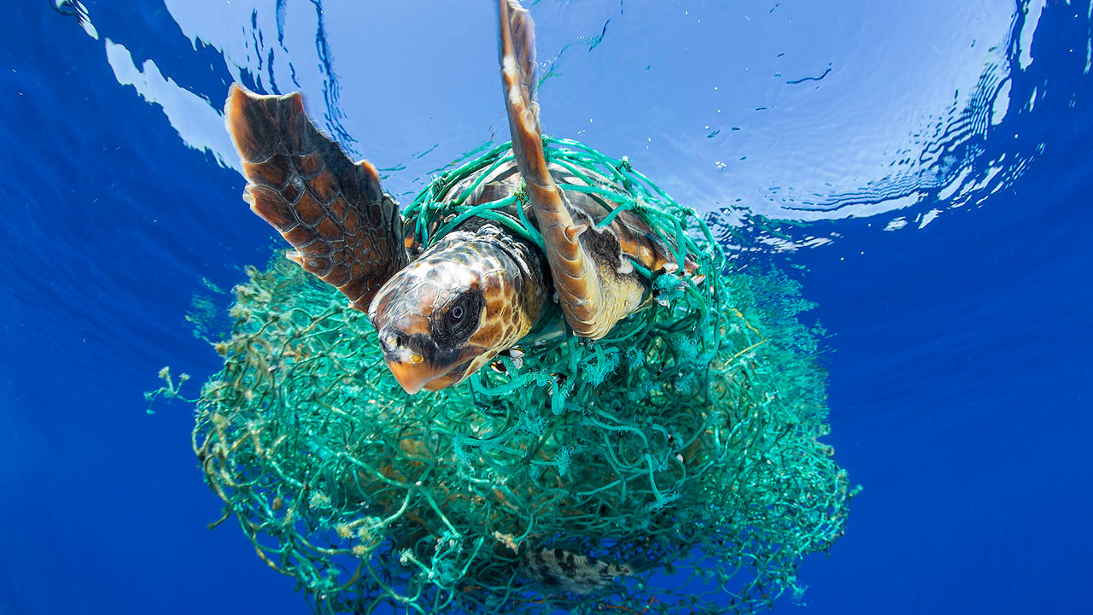

Slide 11
Generally marine pollution affects ecosystem health, public health, recreational water quality and economic viability in the following way:
Eutrophication
Toxicity
Mutagenic and Carcinogenic

Slide 12
There are global and regional Conventions to protect against marine pollution:
Universal:
1982 UNITED NATIONS CONENTION ON THE LAW OF The SEA (so called Constitution of the Oceans).
GLOBAL
MARPOL (Prevention of Pollution from Ships)
London Convention and Protocol (Dumping)
REGIONAL
such as
OSPAR (North-East Atlantic)
Helsinki Convention (Baltic Sea)

Slide 13
Article 207 UNCLOS (1) calls upon States to adopt laws and regulations to prevent, reduce and control pollution of the marine environment from land-based sources, “taking into account internationally agreed rules, standards and recommended practices and procedures”
There are no global conventions Specifically to regulate pollution from land –based sources only soft law-non- binding documents such as:
1985 Montreal Guidelines for the Protection of the Marine Environment Against Pollution from Land-based Sources, and
1995 Washington Declaration and the Global Programme of Action for the Protection of the Marine Environment from Land-Based Activities (gpa) is s probably the most comprehensive international initiative addressing land-based activities.

Slide 14
In 2015, the UN General Assembly adopted the 2030 Agenda on Sustainable Development and, with it, 17 Sustainable Development Goals and 169 targets to be achieved by 2030. They are not legally binding. Their implementation is, however, monitored and reviewed at the global level by the use of a set of global indicators. Many of the goals and targets relate to marine litter in a direct or indirect way. Most importantly, Goal 14 is to conserve and sustainably use the oceans, seas and marine resources. Target 14.1 is to prevent and significantly reduce marine pollution of all kinds by 2025, in particular pollution from land-based activities, including marine debris and nutrient pollution, including plastic litter.

Slide 15
Principles of Protection of Marine Environment:
Principle of Prevention
Precautionary Principle
Polluter Pays Principle
Environmental Impact Assessment

Slide 16
BBNJ
An international Agreement under the United Nations Convention on the Law of the Sea on the Conservation and Sustainable Use of Marine Biological Diversity of Areas beyond National Jurisdiction– known as 'BBNJ' was agreed on 19 June 2023 following conclusion of the fifth round of treaty negotiations at the United Nations headquarters in New York.
The BBNJ treaty addresses, among other things:
the conservation and sustainable use of marine BBNJ;
marine genetic resources, including questions on benefit-sharing (MGR);
Area Based Management Tools (ABMT), including marine protected areas;
environmental impact assessments (EIA); and
capacity-building and the transfer of marine technology (CB&TMT).

