Slide 1
This session:
Module objectives
Introduction to climate politics (with focus on justice)
Deep dives: Arctic (Eda Ayaydin) + Paris (Edouard Morena)
Assessment
Podcast (40%)
2000 word essay (60%)
Questions to class
Translating science into policy (origins of the international climate regime)

Slide 2
What words do you associate most with climate change?
ⓘ Start presenting to display the poll results on this slide.

Slide 3
What does climate change mean for you?
ⓘ Start presenting to display the poll results on this slide.

Slide 4
Is climate change the most important challenge of our times?
ⓘ Start presenting to display the poll results on this slide.

Slide 5
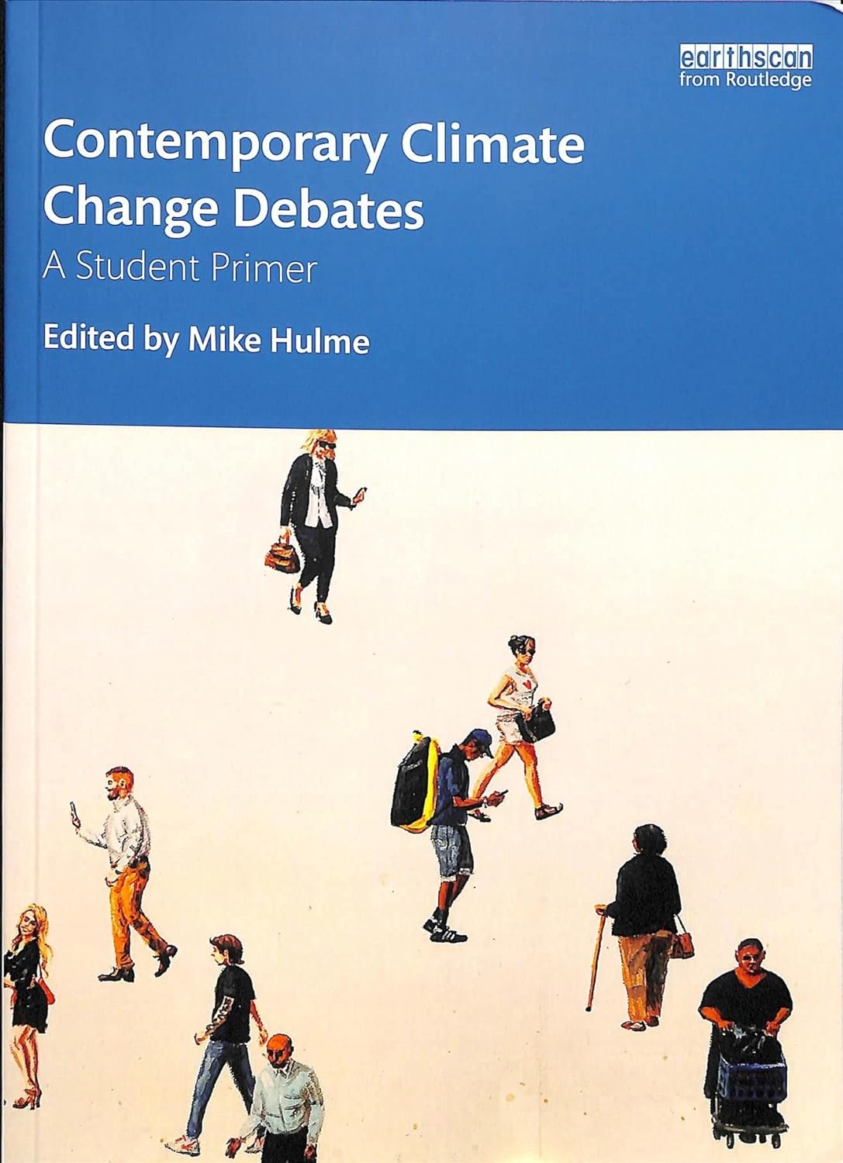

Slide 6
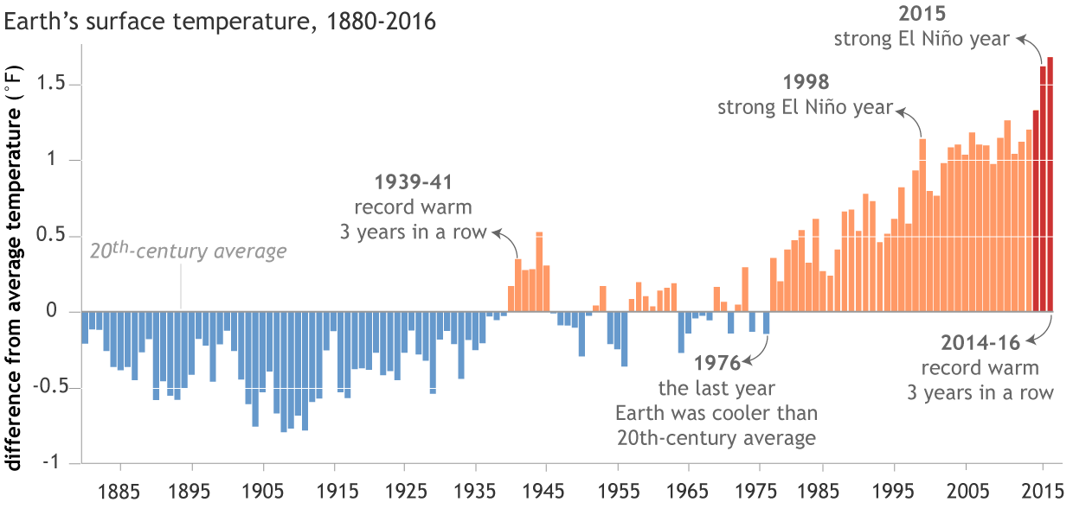

Slide 7
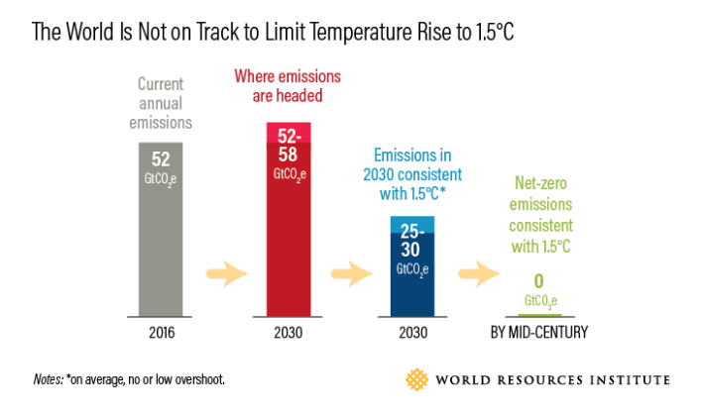
Source: https://www.wri.org/blog/2018/10/8-things-you-need-know-about-ipcc-15-c-report

Slide 8
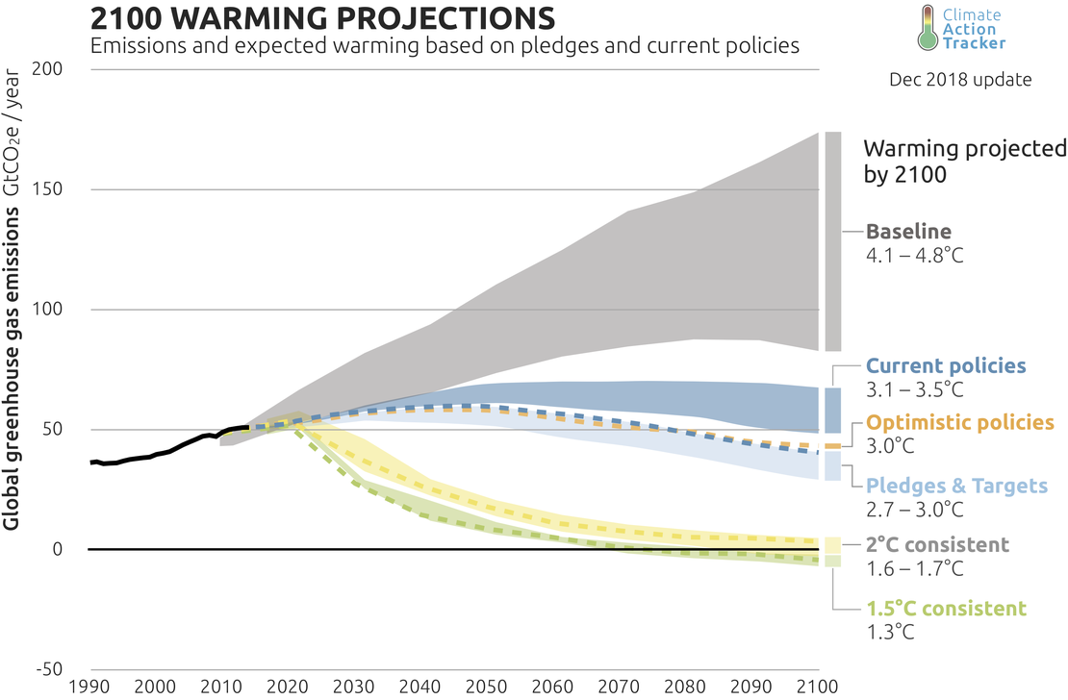

Slide 10
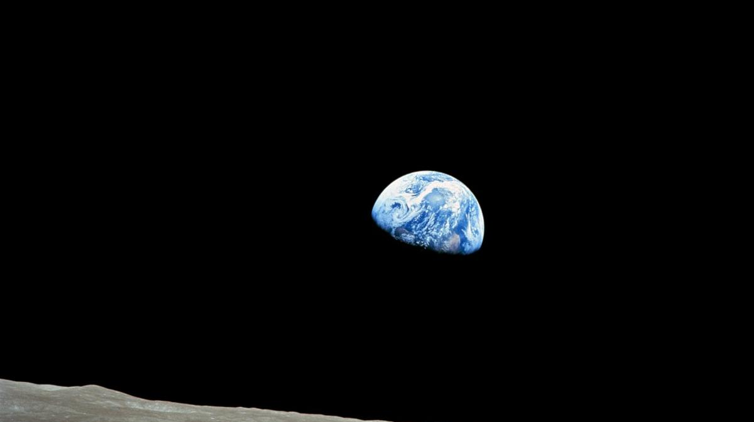

Slide 11
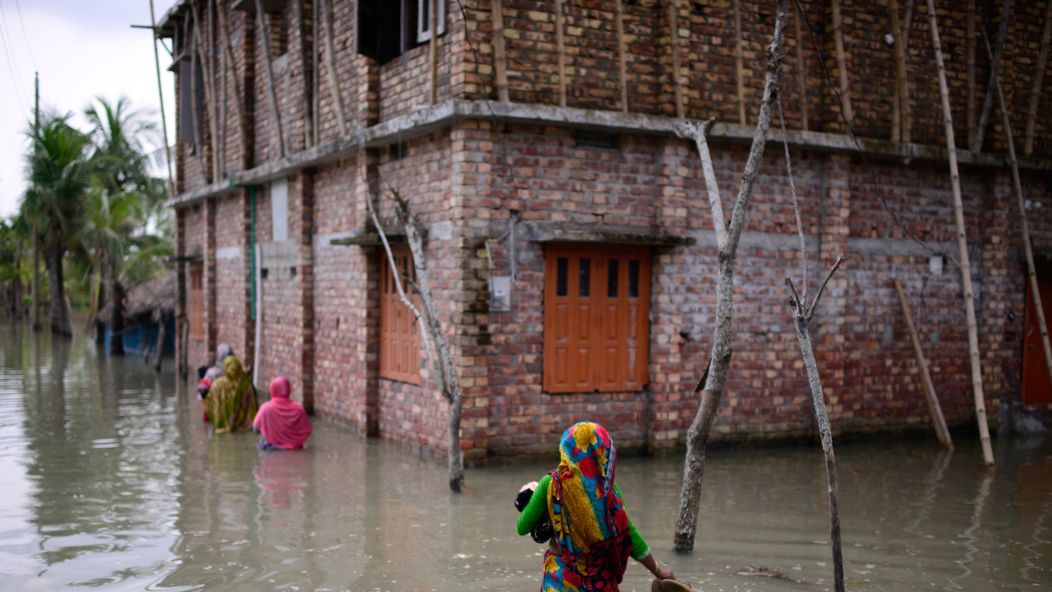

Slide 12
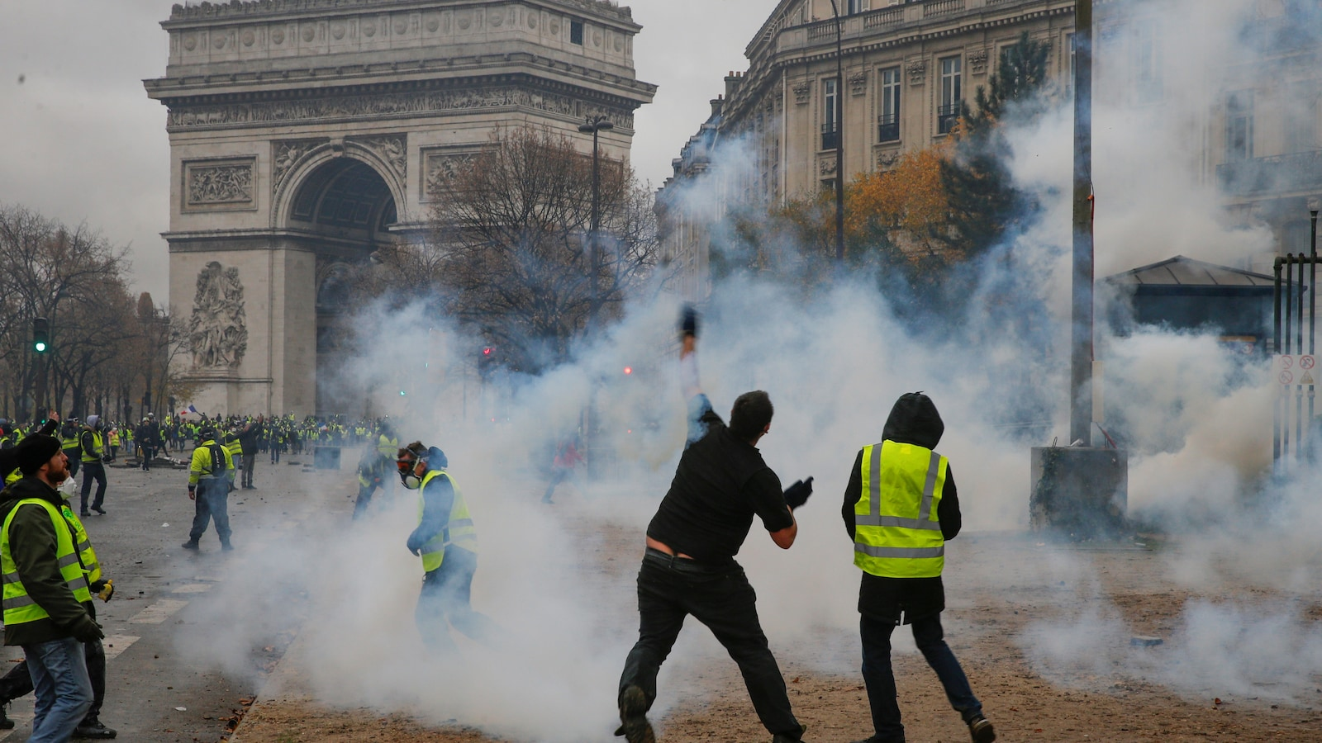

Slide 13
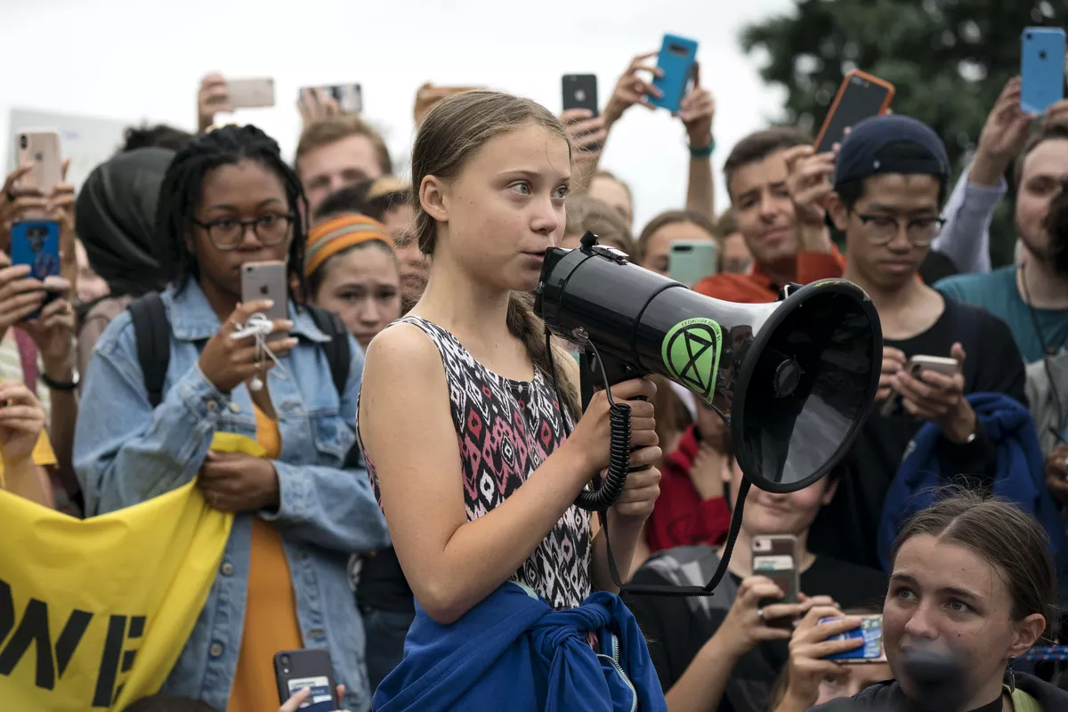

Slide 14
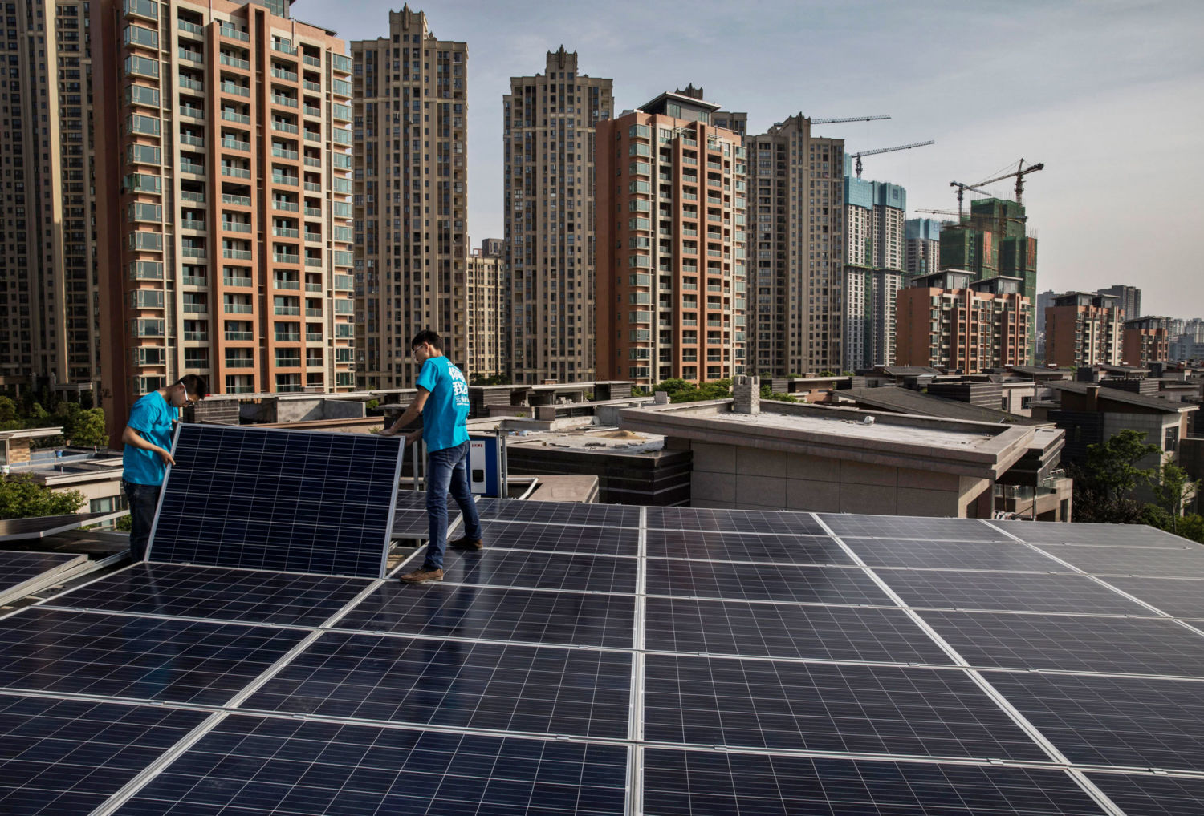

Slide 15
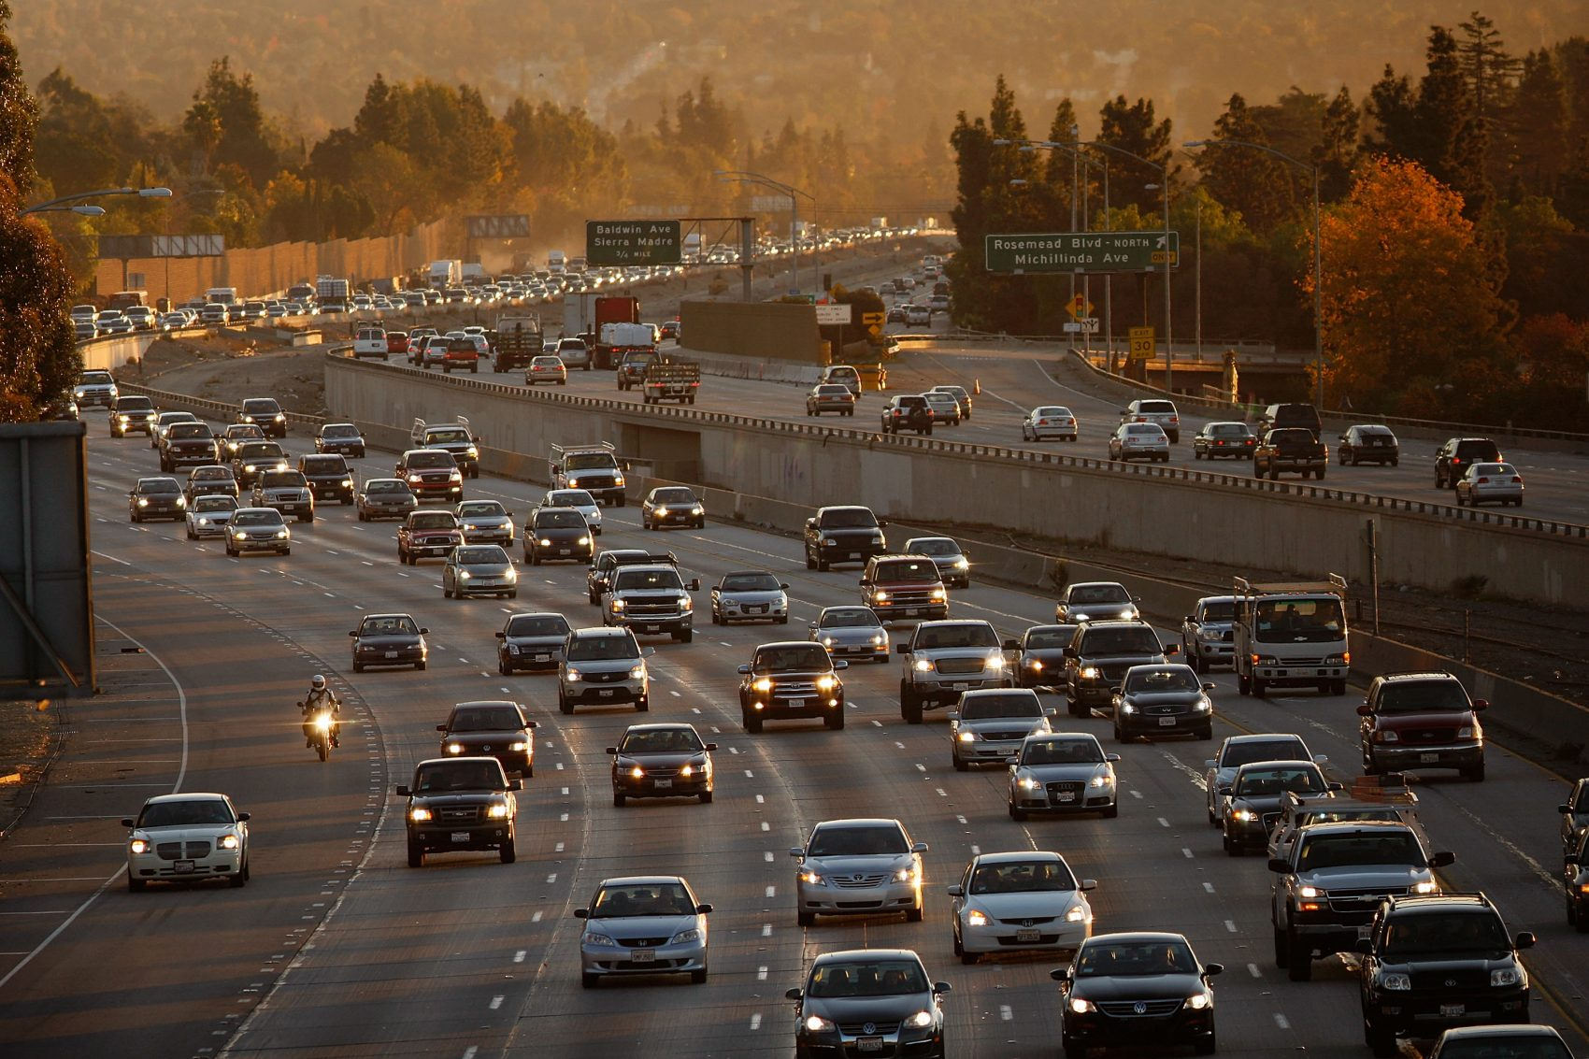
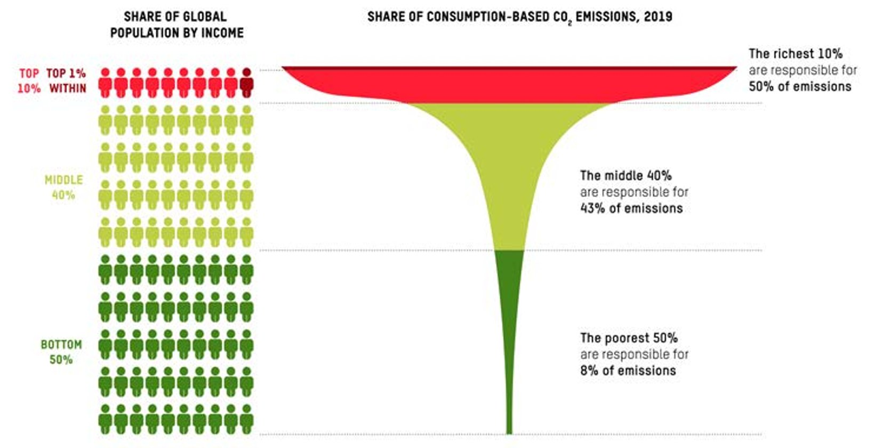
Source: https://oxfamilibrary.openrepository.com/bitstream/handle/10546/621052/mb-confronting-carbon-inequality-210920-en.pdf?sequence=1&isAllowed=y

Slide 16
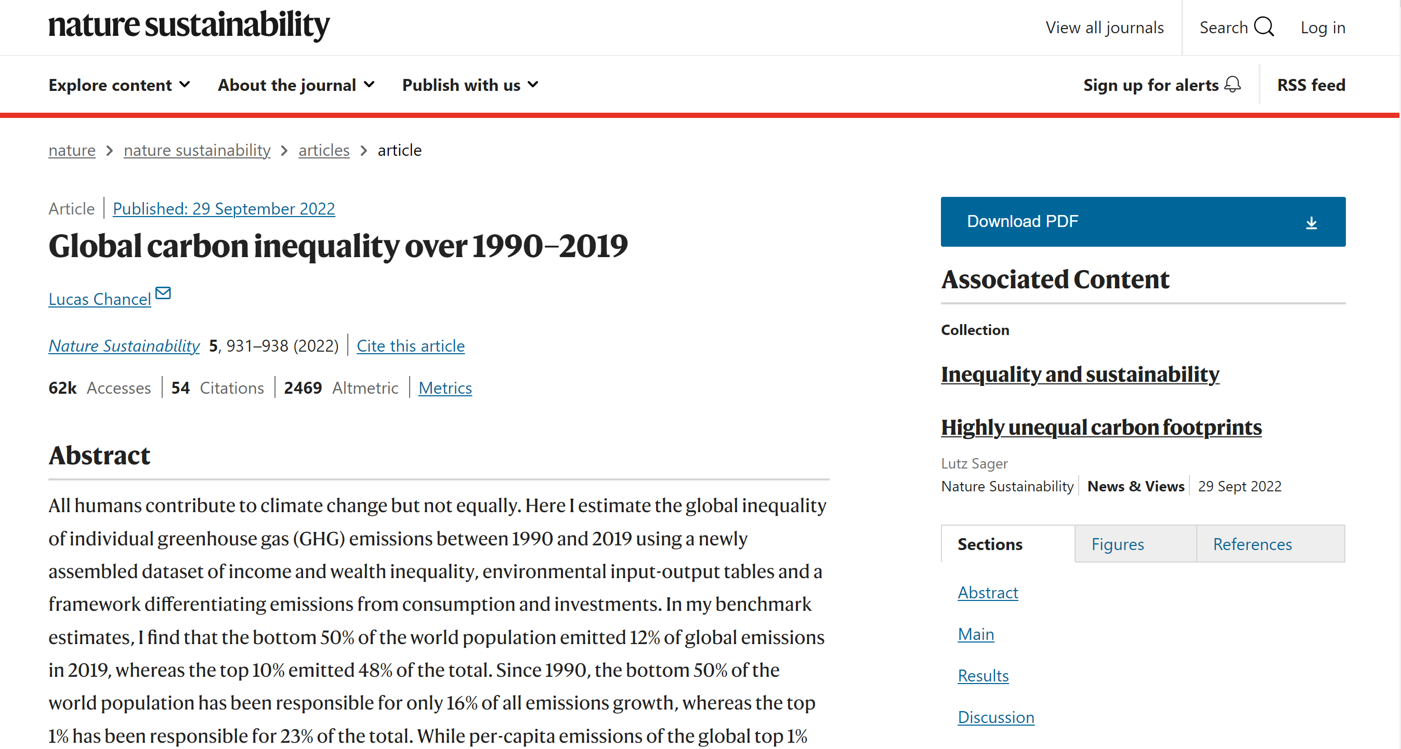

Slide 17
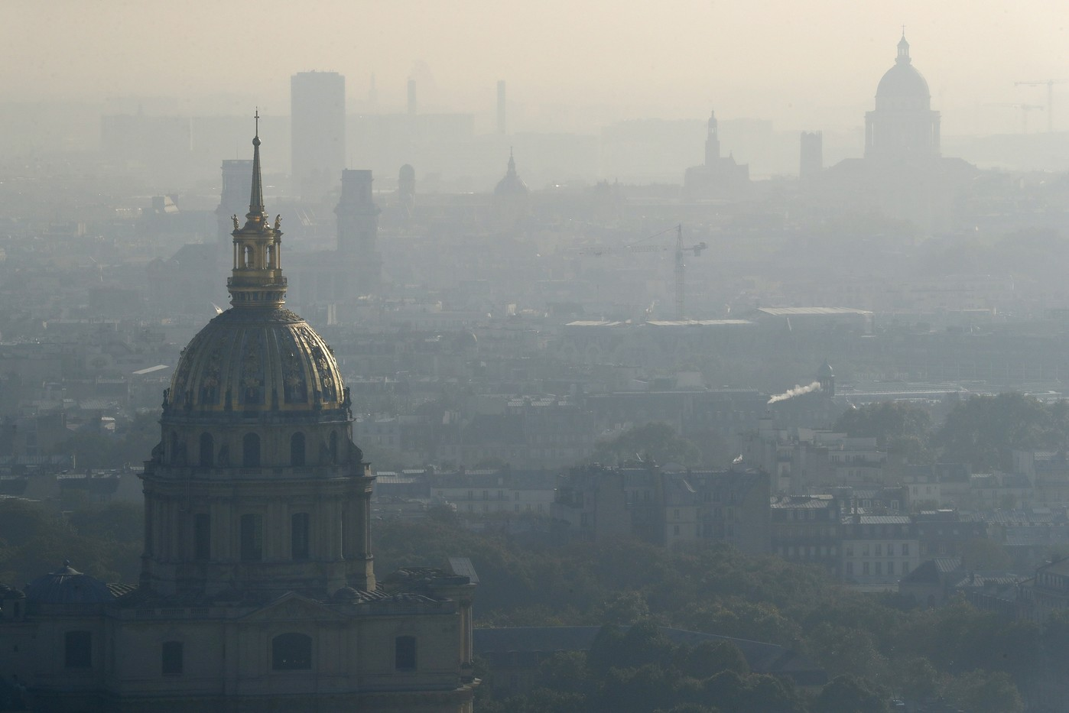
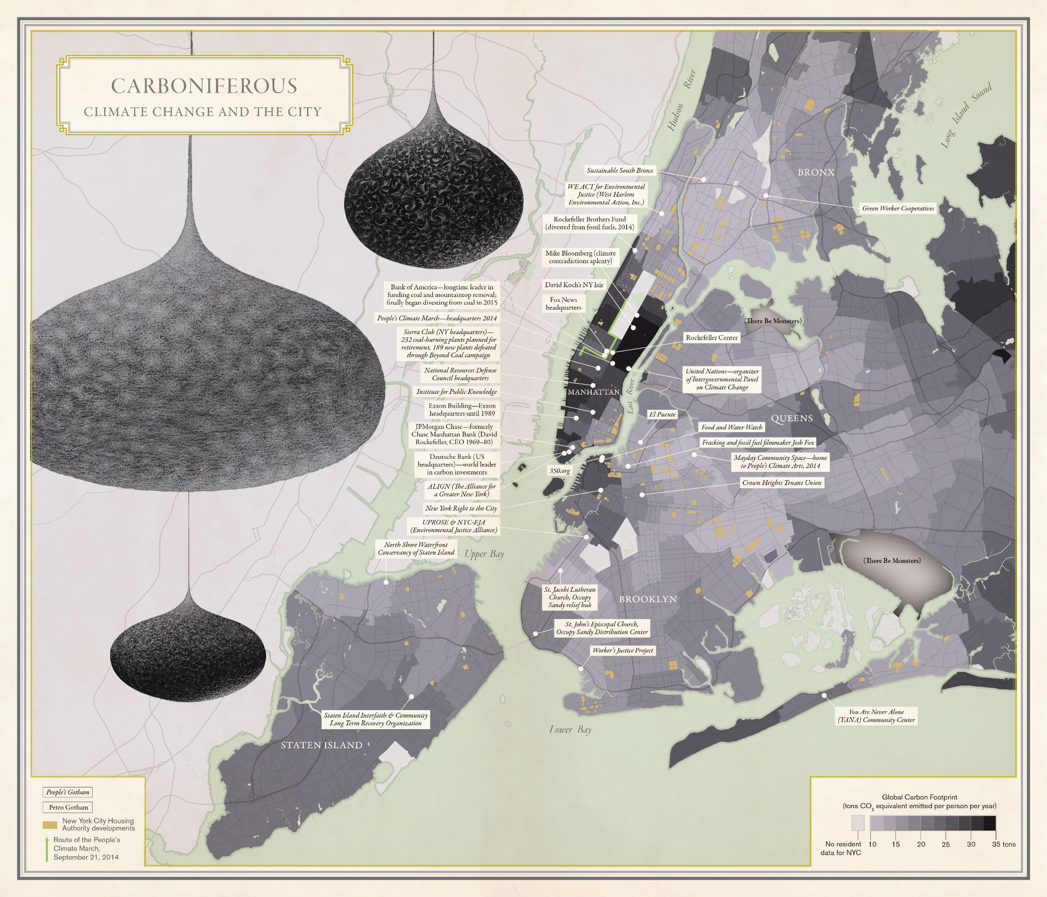
Aldana-Cohen 2016 (Image credit: University of California Press)

Slide 18
Introduction
The origins of the international climate regime

Slide 19
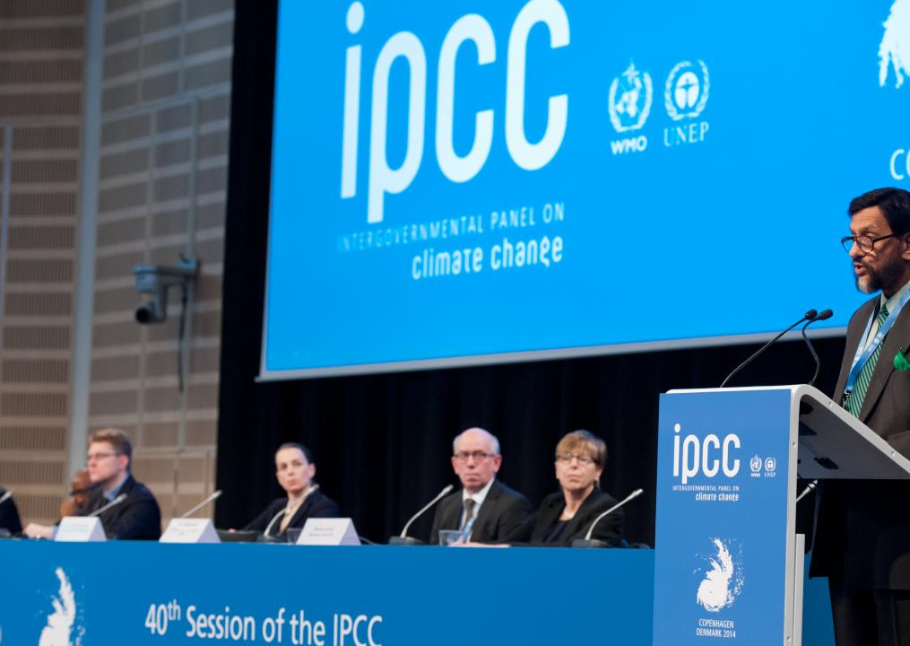
I. What is a regime? (1)
Climate regime: often associated with IPCC and UNFCCC
Environmental regime:
« Intergovernmental institutions that give rise to social practices, assign roles, and govern interactions to address situations of ecosystem degradation through overuse (for instance the fisheries governance) or through pollution (for instance the climate change regime). » (Orsini & Morin, 2020:171).
Occupy intermediary position:
Shaped by structures in place (including power distribution or prevailing ideas)
BUT they also guide and constrain the behaviour of actors.

Slide 20
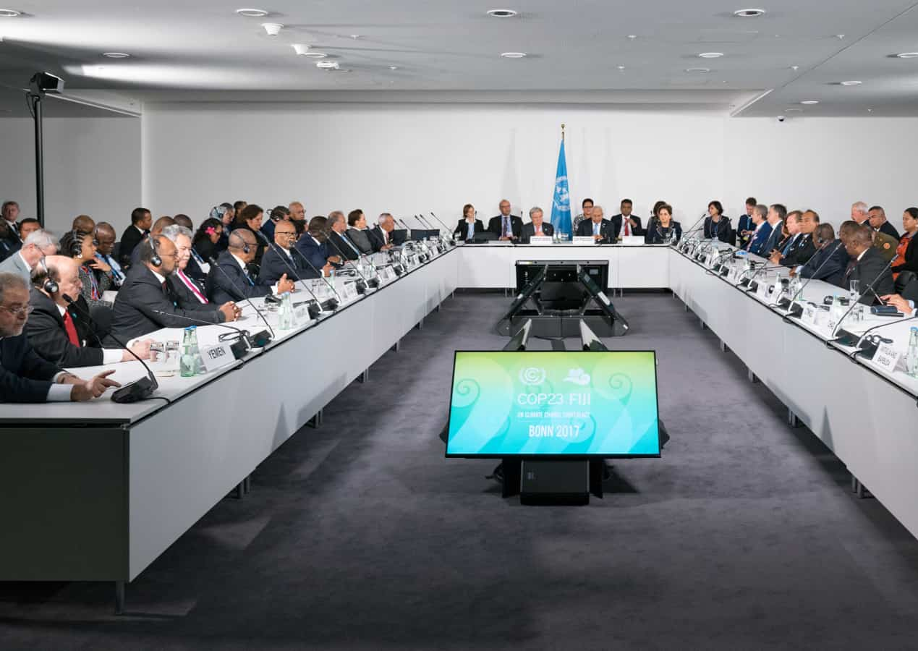
I. What is a regime? (2)
International regimes: not necessarily centered on a formal treaty or an intergovernmental organization.
Implicit rules that lay out actors' expectations
BUT most regimes are formalized by international treaties.
Treaty negotiations tend to evolve in a path dependency manner:
Political declarations → Framework conventions → Protocols → Follow-up annexes and decisions

Slide 21
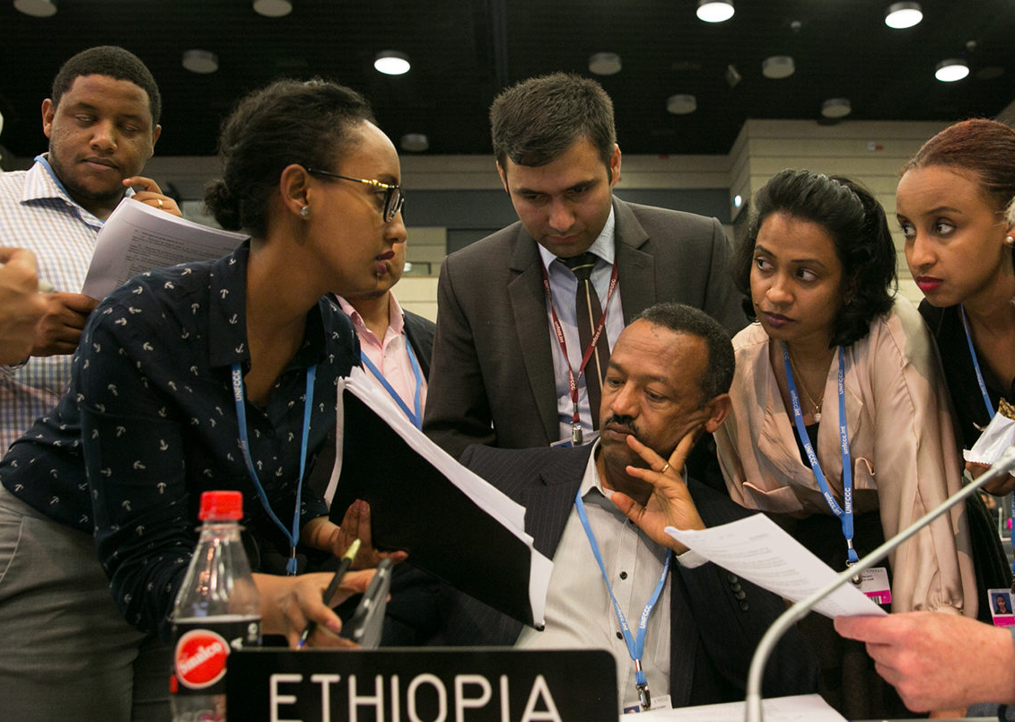
II. How does the climate regime work? (1)
Negotiations: core part of the regime
Range of actors, institutions and decision-making processes
3 are critical (Newell and Bulkeley, 2010:17):
UNFCCC Secretariat: organizes and oversees negotiations
UNFCCC Conference of the Parties (COP)
Annual meetings to review progress on commitments contained in climate treaties
Update them
Ultimate decision-making body in climate negotiations
UNFCCC Subsidiary Bodies and Ad Hoc Working Groups
Focus on specific issues

Slide 22
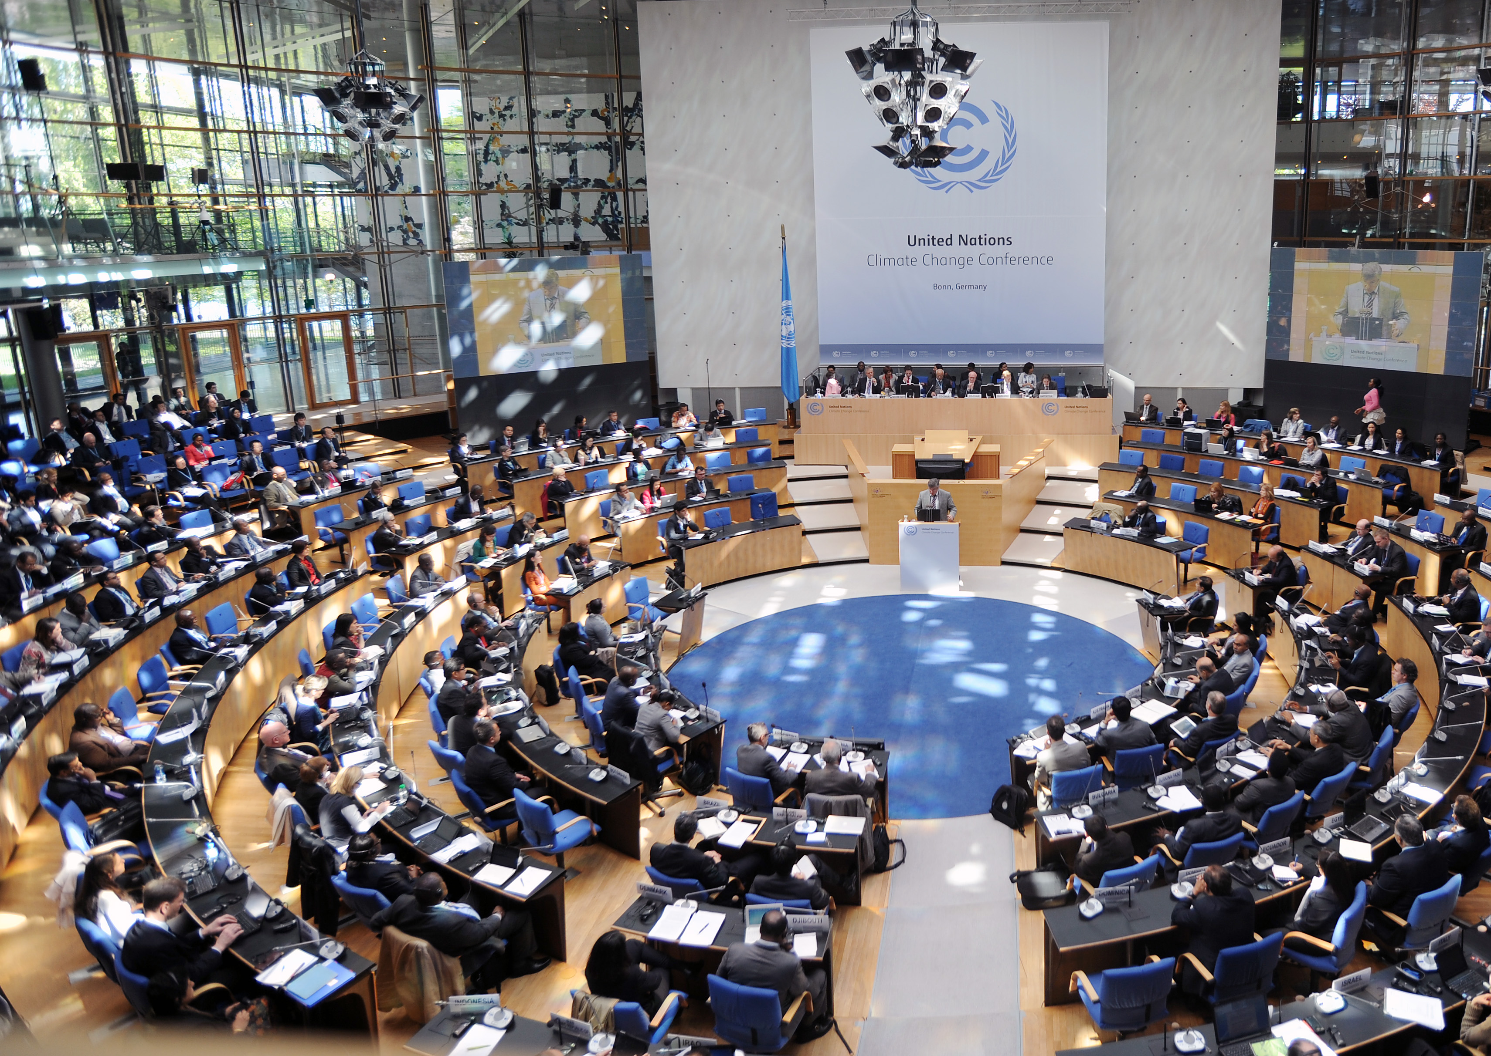
II. How does the climate regime work? (2)
Blocs and negotiating coalitions to enhance their influence and advance common agendas.
Pamela Chasek: “A coalition is an ad hoc grouping of nations united for a specific purpose.”
Increase relative strength
Create the necessary structure to simplify treaty negotiations (reducing number of speakers)
Goals can be general (wording) or very specific
In climate/environment: often based on level of development, or shared geopolitical or socioeconomic interests
G77+China, Africa Group, Umbrella Group, EU, AOSIS, OPEC, LDC, BASIC...

Slide 23
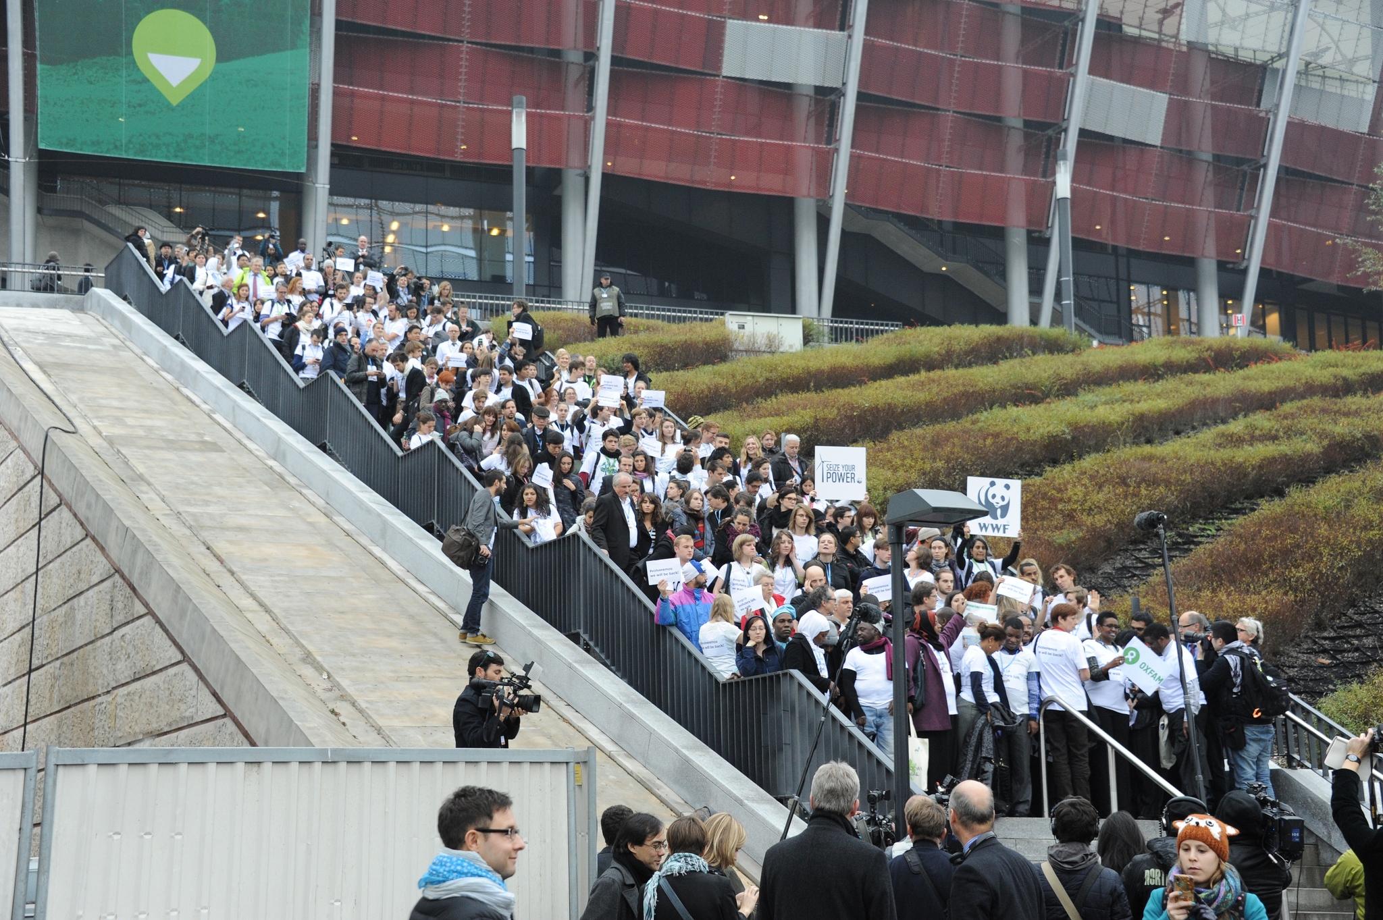
II. How does the climate regime work? (4)
Not just States.
Non-state actors have also historically played an important part in the international climate regime.
Structured through coalitions (e.g. Climate Action Network)
Major Groups within the UNFCCC.
“The neat distinctions that underpin the official roles and status ascribed to non-state actors describe poorly the reality of actors and individuals that move in and out of these categories, constructing and participating in coalitions and network formations that bypass traditional 'levels of analysis', and producing climate governance in their wake.” (Newell & Bulkeley, 2010:34)

Slide 24
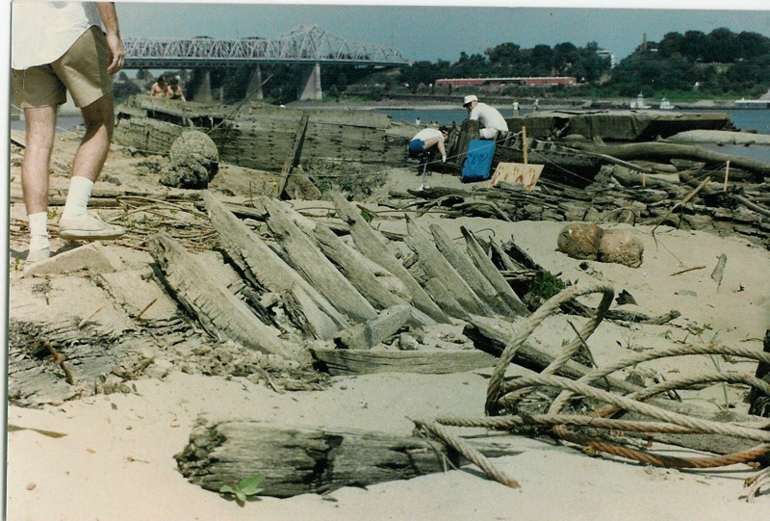
III. From science to policy (1)
Role of science/scientific community
1970s onwards: growing scientific interest in Man's impact on global climate (Agrawala, 1998:606)
Early 1980s: focus on possibility of warming trends linked to growing GHG concentrations (move away from variability)
1979: 1st World Climate Conference (WMO)
Led to creation of World Climate Programme (WCP): WMO, UNEP and ICSU
Series of workshops in Villach (Austria): 1980, 1983, 1985
By mid-1980s: Consensus reached. Recommends that "scientists and policymakers should begin active collaboration to explore the effectiveness of alternative policies and adjustments."
Context of growing media and political interest.
1988: James Hansen (NASA), Senate hearing. 99% sure that the Earth is warmer than it had ever been measured to be.

Slide 25
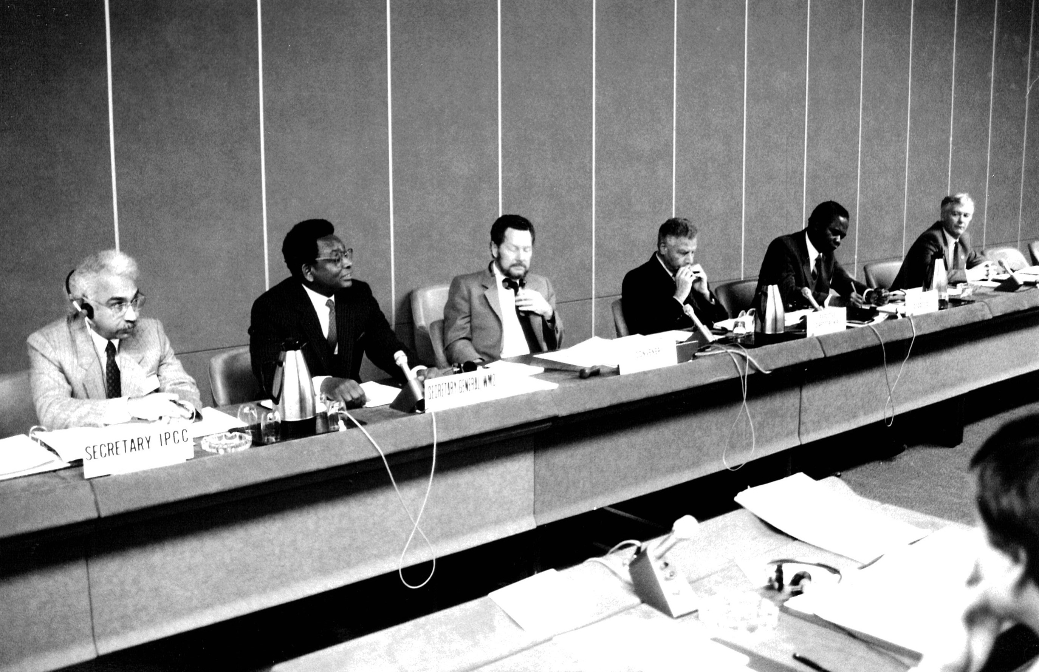
III. From science to policy (2)
Important actor: USA
Had most cumulative expertise in climate change research (government-funded programmes, EPA, Department of Energy...)
Also had huge stake in climate problem: biggest contributor to GHG emissions.
Biggest financial patron of UN system (influence on WMO and UNEP)
USA pushes for creation of “intergovernmental mechanism” to conduct scientific assessment of climate change.
Preserve government oversight
IPCC assessment summaries = politically negotiated
1988: Creation of Intergovernmental Panel on Climate Change (IPCC)
Science as battleground (severity of threat, causal mechanisms...)

Slide 26
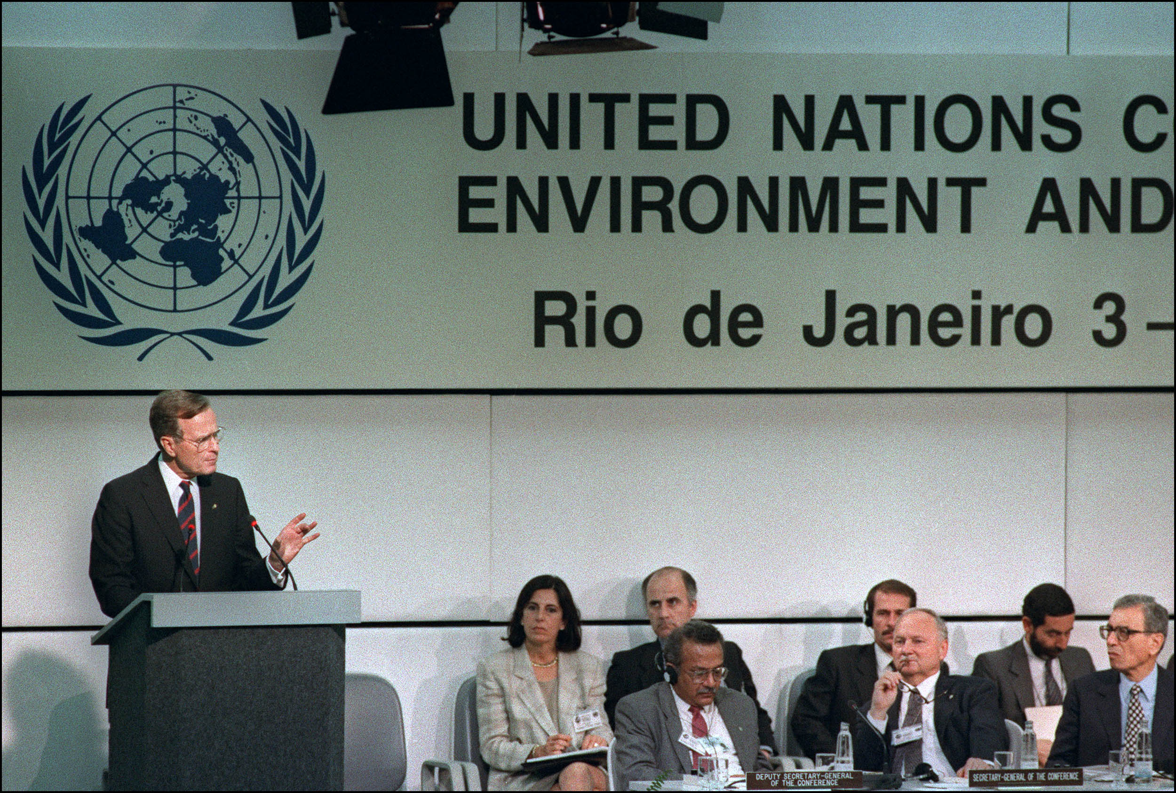
III. From science to policy (3)
Growing recognition of need to establish convention.
Vienna Convention for the Protection of the Ozone Layer (1985) and Montreal Protocol (1987)
1988: World Conference on the Changing Atmosphere (Toronto)
At UN Conference on Environment and Development (UNCED) - Rio 92: Agreement to create UNFCCC
Objective: “To achieve stabilization of global greenhouse gas concentrations in the atmosphere at a level that would prevent dangerous anthropogenic interference with the climate system. Such a level should be achieved within a timeframe sufficient to allow ecosystems to adapt naturally to climate change, to ensure that food production was not threatened, and to enable economic development to proceed in a sustainable fashion.”

Slide 27
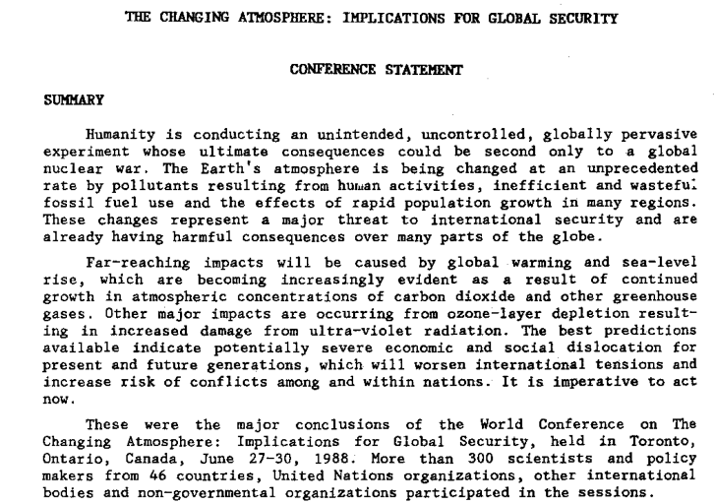

Slide 28
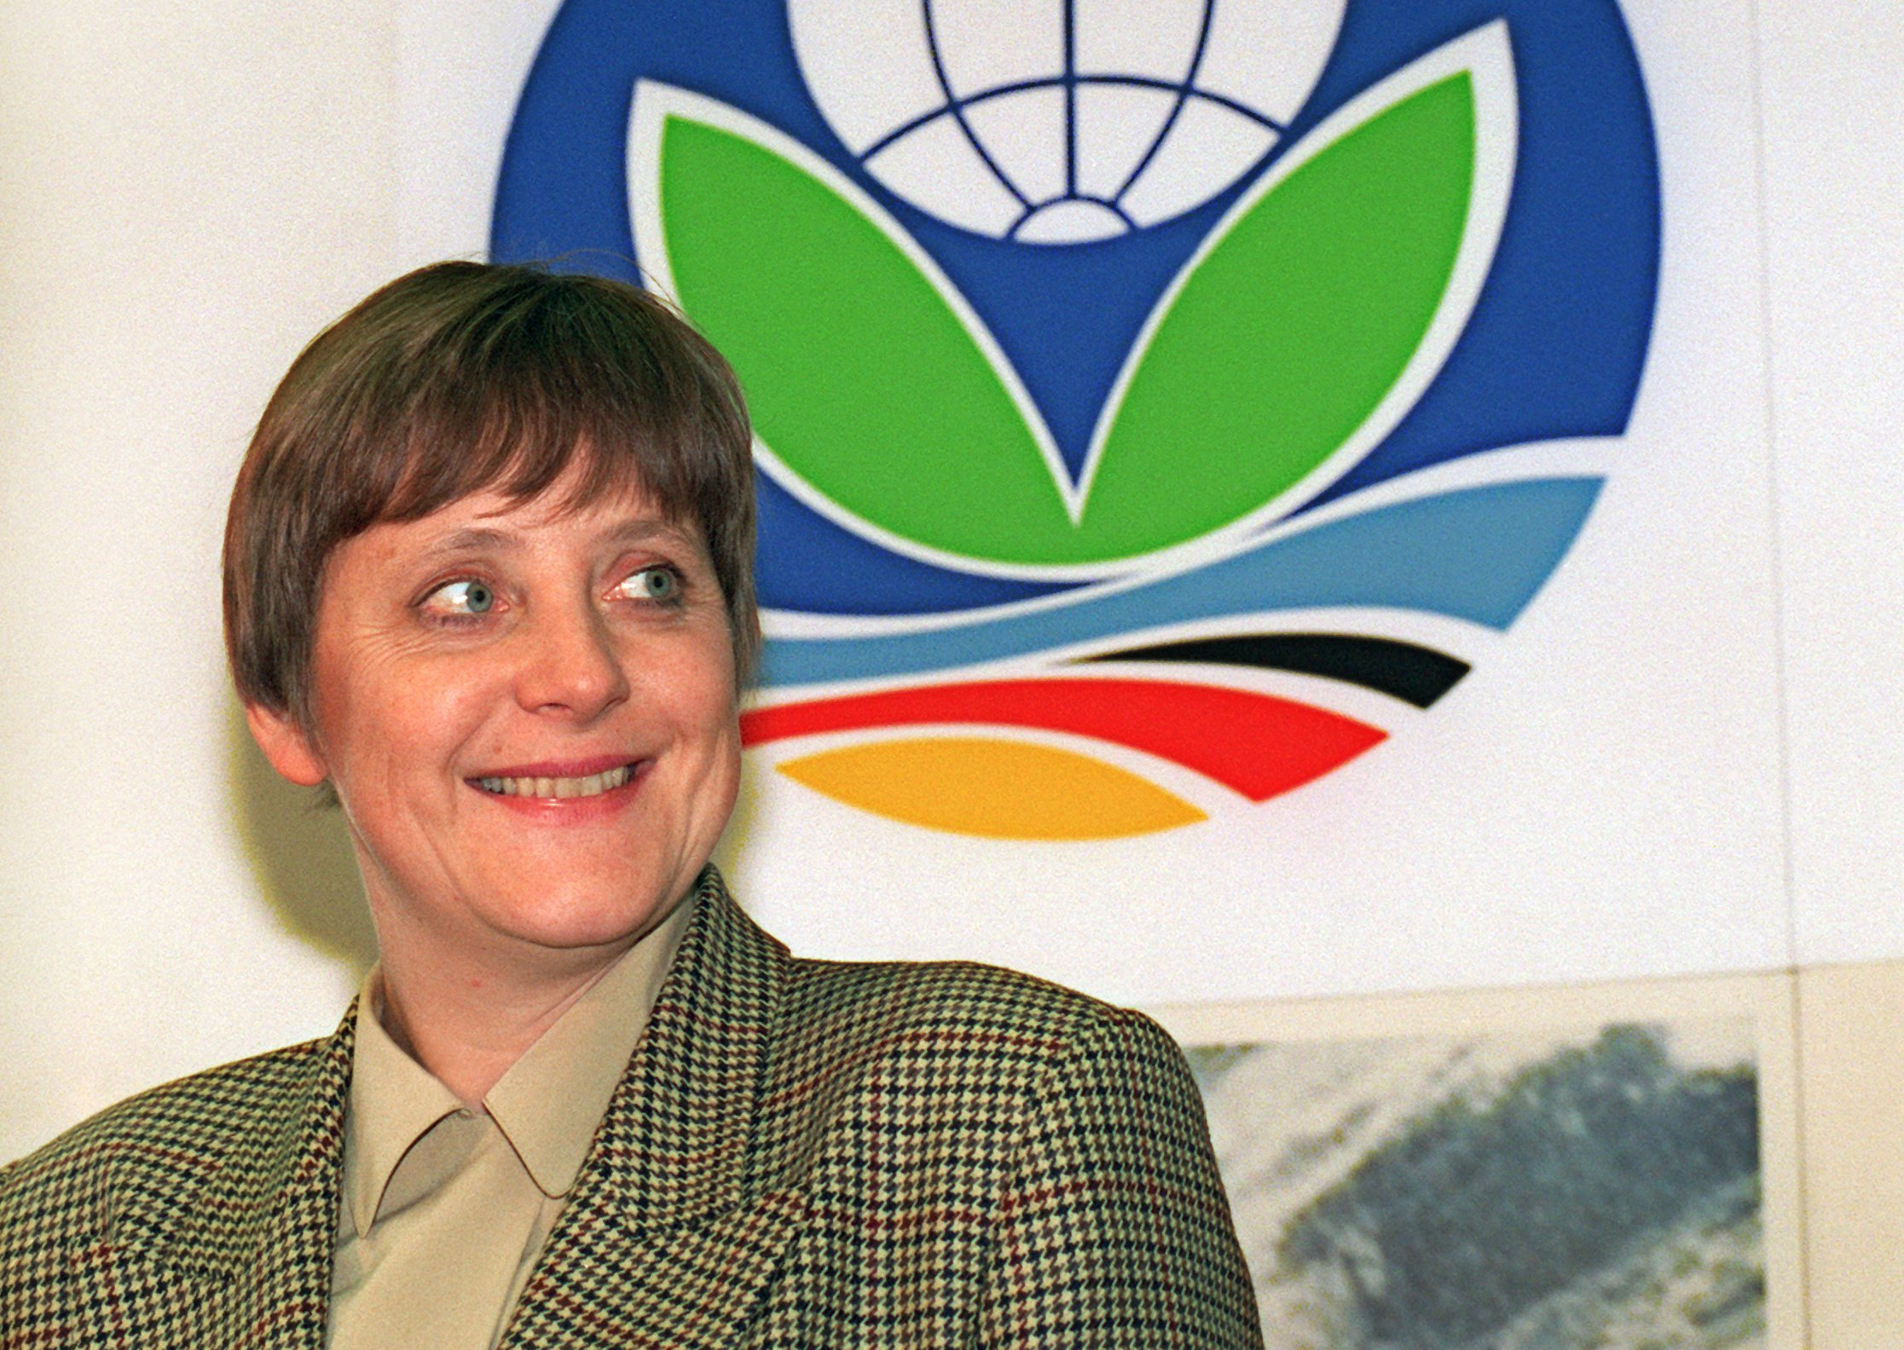
III. From science to policy (4)
UNFCCC establishes principle of common but differentiated responsibility.
Recognizes that developing countries were not yet in a position to assume their own obligations (financial and technology transfers).
Things get complicated: How do you realize objective laid out in UNFCCC?
COP1 Berlin (1995): Berlin Mandate
Quantifiable emissions limitations and reduction obligations
Start of negotiations towards a protocol setting legally binding targets to reduce GHG emissions.

Slide 29
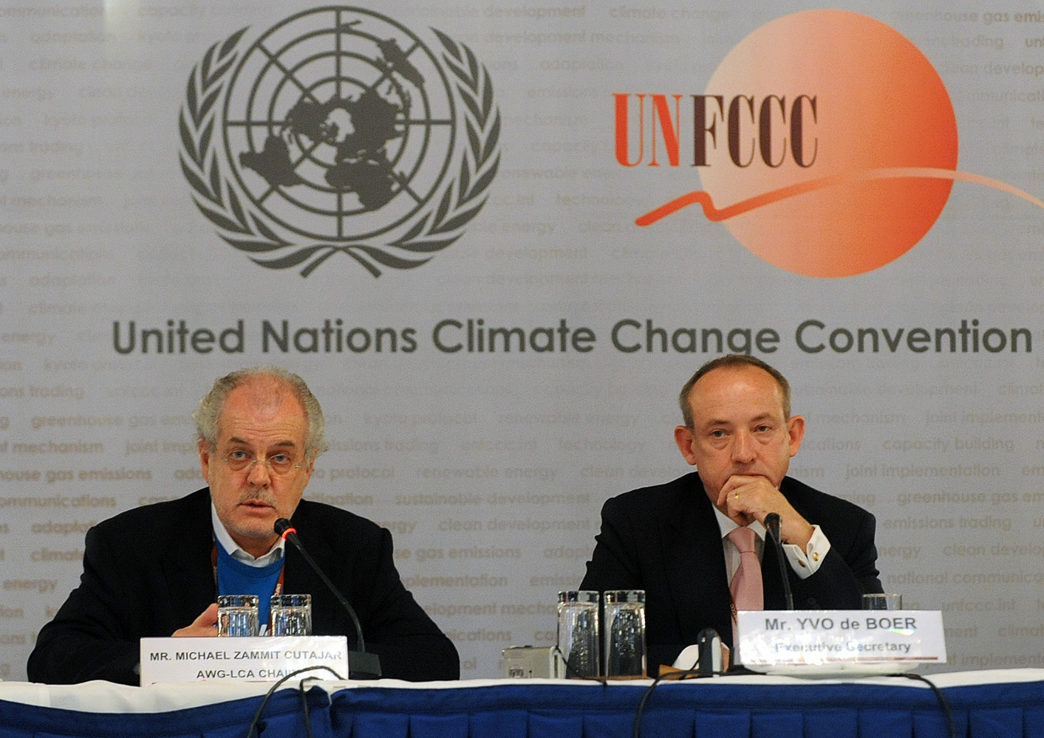
III. From science to policy (5)
5 complicated years of negotiations.
Mobilization of special interests (Big oil).
Huge pressure placed on governments.
In the US: rise of climate sceptics and denialists (funded by fossil fuel interests)
Oreskes & Konway (2010), Merchants of Doubt, Bloombury Press.
At the same time, rise of market-based solutions: Combine economic growth/development and climate action.
Growing influence and involvement of corporate actors/approaches.
Environmental management.

Slide 30
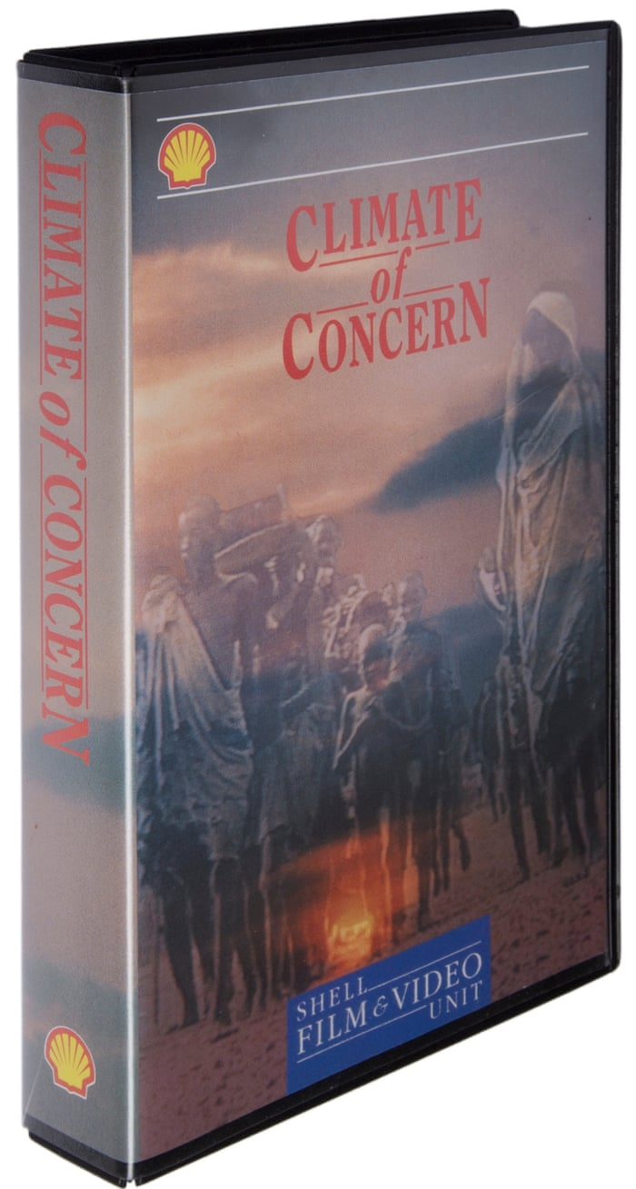
1991

Slide 31
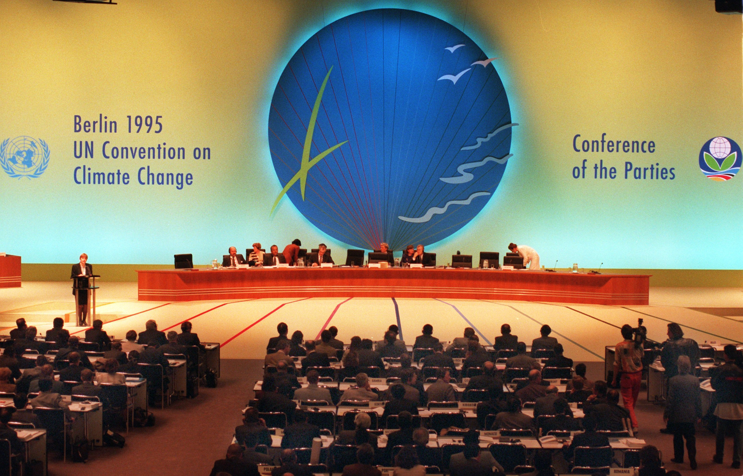
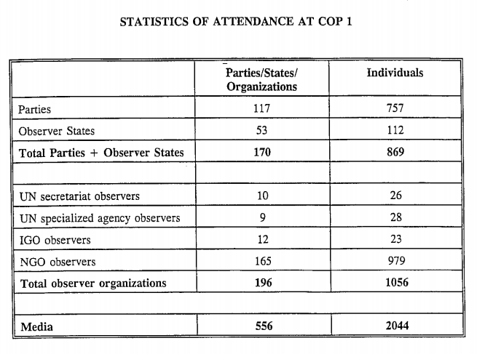

Slide 32
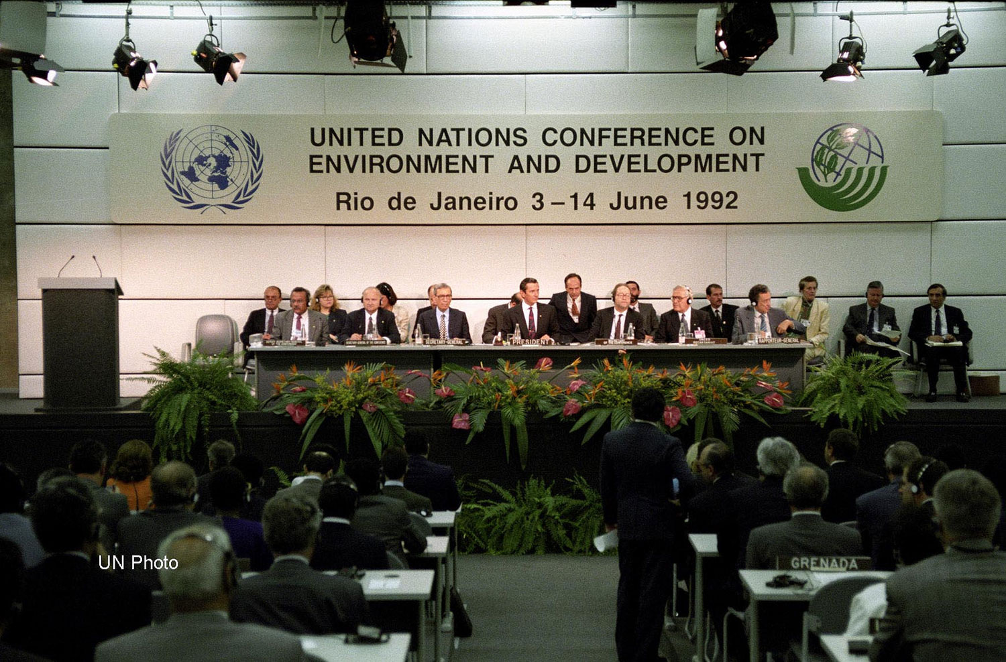
III. From science to policy (6)
1990s: Rise of sustainable Development
Emergence and imposition of “liberal environmentalist” discourse/norms (Bernstein, 2002)
Bernstein: “the view that liberalization in trade and finance is consistent with, and even necessary for, international environmental protection. […] embraced and helped legitimize the new economic orthodoxy then sweeping North and South alike, which promoted open markets, deregulation, and working with the private sector to achieve policy goals.”
Link with notion of “ecological modernization” (Hajer, 1995): idea that there are reformist, pragmatic, fact-based solutions to the environmental problems facing society (link with NPM, CSR).
Pieter Winsemius: 1980s in the Netherlands. Covenants, shared objectives but flexibility in terms of how we attain them.

Slide 33
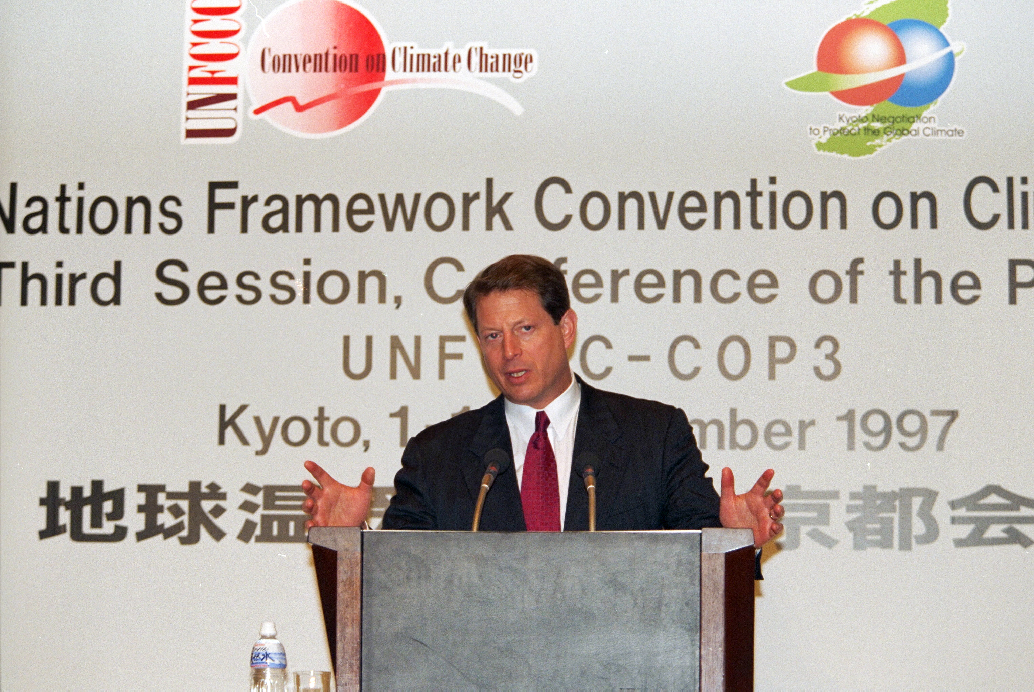
III. From science to policy (7)
1997: Kyoto Protocol
In many ways a US-taylored document:
Designed to appeal to the US
Irony: the US would never ratify it (argument: that US's economic competitors not required to reduce their emissions).
Signed by more than 150 countries
Binds industrialized (Annex 1) countries to reduce GHG emissions by average of 5.2% below 1990 levels during 2008-2012 period.
Fixes differentiated targets for industrialized countries.
Also gives them maximum flexibility on how to reach them:
Through emissions trading (market-based mechanisms), offsetting,…

Slide 34
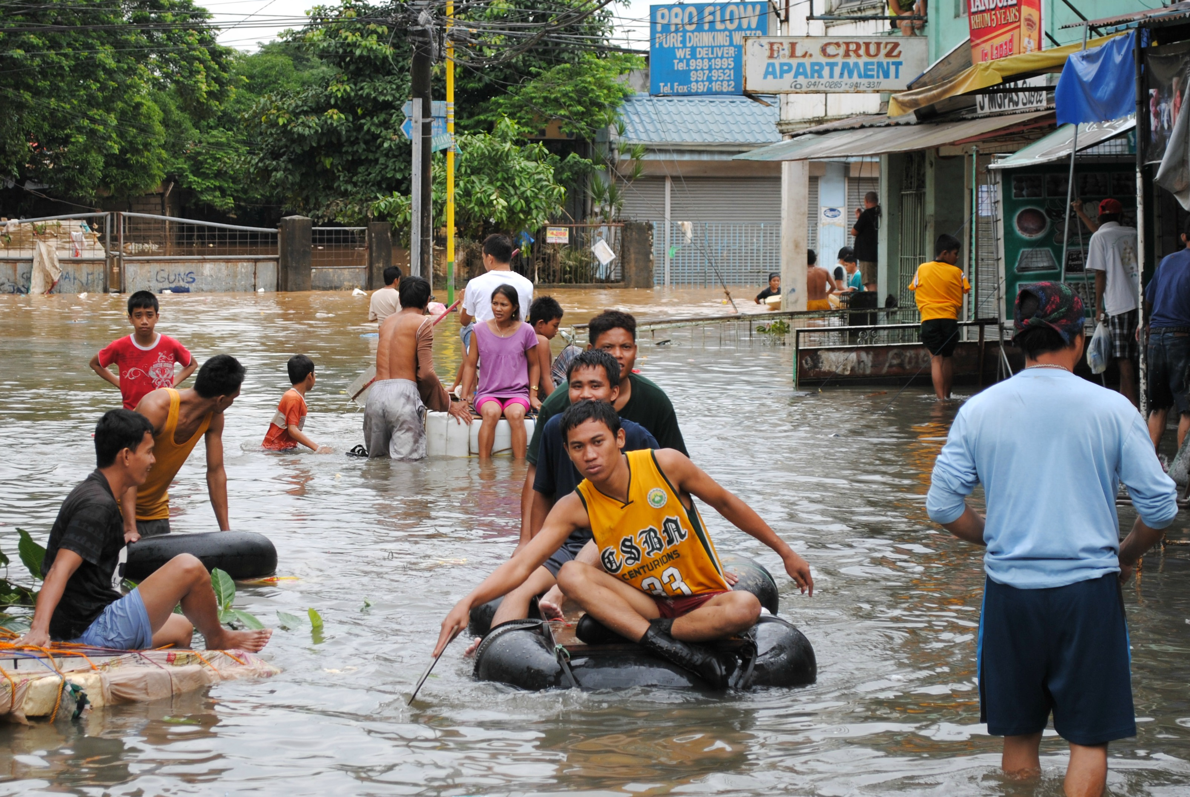
IV. Important dimensions of climate governance (1)
Importance of North-South politics (Newell & Bulkeley, 2010)
“survival” emissions vs. “luxury” emissions (Lohmann, 2011)
“Underpinning this conflict is the fact that while climate change has been largely caused by the wealthy industrialized parts of the world, it is the least developed areas of the world that will suffer its worst consequences. This makes climate change first and foremost an issue of social justice and equity” (Newell & Bulkeley, 2010: 29).
“Common but differentiated responsibility.”
Conditionality of commitment to financial and technological support.

Slide 35
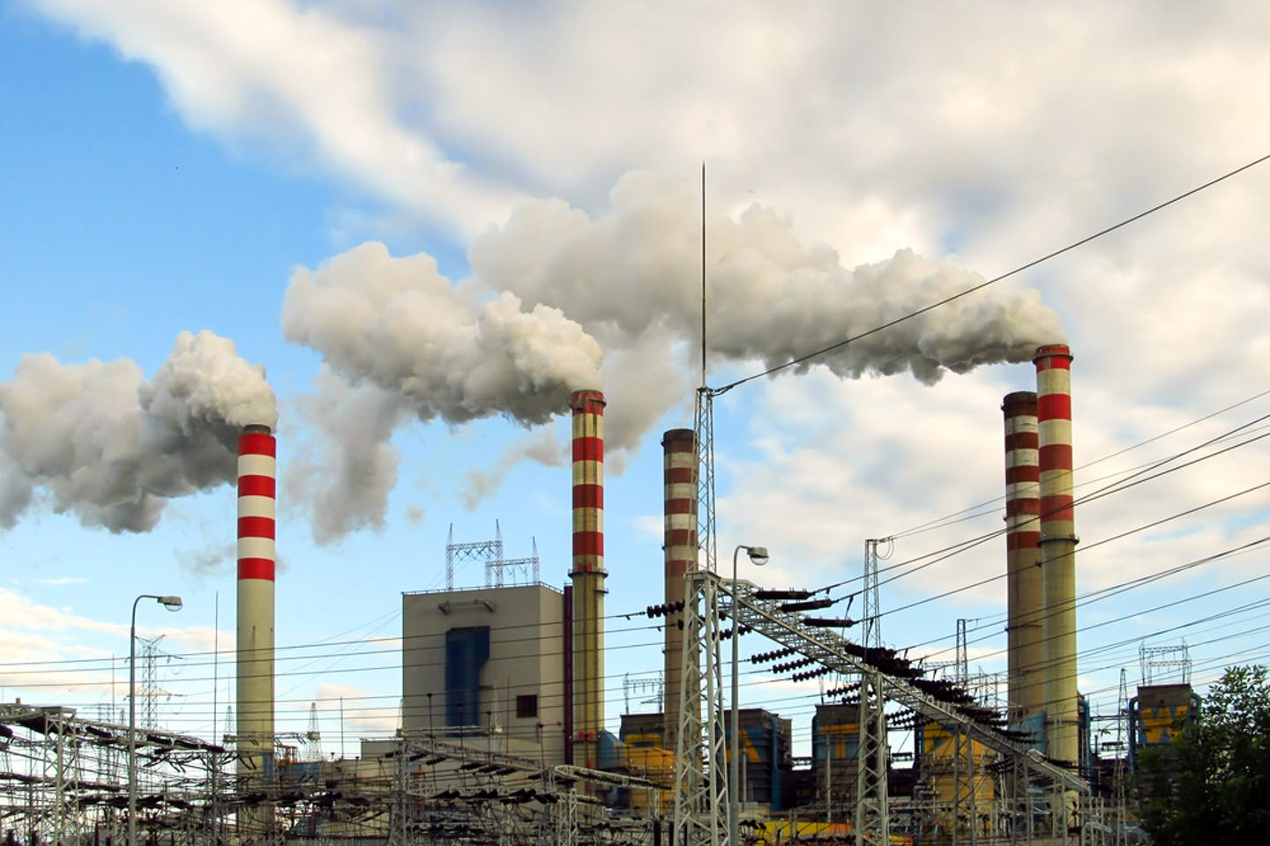
IV. Important dimensions of climate governance (2)
Increasing emphasis on market-based, “bottom-up” solutions
“Flexibility mechanisms”: offsets, credits…
USA pushed this actively
Primacy of (market) efficiency as guiding policy principle (Newell & Paterson, 2006)
Climate governance as product of neoliberalism.
Markets have to be governed: essential to get institutional backing.
Apparent inefficiency of UNFCCC = used as pretext for more market-based solutions

Slide 36
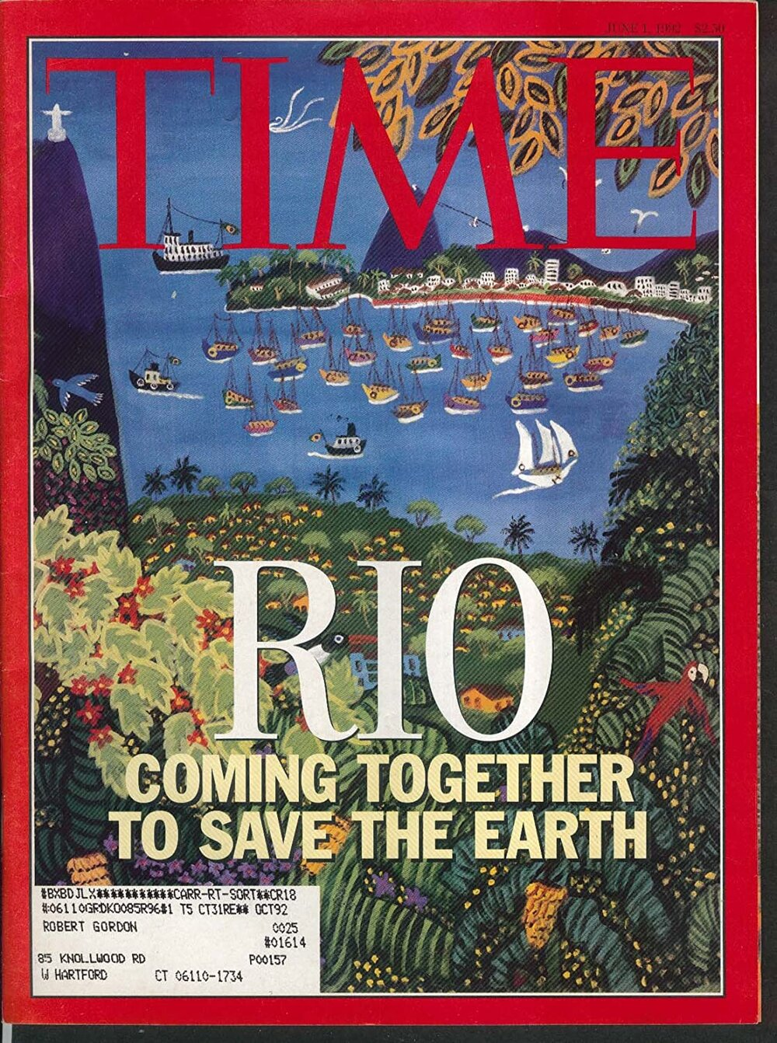
IV. Important dimensions of climate governance (3)
The role of sites/moments in international climate politics.
UN “mega-events” as the infrastructure of global governance
Little, Paul E. (1995), ”Ritual, power and ethnography at the Rio Earth Summit”, in Critique of Anthropology, 15(3), pp.265-288
“UNCED as ritual” “culturally constructed system of symbolic communication” “patterned and ordered sequences of words and acts”
Watch this video (until 6m13s mark): https://www.unmultimedia.org/avlibrary/asset/2078/2078993/
What are the functions of UN ‘mega-events’ like the Earth Summit?
To what extent can the Earth Summit be viewed as a site of performance?

Slide 37
Next two weeks: Focus on climate justice
Actors, debates and strategies deployed at the international level
Example of a concept in dispute: Just Transition
Preparation:
Look up Anabella Rosemberg’s profile
Do the reading

Slide 38
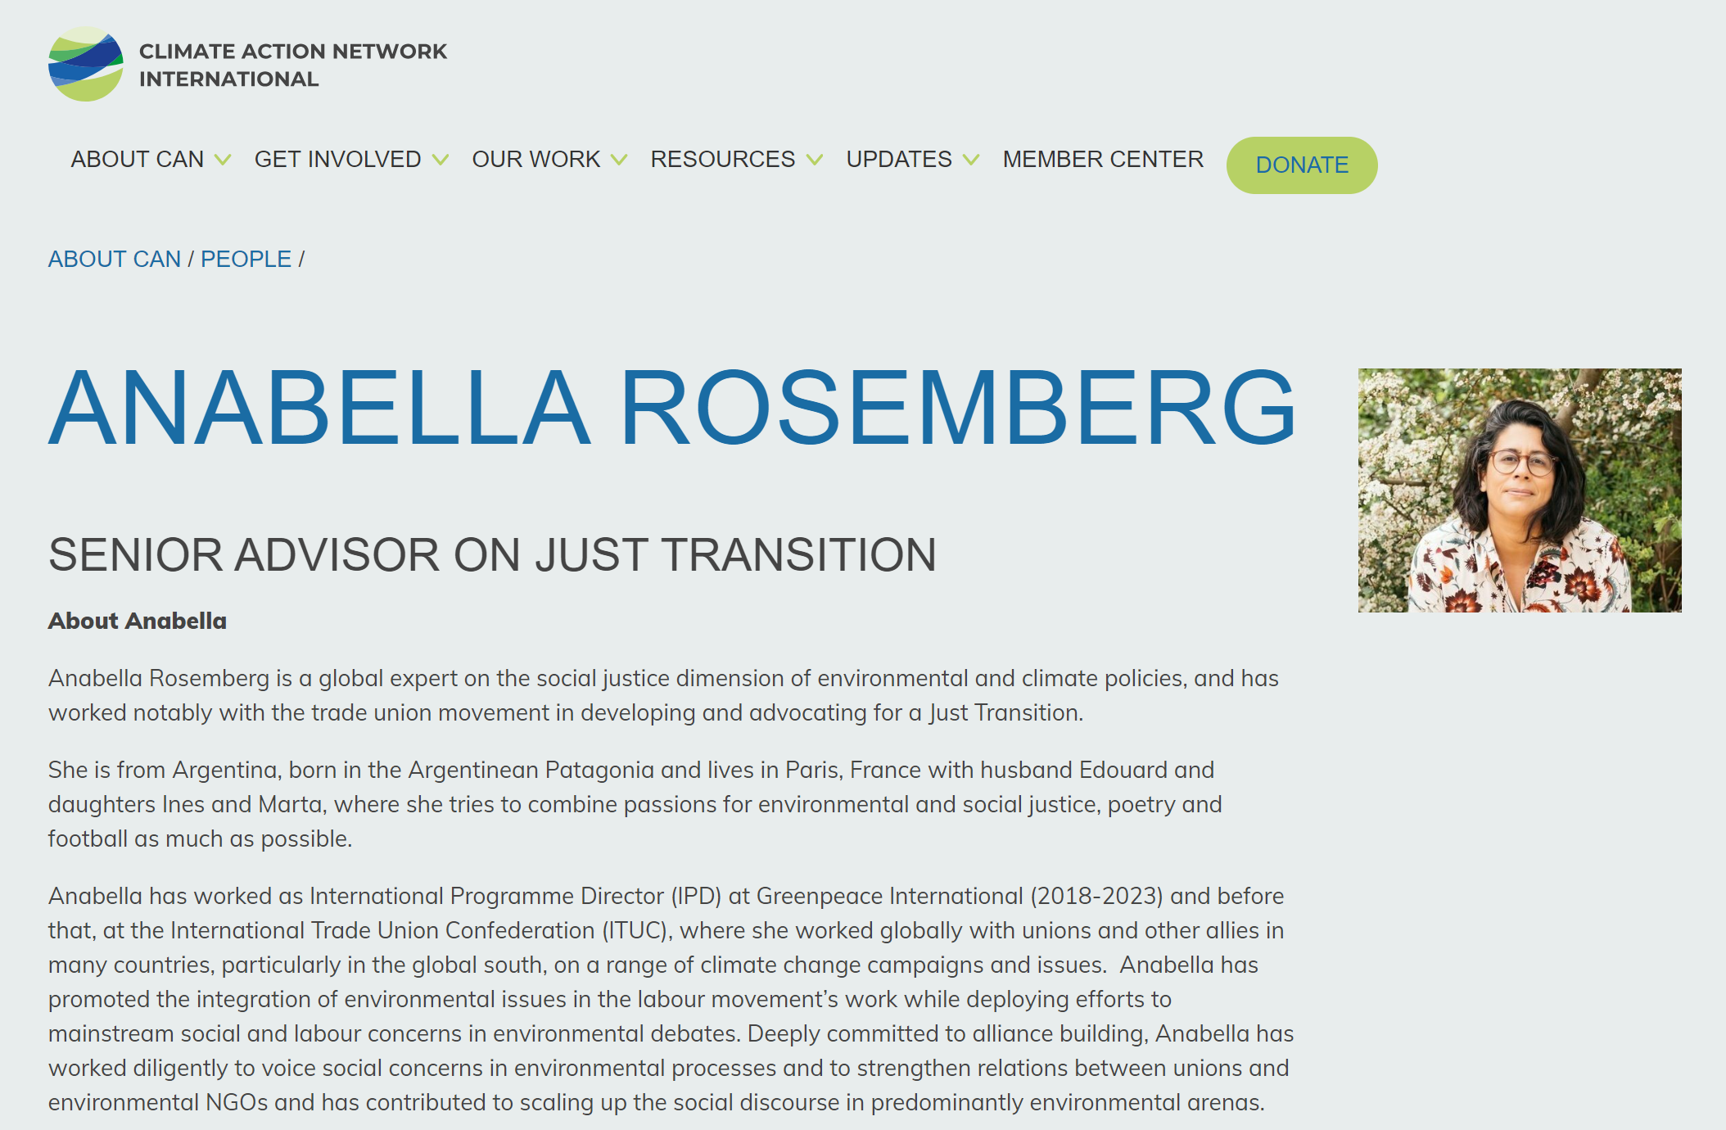

Slide 39
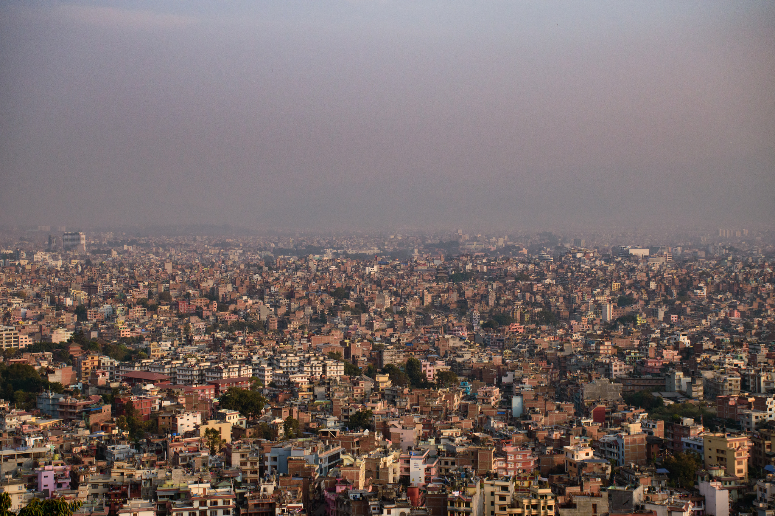
Who is responsible?

Slide 40
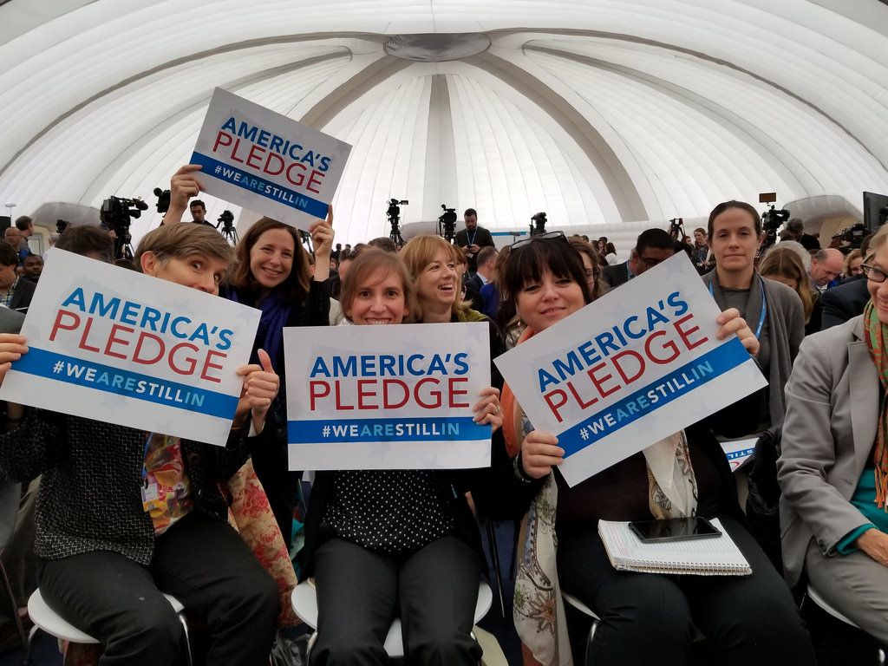

Slide 42
For next week:
Find information on Anabella.

