Slide 1
Week 10: Transnational Chinese cinema and coproductions
Dr Kiki Tianqi Yu

Slide 2
(Critical) transnational cinema
Transnational: tend to be used loosely, widely, and often without any definition.
Can it become something more distinct and specific than just a catch-all category for everything that is not national cinema, or a synonym for existing terms, such as ‘international cinema’ or ‘world cinema’?
Can transnational cinema be defined as a theoretical concept and a set of practices?
‘Critical transnationalism’ (Will Higbee and Song Hwee Lim, 2010)

Slide 3
Conditions of the rise of transnational cinema
Transnational cinema was “growing out of the conditions of globalization, shaped by neo-liberalism, ‘free trade’, the collapse of socialism, and post-Fordist production” (Berry 2010:112).
Transnational cinema marks “a different order of cinematic cultures and industries from the old national cinema order, even though it may emerge as a result of the same capitalist forces that helped to shape the earlier order” (Berry 2010:112).

Slide 4
The old order of nation states can be called as inter-national order.
In the transnational order, the nation state does not disappear. But individuals and corporations have greater relative autonomy from the state in regard to the economy at least and can operate economically across state borders more easily.
The transborder film-making activities in Greater China have been facilitated by this shift.

Slide 5
‘Globalization’ is used as part of the ideological rhetoric of globalism.
‘Transnational’ is used to refer to the specific ‘transborder projects’, Or, the transnational as a set of practice (Anna Tsing 2000).

Slide 6
Transnational cinema encompasses negotiations
National States and national cultures have not disappeared, and have actually “persisted, prospered and even proliferated in the new transnational order”.
Transnational cinema exists because of encounters and negotiations of national spaces, cultures, regulations and economic conditions, etc.
The ongoing encounter indicates that transnational cinema is very different from the fantasy of global smooth space often associated with the ideological rhetoric of globalism. (Berry 2010:113).

Slide 7
Multiple meanings
It can refer to big-budget blockbuster cinema associated with the operations of global corporate capital.
It can refer to small-budget diasporic and exilic cinema, such as “accented cinema”.
It can refer to independent films that challenge national identity…

Slide 8
Transnational Chinese film?
Complicated situation of PRC, Taiwan and Hong Kong:
For PRC: From the official perspective of the government of the People’s Republic, Taiwan is merely a renegade province and not a nation state in its own right.
For TW: And until 1991, the government of Taiwan saw Taipei as its temporary capital until it could return to legitimate rule over all of China.
Hong Kong has never been a nation state. It was a British colony until 1997, since which it has been under the rule PRC, but operating on a ‘one country, two systems’ policy that allows it to retain its pre-1997 laws until 2046, but this has been challenged in the recent governance of HK by PRC.
Or ‘transregional’?

Slide 9
Transnational in Chinese context
Famous examples: Asian martial arts blockbusters.
‘one of the potential weaknesses of the conceptual term “transnational cinema” […] [is that] it risks celebrating the supranational flow or transnational exchange of peoples, images and cultures at the expense of the specific cultural, historical or ideological context in which these exchanges take place’ (Higbee and Lim 2010: 11–12)

Slide 10
The increase in cross-border involvement in film production in the Greater China region.
Various treaties and agreements have eased the flow of money and personnel across borders of the People’s Republic, that flow has now increased to include all three territories.

Slide 11
Chen Kuo-fu 陈国富
Born in 1958 in TW, Chen started his career as a film critic before making his own film in 1989 with the debut School Girl. His films include Treasure Island, The Peony Pavilion, and The Personals.
In 2000 Chen became the head of the production unit of the Asian branch of Columbia Pictures. Accumulated experience in international film making and connections to young Chinese directors.
In 2006, joined Huayi Brothers Media Corporation as a producer and produced many commercially successful genre specific films.

Slide 12
Films Chen produced:
1998 | 《征婚启事》（The Personals）
2003 | 《天地英雄》（Warriors of Heaven and Earth）
2002 | 《双瞳》（Double Vision）
2003 | 《20 30 40》（20:30:40）
2004 | 《可可西里》（Kekexili
2004 | 《天下无贼》（A World Without Thieves）
2006 | 《心中有鬼》（The Matrimony)
2007 | 《集结号》（Assembly）
2007 | 《李米的猜想》（The Equation of Love & Death）
2008 | 《非诚勿扰》（If You Are The One）
2009 | 《风声》（The Message）
2010 | 《唐山大地震》（After Shock）
2010 | 《狄仁杰之通天帝国》（Detective Dee）
2010 | 《非诚勿扰2》（If You Are The One II)
2011 | 《星空》（Starry Night）
2011 | 《转山》（KORA）
2012 | 《画皮2》（Painted Skin II: The Resurrection ）
2012 | 《太极之从零开始》（Taichi：From Zero To Hero）
2012 | 《一九四二》（1942）
2013 | 《狄仁杰前传》（Detective Dee：Rise of The Sea Dragon）
2014 | 《人间小团圆》（Aberden）
2015 | 《鬼吹灯·寻龙诀》（TheGhouls）
2015 | 《少年班》 ^{[22]}
2016 | 《火锅英雄》 ^{[23]}
2016 | 《二代妖精之今生有幸》 ^{[24]}
2021 | 《我要我们在一起》 ^{[30]}

Slide 16
The number of Taiwanese feature films produced each year may be well down from its heyday, this decline does not mean that Taiwanese film-makers are not making films – they are just not making them in Taiwan so often anymore.
Similar patterns can be discerned for HK filmmakers.
Imports from TW&HK are limited by quota (20 then 34) in the same way as for any other foreign films. As a result, many HK and TW film-makers and investors are working and/ or moving their money to PRC to get direct access to the burgeoning mainland market.

Slide 17
Common Economic Partnership Arrangement (CEPA) in operation since 2003
According to CEPA conditions, Hong Kong films with a sufficient degree of mainland participation are treated in the same way as mainland films by the authorities in Beijing.
Such co-productions are not limited by the quotas and have free access to the mainland market.
Chan et al. (2010: 72) report that more than half of the annual output of Hong Kong films now are co-productions of this nature.
Hong kong cinema today, related reports:
https://variety.com/2021/biz/asia/hong-kong-film-industry-1234957370/
https://www.chinadailyhk.com/articles/97/98/200/1555383969931.html

Slide 18
The rise of production studies in Chinese cinema
Studies of transnational Chinese cinema marks a move away from text to the production and consumption cultures.
Studies on co-productions.
East Asian Screen Industries (Davis and Emilie Yueh-yu Yeh, 2008).

Slide 19
Film co-productions
Film co-productions “requires a deeper understanding of nuances, cultural complexity and entertainment values”.
Soft power competition: East Asian countries use pop culture exports to influence the opinions and attitude of international audience. Korea, Japan.
For a long time, China’s pop culture presence outside its borders is quite weak compared to other East Asian countries.
HK film and TV in SEA, being taken over by Korean TV dramas and Hollywood films.

Slide 20
The Chinese government has publicly stated its ambitions to use film coproductions as a way to enhance soft power capability through transfer of knowledge capital (skills and know-how).
Chinese filmmakers get to learn how to work with US partners, the United States is conceding some ground to achieve its market ambitions. Hollywood and the United States need access to China’s growing consumer market in order to continue their own growth.

Slide 21
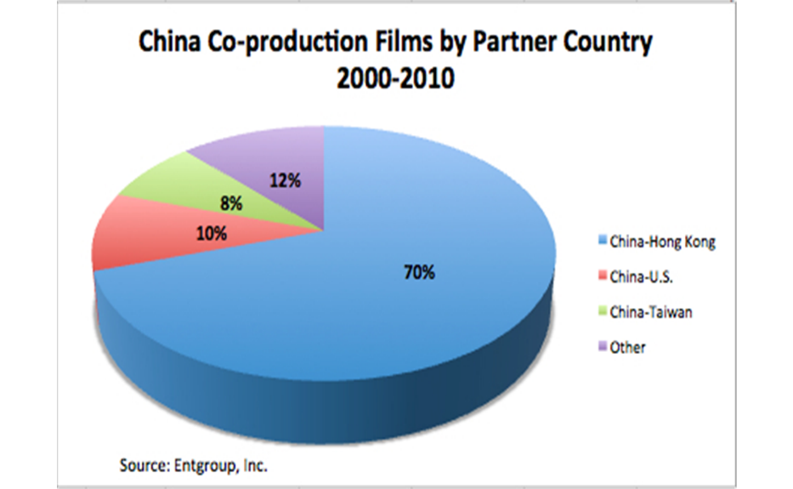
Most of China’s coproductions (68.5%) between 2002 and 2012 have been with Hong Kong;
China–US coproduction constitutes only 8.6% of the total (Zhan, 2013).

Slide 22
Fake coproductions
DMG then CEO Dan Mintz said, ‘there are many obstacles to overcome for China-US coproduction. The process of China-US coproduction is tough for Chinese filmmakers. The contradiction of interest and culture cannot be avoided’ (cited in Yang, 2012, p. 38).
Superficial changes with little investment from China.
Unnecessary/unimportant characters played by Chinese actors
Unnecessary location shooting in China that is not important to the storyline
Superficial product placement

Slide 23
Iron Man 3
The International Version and the Chinese version
Certain scenes with Chinese characters only exist in the Chinese version
https://collider.com/iron-man-3-chinese-only-scenes/

Slide 24
Transformers 4 (2014)
Only one version
Product placement
Featuring Chinese landmarks, and Chinese pop stars
Transformers 4 achieved a box office milestone; it was the first film to exceed US$300 million in box office revenue in China, a figure that was even higher than the film’s earnings in North America (McClintock, 2014).
Still regarded as an imported film rather than joint venture production. Seen by Chinese authorities as having insufficent Chinese elements.
Zhu: it sells American dreams rather than Chinese dreams – fight for soft power.

Slide 26
“The fake coproduction can be seen as a template during this transition stage. The template of inserting China into existing Hollywood blockbusters has mostly seen success at the Chinese box office, although the films have failed to achieve real coproduction status. In order to achieve ‘real’ coproduction status (i.e. joint production), positive Chinese elements, a significant Chinese cast presence and a greater proportion of Chinese investment are required. In this regard, China is using its market power to induce Hollywood’s cooperation and is using Hollywood’s global reach to ‘transmit favourable narratives and images about China to the Western (and Westernised) world’ (Homewood, 2014)”.
Weiying Peng, “Sino-US film coproduction: a global media primer, Global Media and China, 2016, Vol. 1(4) 295–311

Slide 27
Would a Hollywood film production with substantial amount of Chinese involvement still be appealing to global audiences?
Will Hollywood–China hybrids end up like those of China–Hong Kong, where audiences won’t be able to say whether a film is a Hollywood blockbuster, a Chinawood blockbuster or a Hollywood–China blockbuster?

Slide 28
Recommended reading:
Hollywood Made in China (Aynnes Kokas, 2017).
Made in Hollywood, Censored by Beijing (Tager, 2020)
Hollywood Diplomacy: Film regulations, foreign relations, and East Asian representations (Hye Seung Chung 2020)

Slide 29
Hero as a transnational Chinese film
cost US$31 million, is China's "largest-ever, mega-budget blockbuster."
Reportedly grossed 100 million yuan (US$12 million) during its first week.
In contrast, "Titanic" too two weeks to achieve the same level of success in 1998 when it was released in China.
Miramax purchased for US$20 million the North American and European rights.

Slide 30
Why Hero was so successful at the domestic box office?
Film distributors worked closely with law enforcement officials to crack down on piracy.
Chinese officials have blocked at least 20 websites providing illegal, video-format downloads of "Hero."
"If 'Hero' is pirated at the beginning of its screening in the Chinese mainland, it will lose half of its box office revenues," Zhang Yimou told China Central Television.

Slide 31
Hero
Negotiations on cultural, economic and regulation aspects.

