Slide 1
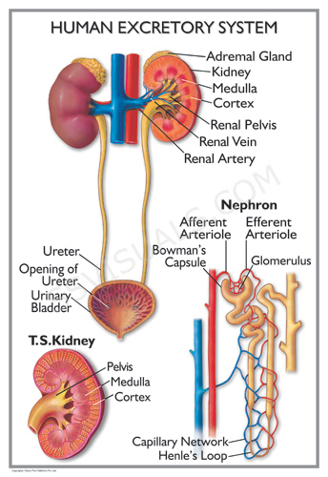
Renal system

Slide 2
Learning objective
“Students should demonstrate an understanding of the basic anatomy of the kidney and nephron. Students should demonstrate an understanding of the function of the nephron, how urine is produced via the countercurrent mechanism and how the water potential affects this. Students should understand the difference between haemodialysis and peritoneal dialysis and how urine can be used to test for substances.”

Slide 3
Lesson aims
By the end of the lesson, you should be able to:
1. Describe the structure of the kidney and the structure and function of the nephron
2. Describe the countercurrent mechanism and how water potential is controlled
3. Describe how salt damages the kidney
4. Describe two types of dialysis used in kidney failure and the advantages and disadvantages of both
5. Describe how urine can be used to test for different substances

Slide 4
Kidney structure
We have two bean-shaped kidneys, around 11cm in length, 150 g
Surrounded by fat (adipose tissue) – why?
Kidneys play a major role in excretion such as removing urea
They also regulate the water potential of blood (osmoregulation), pH balance, have a role in blood pressure regulation and red blood cell production (what hormone do they produce?)

Slide 5
Kidney structure
Kidneys are surrounded by a thin, strong fibrous capsule
Under the capsule is the cortex made up of convoluted tubules and renal corpuscles (glomerulus and Bowman’s capsule)
Within the medulla are renal pyramids (around 8 – 18 of them) separated by the renal column
There are minor and major calyces. The major calyces join up to form the renal pelvis which collects urine and funnels it into the ureter

Slide 6
Kidney structure
Blood enters the kidneys via the renal artery which divides and ends up as arterioles in the cortex
Arterioles split further into several very small blood vessels called a glomerulus (“tuft” of blood vessels) which sits in a cup-like structure called the Bowman’s capsule.
As blood flows through the glomerulus (in through the afferent arteriole and out through the efferent arteriole), substances are filtered out
The efferent arteriole is smaller than the afferent arteriole so blood in the glomerulus is under pressure

Slide 7
The nephron
The nephron is the functional unit of the kidney
Each kidney contains about a million nephrons
As blood in the glomerulus is under high pressure, fluid and small molecules are forced out of the capillary and into the Bowman’s capsule
Large molecules (e.g. proteins) are left behind as they cannot pass through the capillary wall, basement membrane and epithelium of the Bowman’s capsule

Slide 8
The nephron
The resulting filtrate in the Bowman’s capsule enters the nephron and anything useful to the body is reabsorbed
Selective reabsorption starts in the proximal convoluted tubule, continues in the loop of Henle and is finalised in the distal convoluted tubule
Anything that the body can use is reabsorbed by the capillaries wrapped around the nephron

Slide 9
The nephron
The proximal convoluted tubule (PCT) absorbs glucose, amino acids, vitamins and some salts
The epithelium of the PCT has microvilli to provide a large surface area for reabsorption with substances passing back into the surrounding capillaries
Reabsorption takes place via active transport and facilitated diffusion
125ml of filtrate is produced per minute by both kidneys - most of this is reabsorbed

Slide 10
The nephron
Some urea is also reabsorbed by diffusion
Much reabsorption of water takes place by osmosis
The water potential of blood is lower than that of the filtrate so water is reabsorbed along the loop of Henle, the distal collecting duct and the collecting tubule
The resulting filtrate enters the ureter and then stored in the bladder

Slide 11
Recap
Briefly summarise the structure of the nephron, how blood is filtered at the glomerulus and what is reabsorbed and where

Slide 12
Controlling water potential (water moves from an area of high water potential to lower water potential)
The amount of water in the blood needs to be kept constant
Water is lost via urine, sweat and in your breath
If the water potential of blood is too low (you are dehydrated), more water is reabsorbed by osmosis into the blood via the capillaries surrounding the tubules of the nephron
The resulting urine is darker, more concentrated and less is produced
If the water potential of blood is too high (you are very hydrated), less water is reabsorbed into the blood by osmosis from the tubules of the nephron
The resulting urine is pale, less concentrated and more is produced

Slide 14
Loop of Henle and the countercurrent multiplier mechanism
The loop of Henle comprises the descending limb and the ascending limb
This is the basis for the countercurrent multiplier mechanism
Na⁺ and Cl⁻ ions are actively pumped out near the top of the ascending limb into the medulla – this sets up a concentration gradient
Water cannot follow as this part of the limb is impermeable

Slide 15
Loop of Henle and the countercurrent multiplier mechanism
As there is now a high concentration of Na⁺ and Cl⁻ ions in the interstitial (tissue) fluid near the top of the descending limb, water potential here is lower than in the filtrate
As the water potential of the filtrate is higher than the water potential of the tissue fluid surrounding the descending limb, water leaves via osmosis and enters the blood

Slide 16
Loop of Henle and the countercurrent multiplier mechanism
Na⁺ and Cl⁻ ions also leave the lower part of the ascending limb via diffusion which makes the water potential of the tissue fluid in the medulla even lower
As the ion concentration in the medulla is increased, the water potential is lowered and this causes water to leave the collecting duct by osmosis

Slide 17
Osmoregulation and variation in water reabsorption
The longer the loop of Henle, the greater the reabsorption of water from the filtrate
Some animals living in hot conditions will have very long loops of Henle so they can conserve water
Humans can vary and control the volume of water reabsorbed via anti-diuretic hormone (ADH)
Water potential of blood is monitored by osmoreceptors in the hypothalamus
When the water potential is low, the hypothalamus signals to the ______________to produce ADH
ADH is released into the blood and travels to the distal collecting tubule and collecting duct to make them more permeable to water via aquaporins (water channels) which are embedded in the cell membranes
Water is therefore reabsorbed into the medulla and then into the blood
Less urine is produced and it is more concentrated

Slide 18
Osmoregulation
If someone drinks lots of water, osmoreceptors detect this in the hypothalamus
Less ADH is produced by the posterior pituitary
This leads to fewer aquaporins in the cell membrane being open
Less water is reabsorbed so more dilute urine is produced in larger volumes
This is an example of negative feedback
If someone eats a high salt diet, this can damage the kidneys as salt decreases the water potential of blood plasma leading to more water in blood vessels
Increased volume of water leads to increased blood pressure
An increase in blood pressure can damage the capillaries of the glomerulus (remember, they are already under increased pressure) so ultrafiltration is affected

Slide 19
Salt in blood plasma
Salt is able to dissolve easily in blood plasma
This happens because of unbalanced sharing of electrons leading to water having slightly positive and slightly negative ends
The slightly positive and slightly negative ends are then attracted to the positive and negative ions
The water molecules form groups or clusters around the ion which keeps them apart from each other, leading to the solute being dissolved

Slide 20
Recap
Briefly summarise the countercurrent mechanism
Include what happens at the different parts of the nephron with Na⁺, Cl⁻ and water
How does ADH affect water reabsorption?

Slide 21
Urine
Made up of water and dissolved salts
Some hormones and excess vitamins (which vitamins are excreted in urine – look this up)
Urine should not contain proteins, blood cells, glucose, amino acids
Urine is considered to be sterile (but…)
What is cystitis and pyelonephritis?
What are kidney stones?
How do pregnancy kits work?

Slide 22
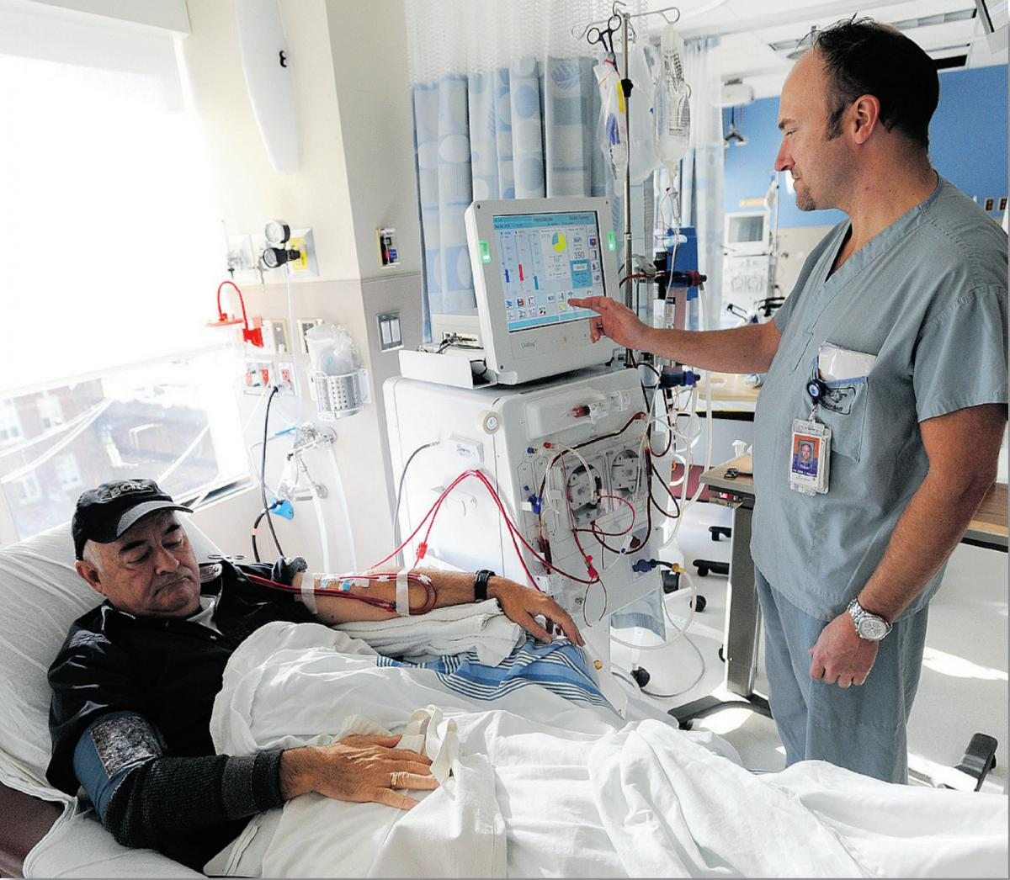
Kidney (renal) failure

Slide 23
Kidney failure and detecting chemicals
Kidneys can be damaged and fail to work properly by:
Infections – may cause inflammation which damages cells. This can lead to poor filtration at the Bowman’s capsule or poor reabsorption in the nephron
High blood pressure – this can lead to damage in the glomerulus. Pressure in the glomerulus is already high, so an increase can lead to the capillaries being damaged and large molecules like proteins escaping into the urine
Kidney failure can lead to:
Build up of waste products; build up of urea can cause weight loss and vomiting
Fluid accumulation – kidneys cannot remove water effectively so it builds up and causes swelling
Electrolyte imbalance – possible acidosis, or salt accumulation, disruption of calcium and phosphate can lead to osteoporosis
Anaemia – lack of haemoglobin and red blood cells (why?)

Slide 24
Dialysis
Two main types of dialysis – haemodialysis and peritoneal dialysis
Haemodialysis – patient’s blood is taken into a machine.
Blood is passed along one side of a partially permeable membrane while on the other side of the membrane is dialysis fluid
Waste products, excess water and ions diffuse through the membrane in to the dialysis fluid
Carried out in hospital 2-3 times a week and takes 3-5 hours

Slide 25
Peritoneal dialysis and kidney transplants
Dialysis fluid is introduced into the patient via a tube into the abdominal cavity
Waste passes from the patient’s blood across the peritoneum (membrane in the abdominal cavity) and into the dialysis fluid.
Dialysis fluid can then be drained.
Can be done overnight or several times during the day at the patient’s home but there is a risk of infection and there are no dialysis-free days
Kidney transplant can be from a living or dead donor
Has to be tissue-typed
Cheaper and more convenient than dialysis but involves an operation which always carries a risk and there is a risk of rejection so anti-rejection drugs are needed

Slide 26
Pregnancy test kits
Many tests involve examining urine
From early pregnancy, human chorionic gonadotrophin (hCG) is released and is excreted via urine (A)
The test kit contains antibodies to hCG and they are also attached to blue beads (B)
hCG binds to the antibodies (B) and continues to travel up the stick

Slide 27
Pregnancy test kits
Further up the stick are immobilised antibodies to hCG (C)
hCG then binds to the immobilised antibodies, concentrating the blue beads producing a line.
If no hCG is present (not pregnant), the antibodies pass straight through and no line is formed
Further up the stick are more immobilised antibodies (D) that recognise the other end of the antibodies from (B)
This is to prove that there was enough urine on the stick and that the test has worked

Slide 28
Drug testing
Athletes undergo regular drug testing
One groups of drugs to be misused are anabolic steroids
Urine is tested via gas chromatography/mass spectrometry (GC/MS)
Urine is vaporised and forced through a tube containing a polymer
Different substances move through the tube at different speeds and are separated
The separated substances are then converted to ions in a mass spectrometer to separate them further based on their mass and charge. This is compared to controls
Recreational drugs (e.g. cannabis, ecstasy or cocaine or their metabolites) can be tested for using test strips which have antibodies embedded into them. Colour reactions can occur in positive results which can lead to further testing using GC/MS

Slide 29
Questions
Why do people abuse anabolic steroids?
What are the effects and side effects of steroid abuse?
What other substances can be tested for in urine?

Slide 30
Lesson aims
By the end of the lesson, you should be able to:
1. Describe the structure of the kidney and the structure and function of the nephron
2. Describe the countercurrent mechanism and how water potential is controlled
3. Describe how salt damages the kidney
4. Describe two types of dialysis used in kidney failure and the advantages and disadvantages of both
5. Describe how urine can be used to test for different substances

