Slide 1
Covid-19: a tame or a wicked global health problem?
Dr Andrew Harmer
Notes:
What does covid 19 relate to things we have learnt in the last few months about global health governance and law?

Slide 2
Outline of today’s taster session
What is Covid-19?
What are tame problems?
What are wicked problems?
Is Covid-19 a tame or a wicked problem?
Notes:
Epidemiology is the branch of medicine which deals with the incidence, distribution, and possible control of diseases and other factors relating to health.

Slide 3
Covid-19
Notes:
Targets respiratory system
Transmitted through respiratory droplets and contact
Previous outbreaks of coronaviruses
SARS (2003)
MERS (2012-)
Covid-19 mortality about 1%
Covid-19 mortality much higher in older population
Covid-19 - Dec ‘19, cluster of patients in Wuhan, China
Linked to wet market (Huanan Seafood Wholesale Market)
Zoonotic: Originally from bats, possibly via pangolins

Slide 4
Notes:
Problem formulation: The problem is clear; there is agreement about it; and it can be stated as a gap between what is and what ought to be.
Testability: Potential solutions can be tested as either true or false.
Finality: Problems have a clear solution and end point.
Level of analysis: There’s a clear root cause; no doubt about what level to intervene; parts are easily separated from the whole.
Replicability: The problem may repeat itself many times; applying formulaic response produces predictable results.
Reproducibility: Solutions can be trialed and excluded until correct solution found.

Slide 5
A tame problem
The ‘problem’ is clear;
It has a clear beginning and end point;
There are clear ‘parts’ to the problem and we know when to intervene;
We can test and trial results until we get the ‘right’ solution.
Notes:
Problem formulation: The problem is clear; there is agreement about it; and it can be stated as a gap between what is and what ought to be.
Testability: Potential solutions can be tested as either true or false.
Finality: Problems have a clear solution and end point.
Level of analysis: There’s a clear root cause; no doubt about what level to intervene; parts are easily separated from the whole.
Replicability: The problem may repeat itself many times; applying formulaic response produces predictable results.
Reproducibility: Solutions can be trialed and excluded until correct solution found.

Slide 6
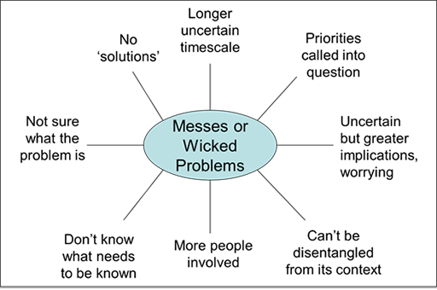

Slide 7
Is Covid-19 a ‘tame’ or a ‘wicked’ problem?
Spend a few moments writing down an answer to this question: what is ‘the problem’ of Covid-19?

Slide 8
There are, of course, multiple ‘problems’
Notes:
Should we close borders? WHO says no. And we don’t know what will happen until we try it? If we do, we might be described as being racist!

Slide 9
There are, of course, multiple ‘problems’
Notes:
Should we close borders? WHO says no. And we don’t know what will happen until we try it? If we do, we might be described as being racist!

Slide 10
There are, of course, multiple ‘problems’
Notes:
Should we close borders? WHO says no. And we don’t know what will happen until we try it? If we do, we might be described as being racist!

Slide 11
There are, of course, multiple ‘problems’
Notes:
Should we close borders? WHO says no. And we don’t know what will happen until we try it? If we do, we might be described as being racist!

Slide 12
Does the pandemic have a clear beginning and end?
Spend a few moments writing down an answer to this question: when did the pandemic start?
Notes:
Trump – it will all be over by Easter, Christmas, etc

Slide 13
I am sure your answer was ‘no’ but, if not, consider...
In many countries, Covid-19 is just beginning;
Were we prepared?
A vaccine may end the pandemic but the health consequences of economic recession or even depression will continue.

Slide 14
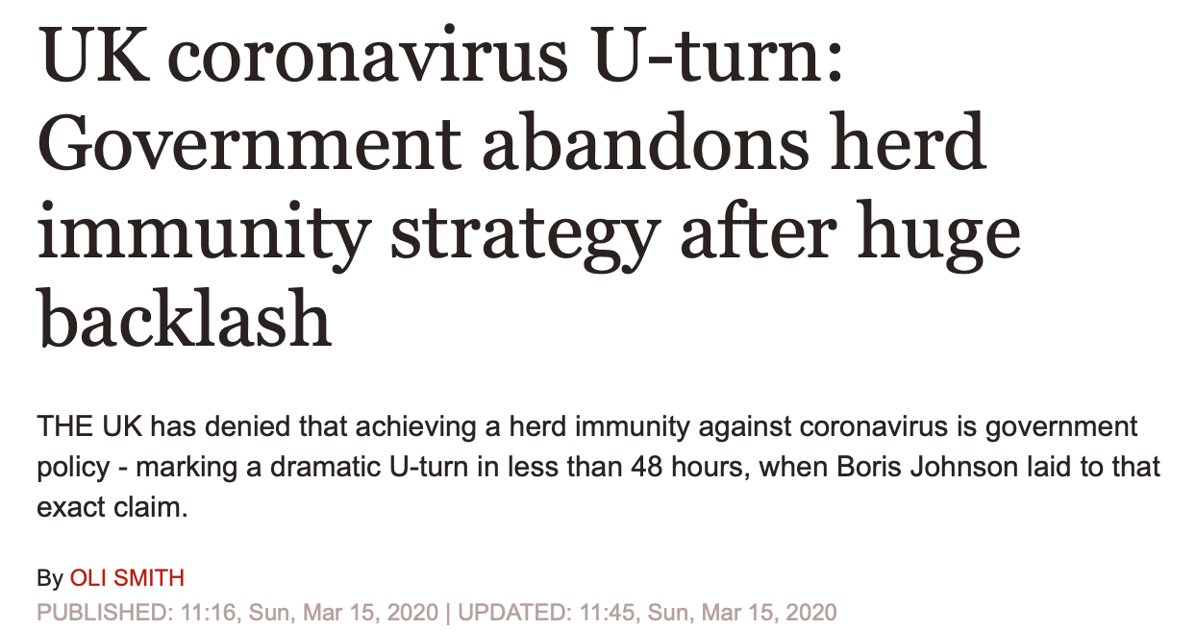
Are there clear parts to the problem? Do we know when to intervene?

Slide 15
Can we test and trial results until we get the ‘right’ solution?
Solutions to wicked problems evolve over time;
Problems only become apparent once solutions have been applied.

Slide 16
Covid-19 is a ‘wicked’ not a ‘tame’ problem.
The problem is difficult to define and there is no agreement about it;
No single set of criteria exist to determine if a solution is right or wrong;
There is no beginning or end point;
There are multiple levels of intervention and the parts aren’t easily separable from the whole;
Every problem is unique so be wary of ready formulae, which will have limited value;
There are no trial opportunities; once you try something, it’s difficult/can’t be undone.
Notes:
Listen to your intuition – what do you feel is right?
Science – what does it tell us?
What did others do?
Rigorous decision-making process.

