Slide 1
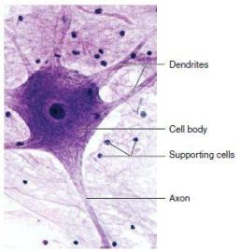
The nervous system
Neurones and receptors

Slide 2
Learning objective
“Students should understand the different types of neurone, their anatomical differences and how action potentials are generated. Students should be able to explain the “all-or-nothing” principle.”

Slide 3
Lesson aims
By the end of the lesson, students should be able to:
1. describe the different types of neurone and their roles;
2. how myelinated neurones differ from non-myelinated neurones and saltatory conduction;
3. the different stages of an action potential.
4. the “all or nothing” principle.

Slide 4
Neurones and receptors
We have respond or act to changes or stimuli externally (eg temp) and internally (eg glucose levels) in order to survive
Receptors are designed to detect changes and effectors are designed to cause an appropriate response
Receptors and effectors are connected via neurones - specialised cells which are part of the nervous system. There are three types:
Sensory neurones – conveying nerve impulses (electrical signals or action potentials) from receptors to the central nervous system about something that has happened
Motor neurones – convey nerve impulses from the central nervous system (CNS) to effectors to make something happen in response
Relay neurones – carry nerve impulses between sensory and motor neurones

Slide 5
Neurones
Sensory neurones – short dendrites and one long dendron. Short axon carrying impulse from cell body to terminal then impulse is passed to relay neurone in CNS
Relay neurone (intermediate neurone) – lots of short dendrites to carry impulse from sensory neurone to cell body and then impulse continues to terminals and onto motor neurone
Motor neurone – lots of short dendrites that carry impulse from CNS along a long axon to effector cells

Slide 6
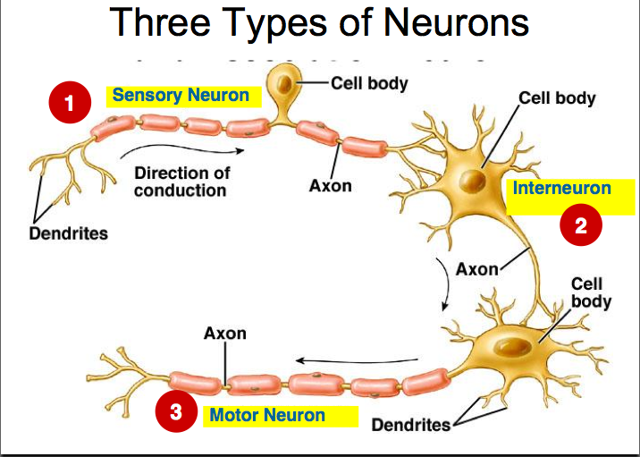

Slide 7
Motor neurone disease (MND)
What is MND?
What are the symptoms?
What is the prognosis?

Slide 9
Sequence of events
Stimulus (change) is detected by receptor cell
Nerve impulse (action potential) is sent along a sensory neurone
At the end of the sensory neurone, chemicals (neurotransmitter) are released and cross synapse (gap between neurones) to start nerve impulse in a new neurone
The CNS receives the information (impulses), makes a decision and sends an impulse back via a motor neurone to an effector (eg muscle)

Slide 10
Sensory neurones and nerve impulses
Sensory neurones react to different stimuli – eg light energy or chemical energy – and convert the energy of the stimulus into electrical energy as the nervous system sends messages in the form of electrical impulses
Sensory receptors are similar to transducers – something that converts energy from one form into another form
When sensory receptors are not being stimulated, they are in a resting state
During this resting state, there is a difference in charge between the outside and inside of the cell so there is a voltage – or potential difference – across the membrane
The difference in charge (potential difference) is maintained via ion pumps and ion channels

Slide 11
Sensory neuropathy
What is sensory neuropathy?
What are the symptoms?
What can cause it?

Slide 12
Nerve impulse
When a cell is resting, the potential difference is called its resting potential
When the receptor is stimulated, the cell membrane becomes more permeable and enters an excited state
Ions can now cross the membrane which changes the potential difference – this is called the generator potential
If the stimulus is large enough, there is a large movement of ions across the membrane and if this reaches the threshold level, an action potential can be generated
To get an action potential, the stimulus has to be large enough to reach the threshold level

Slide 13
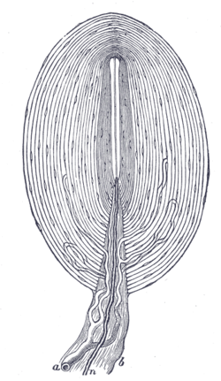
Pacinian corpuscles
Pacinian corpuscles are the bound end of a sensory nerve and detect vibration and pressure in skin - mechanoreceptor
The nerve end is covered by layers (lamellae) of connective tissue and forms an onion-like shape
When the skin is pressed, the lamellae deform and push against the nerve ending
This deforms stretch-mediated sodium channels in the sensory nerve membrane
Sodium channels open so positive sodium ions flood into the nerve cell resulting in a generator potential
If the generator potential reaches the threshold, an action potential will be generated

Slide 14
Polarised membranes
Resting state – positive charge outside the cell membrane compared to inside cell as there are more positive ions outside
Difference in charge between fluids outside and inside cell – polarisation
Voltage (potential difference) exists in resting cells = resting potential (about -70mV)
Resting potential is maintained by sodium-potassium pumps (active transport) and potassium channels (facilitated diffusion)
The sodium –potassium pump pumps 3 sodium ions out for every two potassium ions back into the cell forming a sodium electrochemical gradient
Sodium cannot diffuse back into the cell but potassium can sneak back in via a facilitated diffusion channel

Slide 15
Sodium and potassium movement
Sodium –potassium pump involves active transport so ATP is needed to pump ions against their concentration gradient
3 sodium ions are moved out and 2 potassium ions are moved into the cell
The cell membrane is impermeable to sodium ions but potassium can leave via facilitated diffusion
Outside the nerve cell is positive relative to the inside

Slide 16
Quick questions
How do sensory, motor and relay neurones differ?
How is the resting potential maintained in neurones?
Pacinian corpuscles can be described as transducers – why?
How is the generator potentials generated in Pacinian corpuscles when they are stimulated?
What happens to a cell membrane when a stimulus is detected and what does it lead to?
What happens if the generator potential is big enough?

Slide 17
Action potentials - STIMULUS
Neurone cell membrane is excited by a stimulus
Leads to sodium ion channels opening
Sodium ions move into cell down electrochemical gradient
Makes inside of neurone less negative

Slide 18
Action potentials DEPOLARISATION
If potential difference reaches the threshold - 55mV- voltage-gated sodium ion channels open
Even more sodium floods into the neurone
Get even more depolarisation – positive feedback

Slide 19
Action potentials REPOLARISATION
Once potential difference reaches around +30mV, sodium ion channels close and voltage-gated potassium ion channels open
Membrane is more permeable to potassium so potassium ions diffuse out of cell down concentration gradient
Membrane potential starts to return to resting potential (repolarisation). This is negative feedback

Slide 20
Action potentials HYPERPOLARISATION
Potassium ion channels close but they are slow so more potassium ions leave the neurone and the potential difference becomes even more negative than the resting potential
However, sodium-potassium pump are working to restore the resting potential

Slide 21
Action potentials REFRACTORY PERIOD
Once an action potential has passed, there is a slight delay before the neurone can be excited again – refractory period
Ion channels have to recover
Sodium ion channels are closed during repolarisation
Potassium channels are closed during hyperpolarisation

Slide 22
Recap
Outline the stages during an action potential.
Include which ions move where, which channels are open or closed and correct terminology

Slide 23
Action potential moves along neurone
When sodium ions enter the neurone during depolarisation, some ions diffuse sideways
This results in neighbouring sodium ion channels opening
This causes a wave of depolarisation along the neurone
The wave of depolarisation moves away from membrane which is in refractory period

Slide 24
Bigger stimuli cause more frequent impulses
It does not matter how big a stimulus is - once the threshold is reached an action potential will be fired
If the threshold is not reached, no action potential is fire
All-or-nothing principle
Large stimuli do not cause a larger action potential but they could cause more frequent action potentials

Slide 25
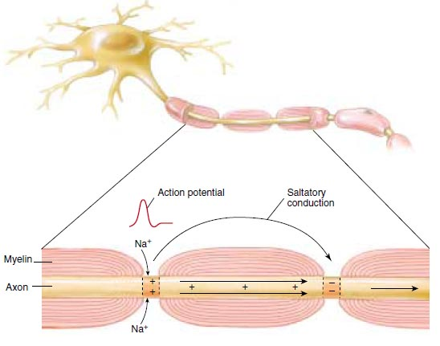
Myelinated neurones
Myelin sheaf – fatty, insulating covering around axon
Myelin is produced by Schwann cells in the peripheral nervous system and oligodendrocytes in the central nervous system
Conduction of action potentials is faster in myelinated neurones
Between Schwann cells are gaps in the myelin called nodes of Ranvier
Lots of sodium ion channels are concentrated at the nodes of Ranvier

Slide 26
Myelinated neurones
Depolarisation will only happen at unmyelinated nodes of Ranvier as this is the only part where sodium ions can get through to the neurone membrane
Impulses jump from node to node as the neurone’s cytoplasm conducts the electrical charge and depolarises the next node
Called “saltatory conduction” and this is fast
In non-myelinated neurones, impulses move along the axon in a wave-like way - slow

Slide 27
Questions
How does an action potential move along a non-myelinated neurone?
Describe saltatory conduction
What is multiple sclerosis?
What are the symptoms?
What causes the symptoms?

Slide 28
Summary
There are three basic types of neurone with clearly defined roles
Action potentials are triggered by a stimulus
Sodium ion channels in the neurone cell membrane open so sodium flood into neurone
This leads to depolarisation and more sodium ions flood in
Sodium ion channels shut and potassium ion channels open so potassium leaves neurone and neurone starts to repolarise
Neurone cell membrane returns to its resting potential
Refractory period – neurone can’t be stimulated
Saltatory conduction – impulse jumps from node to node - fast

Slide 29
Lesson aims
By the end of the lesson, students should be able to:
1. describe the different types of neurone and their roles;
2. how myelinated neurones differ from non-myelinated neurones and saltatory conduction;
3. the different stages of an action potential.
4. the “all or nothing” principle.

