Slide 1
PSA Masterclass 3 PWS questions with answer suggestions 15th November & 6th December 2024
Patricia McGettigan
Clinical Pharmacologist
Head of CPT teaching, QMUL MBBS

Slide 2
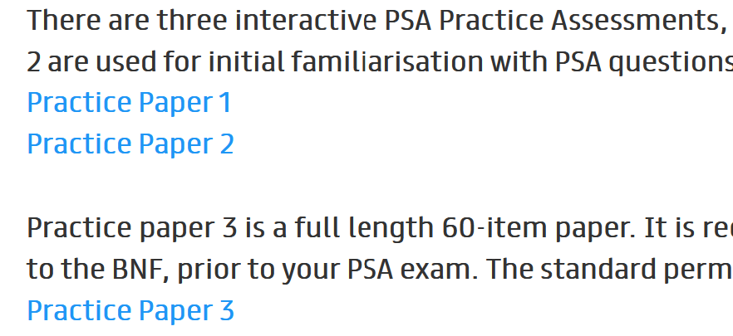
PSA Practice questions – A great resource for you https://prescribingsafetyassessment.ac.uk/Assessment
Sign In to access the papers
Two papers of 30-Q each
One 60-Q paper that can be used as practise in exam conditions
Answers / explanations provided at the end of each paper
Tip: Use the Prescribing Q search boxes to familiarise yourself with finding various medicines, their forms – parenteral, oral, liquid, tablet, etc, how the dosing instructions appear, frequency, etc
Very useful for seeing how fluids are described, how combination medicines are listed

Slide 3
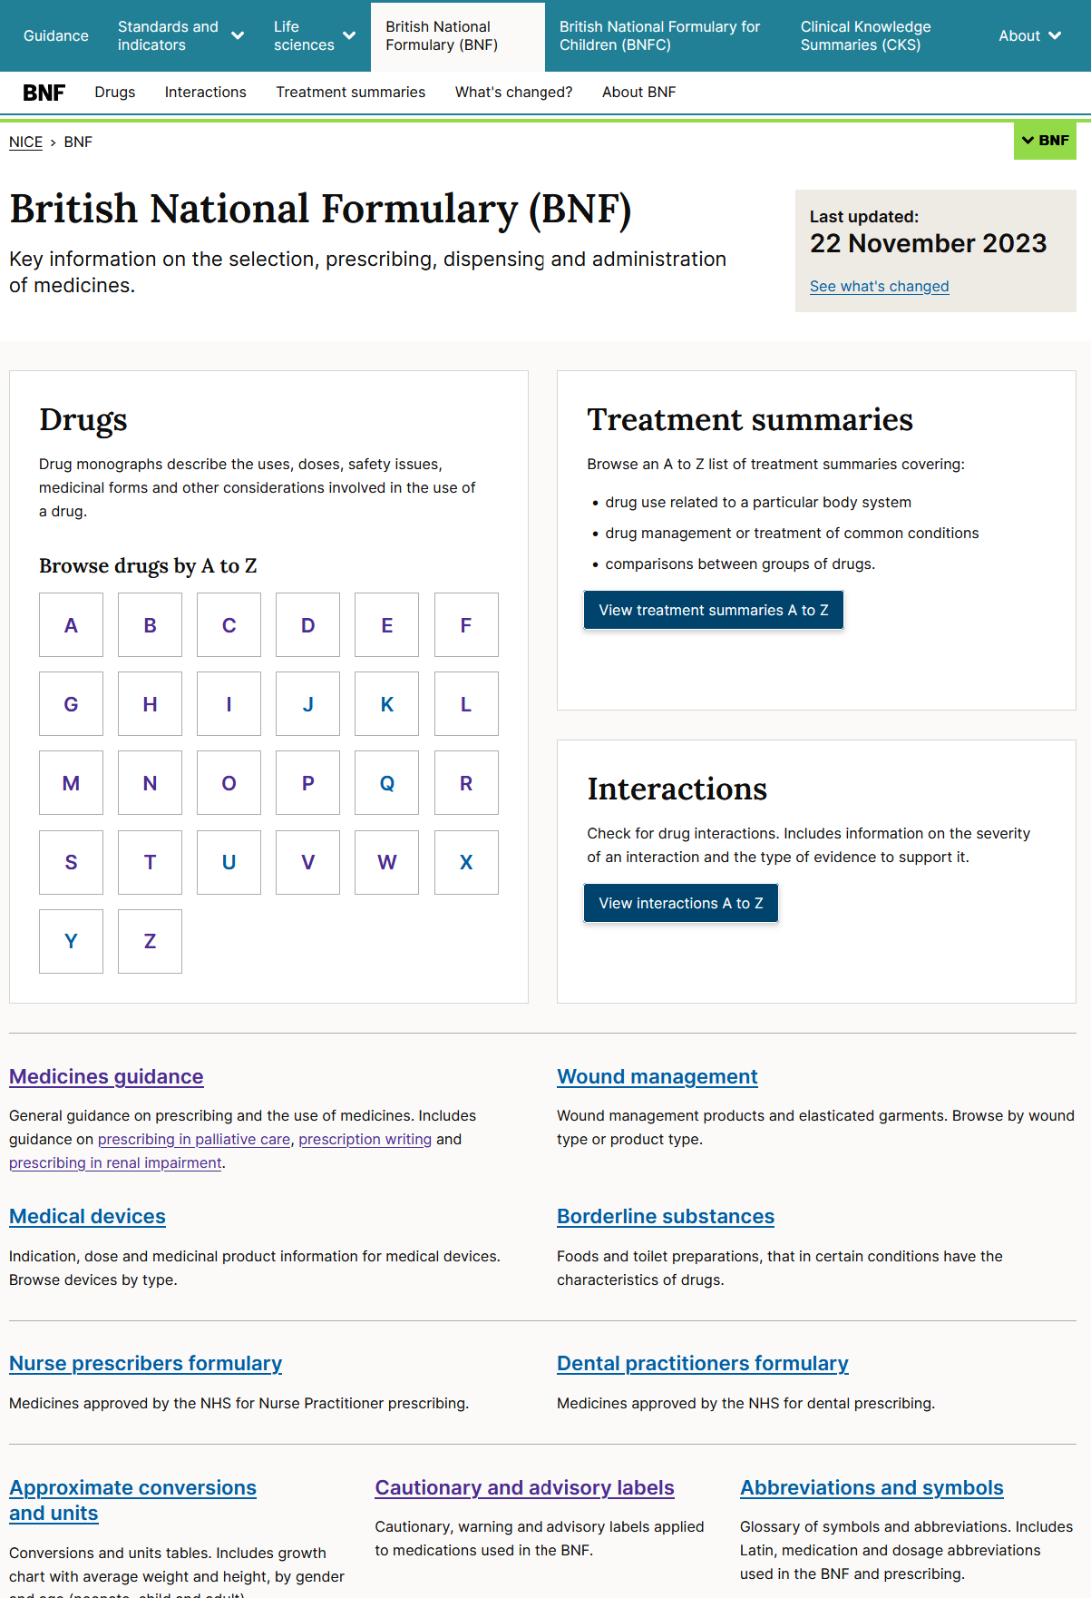
BNF
Spend some time to recall what’s in the BNF – well worth a good look
https://bnf.nice.org.uk/ → https://bnf.nice.org.uk/medicines-guidance/

Slide 4
Recent questions re PSA
Are the PSA papers different from each other?
Yes: Some ‘anchor’ Q, not many, are common across all the papers. Otherwise, Q are different on each paper. Every Q is standard set individually, hence, the pass score for each paper varies a bit.
Do the practice papers when they are made available by MSC–BPS in January 2025 before the PSA
Added Value: In the PWS questions use the prescribing dropdown drug list ‘box’ to practise finding products, especially 1) IV fluids; 2) combination products, e.g., inhalers, HRT, COC.

Slide 5
PWS-1: Hospital once-only
Case 1: A 72y old woman is having cardiac pacemaker insertion today.
Q: Prescribe an appropriate drug to be administered as prophylaxis against infection in advance of the procedure.

Slide 6
PWS-1: Hospital once-only
Case 1: A 72y old woman is having cardiac pacemaker insertion today.
Q: Prescribe an appropriate drug to be administered as prophylaxis against infection in advance of the procedure.
Answer: Cefuroxime 1.5 grams IV 30 minutes before the procedure – this is the only single drug option advised in the BNF; other options are dual antibiotics.
Note: This Q could be written to say that she has had a single dose of flucloxacillin IV and asking you to prescribe a 2nd suitable drug, single dose; this opens up the options to include gentamicin, teicoplanin or vancomycin. See https://bnf.nice.org.uk/treatment-summaries/antibacterials-use-for-prophylaxis/#infective-endocarditis-antibacterial-prophylaxis (Cardiology Procedures).
Make sure you know where to find the very useful BNF section on Antibacterial prophylaxis. Many conditions / procedures are listed – very helpful for PWS & for other PSA questions provided you know where to locate https://bnf.nice.org.uk/treatment-summaries/antibacterials-use-for-prophylaxis/

Slide 7
https://bnf.nice.org.uk/treatment-summaries/antibacterials-use-for-prophylaxis/#infective-endocarditis-antibacterial-prophylaxis

Slide 8
Case 2: An 88y old man admitted with a LRTI and commenced on IV antibiotics, usually well and living independently, has developed infection-associated delirium.
This has not improved with non-drug therapy; he has pulled out his IV cannula and is hypoxic on room air (90%); he refuses oral medicines and inhaled oxygen.
Q: Prescribe a once-only initial therapy to help his situation and facilitate his care.

Slide 9
Case 2: An 88y old man admitted with a LRTI, usually well and living independently, has developed infection-associated delirium that has not improved with non-drug therapy; he has pulled out his IV cannula and is hypoxic on room air (90%); he refuses oral medicines and inhaled oxygen.
Q: Prescribe a once-only initial therapy to help his situation and facilitate his care.
Answer: IM haloperidol 500 microg is reasonable https://bnf.nice.org.uk/drugs/haloperidol/#indications-and-dose
Though sometimes used in practice, lorazepam and promethazine do not have current BNF-listed indications for delirium - wise to avoid these and to choose haloperidol.
‘Elderly delirium’ previously a topic in BNF Treatment summaries is no longer listed.
For your learning, note the ‘Important Safety Information’ section

Slide 10
Case 3: A 6-month old baby girl, 7Kg, in the Paediatric A&E unit, is to be admitted for treatment of moderately severe croup. She is refusing feeds and oral fluids.
Q: Prescribe an initial therapy to be given now to help treat her condition.

Slide 11
Case 3: A 6-month old baby girl, 7Kg, in the Paediatric A&E unit, is to be admitted for treatment of moderately severe croup. She is refusing feeds and oral fluids.
Q: Prescribe an initial therapy to be given now to help treat her condition.
Answer: In A&E, so IV Dexamethasone 150 microg/Kg immediately, single dose, is reasonable; IV access is likely available in A/E; Q may say she has an IV cannula;
BNF says oral or IV (in Dexamethasone monograph); Treatment Summary says IM ‘while awaiting admission’, i.e., before hospital. As she in A&E here & is refusing feeds/fluids, IV best option for this child - pick the right formulation from the drop-down
https://bnfc.nice.org.uk/treatment-summaries/croup/
https://bnfc.nice.org.uk/drugs/dexamethasone/#indications-and-dose
Dose: 150 x 7 = 1050 microg – so round this to 1mg (1000 microg)

Slide 12
Case 3: A 6-month old baby girl, 7Kg, in the Paediatric A&E unit, is to be admitted for treatment of moderately severe croup. She is refusing feeds and oral fluids.
Alternative Q: seen in GP surgery – prescribe a suitable initial therapy
https://bnfc.nice.org.uk/treatment-summaries/croup/

Slide 13
Case 4: A 46y old man admitted with a large upper GI bleed has just had endoscopy that found a small gastric ulcer with evidence of recent bleeding; Post-procedure he is stable, on IV fluids and remains fasting.
Q: Prescribe one drug for initial treatment to reduce gastric acid secretion

Slide 14
Case 4: A 46y old man admitted with a large upper GI bleed has just had endoscopy that found a small gastric ulcer with evidence of recent bleeding; Post-procedure he is stable, on IV fluids and remains fasting.
Q: Prescribe one drug for initial treatment to reduce gastric acid secretion
Answer: IV PPI; NB needs loading, e.g., omeprazole; Initially 80 mg IV over 40–60 minutes – this is all you need to prescribe
On the ward, it would be followed by continuous intravenous infusion of 8 mg/hour for 72 hours, subsequent dose then changed to oral therapy https://bnf.nice.org.uk/drugs/omeprazole/?ref=switch#indications-and-dose
Alternative Q: you are told he’s had 80mg IV over 1h & asked to prescribe appropriate ongoing therapy – this would be the omeprazole IV 8 mg/hour for 72 hours.

Slide 15
PWS-2: Hospital regular prescription
Case 1: A 72y woman has recurrent COPD exacerbations requiring oral steroids and antibiotics. Her current inhaled therapy is aclidinium 340 micrograms/formoterol 12 micrograms/dose (Duaklir Genuair®) (Dry Powder inhaler, DPI) 2 INH 12-hrly; salbutamol 200 micrograms, 1 INH as required.
It is agreed to step-up her preventer therapy and commence an inhaled corticosteroid. She wishes to have a single preventer inhaler only.
Q: Prescribe a suitable product for her

Slide 16
PWS-2: Hospital regular prescription
Case 1: A 72y woman has recurrent admissions with exacerbation of COPD needing oral steroids and antibiotics. Her current inhaled therapy is glycopyrronium / formoterol (Bevespi Aerosphere) inhaler, 2 INH 12-hrly; salbutamol 200 micrograms inhaler, 1 INH as required.
It is agreed to add an inhaled corticosteroid to her therapy. She wants a single preventer inhaler only.
Q: Prescribe a suitable product for her
Answer: COPD Tx Summary says LAMA/LABA/ICS (triple therapy) now https://bnf.nice.org.uk/treatment-summaries/chronic-obstructive-pulmonary-disease/ She wants a single inhaler so Trimbow (MDI) or Trimbow NEXThaler (DPI) suitable; other triple-therapy options as per links below are also fine – same classes of drugs.
https://bnf.nice.org.uk/drugs/beclometasone-with-formoterol-and-glycopyrronium/#indications-and-dose; (Trimbow)
https://bnf.nice.org.uk/drugs/fluticasone-with-umeclidinium-and-vilanterol/
https://bnf.nice.org.uk/drugs/mometasone-furoate-with-glycopyrronium-bromide-and-indacaterol/
Fewer / any (?) marks if ICS/LABA only device prescribed as will need LAMA separate & wanted single device.
This type of Q could also be a GP prescription – See similar case, PWS-4 Case 5

Slide 17
Case 2: A 55y old man has just been diagnosed with pulmonary embolus. He requires anti-coagulation but does not want to have frequent blood tests, if possible. He is stable clinically.
Q: Prescribe suitable anti-coagulation therapy for him to commence now.

Slide 18
Case 2: A 55y old man has just been diagnosed with pulmonary embolus. He requires anti-coagulation but does not want to have frequent blood tests, if possible. He is stable clinically.
Q: Prescribe suitable anti-coagulation therapy for him to commence now.
Answer: Apixaban / Rivaroxaban suitable - both have VTE tx indication & NICE first line - but note high starting dose for a week or so; no mention of renal function – so assume normal indices
Dabigatran or edoxaban need prior tx with LMWH according to the BNF Treatment Summary
LMWH less good choice owing to NICE guidance https://bnf.nice.org.uk/treatment-summaries/venous-thromboembolism/ so likely scores lower than DOAC – and remember, he has to go home on therapy so starting DOAC makes practical sense

Slide 19
Case 3: A 57y old man with alcoholism accidentally overdosed on narcotics. His GCS was 8 and capillary glucose 3.0 on admission. He had naloxone and glucose infusions with good effect and is well and alert with stable glucose and is able to eat. Chlordiazepoxide prn has been prescribed in anticipation of alcohol withdrawal symptoms.
Q: Prescribe an appropriate further medication to minimise his risk of cerebral harm.

Slide 20
Case 3: A 57y old man with alcoholism accidentally overdosed on narcotics. His GCS was 8 and capillary glucose 3.0 on admission. He had naloxone and glucose infusions with good effect and is currently alert, with stable glucose and is able to eat. Chlordiazepoxide prn has been prescribed in anticipation of alcohol withdrawal symptoms.
Q: Prescribe an appropriate further medication to minimise his risk of cerebral harm.
Answer: Prophylaxis (or tx) of (Wernicke’s) encephalopathy is needed – parenteral thiamine, available as Vitamin B complex (Pabrinex) https://bnf.nice.org.uk/drugs/vitamin-b-substances-with-ascorbic-acid/
You have to make this interpretation from the information in the Q and your own clinical knowledge; cerebral harm is a good prompt but you need to know that this means encephalopathy, specifically Wernicke’s
https://bnf.nice.org.uk/treatment-summaries/alcohol-dependence/ Scroll down to find Wernicke’s – then there is a link for “Parenteral thiamine is available as part of a vitamin B substances with ascorbic acid preparation.” Note where / how to find the parenteral formulation in the BNF which is what is needed here. Thiamine alone is available as an oral formulation, not parenteral.

Slide 21
Case 4: A 40y man with ulcerative colitis is admitted with 48h of profuse bloody diarrhoea; already commenced on IV fluids. Regular Tx: Mesalazine orally daily – adherent. He has no allergies.
Q: Prescribe appropriate initial therapy to manage his relapse

Slide 22
Case 4: A 40y man with ulcerative colitis is admitted with 48h of profuse bloody diarrhoea; already commenced on IV fluids. Regular Tx: Mesalazine orally daily – adherent. He has no allergies.
Q: Prescribe appropriate initial therapy to manage his relapse
Answer: Hydrocortisone IV; range 100–500 mg 3–4 times a day; See https://bnf.nice.org.uk/drugs/hydrocortisone/ and ‘Severe inflammatory bowel disease’ in the long list of indications
Methylprednisolone IV also an option https://bnf.nice.org.uk/treatment-summaries/ulcerative-colitis/#drug-treatment

Slide 23
PWS-3: IV fluids
Case 1: A 70y old patient with CKD-4 and IHD is referred to A/E by his GP with K+ of 6.4mmol/L. He is stable clinically. His ECG is shown.
Q: Prescribe appropriate therapy for immediate administration

Slide 24
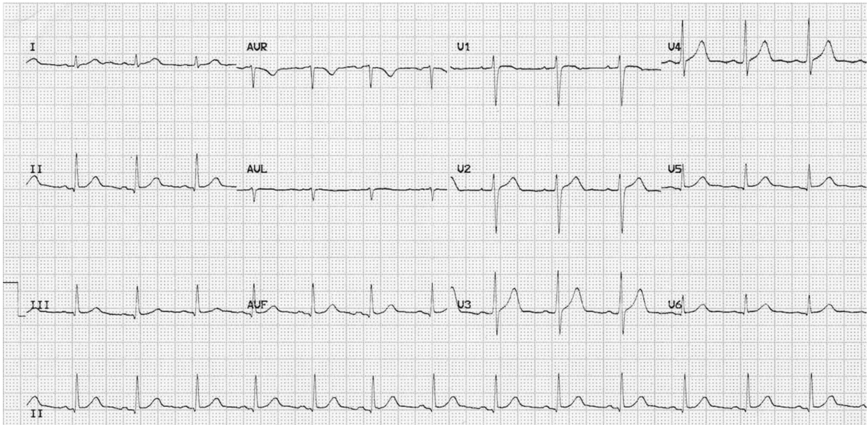
PWS-3: IV fluids
Case 1 alternative: A 70y old patient with CKD-4 and IHD is referred to A/E by his GP with K+ of 6.4mmol/L. He is stable clinically. His ECG is shown.
Q: Prescribe appropriate therapy for immediate administration.

Slide 25
PWS-3: IV fluids
Case 1: A 70y old patient with CKD-4 and IHD is referred to A/E by his GP with K+ of 6.4mmol/L. He is stable clinically. His ECG is shown.
Q: Prescribe appropriate therapy for immediate administration
Answer Case 1: For hyperkalemia with ECG changes, Ca gluconate 10% in single dose of 30mL https://bnf.nice.org.uk/drugs/calcium-gluconate/#indications-and-dose Ca chloride is mentioned in https://bnf.nice.org.uk/treatment-summaries/hyperkalaemia/ but note ‘unlicensed indication’; the patient is not ‘peri-arrest’.
Answer Case 1 alternative: No ECG changes, soluble insulin (e.g., Actrapid) 10-20units in 100mL of 20% glucose IV over 5-15min would be suitable.
In this case, Ca gluconate is less suitable than Insulin/Glucose because there is no evidence of cardiac membrane instability; It will still score, but lower on selection / drug choice section
The fluid & e’lytes tx summary is very useful re composition of various fluids – good to be aware
This Q is more likely to show up in a PSA MAN question because the PSA platform does not have a facility to add a drug to a fluid in a PWS question (see PSA Q papers https://prescribingsafetyassessment.ac.uk/Assessment ). In MAN, you’d have the scenario + ECG and the Q would ask you to select the most appropriate option from a list of 5 options.
Your ECG knowledge directs the selection of most appropriate therapy here

Slide 26
Case 2: A 66y old man admitted after a fall is found to have generalised muscle weakness. He is alert; His BP is 105/74 mmHg; K+ is 2.5 mmol/L; ECG in SR shows new T-wave inversion across most leads.
Q: Prescribe a suitable initial IV fluid to help manage his situation.

Slide 27
Case 2: A 66y old man admitted after a fall is found to have generalised muscle weakness. He is alert; His BP is 105/74 mmHg; K+ is 2.5 mmol/L; ECG in SR shows new T-wave inversion across most leads.
Q: Prescribe a suitable initial IV fluid to help manage his situation.
Answer: Needs K+ (symptomatic hypokalaemia) but we cannot safely administer K+ faster than 20mmol/hr (my safety preference is 10mmol/hr)
So could prescribe 500ml 0.9% NaCl with 0.15% K+ (provides 10mmol K+ in 500mL) over 30min or over 1h; or 1L over 1hr or 2h would be reasonable; or 500ml 0.9% NaCl with 0.3% K+ (40mmol K+/L) over 1hr or 2h; & so on….
Glucose / K+ infusion is not suitable – glucose pushes K+ into cells (insulin), potentially lowering serum K further.
The BNF Fluids & E’lytes Treatment Summary has helpful tables at the end of the section – they show the e’lyte concentrations in different IV fluids https://bnf.nice.org.uk/treatment-summaries/fluids-and-electrolytes/

Slide 28
Case 3: A 55y old patient with well-controlled diabetes taking regular sc insulin is scheduled for a short elective surgery; a variable rate intravenous insulin infusion (VRIII) has been commenced; His obs are all stable; His bloods, including current capillary glucose are fine.
Q: Prescribe a suitable IV fluid to run alongside the VRIII during the procedure.

Slide 29
Case 3: A 55y old patient with well-controlled diabetes taking regular sc insulin is scheduled for an elective surgery that may be prolonged; a variable rate intravenous insulin infusion (VRIII) has been commenced; His obs are all stable; His bloods, including current capillary glucose are fine.
Q: Prescribe a suitable IV fluid to run alongside the VRIII during the procedure.
Answer: Needs Na / K/ Glu fluid; This Q is fine when you know where to find the information
See https://bnf.nice.org.uk/treatment-summaries/diabetes-surgery-and-medical-illness/ Directs you to use Na / K/ Glu fluid https://bnf.nice.org.uk/drugs/potassium-chloride-with-glucose-and-sodium-chloride/
Next, you need to decide the exact preparation to prescribe – go to medicinal forms - https://bnf.nice.org.uk/drugs/potassium-chloride-with-glucose-and-sodium-chloride/medicinal-forms/
BNF does not say % to use; JBDS-IP says: ‘To ensure a steady supply of substrate and to ensure the RDA for sodium is met, it is recommended that 5% glucose in 0.45% saline and 0.15%/0.3% potassium chloride should always be run alongside the VRIII at a rate to meet the patient’s fluid maintenance requirements’
Also decide volume & rate - maintenance: 1L over 8-12h ok; 500ml over 6h ok; etc flexible & patient is well with no fluid deficit; will be changed as needed during surgery; this rate is fine to begin.
The Fluids & E’lytes Treatment Summary has helpful tables (end of the section) – showing the e’lyte concentrations in different IV fluids https://bnf.nice.org.uk/treatment-summaries/fluids-and-electrolytes/

Slide 30
PWS-3 IV Fluids
Review Y5 teaching sessions, especially A/E, ICU-Resus, Surgery
Also, mid-way MBBS teaching sessions in November / December
Common emergency fluid scenarios
Hypokalaemia – e.g., NaCl 0.9% with K+ 0.15%, 1L over 2h → 10mmol/hr; Other volumes / mixes also ok https://bnf.nice.org.uk/drugs/potassium-chloride-with-sodium-chloride/ → see Medicinal Forms
Care with K+ rate; https://bnf.nice.org.uk/drugs/potassium-chloride/#directions-for-administration
Hypoglycaemia – e.g., 10% or 20% glucose 100ml over 15min….. & other options
Hypercalcaemia – e.g., NaCl 0.9% 1L over 4-6h
Shock – fluid bolus – NaCl 0.9%; know volume & time, 500ml in 15min or less
Know maintenance IV fluids & rates

Slide 31
PWS-4: General Practice
Case 1: A 24y old man is diagnosed with OCD. He discusses therapeutic options with his GP. It is agreed to commence drug therapy. He has no drug allergies.
Q: Prescribe a suitable drug for him.

Slide 32
PWS-4: General Practice
Case 1: A 24y old man is diagnosed with OCD. He discusses therapeutic options with his GP. It is agreed to commence drug therapy. He has no drug allergies.
Q: Prescribe a suitable drug for him.
Answer: Any SSRI with OCD indication appropriate – ensure dose correct. Draws on your MBBS Year 4 Psychiatry knowledge

Slide 33
Case 2: A 10y old boy is found to have scabies (care, may be shown a photo which you need to diagnose, not told the dx).
Q: Prescribe a suitable therapy for him.

Slide 34
Case 2: A 10y old boy is found to have scabies (care, may be shown a photo which you need to diagnose, not told the dx).
Q: Prescribe a suitable therapy for him.
Answer: Permethrin topical https://bnfc.nice.org.uk/drugs/permethrin/#indications-and-dose
Similar Q:
Head lice in children / anyone; Malathion.
Threadworms – usually in in children; Mebendazole;
See BNF https://bnfc.nice.org.uk/treatment-summaries/helminth-infections/

Slide 35
Case 3: A 18y old woman attends her GP requesting emergency contraception. Sexual intercourse was approx. 36h ago. She does not wish to have a copper IUD; She has no drug allergies. Her cycles are regular 28 days. LMP began 8 days ago.
Q: Prescribe suitable drug therapy for her
Case 3 Alternative: A 18y old woman attends her GP requesting emergency contraception. Sexual intercourse was approx. 36h ago. She has no drug allergies. Her cycles are regular 28 days. LMP began 18 days ago.
Q: Prescribe suitable drug therapy for her

Slide 36
Case 3: A 18y old woman attends her GP requesting emergency contraception. Sexual intercourse was approx. 36h ago. She does not wish to have a copper IUD; She has no drug allergies. Her cycles are regular 28 days. LMP began 8 days ago.
Q: Prescribe suitable drug therapy for her
Answer: Ulipristal 30mg po; single dose; or levonorgesterol 1.5mg po; single dose; https://bnfc.nice.org.uk/treatment-summaries/emergency-contraception/
Note: Copper IUD is the most effective emergency contraception but not appropriate here.
Case 3 alternative: Only the copper IUD is effective if unprotected sexual intercourse occurred after ovulation (LMP began 18 days ago). Note BNF ‘Hormonal Contraception’ section, “Oral emergency contraception administered after ovulation is ineffective.”
Care with emergency contraception prescribing – BNF – Know where to find the information

Slide 37
Case 4: A 22-month old boy is brought to the GP for review. He has a barking cough for 2 days; his father says it is worsening; temp 37.2C; eating and drinking ok; Weight 12Kg.
Q: Prescribe one drug to minimise his risk of clinical deterioration

Slide 38
Case 4: A 22-month old boy is brought to the GP for review. He has a barking cough for 2 days; his father says it is worsening; temp 37.2C; eating and drinking ok; Weight 12Kg.
Q: Prescribe one drug to minimise his risk of clinical deterioration
Answer: Need to recognise croup; This is mild; Dexamethasone 150microg/Kg for 1 dose is reasonable; See https://bnfc.nice.org.uk/treatment-summaries/croup/ (BNF seems to suggests this ahead of prednisolone – but pred would gain some marks)
Note: Small child – need oral solution: Calculate the dose = 1.8mg
Dexamethasone is available as 2mg/5ml solution; so dose volume is 4.5ml of the 2mg/5ml solution. See https://bnfc.nice.org.uk/drugs/dexamethasone/medicinal-forms/#oral-solution
[OSCEs may include similar dose calc Q; various clin scenarios possible; Request could be: writethe prescription; measure out the oral dose / draw up if e.g. IM / IV dosing]

Slide 39
Case 5: A 55y old woman with distressing menopausal symptoms has discussed the therapeutic options with her GP and it is agreed to commence hormone replacement therapy (HRT). She does not wish to have withdrawal bleeds.
Q: Prescribe a suitable HRT product for her.

Slide 40
See also PWS-2, Case 2 - similar
Case 5: A 55y old woman with distressing menopausal symptoms has discussed the therapeutic options with her GP and it is agreed to commence hormone replacement therapy (HRT). She does not wish to have withdrawal bleeds.
Q: Prescribe a suitable HRT product for her.
Answer: Does not wish to have bleeds so a product providing continuous oestrogen and progestogen is indicated https://bnf.nice.org.uk/treatment-summaries/sex-hormones/ .
Click on ‘estradiol’ – brings up some options but no help as we need estradiol + progestogen & there is no link in the HRT section!
Need to return to the ‘Drugs’ index: ‘estradiol with norethisterone’ is listed; this is what we want here (not an easy Q for any of us unfamiliar with HRT prescribing – not encountered in hospital much; >common in GP, so probably >straightforward for students). HRT is a PWS topic that, if it shows up in the PSA, rewards clinical experience.
SO: Once you get to estradiol with norethisterone, all ok; Could be patch, e.g., Evorel Conti, https://bnf.nice.org.uk/drugs/estradiol-with-norethisterone/medicinal-forms/#transdermal-patch or tablet, e.g. Kliovance https://bnf.nice.org.uk/drugs/estradiol-with-norethisterone/medicinal-forms/#tablet
May have light bleeding / spotting in early months of use; settles & will not have regular monthly bleeding.
Lower score if sequential oestrogen and oestrogen + progestogen product used (e.g., Evorel Sequi) because bleeding will occur.

Slide 41
Case 6. A patient is having end of life care. He is comfortable, not responsive, and has noisy breathing owing to upper respiratory secretions. Positioning has not helped to reduce these.
Q. Prescribe a suitable treatment to help.

Slide 42
Case 6. A patient is having end of life care. He is comfortable, not responsive, and has noisy breathing owing to upper respiratory secretions. Positioning has not helped to reduce these.
Q. Prescribe a suitable treatment to help with the secretions.
Answer: IV therapy is not appropriate at the end of life. IM or SC routes are ok. Options here: Hyoscine SC 20mg every 4 hours or Glycopyronnium SC 200 microg every 4 hours. In both cases, these are start doses (BNF) & this is what you prescribe unless asked for a ‘once only’ /stat prescription. In practice, we may use more frequently as needed for the patient; sometimes SC infusion continuously is needed.
See https://bnf.nice.org.uk/medicines-guidance/prescribing-in-palliative-care/
Spend some time to recall what’s in the BNF – well worth a good look https://bnf.nice.org.uk/ → https://bnf.nice.org.uk/medicines-guidance/

