Slide 1
By Sarah Gerard December 11, 2017
AT WORK

Slide 2
Une ancienne légende raconte que le sphinx dévorait ceux qui échouaient à résoudre son énigme ; qu'en sphinx cohabitaient du lion et de l'oiseau ; et que sphinx deviné se jeta du haut de quelque promontoire. A* danse ; je erre, la nuit. Sur fond de boîtes et de cabarets, à Paris, à New York. Leur histoire d'amour semble répéter la légende ancienne : aux yeux de je, A* devient sphinx. Mais au gré de quelle énigme ? Je ne sait, mais ne peut que deviner obscurément que la résoudre serait perdre A* et ne la pas résoudre, se perdre. Ce livre est un premier roman.

Slide 3
OULIPO
La Littérature Oulipienne est une LITTERATURE SOUS CONTRAINTES.
Et un AUTEUR oulipien, c’est quoi ? C’est « un rat qui construit lui-même le labyrinthe dont il se propose de sortir ». Un labyrinthe de quoi ? De mots, de sons, de phrases, de paragraphes, de chapitres, de livres, de bibliothèques, de prose, de poésie, et tout ça…

Slide 4
Garréta, 2000
to experience empirically not only the contingency of gender, but also its inanity and insignificance as a category (Garréta 2000).

Slide 5
Judith Butler Gender Trouble, 1990, p.149.
“The taken-for-granted world of sexual categorization as a constructed one, indeed, as one that might be constructed differently” (110).

Slide 6
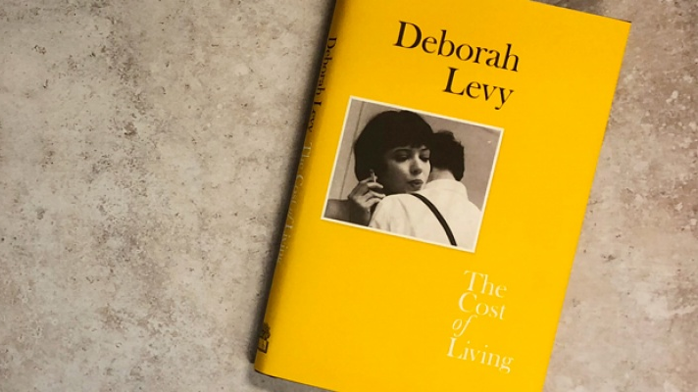
“If we don’t have names, who are we?”
Deborah Levy, The cost of living, London: Penguin, 2016, p.17.

Slide 7
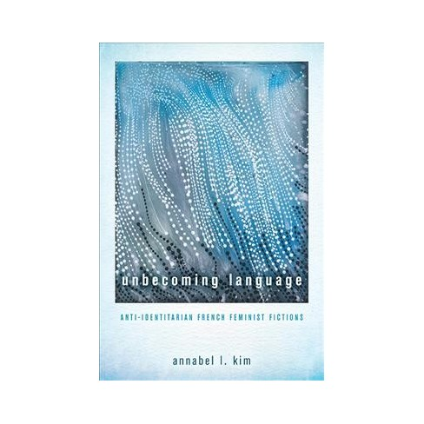
Annabel Kim, Unbecoming language, (Ohio: Ohio University Press, 2018)
Why must we insist on transforming our bodies into linguistic signs?
Do we achieve a greater equality when we realise that bodies are not simply meant to be read or identified so much as to be lived in?

Slide 8
Sphinx, p.5 (French), p.2 (English, 20150
Ma première vision de A*** dut donc se résumer à l’observation mélancolique et dégoûtée d’un ballet de corps que je ne m’efforçai pas de distinguer, sur la scène de ce cabaret où avait décidé de me traîner quelque alcoolique complaisant, au sortir d’une boîte où nous avions mêlé nos désenchantements. Dans cet indistinct tableau qu’à peine je regardai, quelque chose dut me frapper : un souterrain travail commença à s’opérer, creusement, percée de mine dans mon esprit après l’impact aveugle d’un fragment sur ma rétine, car, m’interrogeant par la suite sur ce qui me rendait l’endroit désirable, je ne sus qu’invoquer. Un corps, un seul, mais que je ne songeais pas encore à identifier, avait, sans que je m’en rendisse compte, pourvu le lieu d’une séduction qui dura tant que je n’en cernai pas la cause, n’en discernai pas la racine.
I must have first spotted A*** during a melancholic, disinterested contemplation of a succession of bodies. I wasn’t trying hard to distinguish, on the stage of a cabaret where some obliging alcoholic had decided to drag me, coming from a club where we’d mingled our disappointments. Asking myself afterwards what had made the place so appealing. I couldn’t describe it. In that blur, something must have struck me: something started operated underground, a digging, a tunnelling in my mind following the blinding impact of a fragment on my retina. A body, just noe that I hadn’t identified, surreptitiously had filled the place with a seduction that permeated so deeply I couldn’t discover the cause, I couldn't uncover the root of it. (p.2)

Slide 9
“A different economy of bodies and pleasures”, p.159.

Slide 10
Monique Wittig, Le Chantier littéraire, 138–39.
The ontological farce that consists of trying to divide a being in language by imposing a mark on her, the conceptual maneuver that wrests away from marked individuals what rightfully belongs to them—language—must cease. It is necessary to destroy gender entirely. This endeavour can be entirely accomplished through the use of language.

Slide 11
Embodiment
Cette affection que j'éprouvais pour A*** réclamait son incarnation, ce plaisir que je ressentaisensa compagnie exigeait sa plénitude. Je voulais A***, oui et tous mes autres désirs, besoins, projets pâlissaient auprès de celui-ci. (p.81)
What I was feeling for A*** needed its own embodiment; the pleasure I took in A***’s company demanded its own fulfillment. I wanted A*** it was true, and all my other desires, needs and plans paled in comparison. Suddenly the obsessive clamour for amorous possession took hold of me. (p.37).

Slide 12
New linguistic methods?
“Ma méthode était le doute ; mon plaisir d’instiller dans ces âmes une incertitude quant au succès de leurs minables ruses. Che vuoi ? Je les menais par mes réponses au bord d’une inquiétude essentielle. Je répondais “peut-être”. Jeu dangereux qui me valut bien des blâmes et m’exposa sournois des individus à qui je déniais leur assurance de sujet. J’avais chaque nuit à m’affronter à cette grande panique des désirs individuels qui étaient autant de désirs d’individuation, revendication furieuse s’il en fut. Je tentais parfois – en pure perte mais en malin plaisir – de faire entendre que la somme des plaisirs individuels ne font pas le bonheur de tous” p.75.
“My strategy was to inspire incertitude: I was leading them to the brink of an essential anxiety. My reply was always “maybe”. It was a dangerous game that exposed me to the disapproval, disrespect, or insidious resentment of the people to whom I denied the assurance of being a subject. Each night I would have to confront this great panic of individual desires that were in reality desires for individuation, for furious revindication. Sometimes I would try – utterly in vain but with a perverse pleasure – to make them understand that the sum of individual desires does not add up to the happiness off all” (p.52).

Slide 13
« Sexes mêlés, je ne sus plus rien distinguer » (p.78)
“Crotches crossed, and sexes mixed, I no longer knew how to distinguish anything” (p.54)

Slide 14
Annabel Kim
The sexed nature of bodies in sexual encounters is occluded by treating the body as unspecific skin, flesh, and sweat, and by disregarding genital specificity to articulate instead the confused nature of the coupling. Illegible in terms of its sex, the indeterminate and protean body can reflect whatever the reader desires it to be. The title Sphinx evokes this indeterminacy by referencing the impossibility of knowing, or in this case, the impossibility of figuring (out) the body and giving it an identity. Falling into an identitarian trap, reviewers have tended to read the relationship in Sphinx as heterosexual or homosexual depending on their own sensibilities. Finding it difficult to suspend certainty and commit to indeterminacy, they have assumed there must be some form of sexual difference (or identity) that Garréta had intended to write into being.

Slide 15
J’ai dans la bouche, encore, le goût d’une peau, de la sueur sur cette peau. Contre mes mains l’impression tactile que me firent et cette peau et le modelé de cette chair. . . . Je ne saurais raconter précisément ce qui advint, non plus que décrire ou même faire mention de ce que je fis ou de ce dont je fus l’objet. . . . Sexes mêlés, je ne sus plus rien distinguer.

Slide 16
Céline Sciamma
"C'est le regard de l'autre qui décide de ce qu'on est", commente la réalisatrice.
L'humiliation ne passe que par le regard d'autrui, l'incompréhension renvoyée comme un reflet déformant, mettant en marche une mécanique jusqu'alors insoupçonnée d'auto-dépréciation, là où une toute jeune fille est confrontée à la violence de l'indicible.

Slide 17
CS: Also I had—also it’s about pleasure. We don’t talk—that’s also why I wanted to talk about desire in that when I meet students in screenwriting I tell them ‘ you should be excited, it’s not about if it’s good, am I working enough? It’s also about libido.’ Writing, I mean, it should really be about—it should be fun. You should trust your sensations and it shouldn’t be that serious. Also I think I got more humorous with this whole thing and feel less pressured, weirdly, and felt more free. And also found that—because Tomboy for me was going to be a radical thing, about a young girl performing being a boy and in France regarding gender studies which we partly invented but all the women, the lesbian feminists who invented this were in the US, we’re not into gender studies at all. When Tomboy was released and there was the debate around gay weddings and people were protesting with pictures of the film, the film was in schools and parents were taking their kids out of schools because they didn’t want their kids to see the film. So there were strikes, you know, it was something.

