Slide 1
Paris ou le désert français
Photos by Eric Tabuchi and Nelly Monnier (available here: https://atlasrn.fr/)

Slide 2
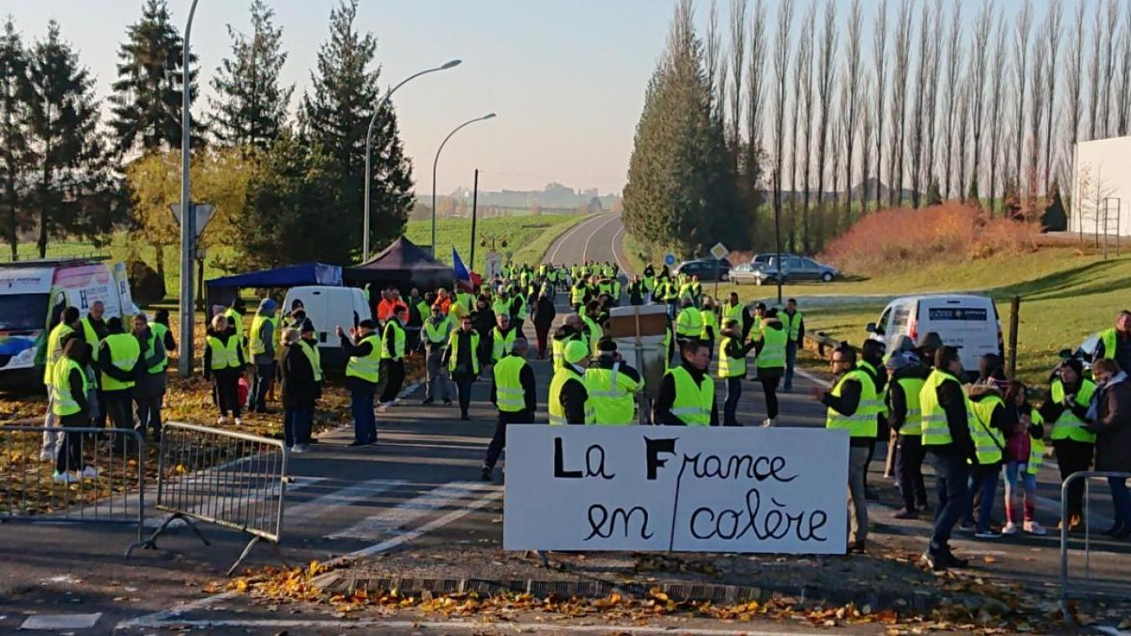

Slide 3
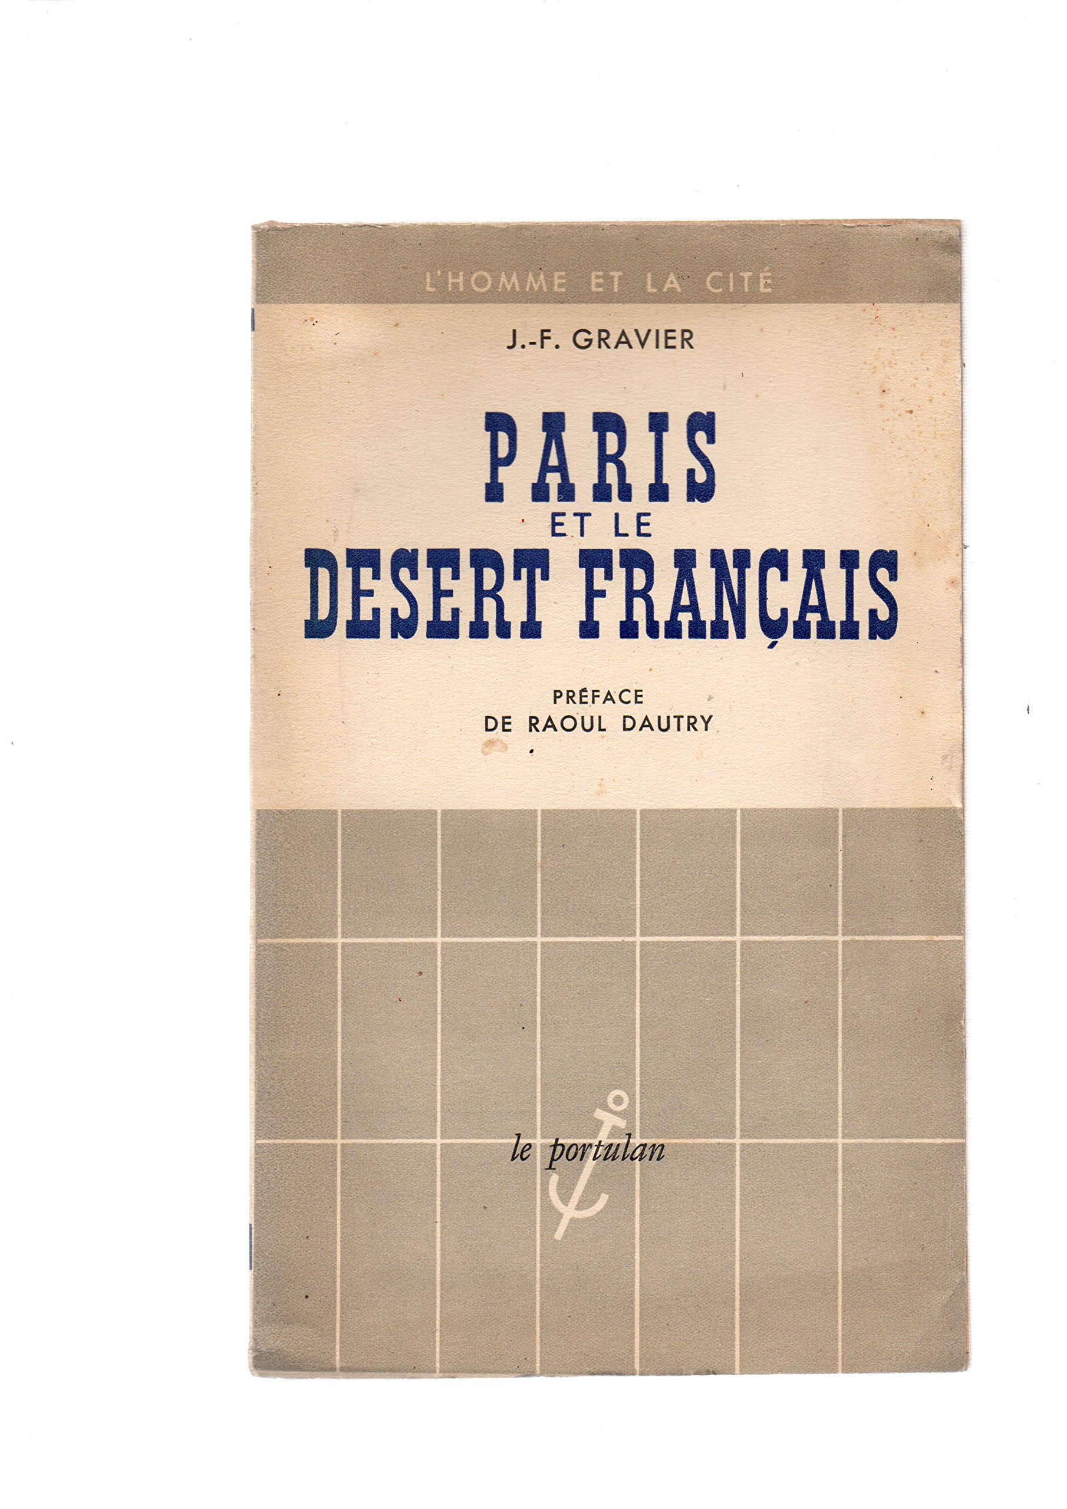
2014
« Un lent processus d’affranchissement des couches populaires est en route […] Ces “affranchis” sont en train de remettre en cause l’essentiel de la doxa des classes dirigeantes, qui n’ont toujours pas pris la mesure du gouffre idéologique et culturel qui les sépare désormais des classes les plus modestes. »
1947

Slide 4
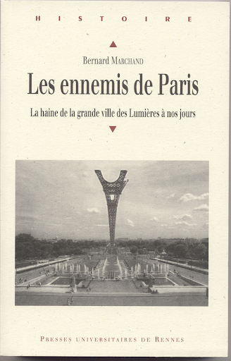
2009
2009

Slide 5
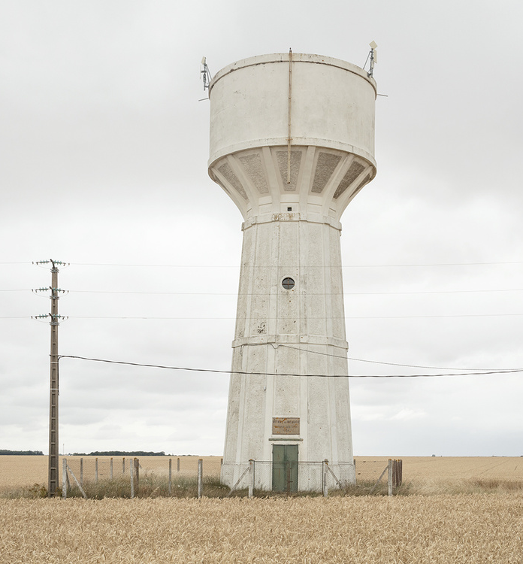
Unity in diversity
France = country with striking regional variations in the physical and human landscape.
"The building materials and architectural styles of northern France have more in common with those of neighbouring Belgium and Germany than with the urban and rural landscapes of southern France. The 'Midi' more closely resembles other Mediterranean countries such as Italy or Spain." (Hargreaves, 2000: 96)
Culinary traditions = no less diverse
Local traditions: variations in folklore and customs
Regional identities

Slide 6
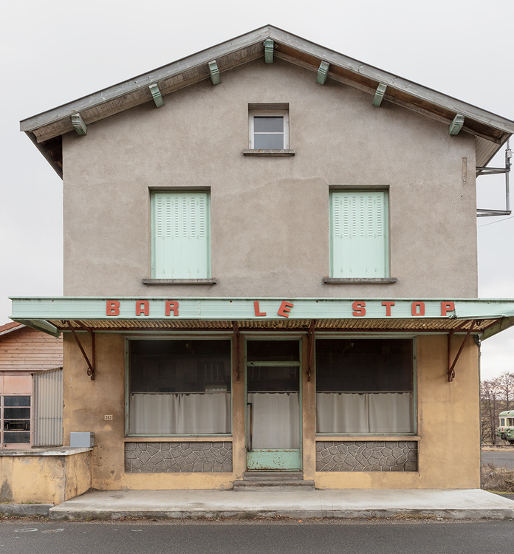
Unity in diversity
"With its long history of centralization, the French state has traditionally been unsupportive and often positively hostile towards both regional and religious diversity." (Hargreaves, 2000:95)
Republican model: equal treatment of citizens and territories
No distinction between territories

Slide 7
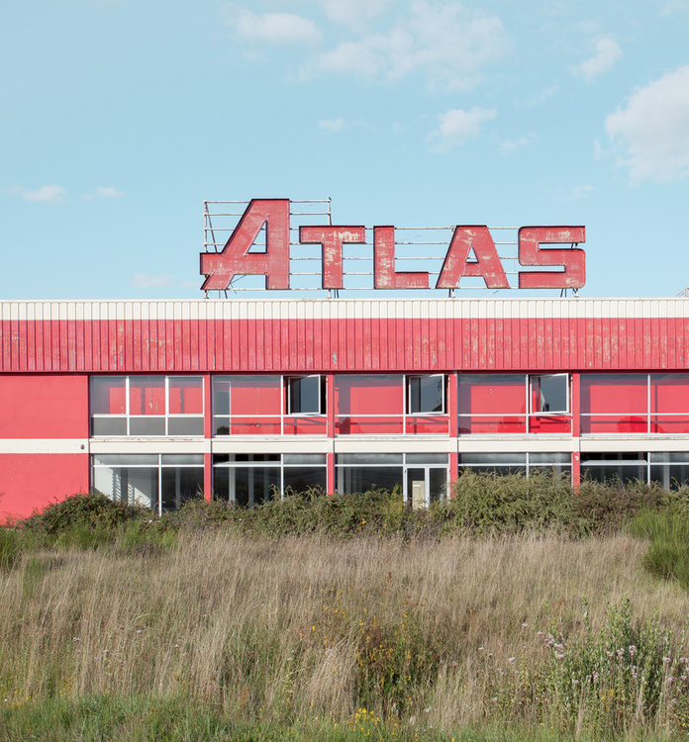
Post-revolutionary France
Revolution and its consequences
"The notion of ‘the one and indivisible Republic' dear to Jacobins […] was invented in many respects as a way of compensating for, and overcoming, this diversity" (Loughlin and Seiler, 2003).
Eugen Weber (1976), Peasants into Frenchmen:
"Diversity had not bothered earlier centuries very much. It seemed part of the nature of things, whether from place to place or between one social group and another. But the Revolution had brought with it the concept of national unity as an integral and integrating ideal at all levels, and the ideal of oneness stirred concern about its shortcomings. Diversity became imperfection, injustice, failure, something to be noted and to be remedied" (Weber, 1976:9).

Slide 8
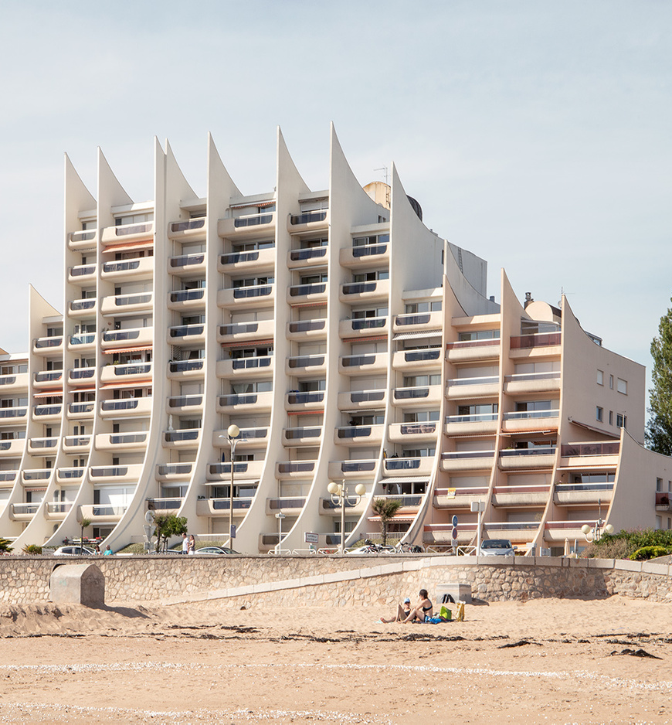
Post-revolutionary France
Administrative translation
The French revolution of 1789 (and its Napoleonic aftermath) swept away provincial autonomy and created a sophisticated administrative infrastructure throughout the French territory (Cole, 2006: 33)
Superiority of central state interests over those of parties, interest groups and localities
At the same time, integration of regional specificities and alignment with the Republic
"Petites Patries" as constitutive part of the "Grande Patrie"
TURNING POINT: By introducing a nationwide system of compulsory, non-religious schooling conducted solely in French, the Third Republic (1870-1940) set out both to tame the cultural influence of the Catholic Church and to marginalize or eradicate regional languages, which were forbidden altogether on school premises.

Slide 9
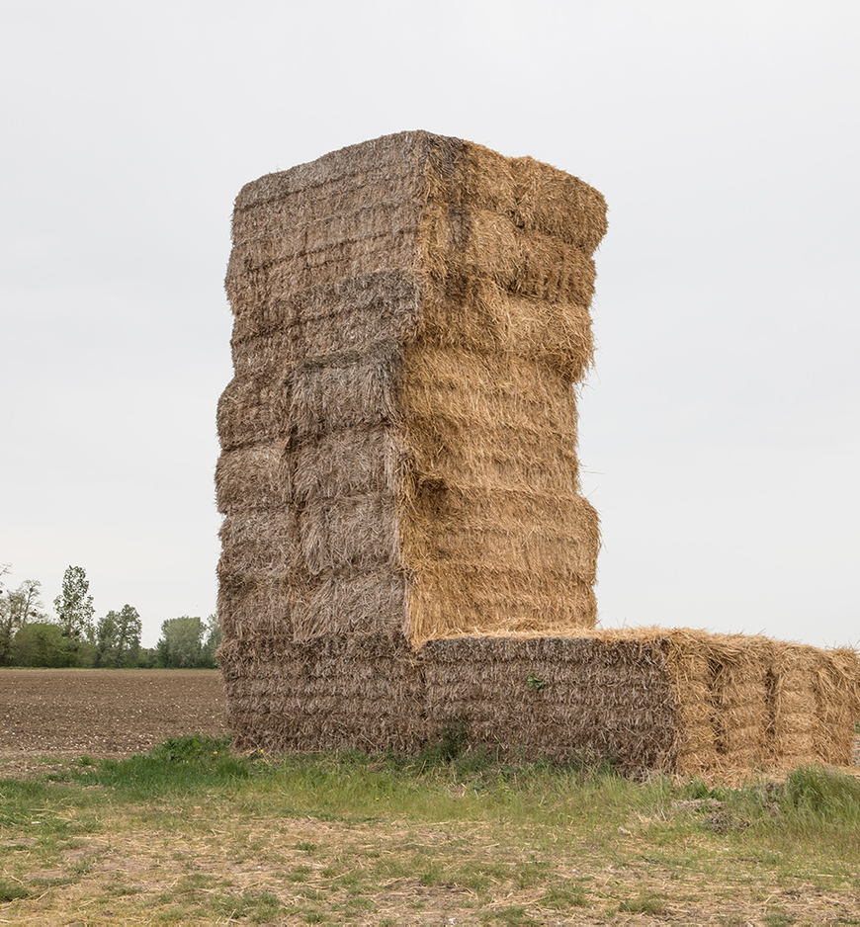
Post-revolutionary France
Shanny Peer (1998), France on display: Peasants, Provincials, and Folklore in the 1937 Paris World's Fair
"the growing reach of the centralized and unified nation-state and the dominant position of urban-Parisian culture in nineteenth- and twentieth-century France were formidable. […] the assimilative strategies of the dominant national culture have included the appropriation by the 'center' of 'peripheral' cultures." (Peer, 1998:9)
1937: Regional particularisms reclaimed as a national heritage and recontextualized in Paris as parts of the unified national whole
Project a 'utopian national whole' that harmoniously integrated regional diversity.

Slide 10
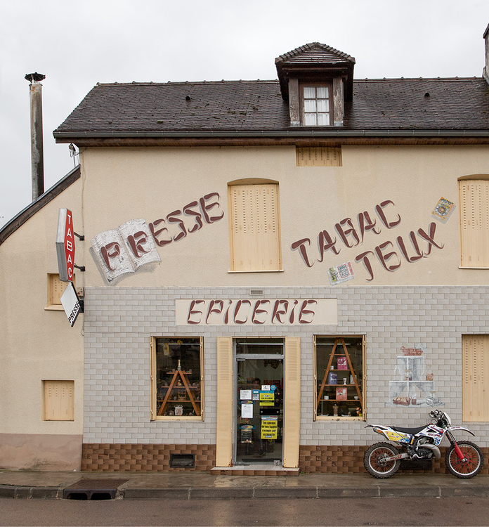
30 Glorieuses
« Le processus de centralisation et de modernisation qui produit l’homogénéité culturelle et l’intégration politique produit aussi la prise de conscience ethnique et un désir croissant d’identification et d’appartenance à une communauté moins impersonnelle que la société nationale. » (Edgar Morin, 1967)
May 68: rejection of modernisation/urbanisation/productivism
"Return to nature", re-celebration of the "authentic"
Reappropriation by the Left

Slide 11
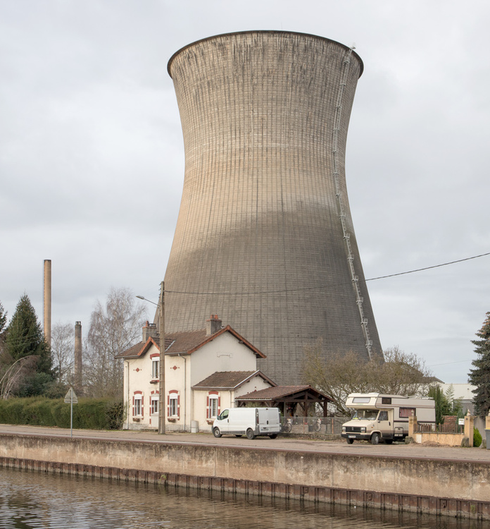
Reappraisal of regional cultures
According to Hargreaves (2000: 95), has been fostered by at least three factors:
Anti-centralizing spirit which emerged from the events of May 1968 and helped to shape the political agenda of the left when it came to power in the 1980s
Fear of Americanization – regional diversity has come to be seen as a valuable element contributing to the uniqueness of French culture
Growth of tourist industries trading on picturesque and folkloric traditions which offer holiday-makers a respite from the sort of global cutlure they can get at home

Slide 12
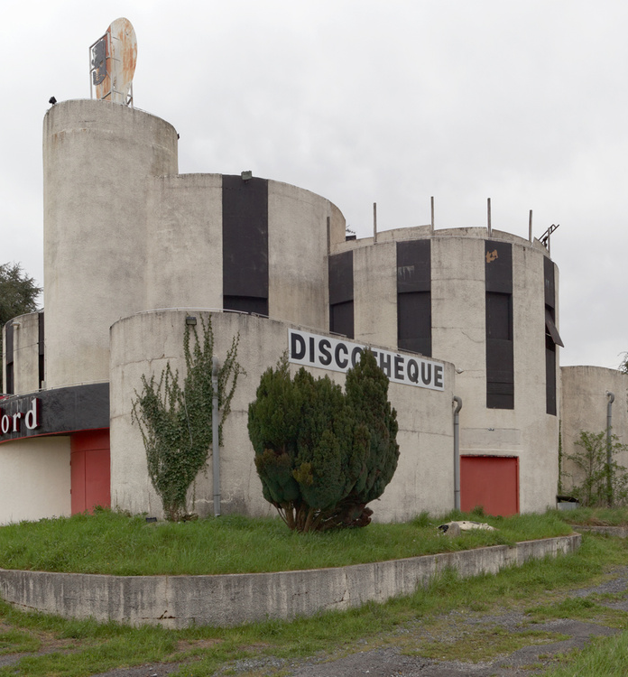
Regional languages and dialects
"Despite the centralist tradition, centrifugal forces are undoubtedly present in France, but where regional cultures acquire a political profile this seldom depends on the local cuisine or folklore. The most potent cultural forces around which regionalist movements now mobilize people are minority languages and dialects" (Hargreaves, 2000:96).
For a long time, early form of what is today standard French was spoken by only a small minority of the population
"What was to become modern French gained its ascendancy because of the privileged status accorded to it by the unifying power of the state, rather than by simple weight of numbers“ (Hargreaves, 2000).
As the power of the central state grew, other dialects and languages were spurned or repressed.
But as they remained widely used, their minority status was political rather than numerical in nature.

Slide 13
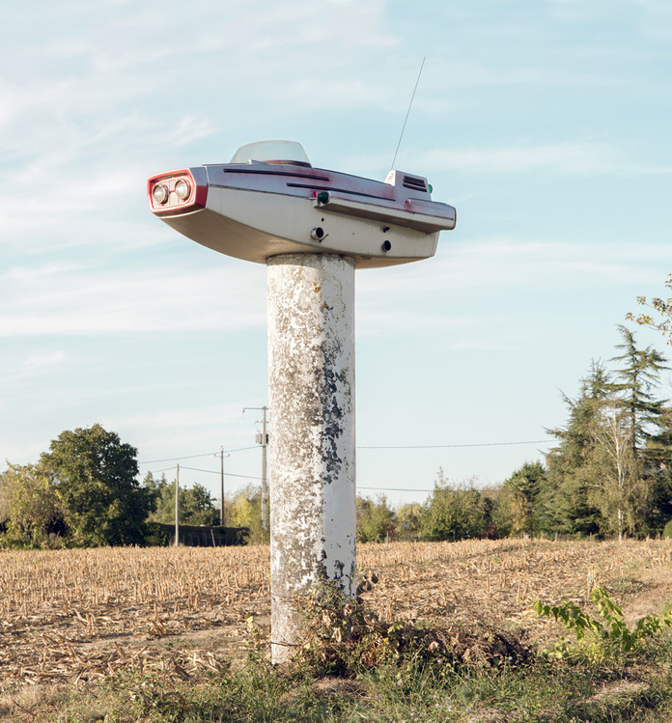
Regionalist movements
WW2: Regionalist movements in areas such as Brittany were badly compromised by collaborating with the Nazis and Vichy regime
Nazis: played on cultural differences in the hope of weakening resistance to the Occupation of France
By contrast: South-West regionalist movements (Catalan, Basque) had long traditions of left-wing leanings
May 68: new wave of thinking
Shift to left of regionalist movements

Slide 14
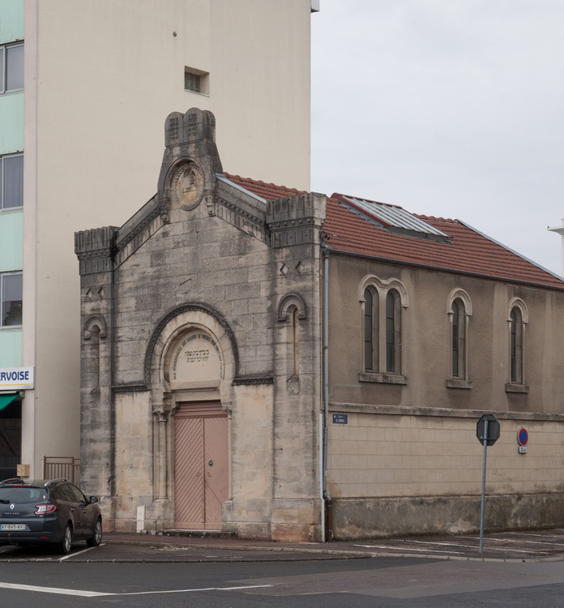
Regionalist movements
Strong cultural, language and territorial defense movements have emerged since the 1970s (Cole and Williams, 2004).
Cultural regionalism has emerged as a powerful force in Brittany, the Basque country and Alsace, and to a lesser extent in Savoy, Normandy, Occitania, Flanders and French Catalonia (Chartier and Larvor, 2004).
1970s:
Nationalisme breton: Union démocratique bretonne
Corse, Alsace, Pays Basque
Front de Libération de la Bretagne
Action pour la Renaissance de la Corse
Mouvement Occitan (Robert Lafont): La Révolution Régionaliste (1967) et Décoloniser la France (1971)

Slide 15
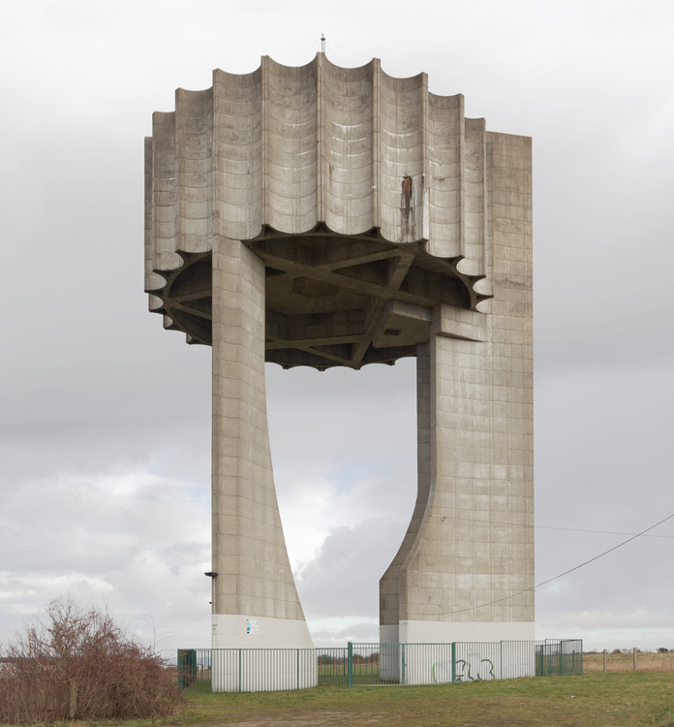
Political/administrative response
Decentralisation and planning
Builds on 'anti-urban' idea that Paris is too big and concentrates too much power and people
"Small body with a big head"
Jean-François Gravier (quoted in Marchand and Salomon Cavin, 2007:31):
"In all domains, the Paris agglomération has behaved since 1850, not as a metropolis giving life to its hinterland, but as a monopolist group devouring the substance of the nation. Its action has multiplied the effects of the first industrial revolution and sterilized most provincial economies by depriving them of their dynamic elements. Decision centres, conception centres, and rare services: Paris has appropriated for itself all these leading activities and has left only subordinate ones to the rest of France. Such absolute dependence is the very characteristic of a colonial rule."

Slide 16
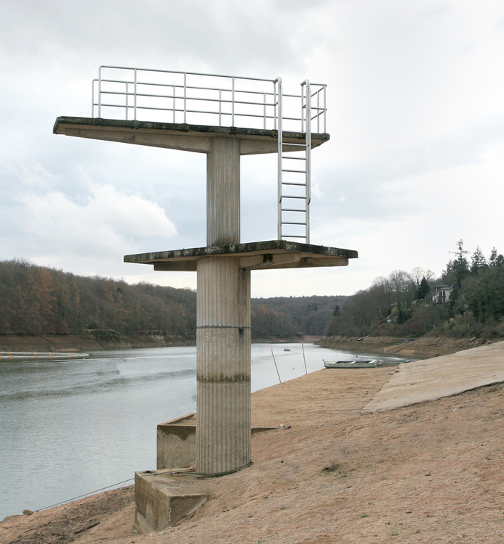
Political/administrative response
Moral arguments: "growth of urbanization, development of big agglomérations and, generally, urbanism (as a way of life) constitute a danger for the health and the morality of the individual, the coherence of the family, the strength and the well-being of a country" (Marchand and Salomon Cavin, 2007:33).
Other arguments:
Baby boom: 28 successive years (1946-1973), 800000 births/year. Drop in mortality rate.
Result: Growing pressures on local administrative systems. Need to reorganise local life (schools, housing, public services...)
Greater mobility
Linked to economic and technological development
More affirmed expression of regional identities
Promotion of local values and traditions

Slide 17
Decentralisation
"La décentralisation est un processus d’aménagement de l’Etat unitaire qui consiste à transférer des compétences administratives de l’Etat vers des entités (ou des collectivités) locales distinctes de lui." (www.vie-publique.fr)
Gathering pace since the 1960s, with the landmark reforms of 1982–1983 and 2003–2004
Alistair Cole (2006):
1. Part of a broader programme of state reform, part of a drive by successive central governments to divest themselves of unwanted or inflationary functions;
2. New forms of local and regional capacity building. Decentralization is best understood in terms of liberating the entrepreneurial energies and political capacity of local and regional players.
3. shaped by new forms of identity-based territorial mobilization.
revival of ethno-territorial identities and a challenge to the centralist model of the unitary state

Slide 18
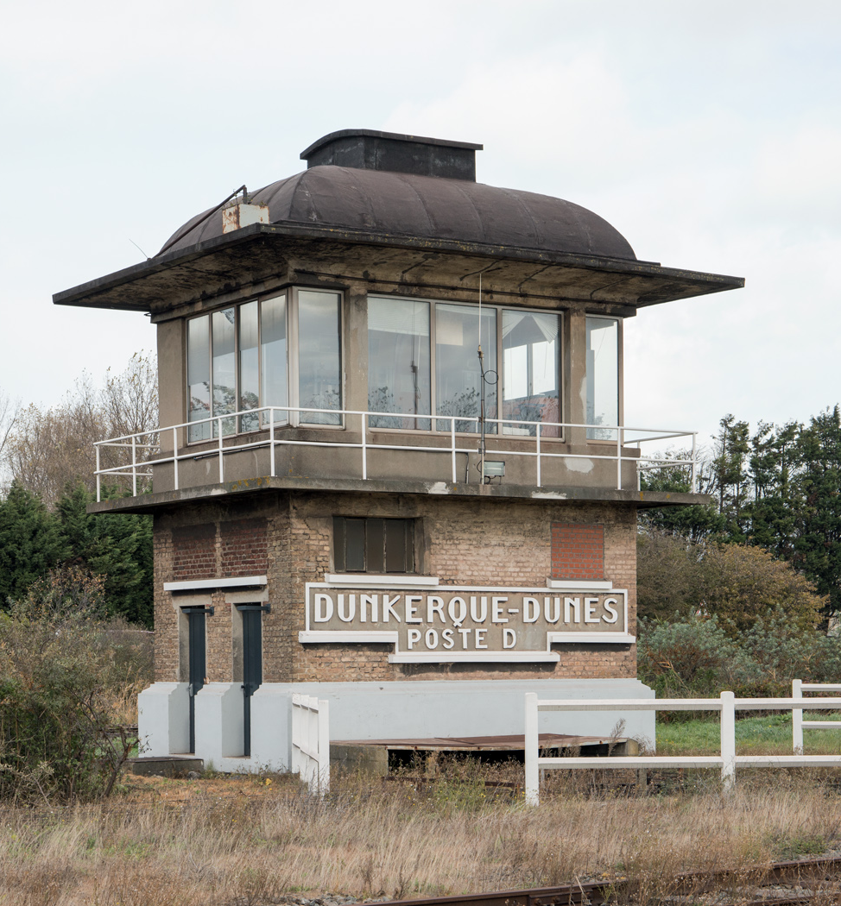
Decentralization policies
First responses to these pressures:
1955: Creation of 22 circonscriptions d'action régionale
1964: Regional prefects
1963: Délégation à l’Aménagement du Territoire et a l’Action Régionale (DATAR)
Promote 'deconcentration'
De Gaulle in March 1968: "The centralisation which for centuries was needed for our country to achieve and to maintain its unity in spite of the diverse nature of the provinces which, one after the other, had been added to it, is no longer essential. On the contrary, regional activity now appears as the springboard for its future economic success" (Brongniart, 1971).

Slide 19
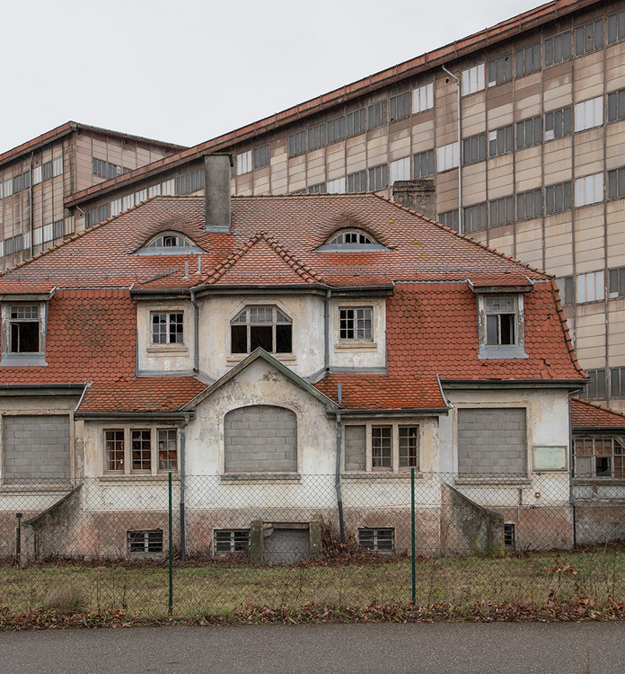
Decentralization policies
1968: Les Citoyens au Pouvoir (Club Jean Moulin)
Mass reduction in number of communes (over 30000 in 2000)
Creation of 12 powerful regions
Left takes up regionalist themes
1970s: regionalist theme as argument to beat the right in power for over 20 years
Context: Economic crisis → Pressure for reform
Changes in local economic makeup
Old industries are disappearing
Rise of the Deuxième Gauche

Slide 20
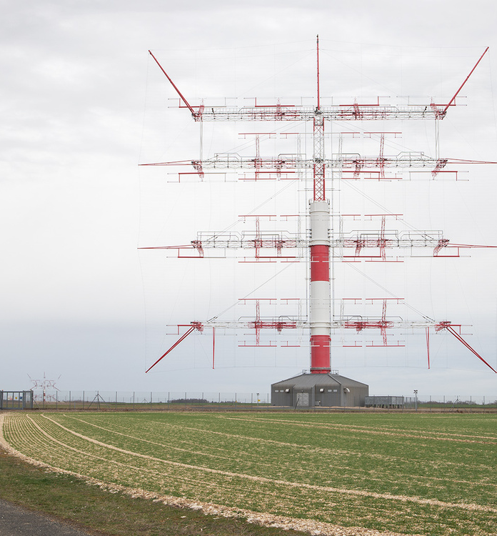
Decentralization policies
French Socialist government’s reforms of 1982–1983 were ambitious
1982 reform: "La grande affaire du septennat" (Mauroy)
Transfer of certain powers to presidents of region and départements
Region has same legal status as communes and départements
The decentralization reforms
Recognized local authorities as fully operational legal entities freed from a priori prefectoral control.
The decision-making responsibilities of local and regional actors were increased, with the extension of sub-national influence into new policy areas such as
social affairs,
economic development
and education (Cole, 2006:34)

Slide 21
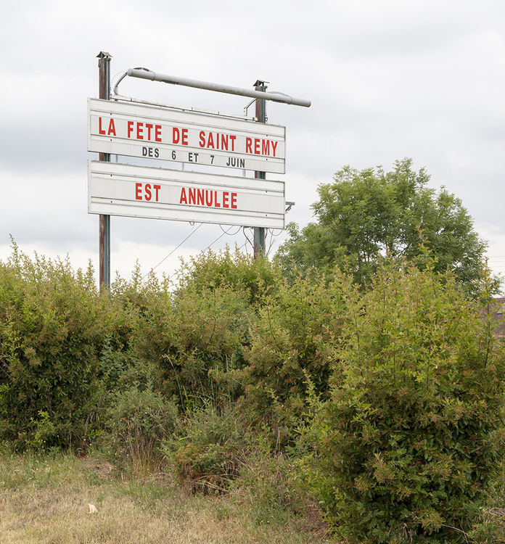
A threat to the Republic?
Yes:
Growing power of regions (2015 law): from 21 to 13 regions
No:
Weakness of regionalists movements (Cole, 2006)
"Mille feuille administratif"
Decentralisation from above: State remains central actor

