Slide 1
Masterclass 2 Extra COM and CAL Questions, Answers and learning points
^{Patricia McGettigan}
^{Clinical Pharmacologist}
^{Head of MBBS CPT teaching}

Slide 2
A BNF Query
How do I know if a drug / product needs a prescription or not?
BNF → Drug of interest, e.g., ibuprofen → Navigate to Section box: “Medicinal forms”
Many brands & strengths - But for each product listed, the “Legal category” line gives prescription status information (next slide)

Slide 3
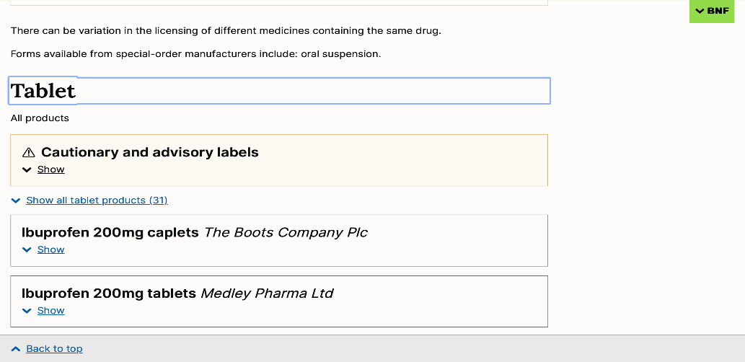
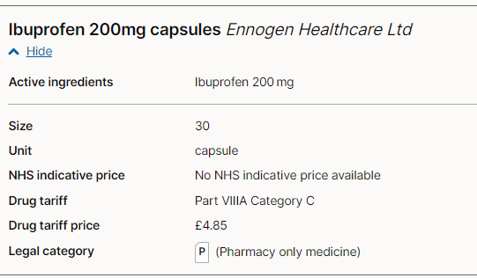
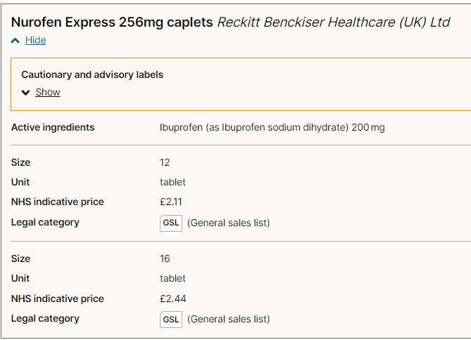
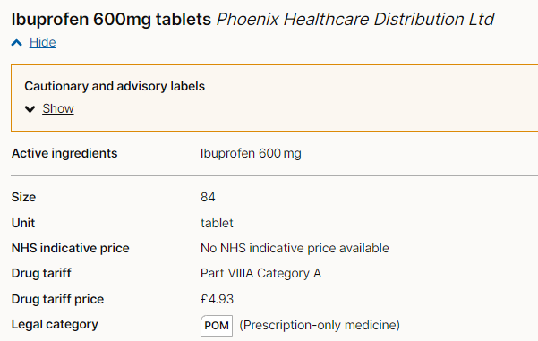
Prescription status information is shown in “Legal category” for each product https://bnf.nice.org.uk/drugs/ibuprofen/#medicinal-forms
Click on e.g., Tablet: long list of products… click on one
Example: Ibuprofen
Legal category: 200mg tablets in packs of </=16 are ‘General Sales List’, GSL - available for general sale in supermarkets – with age check
200mg in packs of >16 are a Pharmacy only medicine (P), available over the counter (OTC) without prescription; pharmacist counsels / checks
400mg tablets are also Pharmacy only (P)
Some strengths /pack sizes are ‘prescription only medicine’ (POM)

Slide 4
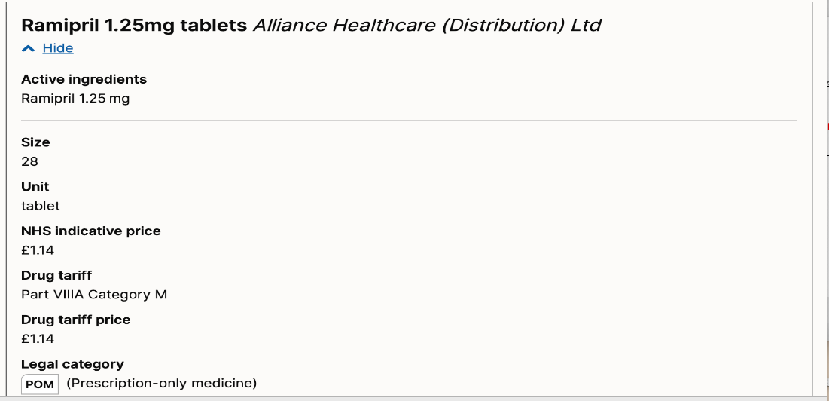
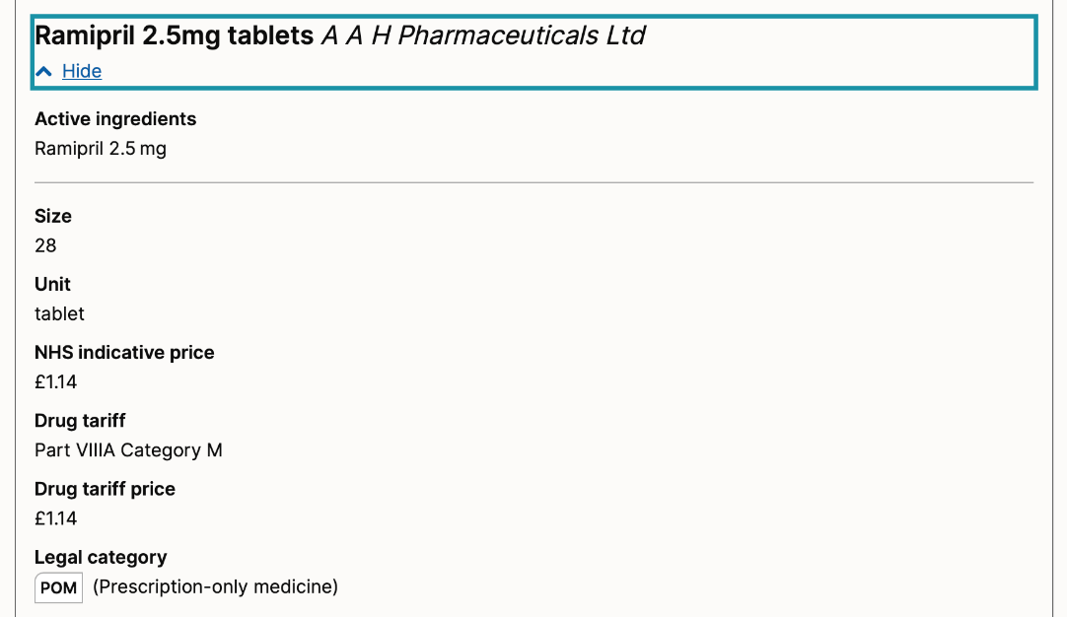
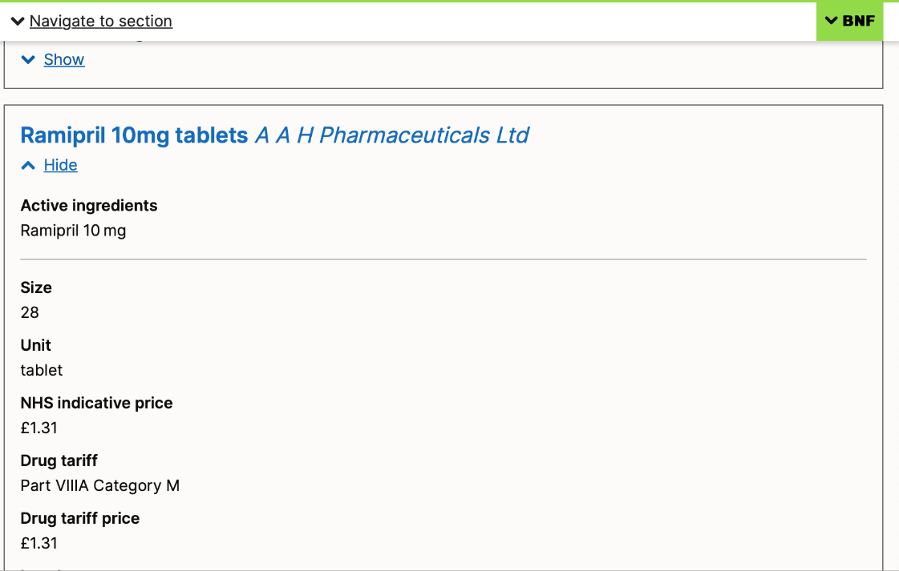
Ramipril
All forms / strengths of ramipril – are prescription only medicines
Legal category = POM – cannot be purchased (legally) without prescription
Off patent – many manufacturers / brands available – long list – prescribe by generic name

Slide 5
COM (Communicating information) questions and associated learning points

Slide 6
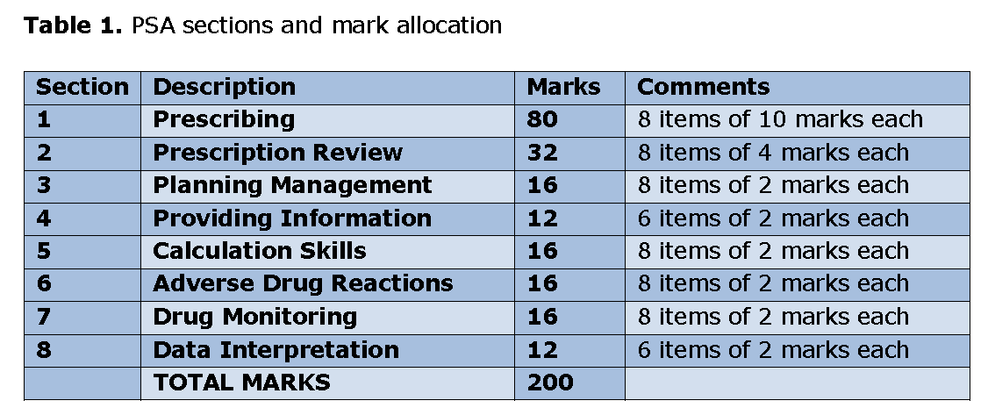
PSA Blueprint, p3 On QM+ for you

Slide 7
Communicating Information Item
ID
COM000
This item is worth 2 marks
You may use the BNF at any time
Case presentation
PMH.
DH.
SH.
INFORMATION OPTIONS
A
B
C
D
E
Question
Select the most appropriate information option that should be communicated to the [patient/mother/staff nurse/GP].
(mark it with a tick)
Answer box
Option A | Justification
Option B | Justification
Option C | Justification
Option D | Justification
Option E | Justification
In the PSA exam, it will as for the best-of-five
In this workshop, the questions sometimes ask for which are true, to serve as a teaching point

Slide 8
COMS questions
Caveat re: “most important / appropriate”
A lot of questions have answers where more than one, or all, options are “true”
Have to select “most important”
Consider “what happens if the patient does not know this?”
Most difficult to teach in theory
Very good reflection of clinical practice
If numerical bullet points, suggested prioritisation

Slide 9
COMS questions – selecting “most important”
Consider “what happens if the patient does not know this?”
Self-reporting / clinician-monitoring of severe side effects
Sick day rules / peri-operative prescribing
Potential teratogenicity
Missed doses / interactions (i.e. things that make treatment less effective)
Risk of adverse effects if stopping medication suddenly?
NOTE:
The PSA question may not have the “clinically most important” option listed
You have to select the “most important of the list”

Slide 10
NB: COMS questions – selecting “most important”
Consider “what happens if the patient does not know this?”
Self-reporting / clinician-monitoring of severe side effects
Sick day rules / peri-operative prescribing
Potential teratogenicity
Missed doses / interactions (i.e. things that make treatment less effective)
Risk of adverse effects if stopping medication suddenly?
NOTE:
The PSA question may not have the “clinically most important” option listed
You have to select the “most important of the list”

Slide 11
Extra practise COM Questions with Answers and tips

Slide 12
Enter Question Text
Communicating Information Item
ID
COM024
He can miss insulin doses sporadically without consequence
He may need to decrease insulin dosage if unwell
He may need to increase insulin dosage if unwell
He should adjust his night-time dose based on his expected dietary intake the next day
He should eat a diet low in carbohydrate and high in protein
He will require regular reviews of his blood glucose control
Case presentation
A 15 year old male is sent home from hospital with a new diagnosis of Type 1 diabetes mellitus. He has been issued a prescription for long- and short-acting insulin.
Question
Select the most appropriate information option that should be communicated to the patient.
(mark it with a tick)

Slide 13
Enter Question Text
Communicating Information Item
ID
COM024
He can miss insulin doses sporadically without consequence
He may need to decrease insulin dosage if unwell
He may need to increase insulin dosage if unwell
He should adjust his night-time dose based on his expected dietary intake the next day
He should eat a diet low in carbohydrate and high in protein
He will require regular reviews of his blood glucose control
Case presentation
A 15 year old male is sent home from hospital with a new diagnosis of Type 1 diabetes mellitus. He has been issued a prescription for long- and short-acting insulin.
Question
Select the most appropriate information option that should be communicated to the patient.
(mark it with a tick)

Slide 14
Sick day rules - Type I diabetes mellitus
Never omit insulin (may need increased – local guidance usually provided)
Maintain adequate (sugar-free) fluid intake
Maintain regular carbohydrate intake – if unable to take solids, in liquid carbohydrate format
Consider anti-emetic if nauseated
Consider oral electrolyte replacement in diarrhoea
If prolonged inability to keep down fluids (e.g. >4hrs), then likely needs hospital admission
Increased blood glucose monitoring (e.g. 4hr-ly, and even more frequently if >moderate ketones)
Ketone testing 2-4 hrly
If persistently elevated, or elevated while low blood glucose – may need hospital admission
Diabetic specialist nurse should provide individualised plan

Slide 15
Sick day rules - Type II diabetes mellitus
Medications | Advice
Patients on oral medication only, not including sulphonylureas | Continue with medication as normal (except metformin if prolonged D/V) Encourage adequate fluid and diet intake Consider providing an oral electrolyte replacement
Patients taking sulphonylureas | Minimum of daily self-blood glucose monitoring Advice should be provided regarding the increased risk of hypoglycaemia and reinforce the importance of taking some form of regular carbohydrate Seek advice if blood glucose persistently elevated (e.g. > 17)
Gliptins (dipeptidylpeptidase-4 inhibitors) e.g., sitagliptin | Not associated with hypoglycaemia – newer agents – wise to d/w diabetic spp nurse / team
SGLT-2i (sodium glucose co-transporter-2 inhibitors) e.g. dapagliflozin | Careful - DKA risk – see Warnings BNF – Monitor ketones - wise to d/w diabetic spp nurse / team [High vigilance if used in T1DM with heart failure or CKD]
Patients taking insulin therapy | Never omit insulin (if regular prescription) Emphasis on the importance of regular carbohydrate intake Minimum twice-daily self-blood glucose monitoring Seek advice if blood glucose persistently elevated (e.g. > 17) Diabetic specialist nurse should provide individualised plan

Slide 16
Enter Question Text
Communicating Information Item
ID
COM026
Amlodipine
Aspirin
Atorvastatin
Bisoprolol
Codeine
Estradiol (Climaval®)
Gliclazide
Metformin MR
Paracetamol
Ramipril
Case presentation
A 53 year old woman attends a pre-op clinic for a knee replacement. Apart from her knee pain, she is asymptomatic with good exercise tolerance. PMH. Previous hysterectomy, NSTEMI 3 years ago, Type II diabetes, severe osteoarthritis
Current medications:
Amlodipine 10 mg orally daily
Aspirin 75 mg orally daily
Atorvastatin 80 mg orally daily
Bisoprolol 5 mg orally daily
Codeine 30 mg orally as required (max 6hr-ly)
Estradiol (Climaval®) 1 mg orally daily as hormone replacement therapy
Gliclazide 80 mg orally two times daily
Metformin MR 1 g orally two times a day
Paracetamol 1 g orally 6hr-ly
Ramipril 10 mg orally daily
Question
Select the drugs that MAY need to be stopped/withheld prior to her surgery.
(mark all with a tick)

Slide 17
Enter Question Text
Communicating Information Item
ID
COM026
Amlodipine
Aspirin
Atorvastatin
Bisoprolol
Codeine
Estradiol (Climaval®)
Gliclazide
Metformin MR
Paracetamol
Ramipril
Case presentation
A 53 year old woman attends a pre-op clinic for a knee replacement. Apart from her knee pain, she is asymptomatic with good exercise tolerance. PMH. Previous hysterectomy, NSTEMI 3 years ago, Type II diabetes, severe osteoarthritis
Current medications:
Amlodipine 10 mg orally daily
Aspirin 75 mg orally daily
Atorvastatin 80 mg orally daily
Bisoprolol 5 mg orally daily
Codeine 30 mg orally as required (max 6hr-ly)
Estradiol (Climaval®) 1 mg orally daily as hormone replacement therapy
Gliclazide 80 mg orally two times daily
Metformin MR 1 g orally two times a day
Paracetamol 1 g orally 6hr-ly
Ramipril 10 mg orally daily
Question
Select the drugs that MAY need to be stopped/withheld prior to her surgery.
(mark all with a tick)

Slide 18
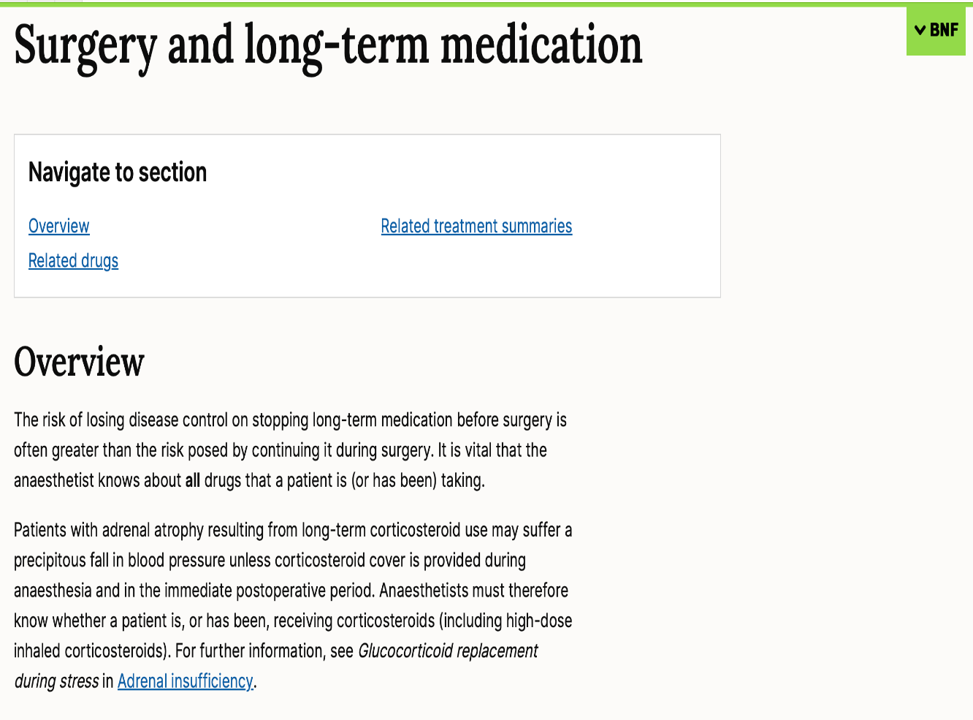
Peri-operative prescribing
Depends on:
Elective
Emergency
NBM
Common drugs involved:
Antiplatelets / anticoagulants
Diabetic medications
Oral
Insulin
Steroids
Anti-hypertensives
Oral contraception / HRT
https://bnf.nice.org.uk/treatment-summaries/surgery-and-long-term-medication/

Slide 19
Drug / Class | “Typical” advice
Steroids | Continue and may need to increase
Antiepileptics, antiparkinsonian, antipsychotics, anxiolytics, bronchodilators, glaucoma drugs, immunosuppressants, thyroid / antithyroid drugs | Continue
some cardiovascular drugs | Continue
Antiplatelets | Discontinue if benefits outweighs risk (i.e continued only if recent MI, PCI, ischaemic CVA)
Anticoagulant | Discontinue if benefits outweighs risk (or may require bridging unfractionated heparin infusion)
ACEi / ARB / potassium-sparing diuretics | Typically withheld 24 hours before surgery
Oral anti-diabetic medications | Can be complex (know where to look in “Diabetes, surgery and medical illness” in BNF) Sulfonylureas omitted while in fasted state https://bnf.nice.org.uk/treatment-summaries/diabetes-surgery-and-medical-illness/
Insulin | Complex (know where to look in “Diabetes, surgery and medical illness” in BNF)
Contraception | Can be complex (know where to look in “Contraceptives, hormonal” in BNF) Oestrogen-containing contraceptives likely need to discontinue with major or significant orthopedic surgery (Progestogen-only are suitable to continue)
HRT | Likely need to discontinue with major or significant orthopedic surgery

Slide 20
Communicating Information Item
ID
COM027
Antidepressants can be addictive
Antidepressants should be taken for at least 6 months after they have recovered
Antidepressants should not be stopped suddenly
Citalopram must be taken at night
It usually takes 2–4 weeks for symptoms to improve
She may require increased doses in the future
She should be vigilant of worsening depressive symptoms and suicidal ideas, and to seek help promptly
Some antidepressants potentially have sedating effects
Case presentation
A 36-year old woman has been attending her GP for a few weeks with moderate depression. She has trialed psychological measures, and this is currently insufficient. A joint decision has been made to start citalopram 20mg once daily.
Question
Select the TRUE information options.
(mark all with a tick)

Slide 21
Communicating Information Item
ID
COM027
Case presentation
A 36-year old woman has been attending her GP for a few weeks with moderate depression. She has trialed psychological measures, and this is currently insufficient. A joint decision has been made to start citalopram 20mg once daily.
Antidepressants can be addictive
Antidepressants should be taken for at least 6 months after they have recovered
Antidepressants should not be stopped suddenly
Citalopram must be taken at night
It usually takes 2–4 weeks for symptoms to improve
She may require increased doses in the future
She should be vigilant of worsening depressive symptoms and suicidal ideas, and to seek help promptly
Some antidepressants potentially have sedating effects (but not citalopram – SSRIs tend to be alerting hence morning dosing; TCAs are sedating, esp in overdose)
Question
Select the TRUE information options.
(mark all with a tick)

Slide 22
Communicating Information Item
ID
COM027
Antidepressants can be addictive
Antidepressants should be taken for at least 6 months after they have recovered
Antidepressants should not be stopped suddenly
Citalopram must be taken at night
It usually takes 2–4 weeks for symptoms to improve
She may require increased doses in the future
She should be vigilant of worsening depressive symptoms and suicidal ideas, and to seek help promptly
Some antidepressants potentially have sedating effects
Case presentation
A 36-year old woman has been attending her GP for a few weeks with moderate depression. She has trialed psychological measures, and this is currently insufficient. A joint decision has been made to start citalopram 20mg once daily.
Question
Select the most appropriate information option that should be communicated to the patient.
(mark it with a tick)

Slide 23
Communicating Information Item
ID
COM027
Antidepressants can be addictive
Antidepressants should be taken for at least 6 months after they have recovered
Antidepressants should not be stopped suddenly
Citalopram must be taken at night
It usually takes 2–4 weeks for symptoms to improve
She may require increased doses in the future
She should be vigilant of worsening depressive symptoms and suicidal ideas, and to seek help promptly
Some antidepressants potentially have sedating effects
Case presentation
A 36-year old woman has been attending her GP for a few weeks with moderate depression. She has trialed psychological measures, and this is currently insufficient. A joint decision has been made to start citalopram 20mg once daily.
Question
Select the most appropriate information option that should be communicated to the patient.
(mark it with a tick)

Slide 24
Anti-depressants (NICE Clinical Knowledge Summaries)
Advise patients starting on antidepressants:
To be vigilant for worsening depressive symptoms and suicidal ideas, and to seek help promptly if they are concerned
It usually takes 2–4 weeks for symptoms to improve
Antidepressants should not be stopped suddenly due to potential for withdrawal symptoms
Antidepressants should be taken for at least 6 months after they have recovered, to reduce the risk of relapse
Antidepressants are not addictive
Some antidepressants, e.g. tricyclics, potentially have sedating effects greatest in the first month, and may affect the person's ability to drive / operate machines.
SSRIs are not sedating.

Slide 25
Enter Question Text
Communicating Information Item
ID
COM024
He can miss insulin doses sporadically without consequence
He may need hospital admission if he has prolonged inability to keep down fluids (e.g. >4hrs)
He may need to decrease insulin dosage if unwell
He may need to increase insulin dosage if unwell
He should adjust his night-time dose based on his expected dietary intake the next day
He should eat a diet low in carbohydrate and high in protein
He will require regular reviews of his blood glucose control
Case presentation
A 15 year old male is sent home from hospital with a new diagnosis of Type 1 diabetes mellitus. He has been issued a prescription for long- and short-acting insulin.
Question
Select the TRUE information options.
(mark all with a tick)

Slide 26
Enter Question Text
Communicating Information Item
ID
COM024
He can miss insulin doses sporadically without consequence
He may need hospital admission if he has prolonged inability to keep down fluids (e.g. >4hrs)
He may need to decrease insulin dosage if unwell
He may need to increase insulin dosage if unwell
He should adjust his night-time dose based on his expected dietary intake the next day
He should eat a diet low in carbohydrate and high in protein
He will require regular reviews of his blood glucose control
Case presentation
A 15 year old male is sent home from hospital with a new diagnosis of Type 1 diabetes mellitus. He has been issued a prescription for long- and short-acting insulin.
Question
Select the TRUE information options.
(mark all with a tick)

Slide 27
Communicating Information Item
ID
COM031
Gastrointestinal side effects can be improved by taking metformin on an empty stomach
Gastrointestinal side-effects are common and diarrhoea is usually transient
He is at risk of diabetic ketoacidosis
He is at risk of lipodystrophy
He should be aware of symptoms of hypoglycaemia
He should seek immediate medical attention if symptoms such as dyspnoea, muscle cramps or abdominal pain occur.
His weight may increase
Metformin is contraindicated in pregnancy
Should be stopped if he has continued diarrhoea or vomiting
Case presentation
A 56 year old man attends his GP with results confirming a diagnosis of type II diabetes. PMH. Type II diabetes.
They agree to start on metformin 500 mg orally daily.
Question
Select the TRUE information options.
(mark all with a tick)

Slide 28
Communicating Information Item
ID
COM031
Gastrointestinal side effects can be improved by taking metformin on an empty stomach
Gastrointestinal side-effects are common and diarrhoea is usually transient
He is at risk of diabetic ketoacidosis
He is at risk of lipodystrophy
He should be aware of symptoms of hypoglycaemia
He should seek immediate medical attention if symptoms such as dyspnoea, muscle cramps or abdominal pain occur.
His weight may increase
Metformin is contraindicated in pregnancy
Should be stopped if he has continued diarrhoea or vomiting
Case presentation
A 56 year old man attends his GP with results confirming a diagnosis of type II diabetes. PMH. Type II diabetes.
They agree to start on metformin 500 mg orally daily.
Question
Select the TRUE information options.
(mark all with a tick)

Slide 29
Communicating Information Item
ID
COM031
Gastrointestinal side effects can be improved by taking metformin on an empty stomach
Gastrointestinal side-effects are common and diarrhoea is usually transient
He is at risk of diabetic ketoacidosis
He is at risk of lipodystrophy
He should be aware of symptoms of hypoglycaemia
He should seek immediate medical attention if symptoms such as dyspnoea, muscle cramps or abdominal pain occur.
His weight may increase
Metformin is contraindicated in pregnancy
Should be stopped if he has continued diarrhoea or vomiting
Case presentation
A 56 year old man attends his GP with results confirming a diagnosis of type II diabetes. PMH. Type II diabetes.
They agree to start on metformin 500 mg orally daily.
Question
Select the most appropriate information option that should be communicated to the patient.
(mark it with a tick)

Slide 30
Communicating Information Item
ID
COM031
Gastrointestinal side effects can be improved by taking metformin on an empty stomach
Gastrointestinal side-effects are common and diarrhoea is usually transient
He is at risk of diabetic ketoacidosis
He is at risk of lipodystrophy
He should be aware of symptoms of hypoglycaemia
He should seek immediate medical attention if symptoms such as dyspnoea, muscle cramps or abdominal pain occur.
His weight may increase
Metformin is contraindicated in pregnancy
Should be stopped if he has continued diarrhoea or vomiting
Case presentation
A 56 year old man attends his GP with results confirming a diagnosis of type II diabetes. PMH. Type II diabetes.
They agree to start on metformin 500 mg orally daily.
Question
Select the most appropriate information option that should be communicated to the patient.
(mark it with a tick)

Slide 31
Anti-diabetic medications
 | Notes
Insulin | Risk of hypoglycaemia Rotate sites of injection Not to massage sites of injection
Metformin | Should be stopped if continued diarrhoea or vomiting GI side-effects are common and diarrhoea is usually transient Seek immediate medical attention if symptoms such as dyspnoea, muscle cramps, abdominal pain, hypothermia, or asthenia occur (lactic acidosis) GI side-effects can be helped by taking with or just after food
Sulfonylureas | Risk of hypoglycaemia Can encourage weight gain
SGLT2 inhibitors (-flozins) | Advised to report symptoms of volume depletion including postural hypotension and dizziness Patients should be informed of the signs and symptoms of diabetic ketoacidosis Should be stopped if hospitalised for major surgery or acute serious illnesses Hypoglycaemia risk especially if co-prescribed with sulfonylurea of insulin)

Slide 32
Enter Question Text
Communicating Information Item
ID
COM022
She should maintain adequate fluid intake
She should not stop taking lithium abruptly
She should report any increased urination, muscle weakness, tremors, confusion or drowsiness
She should report any visual disturbance, persistent headaches
She should seek medical advice if she suffers from diarrhoea or vomiting
She should use appropriate contraception if sexually active
She will need regular blood tests to determine the blood lithium levels
Case presentation
A 38-year old woman attends the Psychiatry Outpatient Clinic. She agrees to start on lithium as treatment for bipolar disorder.
Question
Select the TRUE information options.
(mark all with a tick)

Slide 33
Enter Question Text
Communicating Information Item
ID
COM022
She should maintain adequate fluid intake
She should not stop taking lithium abruptly
She should report any increased urination, muscle weakness, tremors, confusion or drowsiness
She should report any visual disturbance, persistent headaches
She should seek medical advice if she suffers from diarrhoea or vomiting
She should use appropriate contraception if sexually active
She will need regular blood tests to determine the blood lithium levels
Case presentation
A 38-year old woman attends the Psychiatry Outpatient Clinic. She agrees to start on lithium as treatment for bipolar disorder.
Question
Select the TRUE information options.
(mark all with a tick)
NOW
Question
Select the most appropriate information option that should be communicated to the patient.
(mark it with a tick)

Slide 34
Communicating Information Item
ID
COM022
She should maintain adequate fluid intake
She should not stop taking lithium abruptly
She should report any increased urination, muscle weakness, tremors, confusion or drowsiness
She should report any visual disturbance, persistent headaches
She should seek medical advice if she suffers from diarrhoea or vomiting
She should use appropriate contraception if sexually active
She will need regular blood tests to determine the blood lithium levels
Case presentation
A 38-year old woman attends the Psychiatry Outpatient Clinic. She agrees to start on lithium as treatment for bipolar disorder.
Question
Select the most appropriate information option that should be communicated to the patient.
(mark it with a tick)
ALL OF THEM - hard to differentiate meaningfully between these options – Li a more likely TDM or ADR Q

Slide 35
Lithium
Patients should be aware of (and report) symptoms of potential toxicity
visual disturbance, persistent headaches
increased urination, muscle weakness, tremors, confusion or drowsiness
Patients should be aware of (and report) potential causes of dehydration
E.g., vomiting, diarrhoea, profuse sweating with fevers
Risk of toxicity with diuretics
Huge care needed re recognising diabetes insipidus – high fluid intake – can’t concentrate urine (lose ADH sensitivity) – at risk of harm if cannot drink or in hospital if NBM & we think ‘usual’ fluid reqm –
May be MUCH higher – ask the patient / carer
ALWAYS get pharmacy / psych help if you are looking after a patient on Li – applies to all of us
Will need monitoring of blood tests
Lithium, TFTs, U+Es, bone profile
Avoid, if possible, in pregnancy (but not absolute contraindication)
Should not stop treatment abruptly without medical advice

Slide 36
Communicating Information Item
ID
COM028
Hormone replacement is available in tablet, patch, implant, gel formulations
She should continue taking HRT if she is about to undergo surgery
She should stop taking HRT if she becomes hypotensive
She should stop taking HRT if she develops sudden chest pain
She should take the oestrogen-only HRT
There are no changes in risk of stroke with HRT
Case presentation
A 49-year-old woman attends her GP to discuss her menopausal symptoms. She is currently still menstruating. PMH. None.
A joint decision is made to start hormone replacement therapy.
Question
Select the TRUE information options.
(mark all with a tick)

Slide 37
Communicating Information Item
ID
COM028
Hormone replacement is available in tablet, patch, implant, gel formulations
She should continue taking HRT if she is about to undergo surgery
She should stop taking HRT if she becomes hypotensive
She should stop taking HRT if she develops sudden chest pain
She should take the oestrogen-only HRT
There are no changes in risk of stroke with HRT
Case presentation
A 49-year-old woman attends her GP to discuss her menopausal symptoms. She is currently still menstruating. PMH. None.
A joint decision is made to start hormone replacement therapy.
Question
Select the TRUE information options.
(mark all with a tick)

Slide 38
Communicating Information Item
ID
COM028
Hormone replacement is available in tablet, patch, implant, gel formulations
She should continue taking HRT if she is about to undergo surgery
She should stop taking HRT if she becomes hypotensive
She should stop taking HRT if she develops sudden chest pain
She should take the oestrogen-only HRT
There are no changes in risk of stroke with HRT
Case presentation
A 49-year old woman attends her GP to discuss her menopausal symptoms. She is currently still menstruating. PMH. None.
A joint decision is made to start hormone replacement therapy.
Question
Select the most appropriate information option that should be communicated to the patient.
(mark it with a tick)

Slide 39
Communicating Information Item
ID
COM028
Hormone replacement is available in tablet, patch, implant, gel formulations
She should continue taking HRT if she is about to undergo surgery
She should stop taking HRT if she becomes hypotensive
She should stop taking HRT if she develops sudden chest pain
She should take the oestrogen-only HRT
There are no changes in risk of stroke with HRT
Case presentation
A 49-year old woman attends her GP to discuss her menopausal symptoms. She is currently still menstruating. PMH. None.
A joint decision is made to start hormone replacement therapy.
Question
Select the most appropriate information option that should be communicated to the patient.
(mark it with a tick)

Slide 40
Hormone replacement therapy
Choice options | Notes
Formulation | Tablets, patches, implants, gels – patient choice
Cyclical / sequential HRT | Often recommended for women taking combined HRT who are still menstruating Can be monthly HRT (for women having regular periods) or three-monthly HRT (for women experiencing irregular periods)
Continuous combined HRT (ccHRT) | No monthly bleeds Women on sequential HRT may consider changing to continuous combined HRT after 1-2 years (if age≥50) or after 4-5 years (if age<50)
Oestrogen only | Acceptable for women without a uterus
Oestrogen and progestogen | Progestogen needs to be added for women with a uterus to reduce risk of endometrial Ca
Contraception | Should use contraception until two years after last period if age<50, or for one year if age ≥50

Slide 41
Hormone replacement therapy
When to stop HRT (same as combined hormone contraceptives)
Cardio-respiratory (PE/ ACS events) | Sudden chest pain
 | Sudden breathlessness
DVT | Unexplained swelling / pain in one calf / leg
Abdominal (hep-bil obstrn; embolic events) | Severe stomach pain Jaundice (hepatomegaly, abnormal LFTs)
Neurological (TIA / CVA) | Sudden weakness Severe, unusual, prolonged headache Visual disturbance New seizures Any severe neurological effects
Blood pressure | >160/95 mmHg
Pre-surgery
Detection of contraindication

Slide 42
Hormone replacement therapy
Contraindications
Undiagnosed vaginal bleeding
Severe liver disease
Pregnancy
Coronary artery disease
Endometrial cancer
Recent DVT or stroke
Relative contraindications
Migraine headaches
Personal history of breast cancer
Personal history of ovarian cancer
Venous thrombosis
History of uterine fibroids
Atypical ductal hyperplasia of the breast
Active gallbladder disease (cholangitis, cholecystitis)
https://bnf.nice.org.uk/treatment-summaries/sex-hormones/

Slide 43
Hormone replacement therapy
HRT risk
Thromboembolic disease | Linked with a higher risk
Stroke | Slightly raised risk
Cardiovascular disease | Not increased risk if HRT started aged <60
Breast cancer | Oestrogen‑only HRT causes little or no change in the risk Combined HRT may increase risk
Endometrial cancer | Oestrogen‑only HRT associated with increased risk Combined HRT no changes in risk
Ovarian cancer | Both oestrogen-only and combined HRT increases risk, but the excess risk disappears within a few years of stopping

Slide 44
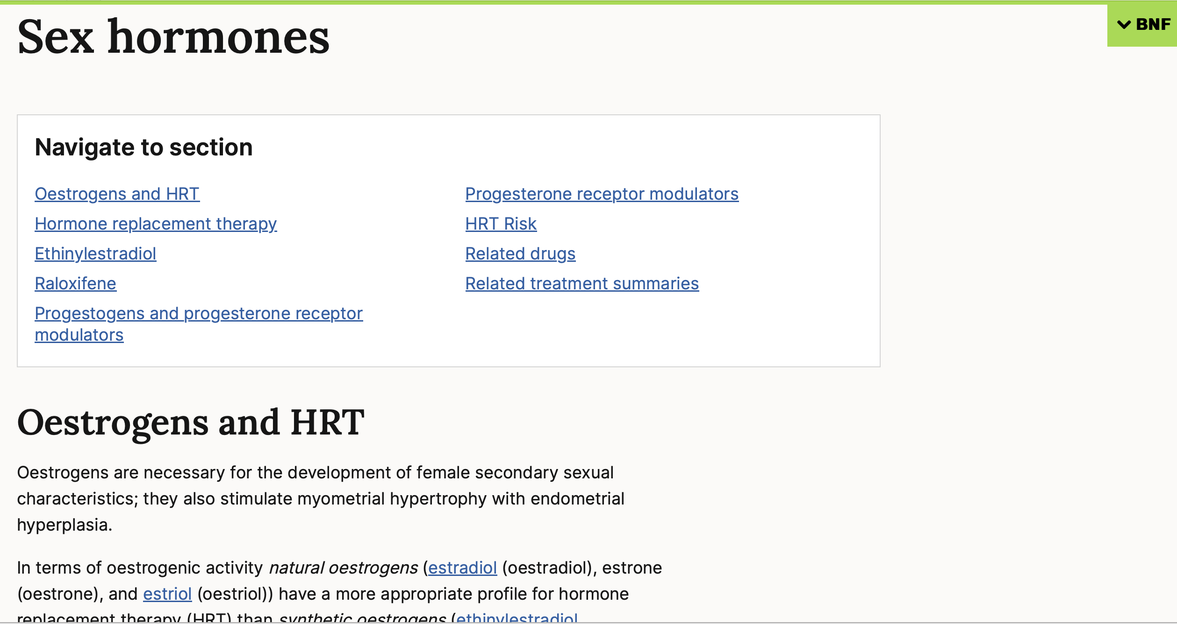
Scroll down – lots of information
https://bnf.nice.org.uk/treatment-summaries/sex-hormones/

Slide 45
Communicating Information Item
ID
COM029
A missed pill is defined as taking the pill >3 hours than it should have been
Her contraception will not be effective if she takes antibiotics like ampicillin, trimethoprim, nitrofurantoin, doxycycline for urinary tract infections
If she misses one pill, she should take an active pill as soon as she remembers and needs to use other forms of contraception for the rest of her cycle
If she vomits within 2 hours of taking the pill, she should take another pill as soon as possible
She should stop taking the pill if she has new severe headaches and see her doctor
Case presentation
A 29-year-old woman attends her GP to discuss contraception. PMH. Frequent urinary tract infections.
A joint decision is made to start Lucette (ethinylestradiol 20 micrograms / drospirenone 3 mg) one tablet daily for 21 days followed by inactive tablets for 7 days.
Question
Select the TRUE information options.
(mark all with a tick)

Slide 46
Communicating Information Item
ID
COM029
A missed pill is defined as taking the pill >3 hours than it should have been
Her contraception will not be effective if she takes antibiotics like ampicillin, trimethoprim, nitrofurantoin, doxycyline for urinary tract infections
If she misses one pill, she should take an active pill as soon as she remembers and needs to use other forms of contraception for the rest of her cycle
If she vomits within 2 hours of taking the pill, she should take another pill as soon as possible
She should stop taking the pill if she has new severe headaches and see her doctor
Case presentation
A 29-year-old woman attends her GP to discuss contraception. PMH. Frequent urinary tract infections.
A joint decision is made to star Lucette (ethinylestradiol 20 micrograms / drospirenone 3 mg) one tablet daily for 21 days followed by inactive tablets for 7 days.
Question
Select the TRUE information options.
(mark all with a tick)

Slide 47
Communicating Information Item
ID
COM029
A missed pill is defined as taking the pill >3 hours than it should have been
Her contraception will not be effective if she takes antibiotics like ampicillin, trimethoprim, nitrofurantoin, doxycyline for urinary tract infections
If she misses one pill, she should take an active pill as soon as she remembers and needs to use other forms of contraception for the rest of her cycle
If she vomits within 2 hours of taking the pill, she should take another pill as soon as possible
She should stop taking the pill if she has new severe headaches and see her doctor
Case presentation
A 29-year-old woman attends her GP to discuss contraception. PMH. Frequent urinary tract infections.
A joint decision is made to start Lucette (ethinylestradiol 20 micrograms / drospirenone 3 mg) one tablet daily for 21 days followed by inactive tablets for 7 days.
Question
Select the most appropriate information option that should be communicated to the patient.
(mark it with a tick)

Slide 48
Communicating Information Item
ID
COM029
A missed pill is defined as taking the pill >3 hours than it should have been
Her contraception will not be effective if she takes antibiotics like ampicillin, trimethoprim, nitrofurantoin, doxycyline for urinary tract infections
If she misses one pill, she should take an active pill as soon as she remembers and needs to use other forms of contraception for the rest of her cycle
If she vomits within 2 hours of taking the pill, she should take another pill as soon as possible
She should stop taking the pill if she has new severe headaches and see her doctor (not well-covered in BNF; severe migraine, venous sinus thrombosis, v high BP)
Case presentation
A 29-year old woman attends her GP to discuss contraception. PMH. Frequent urinary tract infections.
A joint decision is made to start Lucette (ethinylestradiol 20 micrograms / drospirenone 3 mg) one tablet daily for 21 days followed by inactive tablets for 7 days.
Question
Select the most appropriate information option that should be communicated to the patient.
(mark it with a tick)

Slide 49
Contraception
Know (or how to find):
How to start
What to do with missed dose
Monitoring
Contraindication
Interactions
Peri-operative period
Stop for combined pill
Can continue for progestogen only pill
https://bnf.nice.org.uk/treatment-summaries/contraceptives-hormonal/

Slide 50
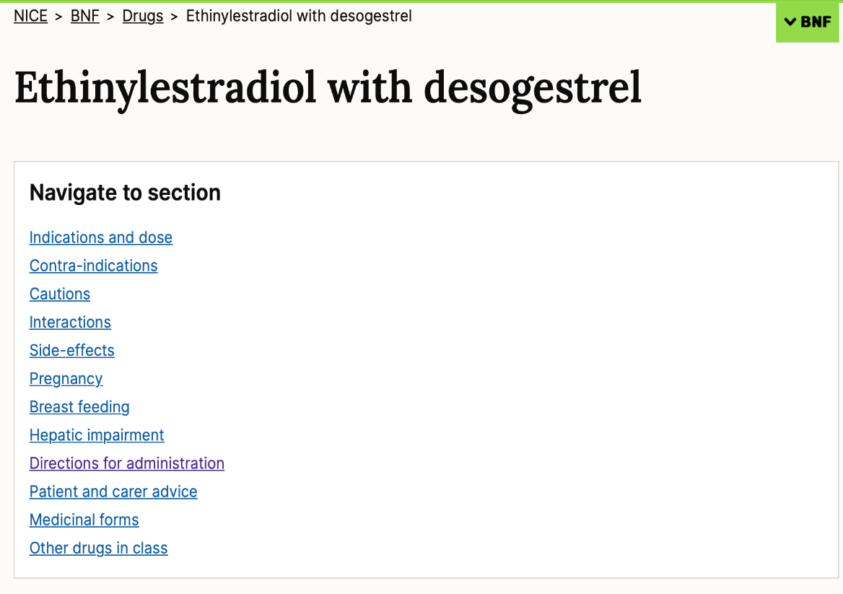
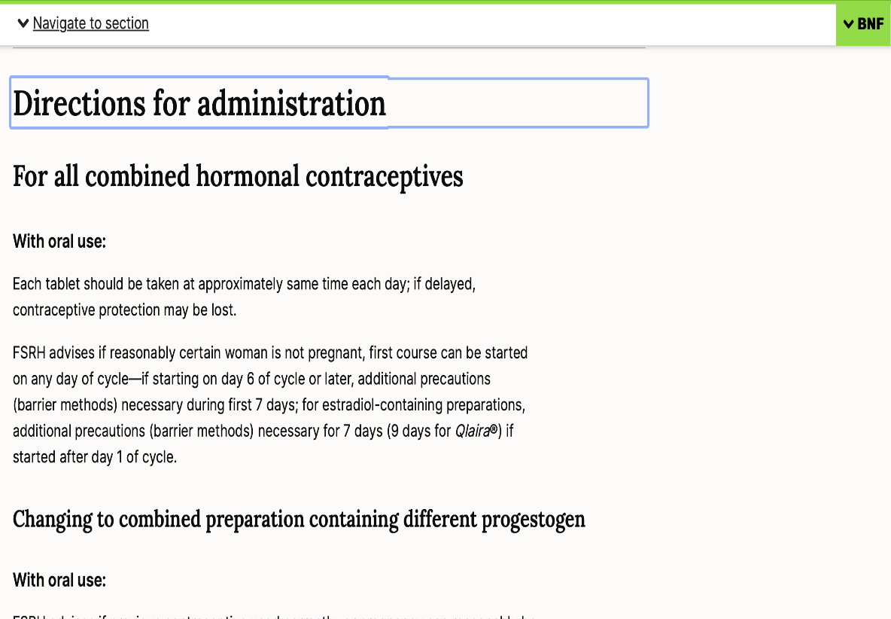
Example for Combined Oral Contraception

Slide 51
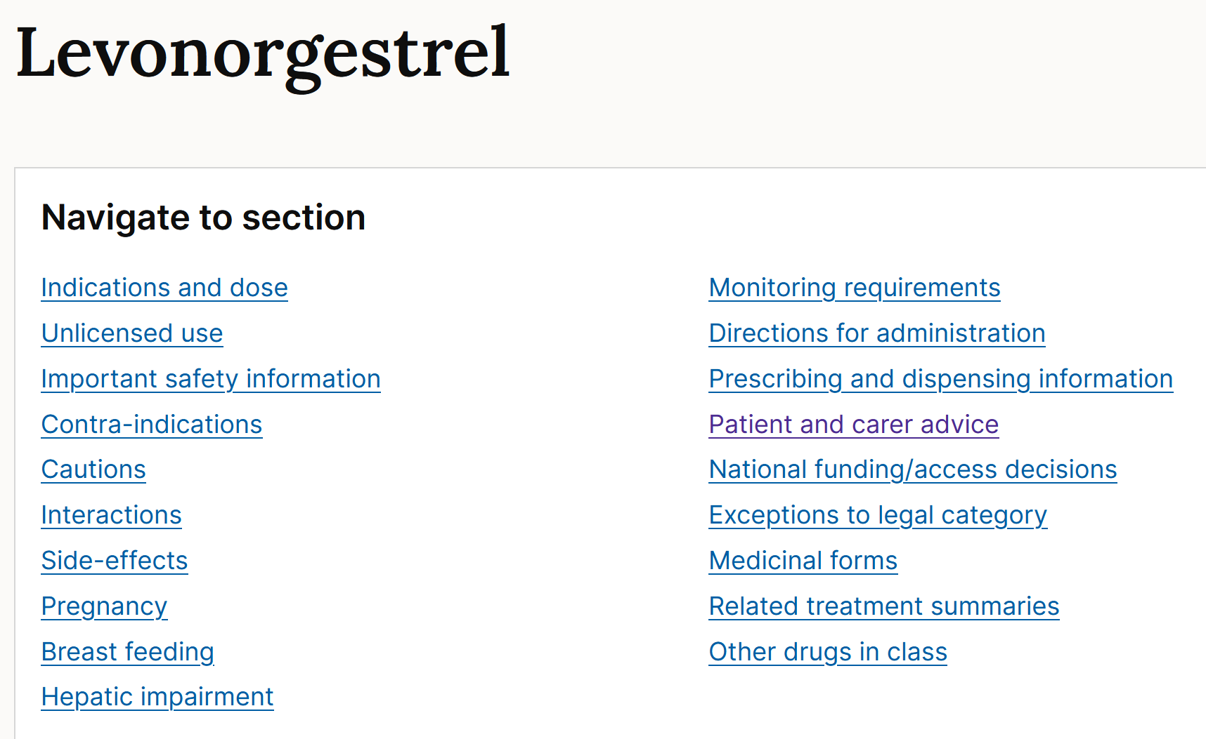
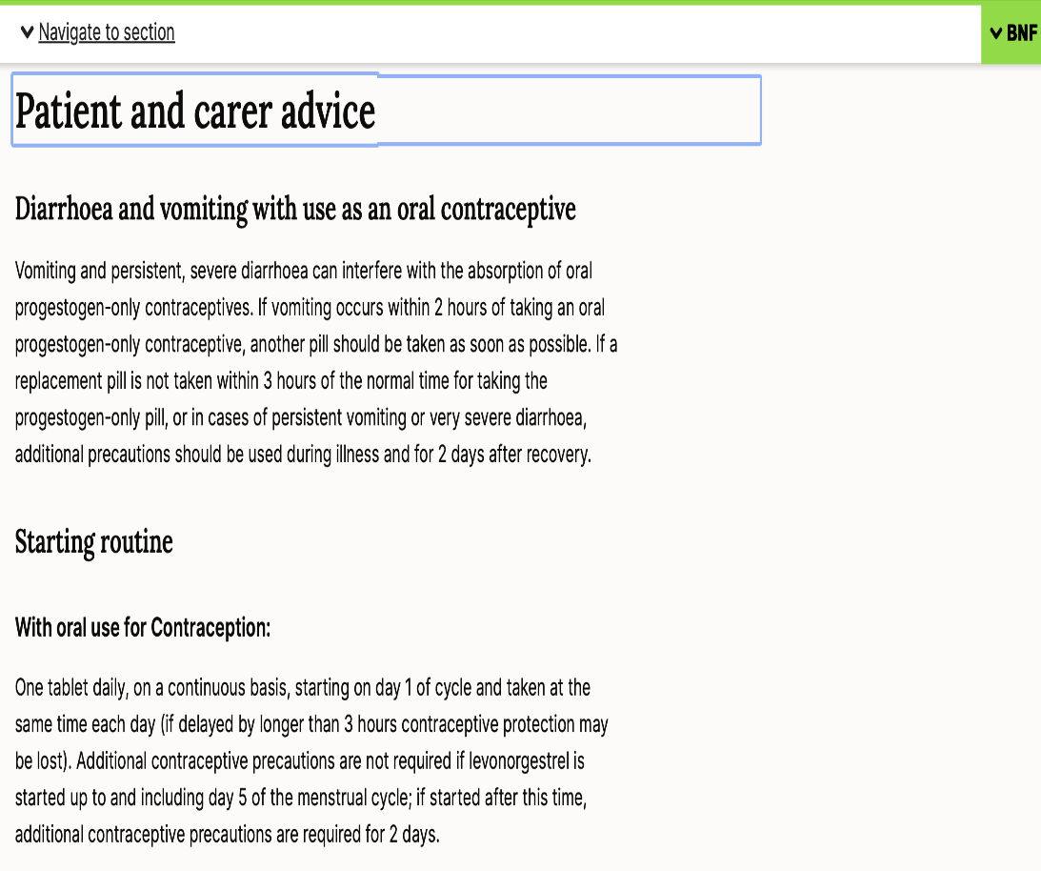
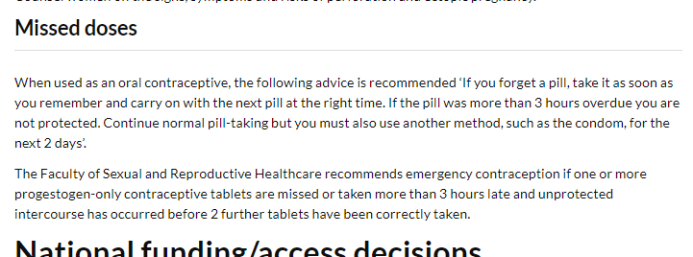
Example: Progestogen-only pill

Slide 52
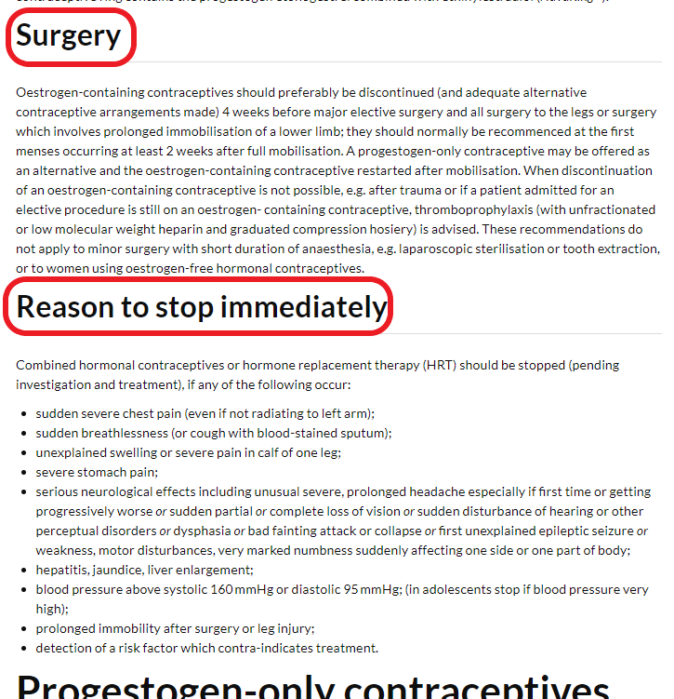
Scroll down for more

Slide 53
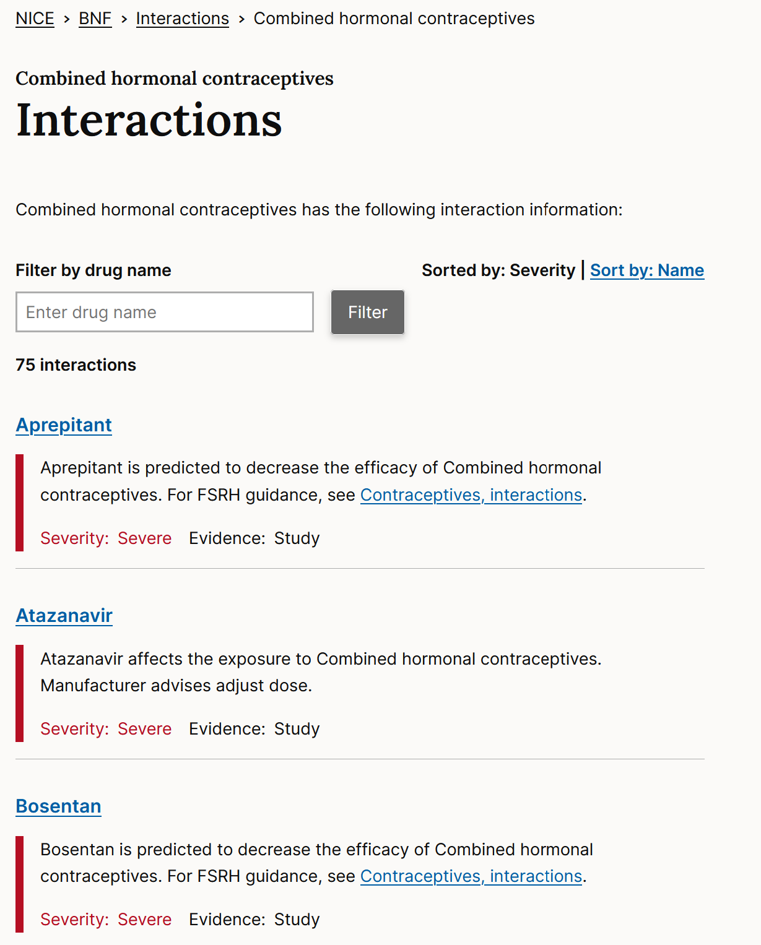
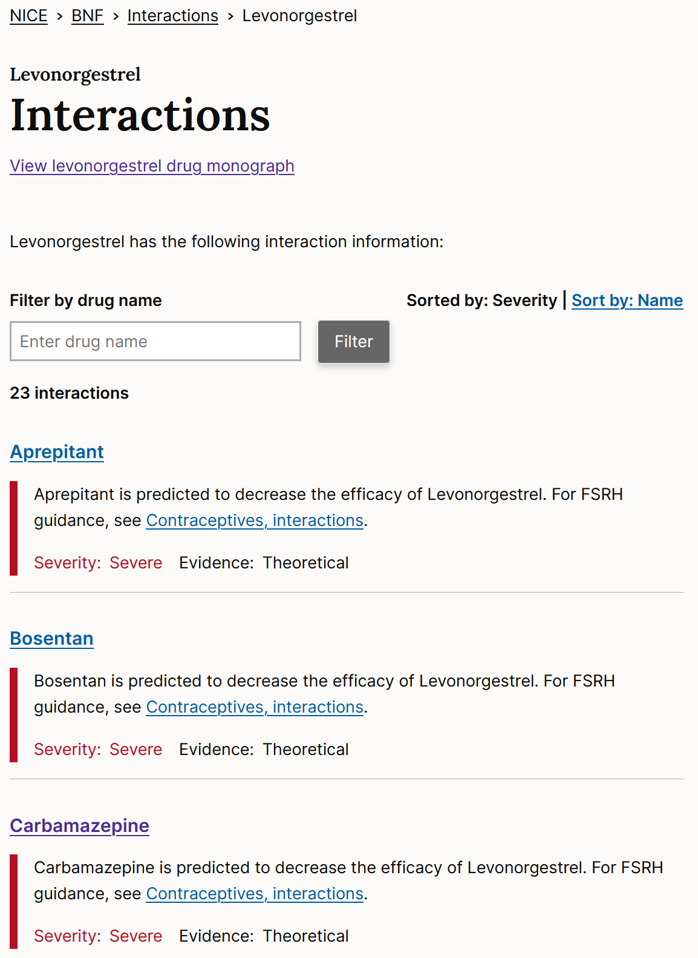

Slide 54
Communicating Information Item
ID
COM030
He requires effective contraception for at least 3 months after treatment
He requires regular monitoring of blood tests for his kidneys and liver
He should be advised to report all symptoms and signs suggestive of infection, especially sore throat
He should take methotrexate on an empty stomach
He should take the folic acid and methotrexate on the same day
It is normal to get mouth ulcers on this treatment and is of no significant consequence
Case presentation
A 28-year old man attends the Inflammatory Bowel Disease Clinic as a follow up for his Crohn’s disease.
It is recommended that he starts on methotrexate 10 mg orally once weekly, with folic acid 5 mg once weekly.
Question
Select the TRUE information options.
(mark all with a tick)

Slide 55
Communicating Information Item
ID
COM030
He requires effective contraception for at least 3 months after treatment
He requires regular monitoring of blood tests for his kidneys and liver
He should be advised to report all symptoms and signs suggestive of infection, especially sore throat
He should take methotrexate on an empty stomach
He should take the folic acid and methotrexate on the same day
It is normal to get mouth ulcers on this treatment and is of no significant consequence
Case presentation
A 28-year old man attends the Inflammatory Bowel Disease Clinic as a follow up for his Crohn’s disease.
It is recommended that he starts on methotrexate 10 mg orally once weekly, with folic acid 5 mg once weekly.
Question
Select the TRUE information options.
(mark all with a tick)

Slide 56
Communicating Information Item
ID
COM030
He requires effective contraception for at least 3 months after treatment
He requires regular monitoring of blood tests for his kidneys and liver
He should be advised to report all symptoms and signs suggestive of infection, especially sore throat
He should take methotrexate on an empty stomach
He should take the folic acid and methotrexate on the same day
It is normal to get mouth ulcers on this treatment and is of no significant consequence
Case presentation
A 28-year old man attends the Inflammatory Bowel Disease Clinic as a follow up for his Crohn’s disease.
It is recommended that he starts on methotrexate 10 mg orally once weekly, with folic acid 5 mg once weekly.
Question
Select the most appropriate information option that should be communicated to the patient.
(mark it with a tick)

Slide 57
Communicating Information Item
ID
COM030
He requires effective contraception for at least 3 months after treatment
He requires regular monitoring of blood tests for his kidneys and liver
He should be advised to report all symptoms and signs suggestive of infection, especially sore throat
He should take methotrexate on an empty stomach
He should take the folic acid and methotrexate on the same day
It is normal to get mouth ulcers on this treatment and is of no significant consequence
Case presentation
A 28-year old man attends the Inflammatory Bowel Disease Clinic as a follow up for his Crohn’s disease.
It is recommended that he starts on methotrexate 10 mg orally once weekly, with folic acid 5 mg once weekly.
Question
Select the most appropriate information option that should be communicated to the patient.
(mark it with a tick)

Slide 58
Contraception requirement for males with certain medications
Methotrexate
Cyclophosphamide and many other powerful immunosuppressants
Some chemotherapy
(Some antifungals and some antivirals)
(Possibly valproate – drug regulatory review ongoing)

Slide 59
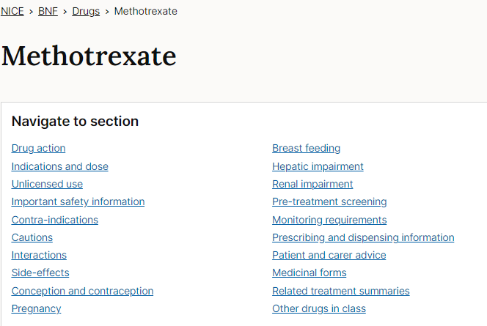
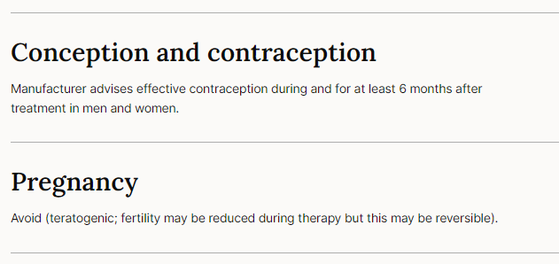
Contraception requirement for males with certain medications

Slide 60
CAL Questions

Slide 61
CAL in the PSA
National PSA results – with practice, everyone does well
Overall scores for CAL questions 75%
QMUL average 76%
~6% of students leave at least one CAL question blank
NOTE: CAL 2 marks / question → 1% of total 200 marks (v Prescribing, 10marks/Q, 5%)
So if you’re needing more than 2 minutes to complete, I suggest switching to work on other Q, especially prescribing Q, and returning to the CAL Q later

Slide 62
CAL in the PSA Types of Question
Examples include
Dose calculation based on weight or body surface area
Diluting a drug for administration in infusion pump.
Convert different expressions of drug doses and concentrations
Correct number of tablets / mLs of injection etc to achieve required dose
Also
Understand rates, times, percentages, tablets, vials
Know which information in Q is needed
Learn to identify distractor / superfluous information

Slide 63
Calculation Skills Item
ID
CAL000
This item is worth 2 marks
You may use a calculator at any time
Case presentation
A [age]-year-old [man/woman/child] presents to [location and situation] complaining of [symptom that might be used as the focus for one of the questions] etc. You are required to give a dose of ...etc. The patient weighs …
[The case presentations should be fairly brief – 2 or 3 sentences]
Answer box
Correct answer
Write the correct answer with units in this box
Working
Write a brief justification of the answer in this box, sufficient to explain how to calculate the correct answer
Calculation
What [total amount/volume/duration/total dose etc.] should the patient [be given, etc.] …… ?
(Write your answer in the box below)
Answer
unit
Fixed units
Slide compilation © 2012 The British Pharmacological Society & Medical Schools Council. All rights reserved.

Slide 64
Calculation Skills Item
ID
CAL038
10
11
22
100
110
Case presentation
An 11-year old boy is in the care of the Paediatric Urologists with recurrent urinary tract infections. Due to his urinary tract anomalies, he is prescribed trimethoprim 2mg/kg (max 100 mg) once daily for prophylaxis of urinary tract infections. He weighs 55kg.
Calculation
What dose (mg once daily) of trimethoprim should be given?
(Write your answer in the box below)
Answer
mg

Slide 65
Calculation Skills Item
ID
CAL038
10
11
22
100
110
Case presentation
An 11-year old boy is in the care of the Paediatric Urologists with recurrent urinary tract infections. Due to his urinary tract anomalies, he is prescribed trimethoprim 2mg/kg (max 100 mg) once daily for prophylaxis of urinary tract infections. He weighs 55kg.
Calculation
What dose (mg once daily) of trimethoprim should be given?
(Write your answer in the box below)
Answer
mg

Slide 66
Calculation Skills Item
ID
CAL038
This item is worth 2 marks
You may use a calculator at any time
Case presentation
An 11-year old boy in under the care of the Paediatric Urologists with recurrent urinary tract infections. Due to his urinary tract anomalies, he is prescribed trimethoprim 2mg/kg (max 100 mg) once daily for prophylaxis of urinary tract infections. He weighs 55kg.
Answer box
Correct answer
100mg
Working
Calculated dose = 2mg/kg X 55 = 110mg BUT maximum dose is 100 mg https://bnfc.nice.org.uk/drug/trimethoprim.html#indicationsAndDoses = Therefore prescribed 100mg For children’s doses especially, may be wise to check if there is a max dose
Calculation
What dose (mg once daily) of trimethoprim should be given?
(Write your answer in the box below)
Answer
100
mg

Slide 67
Maximal dose
On the few occasions that a maximal dose is stated, you need to make sure that this is accounted for.
If there is no maximal dose stated, then there is no maximal dose on this weight-based calculation

Slide 68
Calculation Skills Item
ID
CAL039
0.6
1.2
1.7
2.4
29.1
Case presentation
A 10yr old boy with acute lymphocytic leukaemia under the care of the Paediatric Haemo-oncology team is to be given vincristine injection intravenously at a dose of 2mg/m².
He has a weight of 35kg, and a calculated body-surface area of 1.2m².
Calculation
What dose (mg) of intravenous vincristine should be prescribed?
(Write your answer in the box below)
Answer
mg

Slide 69
Calculation Skills Item
ID
CAL039
0.6
1.2
1.7
2.4
29.1
Case presentation
A 10yr old boy with acute lymphocytic leukaemia under the care of the Paediatric Haemo-oncology team is to be given vincristine injection intravenously at a dose of 2mg/m².
He has a weight of 35kg, and a calculated body-surface area of 1.2m².
Calculation
What dose (mg) of intravenous vincristine should be prescribed?
(Write your answer in the box below)
Answer
mg

Slide 70
Calculation Skills Item
ID
CAL039
This item is worth 2 marks
You may use a calculator at any time
Case presentation
A 10yr old boy with acute lymphocytic leukaemia under the care of the Paediatric Haemo-oncology team is to be given vincristine injection intravenously at a dose of 2mg/m².
He has a weight of 35kg, and a calculated body-surface area of 1.2m².
Answer box
Correct answer
2.4mg
Working
Dose = 2mg/m² x 1.2m² = 2.4mg
Calculation
What dose (mg) of intravenous vincristine should be prescribed?
(Write your answer in the box below)
Answer
2.4
mg
Weight is a distractor in this question

Slide 71
Body surface area
With children, sometimes dosing is based on body surface area.
The body surface area should be provided for you already
But for your information, the way to find it is on the next slide

Slide 72
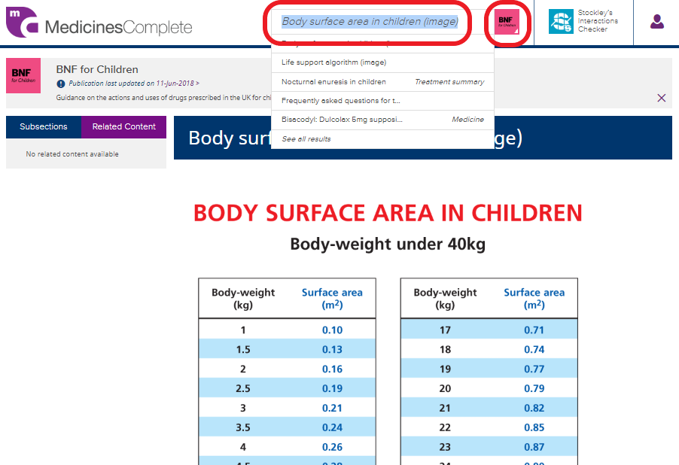
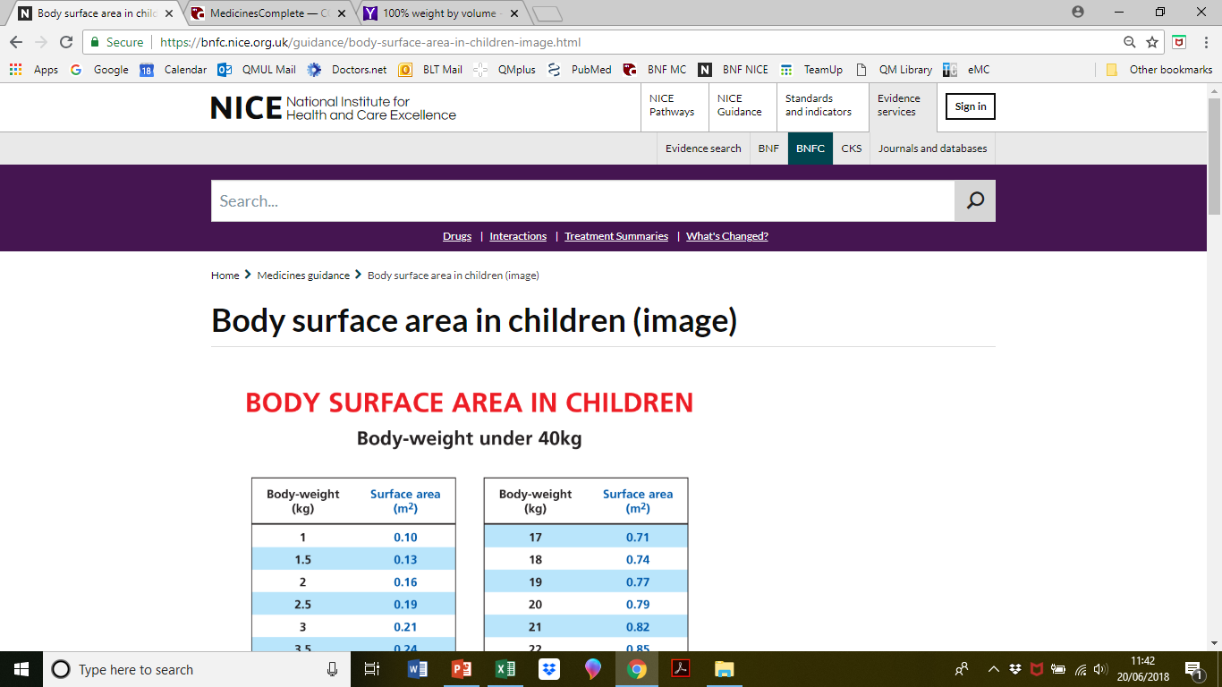
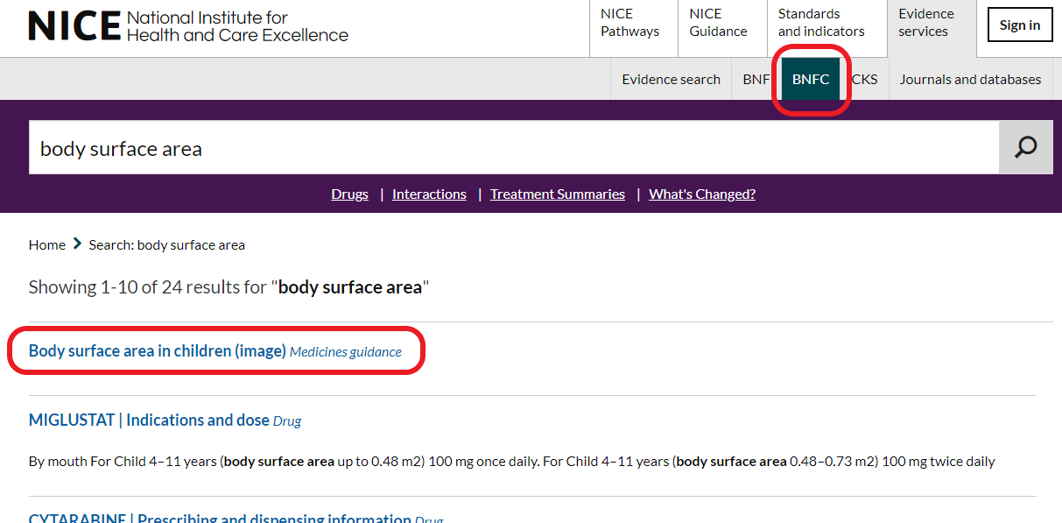
Body surface area conversion
Best seen with BNF-C
Be familiar with both NICE and eMC versions

Slide 73
Calculation Skills Item
ID
CAL040
30
45
50
60
150
Case presentation
A 48 year-old patient has received 30ml of lidocaine hydrochloride injection 0.5% as a peripheral nerve block.
Calculation
What amount (mg) of lidocaine hydrochloride has the patient received?
(Write your answer in the box below)
Answer
mg

Slide 74
Calculation Skills Item
ID
CAL040
30
45
50
60
150
Case presentation
A 48 year-old patient has received 30ml of lidocaine hydrochloride injection 0.5% as a peripheral nerve block.
Calculation
What amount (mg) of lidocaine hydrochloride has the patient received?
(Write your answer in the box below)
Answer
mg

Slide 75
Calculation Skills Item
ID
CAL040
This item is worth 2 marks
You may use a calculator at any time
Case presentation
A 48 year-old patient has received 30ml of lidocaine hydrochloride injection 0.5% as a peripheral nerve block.
Answer box
Correct answer
150 mg
Working
0.5% means 0.5grams (500mg) in 100mls = 5mg/ml. Therefore, in 30mls there are 5mg/ml x 30ml = 150mg.
Calculation
What amount (mg) of lidocaine hydrochloride has the patient received?
(Write your answer in the box below)
Answer
150
mg

Slide 76
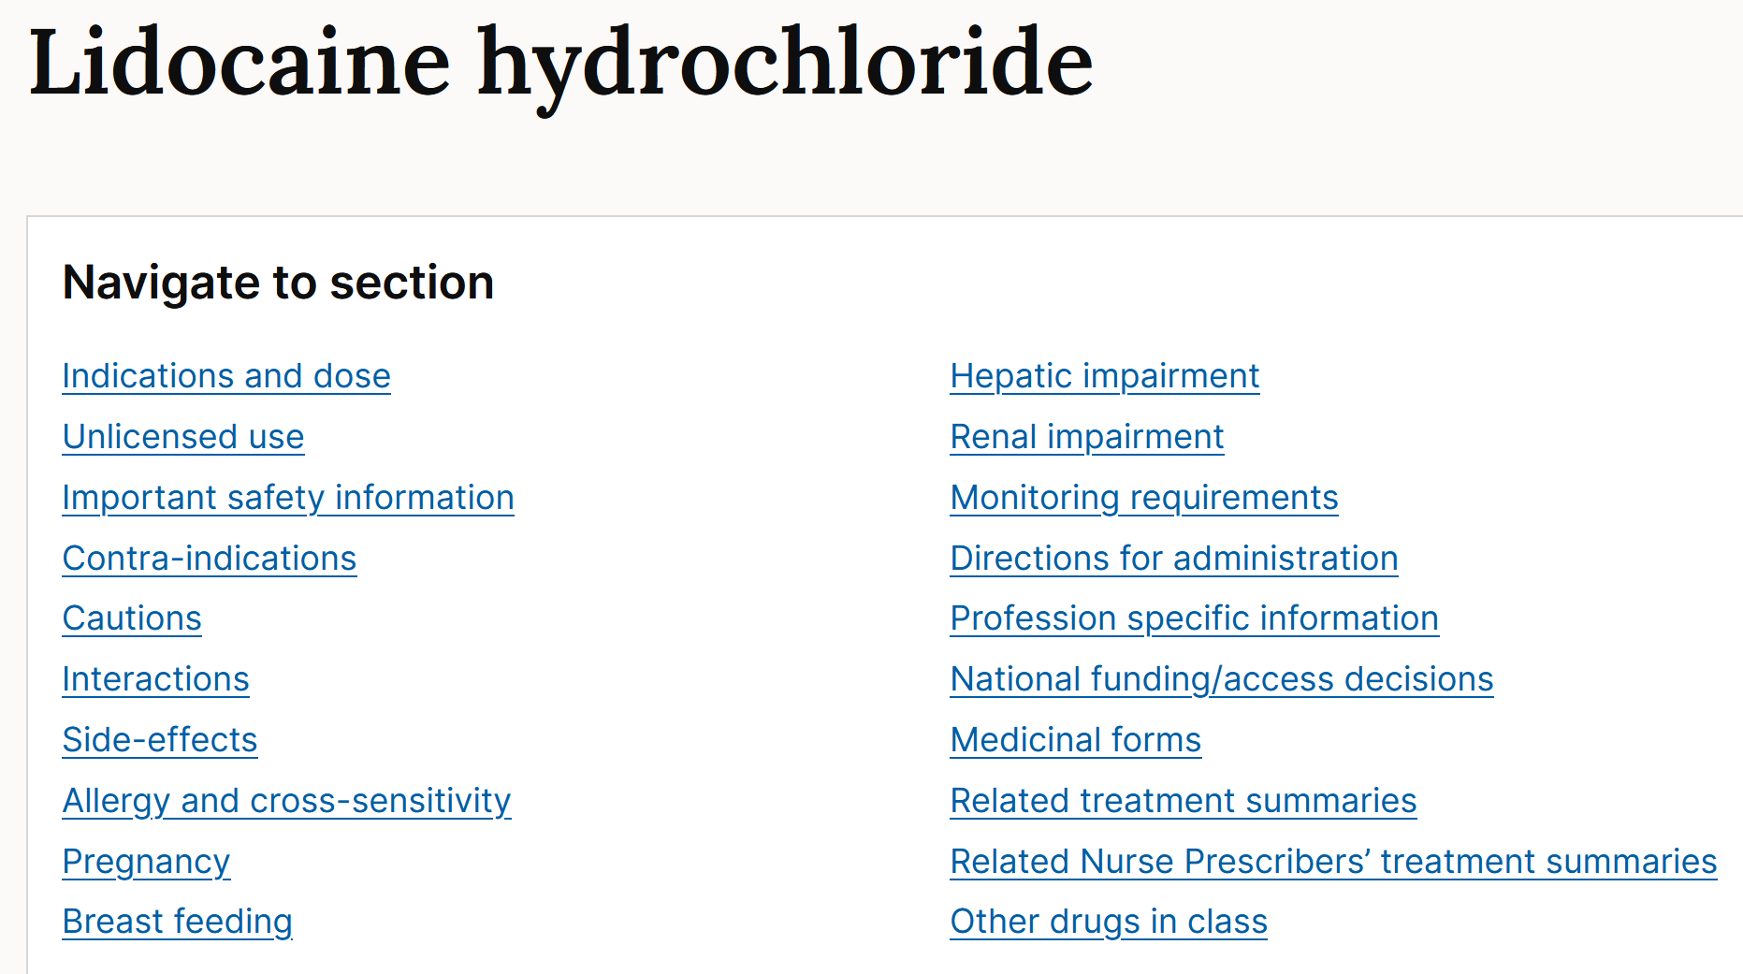
Percentage
Conversions
100% = 1 g/mL
1% = 1g/100mL
But if you cannot remember on the day, the BNF sometimes shows both % and wt/vol for the specific drug
Pick the correct formulation!

Slide 77
Calculation Skills Item
ID
CAL041
0.003
0.03
0.3
3
30
Case presentation
A 67-year old woman suffered a cardiac arrest, and during cardiopulmonary resuscitation, she received 30ml of 1-in-10000 adrenaline/epinephrine intravenously.
Calculation
What amount (mg) of adrenaline/epinephrine has she received?
(Write your answer in the box below)
Answer
mg

Slide 78
Calculation Skills Item
ID
CAL041
0.003
0.03
0.3
3
30
Case presentation
A 67-year old woman suffered a cardiac arrest, and during cardiopulmonary resuscitation, she received 30ml of 1-in-10000 adrenaline/epinephrine intravenously.
Calculation
What amount (mg) of adrenaline/epinephrine has she received?
(Write your answer in the box below)
Answer
mg

Slide 79
Calculation Skills Item
ID
CAL041
This item is worth 2 marks
You may use a calculator at any time
Case presentation
A 67-year old woman suffered a cardiac arrest, and during cardiopulmonary resuscitation, she received 30ml of 1-in-10000 adrenaline/epinephrine intravenously.
Answer box
Correct answer
3 mg
Working
1-in-10000 = 1g/10,000mL = 1000mg/10,000mL = 10mg / 100mL = 0.01g/100mL (aka 0.01%) = 0.1mg/mL (or 100 micrograms/mL) Thererfore 30ml contains = 0.1 mg/mL x 30mL = 3 mg
Calculation
What amount (mg) of adrenaline/epinephrine has she received?
(Write your answer in the box below)
Answer
3
mg

Slide 80
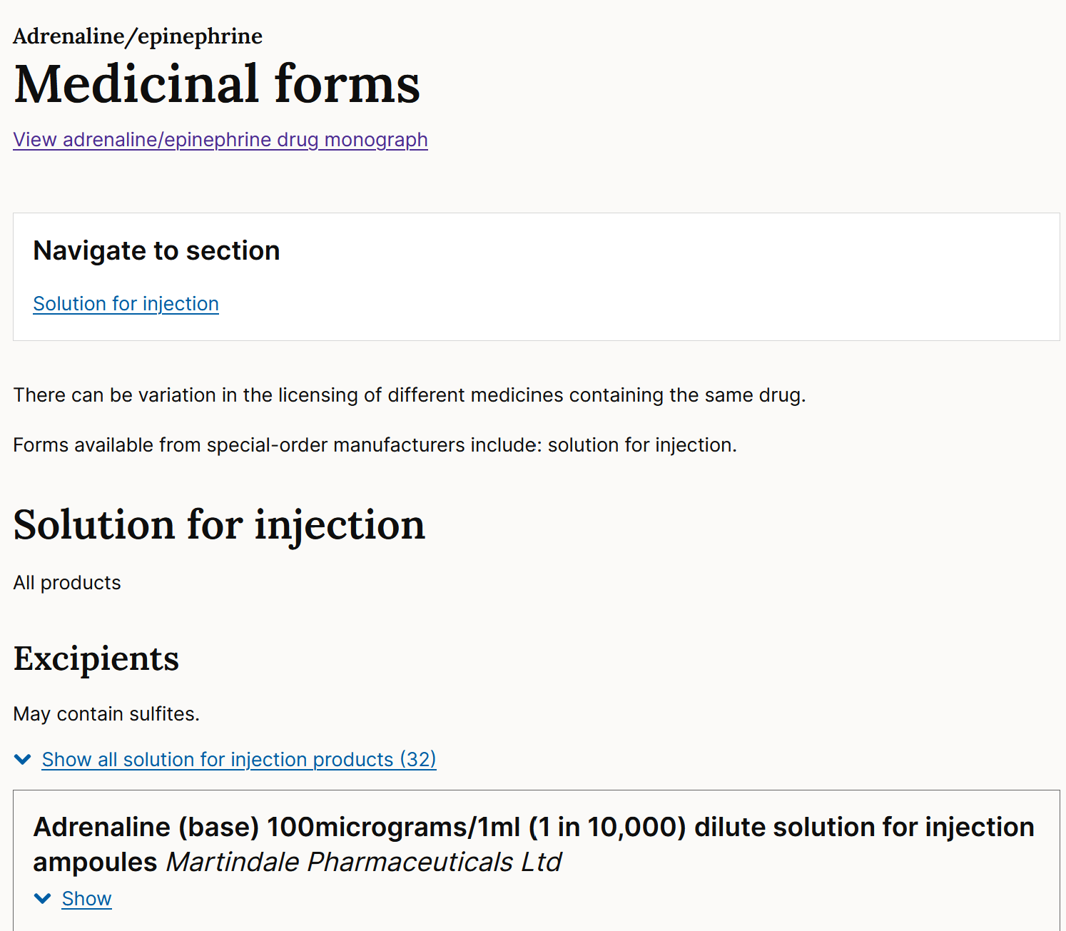
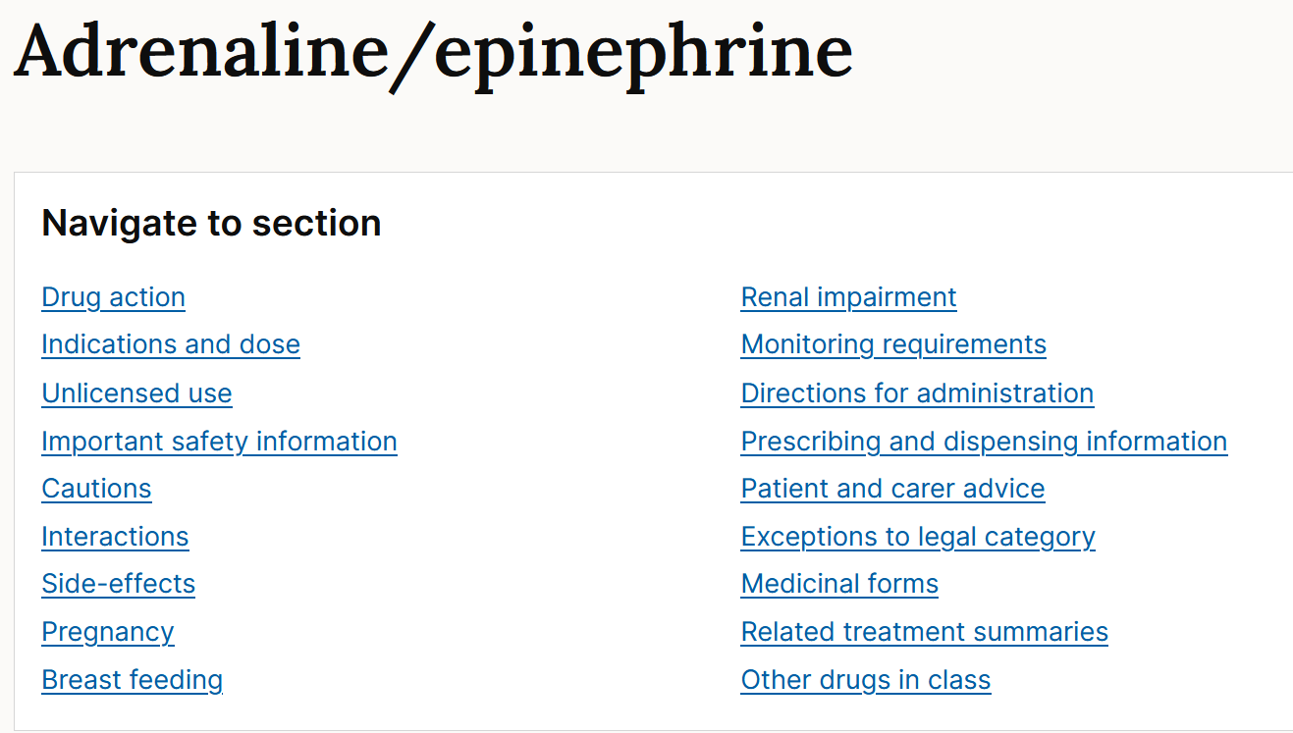
Ratio
Conversions
1-in-1 = 1 g/mL
1-in-1000 = 1g/1000mL
1-in-10000 = 1g/10000mL
(Or however you prefer to remember)
But if you cannot remember on the day, the BNF often shows conversion for the specific drug
Many products
Note also, different strength adrenaline products further down the page

Slide 81
Calculation Skills Item
ID
CAL042
0.96
16.7
60
120
125
Case presentation
A 6-month old girl is being treated for otitis media. She has previously has a severe rash to penicillins. She has been prescribed clarithromycin 7.5mg/kg twice daily.
Clarithromycin oral suspension is available at a concentration of 125mg/ml
She weighs 8kg.
Calculation
What total daily dose (mg) does she need each day?
(Write your answer in the box below)
Answer
mg

Slide 82
Calculation Skills Item
ID
CAL042
0.96
16.7
60
120
125
Case presentation
A 6-month old girl is being treated for otitis media. She has previously has a severe rash to penicillins. She has been prescribed clarithromycin 7.5mg/kg twice daily.
Clarithromycin oral suspension is available at a concentration of 125mg/ml
She weighs 8kg.
Calculation
What total daily dose (mg) does she need each day?
(Write your answer in the box below)
Answer
mg

Slide 83
Calculation Skills Item
ID
CAL042
This item is worth 2 marks
You may use a calculator at any time
Case presentation
A 6-month old girl is being treated for otitis media. She has previously has a severe rash to penicillins. She has been prescribed clarithromycin 7.5mg/kg twice daily.
Clarithromycin oral suspension is available at a concentration of 125mg/ml
She weighs 8kg.
Answer box
Correct answer
120 mg
Working
Each dose is 7.5mg/kg x 8 kg = 60 mg As she requires a twice daily dosing, her total daily dose = 60mg x 2 = 120mg (Concentration is a distractor)
Calculation
What total daily dose (mg) does she need each day?
(Write your answer in the box below)
Answer
120
mg
Alternative Request
How much clarithromycin does she receive in each dose?

Slide 84
First dose vs “total daily dose”
Be wary of whether the question asks for the “first dose”, “each dose”, “total daily dose” etc…

Slide 85
Calculation Skills Item
ID
CAL044
1
6
10
14
26
Case presentation
A 48 year-old patient has already received 14ml of lidocaine hydrochloride injection 0.5% as a peripheral nerve block.
He feels that the local anaesthesia is insufficient and is requesting added lidocaine hydrochloride. The maximal dose for local lidocaine hydrochloride infiltration is 200mg.
Calculation
What additional volume (mL) of lidocaine can be given to the patient before he reaches his maximal dose?
(Write your answer in the box below)
Answer
mL

Slide 86
Calculation Skills Item
ID
CAL044
1
6
10
14
26
Case presentation
A 48 year-old patient has already received 14ml of lidocaine hydrochloride injection 0.5% as a peripheral nerve block.
He feels that the local anaesthesia is insufficient and is requesting added lidocaine hydrochloride. The maximal dose for local lidocaine hydrochloride infiltration is 200mg.
Calculation
What additional volume (mL) of lidocaine can be given to the patient before he reaches his maximal dose?
(Write your answer in the box below)
Answer
mL

Slide 87
Calculation Skills Item
ID
CAL044
This item is worth 2 marks
You may use a calculator at any time
Case presentation
A 48 year-old patient has already received 14ml of lidocaine hydrochloride injection 0.5% as a peripheral nerve block.
He feels that the local anaesthesia is insufficient and is requesting added lidocaine hydrochloride. The maximal dose for local lidocaine hydrochloride infiltration is 200mg.
Answer box
Correct answer
26ml
Working
0.5% means 0.5gram (500mg) in 100mls = 5mg/ml. (See previous slides for percentage calculations) Therefore, volume for the maximal 200mg = (200mg / 5mg/ml) = 40ml Therefore he can still have = (40 – 14) ml = 26 ml
Calculation
What additional volume (mL) of lidocaine can be given to the patient before he reaches his maximal dose?
(Write your answer in the box below)
Answer
26
mL

Slide 88
“How much more is allowed” for PRN medications
I would suggest working out what maximum dose is
Then working out how much has been given
Subtracting one from the other will give the residual
Make sure you are using the right units!

Slide 89
Calculation Skills Item
ID
CAL045
1
2
3
4
5
Case presentation
A 4-year old girl attends Paediatric Neurology clinic as follow up for primary generalised tonic-clonic seizures. She is to be started on Tegretol® (Carbamazepine) 2.5 mg/kg twice a day.
She weighs 16kg.
Tegretol ® is available in 300ml bottles of 100mg/5ml concentration.
Her next clinic appointment is in 24 weeks.
Calculation
How many bottles of 300ml Tegretol® does she need to last her 24 weeks?
(Write your answer in the box below)
Answer
bottles

Slide 90
Calculation Skills Item
ID
CAL045
1
2
3
4
5
Case presentation
A 4-year old girl attends Paediatric Neurology clinic as follow up for primary generalised tonic-clonic seizures. She is to be started on Tegretol® (Carbamazepine) 2.5 mg/kg twice a day.
She weighs 16kg.
Tegretol ® is available in 300ml bottles of 100mg/5ml concentration.
Her next clinic appointment is in 24 weeks.
Calculation
How many bottles of 300ml Tegretol® does she need to last her 24 weeks?
(Write your answer in the box below)
Answer
bottles

Slide 91
Calculation Skills Item
ID
CAL045
This item is worth 2 marks
You may use a calculator at any time
Case presentation
A 4-year old girl attends Paediatric Neurology clinic as follow up for primary generalised tonic-clonic seizures. She is to be started on Tegretol® (Carbamazepine) 2.5 mg/kg twice a day.
She weighs 16kg.
Tegretol ® is available in 300ml bottles of 100mg/5ml concentration.
Her next clinic appointment is in 24 weeks.
Answer box
Correct answer
3
Working
DAILY dose = 5mg/kg x 16kg = 80mg Concentration = 100mg/5ml = 20mg/ml Volume required daily = 80mg / 20mg/ml = 4ml Volume required for 24 weeks = 4ml x 7 x 24 = 672 ml As Tegretol comes in 300ml bottles, she will require 3 bottles
Calculation
How many bottles of 300ml Tegretol® does she need to last her 24 weeks?
(Write your answer in the box below)
Answer
3
bottles

Slide 92
Calculation Skills Item
ID
CAL048
21
28
32
35
42
Case presentation
A 45-year old woman has been admitted to the Cardiology Ward. She has MRSA endocarditis, and together with other antibiotics, she has been prescribed vancomycin 20mg/kg intravenously twice daily.
She weighs 56 kg.
Vancomycin is available in 500mg vials which cannot be re-used, and any residual must be discarded.
Calculation
How many 500mg vials of vancomycin would be required for 7 days (assuming no changes in dose required)?
(Write your answer in the box below)
Answer
vials

Slide 93
Calculation Skills Item
ID
CAL048
21
28
32
35
42
Case presentation
A 45-year old woman has been admitted to the Cardiology Ward. She has MRSA endocarditis, and together with other antibiotics, she has been prescribed vancomycin 20mg/kg intravenously twice daily.
She weighs 56 kg.
Vancomycin is available in 500mg vials which cannot be re-used, and any residual must be discarded.
Calculation
How many 500mg vials of vancomycin would be required for 7 days (assuming no changes in dose required)?
(Write your answer in the box below)
Answer
vials

Slide 94
Calculation Skills Item
ID
CAL048
This item is worth 2 marks
You may use a calculator at any time
Case presentation
A 45-year old woman has been admitted to the Cardiology Ward. She has MRSA endocarditis, and together with other antibiotics, she has been prescribed vancomycin 20mg/kg intravenously twice daily.
She weighs 56 kg.
Vancomycin is available in 500mg vials which cannot be re-used, and any residual must be discarded.
Answer box
Correct answer
42 vials
Working
Single dose = 20mg/kg x 56kg = 1120mg = 3 vials (discarding the excess) Daily dose = 6 vials One week = 42 vials
Calculation
How many 500mg vials of vancomycin would be required for 7 days (assuming no changes in dose required)?
(Write your answer in the box below)
Answer
42
vials

Slide 95
“How many to dispense”
These are not calculations that you will do commonly in clinical practice - but you may - basic calculation
Bear in mind when sometimes you have to round up
E.g. when vials cannot be reused
E.g. when you need to dispense it to the patient to take home

Slide 96
Calculation Skills Item
ID
CAL049
1.8
3.5
7
10.5
21
Case presentation
A 65-year old woman has been taking ferrous gluconate 600 mg orally three times a day. However, as she is having difficulty swallowing tablets, she has requested conversion to Niferex® elixir (100 mg elemental iron / 5ml elixir) to be taken once daily.
Ferrous gluconate 300 mg contains 35 mg elemental iron.
Calculation
What volume of Niferex® elixir (ml) daily is required to replace the elemental iron content of her ferrous gluconate?
(Write your answer in the box below)
Answer
mL

Slide 97
Calculation Skills Item
ID
CAL049
1.8
3.5
7
10.5
21
Case presentation
A 65-year old woman has been taking ferrous gluconate 600 mg orally three times a day. However, as she is having difficulty swallowing tablets, she has requested conversion to Niferex® elixir (100 mg elemental iron / 5ml elixir) to be taken once daily.
Ferrous gluconate 300 mg contains 35 mg elemental iron.
Calculation
What volume of Niferex® elixir (ml) daily is required to replace the elemental iron content of her ferrous gluconate?
(Write your answer in the box below)
Answer
mL

Slide 98
Calculation Skills Item
ID
CAL049
This item is worth 2 marks
You may use a calculator at any time
Case presentation
A 65-year old woman has been taking ferrous gluconate 600 mg orally three times a day. However, as she is having difficulty swallowing tablets, she has requested conversion to Niferex® elixir (100 mg elemental iron / 5ml elixir) to be taken once daily.
Ferrous gluconate 300 mg contains 35 mg elemental iron
Answer box
Correct answer
10.5ml
Working
Total ferrous gluconate dose = 600mg x 3 = 1800mg Ferrous gluconate 300 mg → 35 mg elemental iron Ferrous gluconate 1800 (= 300x6) mg → 35x6 mg elemental iron 210mg Concentration of Niferex = 100mg / 5ml = 20mg/ml Volume = Dose / Concentration = 210mg / 20mg/ml = 10.5ml
Calculation
What volume of Niferex® elixir (ml) daily is required to replace the elemental iron content of her ferrous gluconate?
(Write your answer in the box below)
Answer
10.5
mL

Slide 99
Converting equivalent doses
The required information (for CAL questions) should be in the question (i.e. should not need to look in BNF)
For PWS/MAN questions, you may need to know how to find conversions!
I would suggest working out the “current dose”, and then work out the “equivalent dose/volume/tablets/patch”

Slide 100
Calculation Skills Item
ID
CAL051
12.5
25
40
48
50
Case presentation
A 54-year old man is currently in Cardiac High Dependency Unit with cardiogenic shock. He requires a dobutamine infusion.
The available dobutamine ampoules are at a concentration of 250mg/20ml. This is to be diluted to a final concentration of 0.5mg/ml using 0.9% sodium chloride. The final volume of the syringe driver is 50ml.
Calculation
How much 0.9% sodium chloride (mL) is required for this dilution?
(Write your answer in the box below)
Answer
mL

Slide 101
Calculation Skills Item
ID
CAL051
12.5
25
40
48
50
Case presentation
A 54-year old man is currently in Cardiac High Dependency Unit with cardiogenic shock. He requires a dobutamine infusion.
The available dobutamine ampoules are at a concentration of 250mg/20ml. This is to be diluted to a final concentration of 0.5mg/ml using 0.9% sodium chloride. The final volume of the syringe driver is 50ml.
Calculation
How much 0.9% sodium chloride (mL) is required for this dilution?
(Write your answer in the box below)
Answer
mL

Slide 102
Calculation Skills Item
ID
CAL051
This item is worth 2 marks
You may use a calculator at any time
Case presentation
A 54-year old man is currently in Cardiac High Dependency Unit with cardiogenic shock. He requires a dobutamine infusion.
The available dobutamine ampoules are at a concentration of 250mg/20ml. This is to be diluted to a final concentration of 0.5mg/ml using 0.9% sodium chloride. The final volume of the syringe driver is 50ml.
Answer box
Correct answer
48mL
Working
Initial concentration = 250mg/20ml = 12.5mg/ml Total dose in 50ml = 0.5mg/mL x 50ml = 25mg Therefore volume of stock (12.5mg/ml) dobutamine required = 25mg / 12.5mg/mL = 2mL Therefore volume required make up to 50ml = 50 – 2 = 48mL
Calculation
How much 0.9% sodium chloride (mL) is required for this dilution?
(Write your answer in the box below)
Answer
48
mL

Slide 103
Diluting medications
Many different ways of getting the answer
Suggest:
Working out the initial concentration
Working out the total dose of the whole infusion/injection/solution
Work out how much of the original solution is required
(If required) work out how much of the diluent is required

Slide 104
Calculation Skills Item
ID
CAL052
0.0225
0.6
1.35
2.7
3.7
7.4
45
2700
Case presentation
A 36 year-old man is admitted to the Intensive Care Unit with severe sepsis of unknown origin. He has been prescribed drug X at a dose of 200 nanograms/kg/minute.
Drug X is available at a stock solution of 75mg/5ml, which is subsequently diluted from 5ml to 50ml.
He weighs 75kg.
Calculation
What rate (mL/hr) should Drug X be given?
(Write your answer in the box below)
Answer
mL/hr

Slide 105
Calculation Skills Item
ID
CAL052
0.0225
0.6
1.35
2.7
3.7
7.4
45
2700
Case presentation
A 36 year-old man is admitted to the Intensive Care Unit with severe sepsis of unknown origin. He has been prescribed drug X at a dose of 200 nanograms/kg/minute.
Drug X is available at a stock solution of 75mg/5ml, which is subsequently diluted from 5ml to 50ml.
He weighs 75kg.
Calculation
What rate (mL/hr) should Drug X be given?
(Write your answer in the box below)
Answer
mL/hr

Slide 106
Calculation Skills Item
ID
CAL052
This item is worth 2 marks
You may use a calculator at any time
Case presentation
A 36 year-old man is admitted to the Intensive Care Unit with severe sepsis of unknown origin. He has been prescribed drug X at a dose of 200 nanograms/kg/minute.
Drug X is available at a stock solution of 75mg/5ml, which is subsequently diluted from 5ml to 50ml.
He weighs 75kg.
Answer box
Correct answer
0.6 ml/hr
Working
Dose required = 200 nanograms/kg/min x 75kg = 15000 nanograms/min = 15 micrograms/min = 0.015 mg/min = (0.015*60) mg/hr = 0.9 mg/hr Initial stock solution 75mg/5ml, but diluted into 50ml = 75mg/50ml = 1.5mg/ml Rate = Dose-per-unit-time / Concentration Rate = 0.9 mg/hr / 1.5 mg/ml = 0.6 ml/hr
Calculation
What rate (mL/hr) should the diluted Drug X be given?
(Write your answer in the box below)
Answer
0.6
mL/hr

Slide 107
Calculation Skills Item
ID
CAL053
10
15
20
30
60
90
120
180
Case presentation
A 47-year old man is being treated for osteomyelitis. In addition to other antibiotics, he requires clindamycin 900mg intravenously 8hrly.
The infusion should be at a rate not exceed 30 mg/minutes.
Calculation
What is the minimum duration (minutes) that the clindamycin can be safely infused at each dose?
(Write your answer in the box below)
Answer
minutes

Slide 108
Calculation Skills Item
ID
CAL053
10
15
20
30
60
90
120
180
Case presentation
A 47-year old man is being treated for osteomyelitis. In addition to other antibiotics, he requires clindamycin 900mg intravenously 8hrly.
The infusion should be at a rate not exceed 30 mg/minutes.
Calculation
What is the minimum duration (minutes) that the clindamycin can be safely infused at each dose?
(Write your answer in the box below)
Answer
minutes

Slide 109
Calculation Skills Item
ID
CAL053
This item is worth 2 marks
You may use a calculator at any time
Case presentation
A 47-year old man is being treated for osteomyelitis. In addition to other antibiotics, he requires clindamycin 900mg intravenously 8hrly.
The infusion should be at a rate not exceed 30 mg/minutes.
Answer box
Correct answer
30 minutes
Working
Dose required = 900 mg Rate = Dose / Time Time = Dose / Rate = 900mg / 30mg/min = 30 minutes
Calculation
What is the minimum duration (minutes) that the clindamycin can be safely infused at each dose?
(Write your answer in the box below)
Answer
30
minutes

Slide 110
Calculation Skills Item
ID
CAL054
1
2
3
4
5
6
7
8
Case presentation
A 3-year old girl attends Paediatric Neurology clinic as follow up for focal seizures.
She is to be started on Levetiracetam with planned uptitration.
First 14 days: 10 mg/kg daily
Next 14 days: 10 mg/kg twice daily
Next 14 days: 15 mg/kg twice daily
Next 14 days: 20 mg/kg twice daily
Her next clinic appointment is in 56 days.
She weighs 12kg.
Levetiracetam is available in 100ml bottles of 100mg/ml concentration.
Calculation
How many bottles of 100ml levetiravetam does she need to last her 56 days?
(Write your answer in the box below)
Answer
bottles

Slide 111
Calculation Skills Item
ID
CAL054
1
2
3
4
5
6
7
8
Case presentation
A 3-year old girl attends Paediatric Neurology clinic as follow up for focal seizures.
She is to be started on Levetiracetam with planned uptitration.
First 14 days: 10 mg/kg daily
Next 14 days: 10 mg/kg twice daily
Next 14 days: 15 mg/kg twice daily
Next 14 days: 20 mg/kg twice daily
Her next clinic appointment is in 56 days.
She weighs 12kg.
Levetiracetam is available in 100ml bottles of 100mg/ml concentration.
Calculation
How many bottles of 100ml levetiravetam does she need to last her 56 days?
(Write your answer in the box below)
Answer
bottles

Slide 112
Calculation Skills Item
ID
CAL054
This item is worth 2 marks
You may use a calculator at any time
Case presentation
A 3-year old girl attends Paediatric Neurology clinic as follow up for focal seizures.
She is to be started on Levetiracetam with planned uptitration.
First 14 days: 10 mg/kg daily
Next 14 days: 10 mg/kg twice daily
Next 14 days: 15 mg/kg twice daily
Next 14 days: 20 mg/kg twice daily
Her next clinic appointment is in 56 days.
She weighs 12kg.
Levetiracetam is available in 100ml bottles of 100mg/ml concentration.
Answer box
Correct answer
2
Working
First 14 days = 10mg/kg X 12kg = 120mg/day = 1680 mg Next 14 days = 10mg/kg X 12kg x2 = 240mg/day = 3360 mg Next 14 days = 15mg/kg X 12kg x2 = 360mg/day = 5040 mg Next 14 days = 20mg/kg X 12kg x2 = 480mg/day = 6720 mg Total for the 56 days = 16800 mg Each bottle has 100ml x 100mg/ml = 10000mg levetiracetam Therefore requires 2 bottles
Calculation
How many bottles of 100ml levetiravetam does she need to last her 56 days?
(Write your answer in the box below)
Answer
2
bottles

Slide 113
Calculation Skills Item
ID
CAL055
2.5
3.75
6.25
8.75
9
13.5
33.75
52.25
Not listed above
I need more time
Case presentation
A 35 year-old man was admitted to hospital. He has been prescribed drug X intravenously at a dose of 7.5 micrograms/kg/min. Drug X is available as a 2.5mg/ml solution for infusion.
He weighs 75kg.
Calculation
What rate (mL/hr) of Drug X should the patient be given?
(Write your answer in the box below)
Answer
mL/hr

Slide 114
Calculation Skills Item
ID
CAL055
This item is worth 2 marks
You may use a calculator at any time
Case presentation
A 35 year-old man was admitted to hospital. He has been prescribed drug X intravenously at a dose of 7.5 micrograms/kg/min. Drug X is available as a 2.5mg/ml solution for infusion.
He weighs 75kg.
Answer box
Correct answer
13.5 mL/hr
Working
Dose = 7.5 microg/kg/min x 75kg = 562.5 micrograms/min = (562.5*60) micrograms/hr = 33750 micrograms/hr = 33.75 mg/hr Rate = Dose-per-unit-time / Concentration Rate = 33.75mg/hr / 2.5mg/mL = 13.5mL/hr
Calculation
What rate (mL/hr) of Drug X should the patient be given?
(Write your answer in the box below)
Answer
13.5
mL/hr

Slide 115
Calculation Skills Item
ID
CAL056
3.2
12.5
16
36
40
42
45
46.8
Case presentation
A 54-year old man is currently in Cardiac High Dependency Unit with cardiogenic shock. He requires a dopamine infusion.
The available dopamine ampoules are at a concentration of 250mg/5ml. This is to be diluted to a final concentration of 3.2mg/ml using 5% glucose. The final volume of the syringe driver is 50ml.
Calculation
How much 5% glucose (mL) is required for this dilution?
(Write your answer in the box below)
Answer
mL

Slide 116
Calculation Skills Item
ID
CAL056
This item is worth 2 marks
You may use a calculator at any time
Case presentation
A 54-year old man is currently in Cardiac High Dependency Unit with cardiogenic shock. He requires a dopamine infusion.
The available dopamine ampoules are at a concentration of 250mg/5ml. This is to be diluted to a final concentration of 3.2mg/ml using 5% glucose. The final volume of the syringe driver is 50ml.
Answer box
Correct answer
46.8mL
Working
Initial concentration = 250mg/5ml = 50mg/ml Total dose in 50ml = 3.2mg/ml x 50ml = 160mg Therefore volume of stock (50mg/ml) dobutamine required = 160mg / 50 mg/mL = 3.2mL Therefore volume required make up to 50ml = 50 – 3.2 = 46.8mL (“5%” glucose is a distractor)
Calculation
How much 5% glucose (mL) is required for this dilution?
(Write your answer in the box below)
Answer
46.8
mL

Slide 117
Calculation Skills Item
ID
CAL057
0
0.5
1
2
3
6
9
10
Case presentation
A 11 year-old patient has already received 3ml of lidocaine hydrochloride injection 2% as a peripheral nerve block.
He feels that the local anaesthesia is insufficient and is requesting added lidocaine hydrochloride. The maximal dose for local lidocaine hydrochloride infiltration for his age is 3mg/kg. He weighs 40kg
Calculation
What additional volume (mL) of lidocaine can be given to the patient before he reaches his maximal dose?
(Write your answer in the box below)
Answer
mL

Slide 118
Calculation Skills Item
ID
CAL057
This item is worth 2 marks
You may use a calculator at any time
Case presentation
A 11 year-old patient has already received 3ml of lidocaine hydrochloride injection 2% as a peripheral nerve block.
He feels that the local anaesthesia is insufficient and is requesting added lidocaine hydrochloride. The maximal dose for local lidocaine hydrochloride infiltration for his age is 3mg/kg. He weighs 40kg
Answer box
Correct answer
3ml
Working
Maximum dose = 3mg/kg x 40kg = 120 mg 2% means 2gram (2000mg) lidocaine hydrochloride in 100mls = 20mg/ml. (See previous slides for percentage calculations) Therefore, volume for the maximal 120mg = (120mg / 20mg/ml) = 6ml Therefore he can still have = (6 - 3) ml = 3 ml
Calculation
What additional volume (mL) of lidocaine can be given to the patient before he reaches his maximal dose?
(Write your answer in the box below)
Answer
3
mL

Slide 119
Calculation Skills Item
ID
CAL058
0.6
1.2
2.4
6
12
20
150
300
Case presentation
A 47 year old man is admitted with septic arthritis, and has grown MRSA from his joint aspirate.
He requires an initial prescription of vancomycin at a dose of 20mg/kg every 12 hours. He weighs 60kg
Calculation
What is his total daily dose (g) of vancomycin?
(Write your answer in the box below)
Answer
grams

Slide 120
Calculation Skills Item
ID
CAL058
This item is worth 2 marks
You may use a calculator at any time
Case presentation
A 47 year old man is admitted with septic arthritis, and has grown MRSA from his joint aspirate.
He requires an initial prescription of vancomycin at a dose of 20mg/kg every 12 hours. He weighs 60kg
Answer box
Correct answer
2.4 grams
Working
Single dose = 20mg/kg x 60kg = 1200 mg = 1.2g Daily dose (twice a day) = 2.4g
Calculation
What is his total daily dose (g) of vancomycin?
(Write your answer in the box below)
Answer
2.4
grams

Slide 121
Calculation Skills Item
ID
CAL059
21
28
32
35
42
62
70
84
Case presentation
A 45-year old woman has been admitted with septicaemia. Together with other antibiotics, she has been prescribed gentamicin 1mg/kg intravenously 8hrly.
She weighs 92 kg.
Gentamicin is available in 80mg vials which cannot be re-used, and any residual must be discarded.
Calculation
How many 80mg vials of gentamicin would be required for 7 days (assuming no changes in dose required)?
(Write your answer in the box below)
Answer
vials

Slide 122
Calculation Skills Item
ID
CAL059
This item is worth 2 marks
You may use a calculator at any time
Case presentation
A 45-year old woman has been admitted with septicaemia. Together with other antibiotics, she has been prescribed gentamicin 1mg/kg intravenously 8hrly.
She weighs 92 kg.
Vancomycin is available in 80mg vials which cannot be re-used, and any residual must be discarded.
Answer box
Correct answer
42 vials
Working
Single dose = 1mg/kg x 92kg = 92mg = 2 vials (discarding the excess) Daily dose = 6 vials One week = 42 vials
Calculation
How many 80mg vials of gentamicin would be required for 7 days (assuming no changes in dose required)?
(Write your answer in the box below)
Answer
42
vials

Slide 123
Calculation Skills Item
ID
CAL060
0.3
0.9
2.4
5.4
6
8
9.6
15
Not listed above
Case presentation
A 35 year-old man was admitted to hospital. He has been prescribed drug X intravenously at a dose of 250 nanograms/kg/min. Drug X is reconstituted with 5% glucose to a final solution of 1.25mg/ml for infusion.
He weighs 75kg.
Calculation
What rate (mL/hr) of Drug X should the patient be given?
(Write your answer in the box below)
Answer
mL/hr

Slide 124
Calculation Skills Item
ID
CAL060
This item is worth 2 marks
You may use a calculator at any time
Case presentation
A 35 year-old man was admitted to hospital. He has been prescribed drug X intravenously at a dose of 250 nanograms/kg/min. Drug X is reconstituted with 5% glucose to a final solution of 1.25mg/ml for infusion.
He weighs 75kg.
Answer box
Correct answer
0.9 ml/hr
Working
Dose = 250 nanograms/kg/min x 75kg = 0.25 micrograms/kg/min x 75kg = 18.75 micrograms/min = (18.75*60) micrograms/hr = 1125 micrograms/hr = 1.125 mg/hr Rate = Dose-per-unit-time / Concentration Rate = 1.125mg/hr / 1.25mg/mL = 0.9 mL/hr NOTE: “5%” glucose is a distractor
Calculation
What rate (mL/hr) of Drug X should the patient be given?
(Write your answer in the box below)
Answer
0.9
mL/hr

Slide 125
Calculation Skills Item
ID
CAL061
6
15
22.5
37.5
50
166.7
300
600
Not listed above
Case presentation
A 48 year-old patient has received 15ml of 2.5% w/v Drug X.
Calculation
What amount (mg) of Drug X has the patient received?
(Write your answer in the box below)
Answer
mg

Slide 126
Calculation Skills Item
ID
CAL061
This item is worth 2 marks
You may use a calculator at any time
Case presentation
A 48 year-old patient has received 15ml of 2.5% w/v Drug X.
Answer box
Correct answer
375 mg
Working
2.5% means 2.5grams in 100mls = 2500/100 mg/ml. = 25 mg/ml Therefore, in 15mls there are 25mg/ml x 15ml = 375mg.
Calculation
What amount (mg) of Drug X has the patient received?
(Write your answer in the box below)
Answer
375
mg

Slide 127
Calculation Skills Item
ID
CAL062
0.5
1.5
2.5
4
5
6
7.5
10
Not listed above
Case presentation
A 4 year old boy is being reviewed in Epilepsy Clinic with focal tonic-clonic seizures. He now requires carbamazepine 15mg/kg daily in 3 divided doses.
He weighs 16kg.
Carbamazepine solution is available as a 100mg/5ml suspension.
Calculation
What volume (mL) of carbamazepine oral suspension should be given for each single dose?
(Write your answer in the box below)
Answer
mL

Slide 128
Calculation Skills Item
ID
CAL062
This item is worth 2 marks
You may use a calculator at any time
Case presentation
A 4 year old boy is being reviewed in Epilepsy Clinic with focal tonic-clonic seizures. He now requires carbamazepine 15mg/kg daily in 3 divided doses.
He weighs 16kg.
Carbamazepine solution is available as a 100mg/5ml suspension.
Answer box
Correct answer
4mL
Working
Total daily dose = 15mg/kg x 16kg = 240 mg Single dose = 240mg / 3 = 80 mg Concentration = 100mg/5ml = 20mg/mL Volume = Dose / Concentration = 80mg / 20mg/ml = 4 mL
Calculation
What volume (mL) of carbamazepine oral suspension should be given for each single dose?
(Write your answer in the box below)
Answer
4
mL

Slide 129
Calculation Skills Item
ID
CAL063
1
5
10
12.5
20
25
45
49
Not listed above
Case presentation
A 63-year old man is currently in the Intensive Care unit with a witnessed benzodiazepine-only overdose, with no evidence of other drugs ingested. His airways has been secured. Three separate doses of flumazenil produced a response, but his drowsiness recurs.
A decision is made to start a flumazenil infusion.
Flumazenil is available as 500 micrograms / 5 ml solution, and needs to be diluted with 0.9% sodium chloride to a final concentration of 50 micrograms/mL. The final volume of the syringe pump is 50mL.
Calculation
How much 0.9% sodium chloride (mL) is required for this dilution?
(Write your answer in the box below)
Answer
mL

Slide 130
Calculation Skills Item
ID
CAL063
This item is worth 2 marks
You may use a calculator at any time
Case presentation
A 63-year old man is currently in the Intensive Care unit with a witnessed benzodiazepine-only overdose, with no evidence of other drugs ingested. His airways has been secured. Three separate doses of flumazenil produced a response, but his drowsiness recurs.
A decision is made to start a flumazenil infusion.
Flumazenil is available as 500 micrograms / 5 ml solution, and needs to be diluted with 0.9% sodium chloride to a final concentration of 50 micrograms/mL. The final volume of the syringe pump is 50mL.
Answer box
Correct answer
25mL
Working
Initial concentration = 500 micrograms / 5ml = 100 micrograms/mL FINAL Total dose in 50ml = 50 micrograms/mL x 50ml = 2500 micrograms Therefore volume of stock (100 micrograms/mL) flumazenil required = 2500micrograms / 100micrgrams/mL = 25mL Therefore volume required make up to 25ml = 50 – 25 = 25mL
Calculation
How much 0.9% sodium chloride (mL) is required for this dilution?
(Write your answer in the box below)
Answer
25
mL

Slide 131
NOTE
Some Q here are harder than ‘usual’ PSA questions
The key point is to practice doing Q and to be familiar with the principles
Workbook to follow on QM+
Don’t forget:
There are different ways to get to the correct answer!

